Slide 1



Human-Autonomy Teaming
Foundational Research Activity
ODU Presentation
5.26.2020

Slide 2
Outline
Background (pre-NASA)
Previous NASA Work
  Pathfinder – Live sUAS Operations
  Public Acceptance of Urban Air Mobility – MTurk study
Current and Planned Work
  Approach: Basic research focused on applied problems
  MATB+

Slide 3
Background

Slide 4
Eric Chancey
ODU (M.S. & Ph.D. HF Psychology – 2010-2016)
Jim Bliss – Advisor
Trust in Automation – Sensor-Based Signaling Systems
SBIR/STTRs – DARPA, OSD, Naval Air Systems Command
  Physiological-based performance models, mTBI VE, low-cost marksmanship trainer
Leidos (Sr. Behavioral Scientist – 2016-2018)
DCGS Weapons System Trainer (DWST) – Lead designer of SAT (USAF)
Warfighter Readiness Training Program (AFRL-RHA)
  Command, Control, Communications, Computers, Intelligence, Surveillance, and Reconnaissance (C4ISR)
  JTAC-JFO
Business and Development (B&D)
  Internal Research and Development (IR&D): LCAAT, ROBIN (PI)
  Broad Agency Announcements (BAAs)

Slide 5
Mike Politowicz
University of Michigan (B.S.E. Aerospace Engineering)
GE Aviation Systems (Systems Engineer)
Lead Systems Engineer for B737 Flight Simulation
Simulation development for Flight Management System (FMS) verification & validation
Freelance/Contract (Software Engineer & Product Designer)
Design, development, and release of iOS apps
NASA Ames Research Center (Intern – Flight Deck Display Research Lab)
Effects of new air traffic management (ATM) concepts on workload and situation awareness
Effects of audio cueing on workload and situation awareness
Private Pilot (2007)

Slide 6
Previous NASA Work

Slide 7
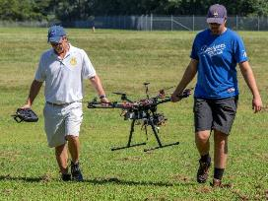
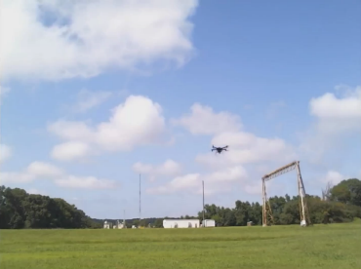
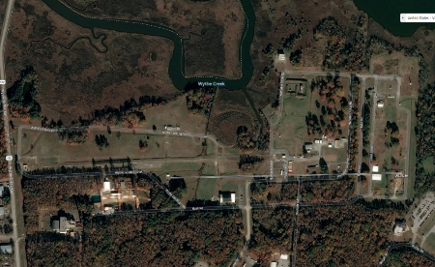
Pathfinder-ROAM: Background
Initial Request
Asked to do “human factors”
No clear requirements
Limited ability to manipulate
Live sUAS Operations
Representative UTM system
Credits: NASA/ David C. Bowman

Slide 8
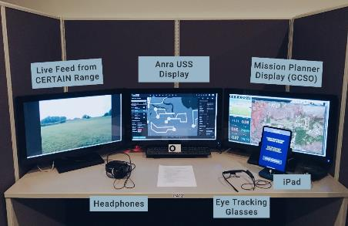
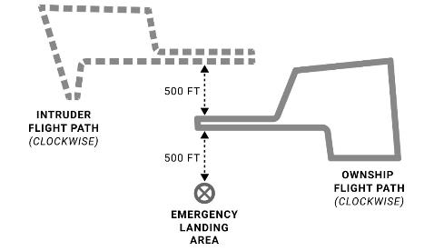
Pathfinder-ROAM: Experiment (Planned)
18 participants monitoring live sUAS operations
  Multiple flight path configurations
  General public
3 × 3 (within subjects) → 10 flights total
  Separation Method
    Autonomous Sense and Avoid, Geofence, Manual
  Incursion Level
    High, Medium, Low
DVs
  WL (TLX), SA (SART), Trust, Eye Tracking, Performance Measures (RT, Accuracy)
Within SS Design |  | Separation Method
 |  | Autonomous Sense and Avoid (ICAROUS) | Geofence (ICAROUS) | None (Manual)
Incursion | None | 1 | 2 | 3
 | Medium | 4 | 5 | 6
 | High | 7 | 8 | 9
 | Failure | x | 10 (always last) | x

Slide 9
Pathfinder-ROAM: Experiment (Actual)
9 participants monitoring live sUAS operations
  One flight path configuration
  NASA civil servants
3 × 2 (within subjects) → 8 flights total
  Separation Method
    Autonomous Sense and Avoid, Geofence, Manual
  Incursion Level
    High, Medium, Low
DVs
  WL (TLX), SA (SART), Trust, Eye Tracking, Performance Measures (RT, Accuracy)
Within SS Design |  | Separation Method
 |  | Autonomous Sense and Avoid (ICAROUS) | Geofence (ICAROUS) | None (Manual)
Incursion | None | x | x | 1 (baseline)
 | Medium | 2 | 3 | 4
 | High | 5 | 6 | 7
 | Failure | x | 8 (always last) | x

Slide 10
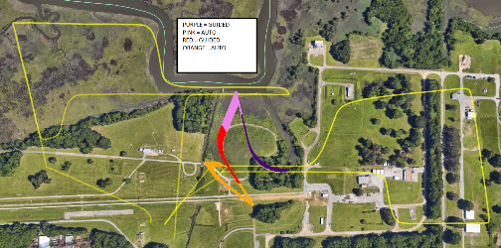
Pathfinder-ROAM: Limitations
Training
  Minimal (~1 hour)
Participants
  May not be representative of operational GCSOs
  Relatively highly educated
  Only 9 total
Scenarios
  Predictable flight path (only one configuration)
  Not randomized, counterbalanced across all participants (only two flight days)
Real separation algorithms
  Unpredictable behavior
Developmental UTM system
  Limited functionality
  Occasional lag
Education Level | Freq.
Some college, no degree | 1
Four year college or university undergraduate degree | 3
Some graduate school, no degree | 1
Graduate degree | 3
Experience
Piloted an airplane | 6
Piloted a commercial off-the-shelf drone | 6
Private pilot license | 1
Drone pilot license, Student pilot certificate | 1

Slide 11
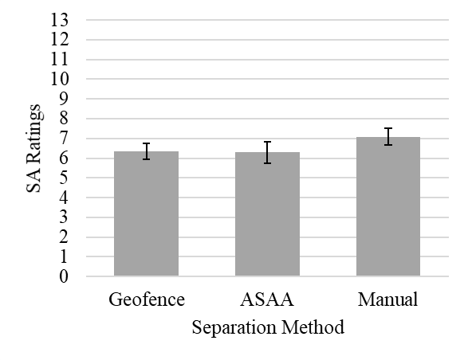
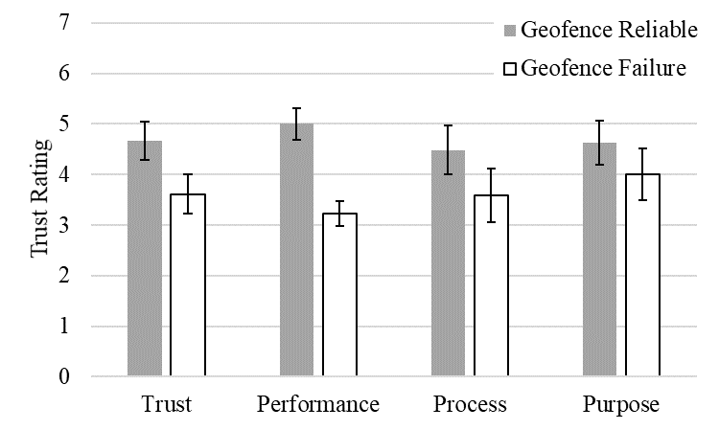
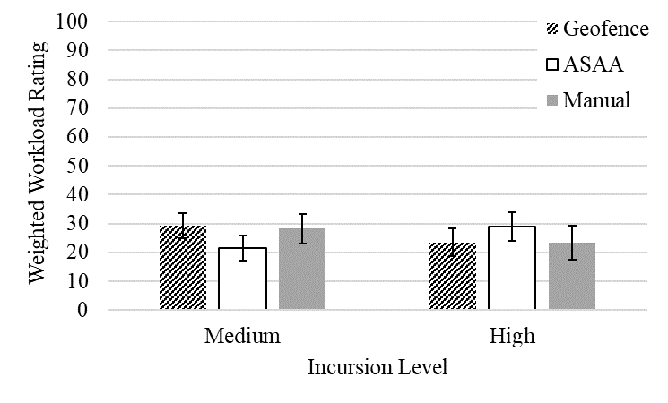
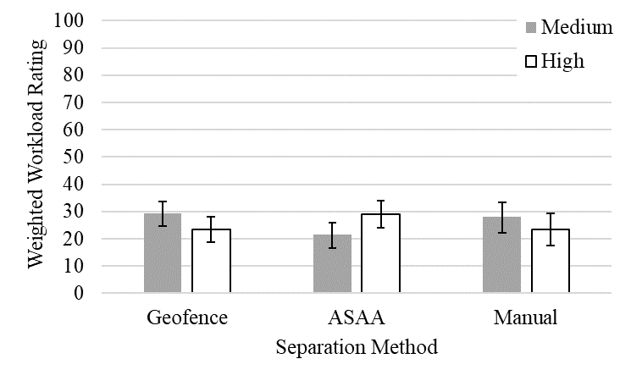
Pathfinder-ROAM: Results
Subjective Data Results
SA significantly lower than manual condition
Trust significantly dropped when Geofence failed
Interaction on WL: ASAA lowest for medium; ASAA highest for High Incursion
Papers
Politowicz, M. S., Chancey, E. T., & Glaab, L. J. (under review). Effects of autonomous sUAS separation methods on subjective workload, situation awareness, and trust. Proceedings of the Human Factors and Ergonomics Society Annual Meeting.
In progress:
  Practitioner Summary: Ergonomics in Design
  Eye Tracking: AHFE 2021
  All DVs: NASA TM
Figure 2. Average aggregate trust ratings (Trust) and trust factors (Performance, Process, Purpose) between the High Incursion, Geofence condition and the High Incursion, Geofence Failure condition
Figure 1. Average SA ratings for Separation Method.
Figure 3. Average weighted workload rating for Separation Method nested within each level of Incursion.
Figure 4. Average weighted workload rating for Incursion nested within each Separation Method.
Note: Error bars represent standard errors.

Slide 12
General Background:
Urban Air Mobility
UAM: “Safe and efficient system for air passenger and cargo transportation within an urban area. It is inclusive of small package delivery and other urban unmanned aerial system (UAS) services and supports a mix of onboard/ground-piloted and increasingly autonomous operations” (Chan et al., 2018, p. 4)
Early Operations (next few years):
  Helicopter Operations, Human Pilot, ATC provides services, VFR
Early Expanded (10 years) → Mature Operations (20 years)
  Increasingly dense airspace and higher tempo flights
  Expanding networks of TOALAs – Vertiports
  Electric Vertical Takeoff and Landing (eVTOL) vehicles

Slide 13
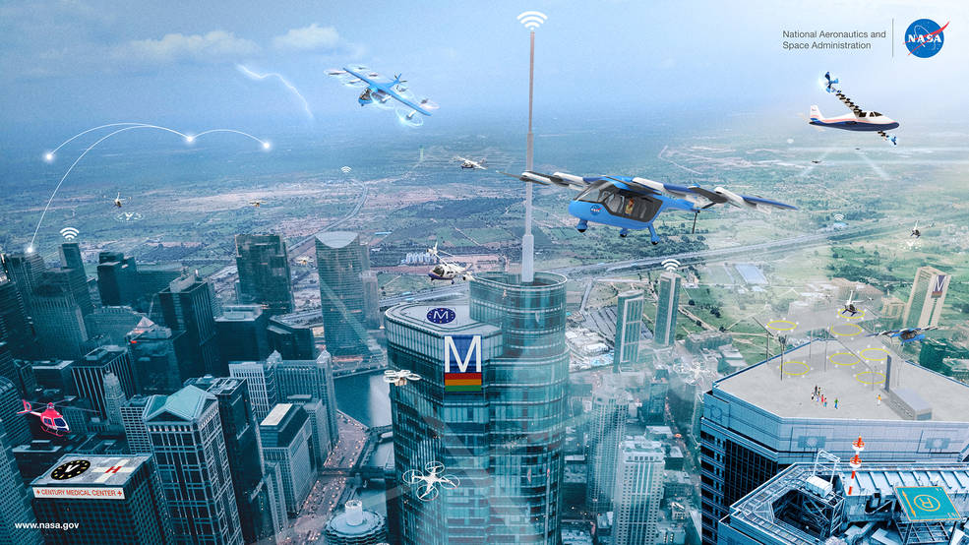
General Background:
Urban Air Mobility

Slide 14
MTurk Passenger Acceptance Studies
Objective: Research the effects of pilot training, level of automation, and level of pilot in command (PIC) distance from aircraft control on public acceptance and intention to use UAM transportation
Three experiments (Experiment 1: n = 240; Experiment 2 n = 200)
Experiment 1: 2 (Pilot Training and Experience: Extensive or Minimal) × 2 (Level of Automation: No Automation, Partial Automation, Conditional Automation, Full Automation) between-subjects design
Experiment 2: one-way five level (Level of Pilot Distance: Onboard Pilot, Remote Control Pilot, Dedicated Remote Operator, Remote Operator, System Monitor) between-subjects design Study hosted on SurveyMonkey through Amazon’s Mechanical Turk website (MTurk)
Experiment 3: Within Subjects Design – Some participants from Experiment 1 were re-tested the week following the crash involving Kobe Bryant (Analyses Not Conducted Yet)
Dissemination of Results
Chancey, E. T. (under review). Effects of Concepts of Operation Factors on Public Acceptance and Intention to Use Urban Air Mobility (UAM) – Trust and Technology Acceptance Modeling. (NASA Technical Memorandum). Hampton, Virginia: Langley Research Center. 0 maps, 83 tables, 36 figures, 102 pages, 52 references, 13 appendices.
Chancey, E. T. & Politowicz, M. S. (under review). Public trust and acceptance for concepts of remotely operated urban air mobility transportation. Proceedings of the Human Factors and Ergonomics Society Annual Meeting.
In Progress
  Journal of Air Transport Management
  Journal of Aviation Technology and Engineering
  AHFE 2021

Slide 15
Additional FY19 Work
Human-Autonomy Teaming Planning Group
  Holbrook, J. B., Prinzel III, L., J., Chancey, E. T., Shively, R. J., Feary, M. S., Dao, Q. V., Ballin, M. G., & Teubert, C. (2020). Enabling Urban Air Mobility: Human-Autonomy Teaming Research Challenges and Recommendations. 2020 AIAA AVIATION.
Simplified Vehicle Operations (SVO)
  Wing, D. J., Chancey, E. T., Politowicz, M. S., & Ballin, M. G. (2020). Achieving resilient performance in airborne UAM operations through human-automation teaming. 2020 AIAA Aviation.
Urban Air Mobility (UAM)
  Harrivel, A., Stephens, C., Holbrook, J., Chancey, E. T., Comstock, R., Kennedy, K., & Walton, J. (2019). Investigations enabled by human performance monitoring to address urban air mobility challenges. AHFE International. Washington D.C.
  Chancey, E. T. & Harrivel, A. (July 24th, 2019). UAM & Human-Autonomy Intersections. EAA AirVenture 2019. Oshkosh, WI.
Multi-Attribute Task Battery (MATB)
  Kennedy, K. Stephens, C. Napoli, N. Comstock, J. R., & Chancey, E. T. (2020). The NASA Multi-Attribute Task Battery: A Computer-based Task Designed to Evaluate Operator Performance and Workload and Incorporate Psychophysiological Assessment. ASMA 2020.
Small Unmanned Aircraft Systems (sUAS)
  https://www.nasa.gov/feature/langley/blazing-the-trail-of-urban-traffic-management

Slide 16
Current and Planned Work

Slide 17
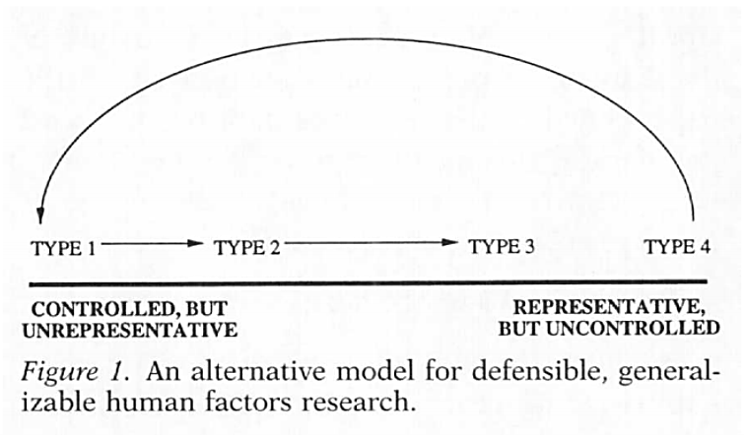
Research Approach
Human-in-the-loop Studies (HITL) → Academic Model with Greater Focus on Application
  Shift between Applied/Type 4 (Quasi-Experimental, Field Studies) and Basic/Type 1 Research (Abstract, tightly controlled laboratory studies)
Vicente, K.J. (1997). Heeding the legacy of Meister, Brunswick, & Gibson: Toward a broader view of human factors research. Human Factors, 39(2). 323-328).

Slide 18
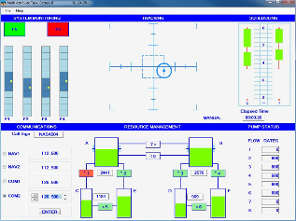
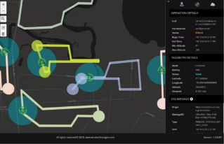
MATB+ Prototype Development
NASA Multi-Attribute Task Battery (MATB)
Low fidelity flight simulator designed to evaluate performance and workload
Popular:
  28 years of use; Over 200 users in over 23 countries (2014); “Research Interest” Index > 99% of all research items on ResearchGate.net (2019); MATB I 366 Citations (2019); MATB II 72 Citations (2019); 70 research activities using MATB as an experimental platform during the last 10 years (2014)
Easily accessible to many researchers (academia, industry, government)
Tasks are abstract enough to be used by non-expert participants
Common tool to enable replicable fundamental research activities
Update for HAT Applications / Set Tone for HAT Research Community
Could be updated to serve as an easily accessible “common-ground” tool to enable researchers to investigate HAT concepts
Abstract task to investigate Remote Supervisory Operations (RSO) without requiring expert participants
HAT principles: Adaptive Calibration, Autonomy Transparency, Adaptive Function Allocation, Playbook/Play calling, HAT Agent Architecture
FY20 Activities
User survey, literature review, and experimental task planning
System requirements document
Prototype software demonstration
MATB
MATB+

Slide 19
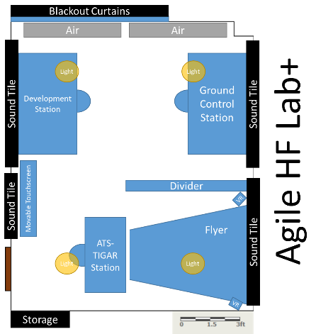
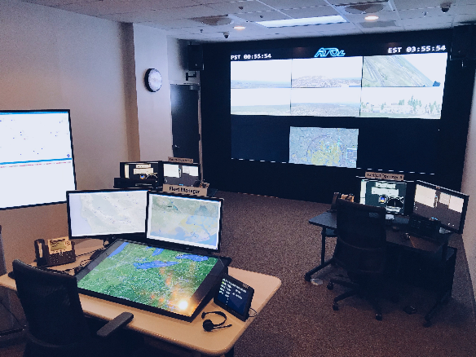
NASA LaRC Facilities
ROAM Lab
Research
Development

Slide 20
Questions?

