Slide 1
Remote Sensing for the PBL: Passive Microwave
Brent Roberts,
NASA MSFC
Earth Science Branch
2020 NASA PBL Incubation Workshop
2020 NASA PBL Incubation Workshop ・ May 27, 2020 ・ jason.b.roberts@nasa.gov

Slide 2

PBL Requirements and
Passive Microwave Remote Sensing
Decadal survey recommends:
PBL profiles of 3D temperature, water vapor, winds ... AND
Also 2D PBL heights, liquid water path (LWP), cloud base, precipitation, and surface fluxes of water and energy.
Resolving the diurnal cycle
Previous talks have highlighted the need for
Observational synergy and
Ability to study coupling between the PBL and surface
Passive microwave remote sensing — both sounding and imaging — have the potential to address, in part, many of these needs. They are particularly well suited for:
All-weather sounding of profiles
Accessibility to surface coupling variables and processes
2020 NASA PBL Incubation Workshop ・ May 27, 2020 ・ jason.b.roberts@nasa.gov

Slide 3
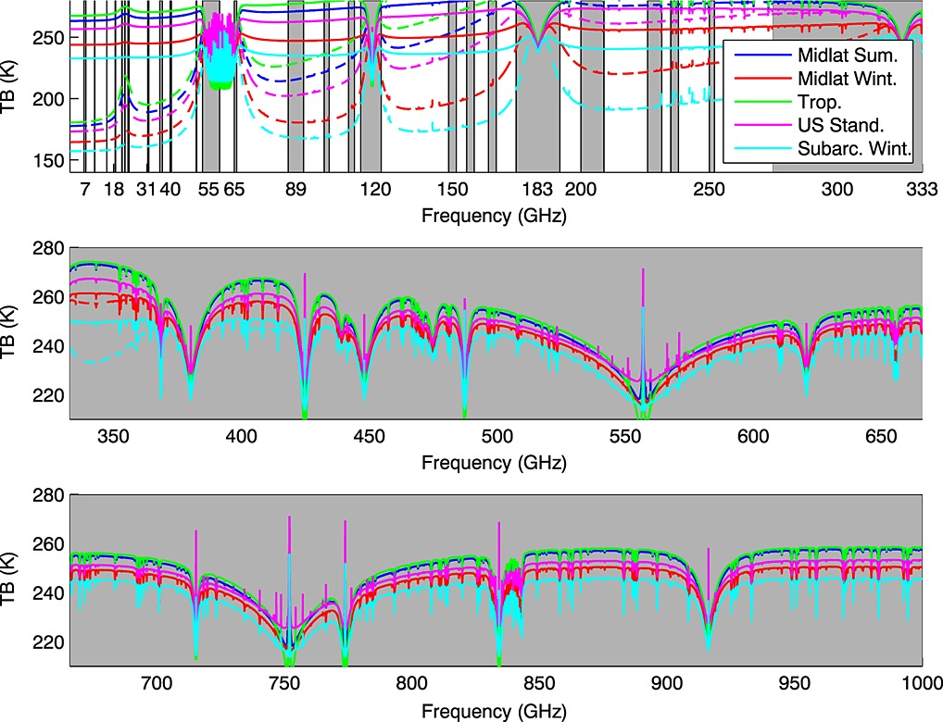
Microwave Sounding:
Temperature and Water Vapor Profiling
Instruments
AMSU-A/B, MHS (1998+)
Measurements
20 channels
Bands: O₂@60GHz; H₂O@183GHz
Sampling and Performance
Horizontal: 50km/15km nadir (T/Q)
Vertical: 2km+
Uncertainties (lowest layer)
  Temperature: 2K RMS
  Humidity: 20-25%
Instruments
ATMS, MWS to 2030+
Measurements
22-24 Channels
Bands: O₂@60GHz; H₂O@183GHz
Sampling and Performance
Horizontal: 30km/15km nadir (T/Q)
Vertical: 1-2km
Uncertainties (lowest layer)
  Temperature: 1-2K RMS
  Humidity: 15-20%
Expected Developments
Hyperspectral microwave remote sensing
Use of the 118 O₂ band for additional information (e.g. TROPICS)
Use of sub-mm bands
  H₂O at 325GHz and 448GHz (ICI)
Miniaturization of microwave remote sensing technologies
Multi-angle techniques
PWV
T(z)
Q(z)
H₂O
Aires et al., 2015:
DOI: (10.1002/2015JD023331)
O₂
O₂
H₂O
... 420, 448
Historical
Present/Near-Term
Future
Program of Record
To be Developed
2020 NASA PBL Incubation Workshop ・ May 27, 2020 ・ jason.b.roberts@nasa.gov

Slide 4
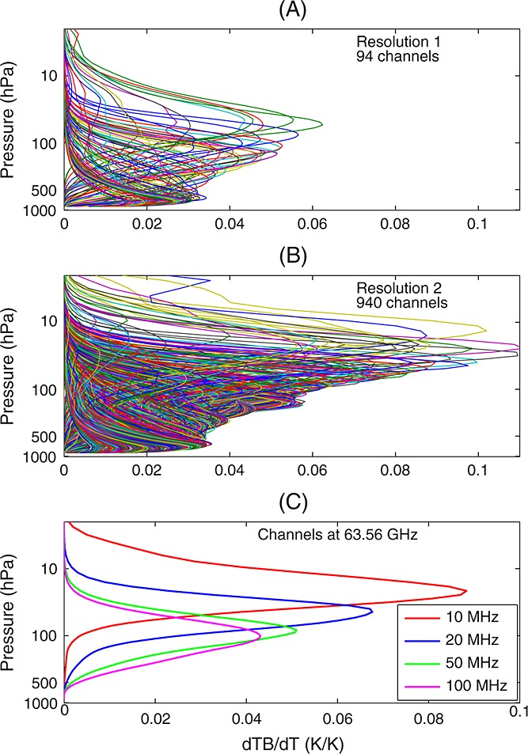
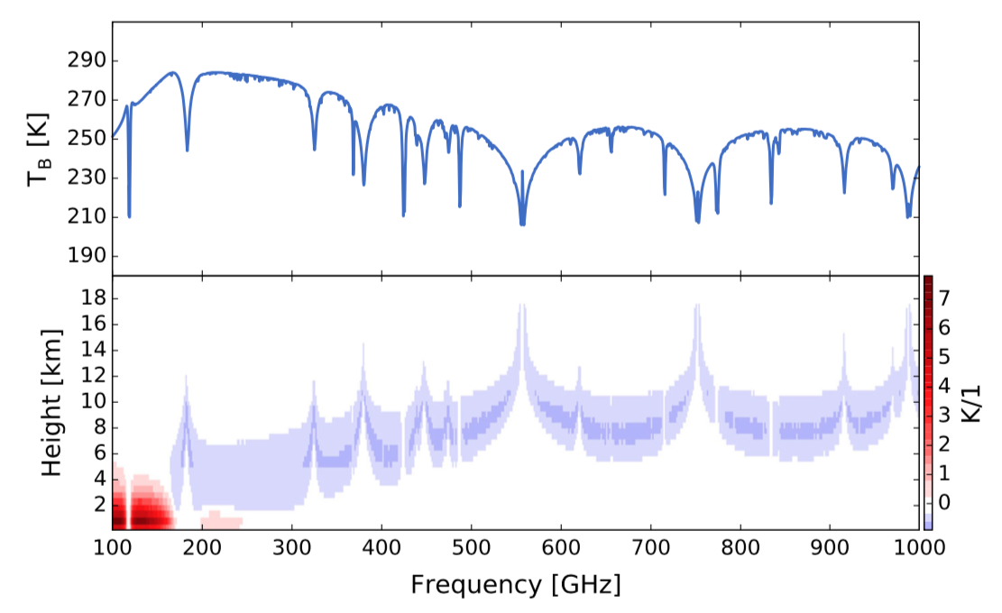
Microwave Sounding:
Hyperspectral MW Sounding
Hyperspectral microwave remote sensing has been advocated as a path forward in microwave sensing within the last decade
  Boukabara and Garret (2011)
  Blackwell et al. (2011)
  Aires et al. (2015)
Technology developments have led to the ability to sample with much finer spectral resolution across the microwave bands
  Digital filterbanks
  Kinetic inductance detectors (KIDS) with very low noise performance
  100s of channels could be observed
  RFI Mitigation
Potential for MW-only retrievals to improve vertical resolution (1-2km) and accuracy with respect to current IR+MW
Nehrir et al. 2017:
DOI (﻿10.1007/s10712-017-9448-9)
Aires et al., 2015:
DOI: (10.1002/2015JD023331)
Information content analyses indicate relatively stronger improvements for low-level water vapor than temperature.
Filterbank technologies are further advanced than KIDS but the latter may offer better signal-to-noise
2020 NASA PBL Incubation Workshop ・ May 27, 2020 ・ jason.b.roberts@nasa.gov

Slide 5
Microwave Imaging:
Surface and Columnar Constraints
Instruments
SSM/I(S), TMI, AMSR-E, WindSat
Measurements
7-12 channels (V/H pol)
6, 10, 19, 22, 37, 85 GHz
Sampling and Performance
LEO, Conically scanning @ ~53°
DMSP Sensors (km):
  60/30/15km @ 19/37/85 GHz
TMI/AMSR-E/WindSat:
  50/25/12/10 @ 6(10)/19/37/85 GHz
Instruments
GMI, AMSR-2, MWI, *SMAP
Measurements
12-26 Channels (V/H pol)
6, 10, 18, 23, 37, 50, 89, 118, 166, 183 GHz
Sampling and Performance
GMI/AMSR2:
  30/15/10/5km @ 6(10)/18/37/89+
MWI
  50/30/10 @ 19/31/50/89+ GHz
SMAP: 36km at L-band (1.4 GHz)
Expected Developments
Potential for observation gaps especially for microwave SST
  WSF-M in 2023?
Miniaturization of microwave remote sensing technologies and advances in deployable antennas
  Compact Ocean Wind Vector Radiometer (COWVR)
Soil Moisture, SST
Winds, PWV, LWP, Sea Ice
Rain Scat
WV
H₂O
Aires et al., 2015:
DOI: (10.1002/2015JD023331)
O₂
O₂
H₂O
... 420, 448
Historical
Present/Near-Term
Future
Program of Record
To be Developed
2020 NASA PBL Incubation Workshop ・ May 27, 2020 ・ jason.b.roberts@nasa.gov

Slide 6
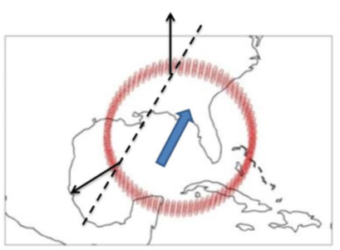
Microwave Imaging:
Compact Ocean Wind Vector Radiometer
Developed as a low-cost alternative to potentially fill in data gap from WindSat; it has been designed to fit SmallSat requirements and retrieve wind vectors, PWV, LWP, and precipitation
Fully polarimetric radiometer measuring at:
  18, 23, and 34GHz channels with V/H/+45/-45/LCP/RCP polarizations
  Resolution of ~25km, 18km, and 12km
Wind vectors are made more accurate by using a full 360° scan to give both fore and aft (i.e. 2-look) observations to better constrain the wind direction signature
  Reduces error and allows retrievals at lower wind speeds.
Launch to ISS is anticipated in 2021. Plans are to fly spare TEMPEST-D that will allow coupling the imager with water vapor sounding channels.
Courtesy of S. Brown (JPL)
2020 NASA PBL Incubation Workshop ・ May 27, 2020 ・ jason.b.roberts@nasa.gov

Slide 7
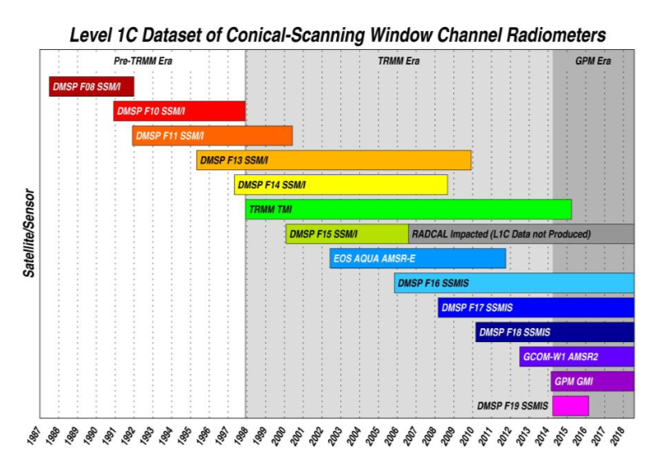
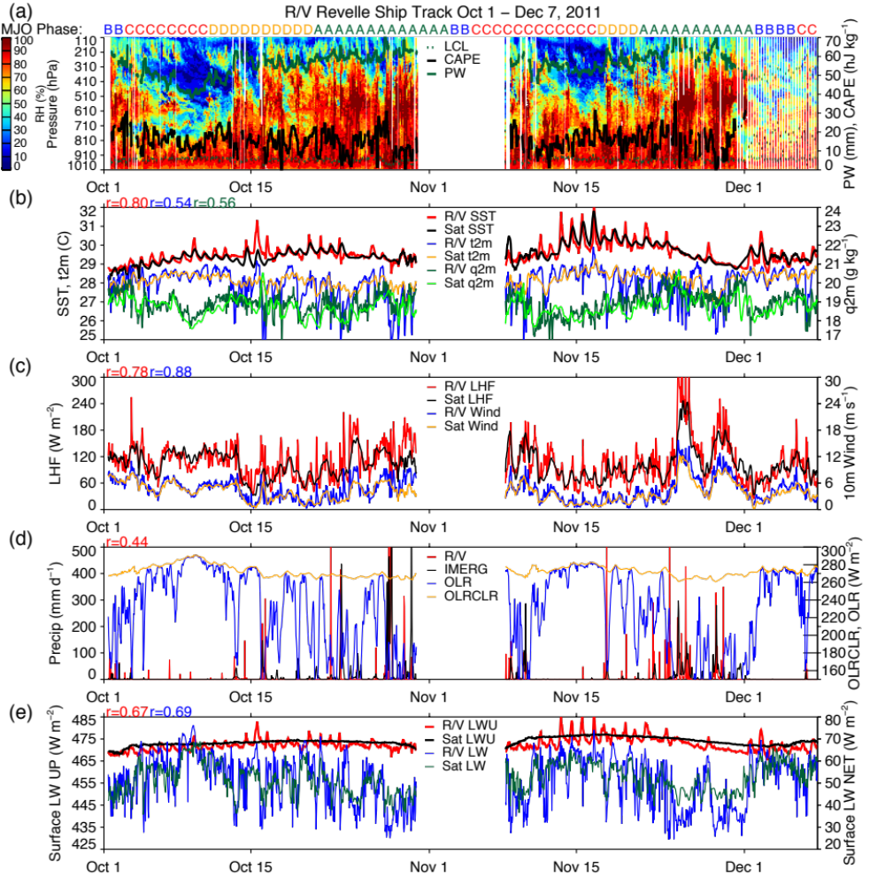
Microwave Imaging Application:
Ocean Surface Turbulent Fluxes
DYNAMO (2011)
Comparisons between ship and satellite observations of SST, winds, humidity, and fluxes
Correlations
SST: 0.80
2m T: 0.54
2m Q: 0.56
LHF: 0.78
Wspd: 0.88
Berg et al., 2018: DOI: (10.3390/rs10081306)
Microwave radiometers have been intercalibrated to 1987 with reference to GMI.
This results in the ability to retrieve long records of near-surface winds and humidity that can be combined with SST to compute ocean turbulent fluxes
The satellite-derived fluxes (SeaFluxV3) can capture a significant amount of the daily variability of the fluxes as a result of high-quality wind, humidity, and temperatures.
However, significant amounts of episodic variability are still being missed such as cold-pools. Sub-daily sampling is not currently available from microwave imager constellation.
2020 NASA PBL Incubation Workshop ・ May 27, 2020 ・ jason.b.roberts@nasa.gov

Slide 8
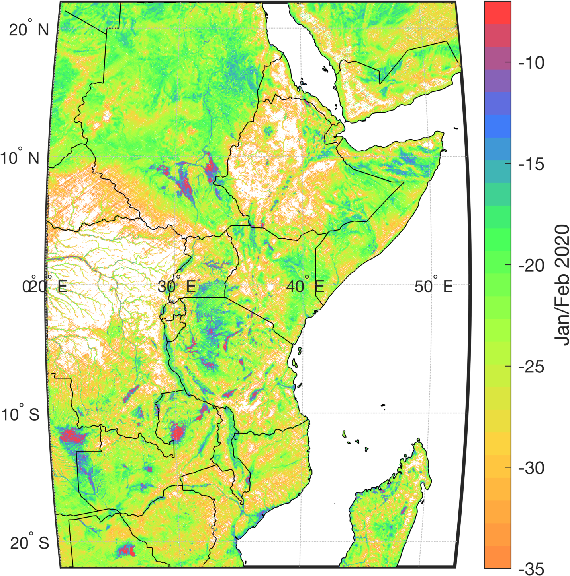
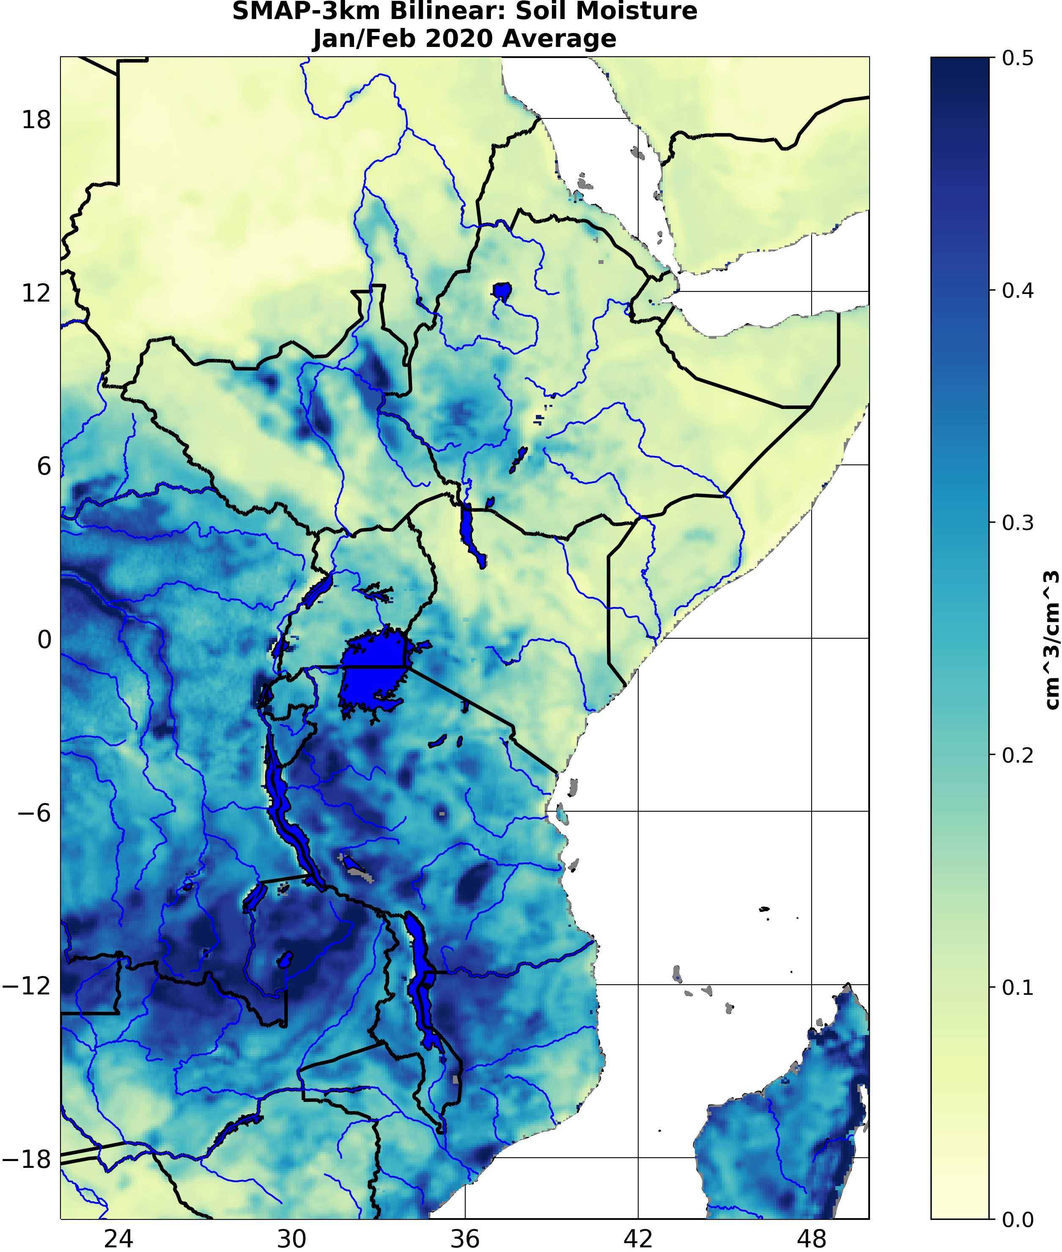
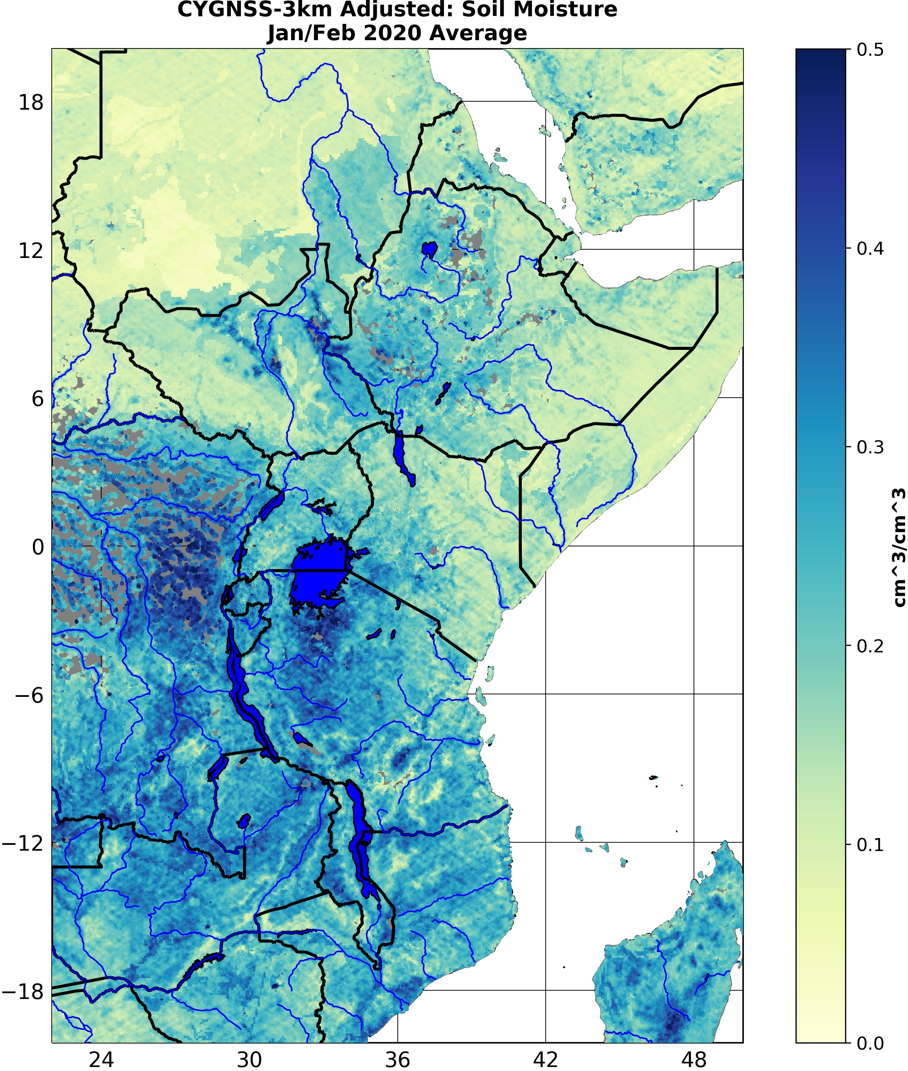
Microwave Imaging* Application:
Soil Moisture
CYGNSS mean power return Jan/Feb 2020
(courtesy C. Chew)
(dB)
Both SMAP and CYGNSS capture residual moisture after Sudanese flooding that is missed in land surface model runs.
SMAP Soil Moisture Estimate
CYGNSS Soil Moisture Estimate
Microwave imaging in the L-band provide useful information on land surface properties. The SMAP mission has resulted in soil moisture estimates at approximately 36km resolution; Image sharpening effort have generated 9km estimates.
Experimental investigations have shown that GNSS reflections measured by CYGNSS capture the signal of soil moisture variability at resolutions down to 3km.
2020 NASA PBL Incubation Workshop ・ May 27, 2020 ・ jason.b.roberts@nasa.gov

Slide 9
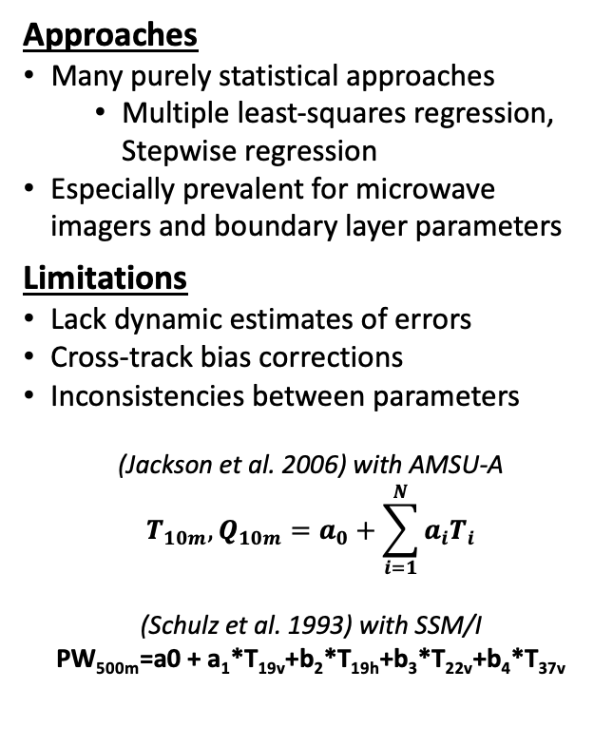
Retrievals:
Mining Useful Information
Approaches
Many purely statistical approaches
  Multiple least-squares regression, Stepwise regression
Especially prevalent for microwave imagers and boundary layer parameters
Limitations
Lack dynamic estimates of errors
Cross-track bias corrections
Inconsistencies between parameters
(Jackson et al. 2006) with AMSU-A
$$T_{10m},Q_{10m}=a_{0}+\sum_{i=1}^{N}{a_{i}T_{i}}$$
(Schulz et al. 1993) with SSM/I
PW_{500m}=a0 + a₁*T_{19v}+b₂*T_{19h}+b₃*T_{22v}+b₄*T_{37v}
Approaches
Tendency towards fully-physical retrievals
  Optimal Estimation (OE) coupling forward models with observations
Can provide a posteriori error estimates useful for assimilations
Forward modeling capture view-angle effect
Machine-learning captures nonlinearities
Limitations
Forward modeling operators are not well tuned (or are slow) for heavily scattering atmospheres
Underconstrained in the PBL leading to over-reliance on a priori and near-surface constraints
Expected Developments
Better integration of machine learning/deep learning with RTMs to improve speed
Further coupling of temperature, humidity, clouds, and surface emissivity within the optimal estimation framework including scattering in forward
  Optimizing retrievals for PBL
Multi-sensor data fusion
  Complementary information from MW imagers and sounders
Historical
Present/Near-Term
Future
Program of Record
To be Developed
2020 NASA PBL Incubation Workshop ・ May 27, 2020 ・ jason.b.roberts@nasa.gov

Slide 10
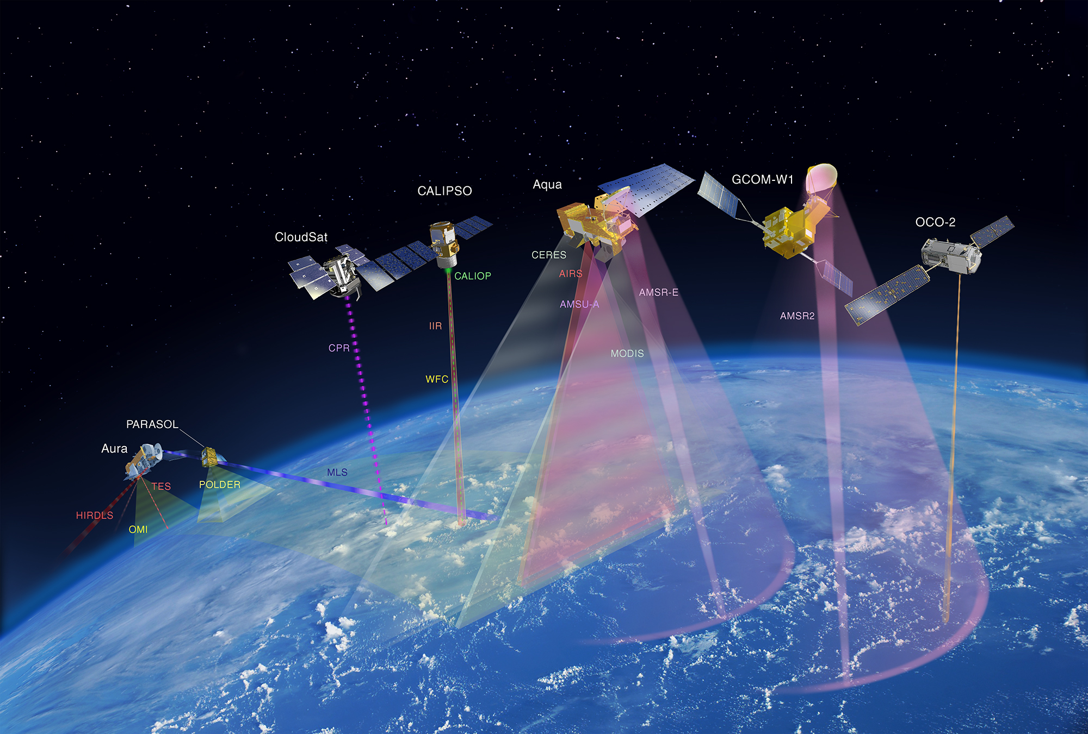
Observing System Architecture:
Completing The Picture
Architecture
Large, costly satellites
Microwave sounders and imagers almost exclusively in sunsynchronous orbit
Lack of coordination between microwave imaging and sounding satellites
Limitations
Lack revisit frequency to really resolve diurnal variability
Not optimized for constraining column and surface coincidently
Data fusion hard to implement for process studies due to sampling
Architecture
Sounders primarily remain in LEO (exception of Megha-Tropiques)
GPM and TRMM missions provide non-sunsynchronous (low inclination) imagers
Coordinated observations (e.g. A-Train, MetOP-SG-A/B) for processes (snapshot)
Limitations
Still lack diurnal resolving capability for sounders; Imagers support composite diurnal cycle studies
Expected Developments
Heavy demand for low-cost/cost-capped instruments
Passive microwave (low power and mass) is a ripe area for development of CubeSat and SmallSat technologies
  Miniaturization of component technologies in communications
Move toward deployable mesh and phased array antennas (i.e. away from heavy mechanically steered mirrors)
Several concepts for getting at time-resolved processes (CYGNSS, TROPICS, TEMPEST, GeoSTAR)
https://www.nasa.gov/content/about-the-a-train
Historical
Present/Near-Term
Future
Program of Record
To be Developed
2020 NASA PBL Incubation Workshop ・ May 27, 2020 ・ jason.b.roberts@nasa.gov

Slide 11
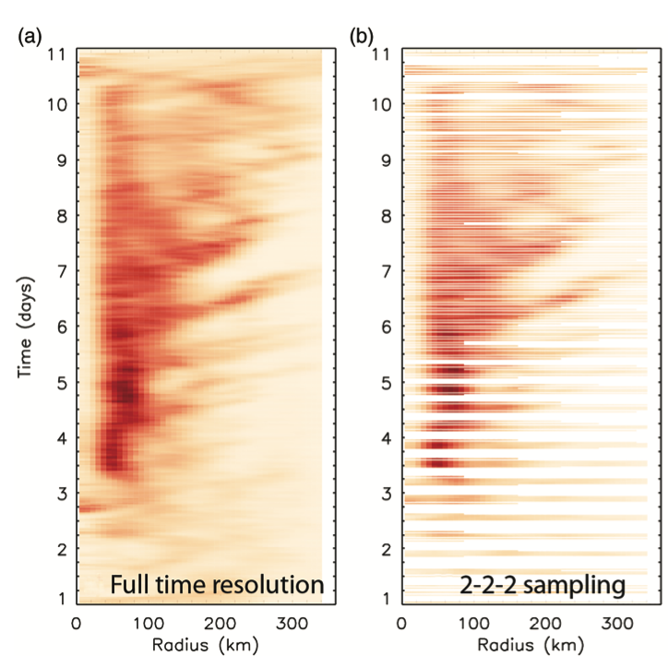
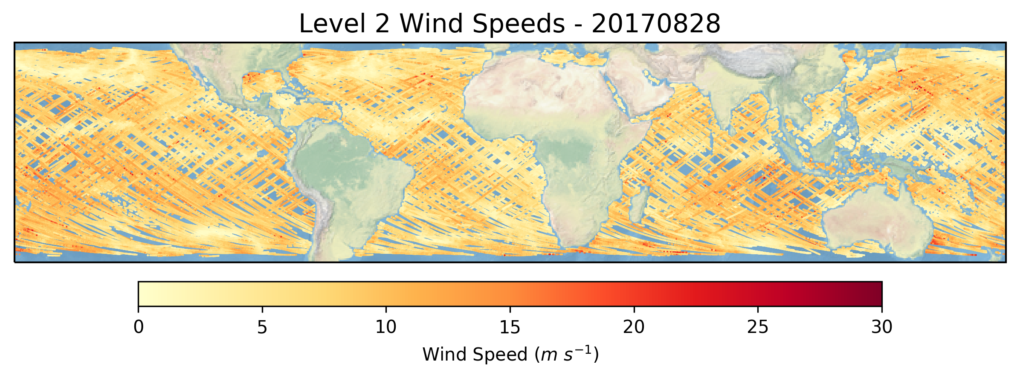
Observing System Architecture:
Resolving Processes in Time
SmallSat/CubeSat Constellations
Geostationary Microwave
CYGNSS (EV-2)
8 nanosatellites deployed into low-inclination orbit and spread apart through differential drag technique
Enabling median revisit times approaching 3-hour at full capacity for wind speed observations in all-weather conditions
TROPICS (EVI-3 Mission)
6 CubeSats with sounding channels at 118GHz (7ch/35km) and 183GHz (3ch/25km) for T(z) and Q(z)
Designed for 2K/25% RMS for temperature/humidity profiles
Baseline/threshold requirements for mean revisit times are 1hr/2hr
GeoMAS, GeoSTAR, GIMS
Multiple concepts have been advocated for geostationary microwave sounding
Many OSSE studies have been conducted showing the potential value of sub-hourly microwave sounding for NWP
  Duruisseau et al. (2017) also note importance of small observations errors
Frequent observations may also support elements of 3D tropospheric winds (e.g., Lambrigtsen et al. 2018)
Blackwell et al. 2017, QJRMS, 10.1002/qj.3290
Temporal sampling of precipitation using baseline configuration
2020 NASA PBL Incubation Workshop ・ May 27, 2020 ・ jason.b.roberts@nasa.gov

Slide 12
Summary:
Supporting PBL Studies in the Microwave
Microwave sounders and imagers are capable of providing important observables for characterizing the planetary boundary layer and provide all-weather and all-surface information
Given their low power and emerging low-mass capabilities, passive microwave observations can serve as a very flexible component for future observing system architectures including cost-capped CubeSat/SmallSat missions.
2020 NASA PBL Incubation Workshop ・ May 27, 2020 ・ jason.b.roberts@nasa.gov

