Slide 1

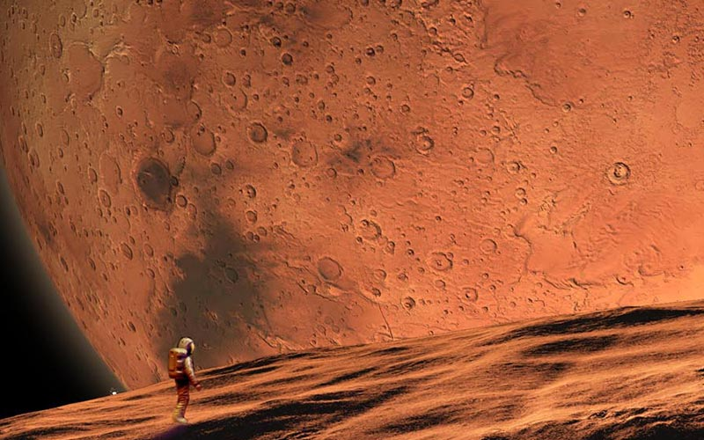
Supporting Astronaut Autonomous Operations in Future Deep Space Missions
Natalia Russi-Vigoya, Ph.D. KBR/JSC
Donna Dempsey, Ph.D. NASA/JSC
Brandin Munson UH/JSC
Alonso Vera, Ph.D. NASA/ARC
Bernard Adelstein NASA/ARC
Shu-chieh Wu, Ph.D. SJSU/ARC
Kritina Holden, Ph.D. Leidos/JSC
11th International Conference on Applied Human Factors and Ergonomics – July 16-20, 2020
Notes:
Hello, My name is Natalia Russi-Vigoya, and today I will be presenting the collaborative work from the authors listed in this slide.
Today I will be presenting The study titled: supporting Astronaut Autonomous Operations in Future Deep Space Missions. This study was performed as part of a larger line of research at NASA, called Human Capabilities Assessment for Autonomous Missions (HCAAM).

Slide 2

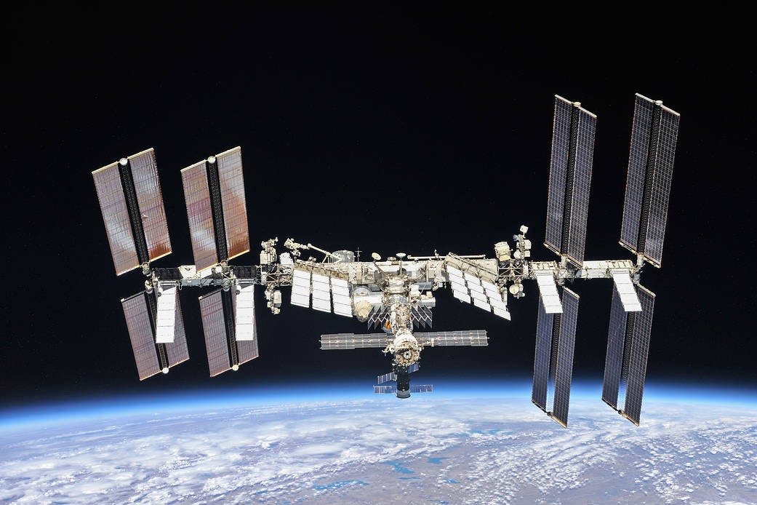
International Space Station
The first module of the International Space Station (ISS) was launched in 1998, with the first long-term residents arriving in November 2000. It has been occupied continuously since that date.
ISS is operated by onboard crew and over 100 flight controllers on Earth.
Notes:
A little be of background, The first International Space station was launched about 21 years ago and 19 years ago, the first residents arrived and have use it continuously
ISS is operated by onboard crew, currently about 6 crew members

Slide 3
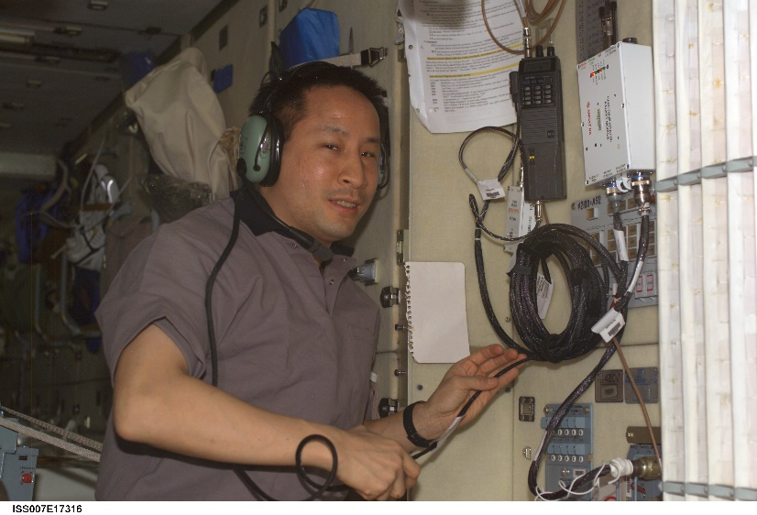

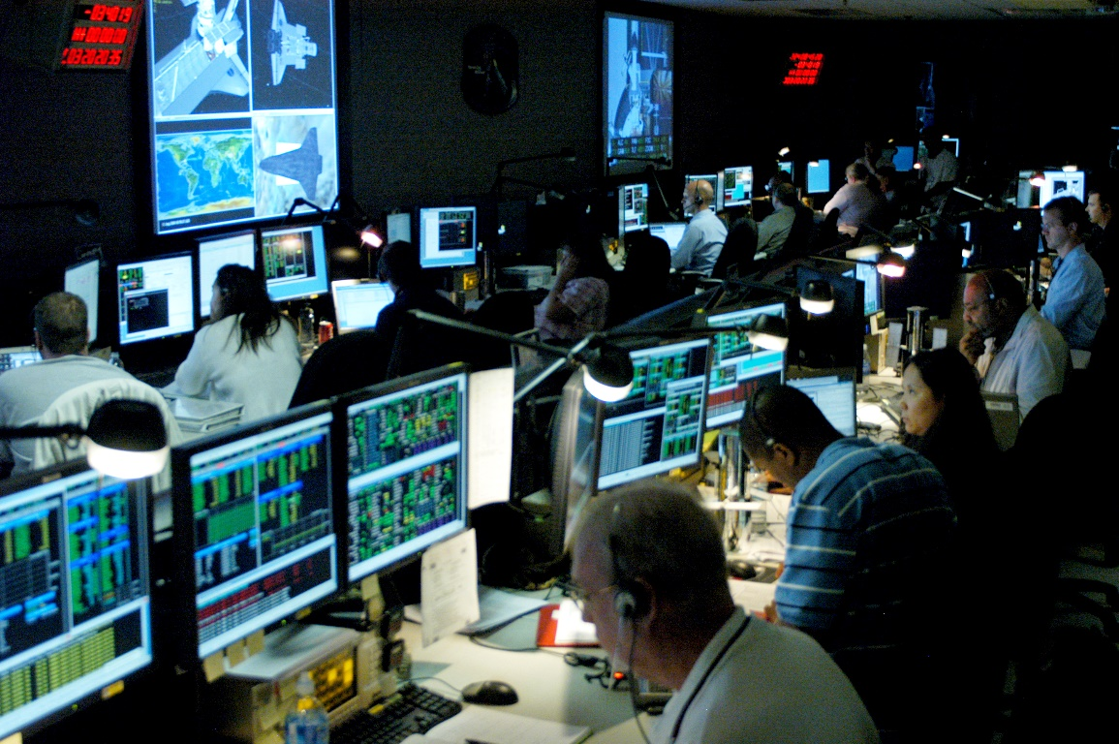
Current ISS Operations: Flight Controller / Crew Partnership
Flight controllers:
  Have near-constant contact with onboard crew
  Command and control ISS
  Assist crew with procedures
  Provide supplemental information
  Monitor operations and check for errors
  Troubleshoot and problem solve
Notes:
Currently, ISS operation have highly qualified individuals with the following characteristics:
Flight controllers manage a lot of things from the ground
Have constant contact with onboard crew
Command and control ISS
Assist crew with procedures
Provide supplemental information
Monitor operations and check for errors
Troubleshoot and problem solve

Slide 4
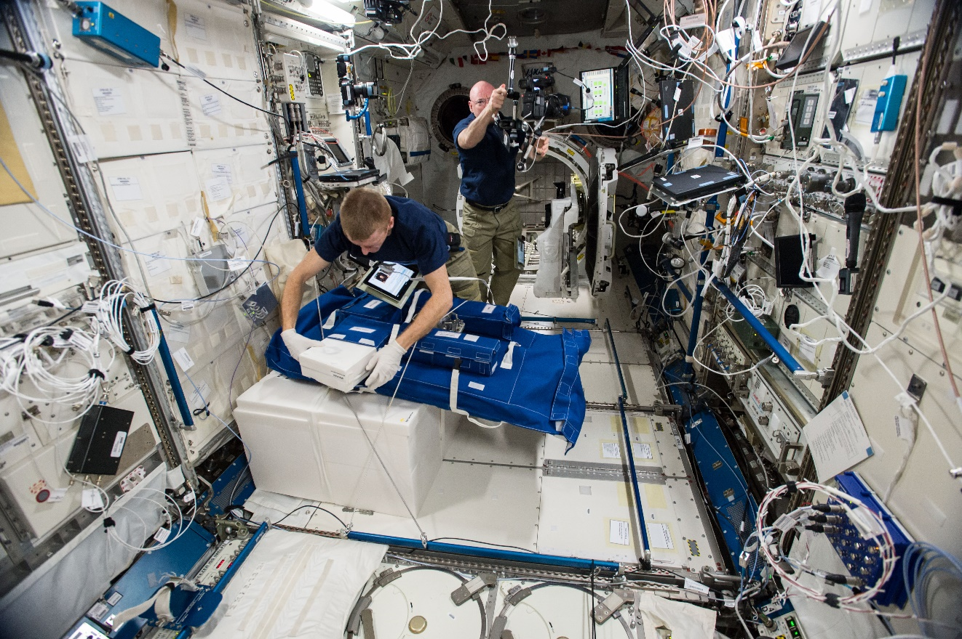
Role of Mission Control as “Problem-Solver”
Astronaut quote from Jack Stuster’s Journals Experiment: “Smart people on the ground will figure it out and let us know what to do. I am sure they are working on some type of plan. All will be good.”*
* https://ston.jsc.nasa.gov/collections/TRS/listfiles.cgi?DOC=TM-2016-218603
Notes:
Here is an Astronaut quote from Jack Stuster’s Journals Experiment: “Smart people on the ground will figure it out and let us know what to do. I am sure they are working on some type of plan. All will be good.”*
Fundamental changes in spaceflight operations from the current heavy dependence on ground mission support will be required for longer-duration missions

Slide 5
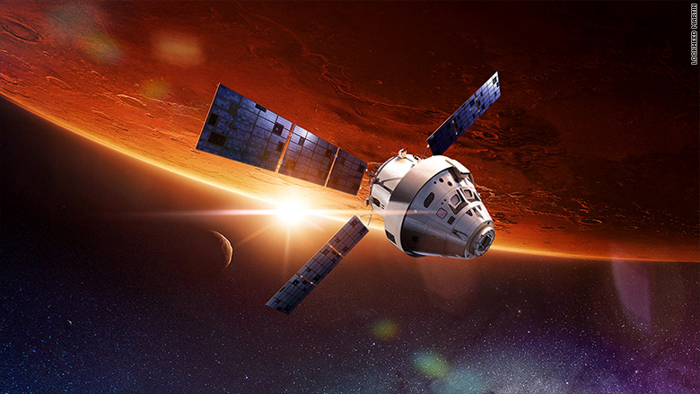
Deep Space Missions will Demand A Different Model
Communication delays and potential blackouts will require increased crew autonomy
  Four crew must be able to do what crew + MCC currently does
Crew will need to rely on:
  Intelligent systems
  Just-in-Time training systems
  Virtual assistants
  Unobtrusive human performance monitoring tools
  Adaptive cognitive/job aids
  Trend Monitoring/Analysis tools
  Trouble-shooting and problem-solving aids
  Decision-Making Aids
  Software development tools for novice programmers
We need to understand the full scope of capabilities that MCC is currently providing in order to develop onboard Intelligent Systems.
Notes:
Periodic communication blackouts will require certain activities currently performed by Ground Controllers (GCs) to be performed partially or entirely onboard.
Instead of relying on real-time interaction with a support team on the ground, crew will be required to be more autonomous.
Developing and planning for the new operations concepts will require understanding and utilizing recent advances…
Perhaps the most critical part of this will be assisting the crew with problem-solving and contingency resolution in relation to what will likely be a next-generation smart spacecraft.

Slide 6
Methodology
Human Capabilities Assessment for Autonomous Missions (HCAAM) Projects:
Review of Standards and Guidelines
Technical Interchange Meeting
MCC Contextual Inquiry
Expert Focus Group
Notes:
A number of activities have been completed as part of the HCAAM effort.
Work began with a gap analysis of existing NASA standards for human spaceflight, and review of requirements, standards, and guidelines from NASA and non-NASA sources related to performance support (e.g., intelligent systems, virtual assistants, and augmented reality).
An Autonomous Crew Operations Technical Interchange Meeting (TIM) was held with NASA and non-NASA experts to discuss challenges and new technologies that may help support astronauts in operating autonomously from MCC.
Contextual Inquiry interviews and site visits at MCC were completed to understand the support MCC provides current crews.
Finally, an expert focus group was held to discuss crew tasks and challenges on a future deep space mission.

Slide 7
Review of Standards and Guidelines
HCAAM Project: Human Performance Standards and Guidelines (S&G)
K. Holden, M. N. Russi-Vigoya, B. D. Adelstein, E. V. Cross, B. A. Munson
Specific Aims:
Identify gaps in NASA human-system integration standards and guidelines needed to support autonomous crew operations for future missions.
Mine and validate relevant standards and guidelines from NASA, DoD, other government agencies, industry, and the published literature.
Format candidate standards and guidelines for submission to the NASA document update process.
Gap Identification
15 SME Interviews
Crew comments
NASA Reports
Autonomous meeting
S&G Collection
26,944 “shall” requirements
32,113 “should” requirements
Keyword Development
Consensus
Nominal Group Method
Delivery Of Results
59 Candidate Standards
427 Candidate Guidelines
Document | Count
MIL-STD 1472G | 18
HF-STD-001B | 23
NUREG-0700 | 10
DOT HS 812 360 | 8
Total | 59
Document | Count
MIL-STD 1472G | 214
HF-STD-001B | 178
NUREG-0700 | 16
DOT HS 812 360 | 7
DOT-VNTSC-FAA-13-09 | 5
ASTM F1166 | 3
HFES 200-3 | 2
CAP708 | 1
DOT/VNTSC-FAA-03-07 | 1
Total | 427
Notes:
Gap analysis
Gap analysis of NASA-STD-3001: NASA Space Flight Human-system Standard Volume 2: Human Factors, Habitability, And Environmental Health
(1) 15 Interviews with NASA 3001 developers/users
(2) Review Crew Comments
- The Flight Crew Integration (FCI) ISS Life Sciences Crew Comments Database has crewmember comments from the ISS Post-Flight Debriefs.
They included their perspective on specific topics regarding all aspects of habitability, systems, and operations onboard ISS.
(3) Review reports from Human Factors and Behavioral Performance research
(4) We participated in the Autonomy Technical Interchange Meeting (TIM) gap list identification
HCAAM keyword development
Government agency/industry standards document search based on keywords
Consensus sessions to select candidate standards and guidelines
Delivery of results to HCAAM researchers and NASA programs
The gap analysis identified 25 areas in NASA human-system integration standards and guidelines documents that will need to be addressed in order to support future autonomous crew operations for Gateway missions.
The gaps included topic areas such as adaptive systems, automation and robotics, autonomy, cognitive aids, decision support, and augmented reality.
To help fill these gaps, 59 standards and 427 guidelines were identified from the review of 164 documents sourced from existing U.S. Government and industry standards documents.

Slide 8
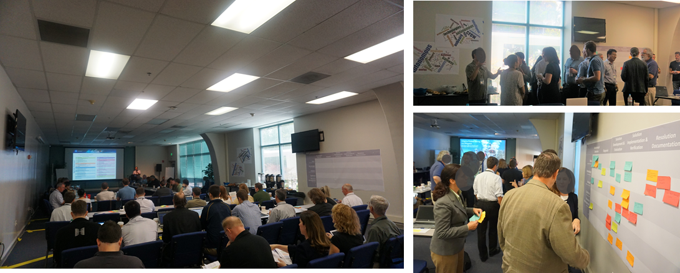
Technical Interchange Meeting (TIM)
HCAAM Project - Supporting Crew Autonomy in Deep Space Exploration: Preliminary Onboard Capability Requirements and Proposed Research Questions
Wu, S. C., & Vera, A. H.
Specific Aims:
Determine:
How intelligent technologies can help make relevant knowledge and information available
How intelligent technologies can help make relevant knowledge and information accessible
How intelligent technologies can help support the crew operating as a team in anomaly response processes?
The TIM gathered over 110 submissions of ideas on the wallboard
Some areas of need that are insufficiently covered by existing technologies, are: The need for knowledge management throughout the steps of problem solving and particularly resolution documentation, and work force management.
The most pressing need for autonomous crew operations is support for the troubleshooting of rare and unanticipated onboard anomalies that might potentially threaten crew and vehicle safety
Notes:
The Autonomous Crew Operations TIM took place at the NASA Ames Research Center. The goal of the meeting was to gather input from five NASA centers, industry, academia, and branches of the Department of Defense (DoD) to address how intelligent technologies can be applied to support crew anomaly response. The TIM hosted 59 attendees from these various institutions, and featured 24 presentations. Attendees shared thoughts about autonomy gaps, and provided potential solution ideas on a collaborative wallboard. The wallboard kept engagement high and promoted significant discussion.
the TIM gathered over 110 submissions of ideas on the wallboard.
Results showed that there are several areas of need that are insufficiently covered by existing technologies, such as the need for knowledge management throughout the steps of problem solving, particularly resolution documentation, and work force management.
The TIM showed that the most pressing need for autonomous crew operations is support for the troubleshooting of rare and unanticipated onboard anomalies that might potentially threaten crew and vehicle safety. For example, in the early days of ISS, high priority anomalies required extended investigation. Rare events can have big consequences. They can also be difficult to train, and the most difficult for intelligent systems to handle .

Slide 9
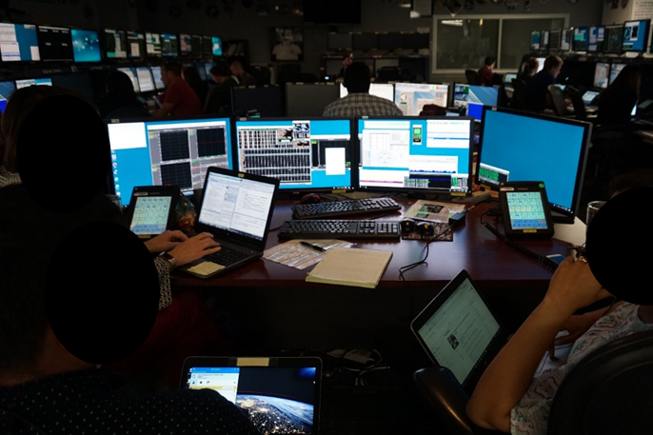
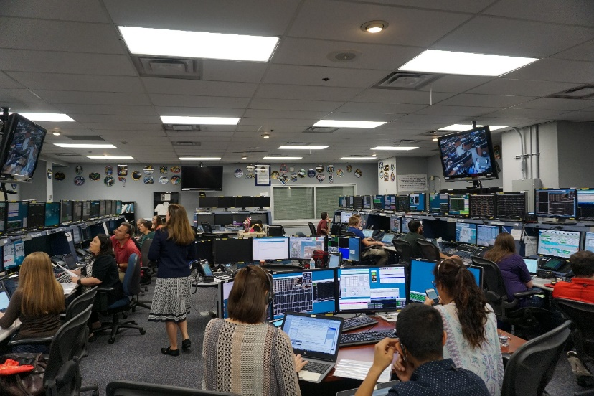
MCC Contextual Inquiry
HCAAM Project: Characterizing Flight Controller Problem-solving Toward Increasingly Autonomous Crew Operations
A. H. Vera, K. Holden, D. L. Dempsey, M. N. Russi-Vigoya, B. R. Beutter, and S. C. Wu
Specific Aims:
Identify and characterize the types of activities currently performed by ground control at the NASA (JSC) that will need to be shifted on-board.
Provide results and inputs to the Autonomous Operations Technical Interchange Meeting for the purpose of scoping the content/goals.
Develop standards and guidelines for the development of autonomous operations concepts and intelligent systems.
Capabilities Needed Onboard Future Autonomous Missions
Advanced Training Systems
Intelligent Information Systems
Problem Solving Aids
Design for Autonomy
Notes:
The aim of the Contextual Inquiry was to characterize the types of activities currently performed by NASA International Space Station (ISS) Flight Controllers to identify capabilities that would need to be shifted onboard in order to enable crew to resolve emergent, unanticipated problems autonomously.
The Contextual Inquiry observations and interviews were performed at the ISS MCC and the Space Station Training Facility (SSTF) at NASA Johnson Space Center (JSC). Researchers worked with Chief Training Officers (CTOs), instructor leads, and instructors from seven disciplines: Robotics (ROBO); Environmental and Thermal Operating Systems (ETHOS); Biomedical Engineering (BME); Operations Support Office (OSO); Extravehicular Activity Office (EVA); Spacecraft Communications (CAPCOM); and Station Power, Articulation, Thermal, and Analysis (SPARTAN).
Researchers also interviewed flight controller instructors from two other disciplines, Behavioral Health and Performance (BHP) and the Visiting Vehicle Office (VVO).
Future Autonomous Missions: Capabilities Needed Onboard
Advanced training systems to provide training on core vehicle systems, as well as generic troubleshooting and problem solving. It should provide refresher training, Just-in-Time training, and stress-inducing simulation training.
Intelligent information systems to provide core system engineering schematics, design documents, job aids (e.g., spreadsheets, equations, calculations, event critical times/durations, tracking grids, “cheat sheets”), and electronic procedures needed to perform, diagnose, maintain, repair, replace, and create new core system components.
Problem solving systems to provide intelligent assistance for fault management, troubleshooting, problem solving, and decision-making. Systems should include flight rules for communication (including time-delayed communication); mindset (i.e., “what-ifs”, “next worse failure” thinking); consideration of integration impacts; handover of a problem; strategies to “divide and conquer;” strategies to maintain situation awareness; and strategies to document events and outcomes for future use.
Design for autonomy, i.e., simplify system designs to reduce the number of components that can fail, and promote ease of training, ease of use, and ease of repair.
In addition, the researchers received input from a flight director, two Mission Evaluation Room (MER) managers, and representatives from the JSC Flight Safety Office. Through observations and interviews, the research team collected information to

Slide 10
Focus Group
HCAAM Project: Development and Validation of an Autonomous Operations Task List
Holden, K., Munson, B., Russi-Vigoya, M. N., Dempsey, D., Adelstein, B.
Specific Aims:
Identify and refine a set of mission tasks that are most likely to pose a threat to crew health and performance during an autonomous phase of a long-duration spaceflight mission.
Validate the draft list of tasks with relevant experts by determining their acceptability, feasibility, and suitability for autonomous operations.
Develop several brief scenarios/vignettes that illustrate the challenges of autonomous crew operations
5 experts participated in the focus group. Areas of expertise included crew, flight/mission control, mission planning, medicine, behavioral health, and training
Ability to respond to medical or behavioral health events
Ability to respond to unanticipated major vehicle or habitat malfunctions
Primary task
Piloting and navigation tasks
Installation/activation/inspection of vehicle/habitat systems
The participants raised the following 3 concerns:
Lack of preparation and experience for autonomous crew operation
Insufficient intelligent system development and testing
Inadequate training approaches for long-duration missions.
Notes:
In addition to the flight control-related activities identified in the Contextual Inquiry, there are many other work and daily living tasks that astronauts will have to perform on a deep space mission (e.g., to Mars). The goal of the expert focus group was to develop a validated high-level list of tasks that crew would need to be able to perform autonomously in the future in order to be successful on future long-duration missions .
The results of this effort will be critically important for informing and focusing research and development teams, because the focus group discussions were structured to characterize challenges that future autonomous crew will face, and highlight solutions that need to be developed.
Focus group participants were experts in their respective fields, selected to represent the following domains/perspectives: crew, flight/mission control, mission planning, medicine, behavioral health, and training. Each of the focus group participants had more than twenty years of experience at NASA in spaceflight training, operations, or research. The focus group was asked to discuss their most serious concerns related to autonomous operations. They were also asked to gain consensus on and validate an autonomous task list, with priority on problem-solving tasks that will be particularly challenging without support from MCC. The experts were asked to brainstorm and discuss their autonomous task concerns before seeing the draft task list. This primed the experts to begin thinking deeply about the topic and provided an opportunity to determine whether their thoughts and concerns about tasks aligned with the draft materials presented. Several scenarios were also drafted to describe autonomous operations.
The autonomous task list and output from the focus group will help researchers, engineers, and others understand the tasks most likely to be influenced by missions requiring greater levels of autonomy

Slide 11
Conclusion
The research activities that have been described here represent the first steps in beginning to understand and address the future challenges of autonomous missions. Results indicate that the key capabilities needed for future missions include advanced training systems, intelligent information systems, problem-solving aids, and autonomy focused design. It will be important to focus near-term efforts in these areas in order to be ready to support crew on future deep space missions.
Notes:
Problem-solving tasks are of particular concern, since one cannot predict with certainty, which problems will arise on these unprecedented missions. Consequently, crews will not be able to be trained on all potential anomalies. Communication delays will exacerbate these challenges, especially when unanticipated anomalies needing prompt resolution occur.
The research activities that have been described here represent the first steps in beginning to understand and address these future challenges.
Results indicate that the key capabilities needed for future missions include advanced training systems, intelligent information systems, problem-solving aids, and autonomy-focused de-sign.
It will be important to focus near-term efforts on these areas in order to be ready to support crew on future deep space missions.

Slide 12
Acknowledgement
This work was funded by the NASA Human Research Program, and the study was performed at the NASA Johnson Space Center. The authors would like to thank E. Vincent Cross II and Brent Beutter for their technical contributions. The authors would also like to thank the NASA Flight Operations Directorate (FOD) for their assistance in conducting the Contextual Inquiry, and all of the participants of the Contextual Inquiry and Expert Focus Group.

