Slide 1
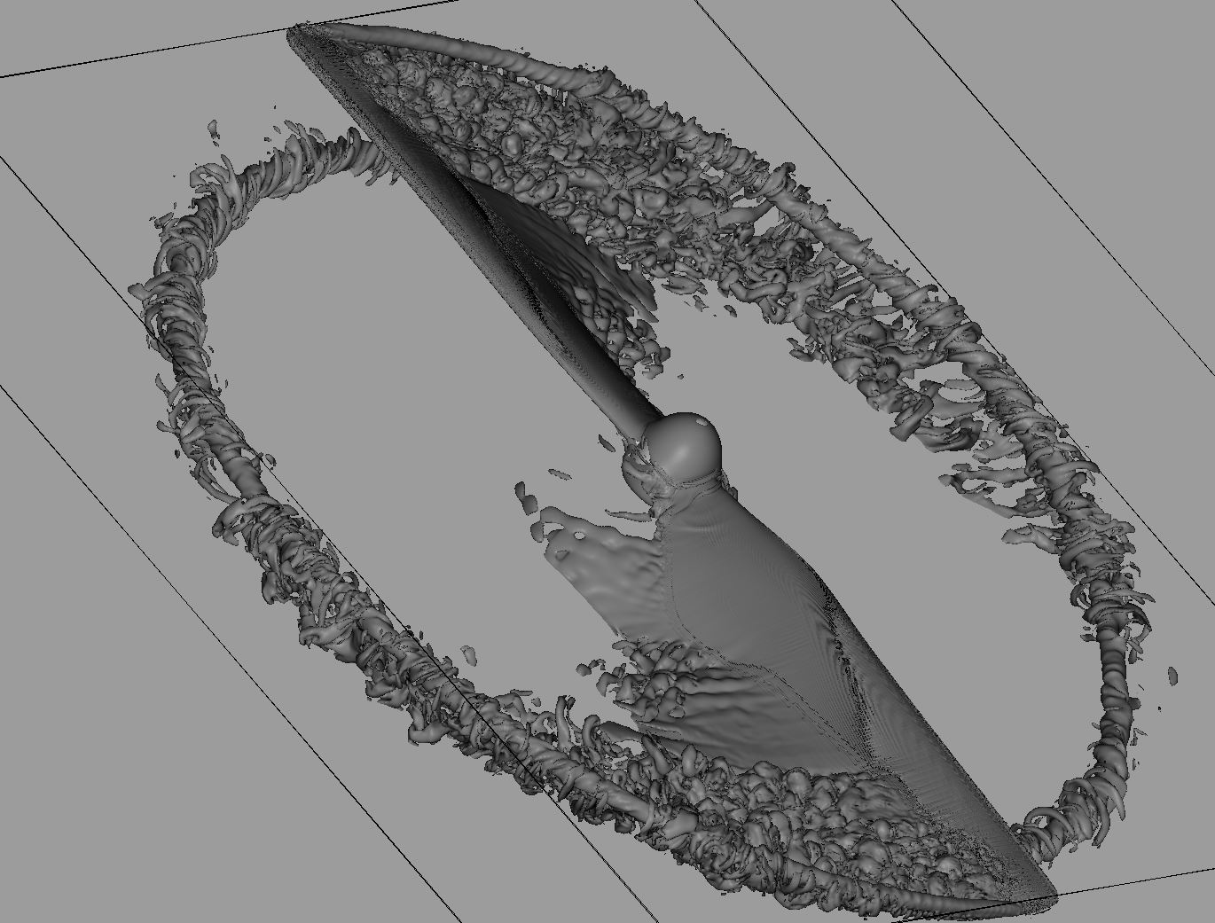
National Aeronautics and
Space Administration
Multi-fidelity Computational Noise Prediction of Representative Small Unmanned Aerial System (sUAS) Rotors
Presented by:
Chris Thurman
March 19, 2020

Slide 2
Outline
Background
Computational Setup
Aerodynamic Results
Aeroacoustic Results
Aeroacoustic Noise Sources
Summary

Slide 3
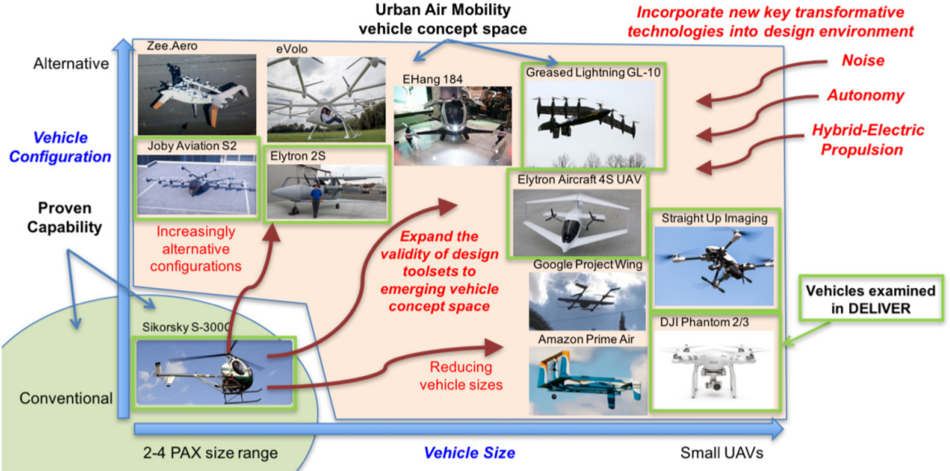
Background
Notes:
What?
Urban Air Mobility (UAM) Vehicles: aviation industry term for on-demand and automated passenger or cargo-carrying air transportation services, typically flown without a pilot.
Why?
Amazon & Uber
Existing technology
No way of determining which vehicle is best suited for a particular application
Flexibility & maneuverability of rotorcraft

Slide 4
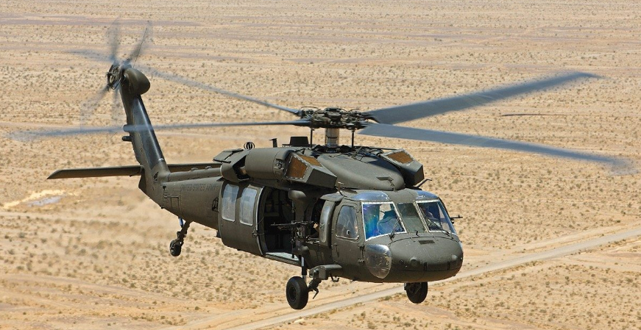
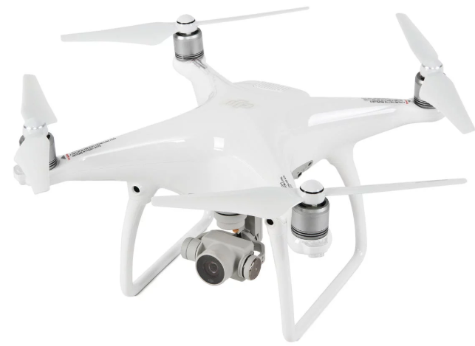
Background
Key Differences:
- Size
- Number of rotors
- Type of rotors
- Rotor proximity to airframe
- Fuselage size
- Flight conditions
Blackhawk
DJI Phantom
Notes:
Key Differences:
Size
Multi-rotor systems with fixed pitch blades as opposed to one main rotor with articulated blades
Fly at significantly different flight conditions
Fuselage size
Airframe proximity to rotor system
Differences affect noise
Shown by Zawodny et al.
Before discussing results, must build an understanding of rotorcraft noise generation mechanisms

Slide 5
Background
Rotorcraft Noise Sources:
Deterministic (tonal)
THICKNESS NOISE
LOADING NOISE
BLADE-VORTEX INTERACTION (BVI) NOISE
HIGH-SPEED IMPULSIVE (HSI) NOISE
Non-deterministic (broadband)
TURBULENCE INGESTION NOISE (TIN)
BLADE-WAKE INTERACTION (BWI) NOISE
BLADE SELF-NOISE
Notes:
Deterministic
Thickness noise: Noise due to displacement of fluid by the rotor blades
Loading Noise: Noise due to force exerted on the fluid by the rotor blade surface
Blade-Vortex Interaction Noise: Technically considered a loading noise. Impulsive loading noise due to a tip vortex impacting a following blade
High-Speed Impulsive Noise: Technically a quadrupole noise source. High intensity, in-plane noise associated with high advancing tip speeds (transonic flow)
Broadband
Turbulence Ingestion Noise: Unsteady loading noise due to ingestion of atmospheric turbulence into the rotor
Blade-Wake Interaction (BWI) Noise: Noise caused by blade interactions with rotor wake turbulence
Blade Self-Noise: Noise produced by scattering of turbulent flow over the blade trailing edge. Turbulent

Slide 6
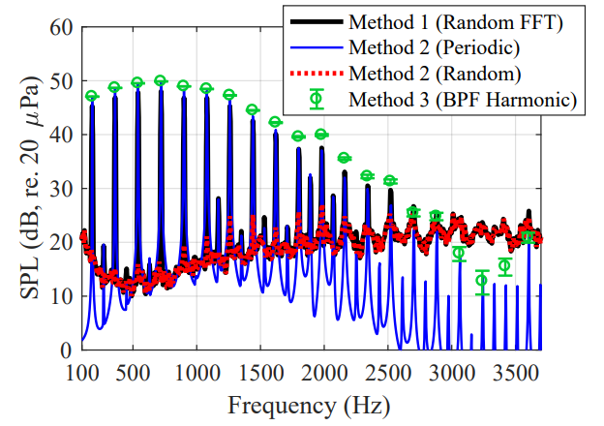
Background
Notes:
Filtered experimental data from rotor airframe interaction paper
Deterministic Noise:
Deterministic > periodic > occurring at the blade passage frequency (BPF)
Tonal in nature denoted by large energy spikes in spectral data
Generally important at lower frequencies
Broadband (random) Noise:
Present throughout spectral data
Dominant at higher frequencies, especially for UAM from which this data was taken
Now that we’ve established some rotorcraft acoustic background, we can discuss some prediction methods
EXTRA:
1. Random data set: narrowband spectra computed using fast Fourier Transform (FFT)
2. Un-filtered rotor revolution: Mean rotor revolution time history computed, subtracted from time record to retain random noise components
3. BPF harmonic-filtered data set: Acoustic time series filtered to retain only harmonics of BPF

Slide 7
Background
Multi-Fidelity Prediction Methods:
Tonal Noise
ANOPP/ANOPP2 (PAS, ROTONET, ABEAT, etc.)
Comprehensive analysis codes (CAMRAD II, DYMORE5, etc.)
Traditional Navier-Stokes solvers
Scale-resolving flow simulations (Lattice-Boltzmann, DNS)
Broadband Noise
Semi-empirical methods (BARC, ASNIFM)
Traditional Navier-Stokes solvers (??)
Scale-resolving flow simulations (Lattice-Boltzmann, DNS)

Slide 8
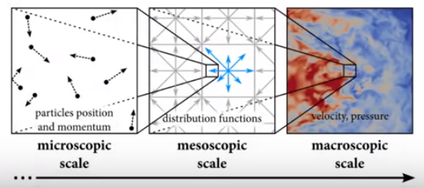
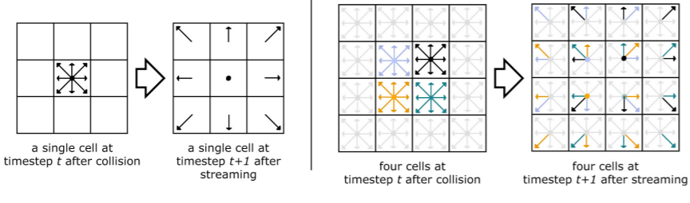
Background
Lattice-Boltzmann method-very-large-eddy simulation (LBM-VLES)

Slide 9
Geometry/Flight Conditions
DJI-9450
R = 4.7 in
c_{0.75} = 0.645 in
Ω = 5100 RPM
M_{tip} = 0.186
SUI Endurance
R = 7.5 in
c_{0.75} = 1.06 in
Ω = 4200 RPM
M_{tip} = 0.244

Slide 10
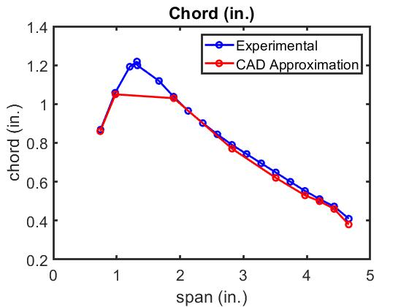
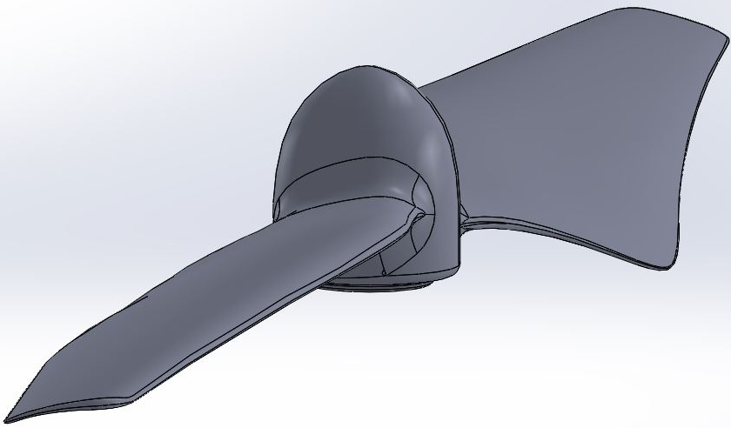
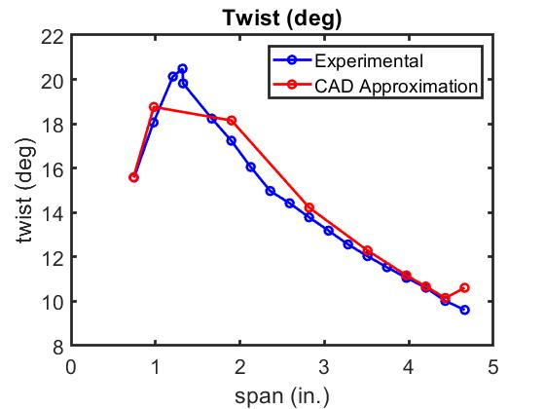
Geometry: DJI-9450

Slide 11
Geometry: DJI-9450

Slide 12
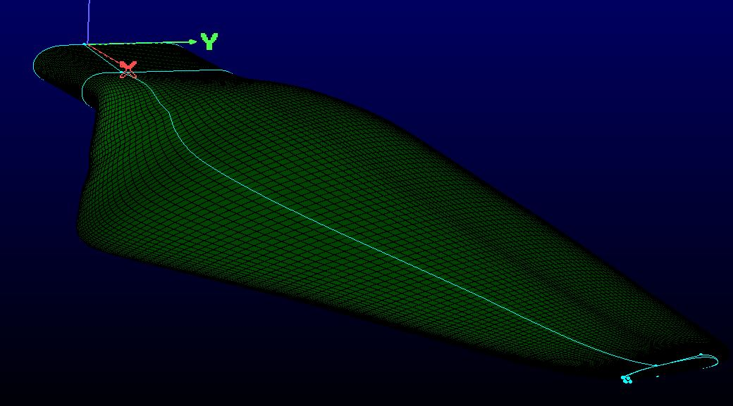
Geometry: SUI Endurance

Slide 13
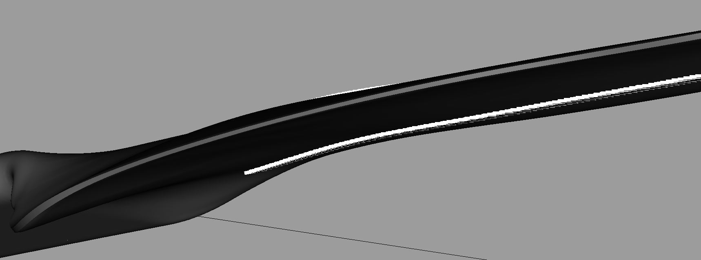
Geometry: SUI Endurance

Slide 14
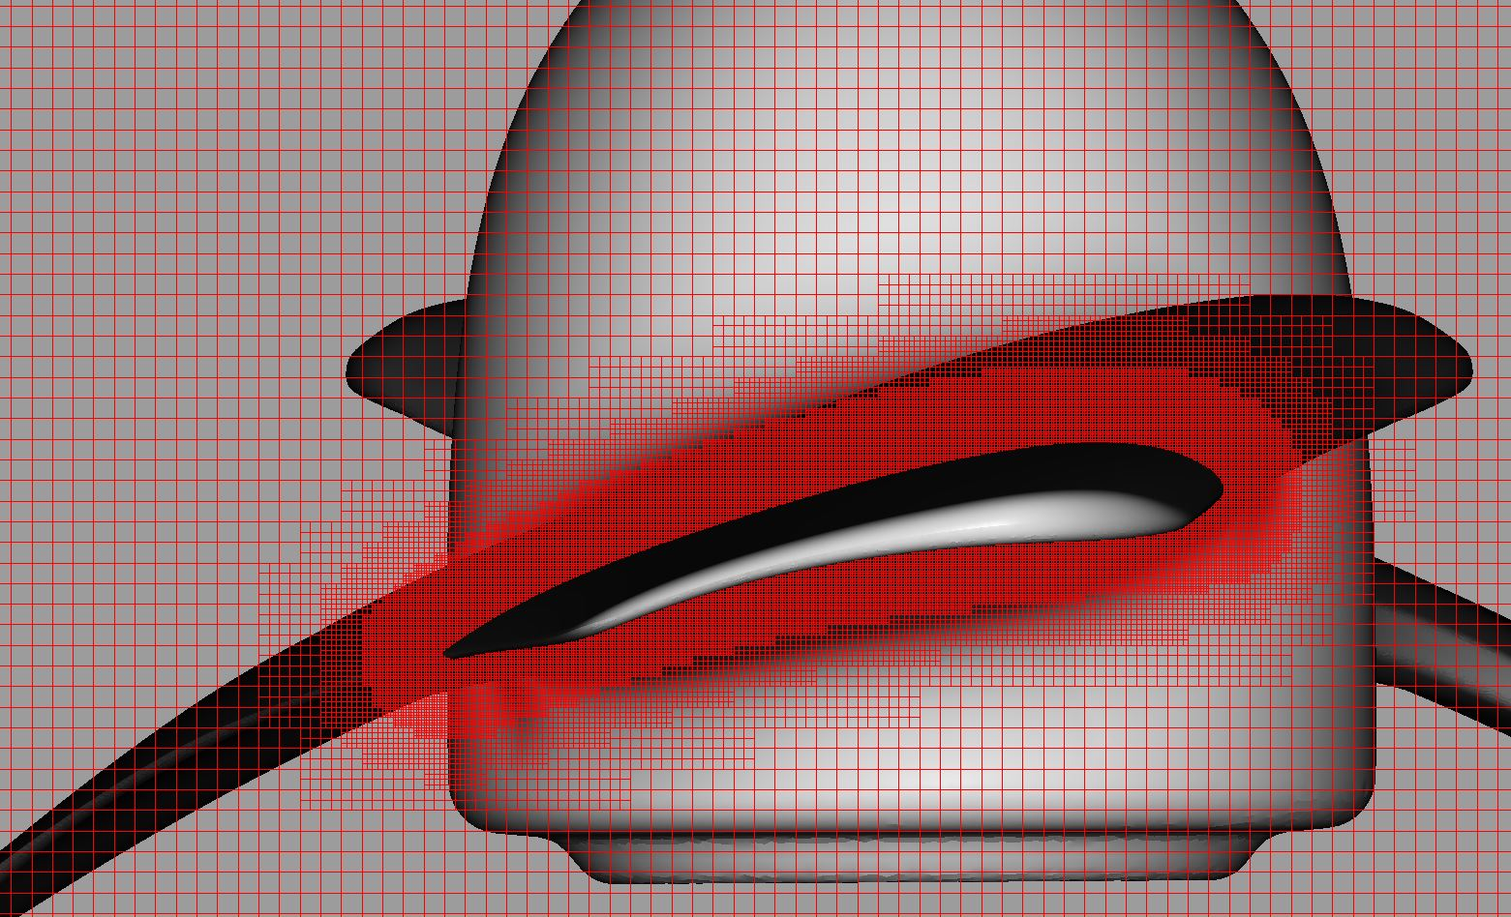
Computational Setup

Slide 15
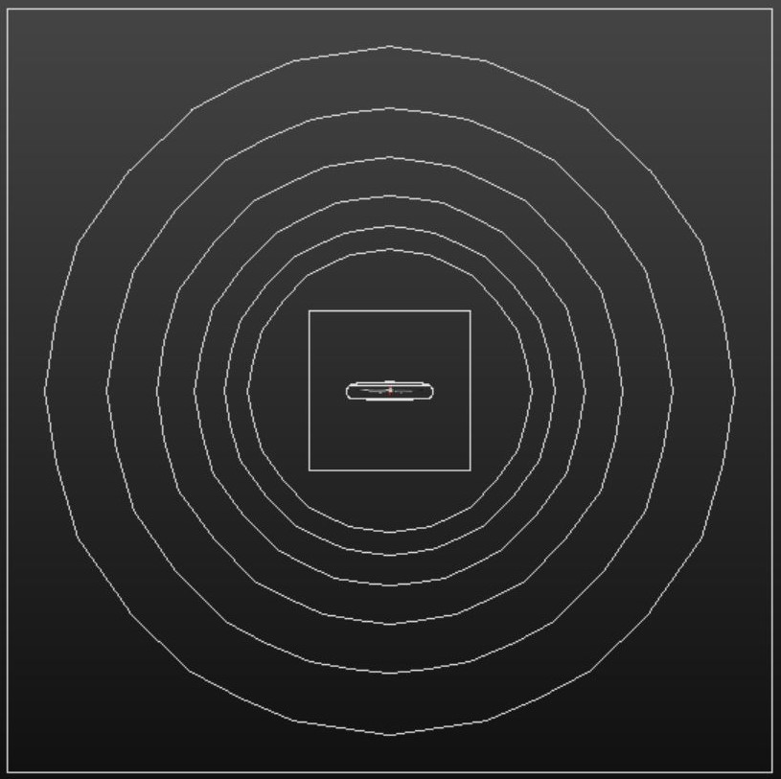
Computational Setup

Slide 16
Computational Setup
DJI-9450
Grid sensitivity
3 meshes, $\sqrt{2}$increase
SUI Endurance
2 meshes, different trip heights
- Light trip: 0.1 mm
- Heavy trip: 0.4 mm

Slide 17
Aerodynamic Results
DJI-9450
SUI Endurance

Slide 18
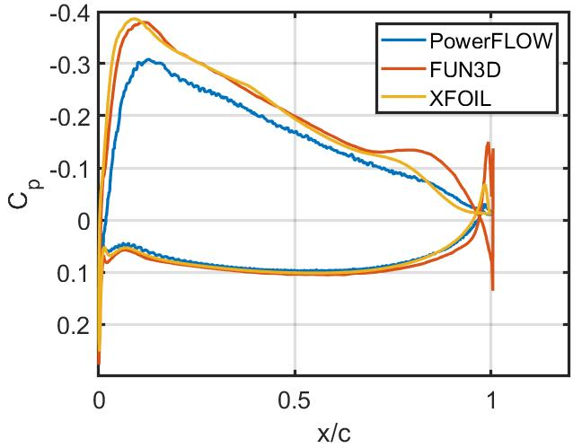
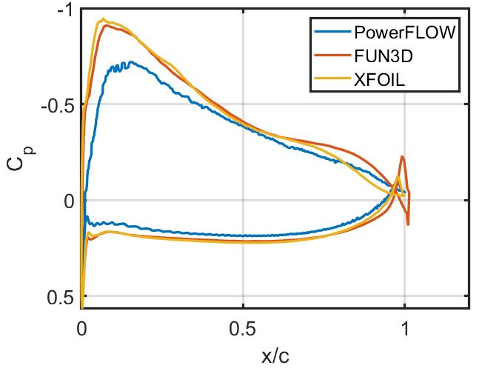
Aerodynamic Results: DJI-9450
0.5R
0.75R

Slide 19
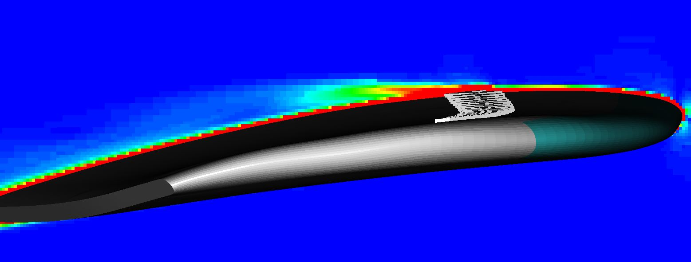
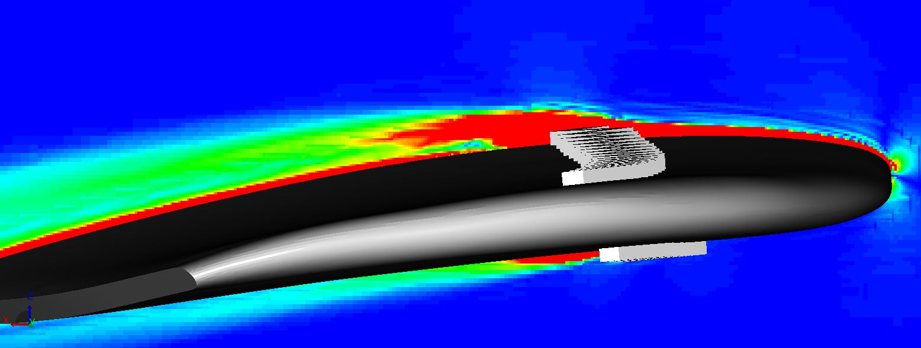
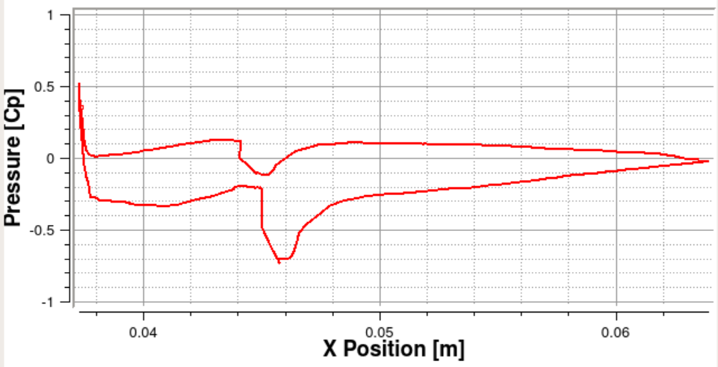
Aerodynamic Results: SUI Endurance
Light Trip
Heavy Trip

Slide 20
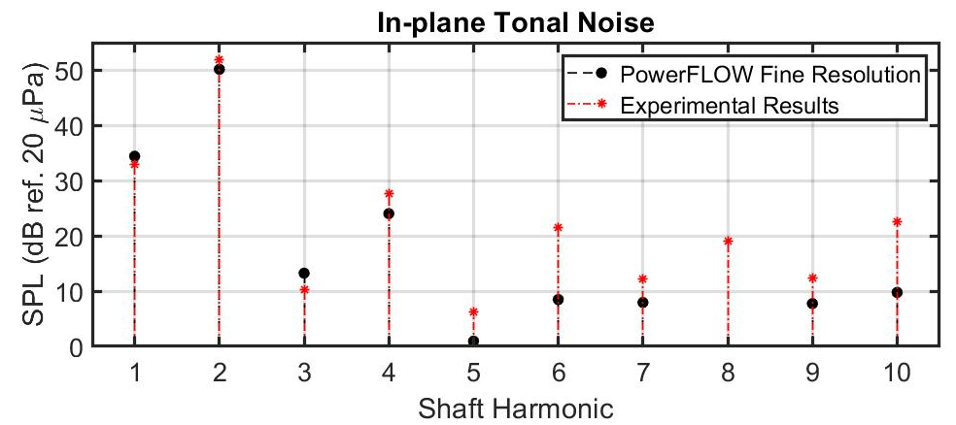
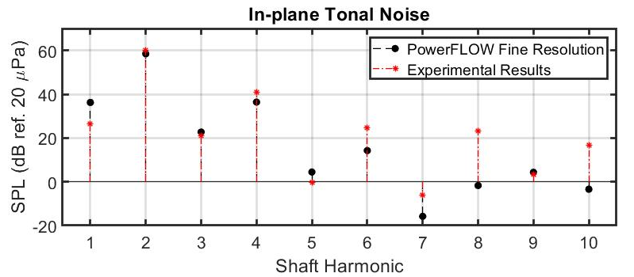
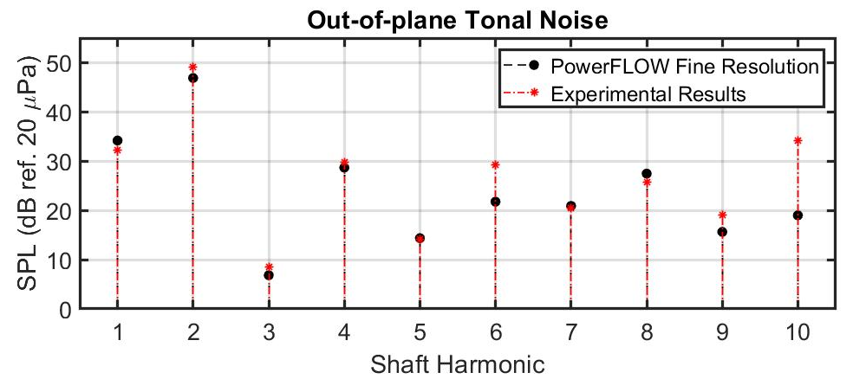
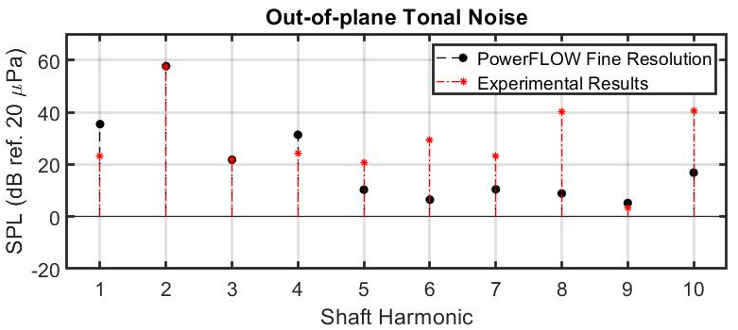
Aeroacoustic Results
DJI-9450
SUI Endurance

Slide 21
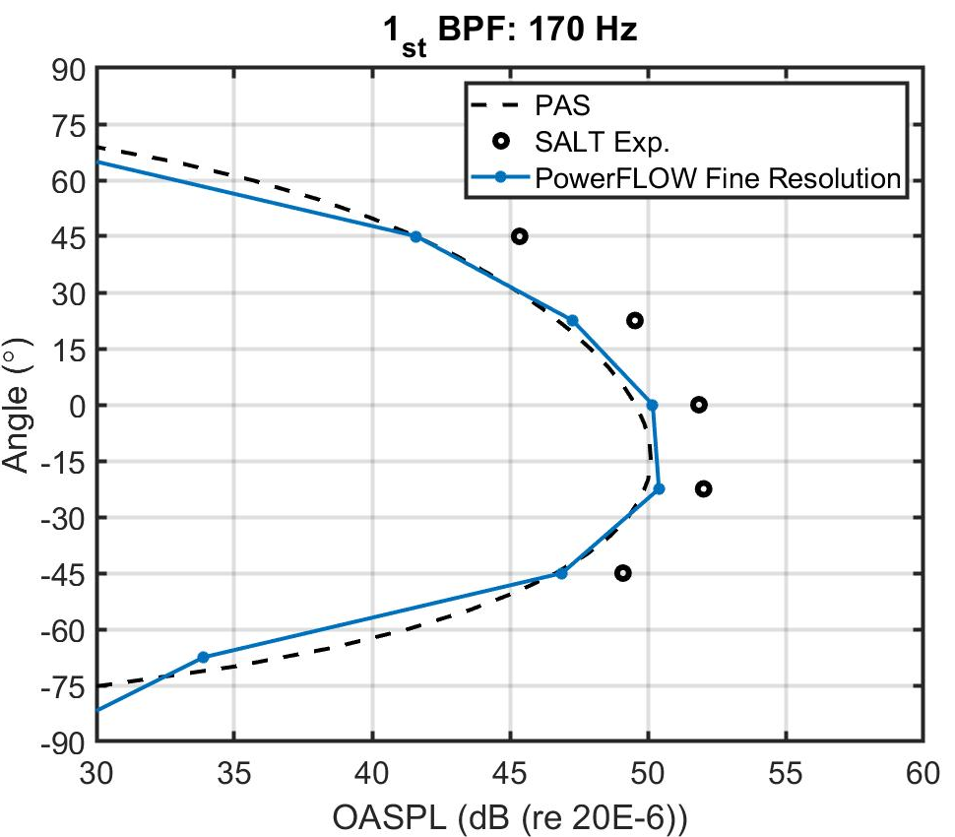
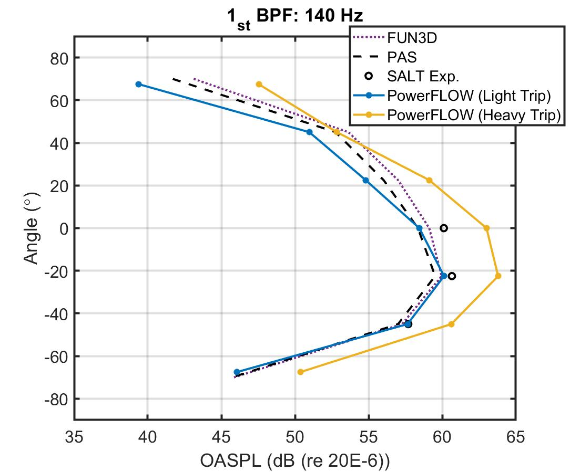
Aeroacoustic Results
DJI-9450
SUI Endurance

Slide 22
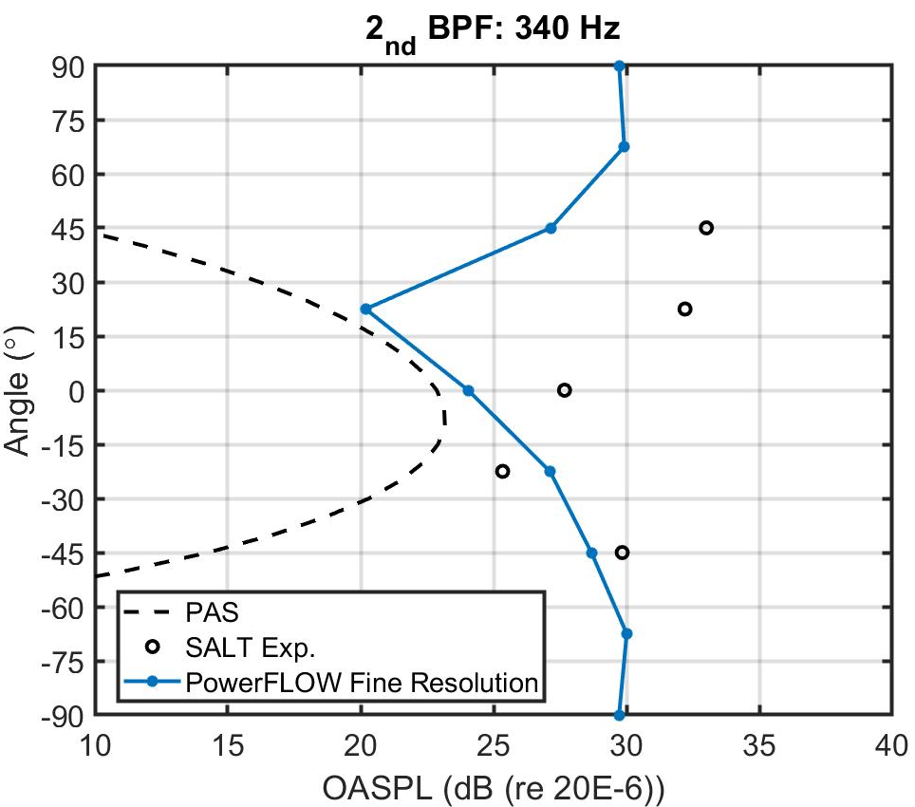
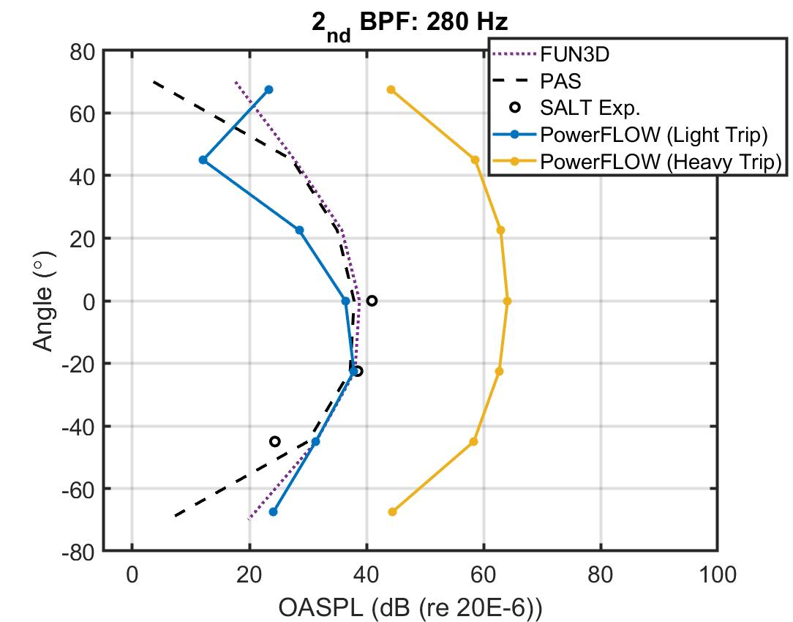
Aeroacoustic Results
DJI-9450
SUI Endurance

Slide 23
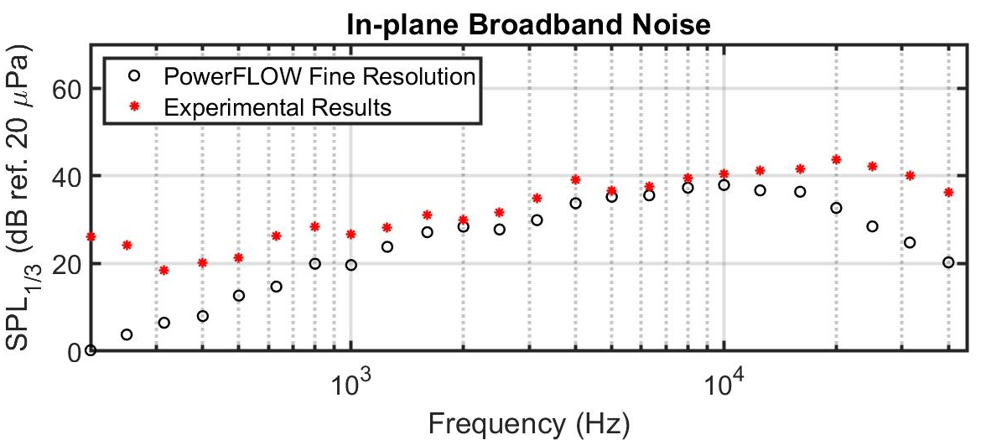
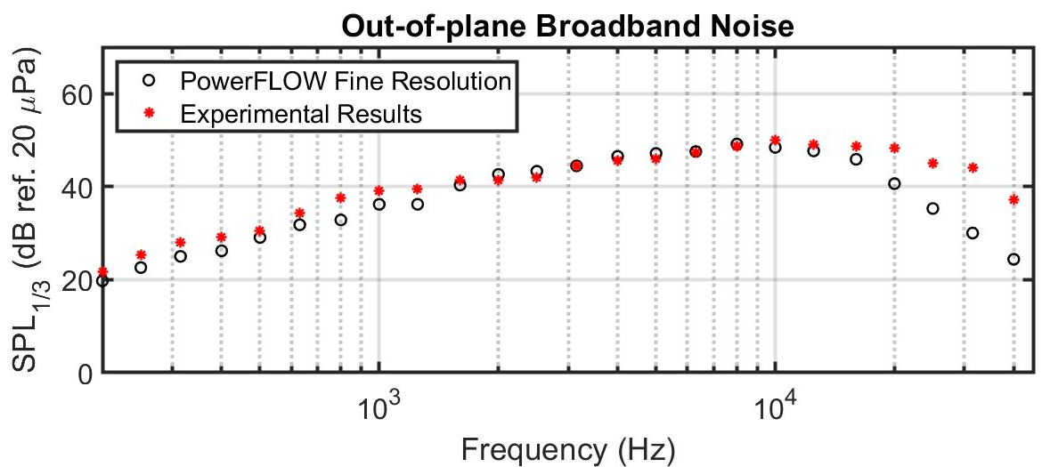
Aeroacoustic Results: DJI-9450

Slide 24
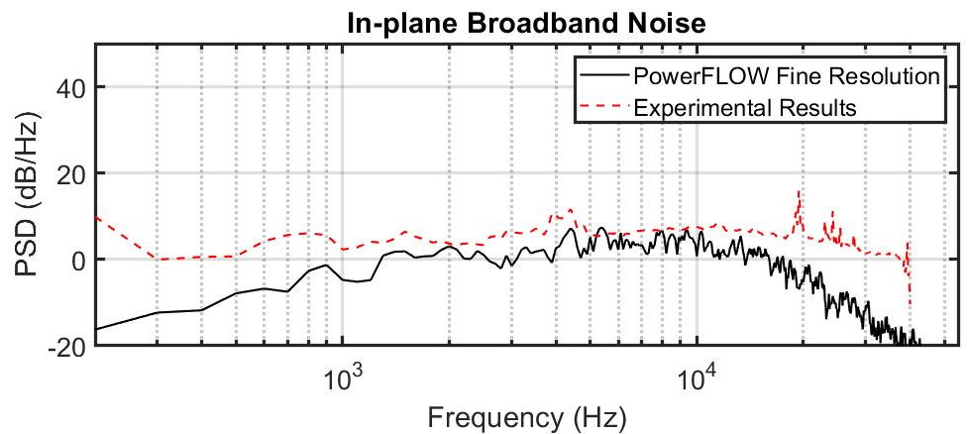
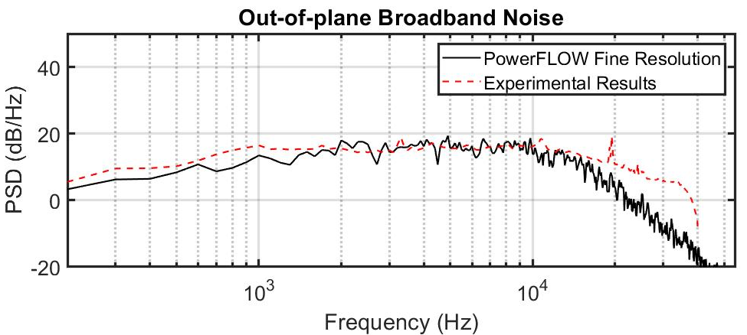
Aeroacoustic Results: DJI-9450

Slide 25
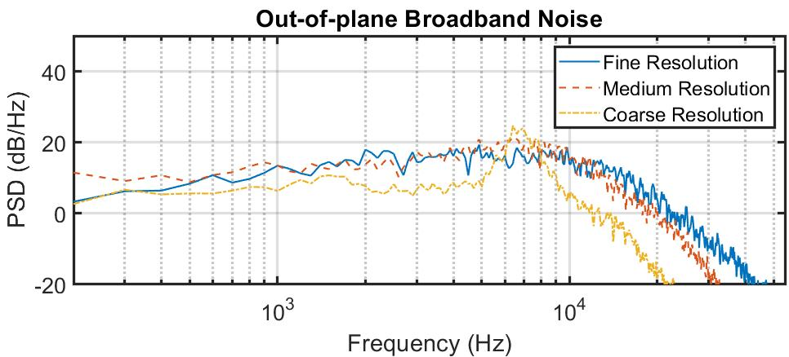
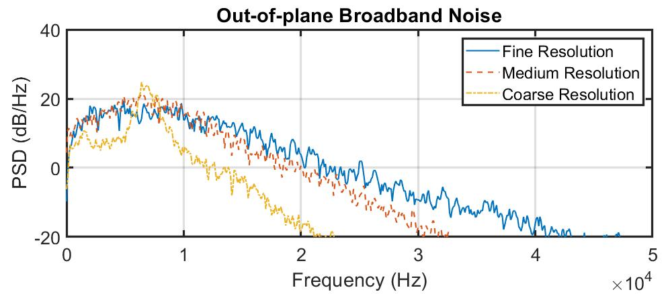
Aeroacoustic Results: DJI-9450

Slide 26
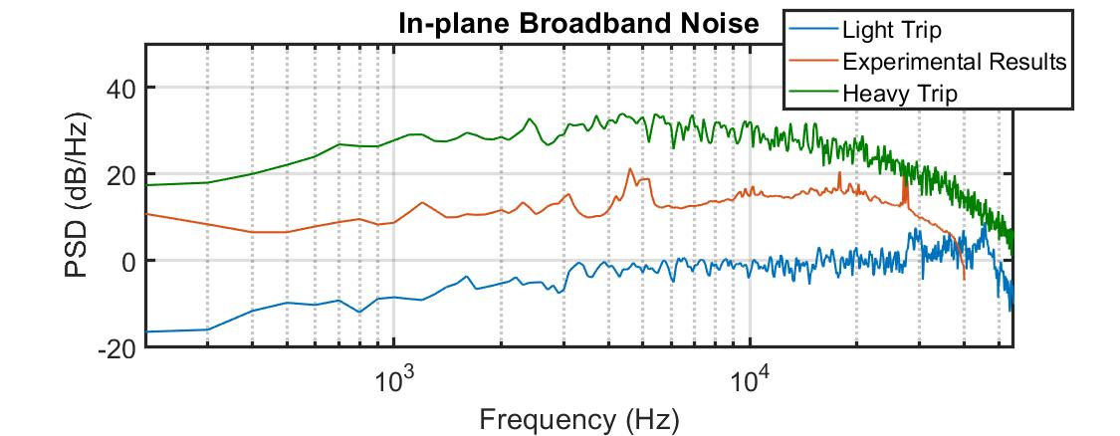
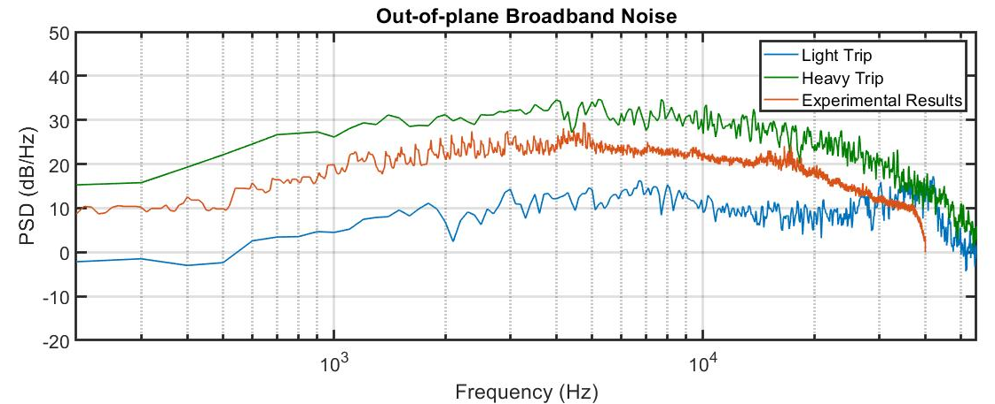
Aeroacoustic Results: SUI Endurance

Slide 27
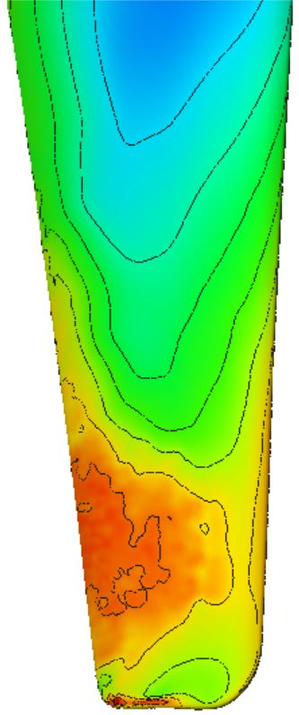
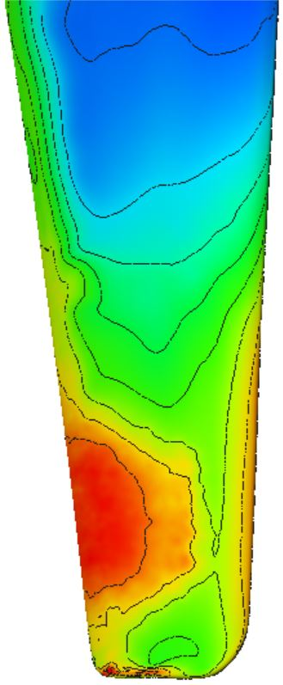
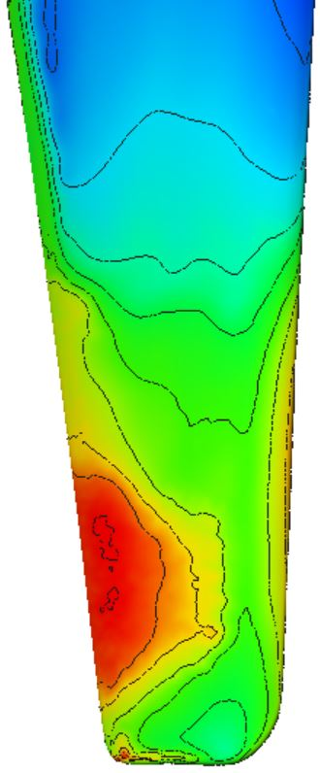
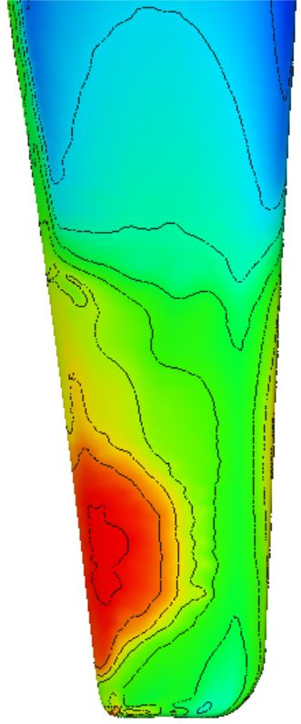
Aeroacoustic Noise Sources: DJI-9450
Fine Resolution
1kHz
2.5kHz
5kHz
10kHz

Slide 28
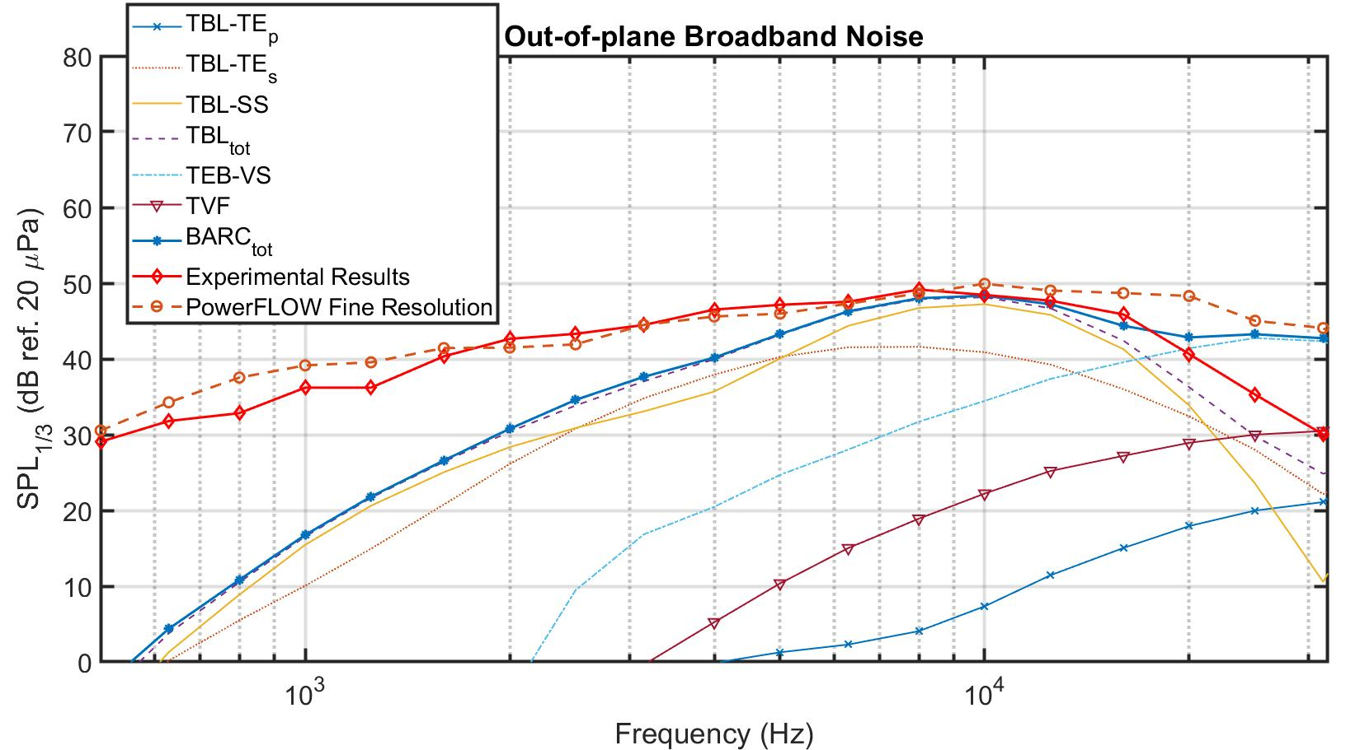
Aeroacoustic Noise Sources: DJI-9450

Slide 29
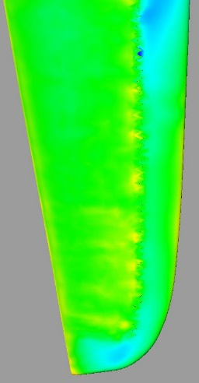
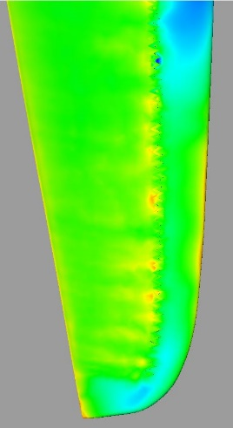
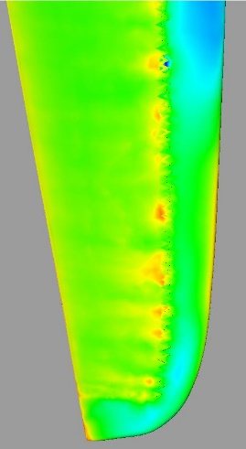
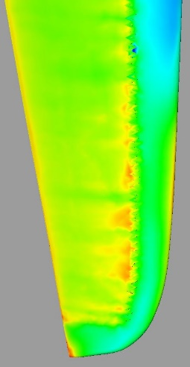
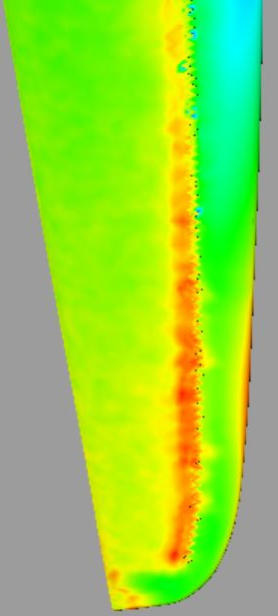
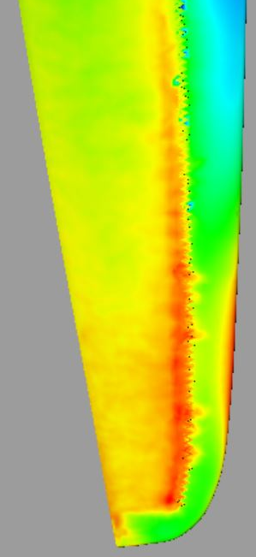
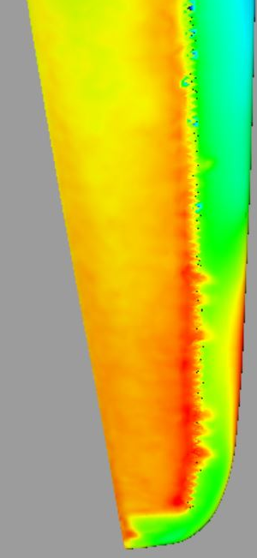
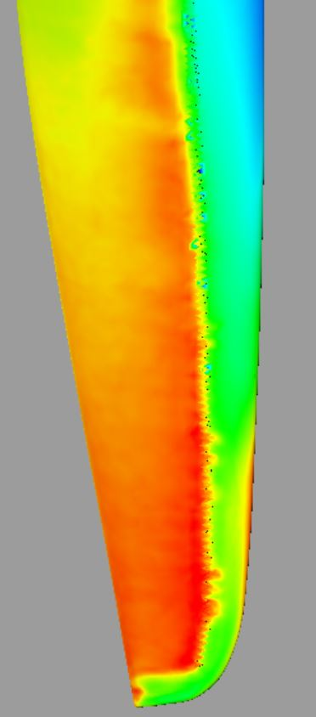
Aeroacoustic Noise Sources: SUI Endurance
Light Trip
Heavy Trip
1kHz
2.5kHz
5kHz
10kHz

Slide 30
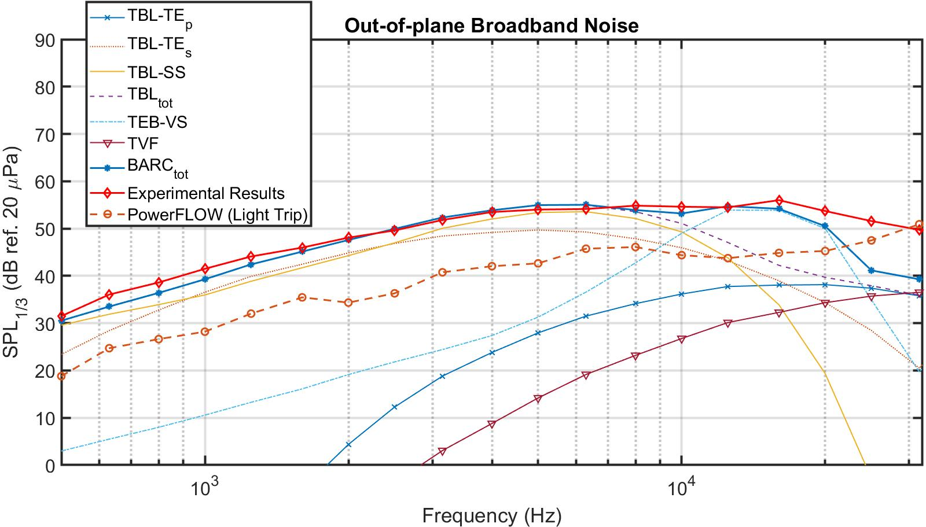
Aeroacoustic Noise Sources: SUI Endurance

Slide 31
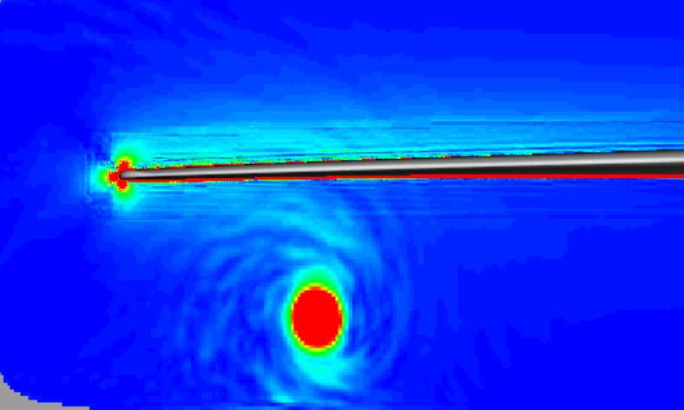
Aeroacoustic Noise Sources
DJI-9450
SUI Endurance

Slide 32
Aeroacoustic Noise Sources: SUI Endurance

Slide 33
Aeroacoustic Noise Sources: SUI Endurance

Slide 34
Summary
Urban Air Mobility (UAM)
Multi-fidelity prediction methods
Lattice-Boltzmann method (LBM)
Computational methodology
Aerodynamic results
Aeroacoustic results
Aeroacoustic sources

Slide 35
Acknowledgements
Dr. Nikolas Zawodny, Dr. Leonard Lopes (Aeroacoustics Branch)
Dr. James Baeder (University of Maryland)
Dr. David Lockard (Computational Aerosciences Branch)
Dr. Damiano Casalino, Dr. Wouter van der Velden (Dassault Systèmes)
Revolutionary Vertical Lift Technology (RVLT) funding

Slide 36
Questions?

Slide 37
References
C. R. Theodore, “A Summary of the NASA Design Environment for Novel Vertical Lift Vehicles (DELIVER) Project,” AHS Pap. 20180001325, 2018. [Slide 3]
“Sikorsky BLACK HAWK Helicopter | Lockheed Martin.” [Online]. Available: https://lockheedmartin.com/en-us/products/sikorsky-black-hawk-helicopter.html. [Accessed: 03-Mar-2019].[Slide 4]
“DJI Phantom 4 Quadcopter Drone [DJI-PH4] | Drones - AMain Hobbies.” [Online]. Available: https://www.amainhobbies.com/dji-phantom-4-quadcopter-drone-dji-ph4/p491255. [Accessed: 03-Mar-2019]. [Slide 4]
N. S. Zawodny and D. D. Boyd Jr, “Investigation of rotor-airframe interaction noise associated with small-scale rotary-wing unmanned aircraft systems,” AHS Pap. 20180001470, 2017. [Slide 6]
O’brien, P., “A Framework for Digital Watercolor,” Masters thesis, Texas A&M University, 2008. [Slide 8]
Shafiai, S. H., “Introduction to the Lattice Boltzmann Method,” [Online]. Avalailable: https://www.youtube.com/watch?v=qhr3pOaShjg [Accessed: 16-03-2020]. [Slide 8]

