Slide 1
Session: ACD-05: Aircraft Concept Design Tools and
Processes II
Data: June 16, 2020
Time: 9:30am - 10:00am

Slide 2
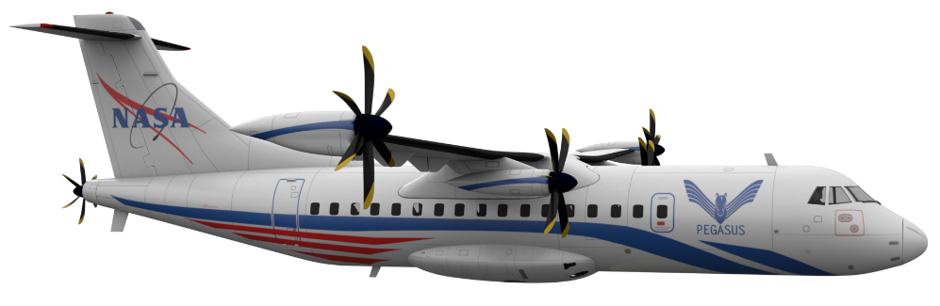
Design of a Distributed Propulsion Concept Using an Adjoint-Based Approach and Blade Element Theory to Minimize Power
AIAA-2020-XXXX
Irian Ordaz
Li Wang
Eric J. Nielsen
In support of the Advanced Air Transport Technology Project
of NASA Advanced Air Vehicle Program
NASA Langley Research Center
AIAA AVIATION
June 16, 2020 irian.ordaz@nasa.gov
This material is a work of the U.S. Government and is not subject to copyright protection in the United States.

Slide 3
Outline
Introduction and motivation
  Technical objectives
Aerodynamic and propulsor model
Approach
  Objective functions
  Performance and propulsor constraints
  Verification of sensitivity analysis
Optimization of PEGASUS concept
Summary and future work

Slide 4
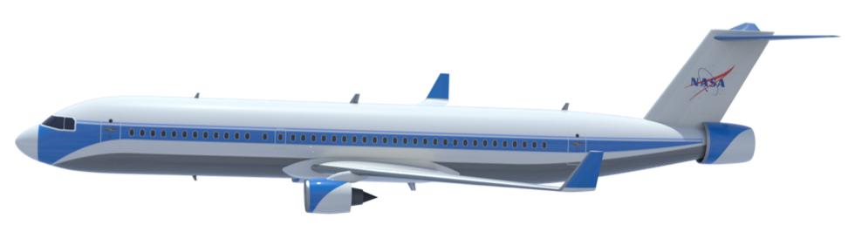

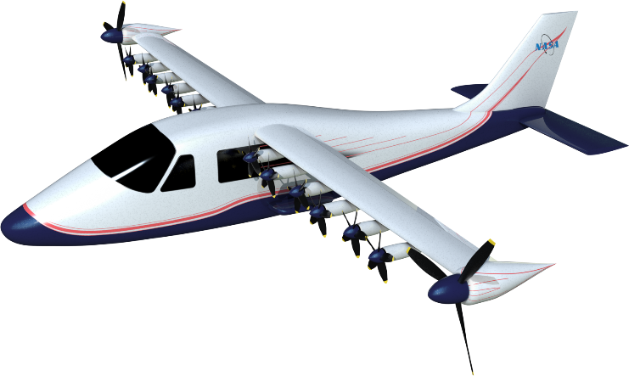
Introduction and Motivation
Growing interest in technologies that take advantage of the complex interactions between the vehicle aerodynamics and the propulsion system in order to increase fuel/energy efficiency
Two technologies of particular interest that leverage aero-propulsive interactions to improve aircraft efficiency are boundary layer ingestion (BLI) and distributed electric propulsion (DEP)
STARC-ABL
(Turboelectric)
PEGASUS
(Parallel Hybrid Electric)
X-57 Maxwell
(All-Electric)

Slide 5
Introduction and Motivation
Growing interest in technologies that take advantage of the complex interaction between the vehicle aerodynamics and the propulsion system in order to increase fuel/energy efficiency
Two technologies of particular interest that leverage aero-propulsive interactions to improve aircraft efficiency are boundary layer ingestion (BLI) and distributed electric propulsion (DEP)
Complex multidisciplinary problem requires closer coupling between the aerodynamic and propulsion disciplines
Propulsion-Airframe Integration (PAI) requires exploration and optimization of a complex design space with computationally expensive design evaluations
Adjoint-based design approach allows efficient gradient-based optimization
  Calculation of gradients with finite difference is not practical for a large number of design variables

Slide 6
Introduction and Motivation
Technical Objectives
Extend design capability to establish a framework for efficient gradient-based optimization of propulsor devices based on actuator disk model design variables including
  Position and orientation
  Size and speed
  Uniform disk loading
  Blade element-based disk loading distribution
Capture aero-propulsive coupling and design sensitivity for complex design spaces with RANS-based analysis and account for swirl effects of propulsors
Understand aero-propulsive design space, including optimal power and thrust split between different propulsors that leverage distributed propulsion and boundary layer ingestion technologies
AIAA 2019-3681

Slide 7
Aerodynamic Model
Overview
Aerodynamic solutions and adjoint-based sensitivities are computed using FUN3D
FUN3D is a finite-volume node-centered unstructured-grid CFD solver for Euler and Reynolds-Averaged Navier-Stokes (RANS) equations
Widely used for high-fidelity analysis and adjoint-based design of complex flows
Solves the Navier-Stokes equations on mixed-element grids containing arbitrary combinations of tetrahedra, pyramids, prisms, and hexahedra
Aerodynamic Analysis
Steady state RANS
Turbulence modeled using the one-equation Spalart-Allmaras model
Tetrahedral grids with initial grid spacing of y+ of 1 or lower
Actuator Disk Model
O’Brien, D., “Analysis of Computational Modeling Techniques for Complete Rotorcraft Configurations,” Ph.D. thesis, Georgia Institute of Technology, May 2006.
The formulation is modified to provide a continuous dependence between the actuator disk coordinates and the force representation on the fluid grid.
Notes:
Explore better vissualization

Slide 8

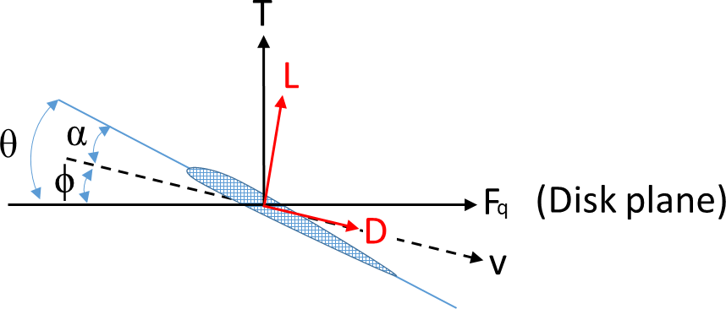
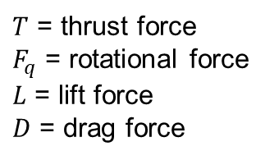
Propulsor Model
Actuator Disk Model
The force and torque distributions are now calculated using blade element theory.
Airfoil characteristics can be specified for each section along the blade span through
  Empirical quadratic drag model:
  C81 table of coefficients of lift, drag, and moment as a function of local Mach number and angle of attack
$T$ = thrust force
$F_{q}$ = rotational force
$L$ = lift force
$D$ = drag force
α = angle of attack
ϕ = flow angle
θ = blade pitch

Slide 9
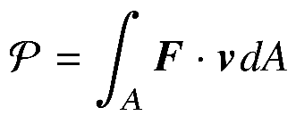


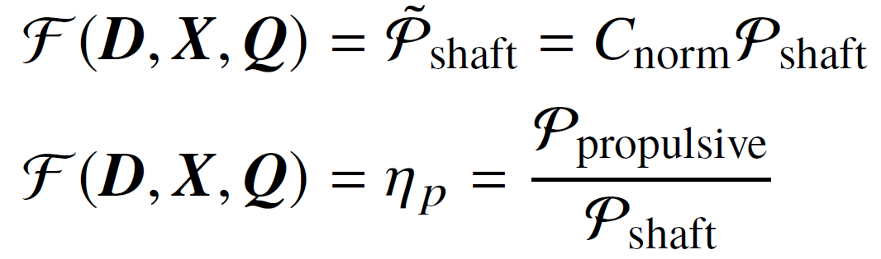
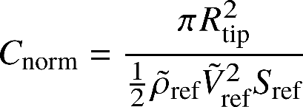
Optimization Formulation
Flow power is calculated as the integral of force and velocity over the disk area
Flow power is decomposed into normal and rotational components
  Normal: propulsive power,
  Rotational/tangential: shaft power,
Objective Functions
D, X, and Q denote design variable, grid coordinate, and flow state variable vector
where

Slide 10

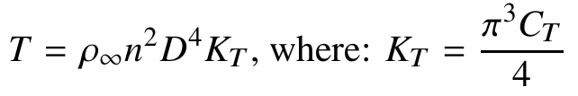
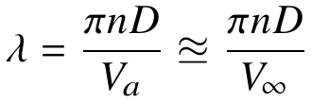
Optimization Formulation
Design variable vector, D, includes
  Propulsor with blade element-based disk loading
  blade collective pitch, θ₀
  blade twist distribution, θ_{t}
  blade chord length distribution, c
  Propulsor with uniform disk loading
  actuator coefficient of thrust, C_{T}
  Propulsor size and speed
  actuator diameter, D
  actuator tip speed ratio, λ
  Propulsor installation
  actuator position, x
  actuator thrust vector angles, ϕ
  Vehicle
  angle of attack, α
  outer-mold-line (OML) shape variables
Actuator load type 7
(pitch distribution)
Actuator load type 1
Common parameters

Slide 11
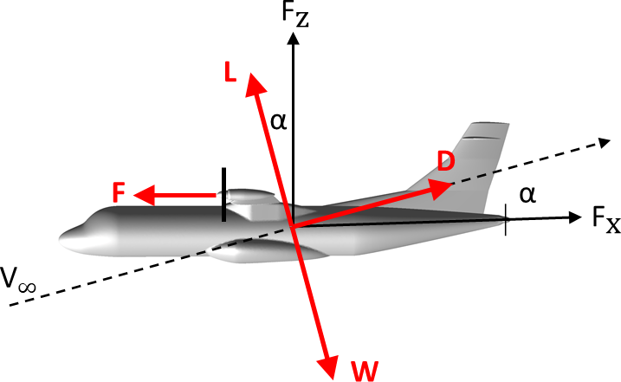
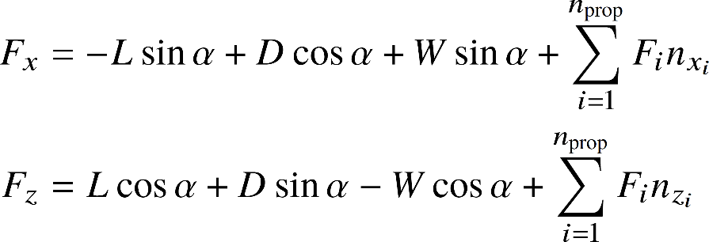
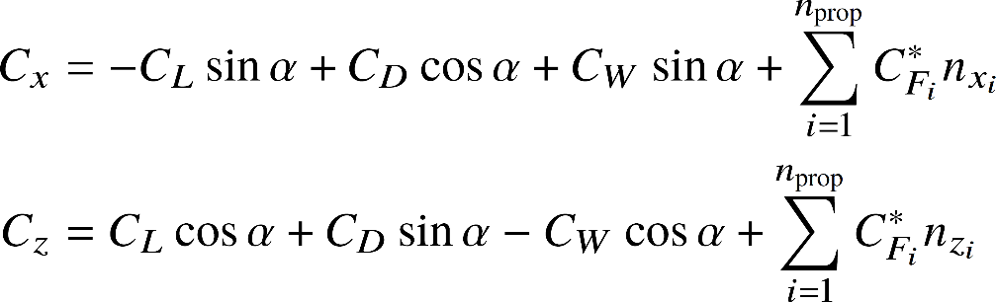
Optimization Formulation
Performance Constraints
Without performance constraints, the problem is ill-posed
All force coefficients are normalized by dynamic pressure and reference area (same as aerodynamic lift and drag coefficients)
Assume flight path angle of zero

Slide 12
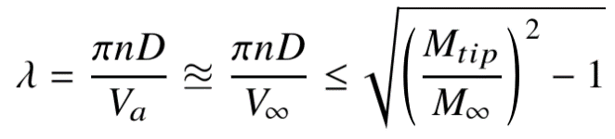
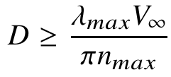
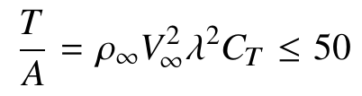
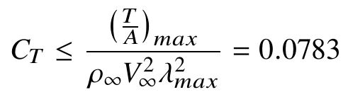
Optimization Formulation
Propulsor / Actuator Constraints
Maximum Mach number at propeller tip → Maximum tip speed ratio
Maximum rotational speed → Minimum propeller diameter
Maximum disk loading → Maximum coefficient of thrust
Actuator load type 1 only (uniform loading)
Some constraints are implicitly captured through the airfoil performance characteristics and the effect on the blade element-based disk loading.
Notes:
It is assumed that the local speed of sound at the propeller tip is approximately equal to freestream speed of sound and that the speed of advance is approximately equal to freestream velocity.

Slide 13
Optimization Formulation
Verification of Linearization
Sensitivity derivatives of the objective and force constraints verified using an independent approach based on complex variables
Complex-variable form of the finite-difference analysis is free of subtraction errors and can be used to verify a manual implementation of an adjoint-based sensitivity analysis.
Sensitivity derivatives computed for a fully turbulent flow over a simple body of revolution with a single actuator disk placed in close proximity
Magnitude of the imaginary perturbation chosen to be 1x10⁻⁵⁰ and all equation sets are solved to machine precision.

Slide 14
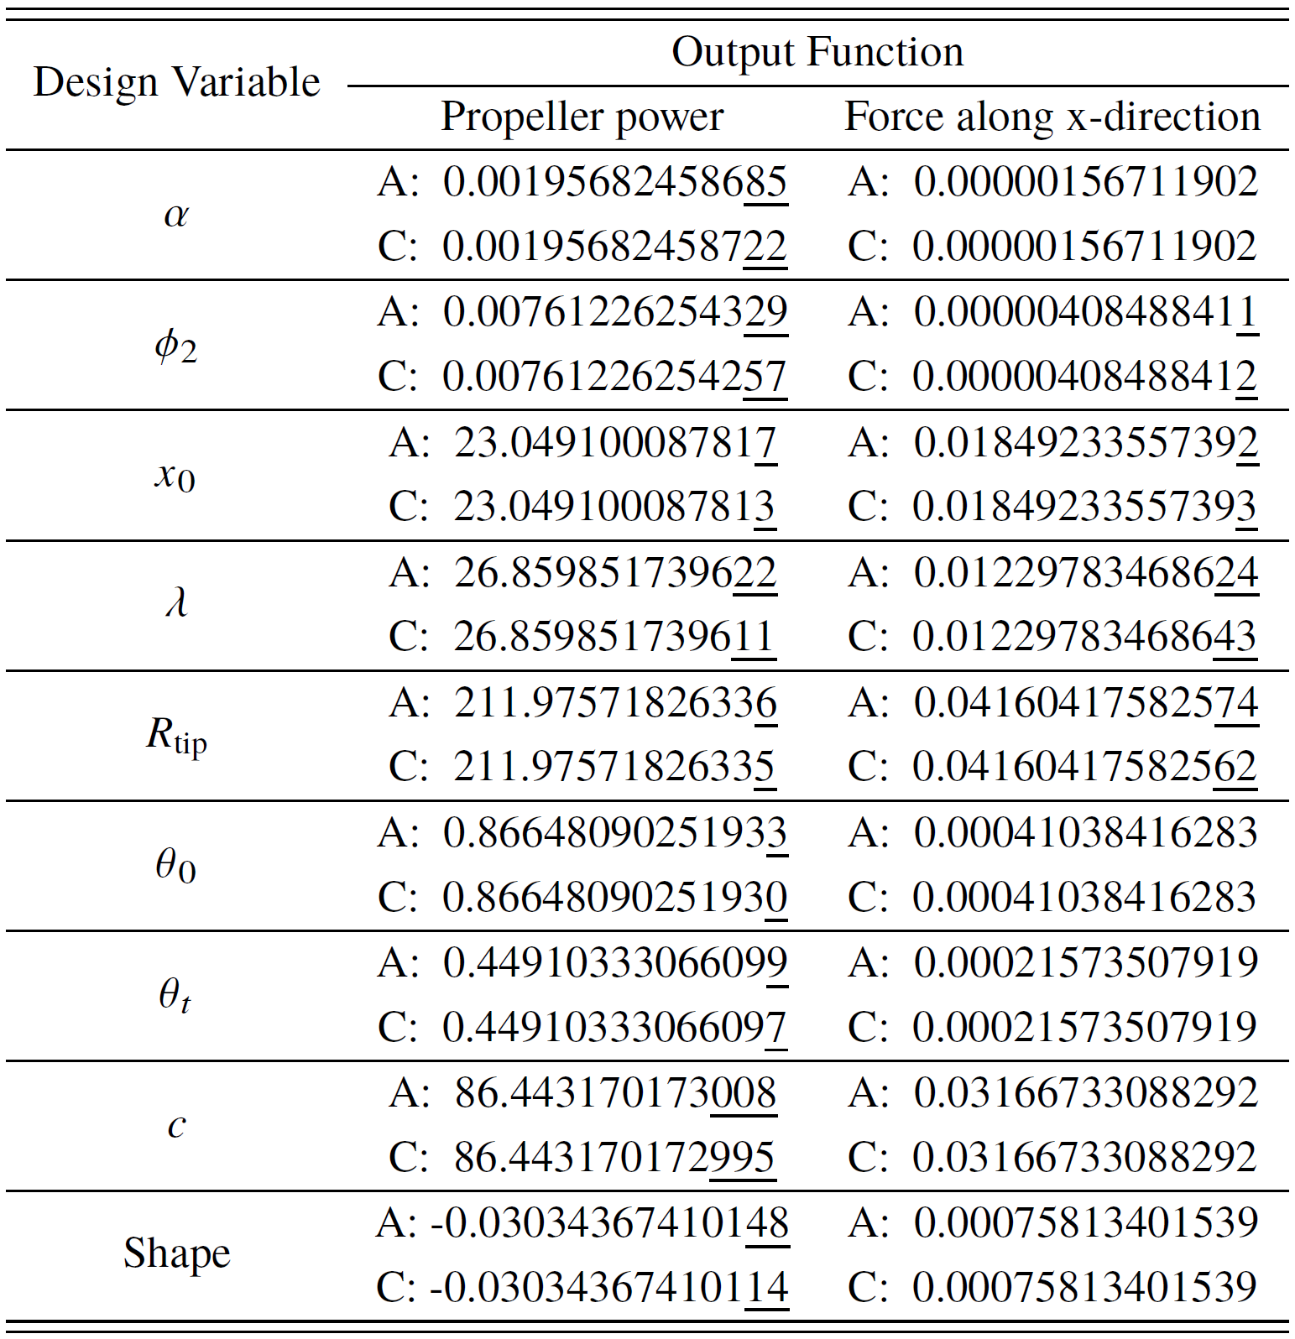
Verification of Linearization
Comparison of sensitivities from adjoint (A) and complex (C) approaches

Slide 15

Demonstration Case: PEGASUS
Overview
Parallel hybrid electric regional aircraft concept with a targeted EIS 2030
Loosely based on ATR 42-500
Cruise Mach number of 0.5, altitude of 20,000 feet, vehicle weight of 35,000 lb, and range 200-400 nmi
Wing tip propellers operate with an inboard-up configuration
Driven by Parallel Hybrid Electric Propulsor
Driven by Electric Motor Propulsor
Driven by Electric Propulsor
Source:
Antcliff, K. R., and Capristan, F. M., “Conceptual Design of the Parallel Electric-Gas Architecture with Synergistic Utilization Scheme (PEGASUS) Concept,” 18th AIAA/ISSMO Multidisciplinary Analysis and Optimization Conference, AIAA Paper 2017-4001, 2017.
Notes:
PAGASUS is a hybrid electric regional aircraft concept based on the ATR-42-500 aircraft and consists of two parallel hybrid electric propulsors located at the wing tips and electric propulsors located mid-wing and at the fuselage tail-cone

Slide 16
Demonstration Case: PEGASUS
Overview
Parallel hybrid electric regional aircraft concept with a targeted EIS 2030
Loosely based on ATR 42-500
Cruise Mach number of 0.5, altitude of 20,000 feet, vehicle weight of 35,000 lb, and range 200-400 nmi
Wing tip propellers operate with an inboard-up configuration
Driven by Parallel Hybrid Electric Propulsor
Driven by Electric Motor Propulsor
Driven by Electric Propulsor
Source:
Antcliff, K. R., and Capristan, F. M., “Conceptual Design of the Parallel Electric-Gas Architecture with Synergistic Utilization Scheme (PEGASUS) Concept,” 18th AIAA/ISSMO Multidisciplinary Analysis and Optimization Conference, AIAA Paper 2017-4001, 2017.
Notes:
PAGASUS is a hybrid electric regional aircraft concept based on the ATR-42-500 aircraft and consists of two parallel hybrid electric propulsors located at the wing tips and electric propulsors located mid-wing and at the fuselage tail-cone

Slide 17
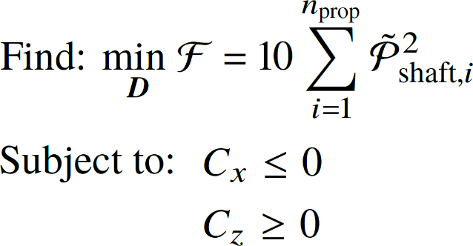
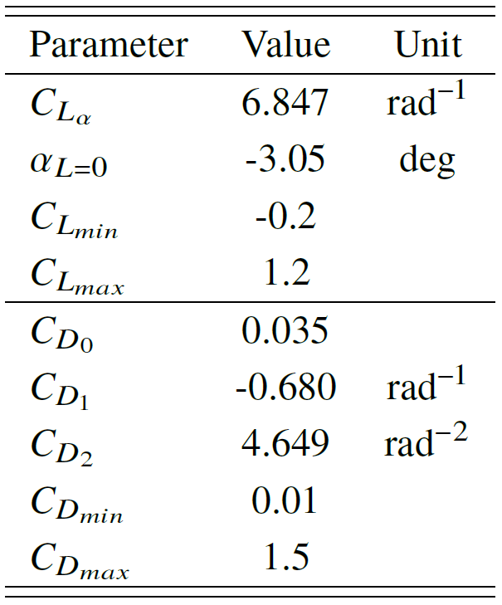

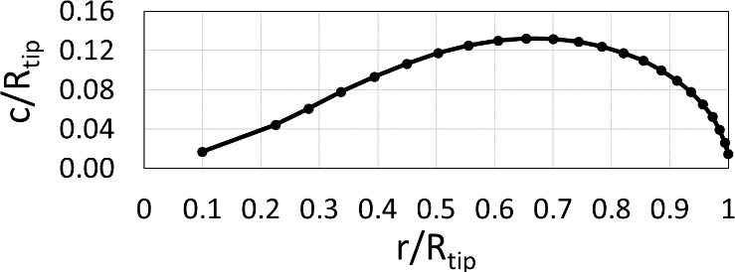
Demonstration Case: PEGASUS
D includes angle of attack, actuator radius, tip speed ratio, and blade pitch for both wing tip and BLI propulsors (51 total design variables)
Maximum propeller tip Mach number is 0.85, corresponding to a maximum tip speed ratio of 1.37
Minimum radius of wing tip mounted propeller is 4 feet, corresponding to a maximum rotational speed of approximately 1,700 RPM
Minimum radius of BLI propeller is 2 feet, corresponding to a maximum rotational speed of approximately 3,400 RPM
Full CFD domain is used to demonstrate design parameter coupling of actuators across symmetry plane
Airfoil characteristics
Chord distribution

Slide 18
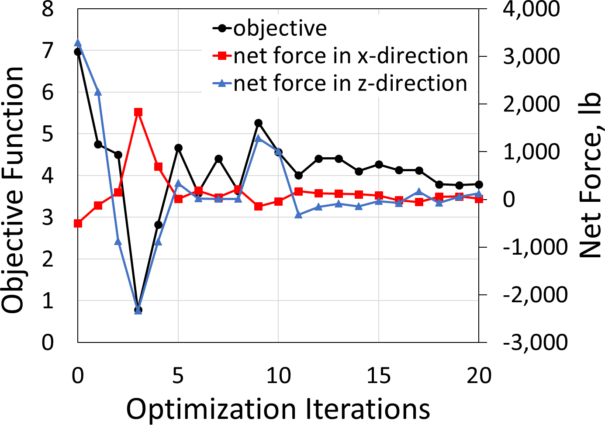
Demonstration Case: PEGASUS
Computational Requirements
Optimization conducted on 3,000 cores of Intel Ivy Bridge processors, dual-socket 10-core E5-2680v2 chip model with a base clock speed of 2.8 GHz
CFD grid generated with AFLR3 consists of 10.8 million nodes and 64.9 million tetrahedral elements
FUN3D RANS flow solver and the adjoint solver with one objective and two constraints require 15 and 10 wall-clock minutes, respectively (5 order magnitude residual decrease)
Complete design with 20 design iterations requires just under 8.3 wall-clock hours
Design History
Notes:
Optimization with finite difference would require over 5 days of wall-clock.

Slide 19
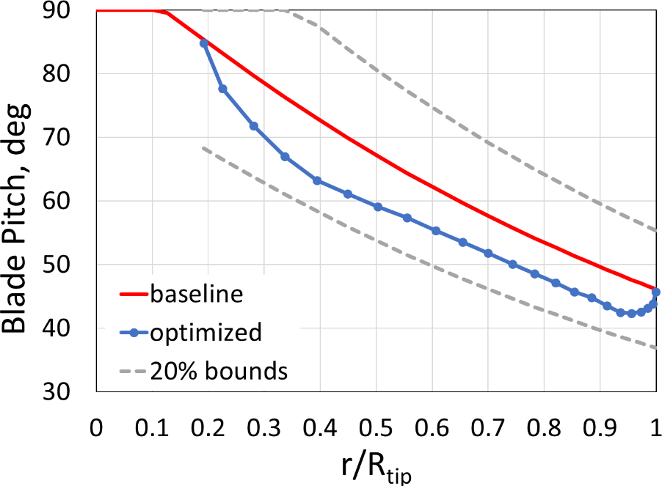
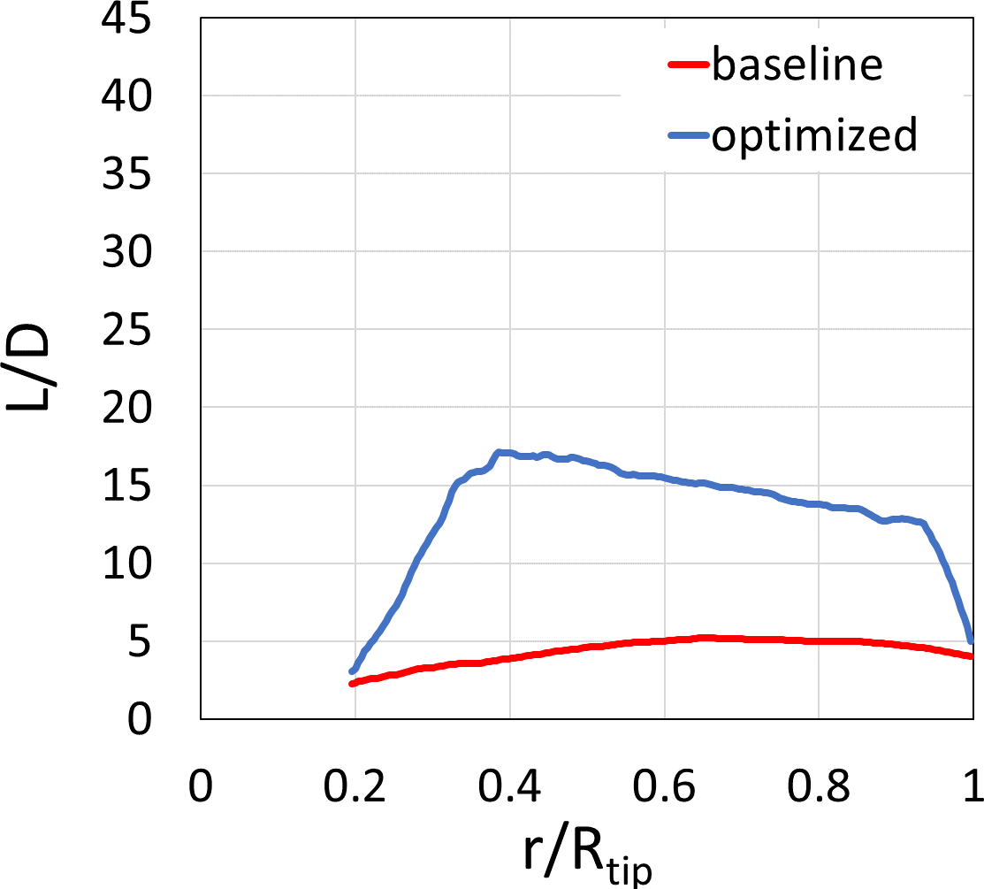
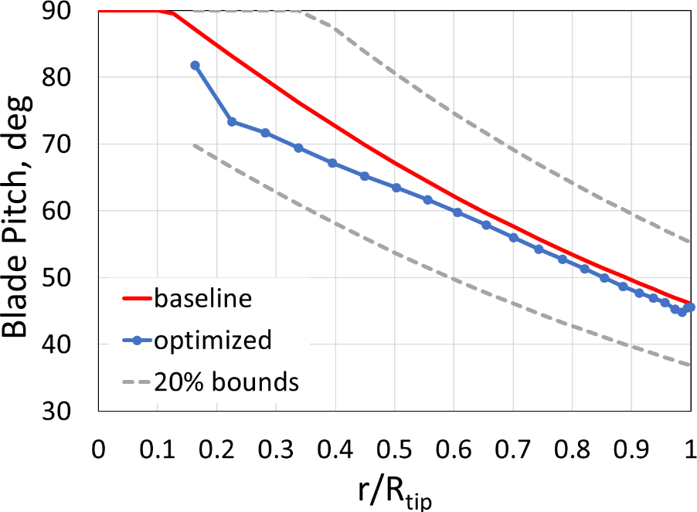
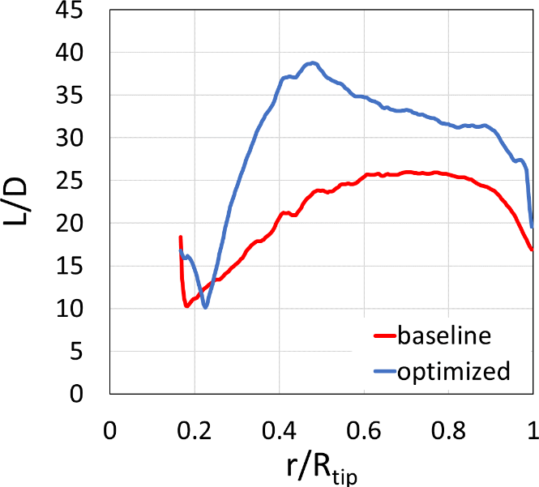
Demonstration Case: PEGASUS
BLI propulsor
BLI propulsor
Tip propulsor
Tip propulsor

Slide 20
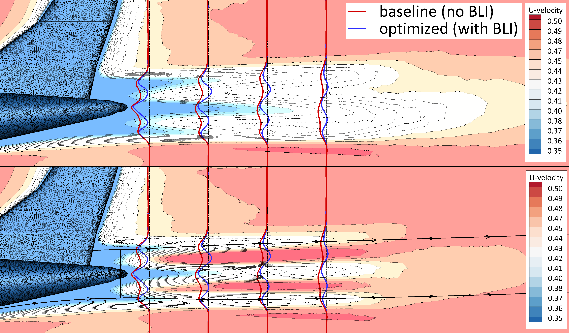
Demonstration Case: PEGASUS
Wake is successfully re-energized but with some practical limitations
Smaller diameter and high rotational speed is beneficial for BLI propulsor (also ideal for tail-strike considerations during take-off)

Slide 21
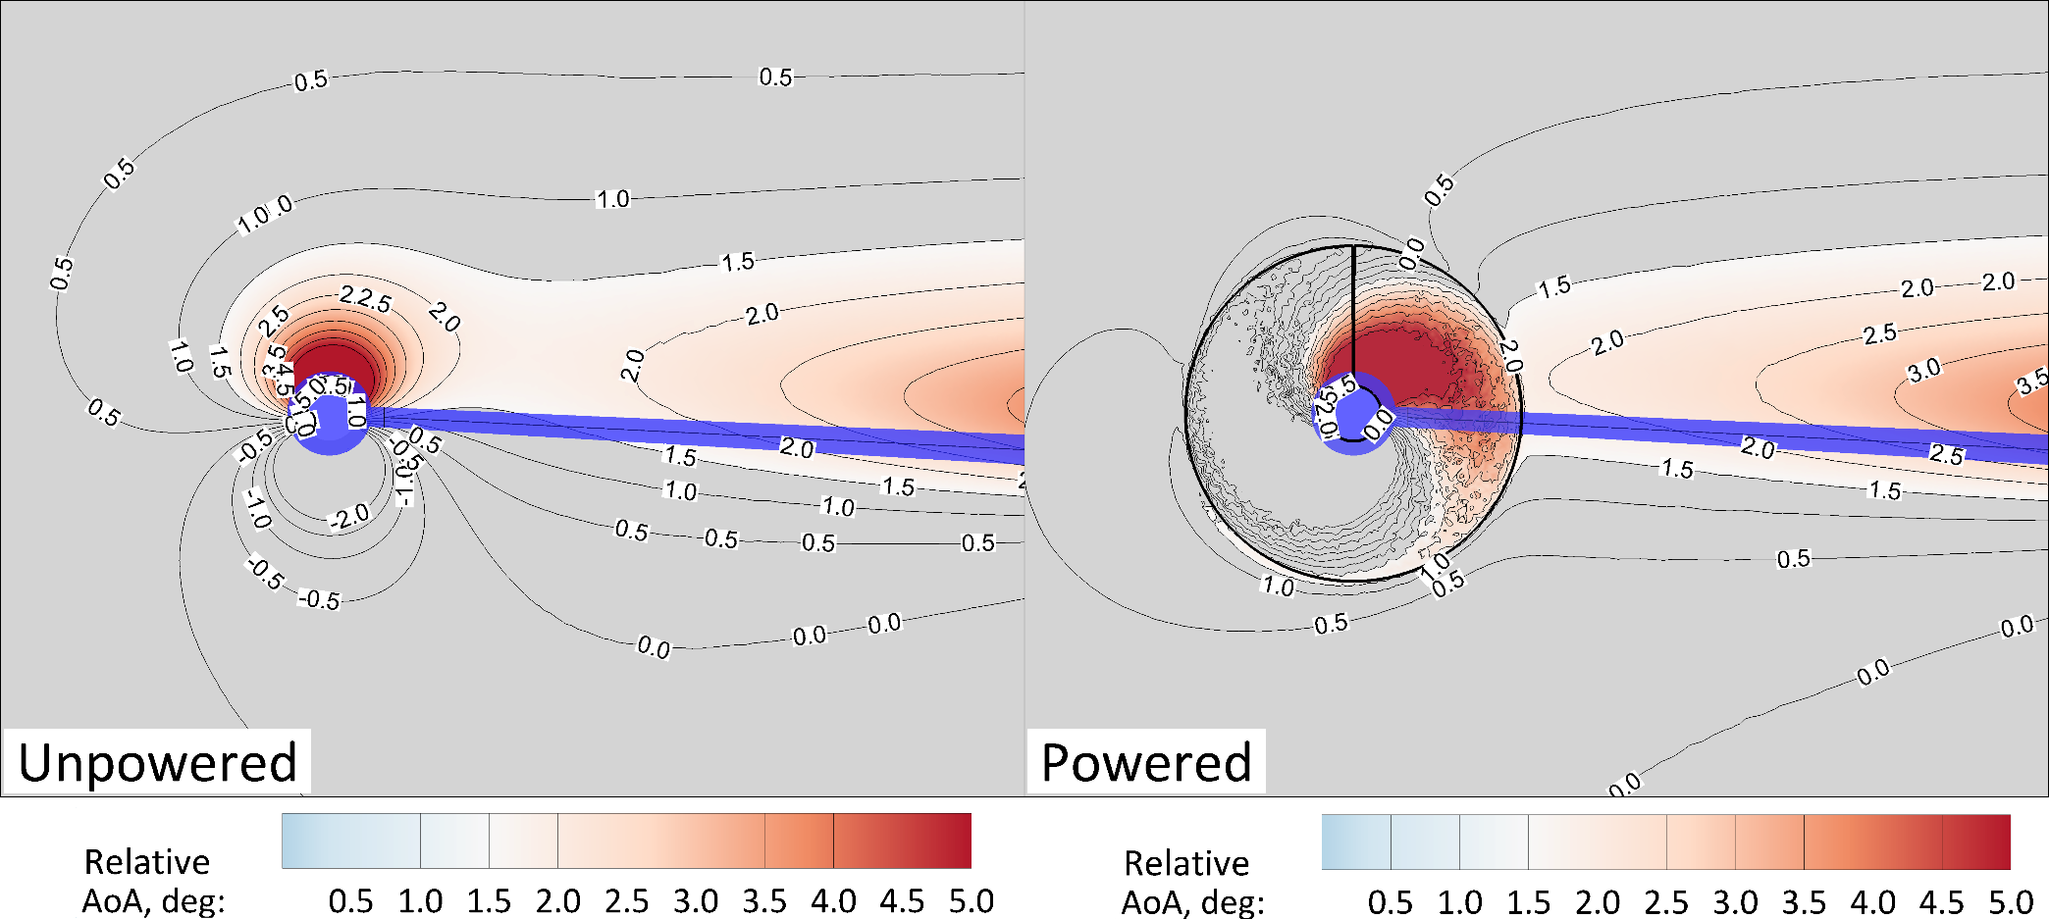
Demonstration Case: PEGASUS
Smaller diameter and lower rotational speed is beneficial for the tip mounted propulsor
Angle of attack at the plane of the propeller remains nearly constant at 1.5 deg on the lower portion of the wing
Angle of attack remains more stable on the upper portion of the wing closer to the propeller (approximately 0.5 deg greater than the unpowered case)

Slide 22
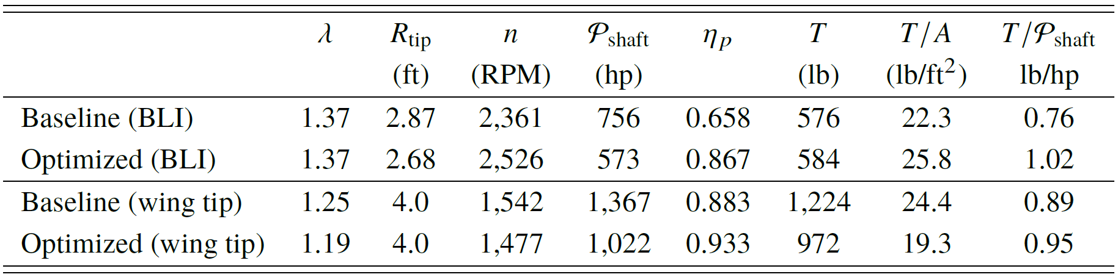
Demonstration Case: PEGASUS
Optimization Results
Optimized power split between the two wing tip and BLI and propulsors remains relatively unchanged at 78/22
Small variation in the thrust split between the two wing tip and BLI propulsors from 81/19 for the baseline to 77/23 for the optimized design
Propeller efficiency of the wing tip is greater than that of the BLI propeller
BLI propulsor is much more efficient at producing thrust for a given power input

Slide 23
Demonstration Case: PEGASUS
Optimization Results
Optimized power split between the two wing tip and BLI and propulsors remains relatively unchanged at 78/22
Small variation in the thrust split between the two wing tip and BLI propulsors from 81/19 for the baseline to 77/23 for the optimized design
Propeller efficiency of the wing tip is greater than that of the BLI propeller
BLI propulsor is much more efficient at producing thrust for a given power input

Slide 24
Demonstration Case: PEGASUS
Optimization Results
Optimized power split between the two wing tip and BLI and propulsors remains relatively unchanged at 78/22
Small variation in the thrust split between the two wing tip and BLI propulsors from 81/19 for the baseline to 77/23 for the optimized design
Propeller efficiency of the wing tip is greater than that of the BLI propeller
BLI propulsor is much more efficient at producing thrust for a given power input

Slide 25
Demonstration Case: PEGASUS
Optimization Results
Optimized power split between the two wing tip and BLI and propulsors remains relatively unchanged at 78/22
Small variation in the thrust split between the two wing tip and BLI propulsors from 81/19 for the baseline to 77/23 for the optimized design
Propeller efficiency of the wing tip is greater than that of the BLI propeller
BLI propulsor is much more efficient at producing thrust for a given power input

Slide 26
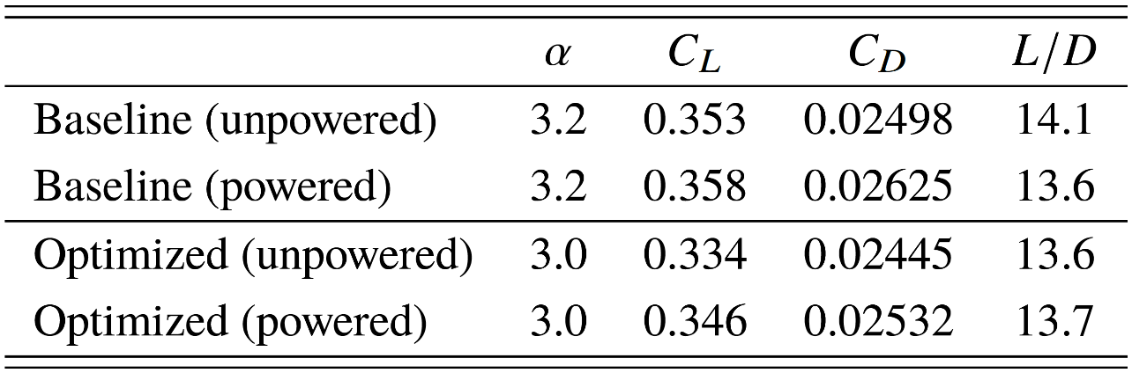
Demonstration Case: PEGASUS
Optimization Results
Angle of attack is decreased from the 3.2 deg to 3.0 deg
Aerodynamic efficiency improved with a total drag reduction of 6%
Impact of propulsor on lift-to-drag ratio is mitigated

Slide 27
Demonstration Case: PEGASUS
Optimization Results
Angle of attack is decreased from the 3.2 deg to 3.0 deg
Aerodynamic efficiency improved with a total drag reduction of 6%
Impact of propulsor on lift-to-drag ratio is mitigated

Slide 28
Demonstration Case: PEGASUS
Optimization Results
Angle of attack is decreased from the 3.2 deg to 3.0 deg
Aerodynamic efficiency improved with a total drag reduction of 6%
Impact of propulsor on lift-to-drag ratio is mitigated

Slide 29
Summary
Implemented discrete adjoint approach significantly reduces the computational time required to perform gradient-based design with RANS analysis
Allows vehicle-level optimization with tightly coupled multidisciplinary analysis
Provides a better understanding of the design space for new advanced concepts which leverage strong aero-propulsive interactions to improve efficiency
Available design sensitivities for propellers allow optimization of
  Size and rotational speed
  Installation (position and orientation)
  Element-based loading distribution
Sensitivity derivatives verified by comparison to the independent complex variable approach
Implementation is generalized and allows for design of concepts with heavily distributed propulsion systems
Notes:
New objectives could reside in disciplinary fields outside aerodynamics and propulsion, such as acoustics, and would allow for a more multidisciplinary and multi-point (e.g., take-off and cruise) design optimization

Slide 30
Future Work
Study the aero-propulsive performance impact of different propulsor configurations
Extend adjoint formulation to allow the calculation of design sensitivity for moment constraints
  Enables design of a one-engine-out take-off scenario
Perform aero-propulsive multipoint design at take-off, climb, and cruise
Develop a surrogate modeling methodology to leverage the efficient design sensitivity calculation in system-level assessment and design
  Allow optimization of more appropriate metric such as block fuel or block energy
  Sampling requirements with adjoint sensitivities scale well for a large number of design variables
Notes:
New objectives could reside in disciplinary fields outside aerodynamics and propulsion, such as acoustics, and would allow for a more multidisciplinary and multi-point (e.g., take-off and cruise) design optimization

Slide 31
Questions?
The authors would like to thank Nathaniel Blaesser at NASA LaRC, and Boris Diskin at the National Institute of Aerospace

