Slide 1
Evaluation of Preliminary Buffet Forcing Function Development based on Wind-Tunnel Tests of Geometrically-similar Models
Patrick S. Heaney, Martin K. Sekula, David J. Piatak,
James M. Ramey, and Francesco Soranna
NASA Langley Research Center
Aeroelasticity Branch
Hampton, VA
8 June 2020
Copyright 2020 United States Government as represented by the Administrator of the National Aeronautics and Space Administration. No copyright is claimed in the United States under Title 17, U.S. Code. All Other Rights Reserved. Published by the American Institute of Aeronautics and Astronautics, Inc. with permission.

Slide 2
Agenda
Background and Motivation
Preliminary buffet forcing function (BFF) development
Results and Analysis
  Case 1: SLS Block 1 crew launch vehicle BFF assembly
  Case 2: SLS Block 1 cargo launch vehicle BFF geometric-analog and assembly
Summary

Slide 3
Background and Motivation

Slide 4
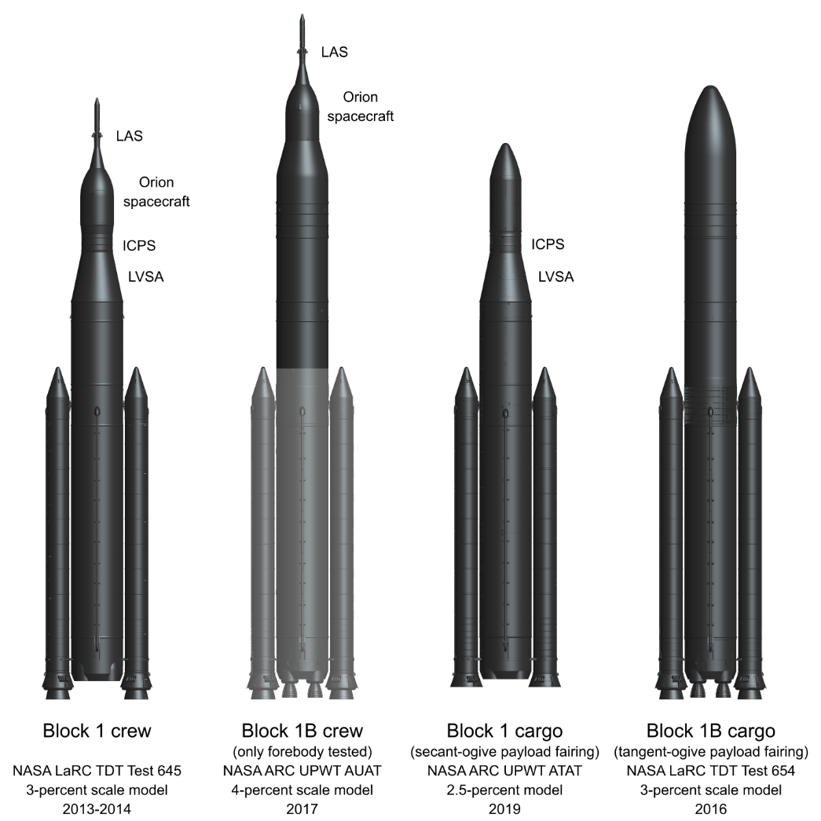
Launch vehicle buffet
Several Space Launch System (SLS)
launch vehicle configurations
Launch vehicle buffet
  Aerodynamic loads caused by unsteady pressure field during ascent that may excite vehicle structural modes
Buffet environments traditionally modeled with buffet forcing functions (BFFs)
  BFFs developed using wind-tunnel test data for rigid models highly-instrumented with unsteady pressure transducers
  Requires extensive time and funding to test new vehicle configurations
Preliminary BFFs may be developed using data from previous wind-tunnel tests of geometrically-similar vehicles
Block 1
crew
Block 1
cargo
Block 1B
cargo

Slide 5
Preliminary BFF development

Slide 6
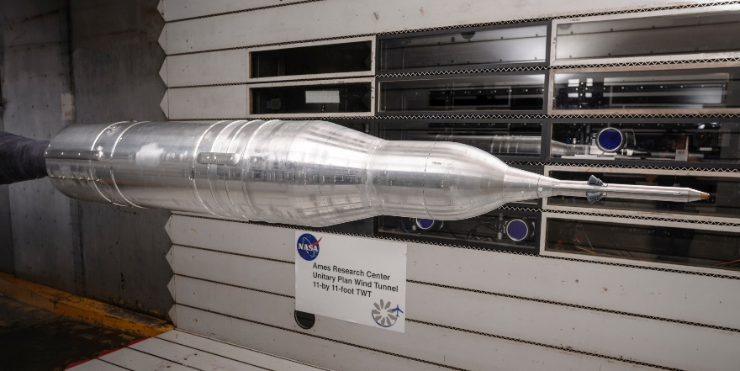
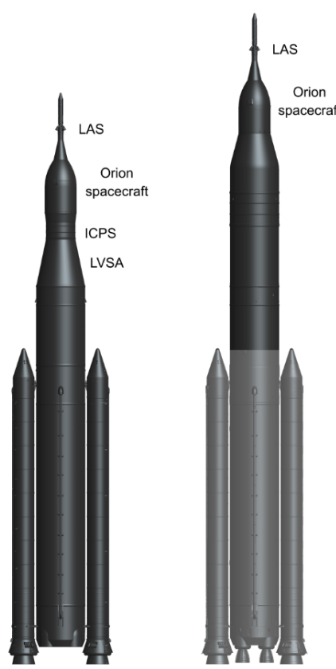
Preliminary BFF development
Assembly process
Assembly process: combining BFFs from multiple parent data sources
  Example: SLS Block 1B crew forebody data assembled with previously-acquired data from the Block 1 crew launch vehicle to develop preliminary BFFs
Possible reasons for assembly
  Increase model-scale for tested vehicle segments for increased sensor density or improved geometric fidelity
  Reduce test and model costs
Potential shortcoming
  Does not model flow coherence across the assembly boundary
SLS Block 1B crew forebody
Block 1B
crew
Block 1
crew

Slide 7
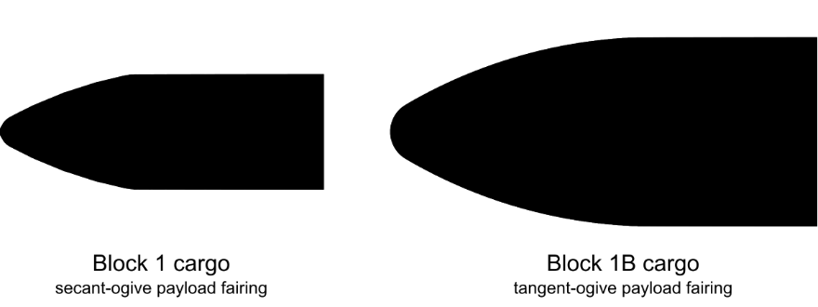
Preliminary BFF development
Geometric-analog process
Geometric-analog process: mapping and geometrically-scaling unsteady pressure data from parent data source to target geometry
  Example: SLS Block 1B cargo payload fairing as a geometric-analog for the Block 1 cargo payload fairing to develop preliminary BFFs
Potential shortcomings
  Integration areas adjusted for geometry differences, but no adjustments are made to the parent unsteady pressure data to account for changes in flow features
  Assumed that mapping sensor locations and coherence lengths approximates differences in the buffet environment
  Differences in protuberances are not considered
Block 1B
cargo
Block 1
cargo

Slide 8
Results and Analysis

Slide 9
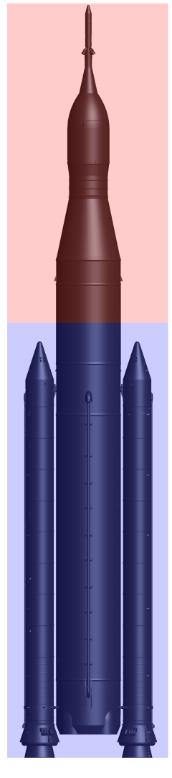
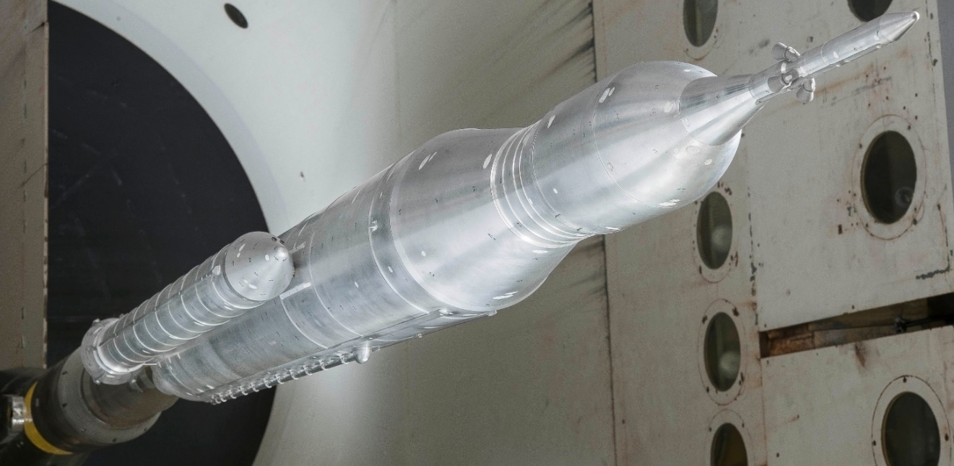
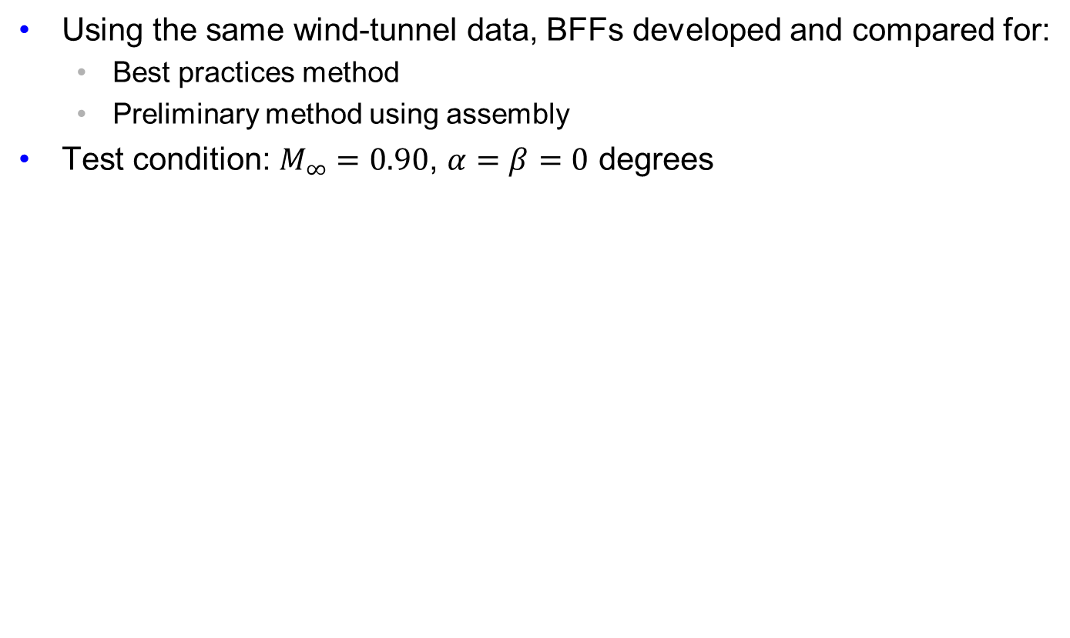
Preliminary BFFs using assembly
SLS Block 1 crew launch vehicle
Using the same wind-tunnel data, BFFs developed and compared for:
  Best practices method
  Preliminary method using assembly
Test condition: $M_{∞}=0.90$, $α=β=0$ degrees
Assembly boundary
for simulated preliminary BFFs
Block 1 crew launch vehicle

Slide 10
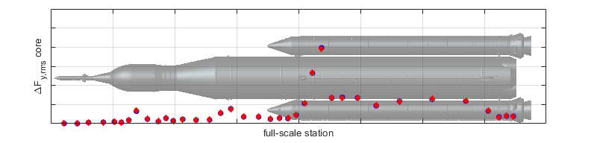
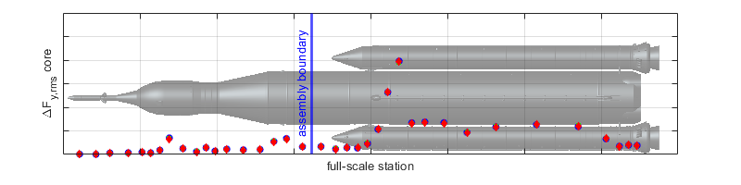
Preliminary BFFs using assembly
Root-mean-square comparison
In general, assembling preliminary BFFs does not have a large impact on the root-mean-square of the BFFs
Best practices method
Preliminary method

Slide 11
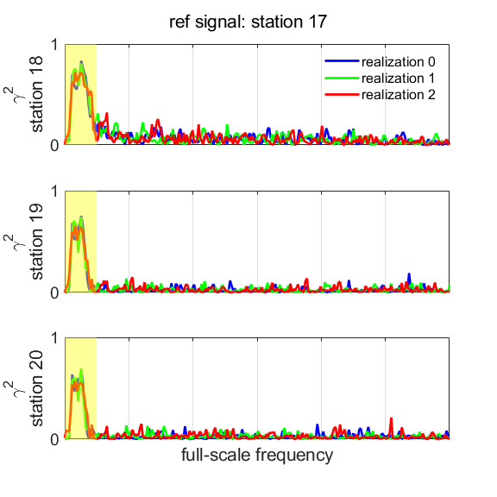
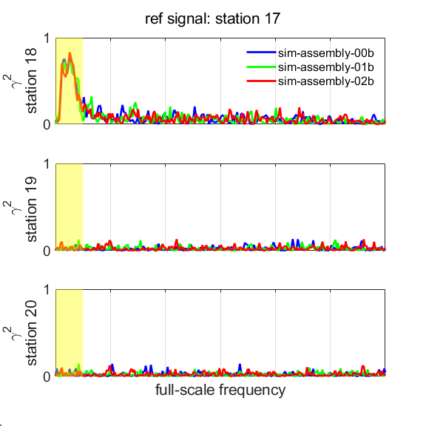
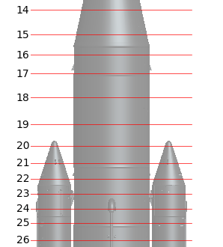
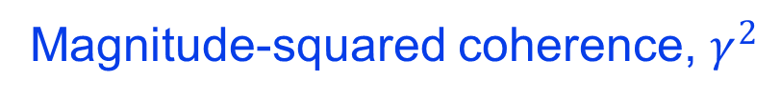
Preliminary BFFs using assembly
Magnitude-squared coherence comparison
In general, assembling preliminary BFFs does not model the flow coherence across the assembly boundary
Magnitude-squared coherence, $γ^{2}$
Best practices method
Preliminary method
Comparison station 1
to
Reference station
Reference station
Comparison station 1
Comparison station 2
to
Reference station
Comparison station 2
Comparison station 3
Comparison station 3
to
Reference station

Slide 12
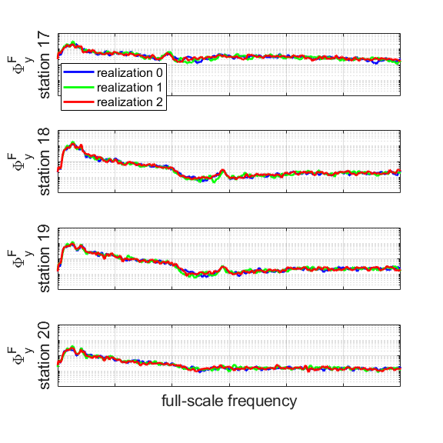
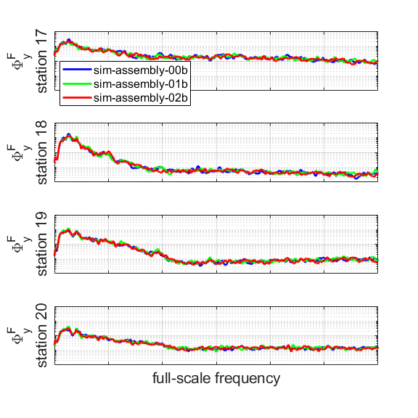
Preliminary BFFs using assembly
Power spectral density comparison
In general, frequency ranges with the most energy coincide with the ranges of relatively high coherence
  Relative impact of not modeling the station-to-station coherence may be significant
Power spectral density magnitude
Best practices method
Preliminary method
Reference station
Reference station
Comparison station 1
Comparison station 1
Comparison station 2
Comparison station 3
Comparison station 2
Comparison station 3

Slide 13
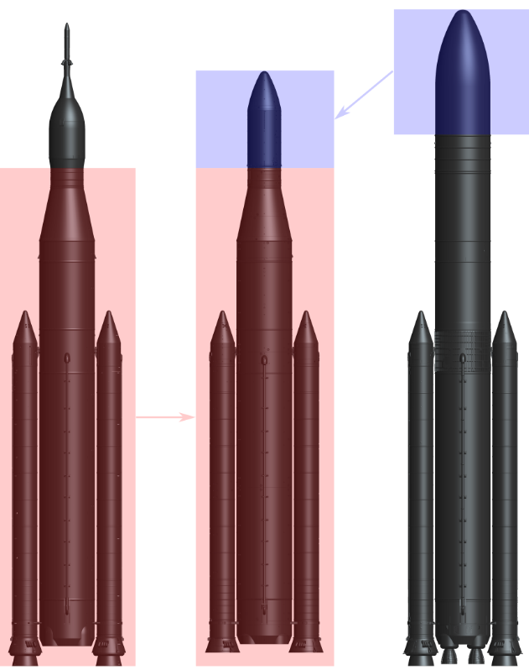
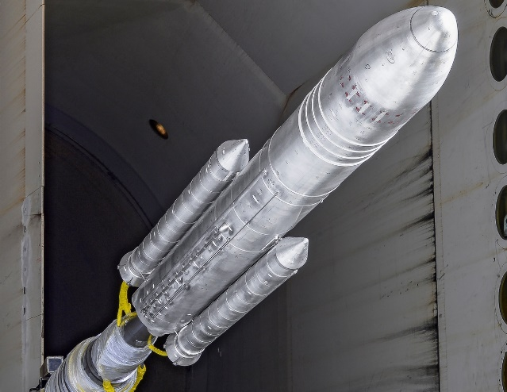
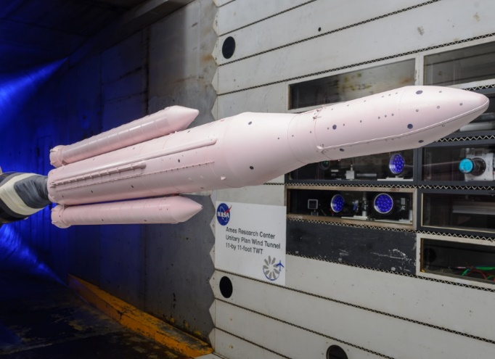
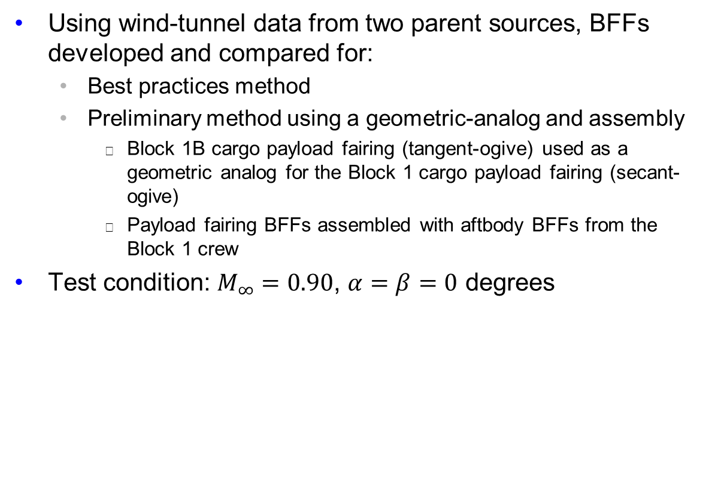
Preliminary BFFs using a geometric-analog and assembly
SLS Block 1 cargo launch vehicle
Using wind-tunnel data from two parent sources, BFFs developed and compared for:
  Best practices method
  Preliminary method using a geometric-analog and assembly
    Block 1B cargo payload fairing (tangent-ogive) used as a geometric analog for the Block 1 cargo payload fairing (secant-ogive)
    Payload fairing BFFs assembled with aftbody BFFs from the Block 1 crew
Test condition: $M_{∞}=0.90$, $α=β=0$ degrees
Block 1B cargo launch vehicle
Block 1 cargo
launch vehicle
Block 1
crew
Block 1
cargo
Block 1B
cargo

Slide 14
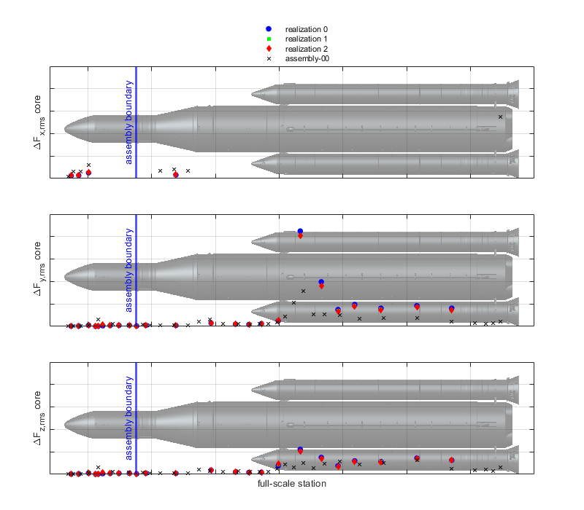
Preliminary BFFs using a geometric-analog and assembly
Root-mean-square comparison
In general, preliminary BFFs show relatively similar root-mean-square trends compared to the best practices BFFs
Notable differences attributable to several sources
  Integration areas differ for different parent data
    Particularly notable in core/booster multibody region
  Payload fairing geometric-analog differences not easily identifiable due to relatively small magnitudes
  Wind tunnel background noise differences
Best practices method
Preliminary method

Slide 15
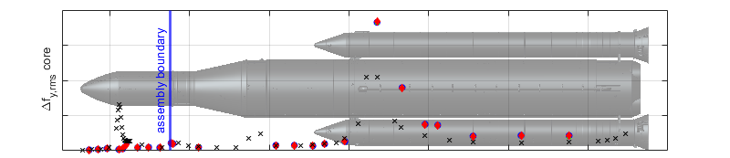
Preliminary BFFs using a geometric-analog and assembly
Root-mean-square comparison, sectional loads
Root-mean-square of sectional loads (BFFs per unit length) can be compared to account for differences in integration lengths between parent data
  Comparison improves in the core/booster multibody region
  Payload fairing shoulder differences are accentuated
Best practices method
Preliminary method

Slide 16
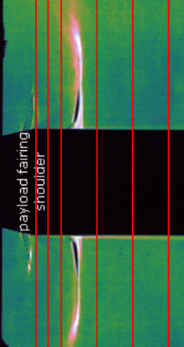
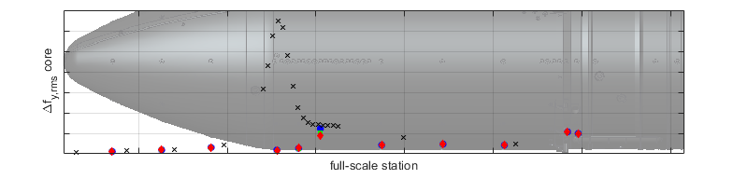
Preliminary BFFs using a geometric-analog and assembly
Root-mean-square comparison, sectional loads on payload fairing
Root-mean-square of sectional loads (BFFs per unit length) on the payload fairing indicates two related limitations of the geometric-analog process
  Best practices method: sparse longitudinal distribution of buffet rings is not sufficient to fully characterize the peak unsteady normal shock environment
  Preliminary method: local unsteadiness associated with the normal shock is characterized but mapped location from the geometric-analog does not correspond to data from actual geometry
Preliminary method
Best practices method
Approximate peak fluctuating environment associated with normal shock

Slide 17
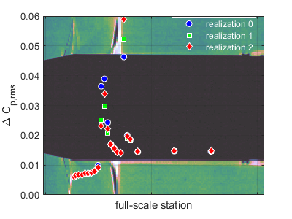
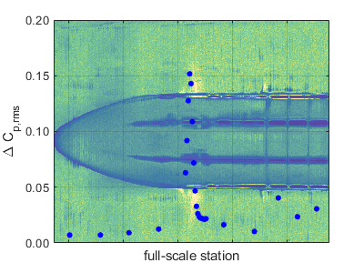
Preliminary BFFs using a geometric-analog and assembly
Root-mean-square comparison, fluctuating pressure coefficient on payload fairing
Comparison of the root-mean-square of fluctuating pressure coefficient on the payload fairing for the geometric-analog and actual model
  Fluctuating magnitudes at the normal shock are significantly larger for the geometric-analog
Actual geometry
Geometric-analog

Slide 18
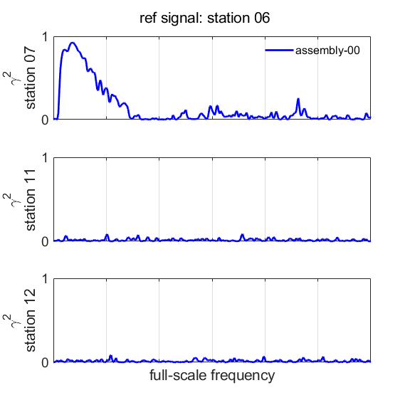
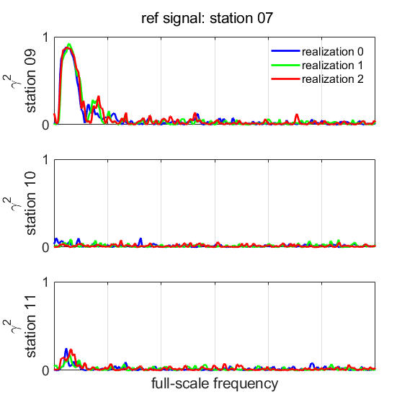
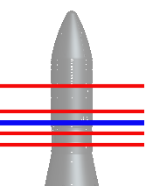
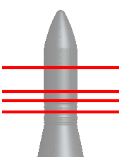
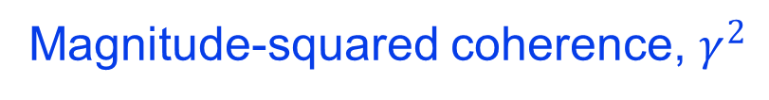
Preliminary BFFs using a geometric-analog and assembly
Magnitude-squared coherence comparison
In general, assembling preliminary BFFs does not model flow coherence across the assembly boundary
  For this case, coherence is relatively low in this region for the full-stack model and the impact of coherence loss is minimal
Magnitude-squared coherence, $γ^{2}$
Preliminary method
Best practices method
Comparison station 1
to
Reference station
Reference station
Comparison station 2
to
Reference station
Reference station
Comparison station 1
Comparison station 1
Comparison station 2
Comparison station 2
Comparison station 3
Comparison station 3
Comparison station 3
to
Reference station

Slide 19
Summary
Despite significant uncertainties, preliminary BFF development is often a useful tool in the early stages of vehicle design
There are several notable limitations of the preliminary development processes
  Assembly process
    Flow coherence is not modeled across an assembly boundary
    Identifying desirable assembly boundaries, where there is naturally low forward-to-aft coherence, is not generally straightforward and generally depends on flow conditions
  Geometric-analog process
    Small differences in geometrically-analogous vehicles may lead to significant differences in the modeled-to-actual buffet environments
    Using a geometric analog will not necessarily model the location nor magnitude of peak fluctuations during transonic flight (particularly in regions of high geometric sensitivity like the payload fairing shoulder)
Forward work to evaluate the impact of these limitations on the true metrics of interest, such as vehicle dynamics during combined loads analysis or vehicle control system effects

