Slide 1
xEVA Compatibility Requirements
Tamra George
5/22/2020
This document has been approved for public release per DAA 20205002693 and does not contain any export control information.

Slide 2
xEVA Requirements Documents
The EVA Office is working toward public release of two documents. Thank you for your patience:
  EVA Compatibility EVA-EXP-0035
  Human Lunar Lander specific EVA Compatibility EVA-EXP-0070
In the mean time please look at these locations for what is available today:
  Draft version of EVA compatibility EVA-EXP-0070 document publically released last year. Although we have since updated the document this will at least give science teams a start:
https://beta.sam.gov/api/prod/opps/v3/opportunities/resources/files/f2d5fc850fef29d71e20080d6c4c9d3a/download?api_key=null&status=archived&token=
  There is also a public website for EVA:
https://www.nasa.gov/suitup
  There is a battery safety requirements document that is required to be followed JSC20793
https://standards.nasa.gov/standard/jsc/jsc-20793

Slide 3
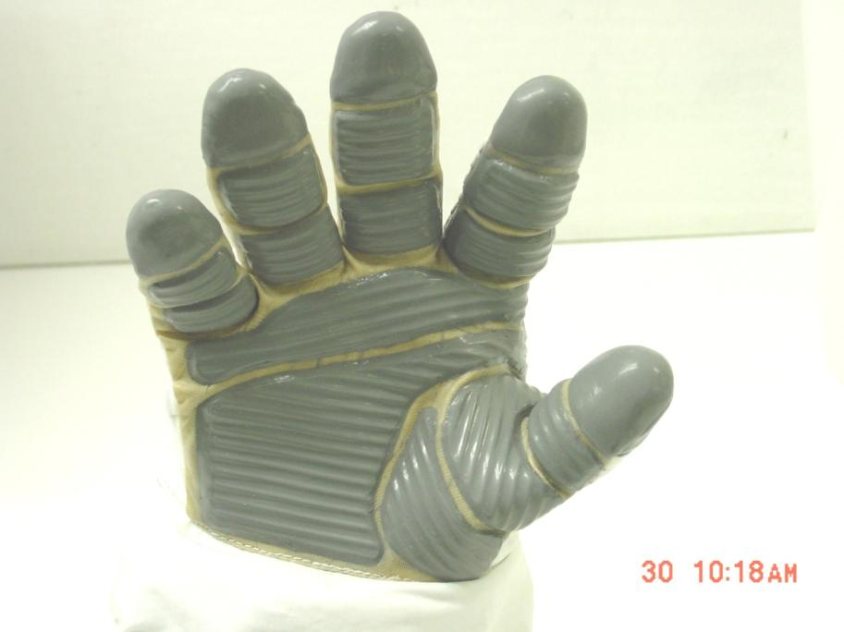
    EVA Limitations
Fatigue
Tactile Feel
Sharp Edge Cuts
Touch Temperature
Size
Grip
3

Slide 4
    EVA Tool Requirements – Common Questions
DISCLAIMER: The following slides are do not encompass ALL requirements. The ones in presentation are for discussion purposes only.
4

Slide 5
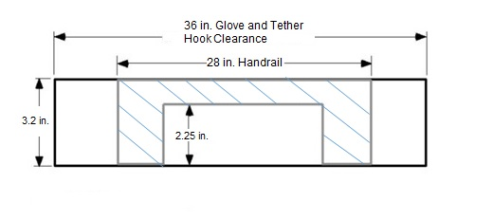
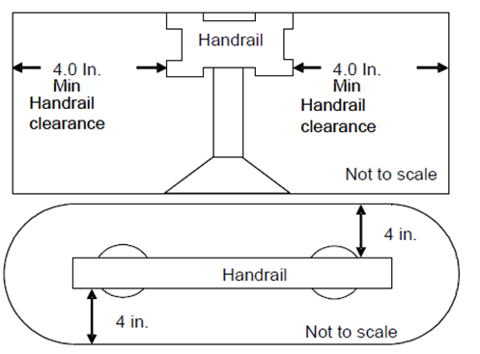
    EVA Tool Requirements – Common Questions
Hand Clearances:
Handles on payloads in EVA-EXP-0070 and EVA-EXP-0035
  Hardware will be required to have a 2.25 inch clearance
  between handle and lower mounting surface for gloved
  hand clearance around handle. [EVASC.0004]
  side clearance of 4 inch defined in [EVASC.0005]
  Handle shall have a minimum grip length of 6 inches
  (15.2 cm). [EVASC.0030]
Switches shall also consider spacing for gloved finger clearance in actuating switch travel.
Switches/levers shall meet actuation forces.
[EVASC.0004] Figure
[EVASC.0005] Figure
5

Slide 6
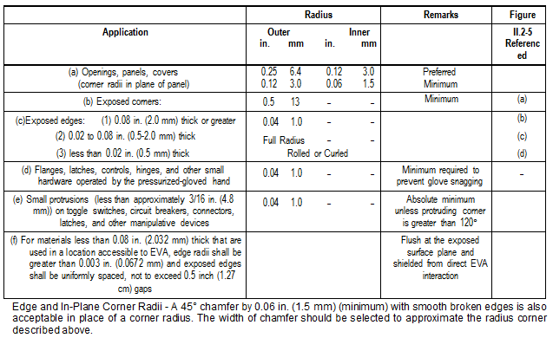
    EVA Tool Requirements – Common Questions Cont.
Sharp Edge Requirements in both 0035 and 0070 (reference [EVSC.0105]):
6

Slide 7
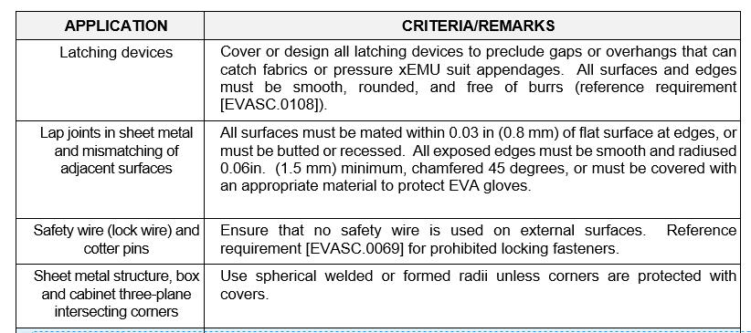
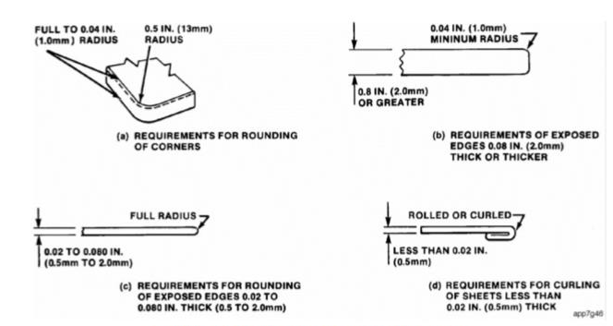
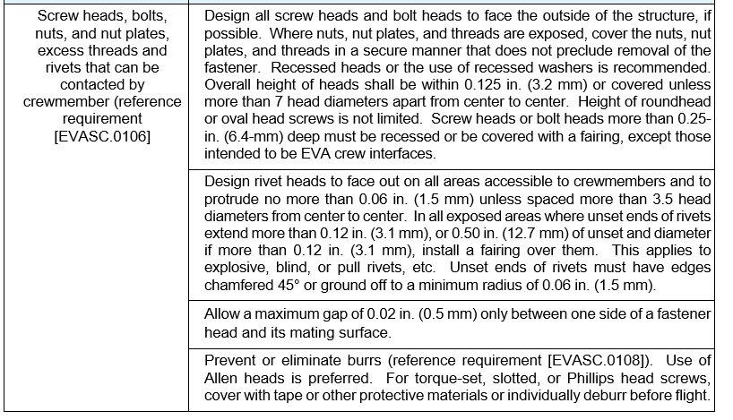
    EVA Tool Requirements – Common Questions Cont.
Sharp Edge Requirements Continued:
Minor modifications were made to this requirement in the updated 0070 that will be released at a later date.
7

Slide 8
    EVA Tool Requirements – Common Questions Cont.
Live Voltage or RPG?
The hardware provider shall design equipment to preclude exposure of electrical potential to the EVA crewmember.
The hardware provider shall design any exposed conducting surfaces that are accessible to EVA crewmember contact (e.g. translation corridors, work areas, and incidental contact zones) to have a low resistance bond of 0.1 ohm or less to structure to alleviate shock hazards.
The hardware provider shall preclude voltage potential discharge to an EVA suited crewmember at voltages above 40V.
No they cannot carry an RTG nor have live voltage.
Minor modifications were made to these requirements in the updated 0070 that will be released at a later date.
8

Slide 9
    EVA Tool Requirements – Common Questions Cont.
Standard Testing:
Standard testing includes but not limited to full functional, radiation, workmanship vibration and thermal. Main goal is to ensure zero hazards that could injure crew or mission.
Battery Testing:
Standard testing includes workmanship vibration and thermal. Radiation testing and other tests to ensure no hazardous condition may occur during operation.
Testing to prove mitigation of thermal runaway propagation.
Battery shall meet NASA-STD-20793 battery safety requirements document
Nothing over 40V
9

Slide 10
    EVA Tool Requirements – Common Questions Cont.
Communication Infrastructure:
This is still in flux. The HLS Vendors may have different infrastructures.
Mobility Assets:
There will not be a rover in 2024 but team is working on cart/carrier to aid in carrying science instruments and tools to enable use in 2024.
10

Slide 11
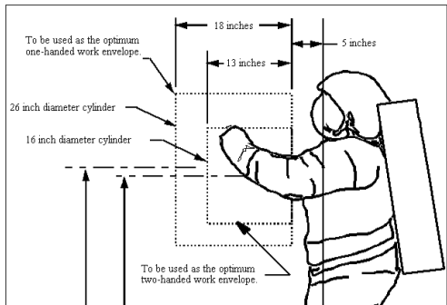
    EVA Tool Requirements – Common Questions Cont.
Work Envelope for Astronaut:
The new xEMU has more mobility and will also be able to kneel on surface but for today please utilize this as reference [EVASC.0035]:
11

Slide 12
    EVA We Can!!!
Basic tools can use off the shelf if meet requirements:
    Ensure all materials are compatible for EVA environment (even greases and lubrications).
Complex tools can be built:
    Takes more involvement of stakeholders to ensure interfaces and performs the required functions.
    More components within tool causes more testing and analysis
    Example cordless socket driver, leak locators, and Batteries

Slide 13
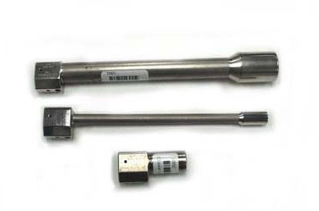
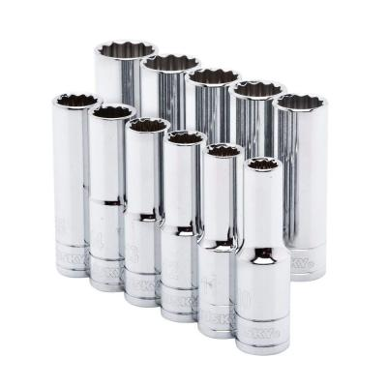
    Off Shelf Example
EVA
Off Shelf

Slide 14
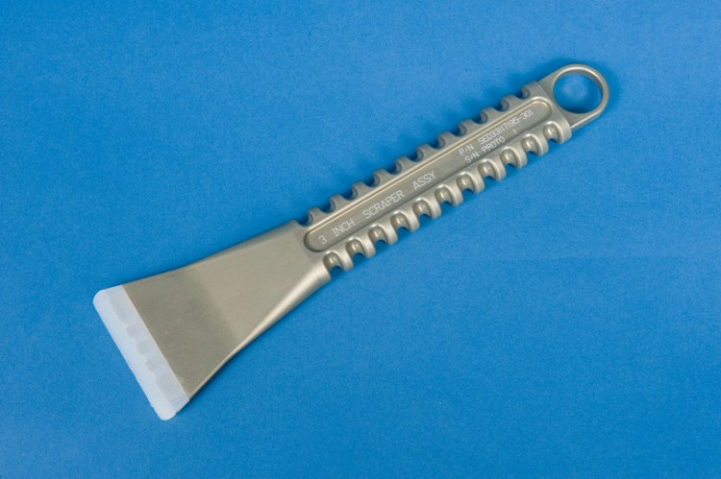
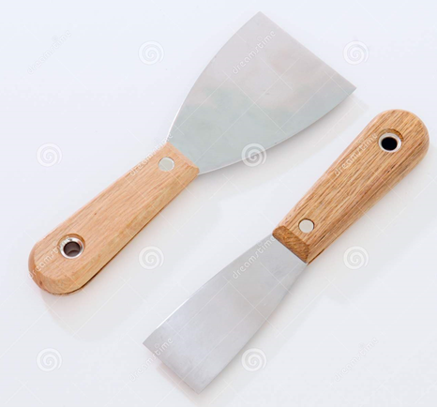
    Simple Example
EVA
Off Shelf
14

Slide 15
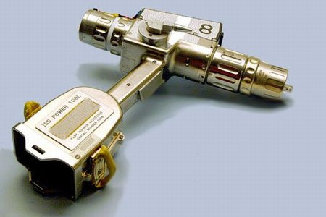
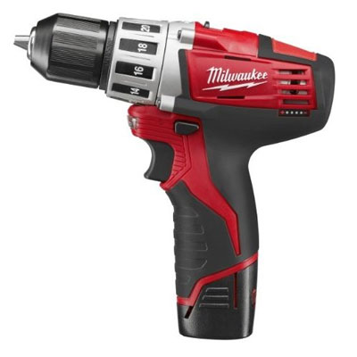
    Complex Example
EVA
Off Shelf
15

Slide 16
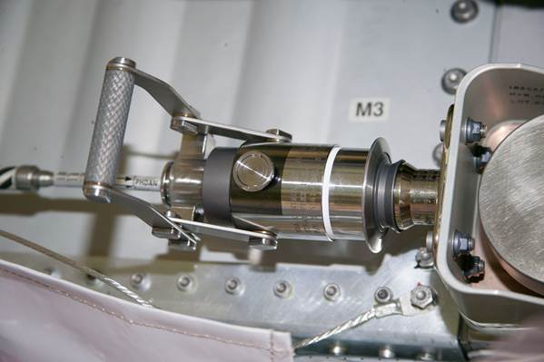
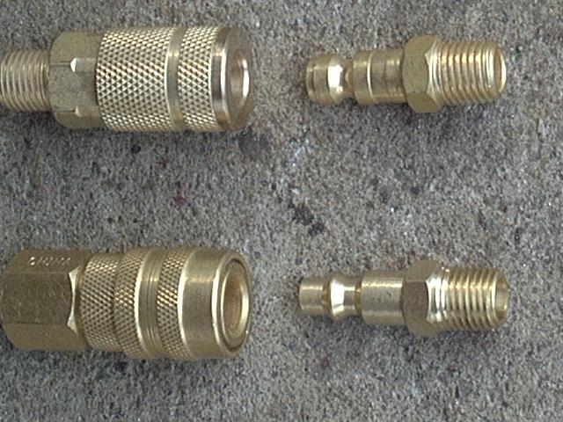
    Fluid Line Quick Disconnects
EVA
Off Shelf
16

Slide 17
    BACKUP

Slide 18
    EVA Tool Reqmnts Include
Many more requirements live in EVA-EXP-0035/0070. There are other documents for environments and vehicle launch loads.
Materials:
  Not conducive to micro biological growth.
  Use metallic materials that are not susceptible to stress corrosion.
  Flammability, Odor, and Offgassing.
  Corrosion resistant.
  Material meets correct material properties
Workmanship:
  Exposed corners and edges shall have EVA specified radius.
  All surfaces and edges shall be free of burrs.
  No exposed screw heads or threads that can lead to snags or sharp edges.
18

Slide 19
    EVA Tool Reqmnts Include
Cleanliness
Operational Life
Shelf Life
Life Cycling of Mechanisms
Maintains structural integrity when exposed to flight and non-flight environments, heating, vibration, acoustic noise, and shock in addition to quasi-static and dynamic loads.
19

Slide 20
    EVA Tool Reqmnts Include
Fracture Control
Strength Requirements -> limit loads, ultimate loads, ultimate factors of safety, and margins of safety.
Electrical Components
Softgood Design
  Thermal Environment includes extreme non-operating temp, operating temp, touch temperature, and delta mating surface difference.
20

Slide 21
    EVA Tool Reqmnts Include
Human Factors:
    Drop Proof Tether Accommodation
    Alignment Marks
    Alignment Devices
    Pinch Points
    Hole Size
    Inadvertent Contact Loads
    Actuation Forces:
      Non-repetitive Actuation Force
      Repetitive Actuation Force
      Finger Actuation Force
      Actuation Torque
    Grip Surface
    Easily Visible Markings
21

Slide 22
    EVA Tool Reqmnts Include
  One-handed, ambidextrous, engagement, disengagement, and operation.
  Driver-type hand tools shall not require a push force to maintain tool engagement while providing torque.
Hand-Actuated Fasteners.
    Fasteners shall be operable by a single pressurized EMU glove.
    Fastener knobs shall be scalloped (unless driven by tool).
22

Slide 23
    EVA Tool Reqmnts Include
EVA Operable Connectors.
    Aligned and mated/demated using one hand, either right or left hand without the use of a tool.
    Spacing between connectors.
    Connectors shall be keyed so that it will be physically impossible to install in the wrong orientation.
    A feature shall be provided to indicate connector mating status.
    Connectors shall have tethered protective caps or covers to prevent physical damage and contamination.
    Connectors shall have visible alignment markings or other methods to ensure proper alignment during mating and demating.
Electrical Connectors.
    The shells extend far enough beyond the pins to prevent pin contact with the mating connector shell during the mating operation.
23

Slide 24
    EVA Tool Reqmnts Include
Fluid and Gas Connectors.
    Pressurized pneumatic connectors and lines shall be tethered or otherwise captured to the main structure.
    Quick disconnect connectors shall be used for EVA.
    Connectors shall be capable of being vented prior to separation.
Pressure
Vibration

Slide 25
    EVA Tool Reqmnts Include
Other Standard Requirements:
    Plasma
    Radiation
    Bench handling
  Safety
    Sharp Edge/Entrapment/Pinchpoints
    EMU Touch Temperature
    Factors of Safety In Loads
    Electrical Shorting Due to Debris
    Shock Protection

Slide 26
    EVA Certification Process
Design
Prototype
Test With High Fidelity Mockups – 1G
Test With High Fidelity Mockups – NBL
Develop Final Design
Review Process
    Materials
    Stress
    Safety
    Operations
    Electrical
    Pressure Systems

