Slide 1
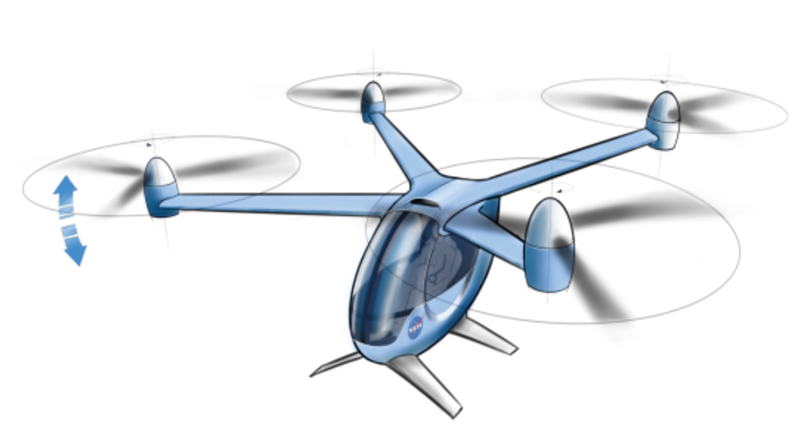

Multidisciplinary Optimization of an Electric Quadrotor Urban Air Mobility Aircraft
Eliot Aretskin-Hariton, Eric Hendricks, Daniel Ingraham, Justin Gray, Sydney Schnulo, Jeffrey Chin, Robert Falck, Dustin Hall
NASA Glenn Research Center

Slide 2
Goals Overview
Demonstrate ability of multidisciplinary analysis tools to perform coupled analysis in the preliminary design phase
Quadrotor and Mission
Optimization Environment
Coupling Subsystems
Subsystem Details
Results
Conclusions

Slide 3
Quadrotor and Mission
Baseline Mission:
Single Passenger
All-electric
92.6 km
1.5km altitude ceiling
200m minimum cruise altitude
Subsystems: Propulsion, Thermal, Mass, Aero, Trajectory

Slide 4




Optimization Environment:
OpenMDAO
  Gradient based optimization
  Analytical derivatives
  Open Source
Dymos
  Allows for time-varying optimal control optimization
  Pseudospectral methods
  Varying fidelity phases
  Open Source

Slide 5
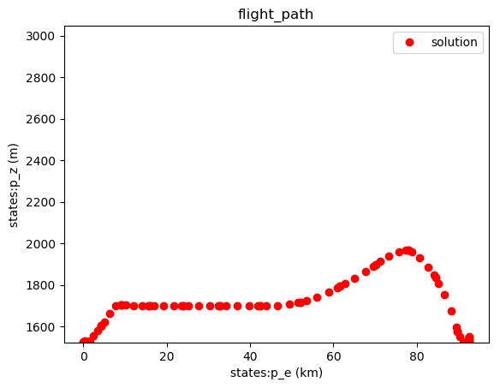
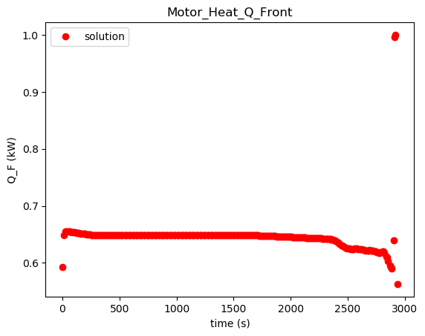
Tandem Flight Phases
Main Phase – Lower Fidelity
Thermal Phase – Higher Fidelity

Slide 6
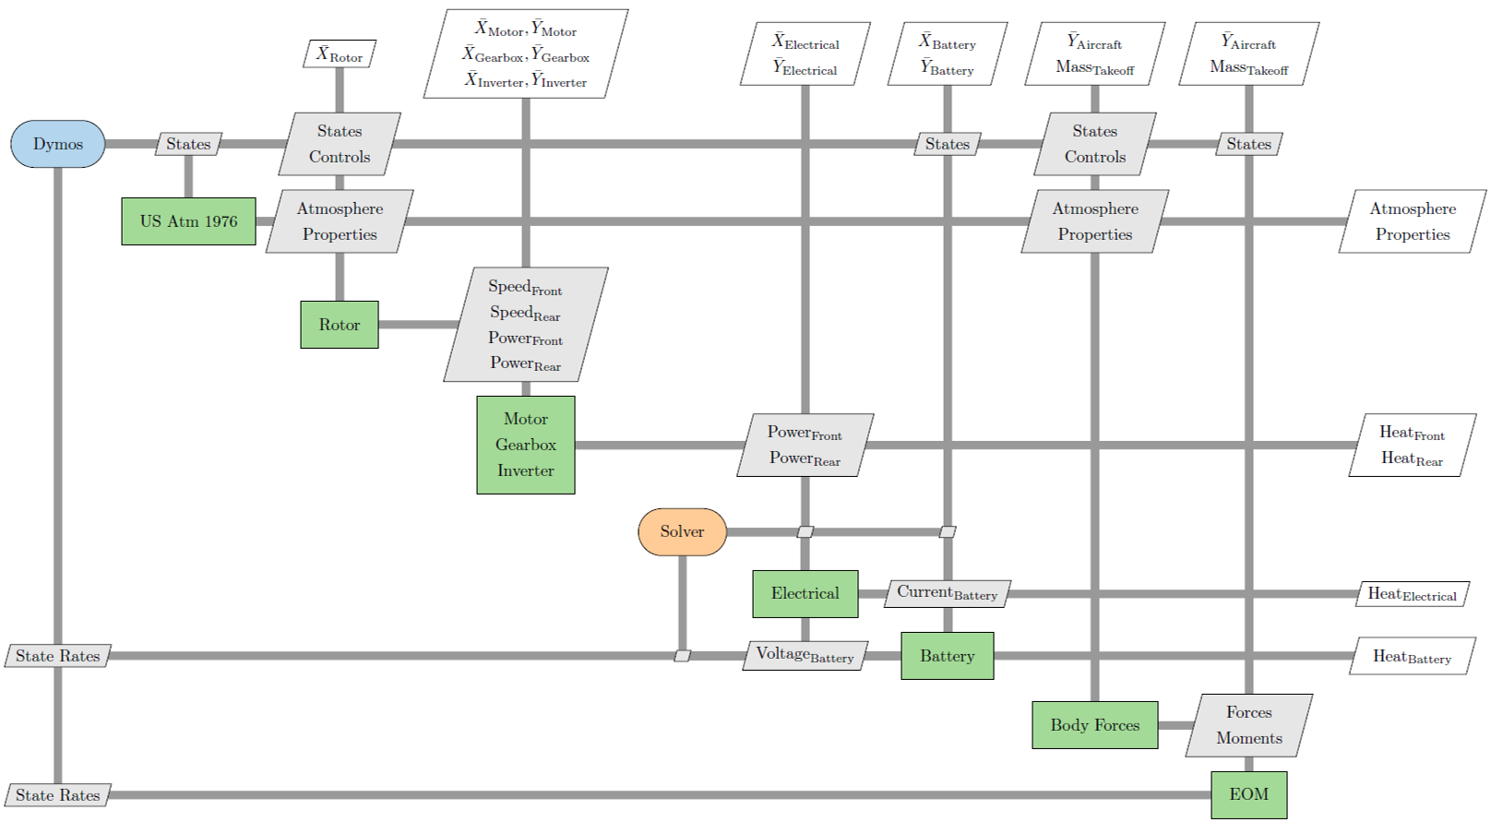
Coupling Subsystems – XDSM Main Phase

Slide 7

Subsystems: Rotor
CCBlade.jl combines momentum theory and blade element theory (BEMT) library created by Andrew Ning
Breaks the blades up into sections or blade elements
Thrust input results in rotation rate output
Fixed pitch propeller
Optimizer Controls: Blade Twist

Slide 8
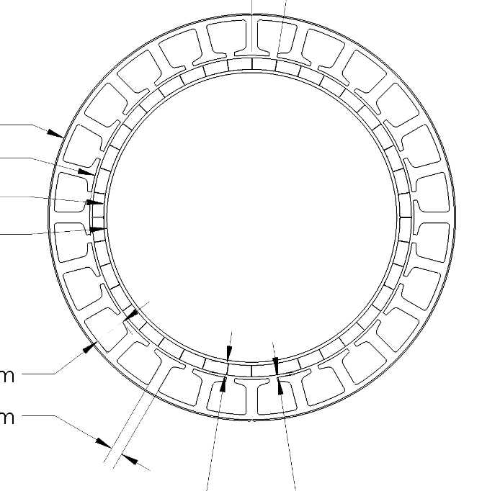
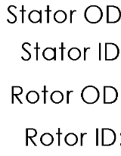




Subsystems: Motor, Gearbox, Converter
Motor is a simple efficiency curve
  2000 rpm at max efficiency 97%
Gearbox has a fixed efficiency 99%
Converter has a fixed efficiency 98%
Heat load sent to thermal system
Optimizer Controls:
  Maximum Rotor Power,
  Optimal Rotor RPM (gearbox ratio)
Future Work:
Mid-Fidelity Motor Model

Slide 9
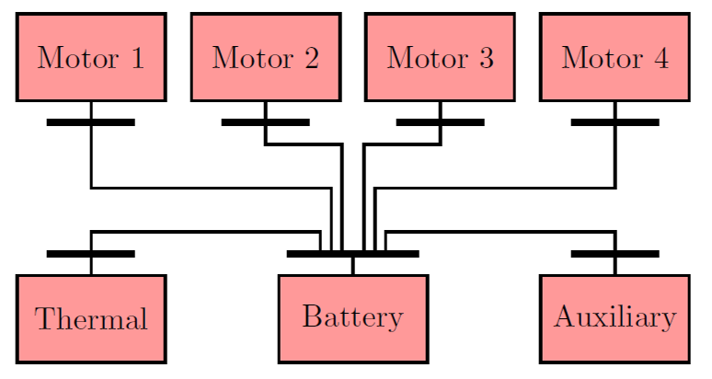
Subsystems: Electrical Power
Zappy load flow model for electrical power distribution is typical of terrestrial power grids
Balances power output by the battery with power demand generated by the motor and line losses
Creates heat load on the thermal system

Slide 10
Subsystems: Battery
Battery model uses battery temperature and state of charge to calculate voltage output.
State of Charge (SOC) starts at 95% charge and is allowed to sink to 20% but the end is just a lower constraint
Creates heat load for thermal system
Optimizer Controls: Total available power (kWh) , Maximum energy draw (amps)

Slide 11
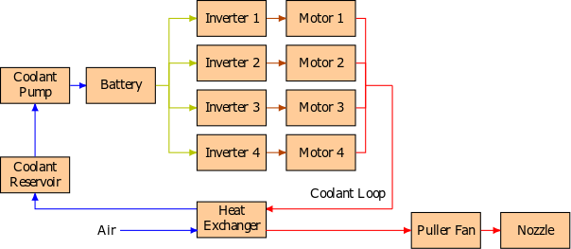
Subsystems: Thermal
Thermal system tracks battery, coolant, forward motor, and aft motor temperatures
Optimizer Controls: Heat Exchanger size, Throat Area

Slide 12
Subsystems: Aerodynamics & Mass
Simple drag with spherical vehicle
Weights for all components
Calculates Masses for:
  Fuselage
  Landing gear
  instrumentation

Slide 13
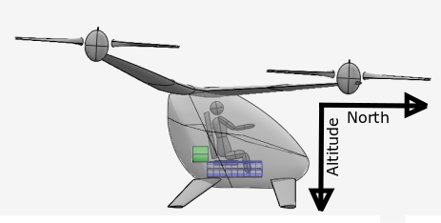
Subsystems: Trajectory
Equations of Motion (EOM) track vehicle translational position and velocity and rotational position and velocity
Uses thrust to calculate translational and angular acceleration based on axi-symmetric inertia matrix
Optimizer Controls: Thrust produced by forward and aft rotors

Slide 14
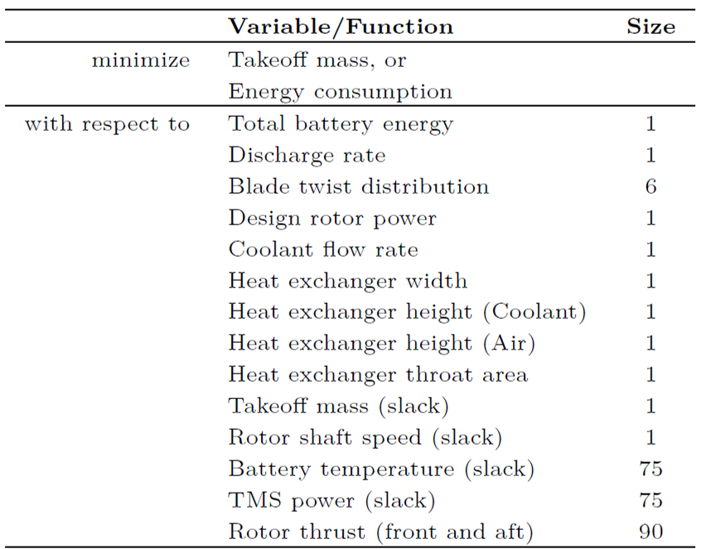
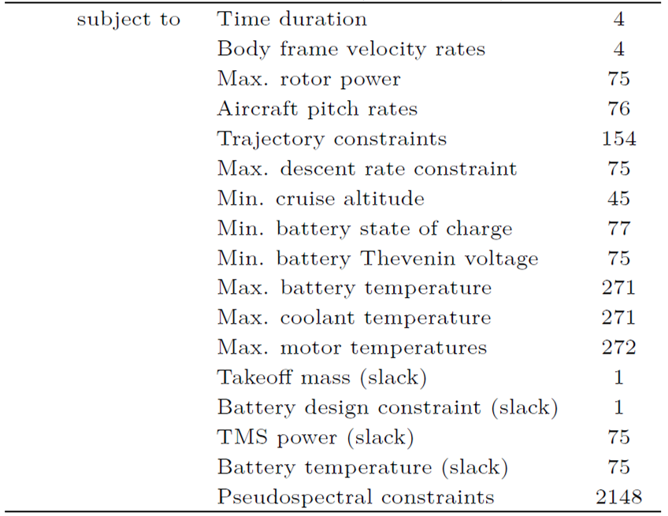
Summary of Problem

Slide 15
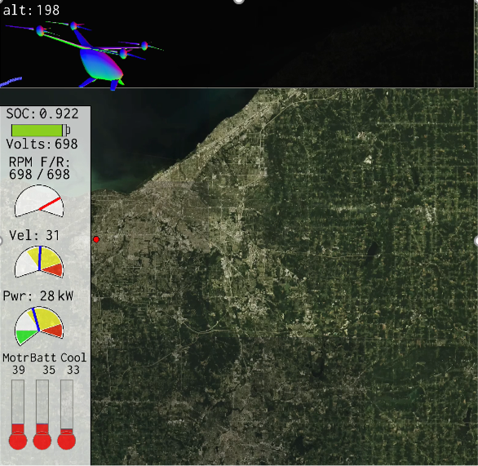
Results: Baseline Video

Slide 16
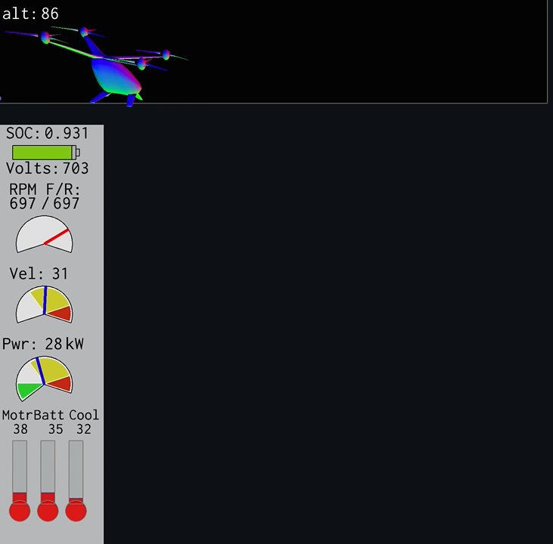
Results: Baseline Video
* Altitude (ft)
* Battery Temp (C)

Slide 17
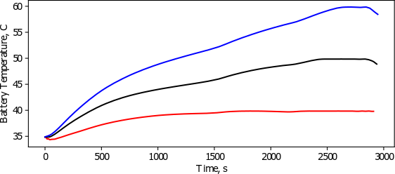
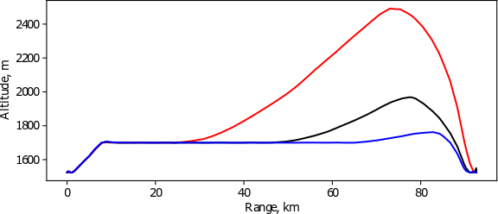
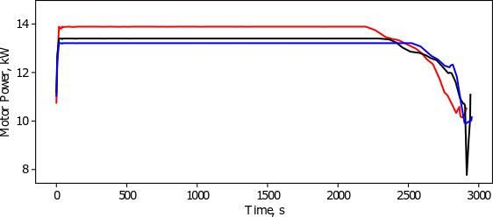

Results: Battery Thermal Sweep

Slide 18
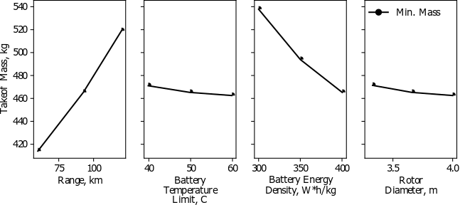
Results: Design Sweeps
Sweeps of Range, Battery Temp, Energy Density, and Rotor Diameter

Slide 19

Conclusions
Thermally constrained trajectory
Battery temp constraints have small effect on system weight
Changing trajectory can be more effective than increasing thermal management system weight
Demonstrated tightly coupled optimization
Questions?
earetski@mail.nasa.gov

