Slide 1
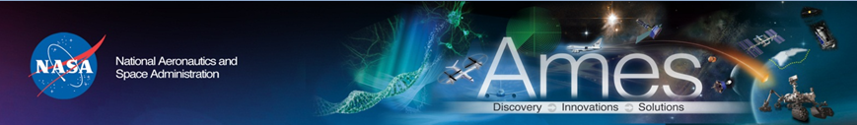
ARC Class D Missions
Using COTS Parts
Kuok Ling
EEE Part LDE
May 27, 2020

Slide 2
Outlines
ARC EEE Part Selection Strategy
Examples from Recent ARC Missions
Considerations for Deep-Space Missions
Conclusions

Slide 3
ARC EEE Parts Management Program
Controlling Document: APR 8730.2 Ames EEE Parts Control Requirements, created in 2009 per NPD 8730.2C
Unique to Ames: Center focus is on Class C & D missions
  APR 8730.2 sets quality control policy w/o undue burden on numerous small and “low-budget” (heavy tailoring <$25M LCC) spaceflight projects at the Center
Project Structures:
  In-house spaceflight h/w development
  Academia partners (e.g. Stanford, Santa Clara, Michigan, Purdue)
  International partners (e.g. DLR, Saudi KACST)
  Partnerships with other NASA centers (e.g. LADEE w/GSFC, ACS3 w/LaRC)

Slide 4
ARC’s Niche/Specialty
ARC’s focus & expertise are in small spacecrafts and nano-satellites:
Small S/C ($100M < LCC < $250M):Class D LADEE, IRIS, LCROSS, & Kepler
Nano-Sats: Class D-
  Low-cost (LCC <$25M)
  Quick turn (< 2 years)
  Short mission life (few hours to < 30 days)
  High risk/high payoff – tech demos, short-duration science, proving concepts, etc.

Slide 5
ARC Philosophy
EEE part selection emphasizes educated & calculated risks
ARC Chief Engineer’s Office, SM&A and PMs agree to take on risks that are too great in traditional NASA sense; but, with our tiny budgets & huge potential scientific gains, it is what defines ARC
Our payload designs sometimes require advanced components that are even ahead of state-of-the-art COTS offerings (e.g. Ultra Violet LED)

Slide 6
ARC’s Approach
Typical ARC missions’ EEE parts are:
  Industrial grade, plastic components (PEMs)
  Not radiation tolerant
  Available in-stock at Digikey, Mouser, Newark, Avnet, free samples from manufacturers, etc.
  Counterfeit control: buy from OEMs & authorized distributors only
Design/risk mitigation approaches:
  Usually reused, after successful missions, on new designs; flight legacy a strong/prime consideration.
  Near-100% COTS use allows multi-revision engineering builds so we can test early & often, especially in S/W, interface, form & fit (3D-printed models), etc. It also shortens development cycle times.
  Strategically using space rated parts and/or redundancy for single-point failures.

Slide 7
ARC Radiation Strategy
  Class D: radiation hardness is overkill & over budget
  Design for radiation tolerance at board/subsystem level, not part level, w/redundancy, monitoring & design mitigation
  TID: typically not an issue for short mission life
  Use commercial grade of rad-hard parts => cost, lead-time++
  SEE approaches:
    SEU: watchdog timers, EDAC, ECC SDRAM, etc.
    SEL: aim to avoid destructive damages
      Over-current/voltage sense-and-reset capability in h/w & under s/w command & control
    SEB, SEDR, etc: take the risk, or buy a rad-tolerant FET.

Slide 8
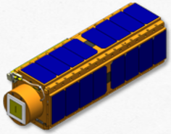
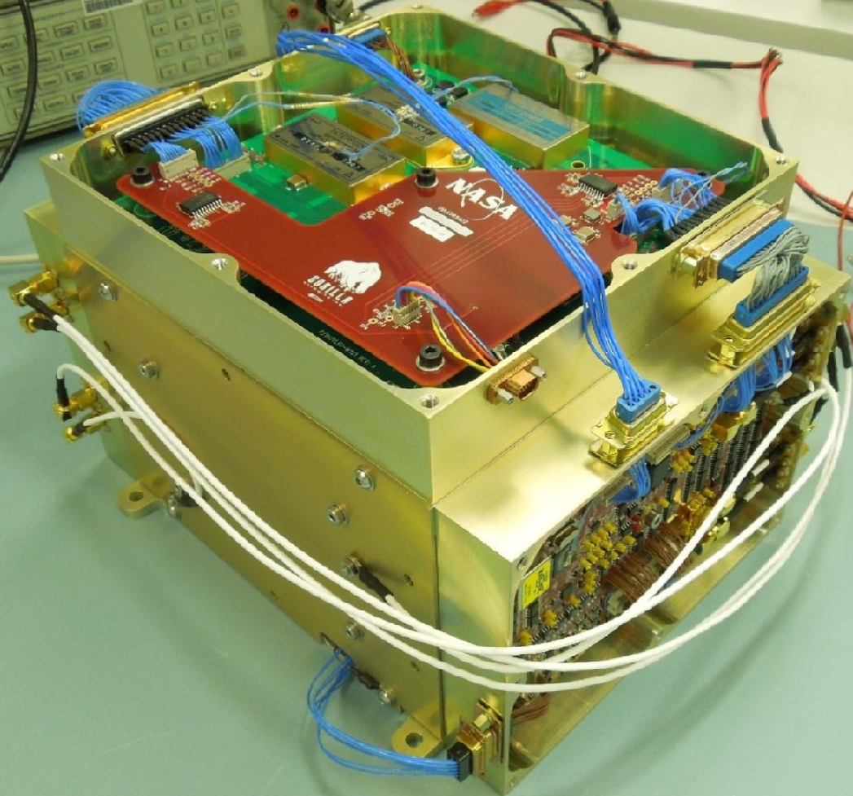
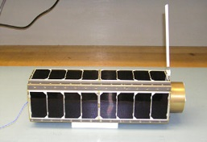
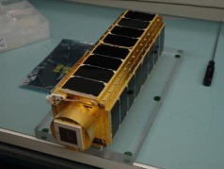
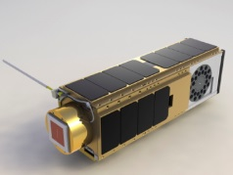
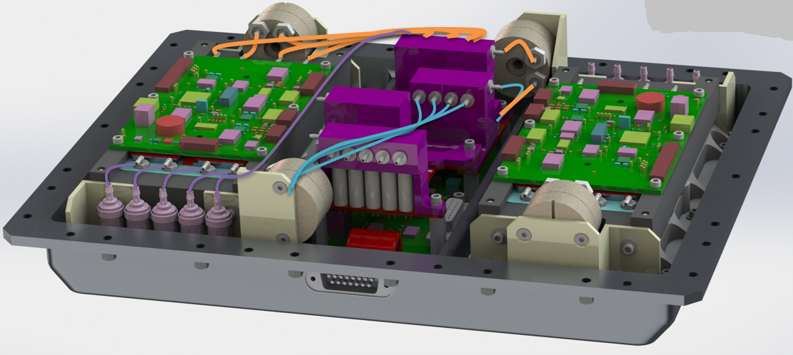
Examples of ARC Class D Projects: Near-100% COTS Parts
 | GeneSat | PharmaSat | SporeSat | O/OREOS | UV LED (P/L) | Eucropis (P/L)
Life-cycle cost | < $10M | < $10M | < $10M | < $10M | <$5M | <$5M
Classification | D- | D- | D- | D- | D (w/KACST) | D (w/DLR)
EEE parts procurement | PO/credit card | PO/credit card | PO/credit card | PO/credit card | Credit card | PO/credit card
Avionics HW (Except Radios) | Built at ARC | Built at ARC | Built at ARC | Built at ARC | Built at ARC | Built at ARC
Instrument | Vendors | Vendors | Vendors | Vendors | N/A | N/A
Project Part Control Plan | No | No | Yes | No | Yes | Yes
Mission Outcome | Fully Successful | Fully Successful | Failed/Partial Success | Fully Successful | Fully Successful | Fully Successful
-SporeSat: OLED package trimming done in water (against datasheet!) at Purdue led to mission failure
-Eucropis is currently active with one more experiment to execute for stretch goal
Notes:
8

Slide 9
O/OREOS Nano-Satellite
Organism/Organic Exposure to Orbital Stresses
Utilized 100% COTS components, including free vendor samples.
‘Test early & often’ philosophy – verify by test
Fault recovery (reset w/current sensing) incorporated at subsystem level
Launched late 2010, operated > 3 yrs (640km orbit)
There have been system resets, some related to power, thermal, and perhaps radiation
No destructive damages

Slide 10
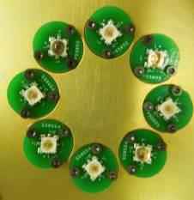
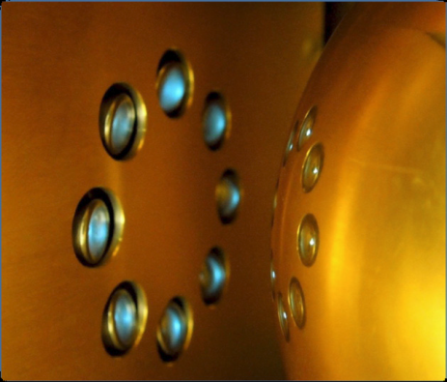
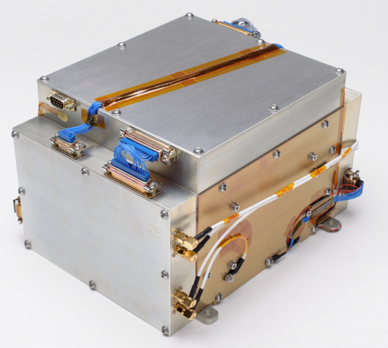
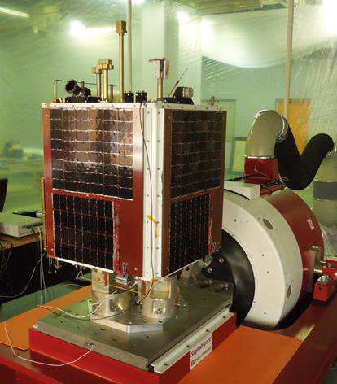
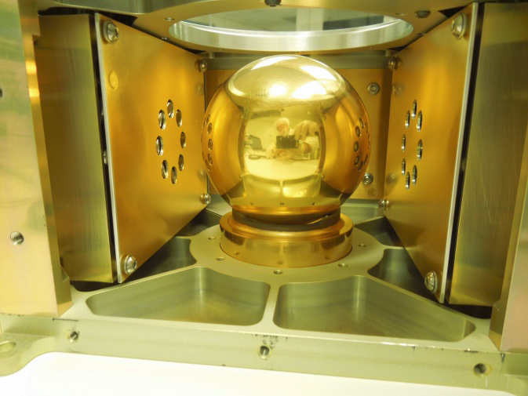
UV-LED Payload
Charge management tech demo for LISA and BBO; ARC, Stanford & Saudi KACST joint project
Non-contacting charge control of floating mass using new solid-state ultra-violet (255nm) LEDs
Goals: Space qualify UV LED (TRL8), demo non-contact AC charge management in space (TRL7)
Payload for Saudisat-4 S/C, launched 6/19/14 onboard Russian Dnepr rocket
All COTS except space rated DC-DC converters for mission critical power & comm box
  Main board: 4.5”x6.5”, 900 parts, 19 layers
  2 sets of expt.: 16 LEDs, 4 bias plates, 9.5W, 2 charge amps using 0201 passives
  Mission can be completed in 5 hours: 1 set of V-I-P curves generated & downloaded
  6.3kg, 23x27x18.5cm
Paper published in Physics journal: Classical and Quantum Gravity, 11/15/2016

Slide 11
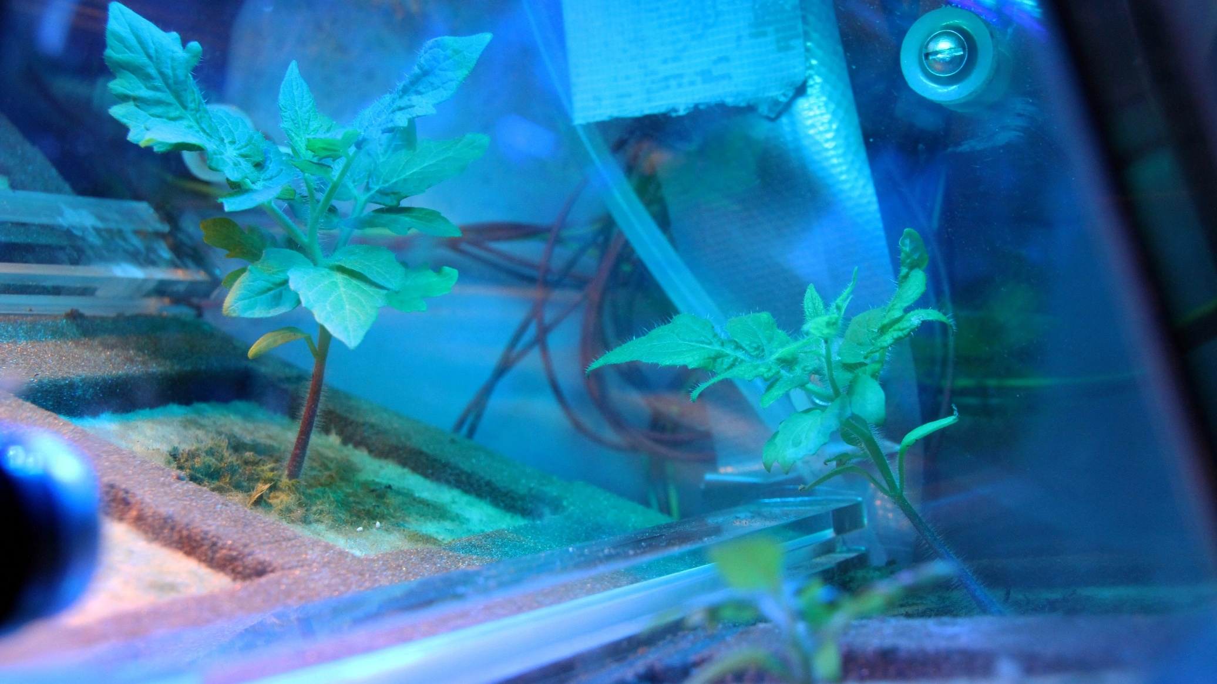
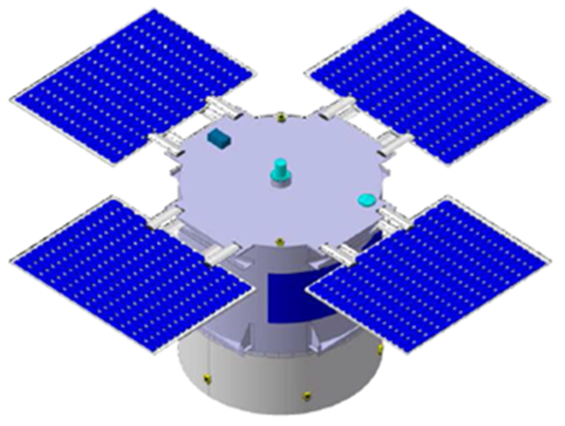
Eucropis Science Goals
S/C Spin Axis
(Sun Pointing)
  Main DLR Payload (PL1): Demonstrate simple life support system with food output (tomatoes) under reduced gravity during space flight
  ARC PowerCell (PL2): Do changes in gravity affect the basic metabolic rate and metabolism of living systems (cyanobacteria and algae function as “plants”)?
  Payload 3 is the Radiation Measurement in Space Instrument (DLR)

Slide 12
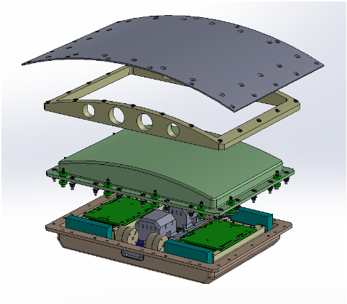
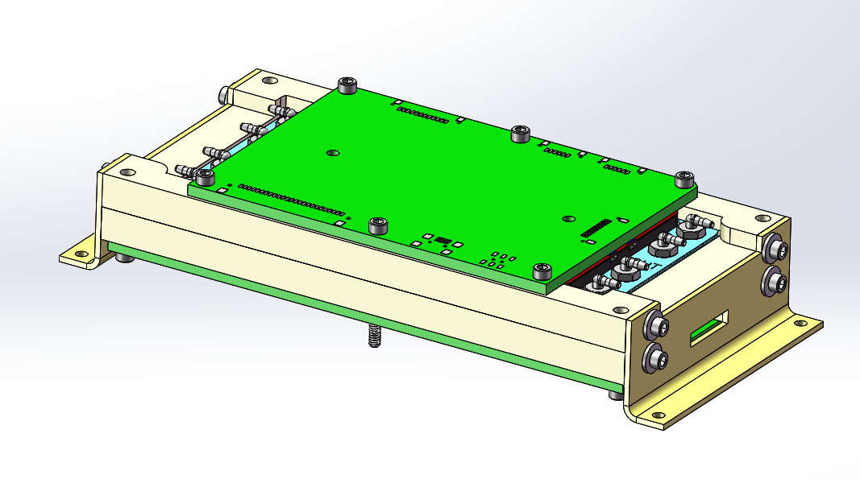

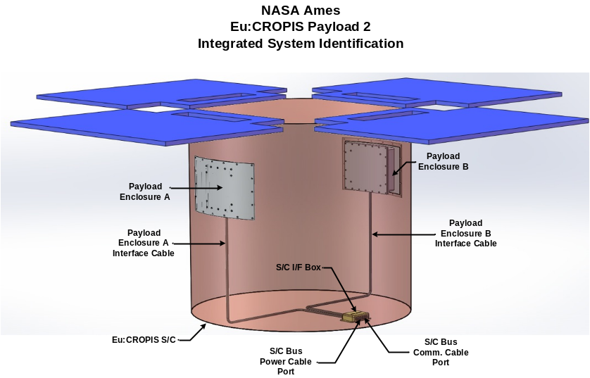
ARC PowerCell Payload
PowerCell
Fluidics Card
Payload Module
Payload Assembly w/
x2 Payload Modules
DLR EuCROPIS S/C
PowerCell
Payload System w/
x2 Payload Assemblies

Slide 13
ARC Powercell (2 Identical) Payloads
  The Eucropis satellite established a variable, artificial gravity by controlling the rate of rotation about its axis.
  One-year mission lifetime, launched Dec. 2018: 6-month duration at each of two gravity levels, Lunar & Martian.
  Orbit: ~600 km, Sun Synchronous Orbit. Two experiments in each PL2 unit.
  Eucropis S/C provides NASA PL2 systems unregulated power and current monitoring along with an RS-422 communication interface.
  Mission goals fully accomplished, encountered RS-422 failure while trying to run an extra experiment with one of the PL2 units.
  Comm. failure traced to radiation damage (TID) to the RS-422 chip: S/C shut unit down when current limit exceeded; but it would work again for a couple hours after restarting before hitting current limit again. May still be able to run (s/w change in operating RS-422 chip) the last experiment.
  Only ARC flight hardware w/o local current sensing and it produced the only part failure in space! The current level monitoring by the S/C is not sensitive or quick enough to shut down and protect against radiation damage.

Slide 14
Sample NanoSat Mission SEE Data
GeneSat: launched on 12/16/2006, 440km orbit, 7-day mission, functional for more than a year before re-entry, no SEL (i.e. no h/w reset due to over current) detected; SEUs probable but we didn’t datalog them. http://www.nasa.gov/centers/ames/missions/2007/genesat1.html
PharmaSat: launched on 5/19/2009, 440km orbit, 4-day mission, functional for more than 2 years before re-entry, no SEL (i.e. over current) detected; SEUs probable but we didn’t datalog them. http://www.nasa.gov/centers/ames/news/features/2009/pharmasat-update_0612.html
O/OREOS: launched on 11/19/2010, 640km orbit, 6-month mission, operated 3+ yrs in space, 1 system reset due to SEL (i.e. over current) on 12/27/2010, 4 beacon radio failures that required a reset (sensing over current & shutting down) on 12/19/10, 3/21, 7/7 & 8/10/11. Likely due to SEE; SEUs probable but we didn’t datalog them.
http://www.nasa.gov/centers/ames/news/releases/2010/10-109AR.html

Slide 15
Conclusions
Class D requires lots of EEE part risk assessment:
  Risk awareness vs. risk ignorance
  Can’t be 100% quantitative; data may be unavailable
Class D requires lots of value assessment:
  I can make this thing a tank, but should I?
  Where are limited resources & schedule best spent?
Size, power & performance often dictate use of COTS parts
Identify risk -> document approach -> get stakeholder buy-ins
Work to NASA & Center guidelines & project requirements
> 30 small/nano-satellites launched w/one failure attributed to a part; S/W (usually Class B) bugs most common issue. ARC COTS use strategy seems to be working well.
~ALL IMAGES COURTESY OF NASA~

Slide 16
Back-up Slides

Slide 17
Considerations for Deep Space
Most ARC missions are Earth-orbiting (LEO) or lunar
Extending this philosophy to deep space (e.g. BioSentinel):
  Longer mission durations = more radiation
    Total Ionizing Dose (TID) solutions:
      Shielding (increases mass) w/Al
      Pay for rad-hard (or tolerant) parts in mission critical & single-string circuits
      Selective up-screening of industrial parts and/or assemblies
    SEE solutions:
      Decrease probability/exposure by decreasing on-time (power off)
      System-level design recovery from SEL (automated) and SEU (cycle)
      Selectively pick rad-tolerant parts for core circuits, use industrial for anything non-critical
  Ground communications can be less frequent
    System-level fault recovery may require more on-board automation
    Use rad-hard ($$) memory for data storage
    Use scrubbing & EDAC for rad-tolerant or commercial memory & accept risk
  Colder operational temperatures -> Industrial ICs Tmin @ -40 ºC (typical)
    Use mil-grade or spaceflight parts (-55 ºC minimum, typ.)
    Some research exists on commercial parts friendly to cryogenic temperatures
      Cryogenics 46 (2006) 231–236 (Patterson, R.L., et. al)
      Cryogenics 52 (2012) 550-556 (Buchanan, E., et. al)
    Radioisotope Heater Units (RHUs) – well known to JPL
      Could be critical for components which are powered off most of the time
      Selectively place Minco flexible heater strips on critical parts

Slide 18

BioSentinel: CisLunar Cubesat Mission
A 6U nanosatellite deployed from the EM-1 (first SLS launch) to access the space environment with biological payloads relevant to human exploration goals. 12-month mission, launch delayed till late 2020 or early 2021.
Size, Power, Composition
6U, ~14kg
< 10W Power
4U biopayload
2U bus (w/ ADCS and radiation spectrometer)
Orbit
Beyond LEO Capability
Cis-lunar, L2 halo, high-earth, high inclination, geostationary
Free flying independent s/c, or 4U biosentinel payload hitchhiker
Modularity
4U of one payload, or 2U each of two different payloads
S/C can support range of specific BioSentinel experiments
Compatible with ISS Nanorack system for a
microgravity, low-radiation control environment
Drawing on Ames’ Biology Nanosat Strengths
Genesat, Sporesat, EcAMSat, Pharmasat, O/OREOS
Payload 2
Payload 1
Bus + Radiation Detector

Slide 19
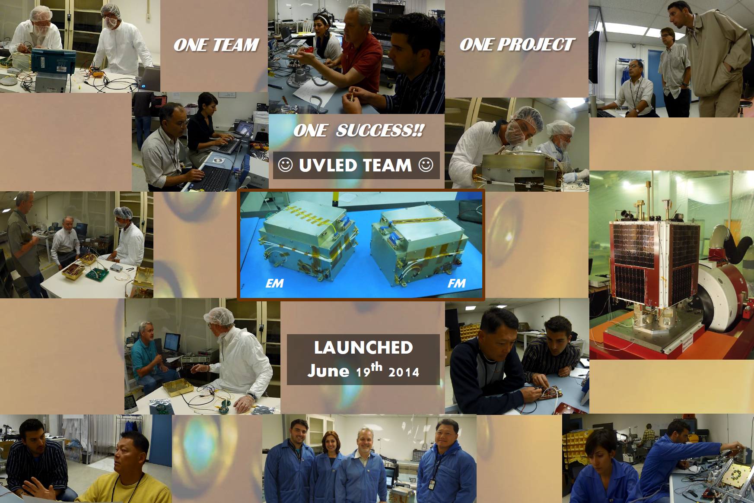

Slide 20
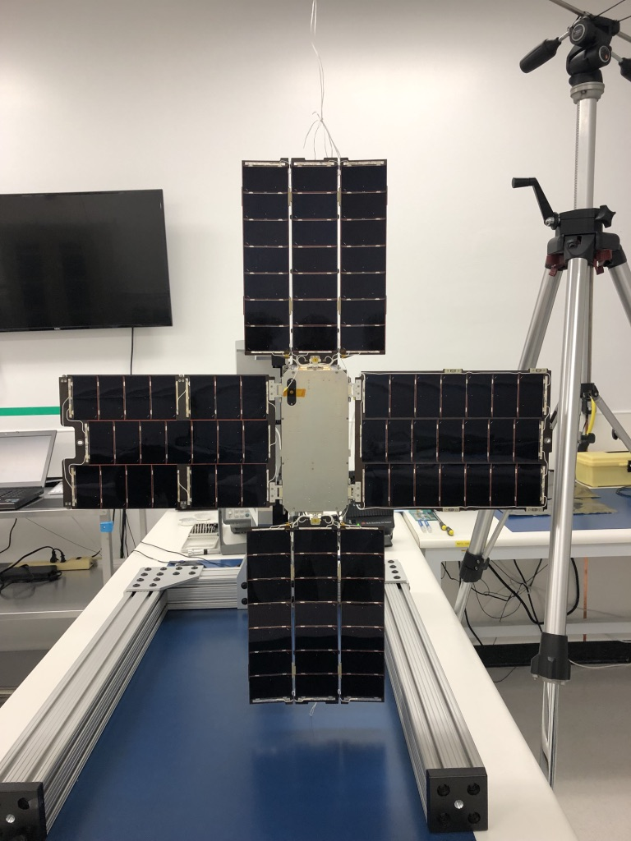
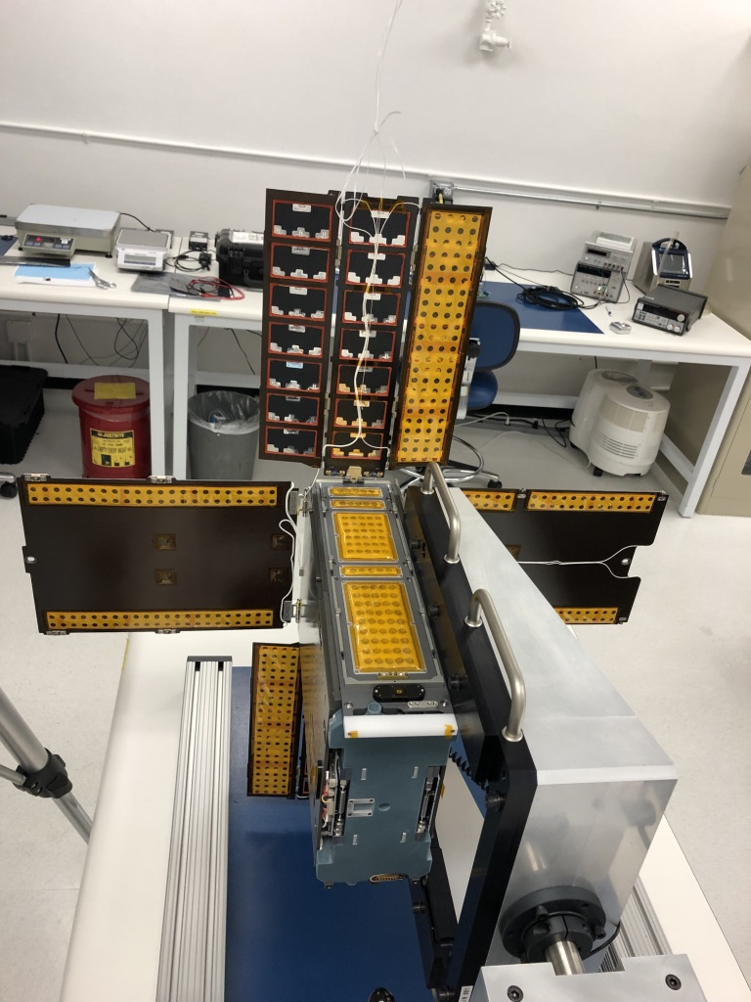
BioSentinel
Front - Bottom View
Back View

