Slide 1
Use Case: Low Boom Flight Demonstrator Signature Validation
Melissa Carter
June 2, 2020
NASA LaRC, RD D301
ARMD CST
Notes:
Red items are to be replaced with your brief statements. Black items should remain as is

Slide 2
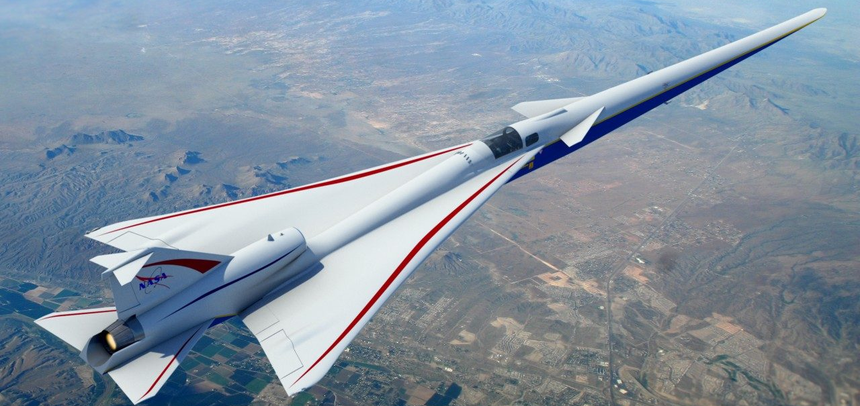
Use Case: Mission Need
Mission: Low Boom Flight Demonstrator (LBFD) Signature Validation Analysis
  Since FY19, the CST project has been working on improving the speed and accuracy of the codes needed for sonic boom signature analysis. NAS has been a critical part of testing the codes and baselining the speed improvements.
Criticality:
  NAS is considered critical as part of this mission. Without these computational resources, the CST project may have to expend significant operational resources to fine tune the flight operations of the X-59 aircraft through many more test flights than currently planned. Adjustments based on computational guidance will be much more efficient than additional flights of this experimental aircraft.
Mission Security Needs: (Confidentiality, Integrity, Availability)
  Due to the X-59 engine, data is EAR
  Current plans have no external collaborators needing NAS access.
HEC Function:
  Current codes: LAVA, CART3D, FUN3D, USM3D, PCBOOM
  Currently HEC primarily used for testing improvements to the code.
  However, during test flights, we will need to be able to submit runs,
  and have them completed overnight for analysis at the start of the workday.
  The output of these data will show how well we are able to predict the near-field and ground boom signature, which is necessary prior to community acceptance testing
Notes:
What is your Objective Key Result (OKR) and how is it measured?
Where do I want to go?
How do I know if I’m getting there?
What do you need from HEC to achieve those results?

Slide 3
Use Case: Current HEC Application Characteristics
Work flow:
  Signatures from flight tests that don’t match precalculated data sets (e.g., deflections different than predicted)
  Interactions limited to ensuring that the proper computational model is uploaded and that jobs are submitted with the proper running conditions
  Due to the nature of flight testing, the results will need to be turned around overnight
Data:
  In: 140-250 million cell grids, FUN3D, USM3D or LAVA input files
  Out: Near field data, range depending on chase aircraft location, actual data needed for comparison will be a pressure line cut
    Output data will be retained if proved to be beneficial to the analysis, retained on LFE until documented in final database
    Statistical analysis versus chase aircraft and propagated to ground to compare statistically with ground measurements. There may be some visualization as well of shock structure in flight.
  Transfer: to HEC storage system
Computation:
  Current run for LAVA: Wall Time: 13 hours, Number of CPUs: 1624, Pleiades systems
Evaluation: Effectiveness of HEC will be measured by queue time and reliability

Slide 4
HEC Needs Assessment Workshop Key Questions
What are the key factors today that affect the load on computing assets and cause it to vary?
  Today, the loads are small and used for testing of code improvements.
  Leading up to the flight tests, we will be building a database of potential flight conditions but this will be done without needing high priority
Are there key functional gaps that exist or are projected in the next 5 to 10 years?
  Constraints on Use Case: Biggest concern is queue time. Has been identified as a risk for the project.
  Impact: The output of these data will show how well we are able to predict the near-field and ground boom signature, which is necessary prior to community acceptance testing
How will this Use Case evolve over the next decade?
  Maturity: Current developmental work will move to production for flights
  Growth: HEC is a key part of the research portfolio. There will be ebbs and peaks in usage, but growth trend is anticipated to be upward.
  Reuse: It is anticipated that the number of people will remain at or almost the same
  Rehosting: Code refactoring, porting to GPUs and utilizing benefits offered by the latest hardware, may be needed to extract the maximum performance and throughput

