Slide 1
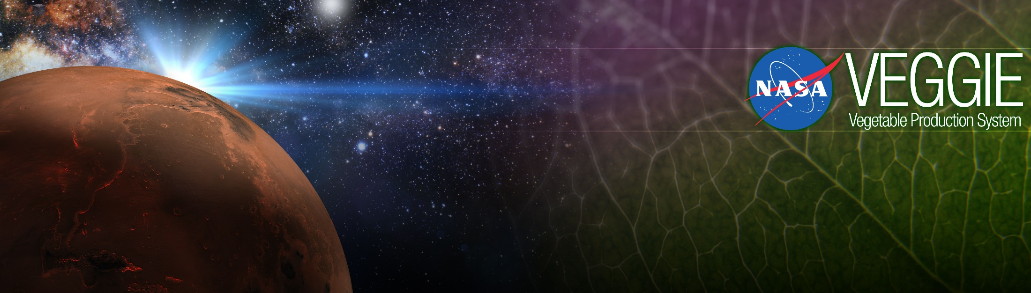
Growing Plants in Space
Gioia Massa
Exploration Research and Technology Programs
NASA, Kennedy Space Center, FL, USA

Slide 2
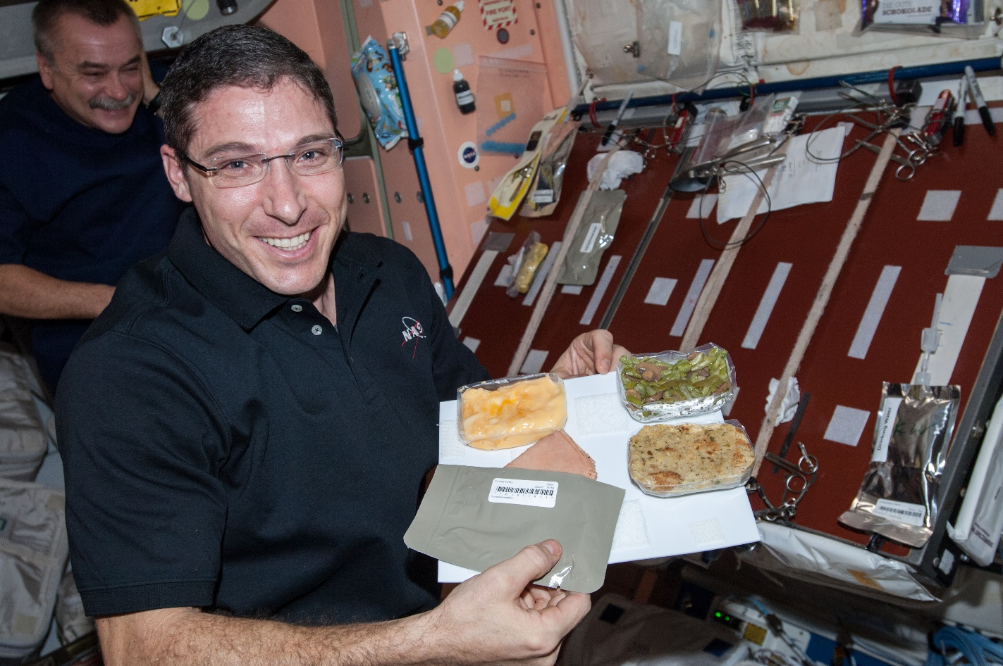
Why grow plants in space?
Food
Psychological well being
Atmosphere
Water

Slide 3
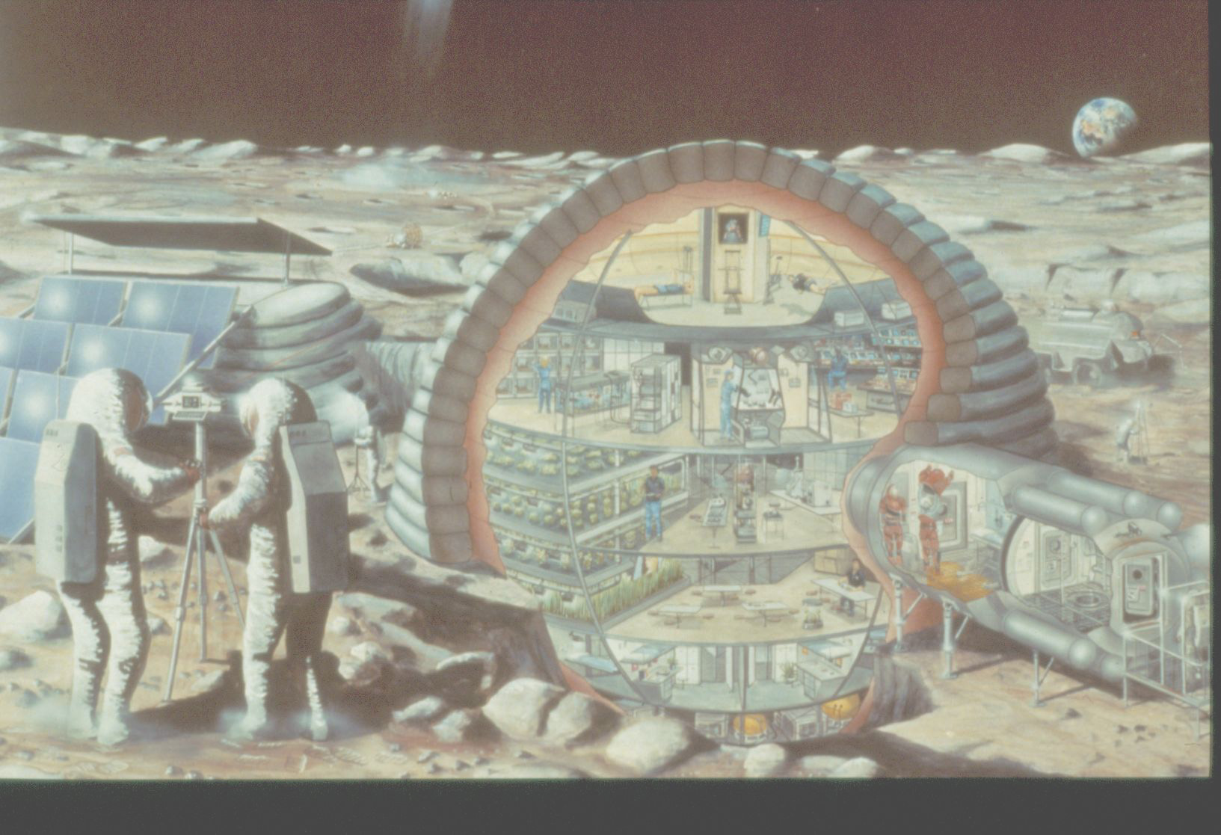

Slide 4
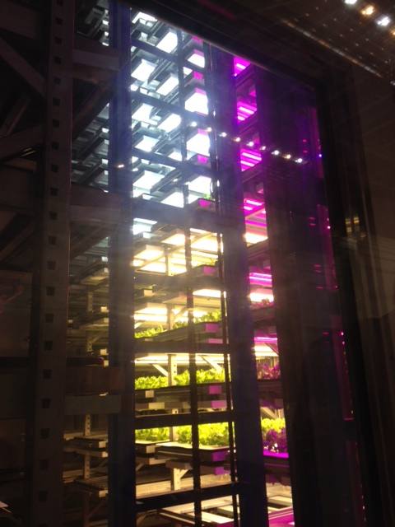
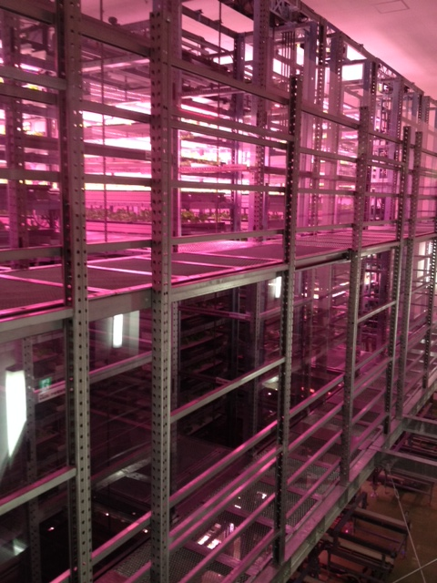
Plant Factories
Photos of Osaka Prefecture University training facility courtesy of Ray Wheeler

Slide 5
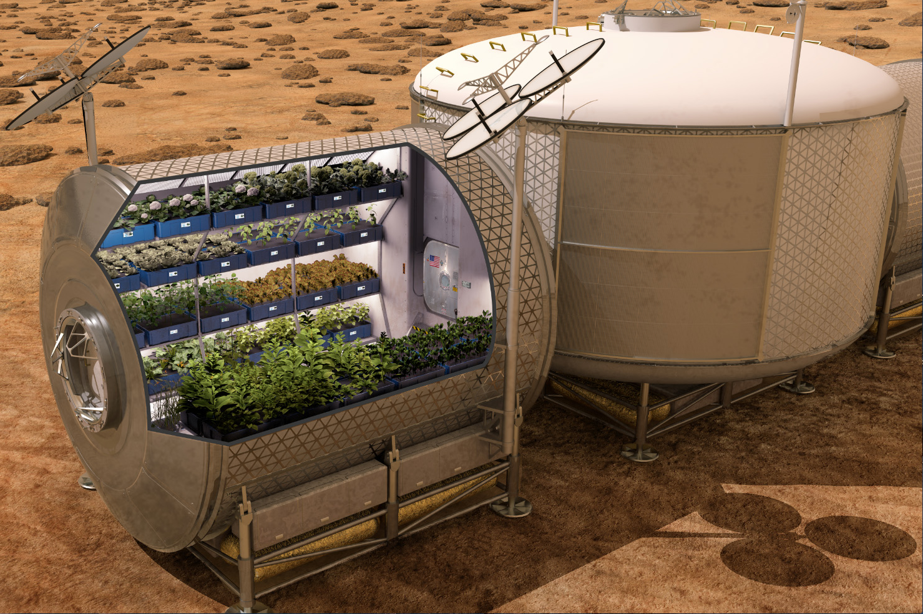

Slide 6
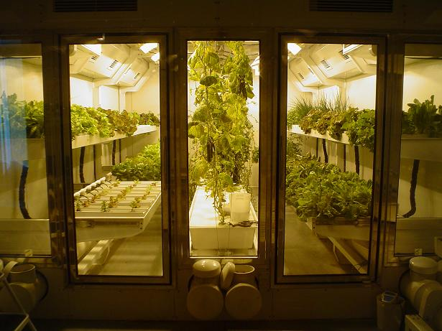
South Pole Greenhouse
Photo from “On the Ice” Blog of Russ Durkee

Slide 7
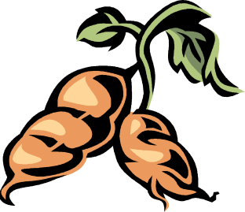

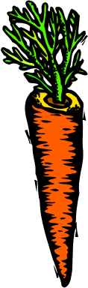
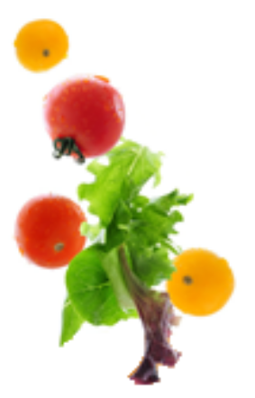
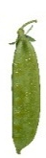

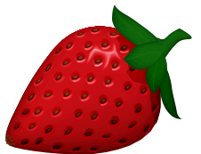
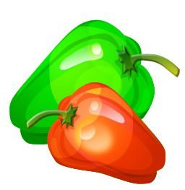

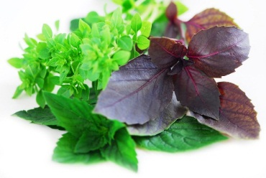


Space Crop Production Candidates
Salad
Leafy Greens
Tomato
Pepper
Radish
Strawberry
Green Onion
Pea
Carrot
Lettuce, Chinese cabbage, Swiss chard, Mizuna, Spinach
Staple Crops
White Potato
Sweet Potato
Rice
Wheat
Dried Bean
Soybean
Peanut
MINIMAL PREPARATION / COOKING
SIGNIFICANT PREPARATION / COOKING
CONSUMED FRESH WITHOUT PROCESSING
Spice
Basil
Mint
Chives
Dill

Slide 8

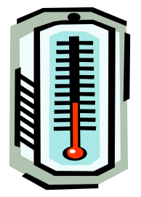
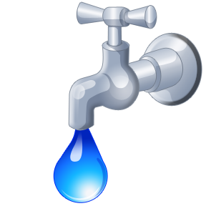
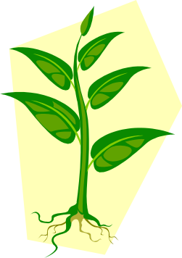
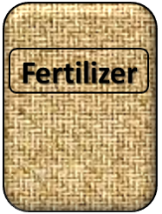

Plant Growth and the Environment
5 Cardinal Factors of Plant Growth…..
O₂

Slide 9

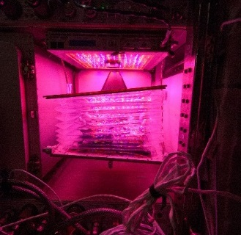
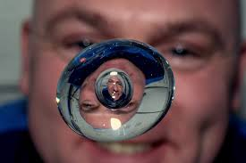

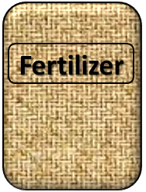
The Space Environment
….and how these work with and without Gravity!
Humans like white light, but plants may grow well with other wavelengths
No convection in space so need to mix the air
O₂
Water forms a ball, and water and air don’t mix well, and roots need both!
Fertilizer is heavy to launch so we need to learn how to recycle plant waste

Slide 10
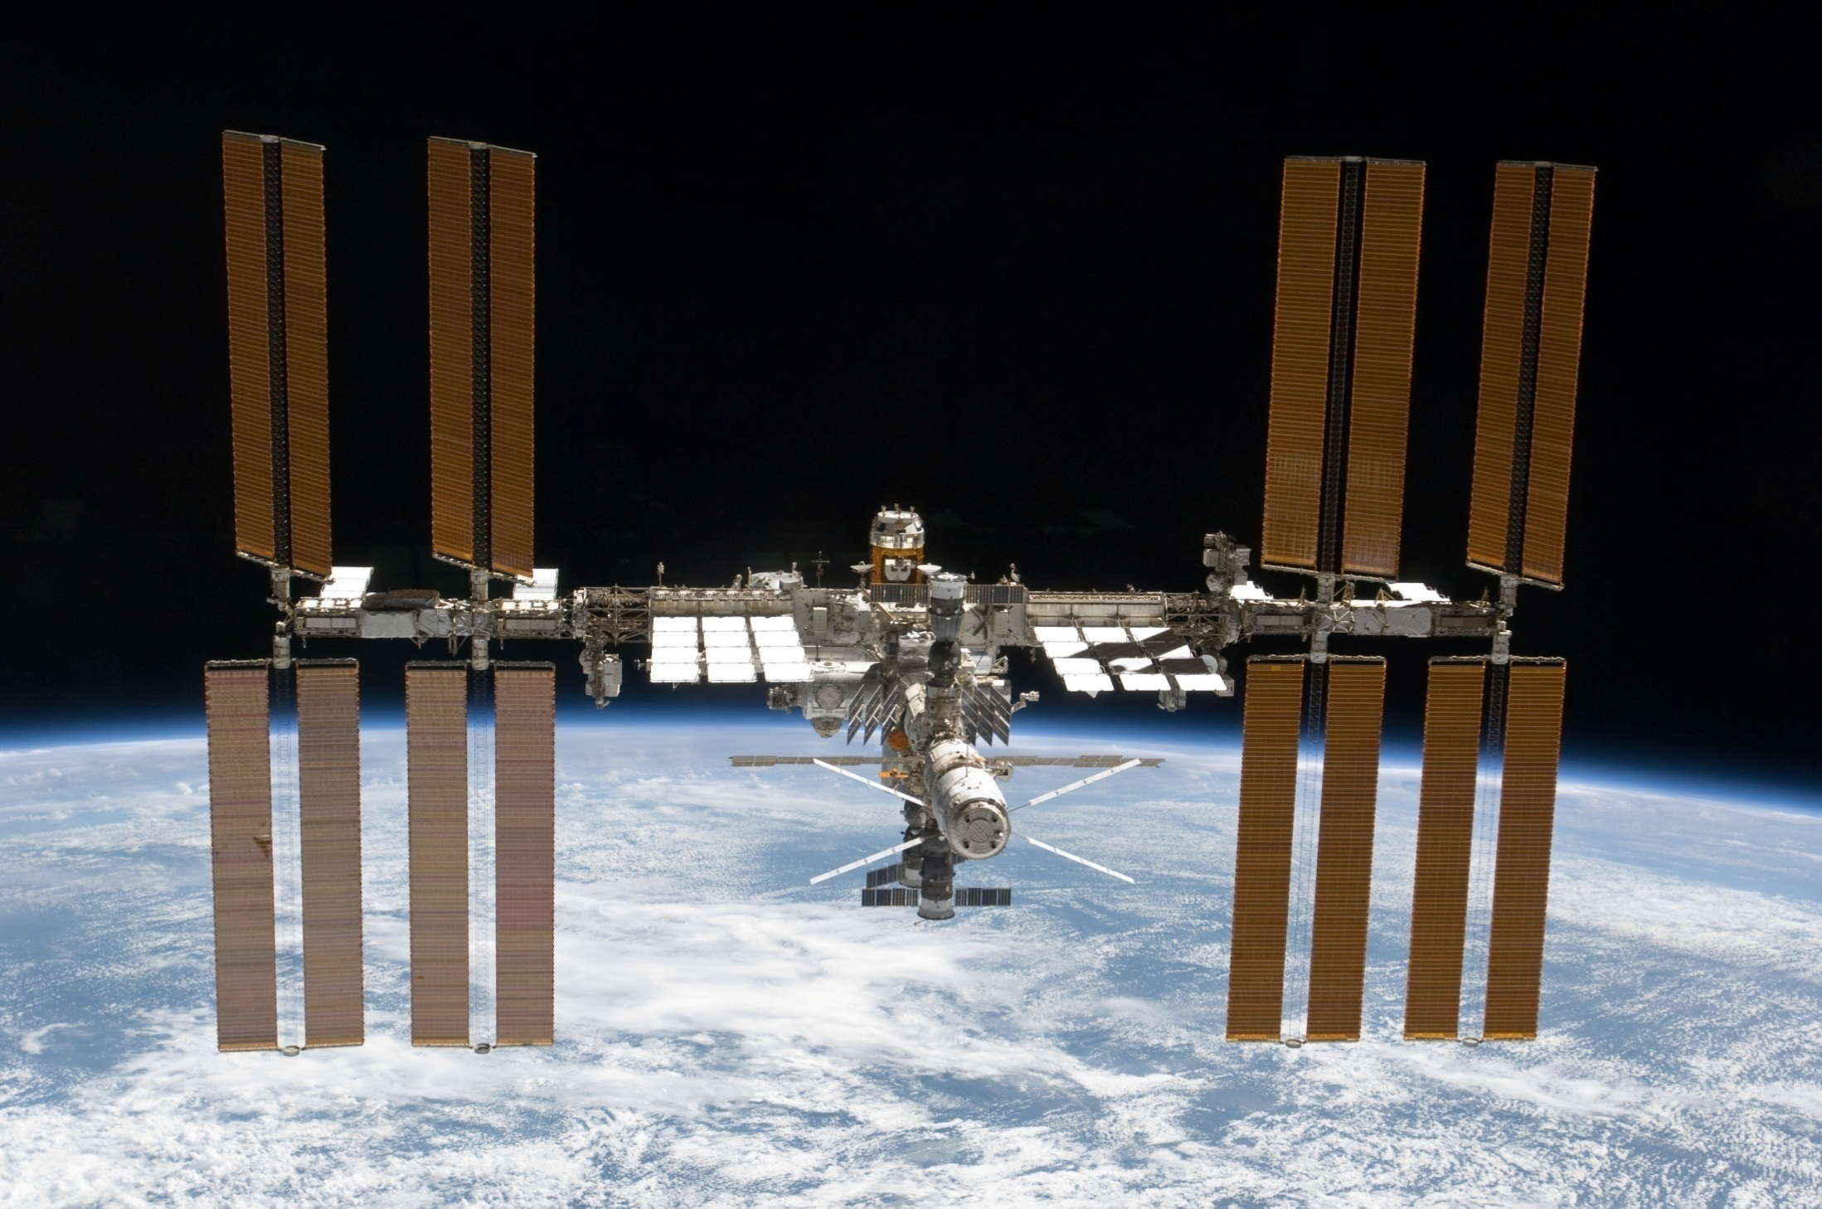
The International Space Station

Slide 11
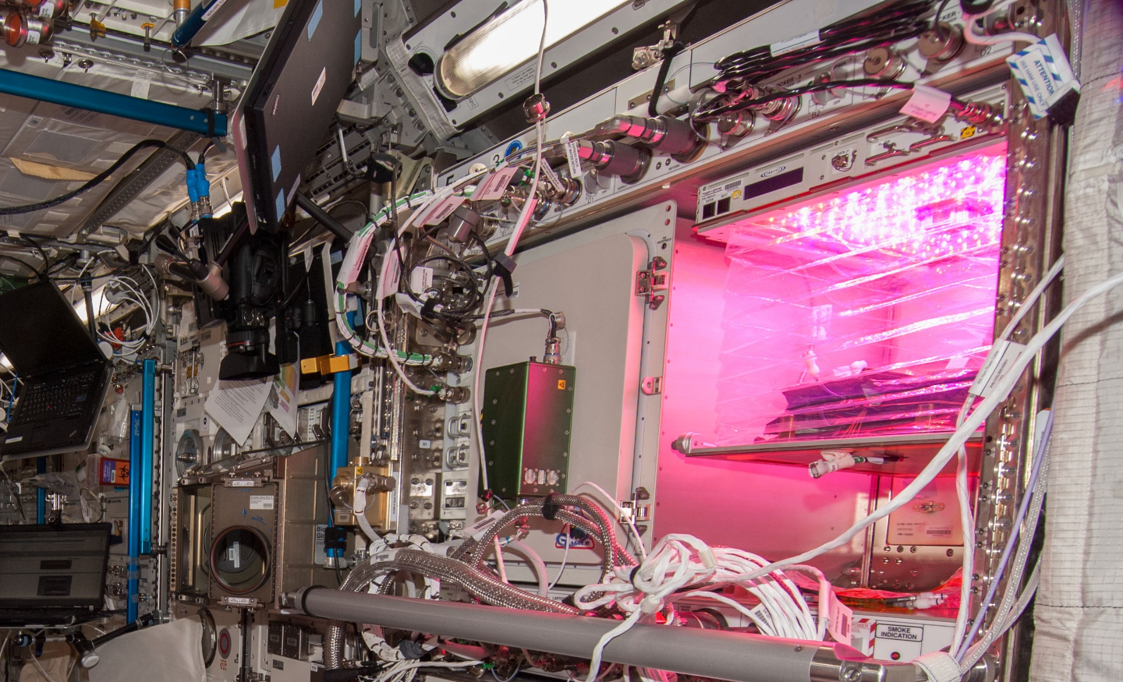
Veggie on ISS

Slide 12
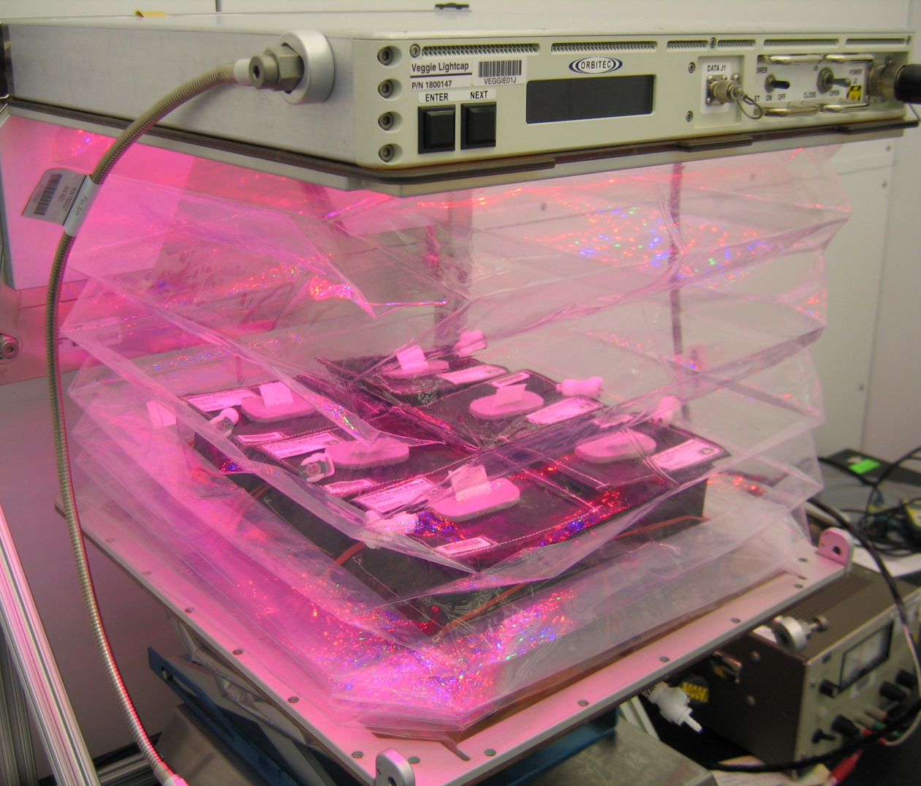
Veggie is designed and built by SNC-ORBITEC

Slide 13
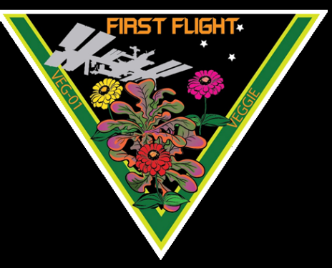
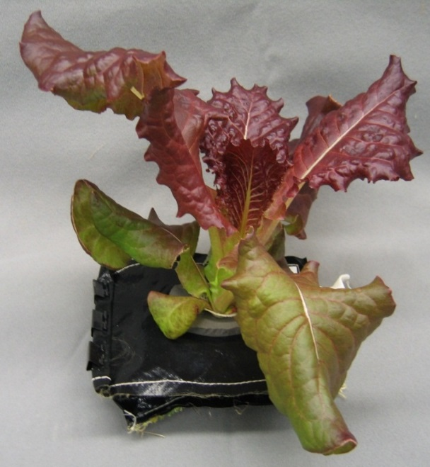
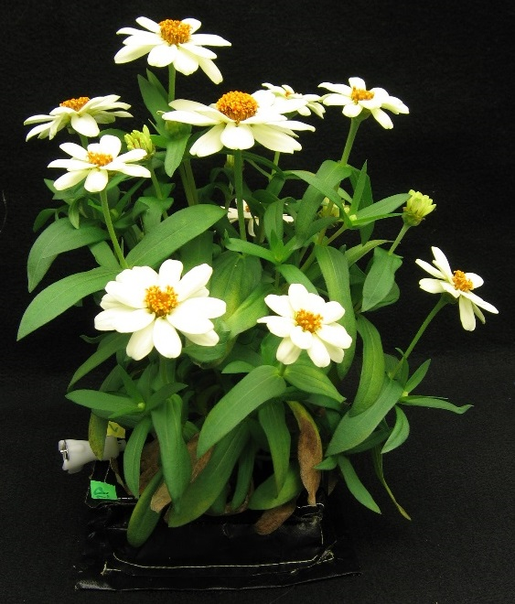
Crop Selection for VEG-01
Reliable germination
Rapid growth
Attractiveness
Low native microbial levels
Palatability / acceptability
Antioxidants
‘Outredgeous’
red romaine lettuce
‘Profusion’ Zinnia
VEG-01 consisted of two sets of ‘Outredgeous’ lettuce and one set of ‘Profusion’ zinnia pillows

Slide 14
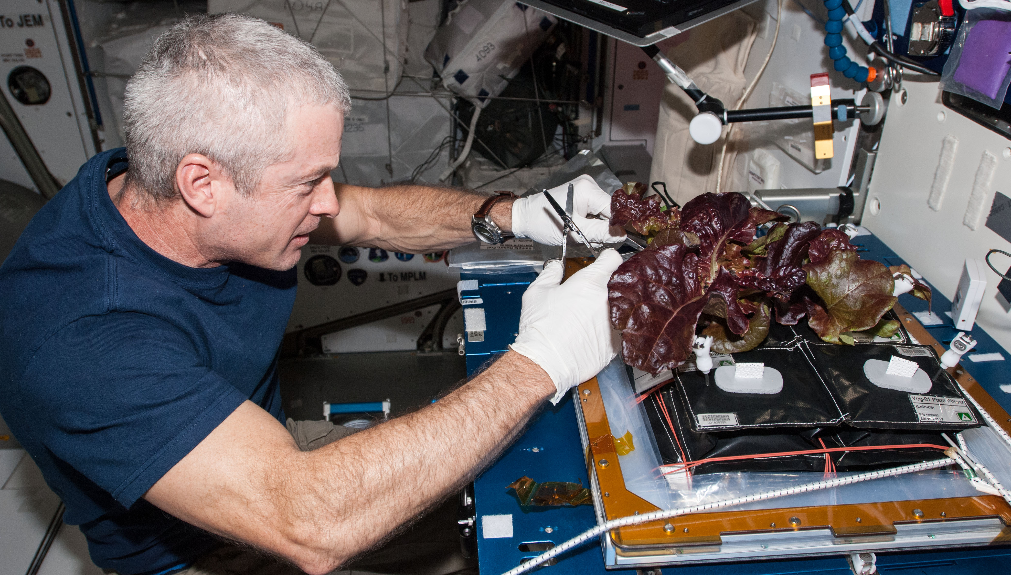
Veg-01A Harvest

Slide 15
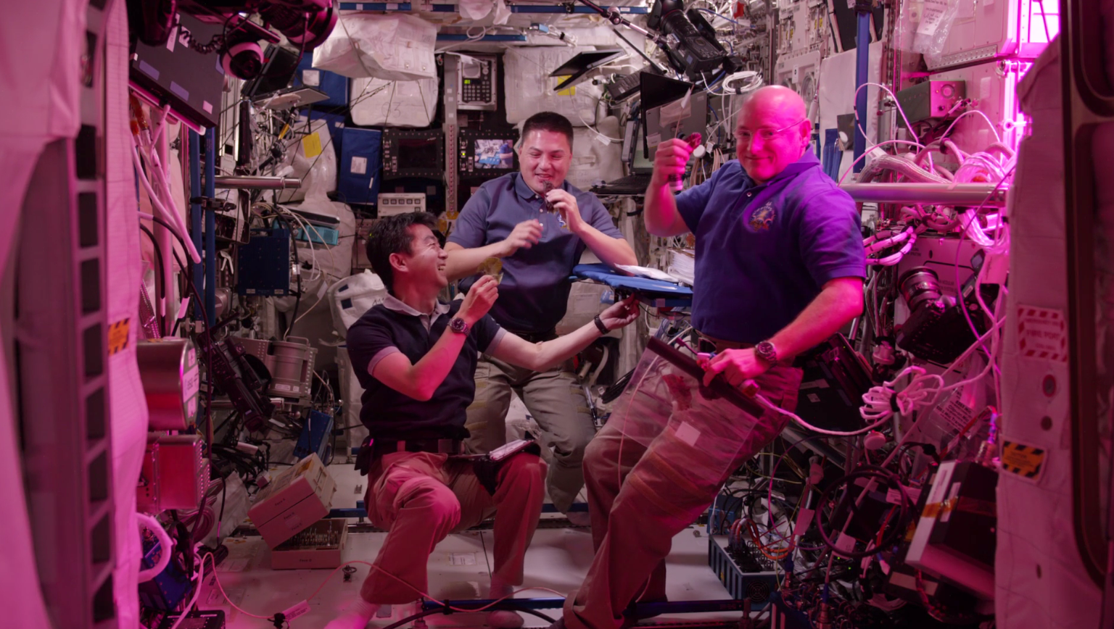
Veg-01B Harvest
Notes:
Veg-01 second crop, first consumption

Slide 16
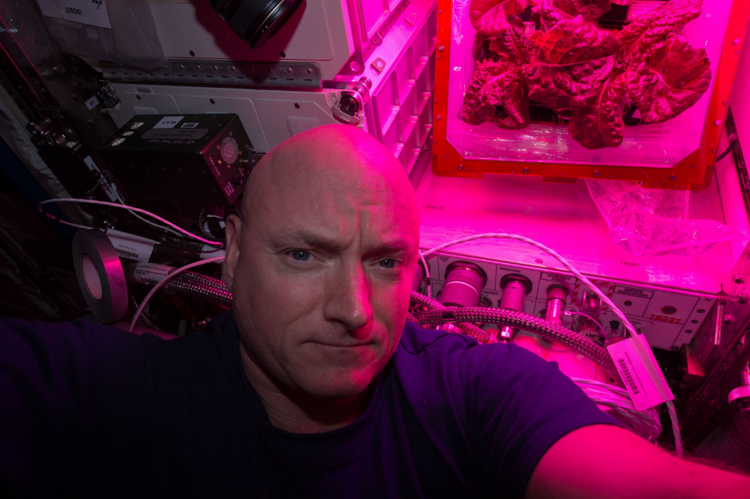
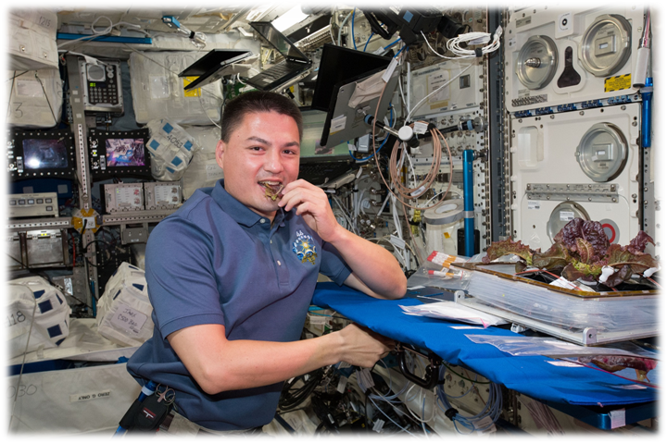
Astronaut Comments
Scott Kelly
  the logistical complexity of having people live and work in space for long periods
  the supply chain that is required
  For Mars, need a space craft that is more self-sustainable with regards to its food supply
Kjell Lindgren
  benefit of eating the fresh food
  contribution that plants have to the ISS ecosystem
  psychological benefit - it’s really fun to see green growing things in the sterile environment of the ISS

Slide 17
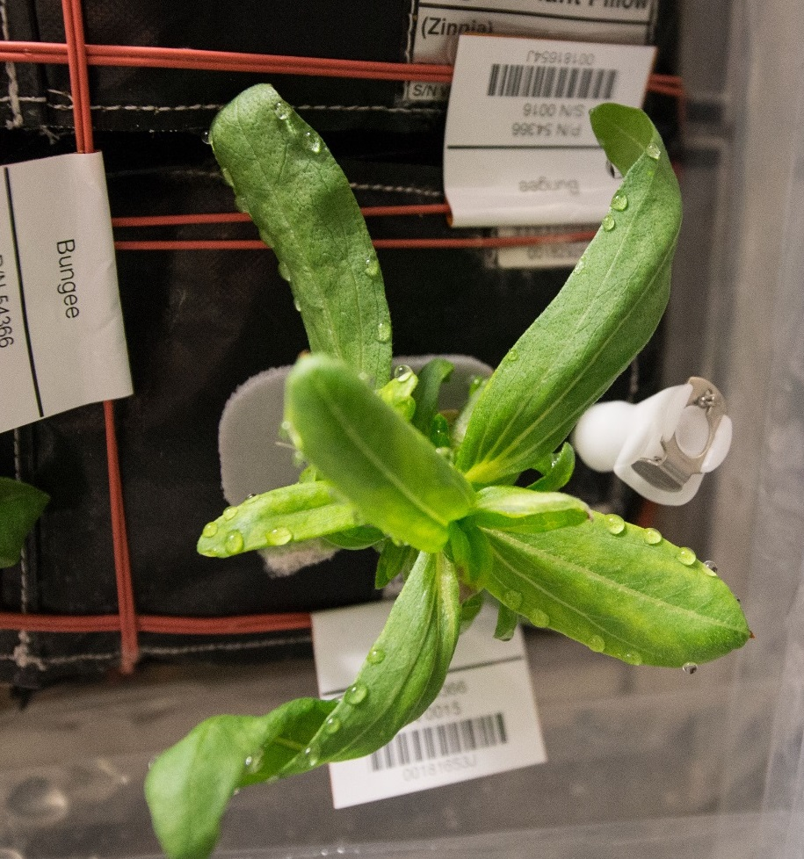
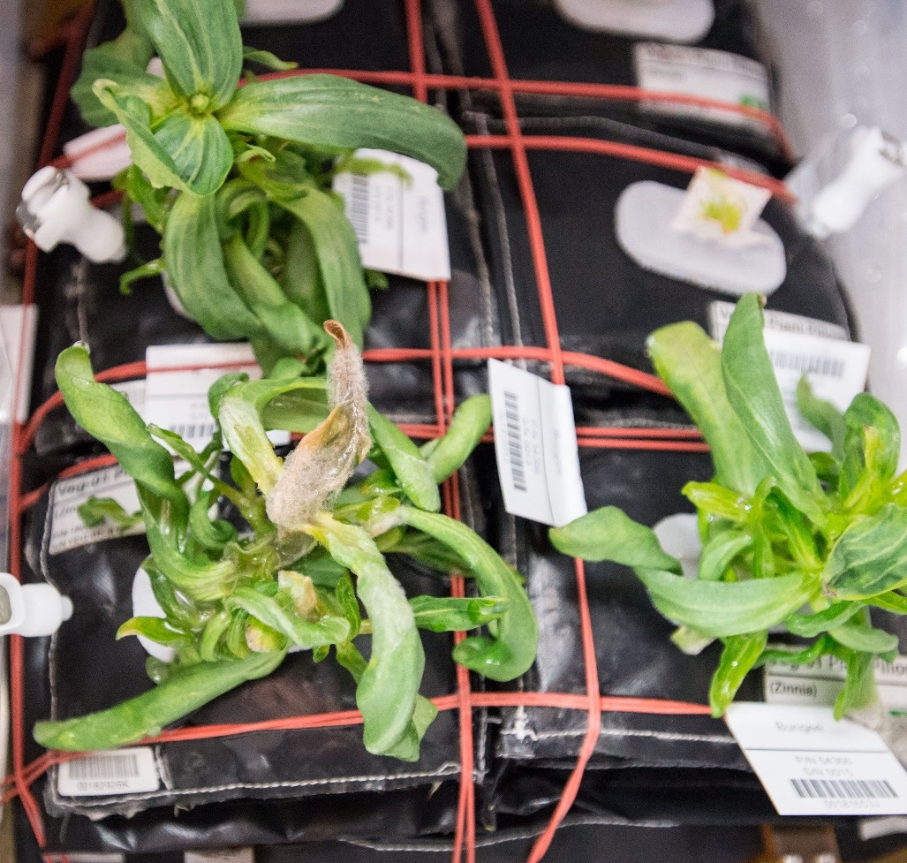
Water Issues / Consequences in Zinnia
Guttation and Leaf Curling
Fungal Development & Abnormal Growth

Slide 18
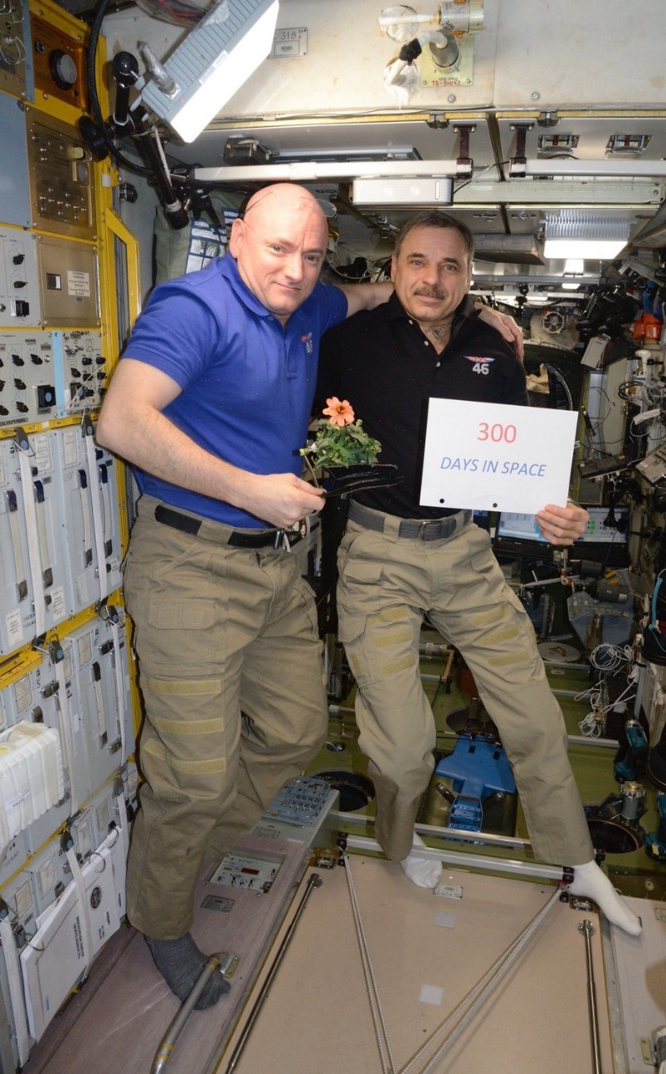
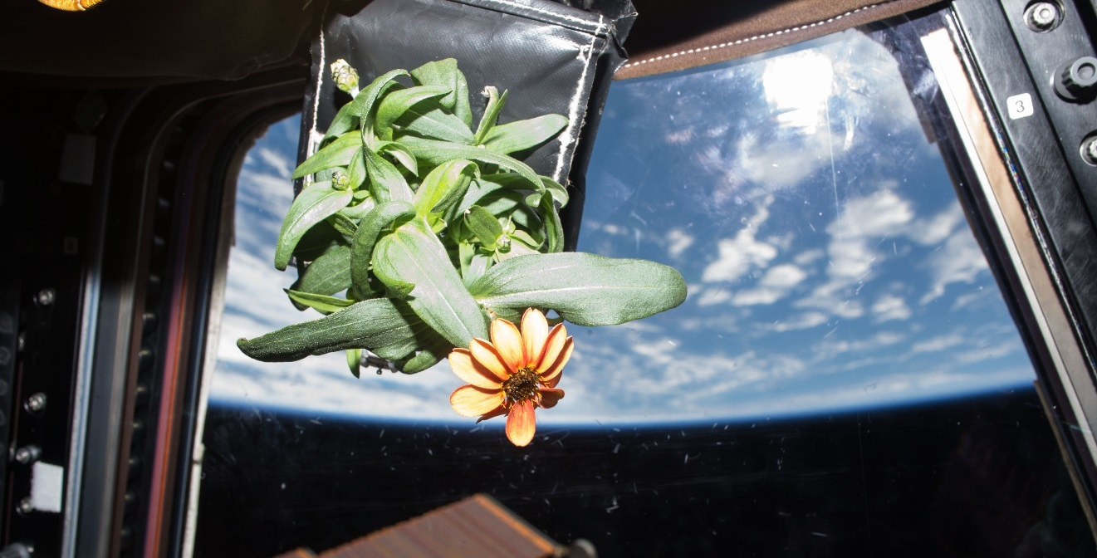
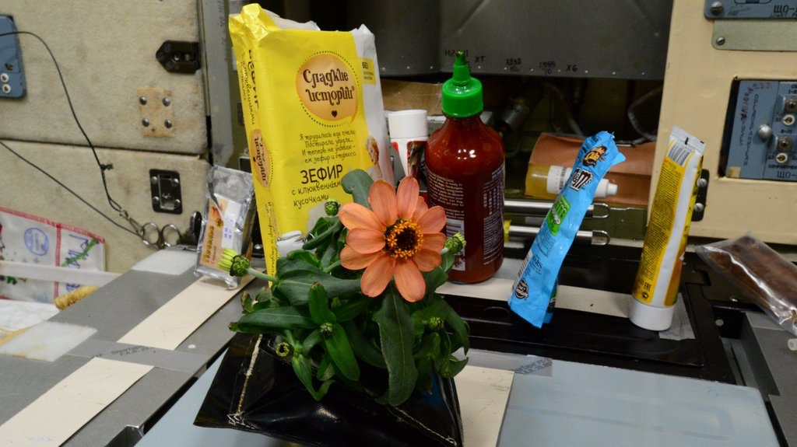
Zinnia Action Shots

Slide 19
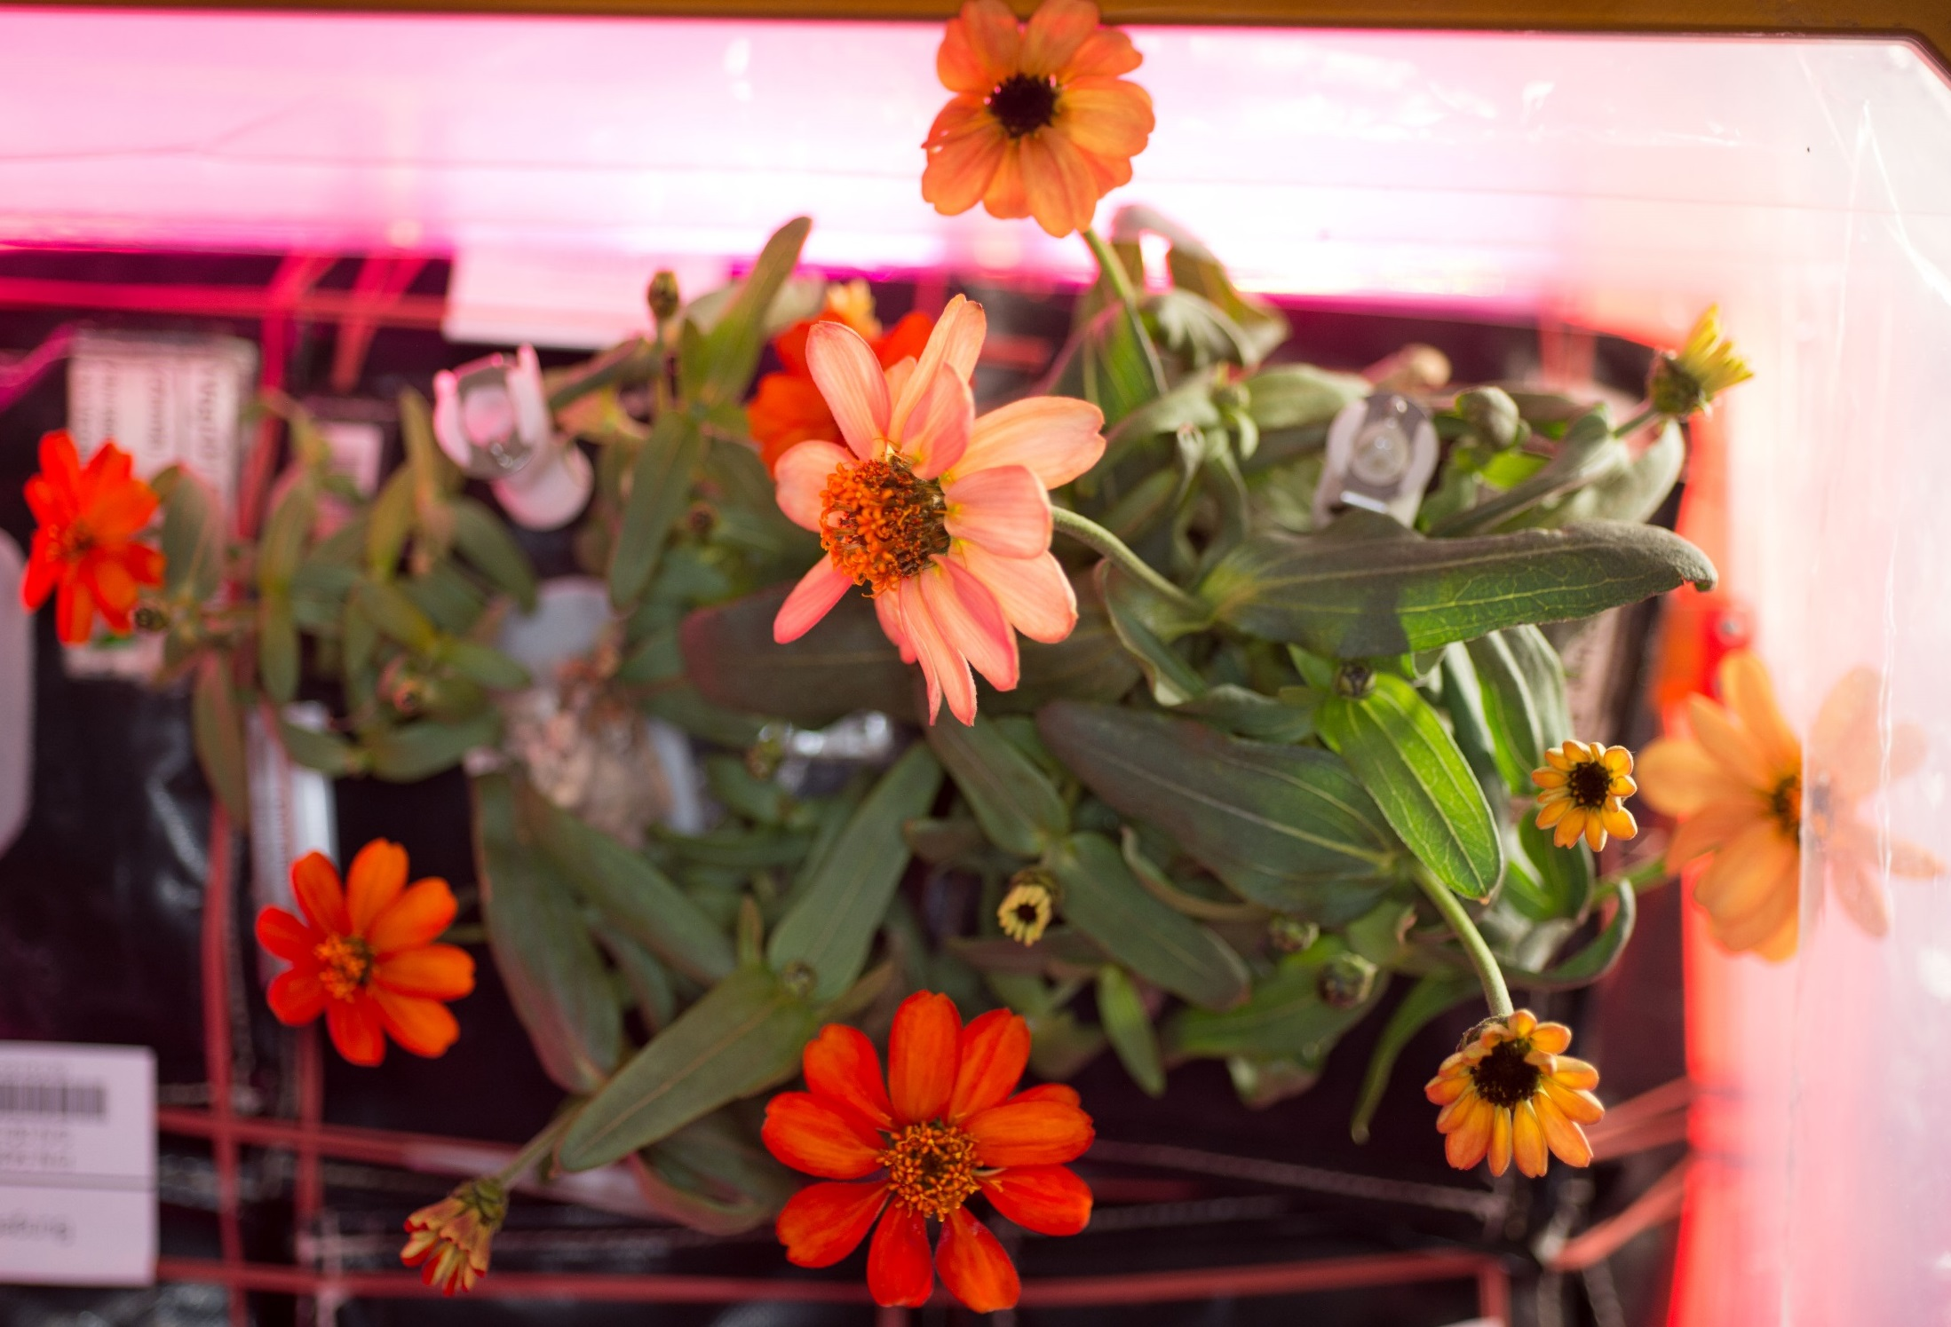
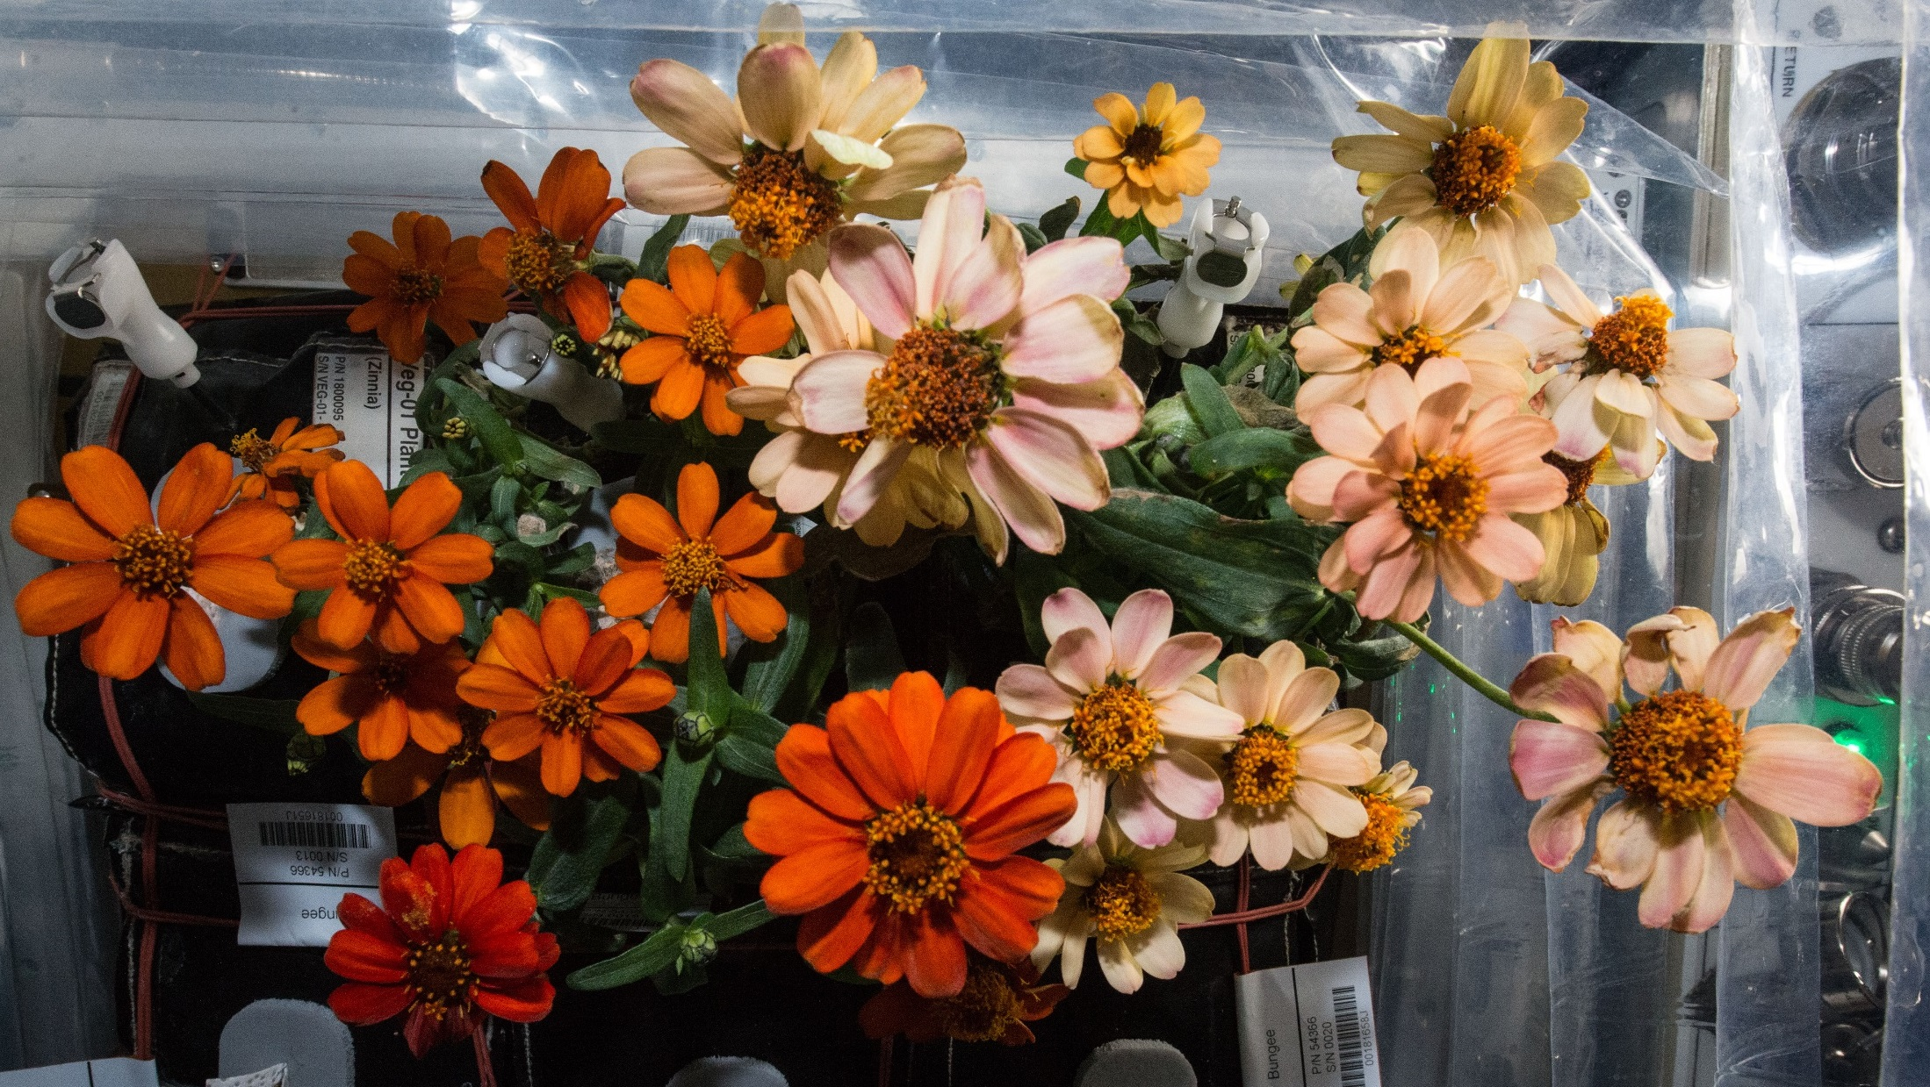
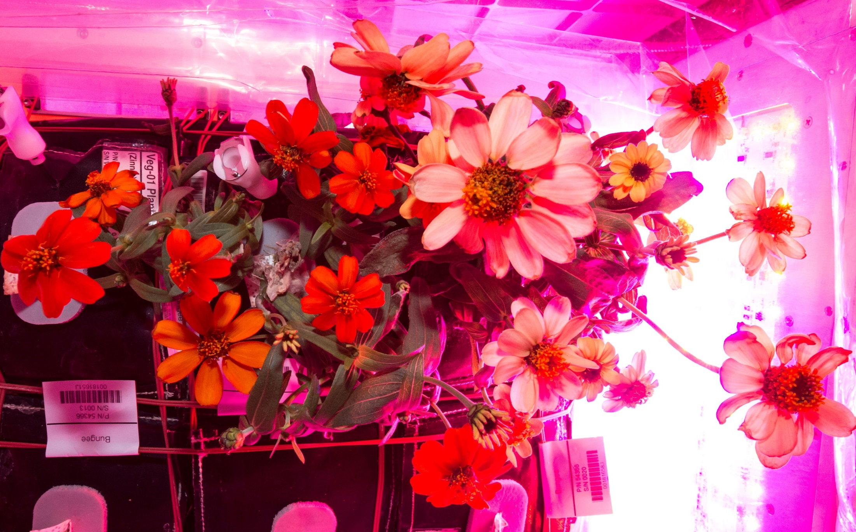
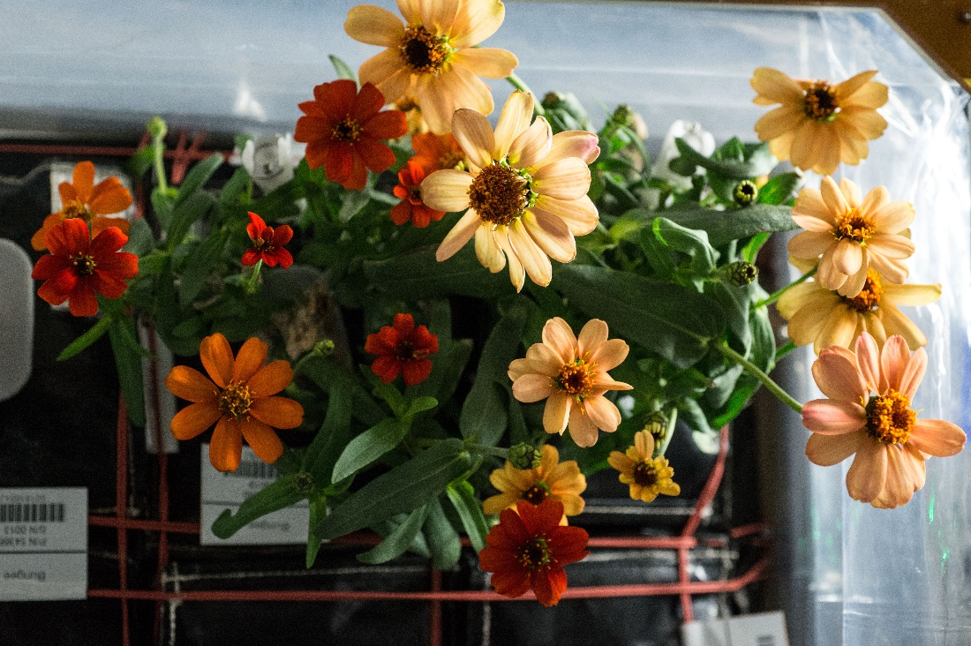
And they bloomed, and bloomed...
77 DAI
80 DAI
71 DAI
87 DAI

Slide 20
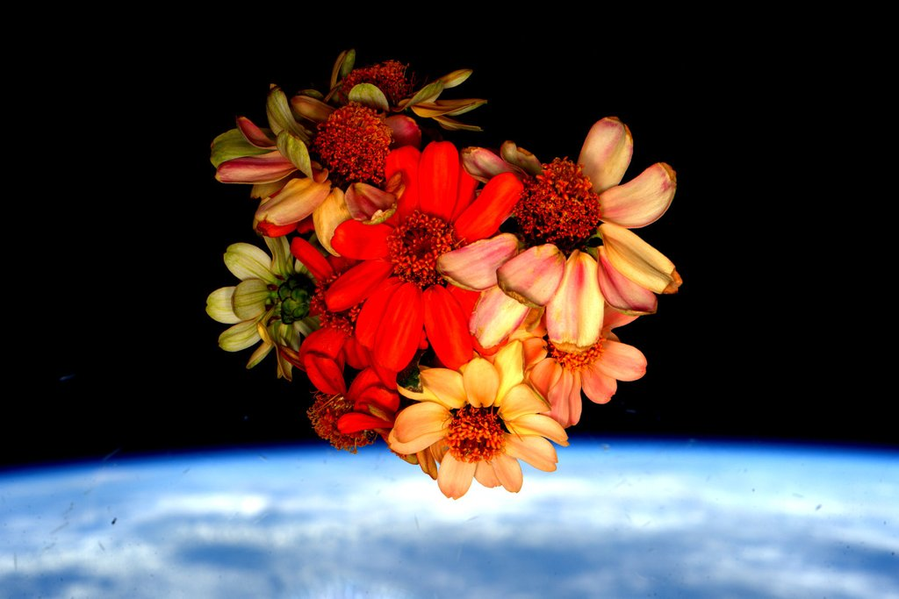
Valentine’s Day Bouquet on the ISS

Slide 21
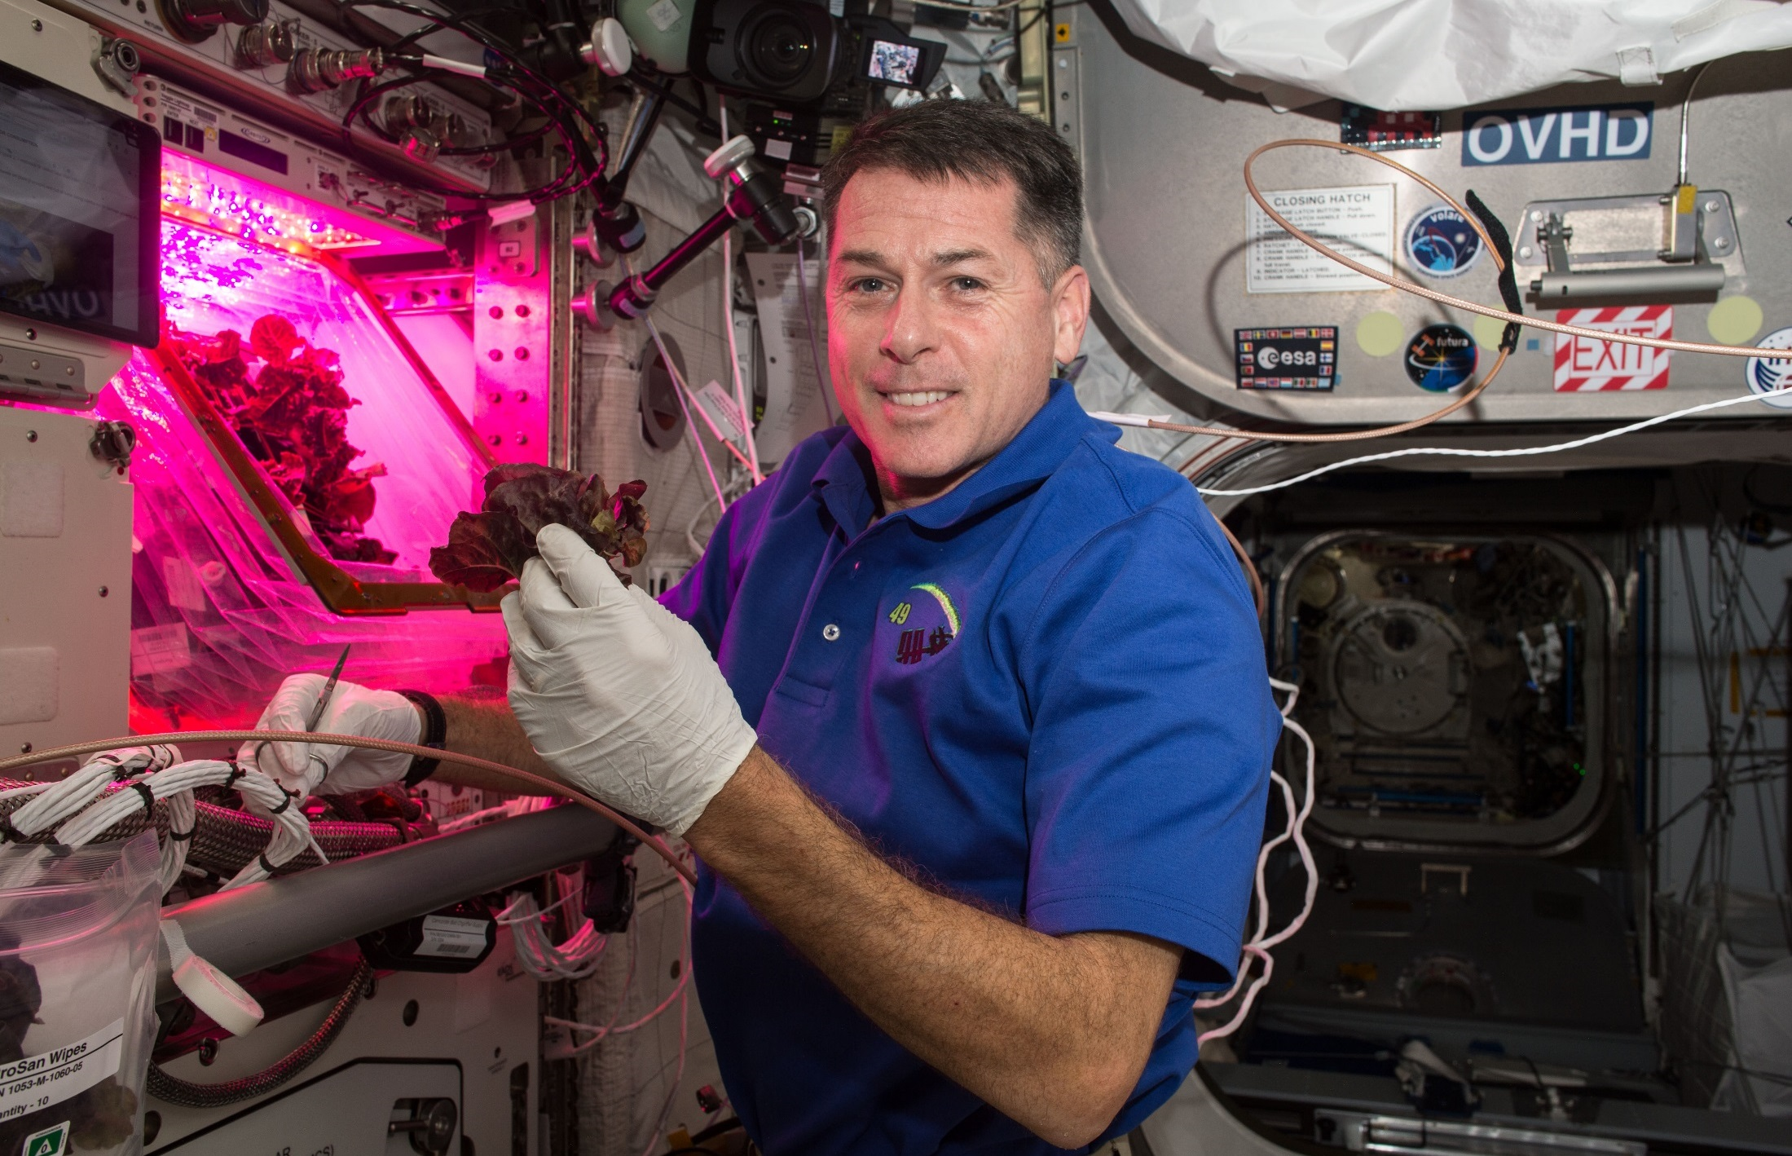
Red Lettuce Cut-and-Come-Again

Slide 22
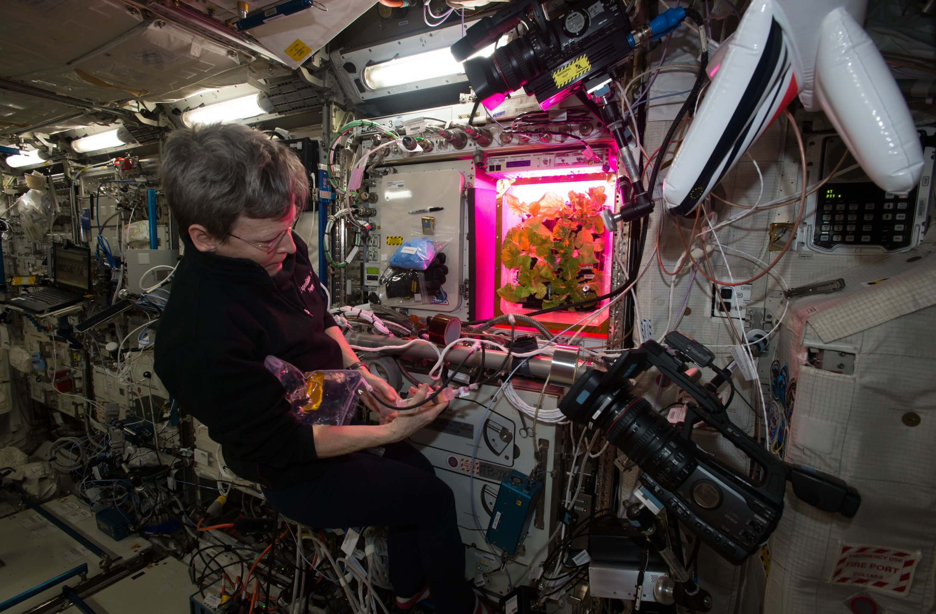
Chinese Cabbage Cut-and-Come-Again

Slide 23
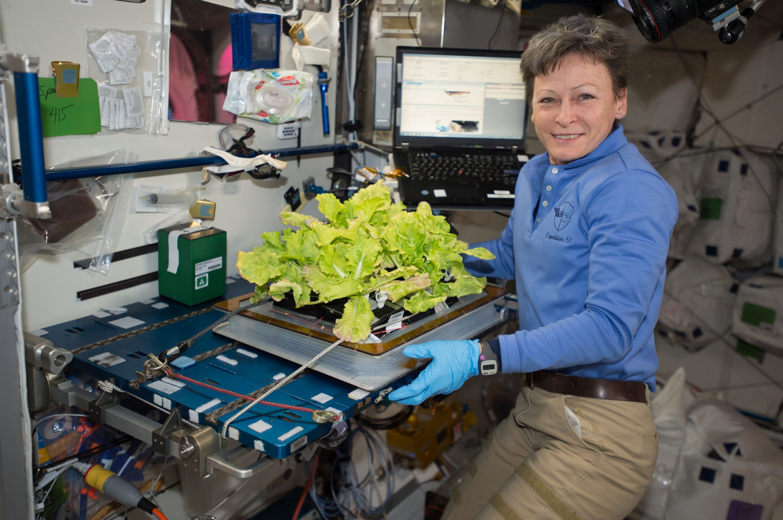
VEG-03C Cut-and-Come-Again

Slide 24
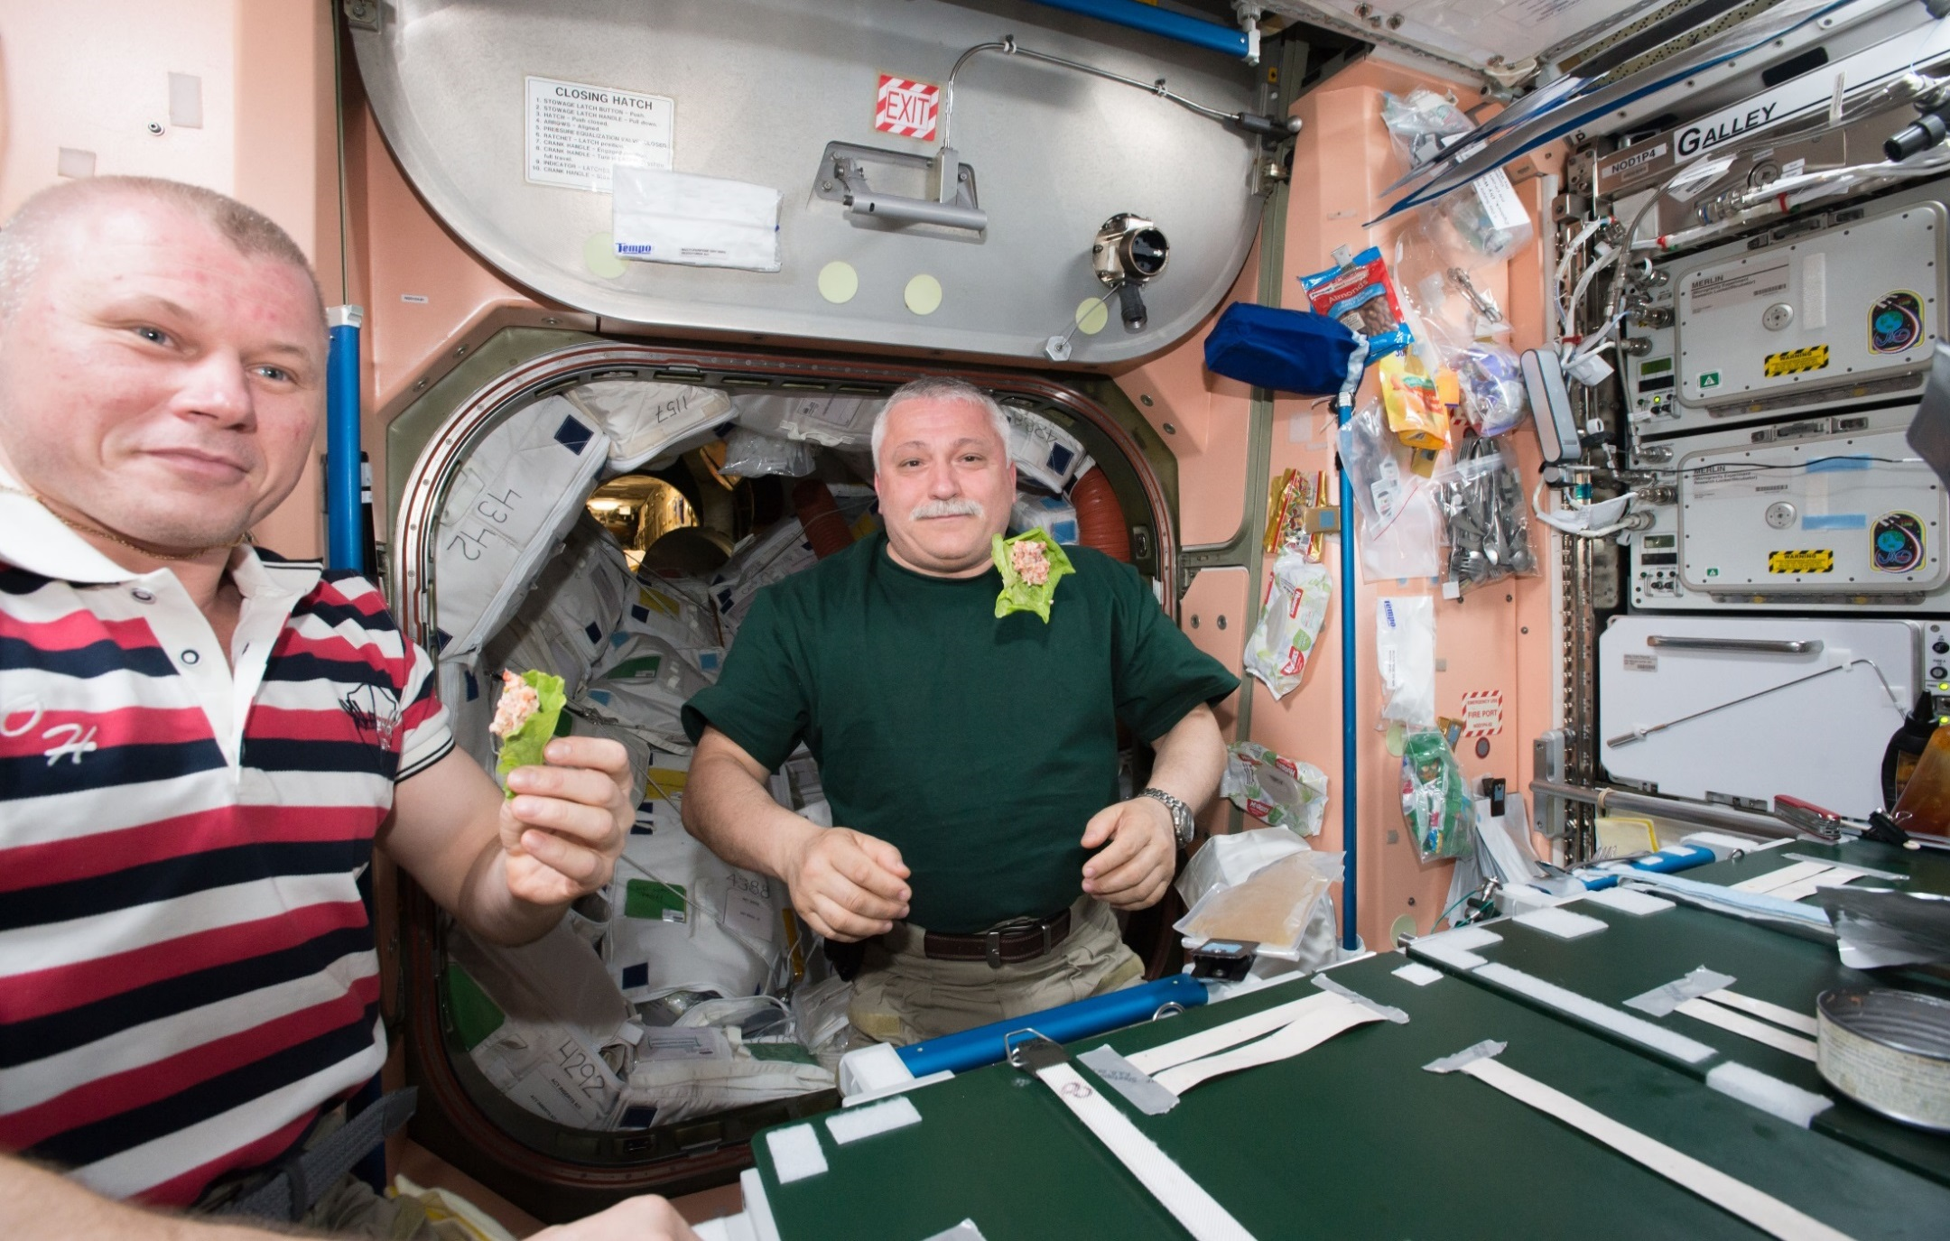
Happy Crew

Slide 25
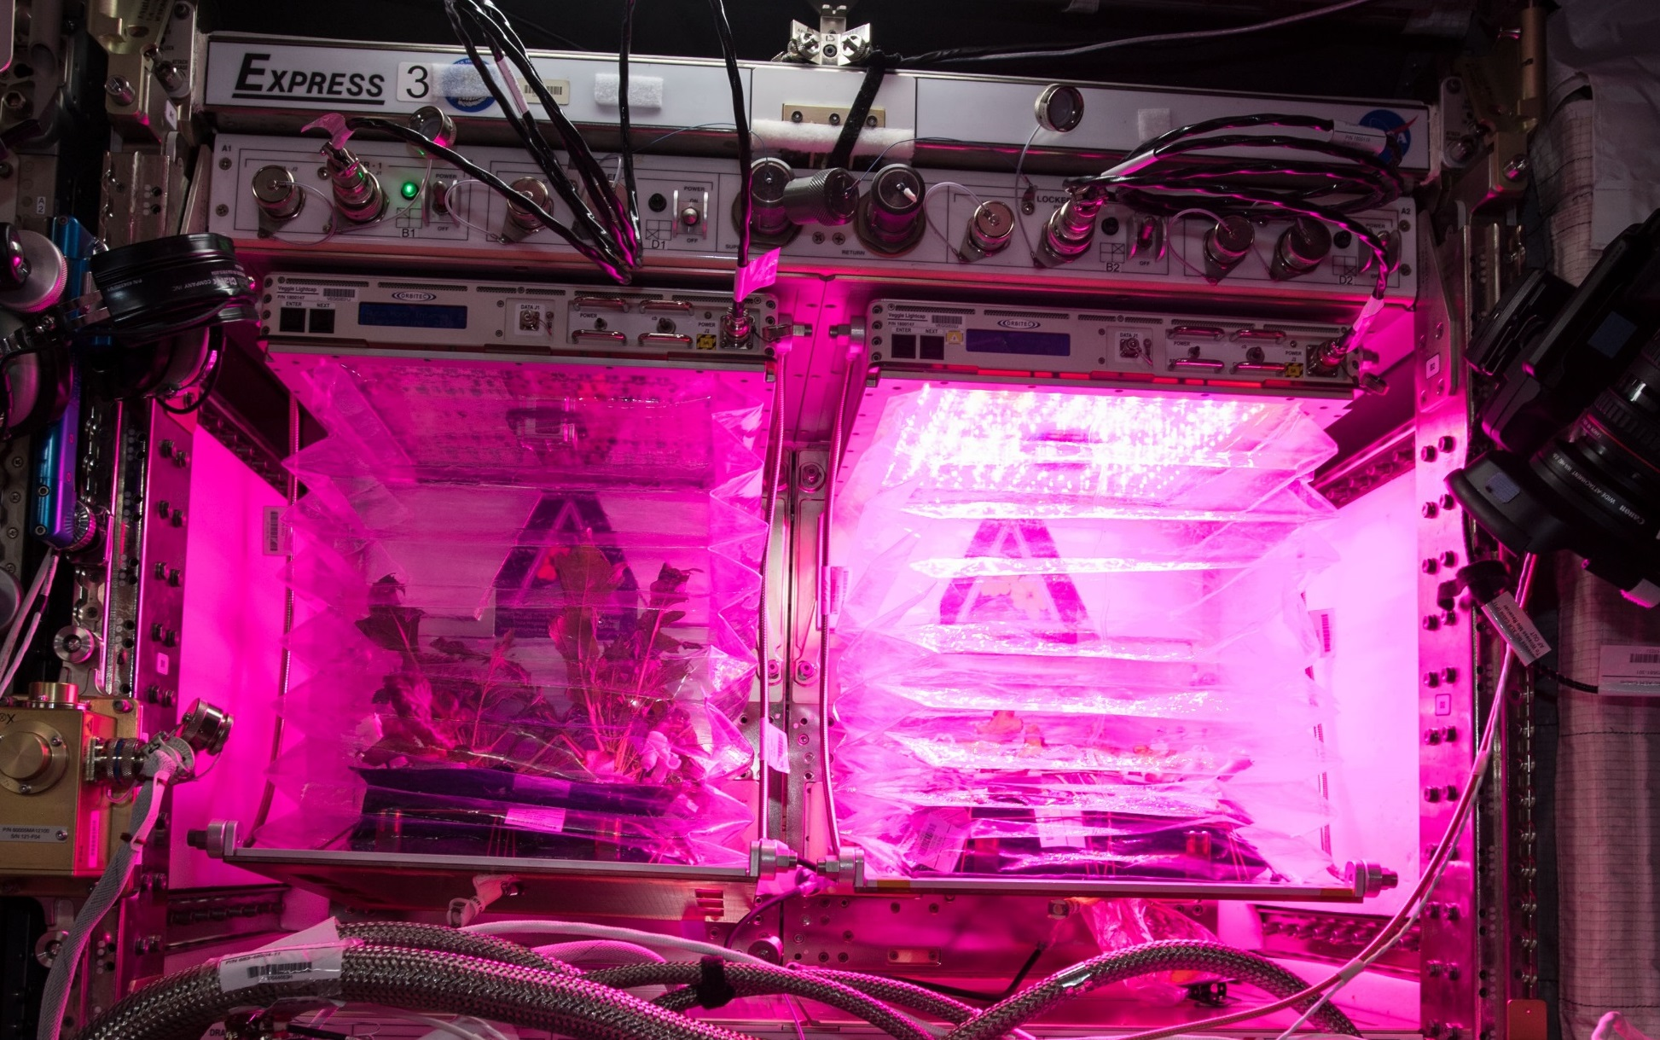
VEG-03E & F - A Tale of Two Veggies

Slide 26
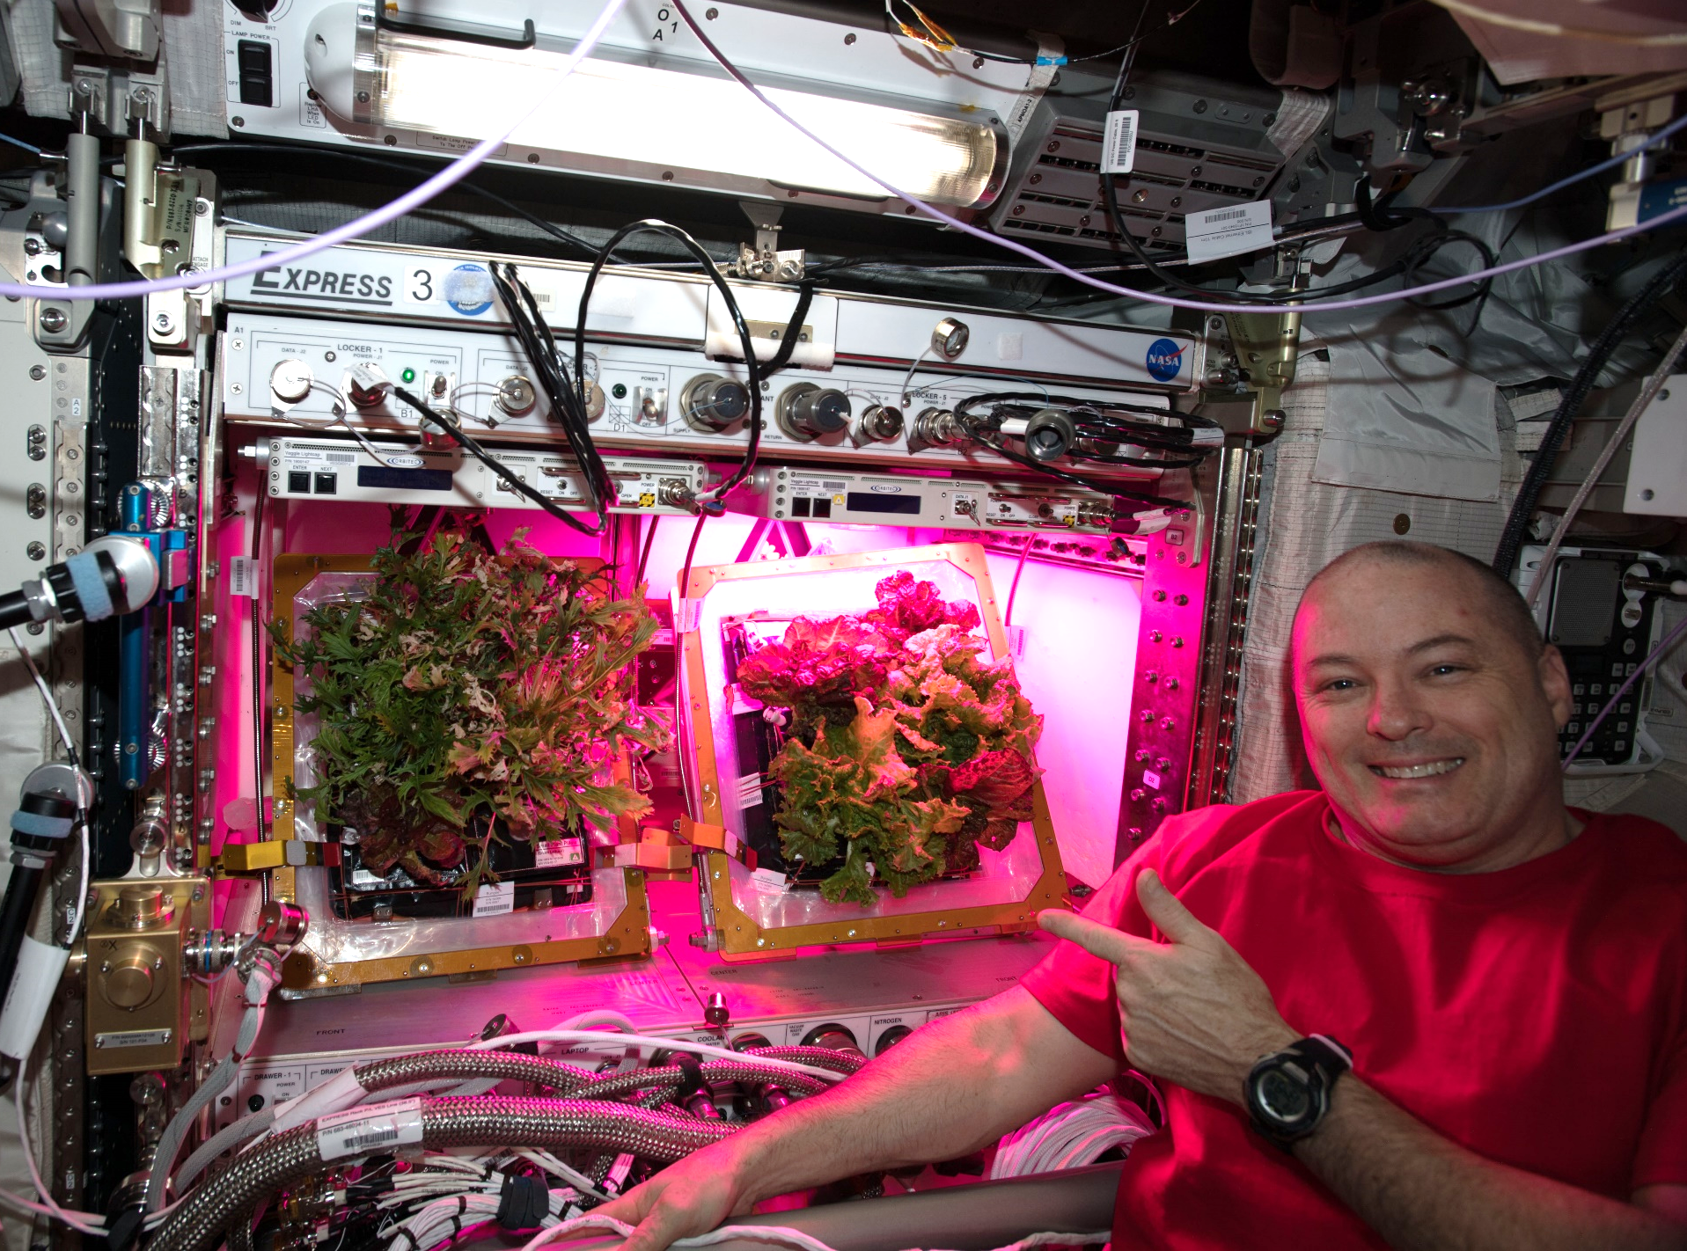
A Tale of Two Veggies

Slide 27
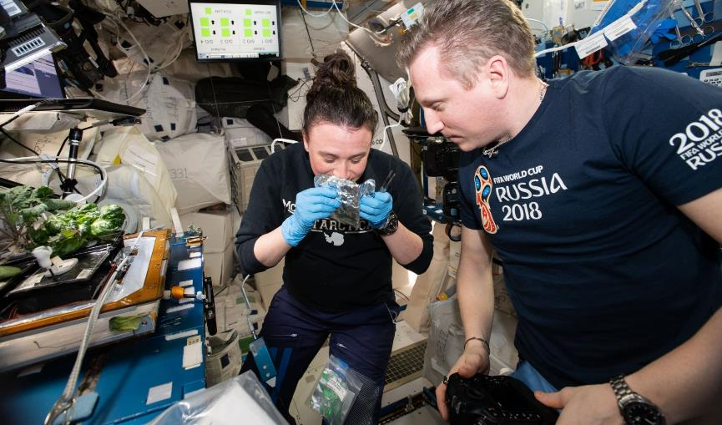

Slide 28
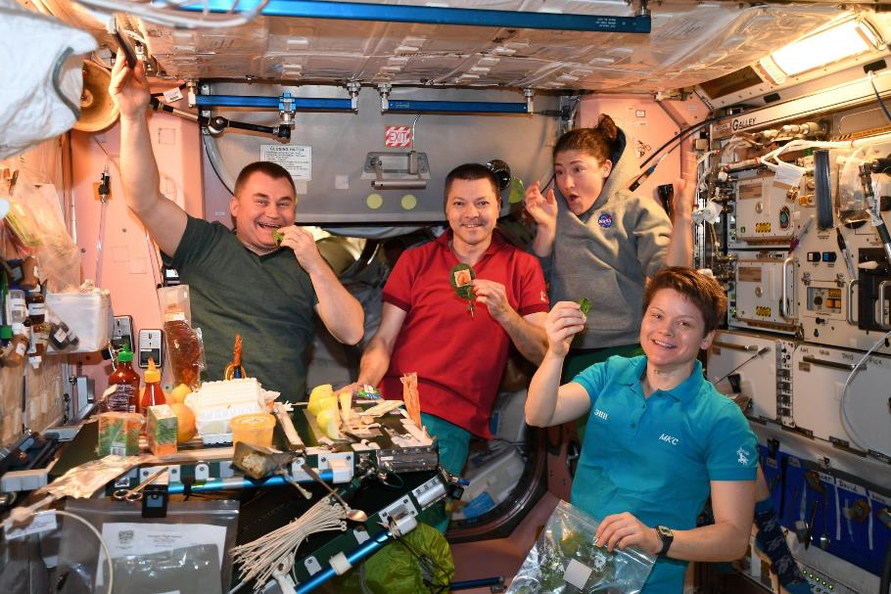

Slide 29
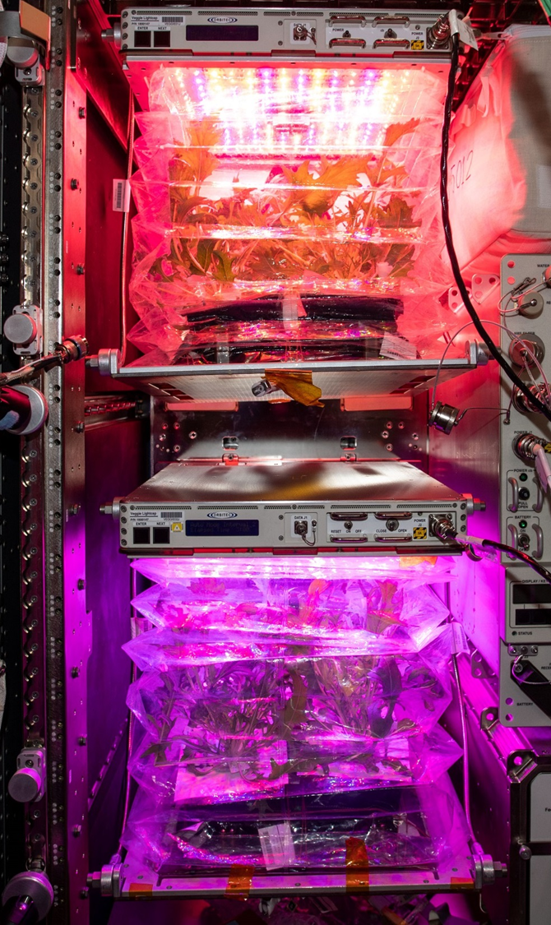

Recently completed on ISS – VEG-04
Research to study the impacts of Red: Blue: Green light ratios on Mizuna crop growth, nutrient composition, organoleptic appeal and microbial food safety with additional assessments of crew behavioral health.
Collaboration between KSC, JSC, Purdue University and SNC-ORBITEC

Slide 30

Thank you!
Veggie and VEG teams at KSC and SNC-ORBITEC
Astronauts Steve Swanson, Rick Mastracchio, Scott Kelly, Kjell Lindgren, Shane Kimbrough, Peggy Whitson, Jack Fischer, Joe Acaba, Scott Tingle, Serena Auñón-Chancellor, Alex Gerst, Anne McClain, David Saint-Jacques, Christina Koch, Nick Hague, Drew Morgan, Jessica Meir
Payload Operations and Integration Center
NASA’s Space Biology Program, ISS Program, Human Research Program

