Slide 1

Continued progress in using CYGNSS to investigate relationships between wind-driven surface fluxes and tropical oceanic convection
Timothy Lang, Xuanli Li, John Mecikalski, Brent Roberts, Lance Belobrajdic

Slide 2
Presentation Overview
Using CYGNSS to investigate winds near tropical oceanic thunderstorms
Update on CYGNSS data assimilation into simulations of tropical convection case studies
Work toward merging CYGNSS with the SeaFlux global flux dataset

Slide 3
Winds near Precipitation with and without Lightning
Precipitation systems typically produce outflows associated with precipitation-cooled downdrafts
What is the impact of enhanced updrafts and ice-based microphysical processes on thunderstorm outflows, relative to precipitation systems without lightning?
Combining CYGNSS with global precipitation and lightning datasets allows us to investigate this question

Slide 4
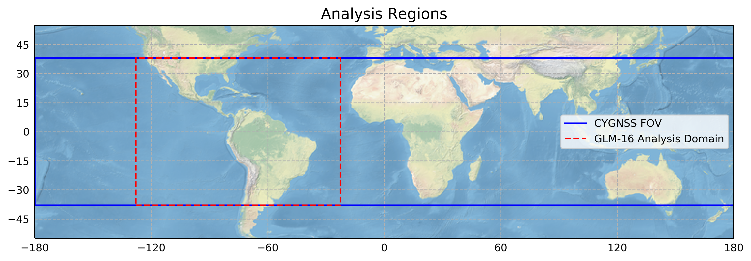
World-Wide Lightning Location Network (WWLLN)
Ground-based global coverage of mostly strong cloud-to-ground (CG) lightning
August-October 2018-2019
Geostationary Lightning Mapper (GLM)
GEO optical total lightning detector (-128￮ to -22.5￮ longitude)
July-December 2018-2019
International Space Station Lightning Imaging Sensor (ISS LIS)
LEO optical total lightning detector (+/- 55￮ latitude)
May 2017 – December 2019

Slide 5
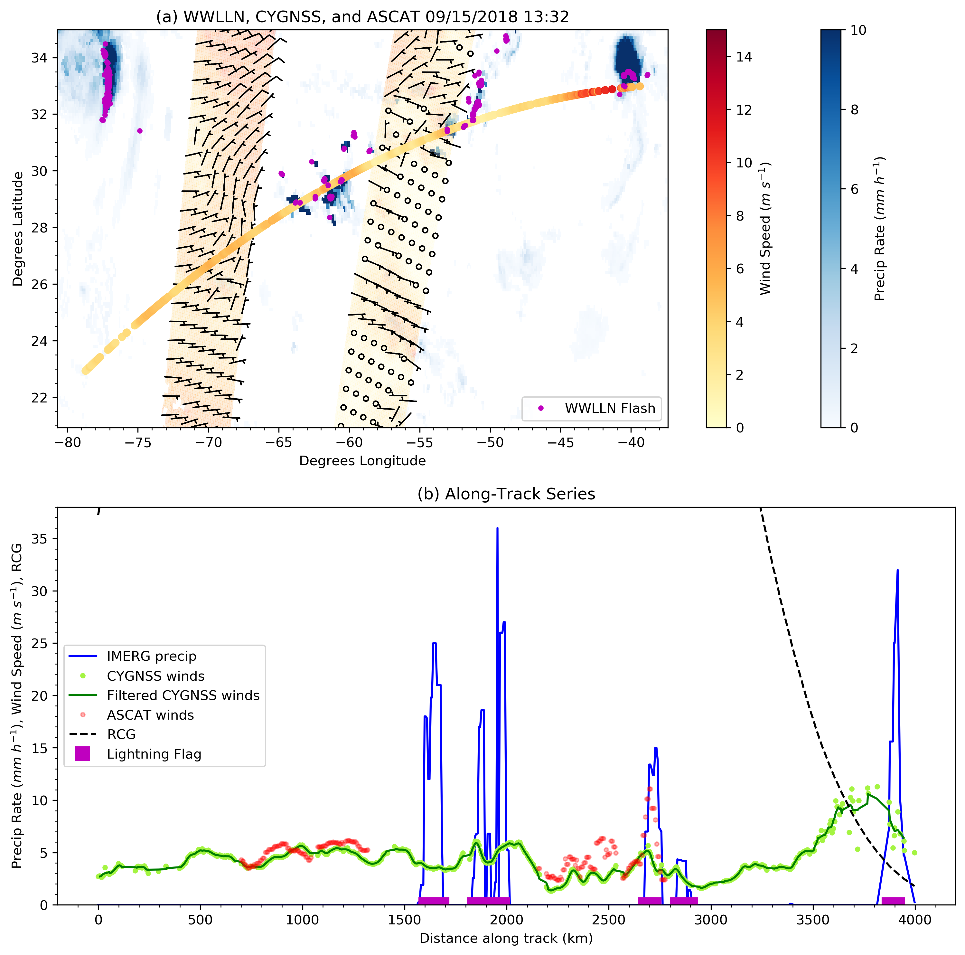
Track-based Analysis Example
Deconvolve daily CYGNSS v2.1 L2 to individual tracks
ASCAT-A/B 12.5-km L2 matched to overlapping tracks during orbits (+/- 45 minutes)
IMERG precip matched to track (+/- 30 minutes)
Overlapping lightning w/in 25 km matched during track
Tracks with no lightning processed separately
Subtract off mean wind along track

Slide 6
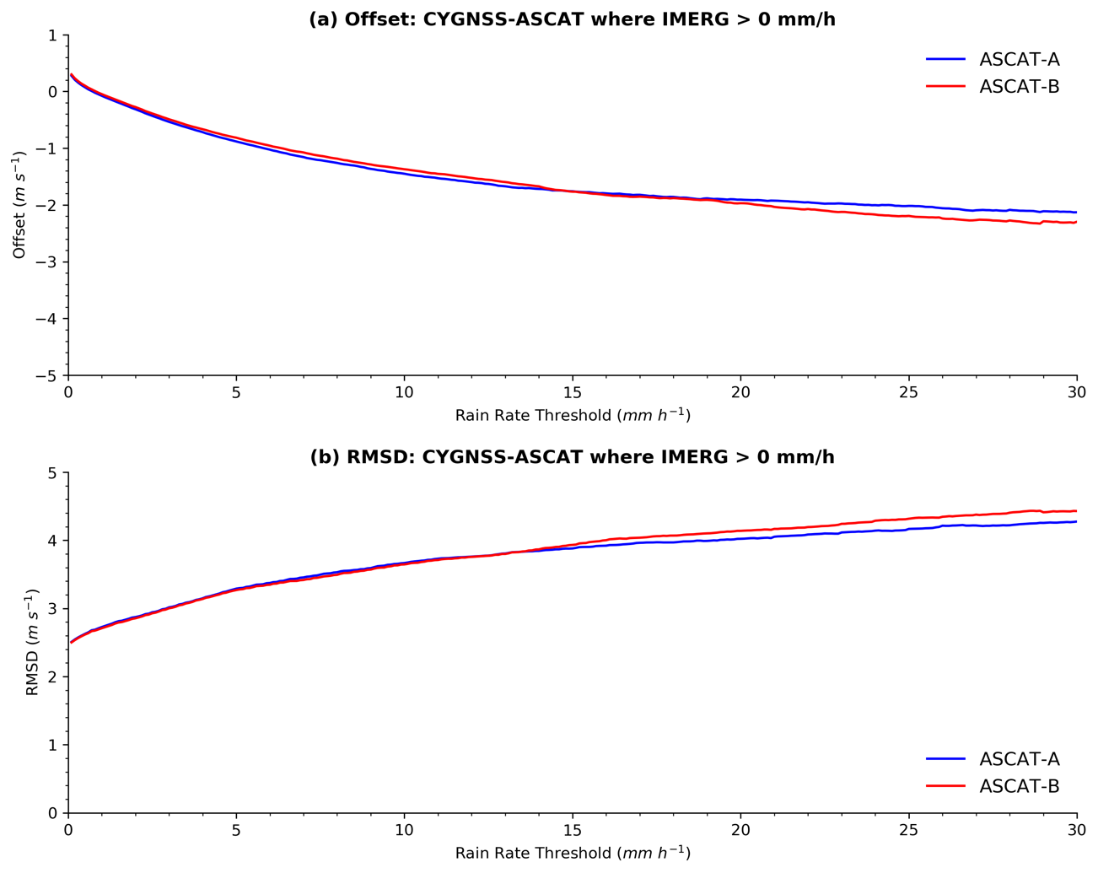
Important Aside
With v2.1 CYGNSS L2, ASCAT mean offset decreases (ASCAT winds become relatively stronger) as precipitation rate increases
RMSD between CYGNSS and ASCAT wind speeds also increases with increasing wind speed
May 2017 – December 2019

Slide 7
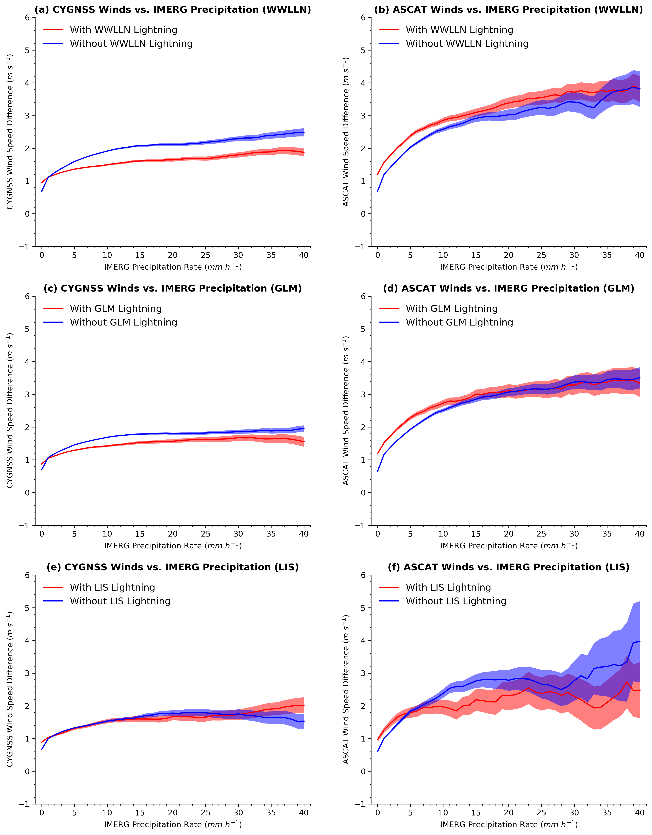
Wind difference as function of precipitation rate
Both CYGNSS and ASCAT indicate winds in precipitation stronger than background (by > 1 m/s)
CYGNSS and ASCAT disagree about effect of winds near lightning – CYGNSS tends to be lower, ASCAT higher
Difference between winds associated with lightning and those not associated with lightning is small (normally < 1 m/s)
ASCAT has ~10x fewer samples than CYGNSS (only using track-matched ASCAT)
Different lightning datasets result in similar conclusions

Slide 8
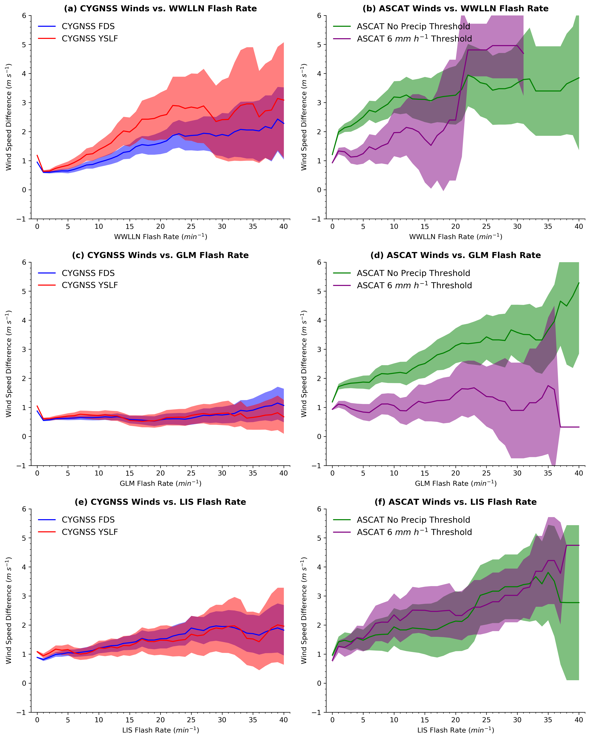
Wind difference as function of flash rate
ASCAT, without accounting for precipitation, suggests winds increase with flash rate
CYGNSS, and ASCAT for R < 6 mm/h, don’t show consistent trends with increasing flash rate
CYGNSS YSLF and FDS behavior similar, except for WWLLN lightning (sensitive to mostly CGs)
WWLLN and GLM have highest number of samples with lightning (~1M each). ISS LIS has the least samples (~150k, LEO instrument)
Sampling limitations at high flash rates, leading to larger uncertainties

Slide 9
Summary of Winds near Precipitation with and without Lightning
Both CYGNSS and ASCAT indicate that near-surface winds are enhanced near precipitation
There is uncertainty about additional wind enhancement near thunderstorms
  CYGNSS and ASCAT disagree about sign of impact
  Effect appears smaller than basic precipitation impact
  Impact of precipitation and wind variability on GMFs?
  Conclusions similar regardless of lightning dataset
Future work – Do CDR v1.0 and/or L2 v3.0 affect the results?

Slide 10
Assimilation of CYGNSS data for tropical convection during 2018 January MJO
Cycled assimilation of combined satellite data (IMERG precipitation, ASCAT ocean surface wind vector, and CYGNSS LF wind speed)
LF – "Limited Fetch" Geophysical Model Function (GMF) used for Young Seas
FD – "Fully Developed”
2. Examining data assimilation impact on TC Irving and a WWB event during 2018
January MJO
Experiments: CTRL – WRF model simulation without data assimilation
DA_com – simulation with assimilation of combined satellite data

Slide 11
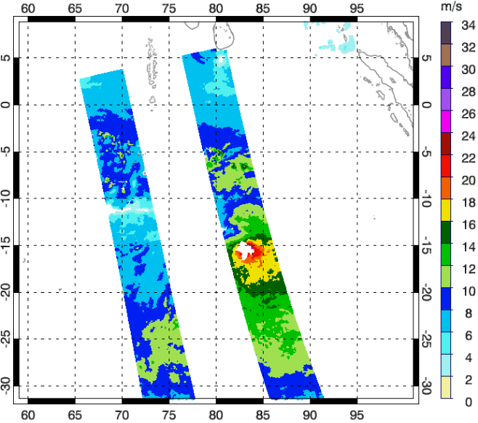
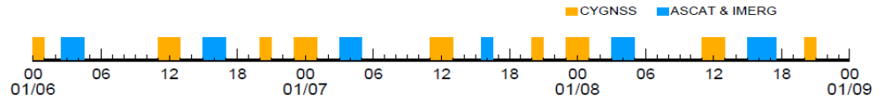
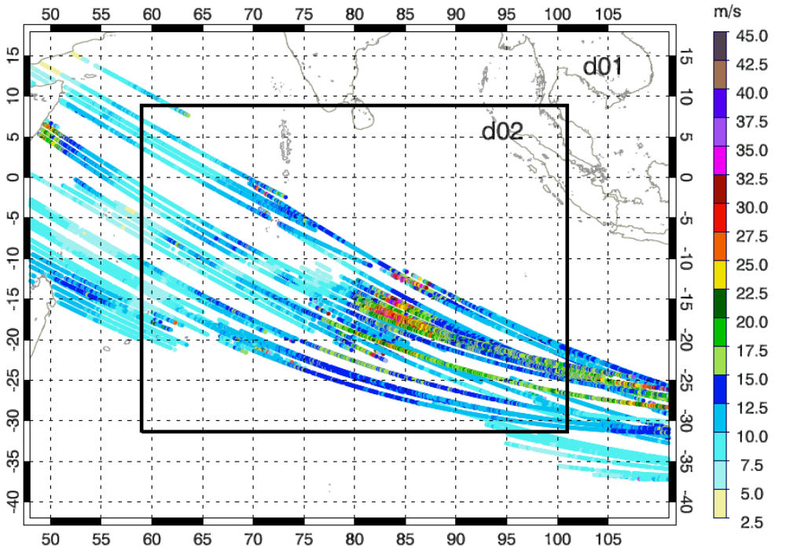
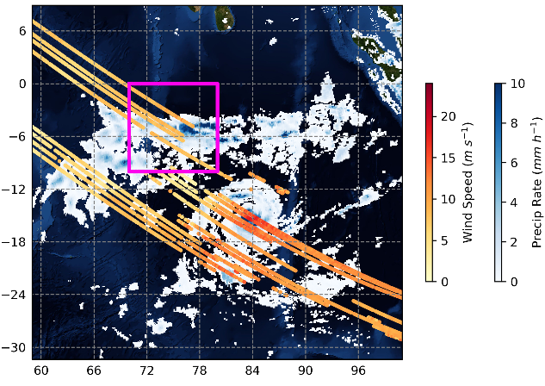
Model configuration and observational data
WRFDA hybrid 4dEnvar
2-nested WRF Domain: 9+3 km resolution
WRF Model Simulation: 00 UTC 6 - 9 January 2018
Data assimilation process
ASCAT wind speed
WWB
WRF Domains & LF wind speed
IMERG precip & FD wind speed
TC Irving

Slide 12
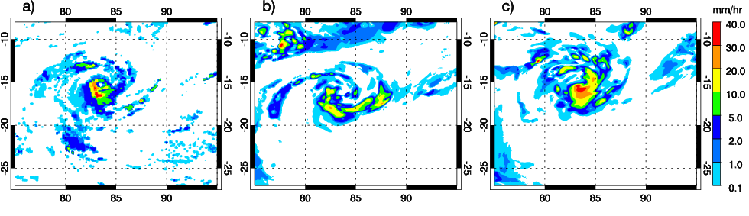
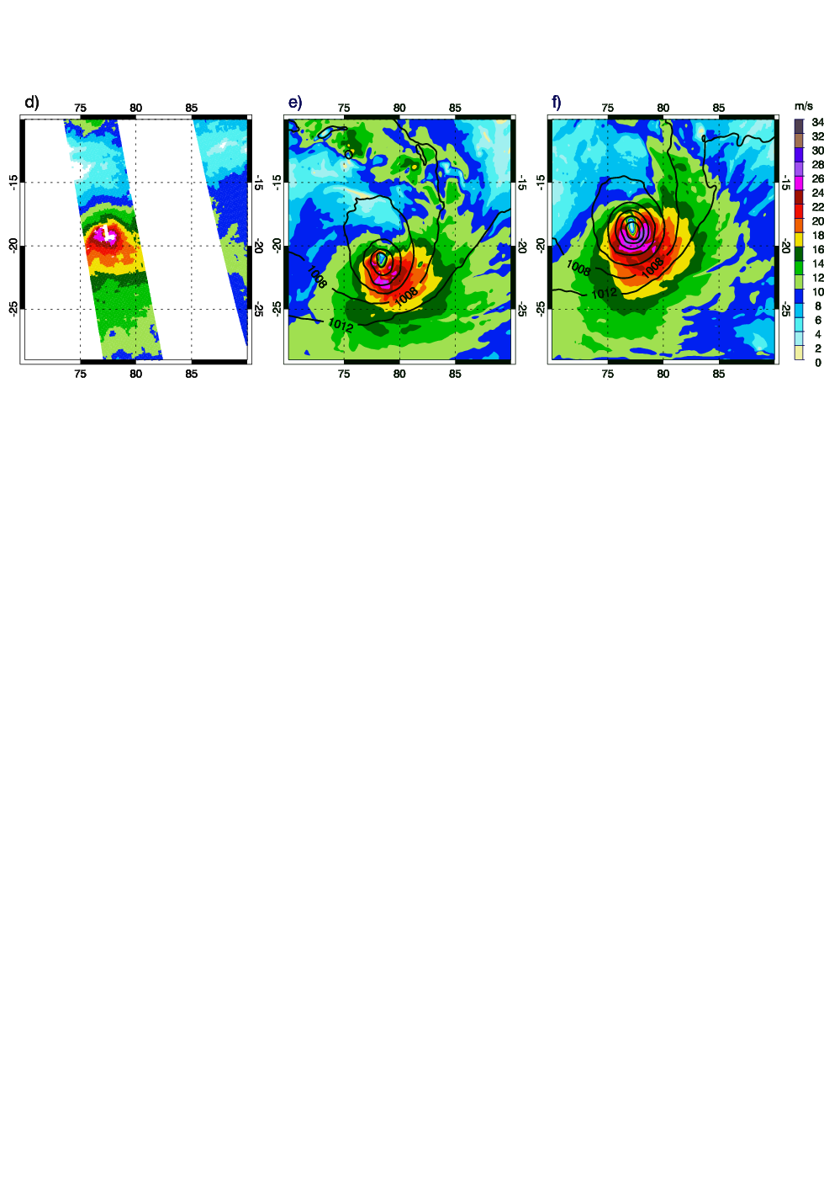
Data assimilation impact on forecast of TC Irving
IMERG
CTRL
DA_com
1-h precip
15 UTC
2018-01-07
Heavier and better organized precip
ASCAT
CTRL
DA_com
10-m
wind speed
15 UTC
2018-01-08
Higher wind
Notes:
1212

Slide 13
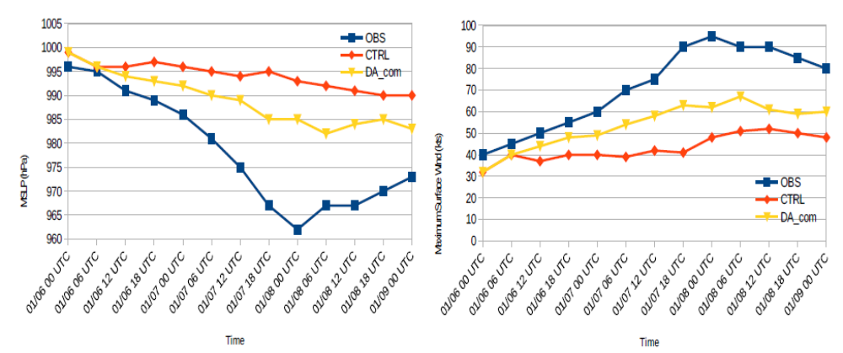
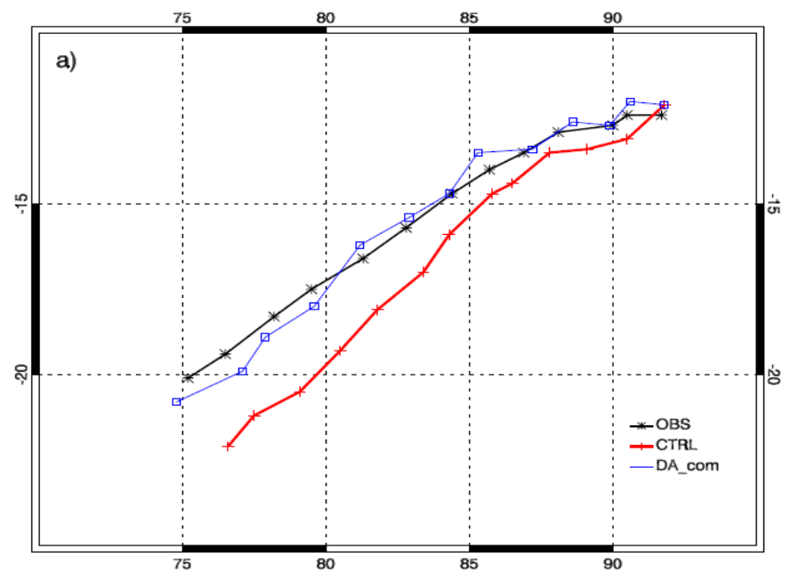
Data assimilation impact on forecast of TC Irving
Intensity
Track
00 UTC 2018-01-06 to
00 UTC 2018-01-09

Slide 14
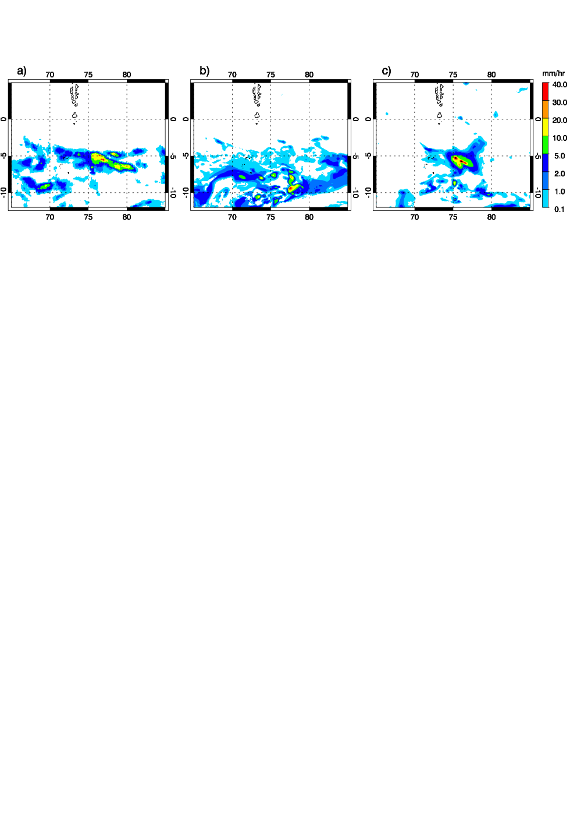
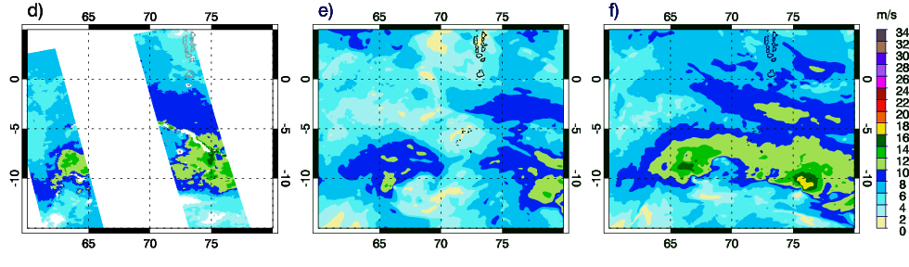
Data assimilation impact on forecast of WWB event
IMERG
CTRL
DA_com
Better location and precip structure
1-h precip
12 UTC
2018-01-07
ASCAT
CTRL
DA_com
10-m
wind speed
16 UTC
2018-01-08
Higher wind
Notes:
1414

Slide 15
Summary of Tropical Convection Data Assimilation
Assimilation of combined data (IMERG, ASCAT, and CYGNSS) showed significant positive impact on precipitation, wind and storm intensity and track of TC Irving.
The structure in wind and precipitation fields across the WWB event have been better represented with the assimilation of the combined satellite data.
Future work: analysis and assimilation of CDR and v3.0 data.
References
Li, X., J. R. Mecikalski, and T. J. Lang, 2020: An Evaluation of CYGNSS Wind Speed Assimilation for Tropical Convection during 2018 January MJO. Remote Sensing, 12, 1243, https://doi.org/10.3390/rs12081243.

Slide 16
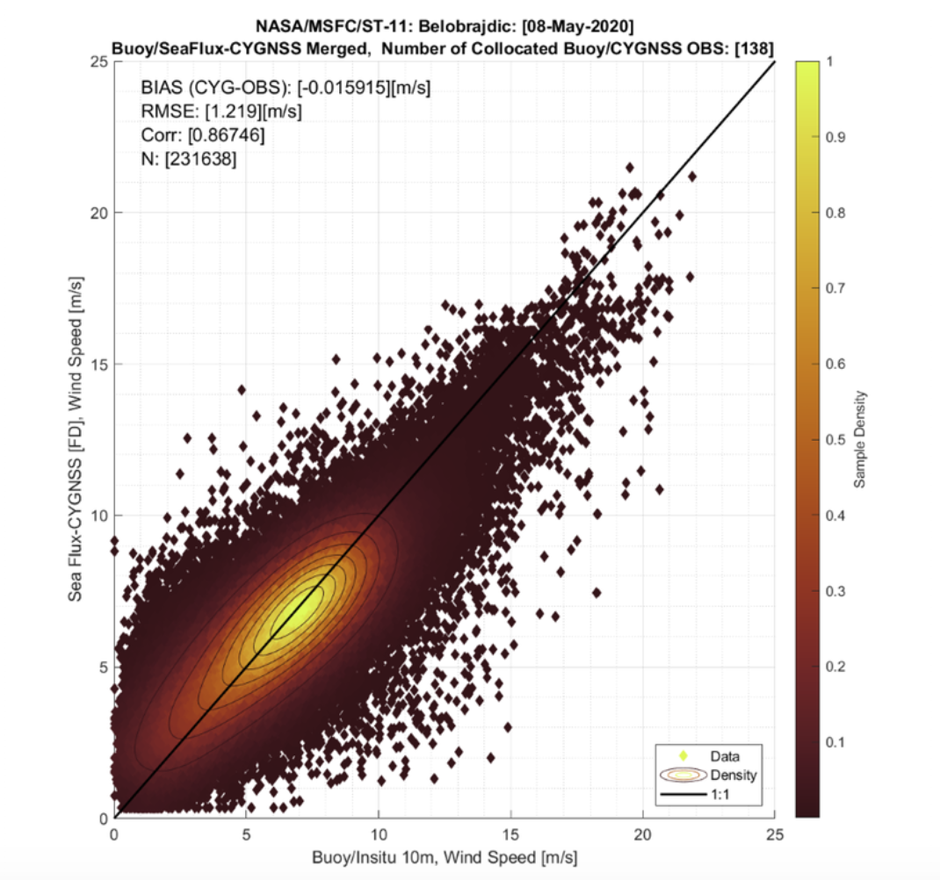
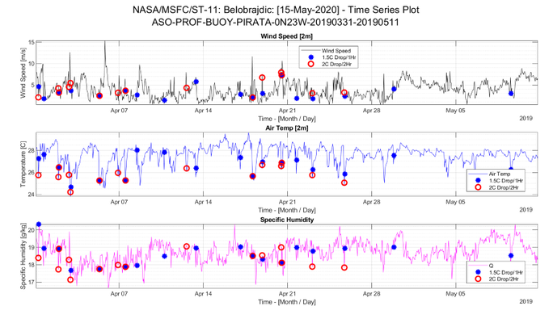
CYGNSS and SeaFlux
Use Kalman filtering and MERRA-2 to merge CYGNSS with the SeaFlux global surface fluxes dataset
Methodology follows Roberts and Lang (2019), updated to use CDR v1.0
Merged dataset agrees well with buoys, potential to investigate fluxes within buoy-observed cold pools
Potential to couple with ASCAT Gradient Feature (GF) proxy dataset for cold pools by Garg et al. (2020)

