Slide 1
Composite Bond Qualification: Material and Process Development Plans for NASA/TTT Project
Frank Palmieri
Presented to Canadian NRC on June 11, 2020

Slide 2
Transformation Tool and Technologies (TTT) Overview
D313 Bond Inspection
Defect inspection in bonded joints
Ultrasonic evaluation of bond strength (non-destructive) using phase-locked method
D309 Bond Failure Modeling
j-integral method development for adhesive fracture
Effects of bondline defects on bond performance
Generalized cohesive model (validated)
Shared Data/Materials
Measured defect data
Model predictions
Bondline Qualification Tools
Shared Data/Materials
Weak/strong specimens
Bondline defect predictions
Shared Data/Materials
Bonded specimens with programmed defects
Bondline defect predictions
Bonded specimens mechanical properties
D307 Bonding Process
Closed loop control of laser surface inspection/treatment and optimized bondline
A.I. tool for robust bond process control
Bond process FEA model for bondline defects
Laser/matter MD model for bonding surface chemistry

Slide 3
Complete Bond-Process Modeling and Validation
Bond Process
Stage 0 Activities
Layup specific defects (Automated and hand) (D313)
Propagation of layup defects to cured surfaces (D313)
Relevant defects: Laps/gaps, debris, fiber waviness, alignment
Stage 0: Laminate fabrication
Stage 1 Activities
Surface treatment/inspection system (D307)
Substrate defect modeling (D307)
Substrate defect detection (D313)
Adhesive material properties characterization (D307)
Relevant defects: Contamination, laminate porosity, degree of cure (DoC) variation, residual stress
Contamination
Stage 1: Pretreatment/ inspection
Cured Laminate
Adhesive
Stage 2: Assembly and in-situ inspection
Stage 2 Activities
Bonding process control (D307)
Porosity and residual stress prediction (D307)
Weak bond prediction (D307)
Weak bond detection (D313)
Bondline defect detection (in-situ) (D313)
Relevant defects: Bondline thickness variation, fiber waviness, porosity, DoC
Porosity
Stage 3: Testing, damage tolerance, and failure mode
Stage 3 Activities
Damage/failure mode prediction (D309)
Modeling to correlate defect and bond strength for optimization (D309)
Defects: Impact damage
Cohesive Failure
Adhesive Failure

Slide 4
Assembly of Composites
Co-Cure
uncured prepreg
Method limited by part complexity
Cure Process
Co-bond
cured
uncured
adhesive
Secondary Bond
cured
uncured
Unpredictable interfaces formed
adhesive
cured
Co-cure produces predictable components and joints but is limited by complexity
Bonded/Co-bonded joints are susceptible to weak bonds
Unpredictable bonds are a concern in primary structure
A redundant load path is used to ensure structural integrity
Notes:
To understand the dependence on redundant fasteners, we have to look at how large scale composite structures are assembled. There are essentially three primary methods for assembling composites: co-cure, co-bond, and secondary bond. During co-cure, two or more parts are cured together in an autoclave resulting in unitized structure. In other words, co-cured joints have continuous matrix resin through the joint. In contrast, co-bonded and secondary bonded joints use adhesive to bond together one or more previously cured components. The adhesive bond results in a material discontinuity that can be observed microscopically.
Co-cured joints are inherently predictable because the joint is inherently interface-free.
First animation
However, co-cure is limited in application by part complexity and size. Quite simply, you cannot produce an entire aircraft or even an entire wing in single cure process. The tooling would be too expensive.
Bonding and co-bonding simplify the assembly of complex structures, but the resulting joints are susceptible to weak bonds leading to unpredictable performance.
Second animation
The lack of predictability in bonded interfaces is a concern in primary structure. So airframers are compelled to use redundant fasteners to ensure structural integrity.

Slide 5
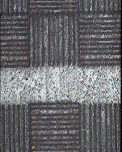
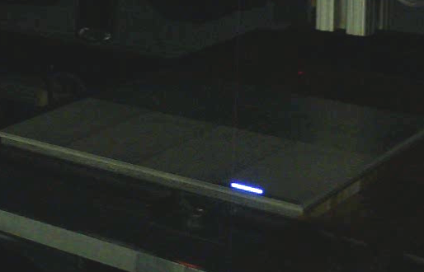
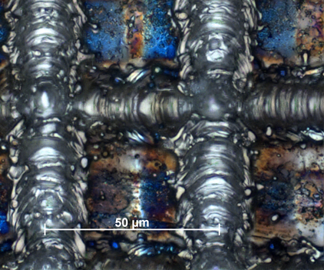
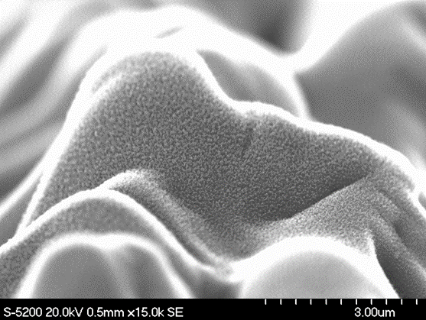
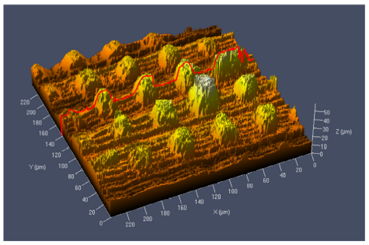
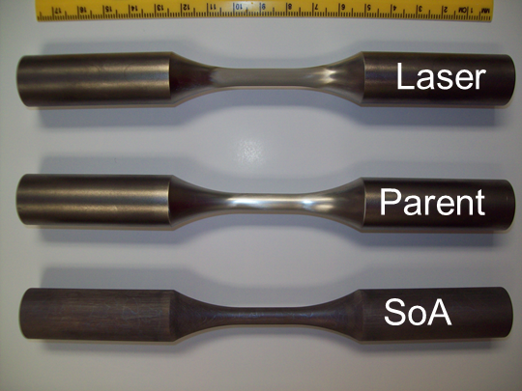
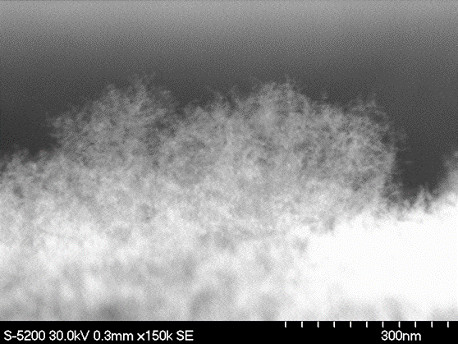
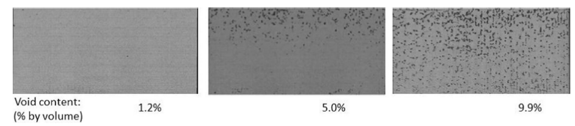
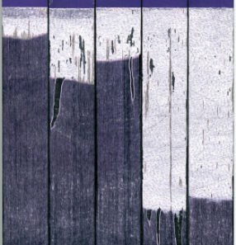
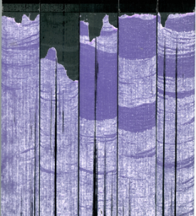
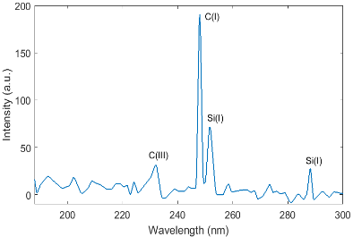
Previous Work with Laser Ablation
2010, “Peel ply mimic” surface treatment”
2012, Green surface preparation of Ti6Al4V
2014, Wedge testing and fatigue data on Ti6Al4V
2013, 3-year, hygrothermal aging study on adhesively bonded CFRP lap shear specimens
2015, Laser ablation process with nanosecond pulse width.
800 mW
200 mW
2016, Sensitivity of surface to silicone.

Slide 6
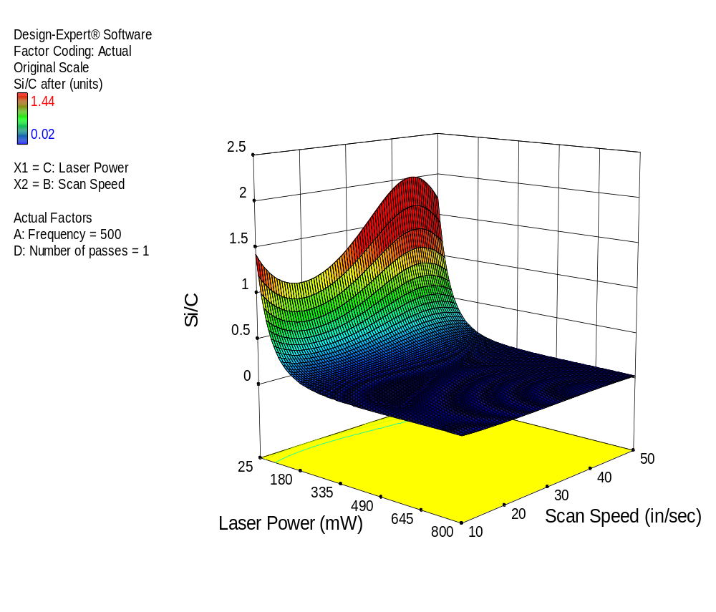
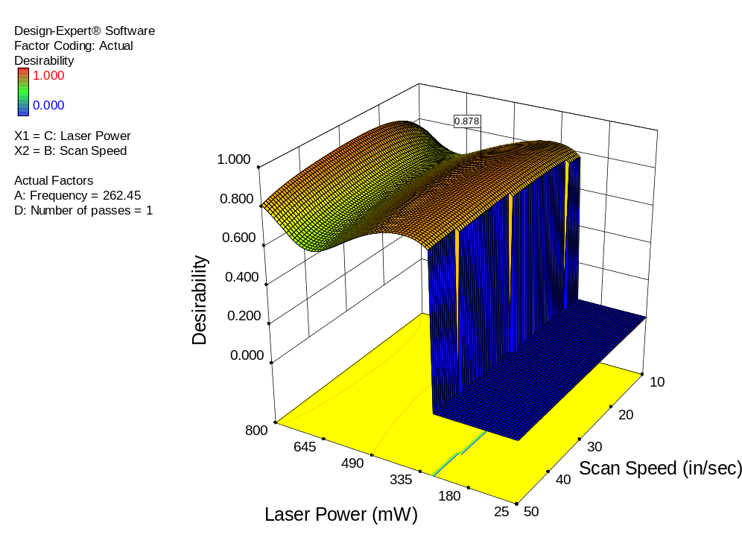
Laser Treatment and Inspection Development (Advanced Composites Project)
Optimized Laser Treatment by design of experiments (DoE)…
…including LIBS Inspection
(Laser Induced Breakdown Spectroscopy)
Power | Frequency | Scan Speed | Passes
374 mW | 263 kHz | 73 cm/s | 1

Slide 7
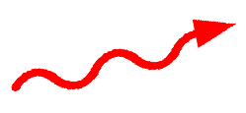
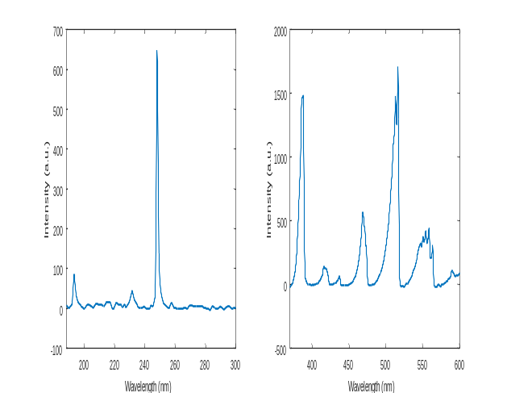
Laser Induced Breakdown Spectroscopy
Detection of light emission from contaminant
Laser pulse
Plasma expansion
Laser induced plasma
Photons
Spectrometer
Ablation
No contamination
Contaminant
Sample
Sample
Ratio of Peak Heights
LIBS spectrum
C height
Result
Si/C
Si height
Wavelength

Slide 8
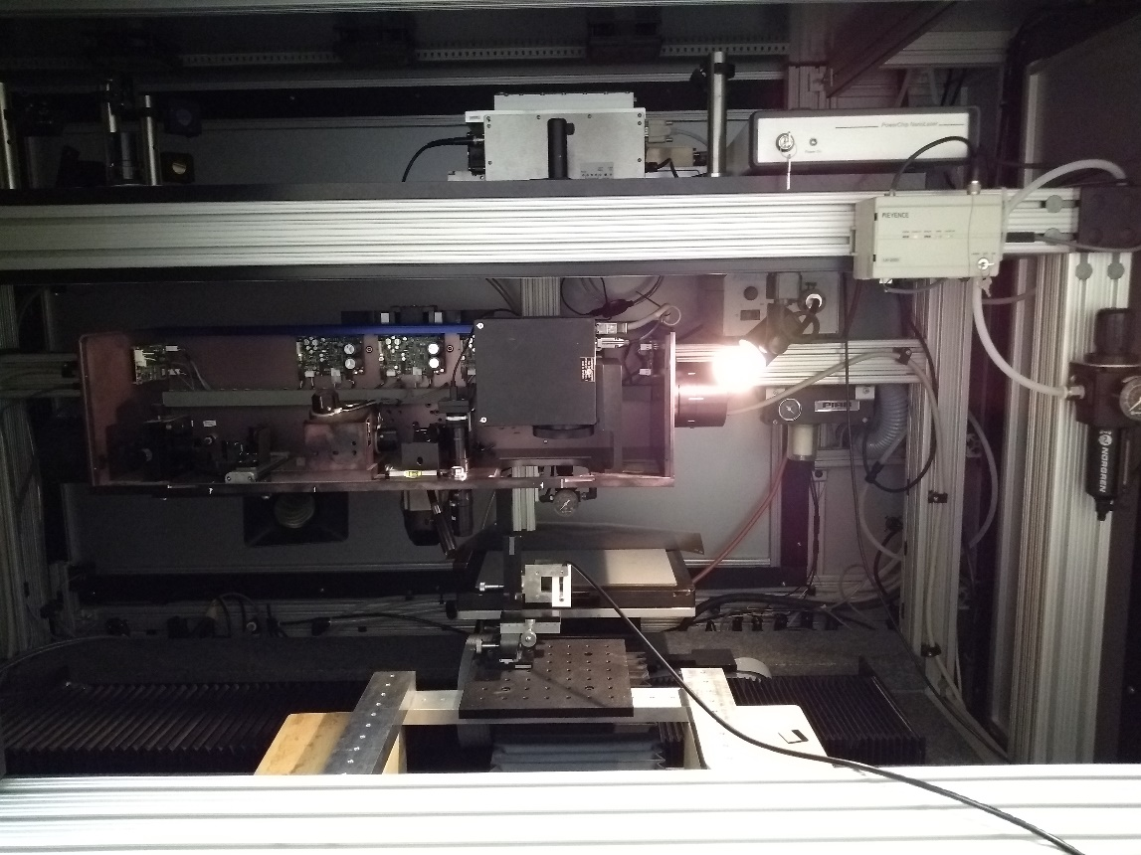
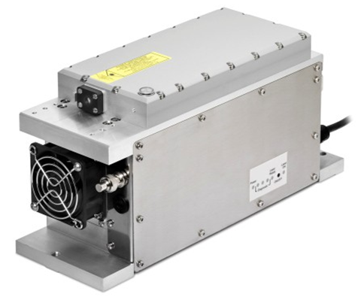
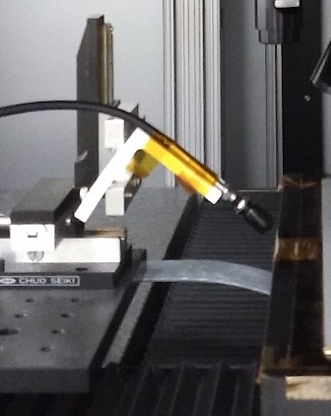
Integrated Laser/LIBS Prototype System
Microchip laser
Galvanometer
31 cm (12.2 in)
XY stage
Collimator
Collimator stage
Optical bundle to spectrometer

Slide 9
Complete Bond-Process Modeling and Validation
Bond Process
Stage 0 Activities
Layup specific defects (Automated and hand) (D313)
Propagation of layup defects to cured surfaces (D313)
Relevant defects: Laps/gaps, debris, fiber waviness, alignment
Stage 0: Laminate fabrication
Stage 1 Activities
Surface treatment/inspection system (D307)
Substrate defect modeling (D307)
Substrate defect detection (D313)
Adhesive material properties characterization (D307)
Relevant defects: Contamination, laminate porosity, degree of cure (DoC) variation, residual stress
Contamination
Stage 1: Pretreatment/ inspection
Cured Laminate
Adhesive
Stage 2: Assembly and in-situ inspection
Stage 2 Activities
Bonding process control (D307)
Porosity and residual stress prediction (D307)
Weak bond prediction (D307)
Weak bond detection (D313)
Bondline defect detection (in-situ) (D313)
Relevant defects: Bondline thickness variation, fiber waviness, porosity, DoC
Porosity
Stage 3: Testing, damage tolerance, and failure mode
Stage 3 Activities
Damage/failure mode prediction (D309)
Modeling to correlate defect and bond strength for optimization (D309)
Defects: Impact damage
Cohesive Failure
Adhesive Failure

Slide 10
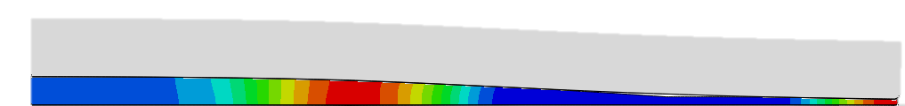
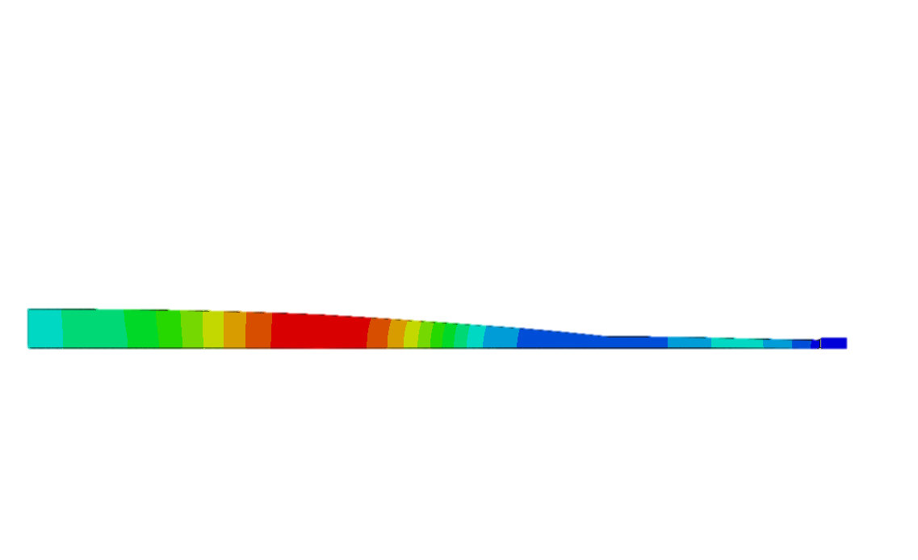

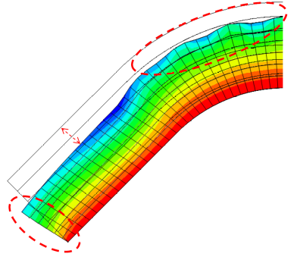
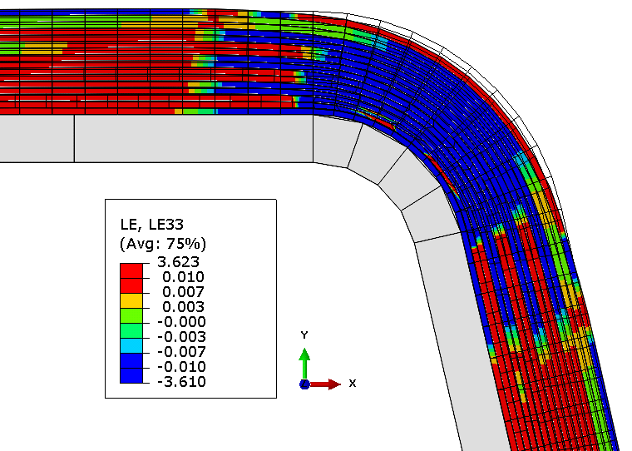
Physics-Based Laminate Cure Process Model
Description:
  Physics-based model that predicts location and magnitude of porosity and fiber waviness defects throughout cure cycle based on process inputs
    Tooling/caul geometry and part layup
    Cure cycle conditions
    Includes property databases for IM7/8552-1 and AS4/8552 prepregs
  Model implemented in finite element analysis software (e.g. ABAQUS)
Validation:
  Experiments on tapered laminates and curved tools validated model predictions
Transition Path:
  Commercially available in COMPRO and RAVEN software marketed by Convergent Manufacturing Technologies
Test Geometry: 32 Ply, Tapered Laminate with ½’’ Flat Caul
t = 100 min,
min viscosity
½’’ caul misfit model - Predict & Measured Results
Fiber Waviness & Corner Thinning Predictions:
Corner Thickening on Concave Mold Geometry (Left)
Corner Thinning on Convex Mold Geometry (Right)
Notes:
With new defect prediction capability, the effects of fiber waviness and multiple types/sources of porosity needs to be understood and characterized. Numerous activities throughout our various organizations are familiar with the concept of Integrated Computational Materials Engineering (ICME) and previous work typically focuses on ‘Porosity’ in a very general sense, the new insights in this improved model instructs us to the source of the porosity which further assists us in understanding the likely size, shape and location of the porosity. As these activities advance we’ll need to understand the structural effects of these independent type of porosity or even fiber waviness and incorporate the new insights into an ICME framework.
From the NASA side, the more technical/personal story is around the validation of the final CDPM. The data in the slide shows resin pressure, not porosity, because porosity data throughout the part is difficult to quantify during cure. Porosity in a laminate is closely and inversely related to the resin pressure, which can be measured throughout the cure cycle with relatively high spatial resolution. Measured resin pressure data is compared with predicted resin pressure to validate the model. CMT developed a set of physics based governing equations based on conservation of energy and mass, but accurate prediction of resin pressure and porosity requires a multitude of material properties, some of which are challenging to measure. NASA performed a sensitivity analysis on material parameters with the low confidence and yielded significant improvement of the model fit to experimental test data (seen in Fig 1 b)

Slide 11
5-Year Objectives: Materials and Processing
Build and test device for rapid manufacturing that integrates closed loop inspection and treatment of composite surfaces for optimized structural bonding
  Implement A. I. algorithm to improve reliability of surface treatment/inspection process
  Use treatment/inspection device to fabricate weak and strong bonded specimens for model development (process and failure models)
Develop bond process model to predict bondline defects (porosity, residual stress, cure-state, fiber volume fraction, etc.)
  Characterization of adhesive properties (adhesive TBD) for material model
  Apply laminate cure modeling tools to bondline material systems
  Fabricate and characterize bonds to validate model
Develop laser/matter molecular dynamics computational tool to model laser surface treatment process
  Surface characterization for model validation

Slide 12
Near-Term Goals: Material and Processing
Year 2020
1) Establish partnership agreements with airframe manufacturers for interest and development of surface preparation techniques.
2) Optimize laser process on composite substrates (Hexcel IM7/8552) for bonding with structural adhesive (TBD)
Year 2021
Evaluate preliminary bond process model built in COMPRO/RAVEN software to qualitatively predict bondline defects: bondline thickness variation, porosity, fiber volume fraction variation, and over/under-cure

