Slide 1
James Webb Space Telescope
Optical Telescope Element /
Integrated Science Instrument Module (OTIS) Cryogenic Vacuum Test
Part III: Preparation for Off-Nominal Events
Kan Yang, Stuart Glazer, Lee Feinberg
NASA Goddard Space Flight Center
Brian Comber
Genesis Engineering Solutions, Inc.
Reference in this course to any specific commercial products, process, service, manufacturer, company, or trademark does not constitute its endorsement or recommendation by the U.S. Government or the NESC Academy.
Notes:
Welcome to the third lecture of the James Webb Space Telescope Optical Telescope Element and Integrated Science Instrument Model Cryogenic Vacuum Test lecture series. In this lecture, we will talk about preparation for off-nominal events. Before we begin, I’d like to acknowledge two co-contributors that were instrumental in the development of the content for this section: Stuart Glazer, who was the thermal lead for the OTIS CV test, and Brian Comber, who was the lead thermal analyst for the ISIM CV tests, as well as the sole developer of the Fusion test monitoring software and the uncontrolled helium shroud warmup analysis methodology that will be discussed in this section.

Slide 2
Overview
This lecture represents the third part of the JWST OTIS Cryogenic Vacuum (CV) Test Lecture Series
  Part I: Thermal Architecture
  Part II: Thermal Analysis
  Part III: Preparations for Off-Nominal Events
  Part IV: Lessons Learned
Objectives of this current lecture:
  Define off-nominal events considered for the OTIS CV test
  Introduce off-nominal safing matrix, including analyses conducted to support matrix
  Describe the preparations made for the OTIS CV test based on planning and analysis
  Recount the actual off-nominal scenario encountered in the OTIS CV test
Notes:
In Part I, we went over the JWST system architecture and the OTIS CV Test setup, and in Part II, we talked about the OTIS CV test thermal model development.
In this lecture, we will define what we considered to be possible off-nominal events in our test. We’ll introduce our off-nominal safing matrix, a tool that we used to document what to do in a range of off-nominal scenarios. We’ll talk about the preparations we made for the OTIS CV test with both thermal analysis and test planning to mitigate the risk of damage to the hardware in the event of an off-nominal scenario, and recount how these plans helped us in the actual scenario we encountered during the test.

Slide 3
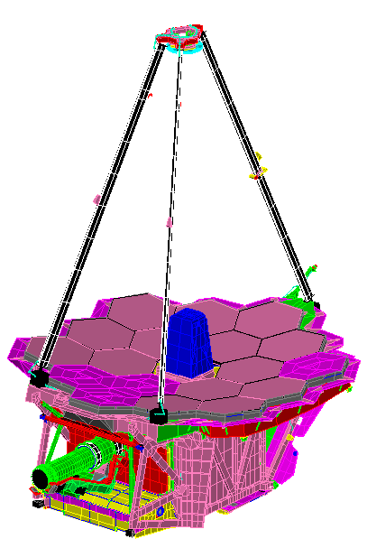
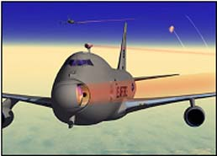
JWST OTIS CV Test Setup: Payload Configuration
Secondary Mirror Assembly (SMA)
Secondary Mirror (SM)
Other Useful Acronyms
GSE: Ground Support Equipment
He or GHe: Helium / Gaseous Helium
K: Kelvin
L&Cs: Limits and Constraints
LN2 / N2: Liquid Nitrogen / Gaseous Nitrogen
ΔT or delta T: Temperature Difference
JSC: NASA Johnson Space Center
Optical Path
Secondary Mirror Support Structure (SMSS)
Aft Optics Subsystem (AOS): Contains Tertiary Mirror (TM) and Fine Steering Mirror (FSM)
Source: NASA/JWST/K. Yang
+V1
+V3
FSM
Primary Mirrors (PMs,18)
Primary Mirror Segment Assemblies (PMSAs) (18 total)
+V2
TM
Thermal Management System (TMS)
Primary Mirror Backplane Support Structure (PMBSS) =
Backplane (BP) + Backplane Support Fixture (BSF)
Deployable Tower Assembly (DTA)
ISIM
Spacecraft Vehicle Thermal Simulator (SVTS) attached to DTA, not shown
ISIM Electronics Compartment (IEC)
(ROOM TEMPERATURE, with radiative view to GSE IEC DSER)
Integrated Science Instrument Module (ISIM), which contains the NIRSpec, NIRCam, FGS, and MIRI Instruments
Harness Radiator (HR)
Notes:
Before we proceed, let’s do a quick review of the major components and their acronyms in the OTIS CV test. Since this current lecture focuses on actions to safe the flight hardware, we’ll specifically review the components of the OTIS payload. First, we’ll follow the optical path to the science instruments: light travels from the 18 hexagonal primary mirror segment assemblies, or PMSAs, to the secondary mirror or SM, supported by a tripodal Secondary Mirror Support Structure or SMSS. Then, light enters the aft optics subsystem or AOS and bounces off the tertiary mirror or TM and fine steering mirror or FSM. From the FSM, it progresses into the Integrated Science Instrument Module or ISIM enclosure, where each instrument has a pick-off mirror to obtain the signal from the primary optical path. The ISIM Instruments, referred to alternatively as the Science Instruments or SIs, are the Near-Infrared Camera or NIRCam, the Near-Infrared Spectrograph or NIRSpec, the Fine Guidance Sensor or FGS, and the Mid-Infrared Instrument or MIRI.
Outside the ISIM, the primary mirror backplane support structure, denoted as the P-M-B-S-S or “Pim-Biss” is the large composite structure that holds both ISIM and the Optical Telescope Element or OTE together, consisting of two parts: the backplane or BP which holds all of the primary mirror segments, and backplane support fixture or BSF which structurally supports the BP and ISIM. The deployable tower assembly or DTA stands off this entire assembly from the spacecraft, and is attached to a test Spacecraft Vehicle Thermal Simulator or SVTS at its –V3 end. Finally, the IEC, which contains all of the companion electronics boxes to the instruments, is held by the BSF on the –V1 side of OTIS, per the V-coordinate system on the center-left-hand side of this slide. The IEC is held at room temperature via flight heaters and views a cold Deep-Space Environmental Radiator or DSER, part of the test Ground Support Equipment or GSE.
For the OTIS CV test, the OTIS payload is nestled within three successive layers: a helium shroud, an LN2 shroud, and the Johnson Space Center or JSC chamber wall, which are respectively 20 Kelvin or K, 90 K, and room temperature at cryo-stable conditions. The Cryo-Pumping Panels, or CPPs, reside between the helium and nitrogen shrouds, and serve as a getter for contaminants.
Please note the other useful acronyms on the upper left-hand corner of this slide. For more details on other acronyms used for the OTIS CV test, or a detailed description of these components and their function, please refer to Part I of this lecture series.

Slide 4
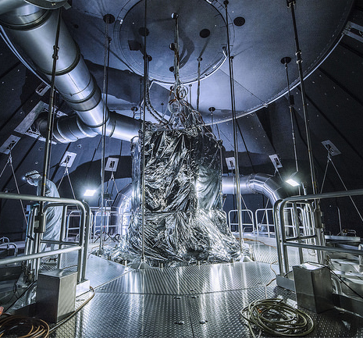
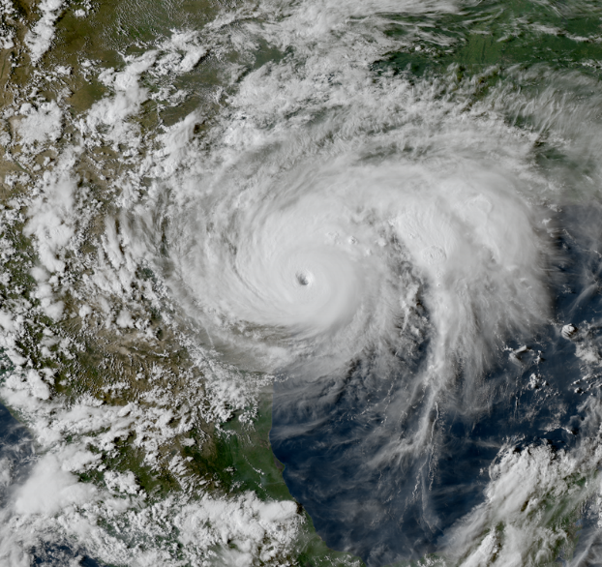
What is an Off-Nominal Event?
An unexpected hardware failure
  Partial loss of vacuum pumps
  Loss of LN2 system
  Loss of Helium system: Main Shroud and Deep Space Environmental Radiators (DSERs), or Cryo-Pumping Panels (CPPs)
  Loss of Spacecraft Simulator (SC Sim), ISIM Remote Services Unit (IRSU), or Other Flight Hardware Failure
  Loss of Data Acquisition Systems: Eclipse, TTS, Fusion
  Loss of Facility electrical power (causes loss of He system and partial loss of vacuum pumps)
A weather event, natural disaster or other critical condition
  Event with 48 hours to safe payload: hurricane alert, pending snowstorm, other predictable severe weather
  Event with 2 minutes to safe payload: fire, lightning strike, other immediate emergency
Source: NASA / Chris Gunn
Source: NOAA, Ref. 1
Notes:
Now, let’s talk about off-nominal events, starting with the definition. An off-nominal event is any scenario or occurrence that causes us to deviate from nominally executing our OTIS CV test plan. It can be one of two major categories: either an unexpected hardware failure, or a weather event, natural disaster, or other critical condition. Of course, events in the second category can also trigger those in the first. For the OTIS CV test, we considered a spectrum of possible hardware failures, including the partial loss of vacuum pumps; the loss of the liquid nitrogen or LN2 system; the loss of the Helium system, which included the Helium shroud, the Deep Space Environment Radiative Sinks or DSERs, and the cryo-pumping panels or CPPs; the loss of the spacecraft simulator, the ISIM Remote Services Unit, which read the flight sensors and command the flight heaters, or a failure of other flight hardware, such as the instrument electronics boxes or flight contamination control heaters; the loss of our test data acquisition systems including the Eclipse, Thermal Test Set or TTS, and Fusion systems discussed in parts 1 and 2; and the loss of facility electrical power which causes failures in both the helium system and vacuum pumps. For the second category, we considered scenarios where we would have either 48 hours or 2 minutes to transition the payload to a safe state. 48 hour safing events include impending hurricanes, snowstorms, or other severe weather; 2 minute events include fires, lightning strikes, or other immediate emergencies which require rapid evacuation of the test facilities.

Slide 5
Previous Off-Nominal Events ^{[2]}
Test | Date | Event | Consequences
OSIM Cryo-Cal 1 | 6/12/2013 | Derecho (high wind storm) – extended power loss in area | Impacts to personnel availability
ISIM CV1 | 10/1/2013-10/17/2013 | 17-day US Government shutdown | Test placed on “hold” – no progress
ISIM CV2 | 7/3/2014 | Emergency light in test control room caught fire | Control room evacuated; test on hold until smoke cleared
ISIM CV2 | 7/8/2014 | Thunderstorm – Power outage at facility | Emergency generator did not start automatically. Helium compressor off for ~ 30 minutes. Shroud warmed, test time lost.
ISIM CV2 | 7/9/2014 | Thunderstorm – Lightning strike at NASA GSFC | Lost cooling water for Helium compressor. Facility electrician was not on shift to restore power to cooling water. Shroud warmed, test time lost.
ISIM CV2 | 7/10/2014 | Continue from above event | Helium compressor turned off without cooling water.
ISIM CV2 | 10/3/2014 | Fire alarm NASA GSFC thermal test complex | Thermal engineers, control personnel briefly evacuated (<30 minutes), test resumed without incident
ISIM CV3 | 1/22/2016-1/25/2016 | Extreme blizzard; ~2 to 3 feet snow in area | Extremely hazardous travel conditions. Test personnel either sheltered at GSFC or if staying within 1 mile of GSFC, were transported to/from GSFC by persons with heavy trucks. Test continued without loss of any facilities.
Thermal Pathfinder | 10/26/2016 | Water pipe break in basement of test complex at NASA JSC | Primary Helium compressor incapacitated during event, had to switch to alternate Helium compressor. Helium shroud in uncontrolled warmup, test time lost.
Notes:
The sheer length of James Webb Space Telescope hardware development, integration and testing always meant that our risks for encountering an off-nominal event were greater than the average flight project, and through the years, JWST hardware has encountered a fair share of unexpected scenarios. This chart lists some of the events immediately preceding the OTIS CV test. At NASA Goddard Space Flight Center or GSFC, the combined duration of all of the OSIM and ISIM tests meant that the ISIM hardware cumulatively spent more than one year under cryogenic vacuum conditions. During that time, the test facilities saw a high wind storm called a derecho that caused widespread power outages through the Washington DC area. A 17-day US government shutdown in the fall of 2013 placed the ISIM CV1 test on hold without any progress, as only essential personnel were allowed into the test facilities during this time. Due to the stable thermal environment and lack of any hardware configuration changes, ISIM thermal test lead indicated that this was the best thermal balance he’d ever gotten in his career. From 2014 through 2016, the ISIM test hardware encountered a fire in the test control room, power outages in the facility, an extreme blizzard, and a lightning strike on the building housing the test chamber. The lightning strike was significant in that it immediately precipitated other hardware failures: as the facility lost power, chilled water was no longer pumped through the test chamber’s helium compressor. Since this chilled water was used for thermal management of the helium compressor to prevent it from overheating, when the compressor shut down as a safety measure, the test operators could no longer control the helium shroud. The helium shroud began drifting back to ambient temperatures, both disturbing the thermal stability as well as presenting a contamination hazard to the optical hardware due to the release of contaminants off of the coldest surfaces inside the chamber. When shroud control was finally regained, even after the hardware was deemed safe, valuable test time had been lost to re-establish the test environment and regain thermal stability. A similar event occurred during the thermal pathfinder test at NASA’s Johnson Space Center. A water pipe break prevented cooling water from reaching the primary helium compressor, causing loss of control of the helium shroud. The helium shroud drifted for almost a day towards ambient temperatures, and test time was lost transitioning to a backup system to regain control.

Slide 6
Why Do We Need to Plan for Off-Nominal
Events in the OTIS CV Test?
Extremely high value flight payload
Long test duration, high test cost
Large temperature range of components
  Electrical boxes in ISIM Electronics Compartment (IEC): 278K, SVTS: 264 K
  Near IR instruments, instrument detectors: 36 K - 42 K, MIRI: 6 K
  GHe shroud, other thermal boundaries: 20K, LN2 shroud: 80K
Complexity of GSE
  16 individually controlled GHe flow valves: 7 for shroud, 9 for individual DSERs & thermal boundaries plus supplemental heater circuits for precise temp. control
Nominal cooldown from ambient to steady state cold planned over 4 weeks
  Structural and contamination L&Cs
Nominal warmup planned over 3 weeks
  Structural and contamination L&Cs. Fear of uncontrolled warmup causing pressure event
Contamination from water moisture and molecular contaminants a major concern
Notes:
With our previous experiences as sufficient warning, we recognized that if the OTIS CV test went through a similar event, it would present even a larger risk to our test hardware. Why was this the case? Well, OTIS was an extremely high-value flight payload with a huge temperature range of components during its cryo-stable test phases: the instruments were all below 42 K, while the electrical boxes in the IEC and the temperatures around the SVTS were more than 200 degrees warmer. The GSE was also complex, consisting of 16 individually controlled gaseous helium zones plus supplemental heater circuits to keep certain hardware at precisely controlled temperatures, ensuring that restoration would be extremely difficult. The test was long, with an over-four-week nominal cooldown to reach the 27 mK/hr thermal stability required for optical testing, and three week nominal warmup back to ambient. Normally, cooldown and warmup are carefully choreographed, relying on precise thermal control of the helium shroud, multiple thermal boundaries, and test and flight heaters to satisfy all of the L&Cs. Should any failure result in loss of helium shroud control or heater control, even if there was no hardware damage that resulted, it may take weeks to regain the required thermal stability. Finally, one of our utmost concerns was also contamination from water moisture and molecular contaminants. With loss of vacuum pumps or loss of helium shroud, a pressure event could change our dominant heat transfer mechanisms inside the chamber, causing rapid temperature and gradient changes. If the flight mirror surfaces are much colder than the helium shroud, this could put them at risk of permanent contamination if they become the collectors for the species frozen on the helium shroud, and a severe enough pressure event may even compromise the structural integrity of the entire payload.

Slide 7
JWST Project-Directed Pre-Test
Preparations
Extensive preparations made during pre-test planning and development
  Critical power supplies; test data acquisition and control systems on uninterruptible power supplies (UPS); diesel generator circuits; spare power supplies/measurement equipment available.
  Redundant flight/test sensors identified, added to control heater circuits.
  Pre-test checkout of JSC facilities (N2 system, He compressors, control software).
  Test GSE checked to assure proper operation and safety of payload during off-nominal conditions.
  Roof repairs made to JSC Building housing Chamber A , cleanroom, control room.
  Alternate control room prepared and checked.
  Critical test control equipment covered with plastic sheeting to protect from potential water damage (dripping from condensation on frozen LN2 pipes)
Staffing shift schedules established prior to test start
  Test support and safety training was required for all personnel
  Payload thermal team had two thermal engineers and at least one additional experienced senior thermal engineer on shift
  GSE thermal team had one GSE thermal engineer and one GSE operator on shift
Notes:
Due to all of the risks associated with off-nominal events, early on in the OTIS CV test development process, the JWST project directed all subsystems to perform extensive planning to assure safety of personnel and flight hardware. This included acquiring spares of critical power supplies and placing all critical systems on uninterruptible power supplies or backup generator power. Control heaters had redundant flight and test sensors identified in case their primary sensors failed, and all facility and test GSE systems were checked out beforehand to make sure they worked as intended. Repairs were also made to the Johnson Space Center building housing Chamber A to ensure its integrity in inclement weather, and critical test control equipment was covered with plastic sheeting to protect it from water damage, including dripping from the condensation on frozen LN2 pipes. As a final backup on the facility side, a completely separate control room in another building was prepared and checked so that our team could seamlessly transition to it should the need arise.
On the personnel side, staffing and shift schedules were established for the entire duration of the test prior to the test start date. All test personnel took test support and safety training, and were required to become familiar with the test facilities and the control and monitoring software. At least one experienced senior engineer per subsystem was always on shift, in addition to the test directors, managers, and subject matter experts. For thermal, this meant that aside from the two payload engineers, one GSE thermal engineer, and one GSE operator who were scheduled to be on shift 24/7, a small group of “floaters”, or thermal engineers with a background in JWST who had a leading role in designing the OTIS test, were always present in the Houston area, on-call for any questions and ready to assist and replace scheduled shift support if necessary. Also, as the possibility of a hurricane impacting the test was identified early in the staffing process, a Hurricane Rideout Team consisting of subsystem leads and subject matter experts was established, and its members took Federal Emergency Management Agency or FEMA training as well as physical exams.

Slide 8
Thermal Off Nominal Event Planning: Consequences, Mitigations
Each team directed to develop procedures and damage mitigation strategies for various off-nominal scenarios, including hurricanes: led to the development of the Thermal Off-Nominal Safing Matrix
The Thermal Off-Nominal Safing Matrix includes columns detailing:
  Thermal consequences for the event if it occurred during 17 different time periods during the test
  Initial response required from Facility, SC Simulator, GSE teams
  Recovery Process
The entire spreadsheet is too lengthy and complex to present in its entirety
  An overview of the scenarios considered and consequences / actions to each of the test phases is given in the following slides
  One detailed example case is presented: 48-hour safing
Notes:
Each team was also directed to develop procedures and damage mitigation strategies for off-nominal scenarios. For this task, Payload thermal developed the OTIS Off-Nominal Thermal Consequences and Mitigations Workbook. This was an excel sheet, reviewed and approved by the GSE thermal, JSC facility, and flight systems teams, which identified all of the major off-nominal events identified on slide 3 and developed mitigation actions to be taken by the payload thermal, GSE thermal and the facility operators depending on the test phase. Please note that the entire spreadsheet is too lengthy and complex to present in its entirety. However, we will present an overview of the scenarios that were considered and their impacts to each of the test phases. We will also look take a detailed look at one of the cases: 48-hour safing.

Slide 9
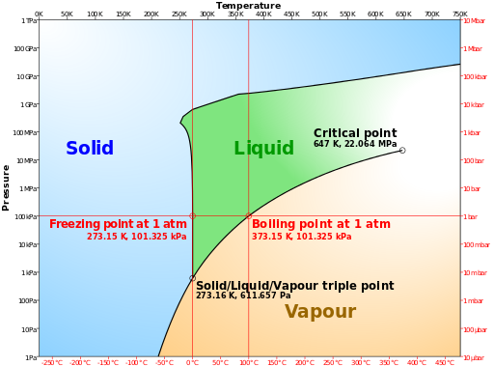
Safe Conditions for the OTIS Payload
Three safe conditions:
  Test under control (nominal operations)
  Test not under control: heaters off, drifting towards ambient, not within water contamination band
  Test not under control: vacuum, drifting towards LN2 shroud temperature, not within water contamination band
Times of greatest risk for hardware damage:
  Times of large ΔTs on OTIS payload,
  when there is large potential for temp
  change as hardware isothermalizes
  Within water contamination band
  Within molecular contamination band
  Large buildup of solid N2 and O2
  on the helium shrouds, scavenger
  plates, and Cryo-Pumping
  Panels (CPPs)
  Payload drifting towards LN2 temps,
  but LN2 supply is depleting
Phase Diagram for Water, Source: Ref.3
Notes:
Before we progress onto the off-nominal matrix discussions, we should define exactly what the safe conditions are for the OTIS CV test. There are three defined safe conditions: the first is with the test completely under control by the operations team in a nominal condition. The second and third describe off-nominal conditions where we do not have direct control of the payload or GSE, but where the hardware is not immediately at risk of damage. Specifically, for the second safe condition, the payload temperatures are above the upper bound of the water contamination band at 170 K and slowly drifting towards ambient temperatures. This condition may occur if control of the payload is lost before 170 K is reached in cooldown, or if warmup has already progressed above 170 K. The heaters are off to prevent any risk of runaway heating, and pressure need not be at vacuum, although vacuum is preferable. Essentially, the chamber would just need to maintain pressure or slowly release its pressure to keep this condition. For the third safe condition, the payload is under vacuum and either below the lower bound of the water contamination band at 140 K drifting towards LN2 shroud temperatures around 80 K, or drifting upwards towards 90 K from cryogenic conditions after the shroud and cryo-pumping panels or CPPs have been burped. As long as the LN2 system is fully functioning, there is sufficient LN2 supply, and the chamber is maintaining pressure, this condition is sustainable. In the event of severe weather or other off-nominal condition, should the team be at an condition where they may lose control of the test, or should the team need to be evacuated due to personnel safety risks, the goal is to leave the payload within either of the latter two conditions so that it is not at immediate risk of damage, and may be recovered when the operations team can return the test back to control.
Having defined our safe conditions, it’s also valuable to delineate the times of our test where the hardware is at greatest risk. These represent times where loss of control could incur the greatest hardware damage. The first is when there are large temperature differences across the OTIS payload or from the OTIS payload to the GSE and facility environment, when we have large potential for rapid temperature change as the hardware isothermalizes. This emphasizes our need to perform a controlled isothermalization of payload, GSE, and environment as much as possible should we be required to evacuate. The second is within the water contamination band, where we are in danger of having water ice deposit on the optics. Note the phase diagram for water on the lower right-hand corner of this slide, which shows that for a given temperature, the phase of water changes with pressure. If there is an uncontrolled pressure increase, water vapor may immediately undergo a phase change and solidify on the coldest, most sensitive optical surfaces. The third is within the molecular contamination band, where it’s in our interest to maintain all sensitive optics as closely as possible in temperature so that they don’t contaminate each other. The fourth is at cryo-stable temperatures when the helium shroud is at 20 K, and there is a large accumulation of solid N2 and O2 on the helium shrouds, scavenger plates, and CPPs. Loss of control of the helium refrigerator here would cause a rapid increase in chamber pressure, precipitating both a contamination risk and hardware damage from the unintended heat transfer between components with large temperature deltas. The final risk describes a scenario that could occur even when the third safe condition, that of the payload at LN2 temperatures, is achieved. Chamber A at NASA JSC can only accommodate a fixed amount of LN2 storage in its external tanks. If the LN2 supply depletes and cannot be replaced due to an unexpected condition, the helium system cannot function without the LN2 to cool it, subjecting the payload to an uncontrolled state.
The next slide will introduce the phases of our cryogenic vacuum test as seventeen distinct time periods during the test when, due to the thermal state of the payload, different actions should be taken to ensure payload safety.

Slide 10
Phases Considered for Off-Nominal
Safing Matrix
Test Phase | When it Occurs
C1 | Pre-Test or Post-Test Ambient Temperature Vacuum Testing
C2 | Cooldown: Before shroud reaches 175K
C3 | Cooldown: Before SIs cool to ~ 175K
C4 | Cooldown: Near-IR SIs in process of being held within 5K, waiting for MIRI
C5 | Cooldown: SIs being stepped down through water contamination band (140K-170K)
C6 | Cooldown: After Near-IR SI heaters turned off, SIs allowed to cool, MIRI > 40K
C7 | Cooldown: After Near-IR SI heaters turned off, SIs allowed to cool, MIRI < 40K
SS | Steady-state Cryo-stable conditions
W1 | Warmup: SIs to 45K and Shroud to 40K (N₂ migrates to CPPs)
W2 | Warmup: MIRI > 45K and He shroud warming to 140K (SIs being warmed by their heaters)
W3 | Warmup: Shroud plateau at 140K before second (major) N₂ burp when CPP warmed > 30K
W4 | Warmup: During N₂ burp at 140K (SIs > 140K, Payload ~140K)
W5 | Warmup: Payload in water contamination band (140K-170K)
W6 | Warmup: During H₂O burp off shroud (Payload ~170K, SIs > 170K)
W7 | Warmup: After H₂O burp, He shroud warming to 220K
W8 | Warmup: Shroud plateau at 220K before molecular contamination band
W9 | Warmup: 220K to ambient through molecular contamination band
Notes:
Here are the test phases we considered for the off-nominal safing matrix. There are a total of seven cooldown phases each denoted with a “C” prefix and a number, and a total of nine warmup phases each denoted with a “W” prefix and number. The cryo-stable phase between cooldown and warmup is denoted with the acronym “SS” for steady-state. In cooldown, C1 is the pre-test ambient vacuum testing, and C2 represents the phase past the actual start of cooldown until the helium shroud reaches 175 K. By C3, the SIs have continued their initial cooldown but haven’t reached their decontamination hold yet until C4. C4 represents the decontamination hold waiting for MIRI to cool in family with the rest of the instruments, and C5 is when all of those instruments step through the water contamination band between 140 and 170 K. Finally, C6 and C7 represent the final cooldown, with the only difference being that in C6, MIRI is above 40K and has not undergone the cryocooler pinch-point.
On the warmup side, W1 marks the first step in warmup when the SIs use their heaters to hold above 45K and the shroud rises above 40 K, causing all of its N2 ice to sublimate and move towards the cryo-pumping panels. Phase W2 encompasses the thermal distortion alignment drift test and most of the mechanism deployment heater tests, as MIRI goes above 45K and the helium shroud slowly gets warmed to 140K. In W3, we are at the shroud plateau before the N2 burp, or rapid pressure rise due to the sublimation of solid N2 collected on cold surfaces, which gets executed in phase W4. After the end of the shroud hold, we enter W5 where the payload is in the water contamination band between 140K and 170K. Once the payload reaches 170K, there is a minor H2O burp inside the shroud in W6 before progressing to W7, where the shroud is warming to 220 K. W8 is just before entering the molecular contamination band, and the final push to ambient through the molecular contamination band is captured in W9.

Slide 11
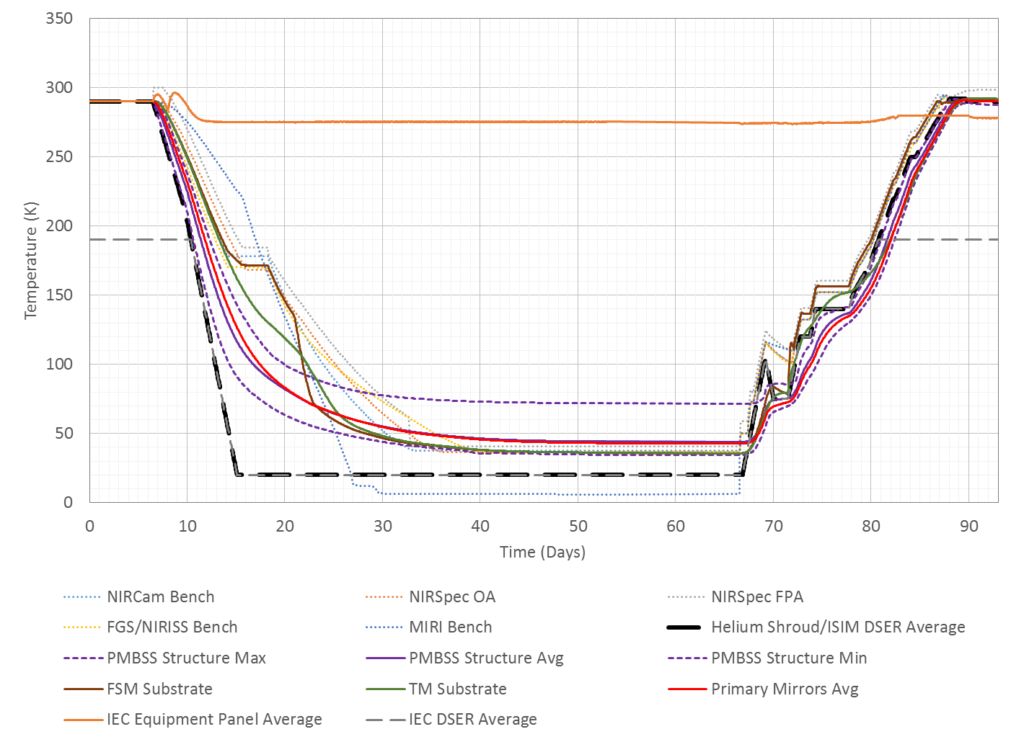
Off-Nominal Phase Correspondence to OTIS
CV Test Thermal Model Predictions
Warm to Ambient
Cool to 80K
Achieve 80K
Cool to 80K
Warm to Ambient
C1
C2
C3
C4
C5
C6
C7
SS
W1
W2
W3
W5
W7
W9
W4
W6
W8
Source: NASA/K. Yang
Notes:
Let’s look how those safe conditions and test phases discussed in the previous two slides are overlaid onto the test profile. In this plot, the horizontal axis describes the number of days into the test, and the vertical axis marks temperature, with all of the lines denoting the temperature of major components through the test. As you can see, the longest phase is steady-state, and the warmup phases are clustered much closer together than the cooldown phases due to the dynamic nature of the warmup procedure, as many environments and test conditions are encountered in rapid succession. Note that there are also additional instructions labeled at the top of the plot, divided by the black hashed lines, which separate multiple cooldown or warmup phases into clearly demarked sections. This is specific to the 48-hour safing procedure and define safety goals during conditions where we may need to evacuate all test personnel and leave the test unmonitored. As mentioned in the previous slide, there are two specific safe temperatures for the payload and shrouds to reside in for uncontrolled long periods of dormancy. The first is with the pressure vessel at ambient and the second is at LN2 shroud temperature at 80 K.
The safe temperature for the payload to aim for is specific to the phase of the test that it is currently in, and represents the closest target to achieve from that phase to thermally secure the payload. In this plot of the test profile, between C1 and C3, in the event of 48-hour safing, it would be quicker for the payload to return to ambient than to reach LN2 temperatures, so in these phases the off-nominal procedure indicates for the payload to be warmed to ambient. However, entering into phase C4 and all the way to W6, cooling or warming to the LN2 shroud temperatures at 80K is easier to achieve, so this safe condition is indicated as the target to aim for during these phases. At LN2 temperatures, even if the liquid nitrogen supply for the LN2 shroud runs out, this shroud would just slowly and gently drift up to room temperature and does not represent a significant hardware risk. After phase W7 is achieved, in the final warmup to ambient, Any phase from W7 onwards should warm back to ambient.

Slide 12
Example of Actions Taken During Weather
Event: 48-Hour Safing
Test Phase | Description | Safing Goal Temp | Facility | Flight Payload / Spacecraft Simulator | GSE
C1 | Pre-Test or Post-Test Ambient Temperature Vacuum Testing | Return to Ambient | Follow warmup plan for 2 days (if not at ambient). Start by Isothermalizing LN2 and Helium shroud, then warm both as much as possible towards ambient. Bring IEC DSER line ambient. | Follow warmup plan for 2 days (if not at ambient). Leave IRSU and SC Sim on to read temps, but turn off all payload heaters and SIs after 2 days. If evacuation is necessary, turn off IRSU and SC Sim. | Follow warmup plan for 2 days (if not at ambient). Maintain IEC DSER temp until ISIM heaters and SIs turned off, after which raise IEC DSER temp to ambient. If evacuation necessary, turn off all GSE heaters.
C2 | Cooldown: Before shroud reaches 175K
C3 | Cooldown: Before SIs cool to ~ 175K
C4 | Cooldown: Near-IR SIs in process of being held within 5K, waiting for MIRI | Cool all Payload and He Shroud to LN2 Shroud Temp (80K) | Burp N2 off He shroud and CPPs if applicable; bring He shroud to LN2 shroud temp (~90K), keep LN2 shroud flooded. Coordinate with GSE thermal for IEC DSER control. | Keep IEC survival heater setpoint at 278K. Turn off ISIM heaters if ISIM Tube max < 140K. Leave IRSU and SC Sim on to read temps, but turn off all payload heaters and SIs before 48 hrs reached. If evacuation is necessary, turn off IRSU and SC Sim. | Control FSM, TM, SM gradients with heaters. Maintain IEC DSER temp until ISIM heaters and SIs turned off, after which raise IEC DSER temp to 273-293K. Harris to decide which GSE heaters to leave on to safeguard GSE/payload.
C5 | Cooldown: SIs being stepped down through water contamination band (140K-170K)
C6 | Cooldown: After Near-IR SI heaters turned off, SIs allowed to cool, MIRI > 40K
C7 | Cooldown: After Near-IR SI heaters turned off, SIs allowed to cool, MIRI < 40K | Achieve LN2 Shroud Temp (80K) on all Payload and He Shroud | When SIs are all >45K, burp N2 off He shroud and CPPs. Then, bring He shroud to LN2 shroud temp (~90K), keep LN2 shroud flooded. Coordinate with GSE thermal for IEC DSER control. | Keep IEC survival temp setpoint at 278K. Warm MIRI using GSE heater >45K if necessary, then use heaters if needed to bring SIs to 80-90K keeping within constraints. Leave IRSU and SC Sim on to read temps, but turn off all payload heaters and SIs before 48 hrs reached. If evacuation is necessary, turn off IRSU and SC Sim. | Use TM, FSM, SM heaters to aid warmup. Maintain IEC DSER temp until ISIM heaters and SIs turned off, after which raise IEC DSER temp to 273-293K. Harris to decide which GSE heaters to leave on to safeguard GSE/payload.
SS | Steady-state Cryo-stable conditions
W1 | Warmup: SIs to 45K and Shroud to 40K (N₂ migrates to CPPs)
W2 | Warmup: MIRI > 45K and He shroud warming to 140K (SIs being warmed by their heaters)
W3 | Warmup: Shroud plateau at 140K before second (major) N₂ burp when CPP warmed > 30K | Cool all Payload and He Shroud to LN2 Shroud Temp (80K) | Follow cooldown plan for 2 days to bring He shroud to LN2 shroud temp. Keep LN2 shroud flooded (~90K). Coordinate with GSE thermal for IEC DSER control. | Bring SIs to 80-90K. Keep IEC survival temp setpoint at 278K. Leave IRSU and SC Sim on to read temps, but turn off all payload heaters and SIs before 48 hrs reached. If evacuation is necessary, turn off IRSU and SC Sim. | Control FSM, TM, SM gradients with heaters. Maintain IEC DSER temp until ISIM heaters and SIs turned off, after which raise IEC DSER temp to 273-293K. Harris to decide which GSE heaters to leave on to safeguard GSE/payload.
W4 | Warmup: During N₂ burp at 140K (SIs > 140K, Payload ~140K)
W5 | Warmup: Payload in water contamination band (140K-170K)
W6 | Warmup: During H₂O burp off shroud (Payload ~170K, SIs > 170K)
W7 | Warmup: After H₂O burp, He shroud warming to 220K | Warm to ambient | Follow warmup plan for 2 days, then bring LN2 shroud to He shroud temp and turn off temp control. Leave scav plates flooded. Coordinate with GSE thermal for IEC DSER control. | Follow warmup plan for 2 days, then turn off SIs and heaters. Keep IEC survival temp setpoint at 278K. Leave IRSU and SC Sim on to read temps, but turn off all payload heaters and SIs before 48 hrs reached. If evacuation is necessary, turn off IRSU and SC Sim. | Follow warmup plan for 2 days. Maintain IEC DSER temp until ISIM heaters and SIs turned off, after which raise IEC DSER temp to 273-293K. Use TM, FSM, SM heaters to aid warmup. Harris to decide which GSE heaters to leave on to safeguard GSE/payload.
W8 | Warmup: Shroud plateau at 220K before molecular contamination band
W9 | Warmup: 220K to ambient through molecular contamination band
Notes:
Now let's take a look at the simplified example of a matrix from the off nominal spreadsheet corresponding to the 48-hour safing actions discussed in the previous slide. The first column and second column show the test phase and description. The third column represents the goal temperature to achieve to safe the hardware, as discussed in the previous slide. The last three columns describe the appropriate response and preemptive actions that need to be taken to secure the hardware before the expected off-nominal event. As you can see, these are partitioned into the responses for the facility team, who controlled the shrouds, compressors, LN2 and helium flows, and pressures; the flight payload team, who were in charge of safing the OTIS payload via control of the IRSU and Spacecraft Simulator; and the GSE Team, who took emergency actions with the GSE hardware surrounding OTIS to safeguard the payload. For the viewer taking this course who is unfamiliar with JWST, the intent of this chart is not for you to understand every single acronym and or every action being taken, but rather to understand the complexity of the lookup tables for safing during these off-nominal scenarios, and to emphasize that detailed and extensive planning was undertaken for every test condition.
Now, let's do a top-level walkthrough of this chart without delving into every detail. (click 1) For phases C1 through C3, the facility response is to first isothermaIize the LN2 and helium shrouds, then warm them both as much as possible towards ambient while bringing the independent IEC DSER helium line up as well. On the spacecraft simulator or payload side, the plan is to follow the warmup procedures from the corresponding temperature regime that the payload is in, and then turn off all heaters after two days in case evacuation is necessary. On the GSE side, the necessity is to maintain IEC DSER temperatures cold to provide a sink for the ISIM electronics boxes until the ISIM heaters and SIs are turned off, after which the IEC DSER is brought to ambient and the GSE heaters are turned off in the event of evacuation.
(click 2) From phases C4-C6, through the ISIM decontamination and final cooldown phases, the target is to cool to LN2 temperatures, where on the facility side an N2 burp may be necessary followed by bringing the helium shroud to LN2 temperatures. For the payload, the IEC survival heaters are maintained at 278 K and the ISIM heaters are turned off as long as the ISIM composite structure no longer emits water below 140 K. On the GSE Side, the GSE heaters are commanded so that the FSM, TM, and SM gradients are maintained. The IEC DSER undergoes a similar procedure as that described for initial cooldown.
(click 3) For Phases C7 through W2, which represent the end of cooldown through beginning of warmup, the facility and spacecraft simulator share the same goals of trying to achieve LN2 shroud temperatures. The helium shroud needs to be burped then set on the path to achieving 90K, while the warmup procedures need to be followed for keeping ISIM Warm to avoid the instruments being contaminated. On the GSE side, the GSE heaters warm the TM, SM, and FSM towards 90 K and the IEC heaters follow a similar warmup procedure as before until the end of the test.
(click 4) Now, progressing to warmup, in phases W3-W6 the procedure is similar to C4-C6 on cooldown, where the shroud, SIs, and mirrors are all set to achieve 90 K. (click 5) In the final phases of warmup from W7-W9, these instructions mirror those for C1-C3 to follow the warmup plan until evacuation if necessary.
Note that while this matrix example has discrete changes for facility, payload, and GSE per block of test phases, not all matrices have all three responses changing at once. A matrix for loss of electrical power, for example, may have the facility response changing almost every test phase, while the GSE response may remain constant through the bulk of the test.

Slide 13
Two Examples of Thermal Analyses
Required for Off-Nominal Event Planning
Example 1: Loss of Spacecraft (SC) Simulator from Phases C4 to SS
  Interrupts test operations by loss of commanding ability
  Loss of the SC simulator also results in loss of operations for instrument electronics boxes and loss of command for thermostatically controlled survival heaters on the IEC radiator panels.
  Since the IEC DSER is nominally controlled to 190K or colder during the entire test, this would result in the IEC and its instrument electronics boxes to fall below their survival temperatures of 253 K
  Analysis was needed to determine the time available to respond to thermally safe the hardware
  Fastest (worst) case cooling occurs when holding IEC panels at 278K (nominally) and IEC DSER is at a sink temperature of 20K
Example 2: Loss of Helium System at Phase SS
  This would be a result of the loss of facility power
  Analysis needed to determine the effect Nitrogen Free Molecular Heat Transfer, Conduction, and Convection would have on the test hardware in the OTIS Cryovac test if Helium Refrigerators were to lose power / lose temperature control
Notes:
While developing the off-nominal matrix, the OTIS thermal team considered which cases and off-nominal conditions would present most risk to our test and flight hardware. For cases where there were small temperature differences between components, back-of-the-envelope calculations using simple physics were sufficient to assess hardware safety. For more complex cases which had more variables, limit and constraint violation concerns, or large temperature gradients within and between pieces of critical hardware, thermal modeling and analysis was required to evaluate the payload’s response understand if risk mitigation steps could be taken.
These analyses were performed with Thermal Desktop™, and gave us a sense of how long we would have to recover the hardware before permanent equipment damage, as well as where failures might occur. Two examples of analyses we performed are discussed on this slide. The first is the loss of the Spacecraft Simulator from the end of cooldown through steady state, as this causes the loss of commanding ability for the ISIM electronics boxes as well as the heaters on the IEC radiator panels. Since the IEC DSER is at 20 K in these phases, whereas the IEC electronics boxes are nominally at 278 K, loss of heater control would cause the warm electronics boxes to rapidly fall below their survival temperatures. Thermal analysis provides us with a timeframe as to how quickly this would occur.
The second analysis is the a loss of facility power causing a loss of both the shroud and cryo-pumping panel helium systems at cryogenic steady-state. In this case, the rapid sublimation of solid species collected on cold surfaces will cause a burp to occur, disturbing both temperature stability and pressure inside the chamber. Concerns were voiced over what effect the resultant forms of heat transfer introduced by the higher pressures, namely nitrogen Free Molecular Heat Transfer, gas conduction, and convection would have on the test hardware. This analysis attempts to quantify the order of magnitude of the response, taking into consideration that the precise amount of contaminants which have collected on the cryo-pumping panels and coldest surfaces, as well as the precise pressures within the chamber due to the burp may not be known.

Slide 14
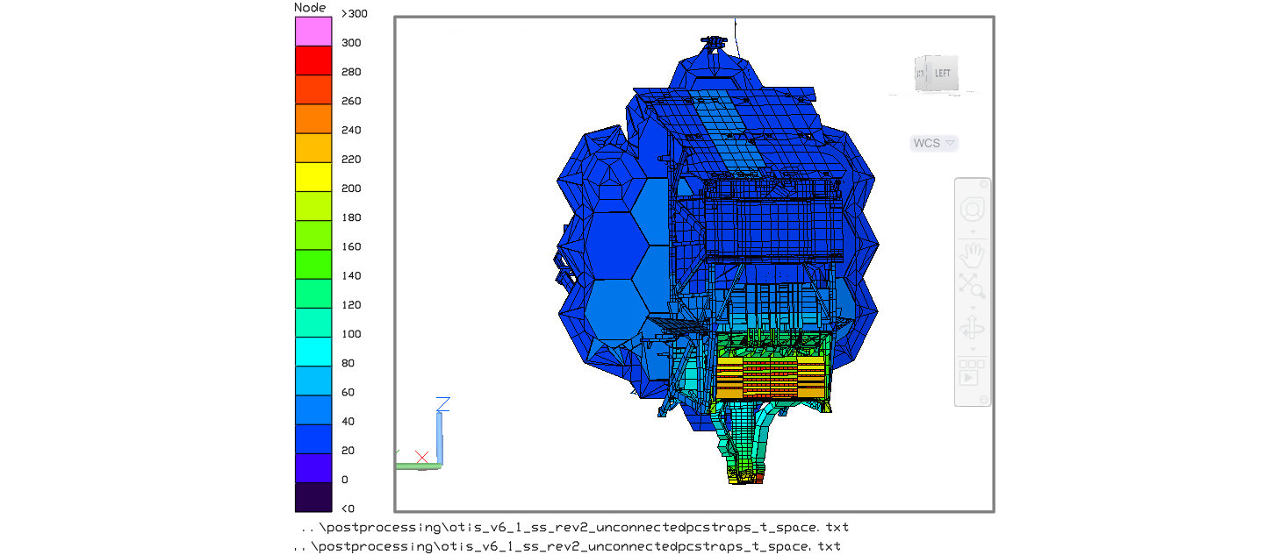
Example 1: Loss of Spacecraft Simulator Thermal Analysis Setup
Source: NASA/JWST/K. Yang
IEC DSER
+V1
+V3
+V2
Notes:
Let’s talk about the first example scenario where the spacecraft simulator fails, causing the IEC radiator panel heater lose control. Shown here is the –V1 side of OTIS, with colors corresponding to the predicted temperatures at cryogenic steady-state conditions. (click 1), As seen from the schematic here, the IEC DSER directly overlays the warm IEC radiator. If the heaters on the IEC were to fail from a loss of the spacecraft simulator, the temperatures on this warm 278K surface would plunge since it is directly viewing a 20K sink.

Slide 15
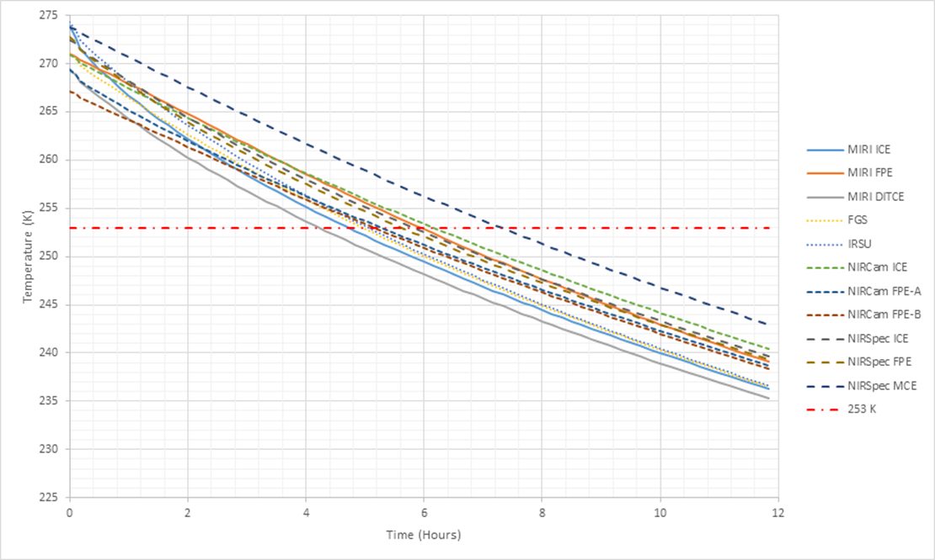
Example 1: Predicted IEC Electronics Box Temperatures during Loss of SC Simulator, DSER at 20K
Boxes controlled at heater setpoints before off-nominal event
First box breaks low red temperature limit after 4 hours
Source: NASA/K. Yang
Notes:
A thermal analysis was set up which allowed the IEC radiator panel heaters and the instrument electronics boxes to operate at their nominal setpoints until quasi-steady state was achieved as an initial condition. At time zero in this analysis, the spacecraft simulator fails, causing the heaters turn off. Now that these boxes are subject to a cold DSER environment of 20 K without active heater control, they begin to fall towards their lower survival limit, indicated by the red dash-dot line at 253 K.
As seen from the plot, the first box breaks its temperature limit after four hours, since its rate of temperature decrease is only limited by its own thermal mass. This gives us the understanding that action must be taken to either recover the spacecraft simulator or find an alternate means to heat the boxes before four hours have elapsed from the start of the off-nominal event. While there was a contingency plan to replace the spacecraft simulator with a backup in case the principal failed, this swap would have taken some time and required personnel expertise to make connector changes and initiate startup procedures. This swap procedure was predicted to take anywhere from 1 to 4 hours depending on time of day and personnel already at JSC. It was clear that another pre-test hardware change and recovery procedure was needed to keep the hardware safe.

Slide 16
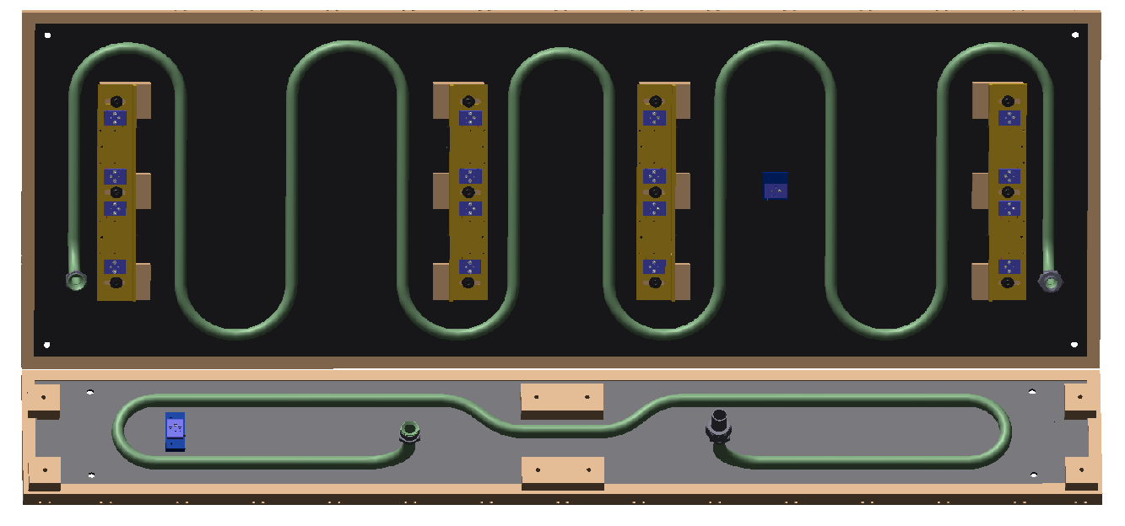

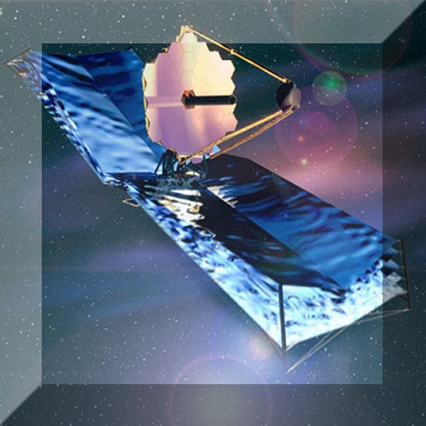
Example 1: Preparations Implemented as a Result of Off-Nominal Planning and Analysis ^{[4,5]}
Contingency mitigations added to hardware as changes from baseline capabilities
  IEC DSER helium lines modified to be controlled individually: provide both cooling at ambient and helium shut-off in emergency scenario.
  Backup SC Sim moved next to primary unit used in test in case primary fails. Backup able to be wired to survival heaters within a short period by qualified personnel.
  Heaters added to IEC DSERs for quick warmup from 20K to 253K (IEC survival temperature) in 3.5 hours, if backup SC sim cannot be started in 15 min.
  Test sensors on flight IEC panels
MIRI GSE heater procedure updated
Hurricane rideout team identified
to stay with hardware in case test
support team needs to be evacuated
  Received FEMA training pre-test
  Critical members of each discipline
  Ensure hardware is safe and
  maintains status quo
Source: NASA/L3 Harris Corp.
IEC DSER Emergency Warmup Heaters
+V2
+V3
Notes:
Due to the urgency to restore IEC heaters from the results of the spacecraft sim failure analysis, we added additional hardware to our test setup that was not initially considered in the baseline capabilities. The IEC DSER helium lines were modified so that they could be controlled individually, with the possibility to be shut off in an emergency scenario. Our partners at Harris Corporation also added an independent warmup heater capability to the IEC DSER panels themselves, allowing for those panels to reach above the 253 K IEC electronics box survival limit before the boxes themselves were predicted to go below that threshold, thus providing a warm backload and safeguard against limit exceedance. These methods to individually control the temperature of the IEC DSER zone actually proved useful in other unexpected ways. During ambient testing, the heat dissipation from powering the IRSU box within the IEC to control flight heaters caused IEC temperatures to skyrocket. The separate helium loop in the IEC became essential as it could pre-warm the IEC environment before its electronics boxes were turned on to prevent any limit exceedances.
In addition, test sensors were mounted to the flight IEC panel so that we were never blind to IEC temperatures in case the spacecraft simulator failed. Furthermore, a procedure was updated to warm MIRI with a GSE heater to prevent contamination in uncontrolled warmup.
One critical factor that must be mentioned as part of our contingency plans was personnel preparedness. These changes in hardware would be meaningless without the engineers and operators who were knowledgeable enough to identify which critical condition we were in and take the correct response actions. Early on, we selected a core group of subsystem engineers that were the experts in each discipline they represented to form a hurricane rideout team in the event of extreme weather. This group included members from all three thermal teams: payload, GSE, and facility. Each member received Federal Emergency Management Agency or FEMA training and a physical to ensure they were fit to carry out duties in the event that the larger test support team needed to be evacuated. Each was also trained extensively with the off-nominal matrix and knew which actions to take to ensure that the hardware was safe.

Slide 17
Example 2: Loss of Helium System During
Cryo-Stable Testing (Phase SS) Analysis Setup
Loss of helium system requires a more complex thermal analysis
  When helium system enters uncontrolled warmup, N2 frozen on helium shroud released at 27-34 K, causing rapid rise in chamber pressure
    Results in change of dominant heat transfer method from pure radiation and conduction at high vacuum to either free molecular heat transfer (FMHT), gas conduction, or convection (along with radiation and conduction)
    Dominant heat transfer method varies between surface pairs, and is determined by the distance between these surfaces and by the chamber pressure
A methodology was developed at NASA GSFC to predict response to uncontrolled helium shroud warmup with order-of-magnitude accuracy
  FMHT calculated using built-in feature in Thermal Desktop™ with pressure-dependent accommodation factor
  Microsoft Visual Basic™ macro to sort through FMHT couplings and apply a factor to approximate conduction/convection based on distance between surfaces: each surface pair in the model was examined to understand which flow regime they would occupy per time step of the analysis
  Additional macro “spoiled”/“shorted” MLI: replaced radiative couplings between MLI layers with linear couplings according to gas condition
Notes:
Now, switching gears, let’s move on to the second scenario. In this example, both helium systems fail, causing an uncontrolled rise in pressure inside the chamber. Understanding the behavior of the payload after this off-nominal event required a more complex thermal analysis, since radiation and conduction are no longer the dominant modes of heat transfer inside the chamber. Due to the extensive duration of the thermal vacuum test, and taking into consideration the length of the time that the test setup spends in a cold environment, gaseous nitrogen present in the chamber solidifies onto the cryo-pumping panels and shroud walls. The worst-case scenario for the amount of solid nitrogen gathered on the shroud is just before warmup, where 35 days have already been spent in cooldown, and 30 additional days have been spent at cryo-stable temperatures. If the helium system enters uncontrolled warmup at this time, the nitrogen frozen on the helium shroud sublimates at 27-34 K, causing a rapid rise of chamber pressure. As nitrogen gas is released, it may deposit on and contaminate the sensitive optics on telescope and instruments. The pressure spike also results in a change of the dominant heat transfer method to either free molecular heat transfer, gas conduction, or convection, in addition to the radiation and conduction heat transfer already present. However, the dominant heat transfer method varies between surface pairs, and requires knowledge of the distance between these surfaces and the chamber pressure.
How do we determine what this is, especially when Thermal Desktop™, the most common thermal analysis software we use, is predominantly configured to handle radiation and conduction? Well, one of our OTIS thermal engineers at NASA Goddard developed a methodology to predict the response to an uncontrolled helium shroud warmup with order-of-magnitude accuracy. Free molecular heat transfer, otherwise known as FMHT, was handled using a built-in feature in the Thermal Desktop™ analysis program with a pressure-dependent accommodation factor. Once the FMHT couplings were calculated, a macro developed in Microsoft Visual Basic™ was used to sort through these couplings and apply a factor to approximate the conduction and convection based on the distance between surfaces. For each time step of the analysis, corresponding to a particular pressure value, each surface pair was examined to understand which flow regime they would occupy. Additionally, there was a macro to short the Multi-Layer Insulation or MLI blanketing. When gas pressure rises, MLI no longer becomes effective as its layers are shorted by gas conduction, removing any isolative effect that was present with pure radiation heat transfer. This macro replaced radiative couplings between MLI layers with linear couplings according to the gas condition.

Slide 18
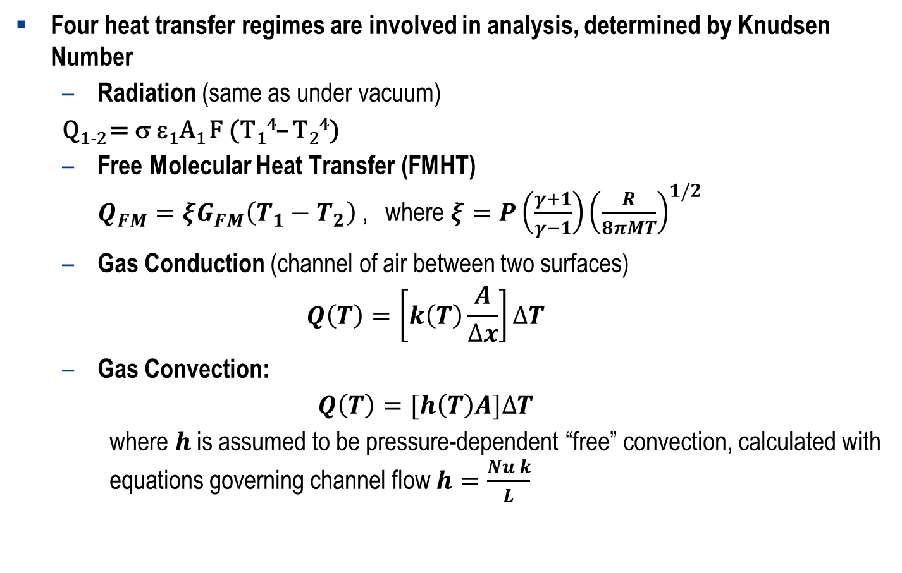
Example 2: Heat Transfer Regimes
Four heat transfer regimes are involved in analysis, determined by Knudsen Number
  Radiation (same as under vacuum)
  Q₁₋₂ = σ ε₁A₁ F (T₁⁴– T₂⁴)
  Free Molecular Heat Transfer (FMHT)
  $Q_{FM}=ξG_{FM}\left(T_{1}−T_{2}\right)$, where $ξ=P\left(\frac{γ+1}{γ−1}\right){\left(\frac{R}{8πMT}\right)}^{1/2}$
  Gas Conduction (channel of air between two surfaces)
  $$Q\left(T\right)=\left[k\left(T\right)\frac{A}{∆x}\right]∆T$$
  Gas Convection:
  $$Q\left(T\right)=[h\left(T\right)A]∆T$$
  where $h$ is assumed to be pressure-dependent “free” convection, calculated with equations governing channel flow $h=\frac{Nu k}{L}$
Notes:
There are four heat transfer regimes involved in this analysis, and the regime between any two surface pairs is chosen by Knudsen Number.
Radiation between the two surfaces is always present, with its equation being the same as under vacuum, albeit with the blankets partially shorted.
For FMHT, the amount of heat transfer is determined by the random bouncing of molecules between two surfaces, as molecules pick up heat from one surface and transfers heat when it collides with another surface. However, with increasing mean free path between surfaces, there is a greater possibility that the molecule from the first surface will collide with another molecule on its journey to the second surface, therefore not making a full transfer of heat from one surface to the other. Thus, the equation breaks down at higher pressures as it will over-estimate the amount of heat transferred.
Gas conduction is approximated as a channel of air between two surfaces. It uses the one-dimensional conduction equation, with the corresponding area and length of the channel that determines the view between these surfaces.
Gas convection is calculated with the one-dimensional convection equation. Here, h, the convection coefficient, is calculated with the equation governing channel flow based on Nusselt number, assuming pressure-dependent free convection.
While gas conduction and convection use highly simplified equations, and there are much more accurate analytical methods to understand the behavior of these modes of heat transfer by nodalizing all of the chamber space between the payload, GSE, and shroud walls, recall that we are only going for order-of-magnitude accuracy in our analysis. Therefore, we want to avoid analysis complexity where we can. By approximating these heat transfer methods as a projected channel between two surfaces, we can work directly with the information already generated by the Thermal Desktop™ software on surface areas and view factors between surfaces. If two surfaces are right next to each other and mostly view each other, then this is a very accurate assumption, and this is also when gas conduction and convection are the most significant contributors to heat transfer.

Slide 19
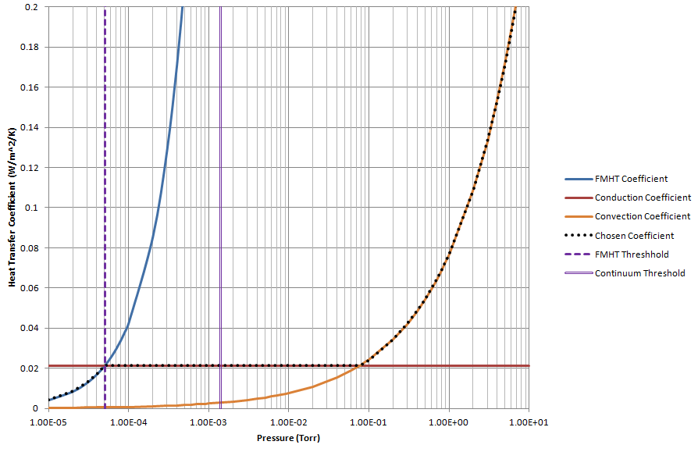

Ex. 2: Heat Transfer Coefficient vs. Pressure for Constant Distance Between Surfaces
Gas Convection
Gas Conduction
FMHT
Source: NASA/Genesis ESI/B. Comber
Notes:
What defines the boundaries where one heat transfer regime was chosen over another though? As mentioned in the previous slide, the heat transfer regime is chosen by Knudsen number, with the critical determining factors being the distance between two surfaces and the chamber pressure. For a given distance, if the pressure is below 5e-4 torr, then free molecular heat transfer is a valid assumption. Between 5e-4 and 1e-3 torr, gas conduction dominates, and further above the continuum flow threshold at 1e-3 torr, we can assume gas convection is the main heat flow driver. In this plot, we can see the heat transfer coefficients vs. pressure calculated for plates 0.3 m apart. Free molecular heat transfer couplings are calculated with the inherent feature in Thermal Desktop™ with an accommodation factor of 1. These FMHT couplings are then scaled using a Visual Basic™ code, using distance between each surface to determine heat transfer regime. In gas conduction, as heat transfer is approximated as a channel of air between those surfaces. Note that the thermal conductivity of the gas remains constant in this regime regardless of pressure. In convection, the convective coefficient is calculated based on free flow through a channel, with Nusselt number being the primary driver.

Slide 20
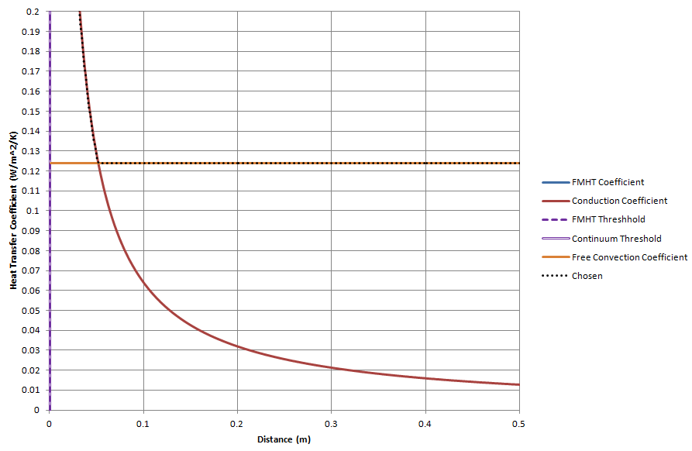
Ex. 2: Heat Transfer Regime vs. Distance for an Example Constant Pressure
Gas Conduction
Gas Convection
FMHT
Source: NASA/Genesis ESI/B. Comber
Notes:
Another way we can look at this is using a plot of constant pressure. At 2.6 torr, a small distance between surfaces means FMHT is valid. With greater distances, gas conduction is a better assumption, and above 5 cm at this pressure, where the convection and conduction lines cross, free convection is the dominant method. Convection is flat here with distance because, now, with the larger distances between surfaces, heat is not transferring directly from surface-to-surface anymore, but the gas in between. The view factors calculated through Thermal Desktop™ serve to distribute the area associated with the couplings among the different surfaces that have line-of-sight to each other, and effectively weight the average sink temperature of the gas.

Slide 21
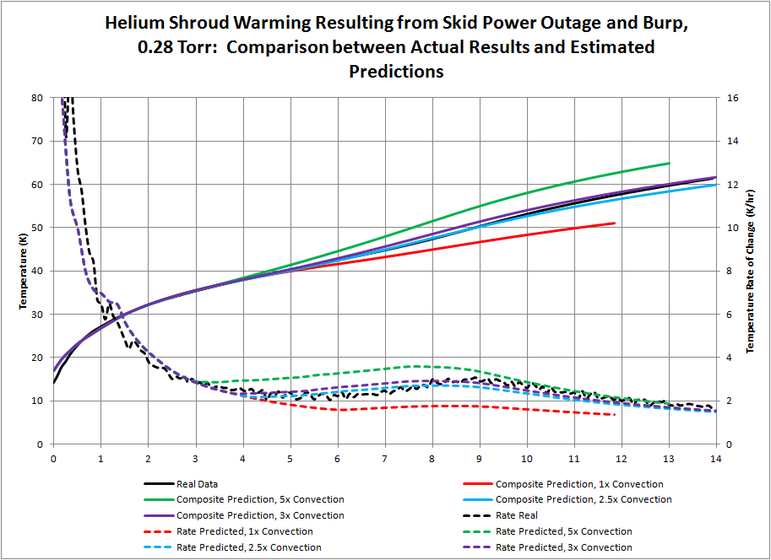
Ex. 2: Model Calibration Based on Data from
Helium Refrigerator Outage in Chamber A
Time from Start of Uncontrolled Warmup (hr)
Source: NASA/M. Woronowicz/Genesis ESI/B. Comber
Notes:
To calibrate this model, we wanted to compare our predictions against measured data to understand how well it performed. In a precursor test to OTIS CV, the helium refrigerator was turned off allowing for uncontrolled shroud warmup, and the response was recorded. The only input to the model here was the gas pressure profile from this uncontrolled warmup scenario. In this plot, for the first hour, the shroud warms up without much pressure increase. From three to five hours, the gas conduction gives way to convection. The model was tuned trying different convective coefficient values to see which best matched the shroud response given a maximum measured pressure of 0.28 torr at 8 hours into the uncontrolled warmup, when temperature rate of change peaks and decreases. It can be seen from this plot that 2.5 times the baseline convective coefficient best matched the data in both predicted temperature response and temperature rate of change.
It is worth reiterating here that the method developed for predicting off-nominal uncontrolled warmup on the payload was meant to just achieve order-of-magnitude accuracy. We didn’t want to go through the exercise and expense of buying a CFD program and trying to model a cryogenic condition with multiple phases and flow regimes, especially in these rarefied flow conditions. This method with simplified assumptions about convection and conduction was developed to see if we could dismiss our concerns about catastrophic hardware damage during an unplanned burp, and the results gave enough confidence that we would have enough time to respond and avert disaster, so management was comfortable allowing the test to go forward. However, what I’d like to draw your attention to is the fact that, even with the large simple volumes of the shrouds and pressure vessel, the baseline methodology worked very well, as represented by the red line. With a factor of 3, not even an order of magnitude, this methodology worked extremely well and the predictions nearly overlapped the trends from real test data. Also of note is that the initial transient, which was dominated by FMHT and conduction, did very well with just slight tuning of the shroud emissivity. For convection, the only tuning was to to try to capture the small hump in the rate of change, which it did.

Slide 22
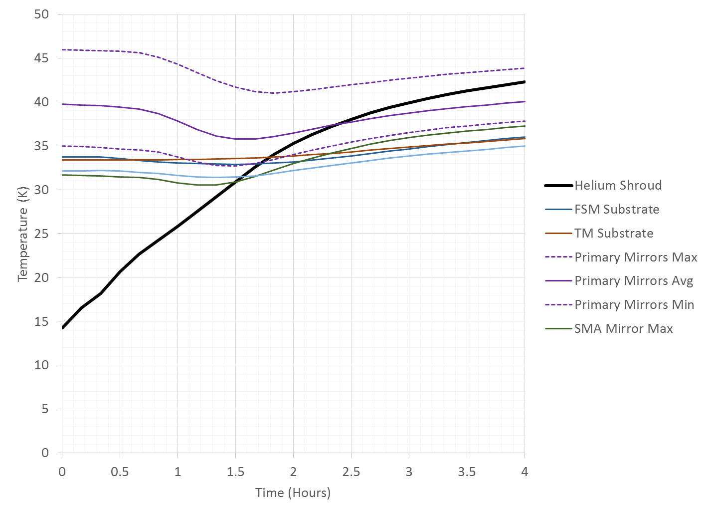

Example 2: Warmup of OTE Components
Helium shroud warmup profile is matched to Chamber A data for power outage and N2 “burp”
Source: NASA/K. Yang
Notes:
Now having matched the helium shroud response to data, we can run the model with those calibrated factors to see what the payload response is. In this plot of mirror temperature predictions vs time after the start of uncontrolled shroud warmup, it can be seen that the mirrors cluster more closely together in temperature due to the increased heat transfer couplings between them, and begin following the shroud in warming up after its temperature surpasses the colder mirrors.

Slide 23
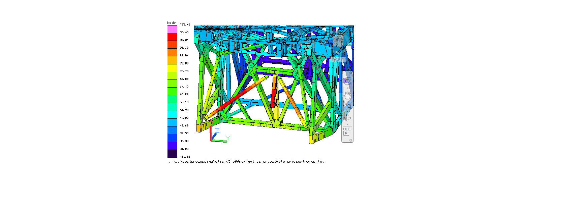
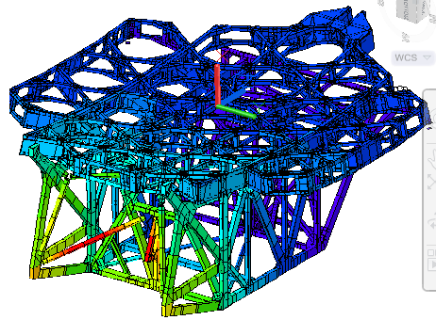
Example 2: PMBSS Gradients at Four Hours
into Off-Nominal Warmup
Temp (K)
Source: NASA/K. Yang
Notes:
These predictions also allowed us to understand how uncontrolled warmup impacted hardware safety, and what potential limit and constraint violations to look out for should we enter this type of scenario. Shown here are temperature contours over the PMBSS composite structure at four hours into off-nominal uncontrolled warmup. If you recall from the previous lecture, the PMBSS structure had very strict temperature- dependent delta-T constraints. Through these analysis results, we can see the location on the PMBSS structure with the greatest potential for the constant violation resides in the beams near the core region on the lower left hand side of the left figure. Due to its proximity to the IEC, The higher pressure causes it to couple better with the IEC's warm temperatures, resulting in an exceedance of delta-T limits.

Slide 24
Hurricane Safing
The 48-hour safing procedure was specifically developed for the threat of hurricanes in Houston
  The OTIS CV test spans nearly the entire hurricane season
6 different conditions are possible during a hurricane threat
  Hurricane being tracked, but no action taken (uncertainly of impact to test location)
  Warning given to team of need for evacuation (48-hour safing in effect to either warm to ambient or warm/cool to LN2 shroud temperature)
  Test support team has evacuated, and only hurricane ride-out team remains (test support team consists of only critical personnel with additional training)
  Warning has given to hurricane ride-out team of need for evacuation
  No team is present to monitor the test
  Post Storm Response Team joins Ride-Out team
During the OTIS CV test, condition 1 went into effect due to the impact of Hurricane Harvey from August 26th-30th, 2017
  While the test team wasn’t evacuated, various parts of other conditions were also implemented
Notes:
Now, let’s tie these analyses and preparations back to the 48-hour safing procedure that we discussed earlier in the lecture. As mentioned before, this procedure was specifically developed for the threat of hurricanes in Houston, since the OTIS CV test completely fits within, and nearly spans, the entire hurricane season. We identified via the matrix six separate possible conditions during the hurricane threat with increasing levels of severity, each with different steps to execute. The first is identifying and tracking the threat of a hurricane, but not yet taking action since we still hope that the hurricane will not impact us. In condition two, when the impact of the hurricane is understood and imminent, warning is given to evacuate. During this time, team is taking action to safe the hardware via the 48-hour safing procedure. According to this matrix, the team will either try to warm to ambient, or warm or cool to LN2, depending where the average temperature of the test article resides. In condition 3, the larger test support team for nominal operations has evacuated, and only the hurricane ride-out team remains. The ride-out team solely maintains the status quo of the test. They would not operate heaters, for instance, because the much reduced team would be unable to adequately monitor them. In this condition, the IEC heaters and spacecraft simulator would be allowed to remain on, but IEC DSERS may be warmed up in the event of implementation of the next condition. In condition 4, if the storm worsens and extreme weather necessitates the evacuation of the ride-out team, the team would ensure that the payload is achieving or has already achieved a safe thermal condition. By condition 5, the team has evacuated, leaving the payload unmonitored within the pressure vessel. After the storm, condition 6 is implemented, where a post-storm team joins the ride-out team in returning to the test facility and re-establishing control of test operations.
In the OTIS CV test, the threat of Hurricane Harvey from August 26th-30th of 2017 caused condition one to go into effect. However, due to the uncertainty of its impact to our test location, 48-hour safing in condition 2 was not immediately implemented. At the time, the cooldown phase of the OTIS CV test had just recently been completed, with cryogenic temperatures and stability requirements having been achieved. Transition to 48-hour safing, which would have necessitated warming the payload to achieve the LN2 shroud temperature, would have perturbed the stability of the payload and required weeks to recover back to the cryo-stable condition. Therefore, JWST management made the decision to maintain the payload at this cryogenic condition, with the understanding that if loss of power or another critical failure were to occur, the team would be fully prepared to implement warmup to the LN2 safe condition immediately. The next slides will speak to the OTIS CV team’s experience during Hurricane Harvey, and how our extensive preparations helped us with our own off-nominal condition.

Slide 25
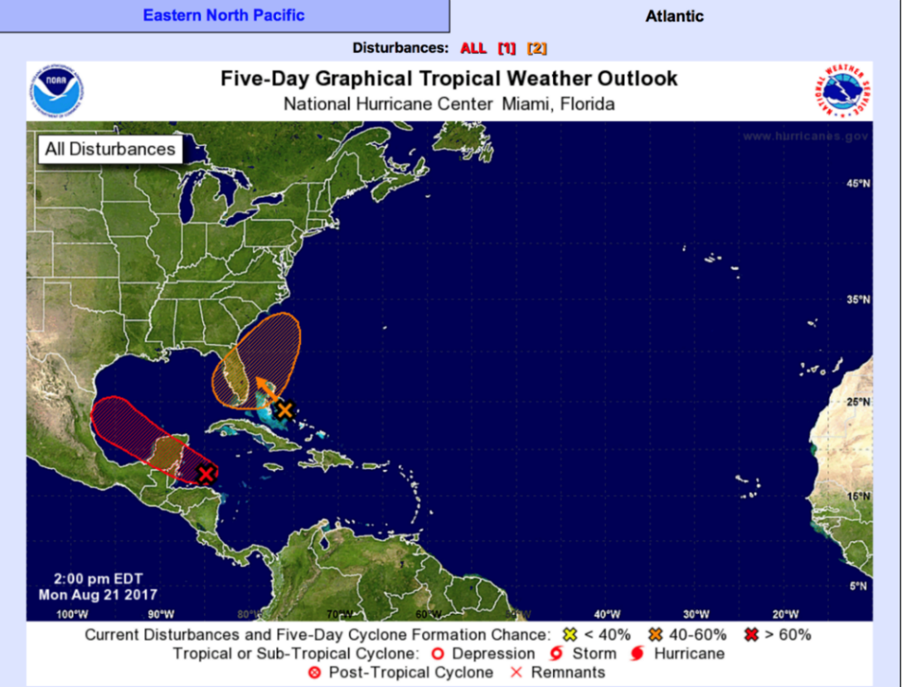
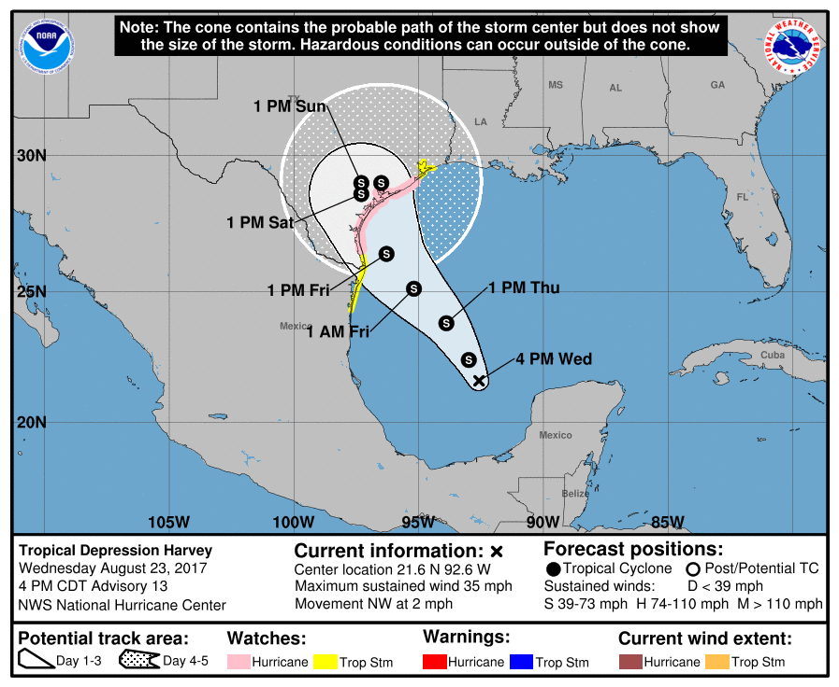
Early Warnings for Hurricane Harvey
Hurricane forecasts were monitored daily throughout OTIS CV test. Initial warnings of possible Hurricane Harvey impacting Houston area were seen ~5 days before landfall
Source: NOAA/National Hurricane Center, Ref. 6
Source: NOAA/National Hurricane Center, Ref. 6
Monday, August 21st, 2017
Wednesday, August 23rd, 2017
Notes:
From the start of the OTIS CV test, hurricane forecasts were monitored daily by the management team. On Monday, August 21st, 2017, about a month into the test, we noticed that there was a disturbance in the Gulf of Mexico with a greater than 60% cyclone formation chance. By Wednesday, Harvey had become a tropical cyclone with high potential of impacting the Texas coast that Saturday.

Slide 26
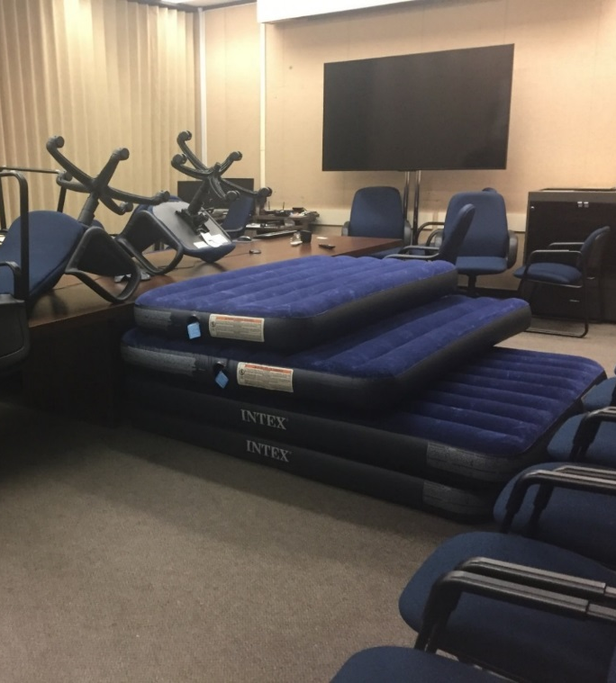
Initial Preparations
By Friday, August 25, JWST project had purchased 40 air mattresses and stockpiled food rations for several days
Potential effect on personnel was severe, since most test participants were non-resident in Houston area and had to fly in from around the US and world to staff the test.
Plans were made to extend shifts to 12 hours to minimize travel to/from hotels
Hurricane Ride-out team members were identified, prepared to stay at JSC
Hurricane safing procedures were reviewed; plans to deal with individual system failures were printed
Source: NASA/L. Feinberg
Notes:
By Friday, August 26th, the project had made preparations for the team to ride out the storm. They had purchased 40 air mattresses and stockpiled food rations for several days, as well as encouraged each team member to ensure that they had water and food stores within their hotel rooms. Since most test participants had traveled to Houston from across the United States and around the world, they did not have prior experience with hurricanes, and therefore the project’s actions were critical to ensure that all personnel were prepared. The air mattresses became integral to the comfort of the team during the storm, but the lesson learned for next time was to buy blankets and pillows, and make sure the lights can turn off in all of the facilities that we’re sleeping in.
Plans were made to extend shifts from the nominal duration of eight hours to twelve hours to minimize the amount of travel between the hotels and the test location. All of the members identified to work shifts during the storm had gone through the prior ride-out team training, and those with high-clearance vehicles such as trucks and sports utility vehicles were tasked with traveling to each hotel in a convoy during shift transitions, so that no individual team member would be at risk by driving by themselves through flooded streets. On the test operations side, each team reviewed their own hurricane safing procedures and printed plans to deal with possible failures within their subsystems.

Slide 27
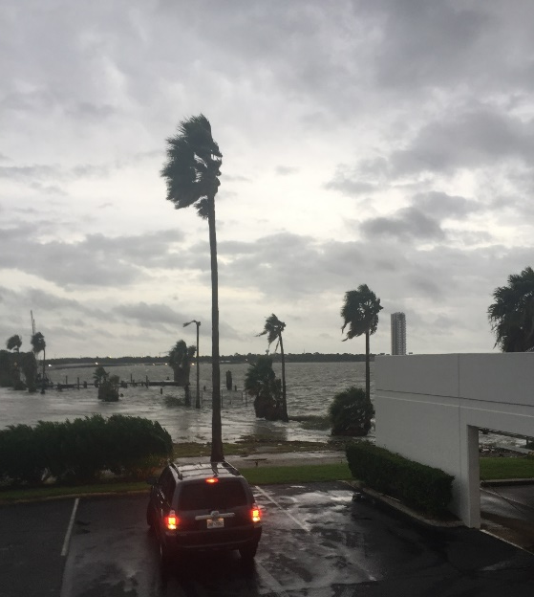
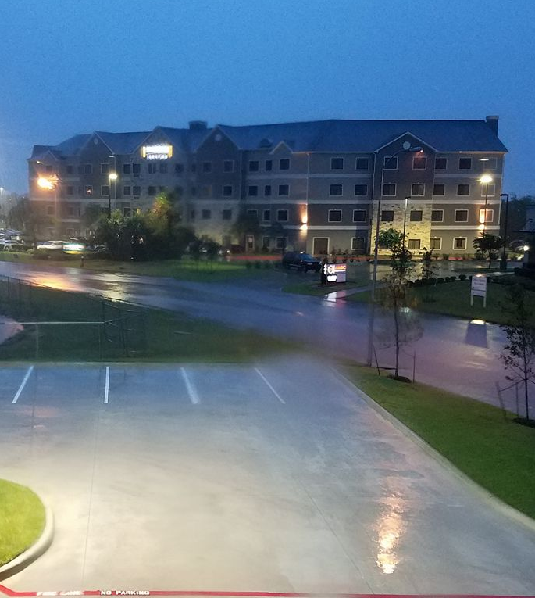
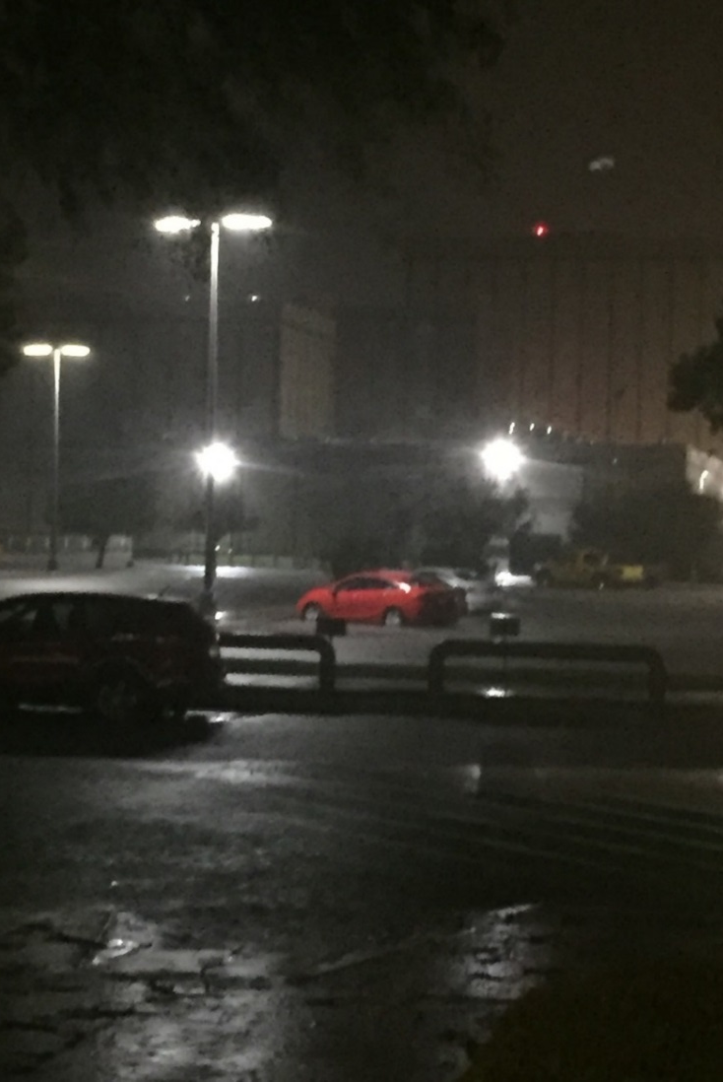
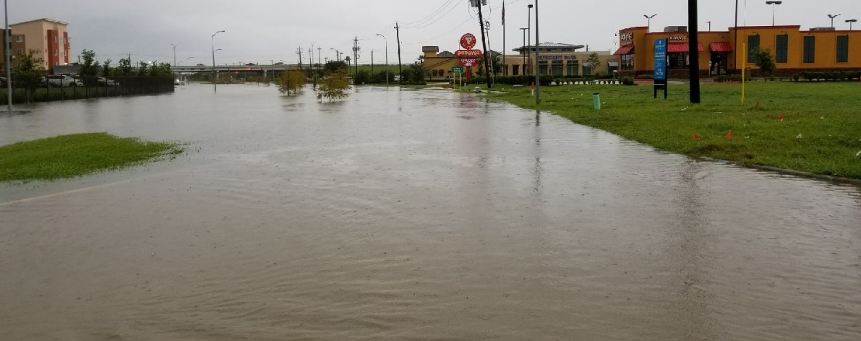
Harvey Strikes the Houston Area:
August 25th-August 27th, 2017
Source: NASA/L. Feinberg
Source: NASA/K. Yang
Strong winds as Harvey hits Clear Lake on 8/25/17
Hotels in Clear Lake, TX for OTIS CV Test Personnel
Source: NASA/L. Feinberg
Source: NASA/L. Feinberg
Flooding in Webster, TX
Parking lot outside NASA/JSC Chamber A
Notes:
Friday night into Saturday, twenty inches or fifty centimeters of rain fell overnight, causing flash flooding and tornado warnings. This was about 40% of the total 51 inches, or about 130 cm, of rain that fell in the Houston area during the entire week of the storm. Travel was extremely hazardous, and critical test personnel were called into Johnson Space Center prior to impact in case access became impossible. Only one center entrance was open during the storm, and this was closed for several hours on the first day due to flooding. The roads adjacent to hotels in Clear Lake, Texas had become rivers with more than a foot of flowing water, and as cars became stranded in the rushing currents, the Texas National Guard was deployed to rescue civilians caught within.

Slide 28
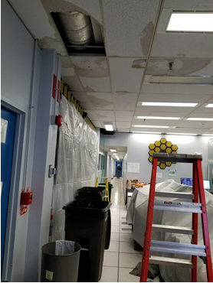
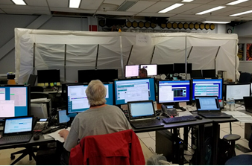
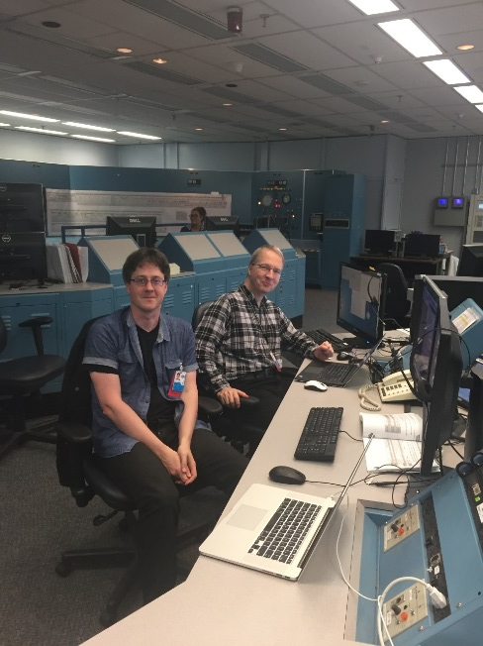
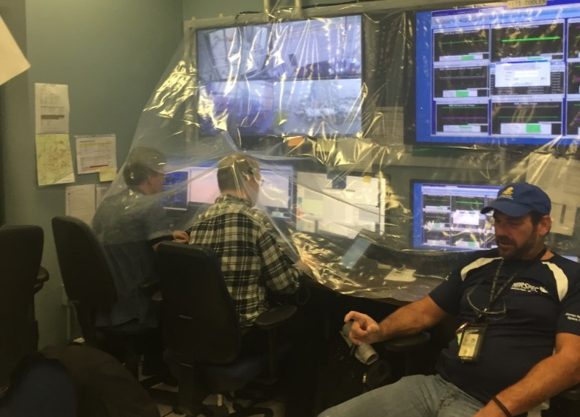
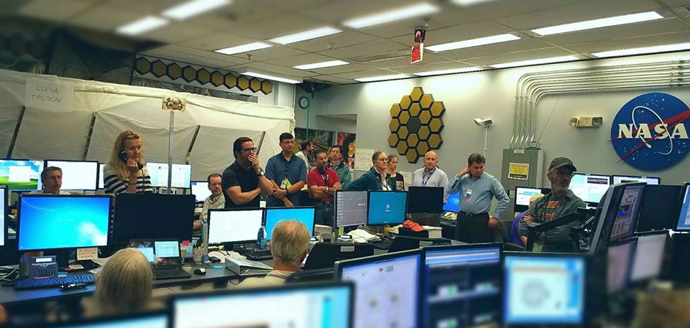
Dealing With Harvey: Test Facilities
Source: NASA/L. Feinberg
Source: NASA/L. Feinberg
Source: NASA/L. Feinberg
Water Damage in Control Room
Plastic Sheeting to Protect Test Stations
Facilities Engineers
Source: NASA/L. Feinberg
Source: NASA/K. Yang
Plastic Sheeting for Personnel
Shift Handover Meetings
Notes:
Within our test facilities, the payload was kept at its existing thermal conditions, but optical testing was temporarily curtailed to ensure hardware safety. We also observed water damage in our control rooms, and lots of heavy duty plastic sheeting was erected to protect the electronics and hardware on our test stations. Our lesson learned here was to keep lots of plastic sheeting and tape around! Shift transitions took on an even more crucial function through this period given the dynamic nature of the storm as they became opportunities for management to discuss and communicate their latest decisions with the rest of the team, for management to request critical personnel to travel in for the next shift, as well as for team members to secure transport on convoys back to their hotels.

Slide 29
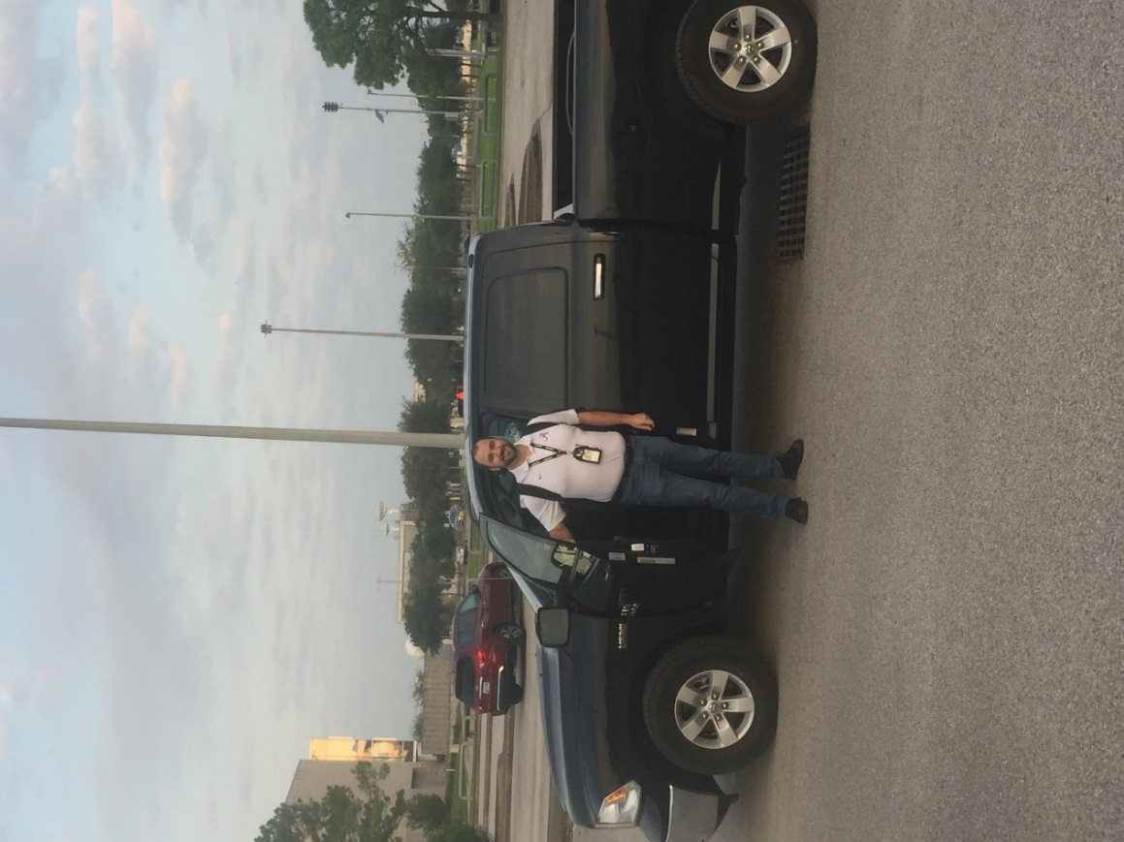
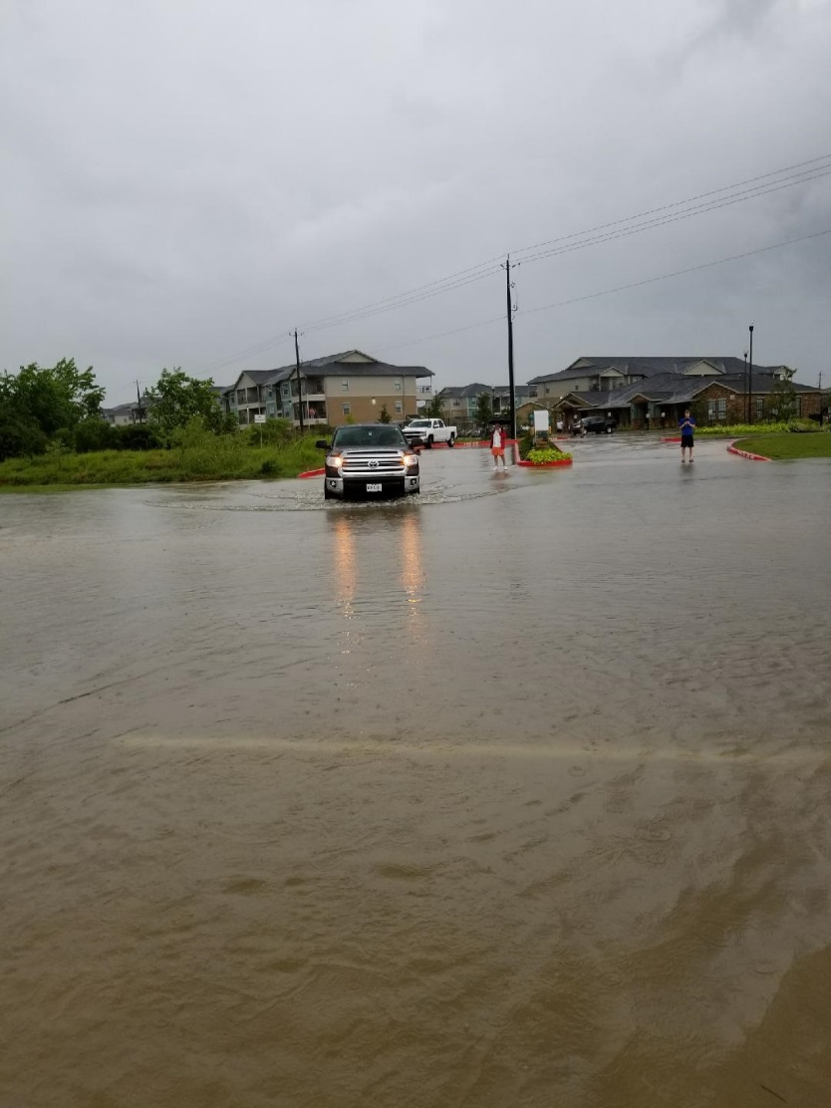
Dealing with Harvey: Several Days into the Storm
Hurricane was slow moving, bands of intense rainfall, winds persisted for 4 days
Carpools organized using trucks / SUVs to ferry personnel to / from hotels due to local road flooding
Road flooding in Houston prevented timely LN2 deliveries for ~ 3 days (only had 5 days reserve on-hand). Great efforts were made to bring in LN2 from alternate supplier.
NASA JSC area fortunately did not lose commercial power, which would have resulted “loss of helium system” scenario
Commercial air travel from local airports was impacted for several days after the hurricane. NASA GSFC, NGAS, Ball Aerospace made special arrangements to provide replacement test support crews
Source: NASA/L. Feinberg
Source: NASA/L. Feinberg
Notes:
Over the next four days, Harvey stalled over Houston, drawing moisture from the gulf and pouring it over Houston in bands of intense rainfall and wind. Severe flooding closed many roads, preventing timely LN2 deliveries to the chamber. This represented a danger to the OTIS CV test team because the cryopumps and helium refrigerator for Chamber A required LN2 for cooling. If the LN2 reserve were to be depleted, these systems would fail, causing the pressure to increase and the environment around the test article to warm, thus disturbing our thermal stability and introducing risk of uncontrolled warmup to the hardware. Fortunately, we were able to bring LN2 from an alternate supplier through great efforts by the management team, and we did not lose commercial power. These allowed us to maintain the payload both safe and stable during the duration of the hurricane.
As for the test personnel riding out the storm in Houston, the carpools continued to be extremely effective to ensure safety between the hotels and Johnson Space Center, and there was great camaraderie among the team members as each brought in food and offered help in their own way to keep everyone in high spirits. The commercial airports around Houston were closed until several days past the hurricane, and to prevent burnout NASA, Northrop Grumman Aerospace Systems or NGAS, and Ball Aerospace each made their own arrangements to bring fresh supplies in and replace test support crews.

Slide 30
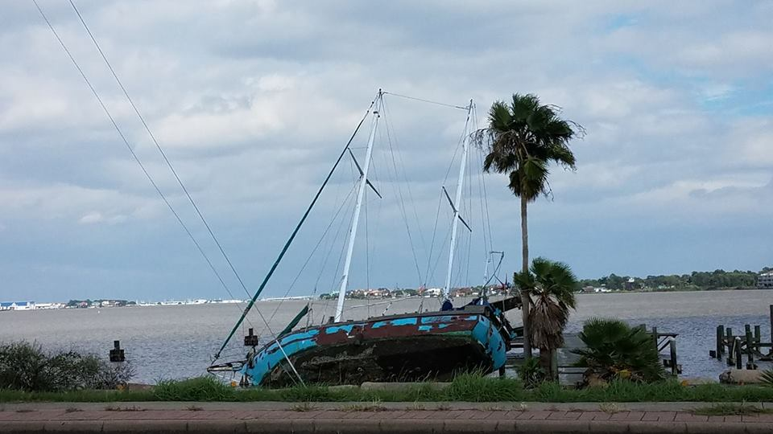
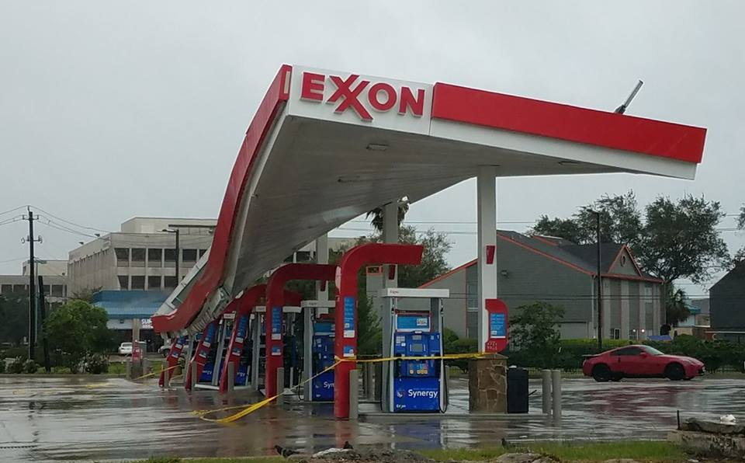
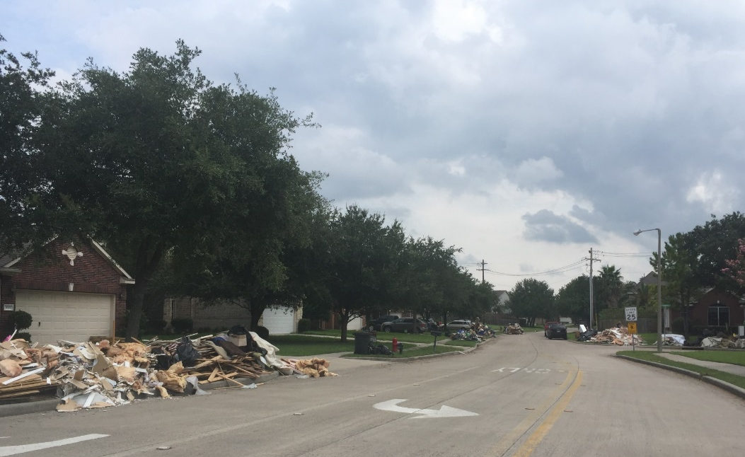
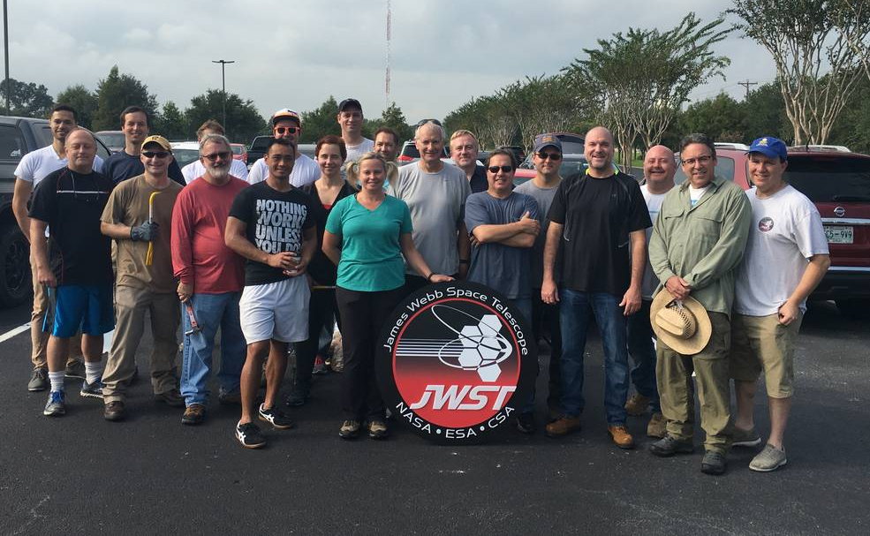
Post-Storm Impacts to the Surrounding Area
Source: NASA/K. Yang
Source: NASA/K. Yang
Source: NASA/L. Feinberg
Source: NASA/The Harbor Church Ref. 7
Notes:
Outside of our own experience at JSC, we were also keenly aware of how serious the storm's impact was on the larger Houston community. Most local businesses were either closed or operated under severe restrictions for quite some time after the hurricane, despite the need for basic necessities. Travel to and from Houston was limited. Widespread flooding occurred, and there was pervasive structural damage near us from the many tornadoes that the hurricane spawned. Many homes were destroyed and lives were lost. After the storm subsided, members of our JWST team gave back by volunteering in recovery efforts. Countless members of the community were now faced with a long road to normalcy after the most costly storm in US history, and we wanted to help in all we could as thanks for a city that welcomed and embraced us through the many years of James Webb Space Telescope testing, from the pathfinders through OTIS CV.

Slide 31
Lessons Learned from Hurricane Harvey
Extensive training of support team is critical to test success, especially familiarity with the hardware and how to execute safing in off-nominal scenarios.
Plan for enough shift support personnel to cover in the event of weather-related events, illness, unplanned test events requiring additional personnel.
Ensure test documentation is up to date and correct.
In addition to comprehensive planning for the test, extensive contingency plans and mitigations need to be developed to ensure personnel and payload safety.
Check as many failures or mitigations as possible prior to final testing to verify how all GSE systems work after a partial failure:
  Do generators start automatically? Is there enough fuel? Enough LN2 for shroud?
  Are manual operations needed to restart certain equipment? Are the processes in place to restart them?
  Are critical GSE and power supplies on UPS and/or generator circuits? Are personnel trained to replace them in the event of an emergency?
  Are there redundant sensors for heaters and redundant GSE heater circuits?
  Hardware backups should always be available: power supplies for critical thermal boundaries/heaters, test measurement equipment, data systems, control electronics, and facilities to allow continued testing or safe test end
Notes:
So what were some of the most important lessons we learned from our own off-nominal event experience? Well, first, training is critical to ensure all members of your team are familiar with the hardware and the correct knobs to turn in an emergency. A scenario like a hurricane is not an appropriate time to start rifling through manuals to figure out where things are. A comprehensive shift schedule and contingency plan are also crucial. However, what may be even more important is to verify that we have the appropriate redundant systems, and that all of them are working before the start of the test. This includes checking as much GSE as possible before a test to ensure that they work in the event of a failure.

Slide 32
Recommendations for Off-Nominal
Planning of Large System-Level Tests
Prior to major thermal vacuum tests, projects should list potential off-nominal events and their effects
  Evaluate risks of failures of GSE, flight hardware, flight software, facilities, utilities, personnel evacuations, etc. in terms of impact to flight hardware
  What is the programmatic impact for repairs? How do they affect schedule and cost?
  Project must be willing to accept remaining risks
Make as many facility and utility provisions as robust as possible. Demonstrate pre-test (without risking flight hardware).
Even if there are certain potential facility or utility failures that cannot be prevented, evaluate potential damage and devise test workarounds or emergency procedures
Notes:
What do we then recommend to other projects going forward in their major thermal vacuum test campaigns? Future projects should evaluate the risks of all potential failures and their programmatic impacts. For those that do not have mitigations, the project must be willing to accept the remaining risks. Projects should make as many facility and utility provisions as robust as possible and demonstrate their functionality pre-test, as well as devise workarounds for potential failures that cannot be prevented. The James Webb Space Telescope has been through a wide range of off-nominal scenarios since the start of I&T, and if there's any consistent rule we can derive from our experiences, it's that what we encounter will always be unpredictable.

Slide 33
Part III Summary
In this lecture, we covered the OTIS CV test off-nominal planning and analysis, and spoke to our own off-nominal scenario experience
  Off-nominal matrix
  Hardware and procedural preparations for off-nominal scenarios
  Our experience during Hurricane Harvey in 2017
In the next lecture, we will discuss the lessons learned from the OTIS CV test
  Both from NASA perspective and those of our partners:
    Northrop Grumman Corporation and Ball Aerospace (flight payload)
    Harris Corporation (GSE)
Notes:
In this lecture, we discussed the extensive preparations that the OTIS CV test team made to prepare for off-nominal scenarios, as well as our own experience with hurricane Harvey. In the next lecture, we will look at some of the lessons learned from the multiple years of the OTIS test campaign, including those not just from NASA'S perspective, but those of our partners as well.

Slide 34
Reference: Acronyms
Acronym | Definition | Acronym | Definition
AOS | Aft Optical System | ESA | European Space Agency
ACF | Auto-Collimating Flat | FGS | Fine Guidance Sensor
ADIR | Aft Deployable ISIM Radiator | FIR | Fixed ISIM Radiator
ASPA | Aft Optical System Source Plate Assembly | FPA | Focal Plane Arrays
BP | Back Plane | FSM | Fine Steering Mirror
BSF | Backplane Support Fixture | GSE | Ground Support Equipment
CoCOA | Center of Curvature Optical Assembly | GSFC | NASA Goddard Space Flight Center
CPP | Cryo-Pumping Panels, cold panels between the Helium and LN2 shrouds at NASA JSC | HOSS | Hardpoint and Offload Support Structure
CSA | Canadian Space Agency | IEC | ISIM Electronics Compartment
CTE | Coefficient of thermal expansion | IR | Infrared
CV | Cryogenic Vacuum | ISIM | Integrated Science Instrument Module, which contains the Science Instruments (SIs)
ΔT, Δt | Change in temperature; change in time | JSC | NASA Johnson Space Center
DTA | Deployable Tower Assembly | JWST | James Webb Space Telescope
DSERS | Deep Space Environment Radiative Sink | K | Kelvin
EC | European Consortium | L&Cs | Limits and Constraints

Slide 35
Reference: Acronyms
Acronym | Definition | Acronym | Definition
L5 | Layer 5 Sunshield simulator | POM | Instrument Pick-Off Mirror
LN2, N2 | Liquid Nitrogen; Gaseous Nitrogen | PM | Primary Mirror(s)
LRM | Launch Release Mechanism | PMSA | Primary Mirror Segment Assembly
MIRI | Mid-Infrared Instrument | PMBSS | Primary Mirror Backplane Support Structure (BSF + BP)
MLI | Multi-Layer Insulation | Q | Heat
NASA | National Aeronautics and Space Administration | SI | Science Instrument
NGAS | Northrop Grumman Aerospace Systems | SINDA | Systems Improved Numerical Differential Analyzer modeling tool
NIRCam | Near-Infrared Camera Instrument | SM | Secondary Mirror
NIRSpec | Near-Infrared Spectrograph Instrument | SMA | Secondary Mirror Assembly
OA | Optical Assembly | SMSS | Secondary Mirror Support Structure
OGSE | Optical Ground Support Equipment, a series of pre-OTIS Optical pathfinder tests | SVTS | Space Vehicle thermal Simulator
OTE | Optical Telescope Element | TM | Tertiary Mirror
OTIS | Optical Telescope Element plus Integrated Science Instrument Module (OTE + ISIM) | TPF | Thermal Pathfinder test
PG | PhotoGrammetry cameras | W | Watt(s)

Slide 36
References
“Hurricane Harvey near the coast of Texas at peak intensity late on August 25, 2017.” Image sourced from NOAA’s GOES-16 satellite. Accessed via University of Colorado RAMMB/CIRA Slider. Aug. 25, 2017. https://commons.wikimedia.org/wiki/File:Harvey_2017-08-25_2231Z.png
Glazer, S. Yang, K., Comber, B., Ousley, W., and Cleveland, P. “Off-Nominal Planning for the Cryogenic Vacuum Test of the JWST Optical Telescope Element/Integrated Science Instrument Module at JSC.” 48th International Conference on Environmental Systems, Albuquerque, NM, July 8-12, 2018.
“Phase diagram of water simplified.” Wikimedia commons, created by user Cmglee. Source: https://commons.wikimedia.org/wiki/File:Phase_diagram_of_water_simplified.svg
Havey, K., Cooke, D., Huguet, J., and Day, R. “Thermal Management of JWST Cryo-Vacuum Test Support Equipment.” 48th International Conference on Environmental Systems. Albuquerque, NM, July 8-12, 2018
Havey, K., Huguet, J., Cooke, D., and Day, R. “Highly Specialized GSE Required for JWST Verification.” 20hermal and Fluids Analysis Workshop. Galveston, TX, Aug. 20-24, 2018
“Hurricane Harvey Advisory Archive.” NOAA National Hurricane Center and Central Pacific Hurricane Center. Aug. 31, 2017. https://www.nhc.noaa.gov/archive/2017/HARVEY.shtml
Villard, E. “James Webb Space Telescope Members Volunteer Following Historic Texas Hurricane.” National Aeronautics and Space Administration featured article. Sep. 21, 2017. https://www.nasa.gov/feature/goddard/2017/james-webb-space-telescope-team-members-volunteer-following-historic-texas-hurricane

