Slide 1
PolySafe: Conflict Detection in a Polynomial Airspace
Brendon Colbert*, Tanner Slagel*, Luis Crespo*, Swee Balachandran** and César Muñoz*
*Dynamic Systems and Control Branch & Safety-Critical Avionics Systems Branch
NASA Langley Research Center, Hampton, VA
** National Institute of Aerospace, Hampton, VA

Slide 2
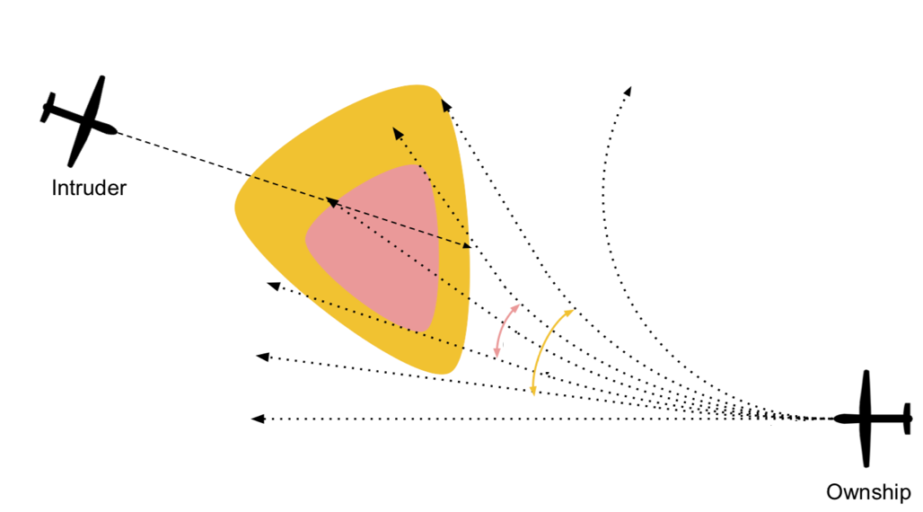
What is a Conflict?
A conflict occurs when a user defined set of constraints is violated.
Conflict detection determines when the set of constraints are violated.
Note: A conflict does not indicate that a collision has occurred.
The orange and red area depict two user defined sets of constraints between the two aircraft.

Slide 3
Goal
To develop an efficient and formally verified conflict detection algorithm for arbitrary polynomial constraints in continuous time.
Our approach is called PolySafe.
Given:
A polynomial path $r\left(t\right)=[p_{x}\left(t\right),p_{y}\left(t\right),p_{z}\left(t\right)]$
A time interval $T=\left[t_{0},t_{f}\right]$
A set of (possibly) time-varying obstacles
$$O_{b}(t)=\left\{(x,y,z) | p_{j}\left(x,y,z,t\right)≤0 ∀ j=1,…,m\right\}$$
where $p_{j}\left(x,y,z,t\right)$ are polynomial functions.
Return:
The initial time of a conflict, if a conflict occurs, or a verification that no conflict occurs

Slide 4
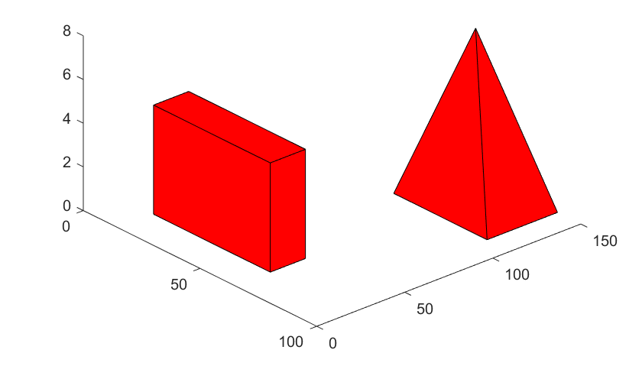
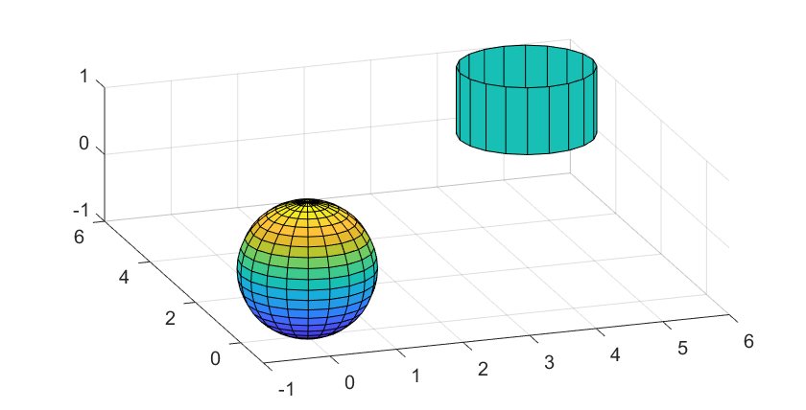
Obstacles Specified as Polynomial Constraints Include
Simple Polyhedron:
Curved Surfaces:
Cube: $x≥0; x≤5;$
$z≥0;z≤1;$
$y≥0;y≤5;$
Floor: $z≥0$;
Ceiling: $z ≤30;$
Sphere: ${R^{2}−(x−a)}^{2}−y^{2}−z^{2}≥0;$
Cylinder: $z≥0;$
$z≤1;$
$R^{2}−{(x−a)}^{2}−({y−b)}^{2}≥0;$
Unions and intersections of these obstacles are also valid.

Slide 5
Obstacles can change with time
Simple Polyhedron:
Curved Surfaces:
Cube: $x+at≥0; x≤5;$
$z≥0;z≤1;$
$y≥0;y≤5;$
Floor: $z≥0$;
Ceiling: $z ≤30+t;$
Sphere: ${R^{2}−(x−at+bt^{2})}^{2}−y^{2}−z^{2}≥0;$
Cylinder: $z≥0;$
$z≤1;$
$R^{2}−{(x−at+{bt}^{2})}^{2}−({y−ct+{dt}^{2})}^{2}≥0;$
Obstacle inequalities may vary with time as well.

Slide 6
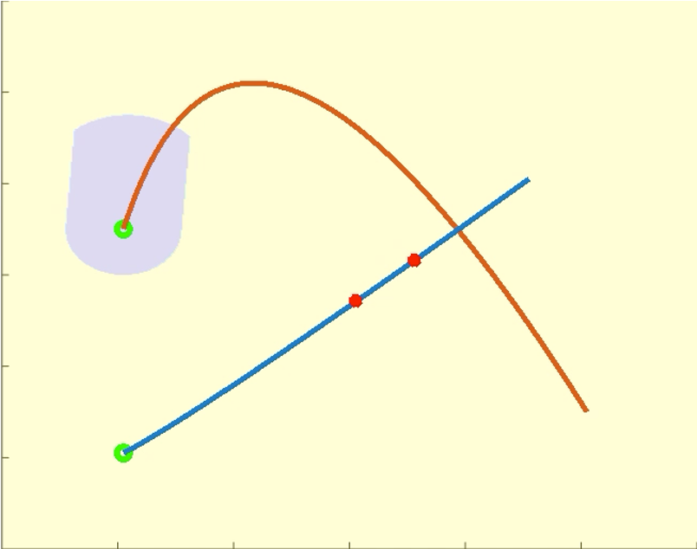
The Well-Clear Volume
The well-clear volume is a dynamic constraint.
Both the shape and position change as a function of the relative position and velocity of two aircraft.
Can be represented as the union of three sets of polynomial constraints.
The dynamic well clear volume (purple) between two aircraft (green) can be represented with the union of polynomial constraints and conflicts (red) can be detected.

Slide 7
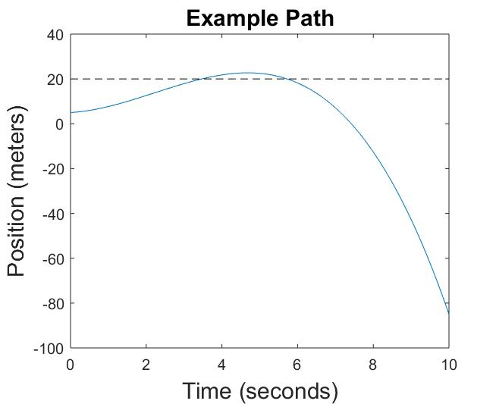
PolySafe Example
Path:
$x\left(t\right)=−0.3t^{3}+2t^{2}+t+5$
Obstacle:
$x≥20$
Time Constraints:
$0≤t≤10$
Replacing $x$ with $x\left(t\right)$ results in these Polynomial Constraints:
$t≥0$; $10−t≥0$; ${−0.3t}^{3}+2t^{2}+t−15≥0.$

Slide 8
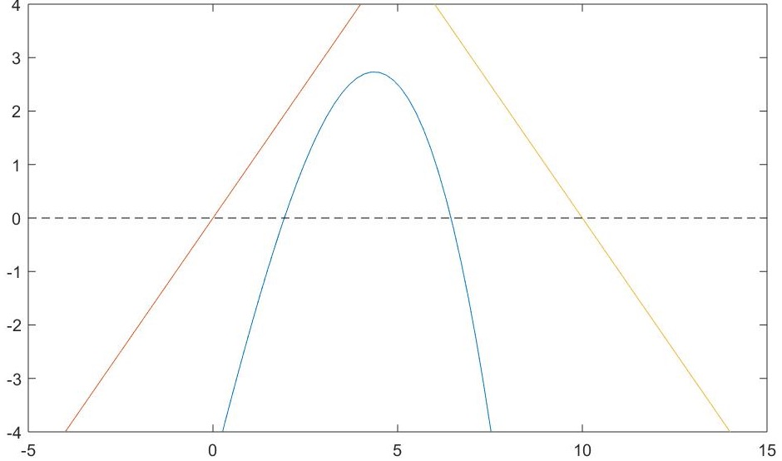
$$t≥0$$
$$−t+10≥0$$
$$x(t)≥20$$

Slide 9
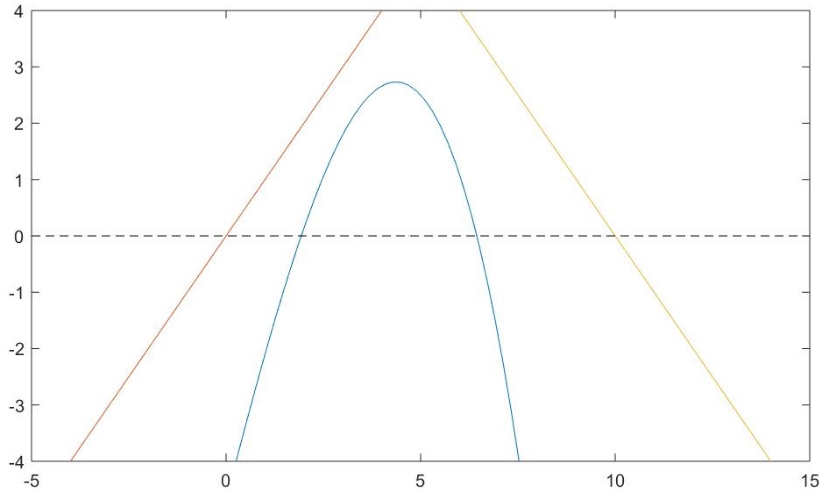
$$t≥0$$
$$−t+10≥0$$
$$x(t)≥20$$
Obstacle

Slide 10
$$t≥0$$
$$−t+10≥0$$
$$x(t)≥20$$
Obstacle

Slide 11
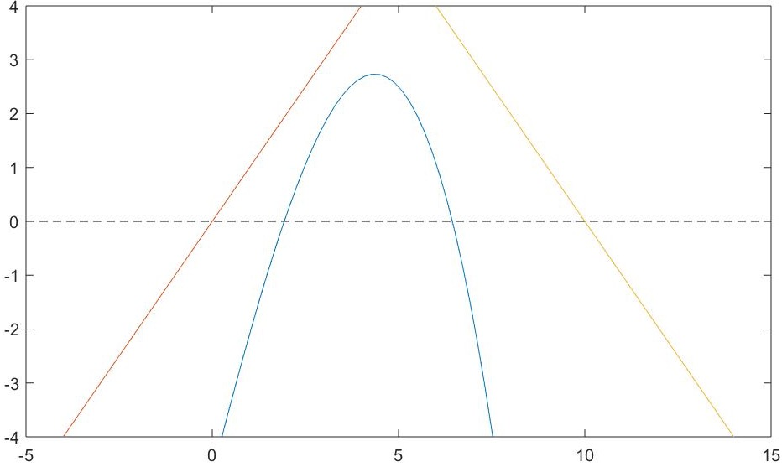
$$t≥0$$
$$−t+10≥0$$
$$x(t)≥20$$
Obstacle

Slide 12
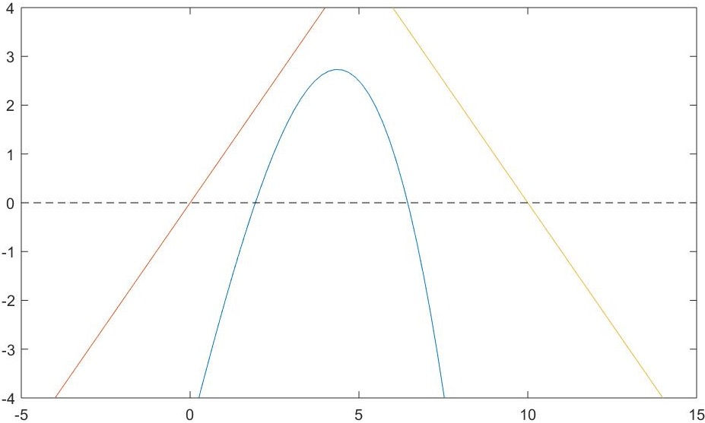
First conflict
occurs at a root.
Conflict
ends at a root.
$$t≥0$$
$$−t+10≥0$$
$$x(t)≥20$$
Obstacle

Slide 13
No root means no conflict
$$t≥0$$
$$x(t)≥25$$
$$−t+10≥0$$
$$x(t)≥20$$
Modified
Obstacle
Obstacle

Slide 14
Modified
Obstacle
First conflict occurs sooner (still at a root)
End of conflict occurs later (still at a root)
$$t≥0$$
$$−t+10≥0$$
$$x(t)≥18$$
$$x(t)≥20$$
Obstacle

Slide 15
The PolySafe Algorithm
Replace x, y, and z in the inequality constraints with 𝐱(𝐭),𝒚(𝒕),𝒛(𝒕)
$Example Obstacle: x≥0; x≤5;$
$Example Univariate Inequalities: bt^{2}+ct+d≥0; bt^{2}+ct+d≤5$
Find the roots of these univariate polynomials
Analytical solutions for low degree polynomials, fast numerical solutions for higher degrees.
Reject invalid roots (imaginary roots or roots outside the time interval T)
Evaluate each inequality constraint at the initial time
Violated (positive)
Not Violated (negative)
Update the evaluation at each root
Return conflict time and location if any exist

Slide 16
PolySafe is Formally Verified
Theorem 2. For a polynomial path $r\left(t\right)=[p_{x}\left(t\right),p_{y}\left(t\right),p_{z}\left(t\right)]$, an obstacle
$$O= \left\{(x,y,z) | p_{j}\left(x,y,z,t\right)≤0, ∀ j=1,…,m\right\}$$
where each $p_{j}\left(x,y,z,t\right)$ is a polynomial function, and $t_{0},t_{f}$such that $t_{f}>t_{0}$, the PolySafe algorithm returns $t^{∗}$, if and only if the earliest violation between $r\left(t\right)$ and $O$ in ${[t}_{0},t_{f}]$occurs at $t^{∗}$.
Theorem 2 is verified in the Prototype Verification System (PVS)
PVS provides a high-level assurance of mathematical correctness of the algorithm.
The verification states that under real arithmetic, if all roots of the polynomial are precisely known, then PolySafe is guaranteed to detect the earliest conflict.

Slide 17
The Efficiency of PolySafe
We randomly generate degree 3 polynomial paths to test the average speed of PolySafe.
For each geometrical shape we perform 1000 tests and report the average time and the standard deviation as well as the number of constraints used to make the shape.
Obstacle | Max Degree | Number of Constraints | Time (ms) | STD (ms)
Pyramid | 3 | 5 | 0.215 | 0.047
Cube | 3 | 6 | 0.281 | 0.092
Sphere | 6 | 1 | 0.073 | 0.012
Cylinder | 6 | 3 | 0.159 | 0.029
Well-Clear | 24 | 16 | 0.829 | 0.127
* Tests performed on a computer with a 2.8GHz quad-core Intel Core i5 processor and 8 GB of 1867MHz LPDDR3 onboard memory

Slide 18
Applying Well-Clear Conflict Detection
Efficient detection of obstacles allows the consideration of complex airspaces.
The piecewise polynomial path (blue) composed of 11 polynomials can be verified in approximately 30 ms.
Efficiency of PolySafe allows us to check for conflict detection in real time as flight paths change.
PolySafe can detect conflicts with static (grey) and dynamic (red) obstacles, for UAS (green) following a piecewise polynomial path (blue).

Slide 19
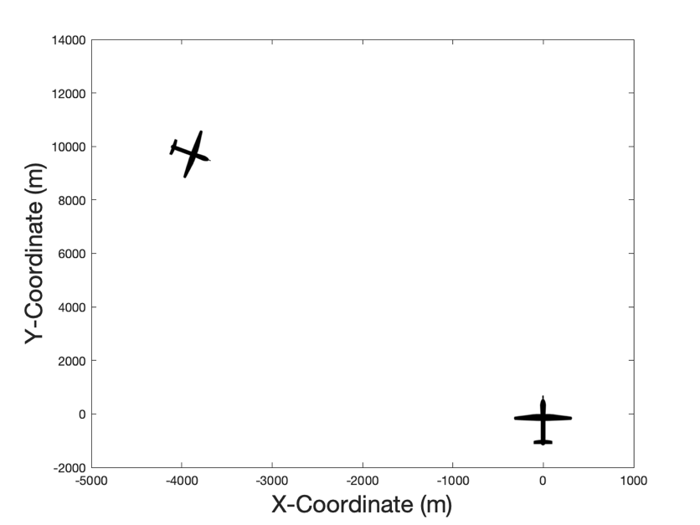
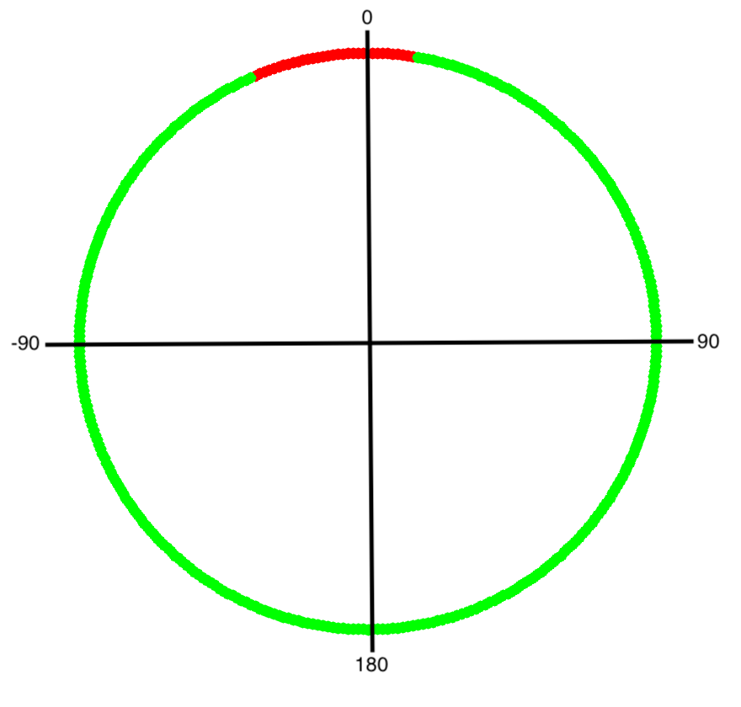
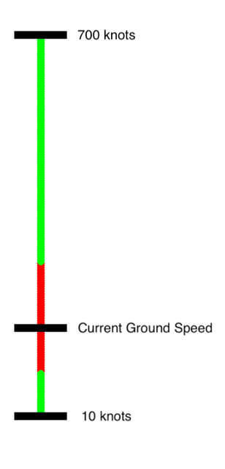
Applying Well-Clear Conflict Detection
Path Warning/Resolution:
Assume other plane is travelling at a constant speed on a linear path.
We can warn if a current trajectory produces a conflict.
We can test simple maneuvers to find a resolution (<.1 seconds)
Valid Headings
Valid Ground Speeds

Slide 20
Summary of PolySafe
No discretization – Checks for conflicts in continuous time.
Very efficient – Checks for hundreds of obstacles in just a tenth of a second.
Complex obstacles – Obstacles are defined by polynomial inequalities and can be time varying.
Accepts complex paths – Piecewise polynomial paths can be checked efficiently.
Formally verified in PVS.

Slide 21
Future of PolySafe
How do numerical errors in calculating the roots of the univariate polynomials affect PolySafe?
Can we account for uncertainty in the position and velocity of the aircraft.
How can we use PolySafe with path resolution algorithms to resolve conflicts.

