Slide 1

Flood Pilot Update
Committee on Earth Observation Satellites
Guy Schumann, Remote Sensing Solutions
Andrew Molthan, NASA Marshall
Mitch Goldberg, NOAA/NESDIS
Flood Pilot Group Discussion
8 June 2020

Slide 2
Co-Leads and Introductions
Dr. Guy Schumann, Remote Sensing Solutions
  Principal Scientist at Remote Sensing Solutions Inc. His research and expertise focus around flood risk, from local to global scale, using flood modeling, prediction and remote sensing
Dr. Mitch Goldberg, NOAA/NESDIS
  NOAA’s Chief Scientist for Low Earth Orbiting Satellites; leads the NESDIS Satellite Proving Ground program to improve NOAA services
Dr. Andrew Molthan, Marshall Space Flight Center
  Research Meteorologist at NASA Marshall, collaborates with NASA’s Disasters Program to help the disasters community use NASA data and tools

Slide 3
Highlights Since Last Meeting
WGDisasters Meeting in March (virtual)
  During a one-day session, we met with all interested parties and discussed the kickoff and goals of a WGDisasters Flood Pilot
    Goals include looking at case studies of interest for optimal combination of optical imaging from geostationary and polar orbit, and complementary SAR observations.
    From these case studies, work with community of partners to document needs, requirements, and best practices.
    Solicited input on case studies of interest to partners using a Google Forms approach and follow-up emails.

Slide 4
Goals for Today’s Meeting
WGDisasters Meeting of June 8
  Review inputs collected from partners during March meeting, Google Forms submissions, and follow-ups that took place via email.
  Clarify and refine focus areas for a small number of case studies for collaboration by CEOS WGDisasters Flood Pilot partners, through various means:
    Contributing your expert analysis of the event derived from optical/SAR approaches, models, and other in situ observations of the flood event.
    Begin discussions about agency sharing of additional data products that partners can use to develop and compare flood mapping approaches.

Slide 5
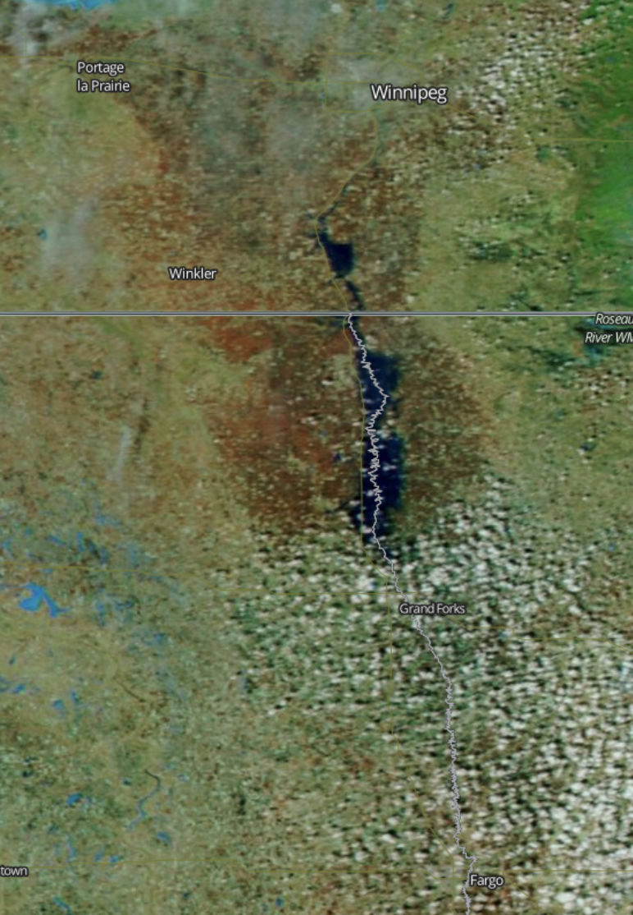
Red River of the North
Winter-Spring 2020
Seasonal, significant flooding often due to rapid snowmelt and rainfall in late winter and early spring
Unique advantages for SAR in helping penetrate cloud cover
Optical NIR/SWIR help to separate water, snow and other features
Expected Outcomes
                SAR-based maps of flood extent generated through Radarsat-2 and Radarsat Constellation Mission (RCM) imaging
GEO and LEO optical imaging provided by GOES ABI and JPSS/VIIRS instruments
Additional flood mapping available from Sentinel-2 and Landsat imagers
Commercial data (Planet) exploration potential through the NASA (TBC)
Explore combinations of optical/SAR for individual daily and maximum extent mapping
Winnipeg
Fargo
NASA MODIS via Worldview
Status and Level of Effort
Data Needs, Challenges, and Risks
                Leads: NRCan, NOAA, NASA
                Radarsat-2 and RCM maps have been developed for recent extremes in April 2020, along with products available from ABI/VIIRS instruments
                Additional mapping available from Sentinel-1
                Pursuing data access through other platforms, including Sentinel-2/Landsat and Planet
                Seeking other SAR data to expand frequency and polarization diversity; coherence-based approaches.
                Identify in situ data for individual daily product validation and maximum flood extent through high water marks or other approaches.
                Additional data collection potential
                DigitalGlobe/Planet Labs imaging
                Commercial SAR collections
                Civil Air Patrol / other aerial imaging or information shared via social media

Slide 6
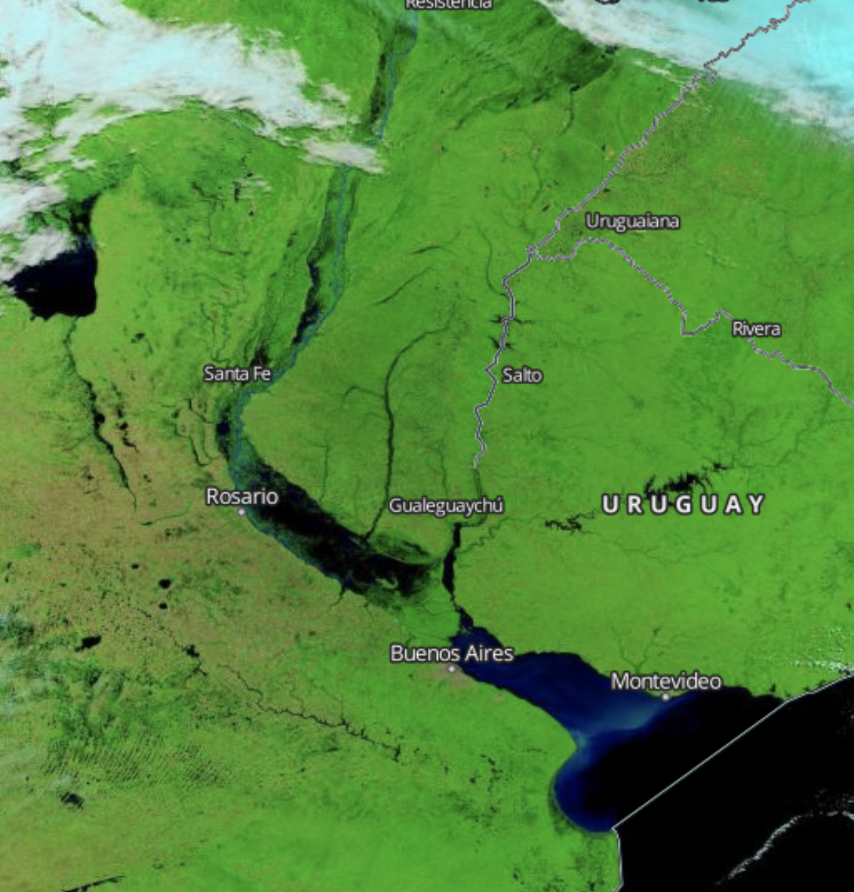
Río de la Plata Basin – Transboundary Flooding
Event Dates TBD
The second largest drainage basin in South America, it touches on or includes five countries with unique water management and mapping approaches
Includes the Paraná, Paraguay and Uruguay Rivers.
Expected Outcomes
                SAR-based mapping of flood extent from events of interest, complemented by GEO and LEO via GOES/ABI and JPSS/VIIRS
Additional flood mapping available from Sentinel-2 and Landsat imagers
Commercial data (Planet) exploration potential through the NASA (TBC)
Collaborations among affected partners to better understand needs for data sharing, flood mapping, and response efforts
NASA MODIS via Worldview
Status and Level of Effort
Data Needs, Challenges, and Risks
                Leads: CONAE, TBD
                Region of interest identified and refining to include significant events for data sharing. SAOCOM data available for sharing but similar flood events have not yet occurred in this area during mission time.
                Look for additional in situ data to help characterize success of mapping efforts.
                SAOCOM data available to be shared but a major flood event has not yet occurred in this region in the SAOCOM database.
                Additional data collection potential
                DigitalGlobe/Planet Labs mapping available through NASA Commercial Data Buy

Slide 7
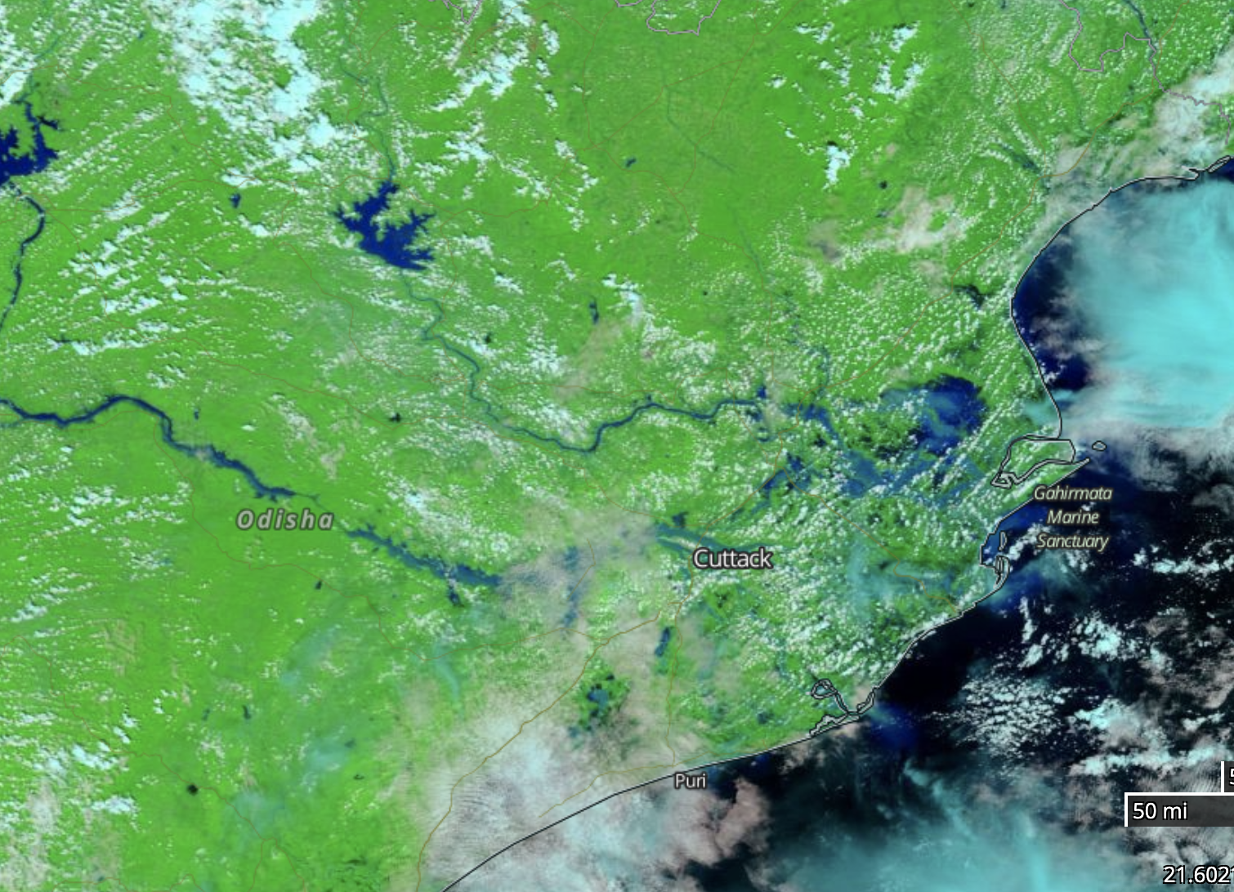
Mahanadi River Delta – Coastal Flooding
Cyclone Amphan (2020) or Cyclone Fani (2019)
A large, relatively flat and expansive basin in eastern India, the Mahanadi experiences flooding from heavy monsoonal rains, typhoons, and related storm surge
Recently impacted by Typhoon Amphan, in addition to past storm events
Expected Outcomes
                Improved capability to map flood extent from combined optical and SAR; continued development of algorithms to benefit during NISAR operations period
                Produce flood inundation maps, hazard maps, vulnerability maps, and combine with available flow data and other in situ observations
NASA MODIS via Worldview
Status and Level of Effort
Data Needs, Challenges, and Risks
                Leads: ISRO, TBD
                Region of interest and potential events have been defined, need to bring together available data sets from free and open sources or those shared (Sentinel-1, geostationary/LEO, Landsat/Sentinel-2) and others
                In situ data needed for flood observations at any given time and to understand maximum extent or high water mark coverage
                Looking for additional data coverage from multiple sensors including ASTER, CARTOSAT-1, ALOS DEM, CARTOSAT-2 high resolution images, Radarsat-1, 2 and RISAT-1 images and Sentinel-1 A/1B datasets
                DigitalGlobe/Planet Labs mapping may be available through NASA Commercial Data Buy or other Charter assets

Slide 8
Other Cases
CEOS Flood Pilot interested parties had other cases proposed and are encouraged to continue – we welcome shared information about those cases beyond the three proposed.
If we can get more detail about some regional events (e.g. China/Pearl River) and others, we can form additional teams focused on helping develop and test use cases in those areas.
  We would like to stay limited to no more than 5 team-focused case studies to help keep focus and monthly progress.

Slide 9
Case Study Team Expectations
We would like to select the previous case studies as our first areas of interest as they touch on a few thematic areas where multiple parties and collaborators can exchange data and information:
  Interior, seasonal flooding attributed to combined snowmelt and heavy rain – Red River of the North
  Transboundary flood issues in a complex basin – La Plata River Basin in South America
  Coastal, river delta, and tropical cyclone impacts – Mahanadi River Delta of eastern India
We would like participants to identify cases where they are willing to collaborate, develop and share flood mapping, and prepare to share their progress in a series of monthly, brief follow-up calls.
We will also work together on formal CEOS processes of identifying and sharing additional data sets.

Slide 10
Data Needs
Each team should spend the next two weeks confirming their case of interest and identifying complementary data sets or products they would like help in acquiring from CEOS partners.
For those participating from data-providing agencies, help us by identifying products you can share for the following regions and periods:
Red River of the North
  March, April, and May 2020
La Plata River Basin
  Dates TBD
Mahanadi River Delta
  Cyclone Amphan, Mid-Late May 2020
  Cyclone Fani, Late April to Early May 2019

Slide 11
Data Needs
Teams will need to provide information for the CEOS data management and access process.

Slide 12
Recurring Tag-Ups
We would like to find a recurring, common time for follow-up discussions to share highlights of case study progress, data topics, and other needs.
This time of day and week seemed popular – any objections to looking for a recurring time, such as the “Second Monday of the month at XX UTC…” to help with organization?
  If scheduled days fall on a holiday or significant conferences, etc. then such a month could be postponed or cancelled.

Slide 13
Backups

Slide 14
Combined Value of LEO/GEO and SAR
Questions:
  What are the water extent and flood mapping activities currently being tackled by the CEOS partner community?
    Capture efforts in optical, SAR, other platforms
  What are the requirements (and potential desirements) for sustaining and improving these capabilities?
  What observations or modeling resources are available to assist with calibration/validation of LEO/GEO, SAR, and their combination?
  How can we best combine these diverse measurements to improve the value of LEO/GEO and SAR to the community?
  How are resulting data and products currently being shared and used by the disaster risk, resilience, and response community?

Slide 15
Proposed Pilot Objectives
Objective A
  Solicit input from CEOS partnering agencies and participants on current and upcoming efforts to map water and flood extent from diversity of LEO/GEO and SAR contributions
Objective B
  Capture underlying requirements and future needs to sustain and improve upon these capabilities.
Objective C
  Explore ideal combination of LEO/GEO/SAR flood mapping outputs, using representative regional events of interest to partners.
  Develop and document best practices for combining and sharing flood information from multiple platforms with diversity in sensor, spatial/temporal resolution, etc.

Slide 16
Proposed Pilot Deliverables
Objective A
  Document requirements, current and future needs for remote sensing in LEO/GEO and SAR to sustain and advance water and flood extent mapping capabilities.
Objective B
  Develop and share information online to aggregate sources of water extent and flood mapping information
Objective C
  Demonstrate and document best practices for combining LEO/GEO and SAR flood extent mapping

Slide 17
Questions / Group Discussion
What are your thoughts about these objectives?
How can CEOS best bring together partnering agencies to capture needs and improve combined use of LEO/GEO/SAR?
How would your team contribute to these efforts?

Slide 18
Proposed CEOS Objectives
Assist CEOS partners with developing documented requirements or future needs for the mapping of water and flood extent from Earth observations
Aggregate information about CEOS community flood mapping efforts and share through an online portal for background and access to resources during flood events
Develop and demonstrate best practices for combining multiple platforms and sources of information to assist in response to major flood events mapped with LEO/GEO and SAR assets

Slide 19
Proposed CEOS Contributions
Serve as coordinating body to facilitate participation by member agencies, through WGDisasters
  Share information on the current state of flood mapping and promising new techniques leveraging LEO/GEO and SAR
  Coordinate and support sharing of imagery to support analysis of past regional events of interest and those that may arise during the time of the pilot collaboration
  When possible, provide feedback to other CEOS efforts (e.g. CARD4L, etc.) supporting routine and improved access to LEO/GEO and SAR data sets
  Partnering agencies provide appropriate project support to oversee implementation and execution of pilot activities

Slide 20
Proposed Next Steps
Discuss concept of WGDisasters Flood Pilot among potential partners, suggest revisions and refined direction
Create portfolio of the flood community – document remote sensing requirements, data formats, and ancillary data across optical and SAR platforms
Identify water extent and flood mapping capabilities and techniques throughout CEOS agency efforts
Create a CEOS Flood Portal to share documentation on requirements and capture capabilities for flood detection along with related forecasting and analysis websites.
Use case studies to explore best practices for combining LEO/GEO and SAR information from multiple spatial/temporal resolutions
Share lessons learned on mapping capabilities and combined LEO/GEO and SAR in partnership with WGCapD

Slide 21
Expressions of Interest
Potential Participants | Organizations
Theodora (Dorella) Papadopoulou Philippe Bally Roberto Ruadi Patrick Matgen | ARGANS European Space Agency CIMA Research Foundation Luxembourg Institute of Science and Technology (LIST)
Haris Kontoes Issaak Parcharidis | National Observatory of Athens University of Athens
Weiyuan Yao | Academy of Opto-Electronics / Chinese Academy of Sciences
Shantanu Bhatawdekar Praveen Thakur Prakash Chauhan S. P. Aggarwal | Indian Space Research Organization
Álvaro Soldano | Comisión Nacional de Actividades Espaciales (CONAE)
Sandro Martinis | German Aerospace Center (Deutsches Zentrum für Luft- und Raumfahrt; DLR)
Yves Crevier Vern Singhroy Vince Decker | Canadian Space Agency Natural Resources Canada

Slide 22
Expressions of Interest
Potential Participants | Organizations
Franz Meyer | University of Alaska Fairbanks
Kristy Tiampo | University of Colorado
Sang-Ho Yun Savannah Cooley | NASA / Jet Propulsion Laboratory
Guy Schumann | Remote Sensing Solutions

Slide 23
Questions / Group Discussion
Are expected CEOS Contributions reasonable?
Are there new partners looking to engage and contribute?
What capabilities or areas of expertise can your agency contribute?

Slide 24
Questions / Group Discussion

