Slide 1


Being an Environmental Engineer at NASA
National Aeronautics and Space Administration
Ryan O’Meara
www.nasa.gov

Slide 2


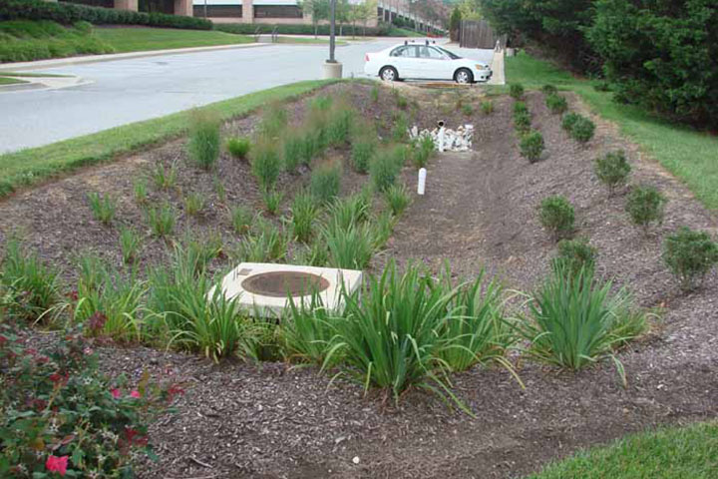
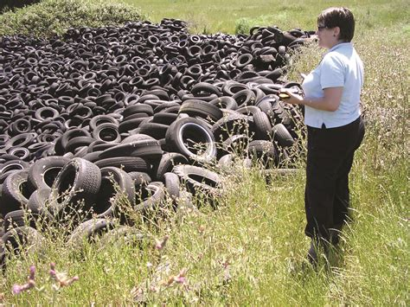
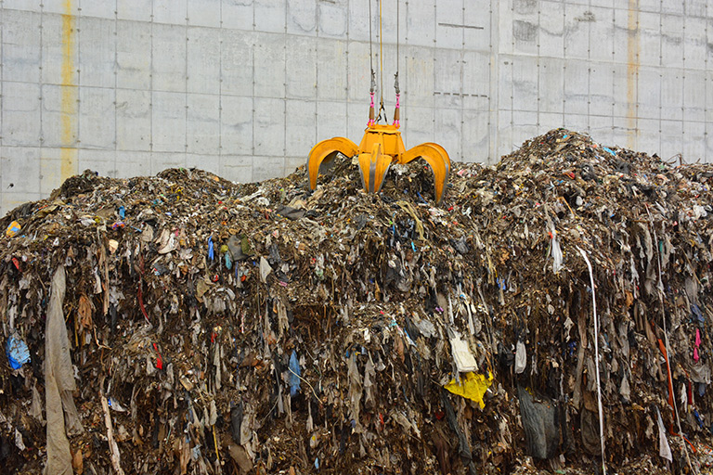
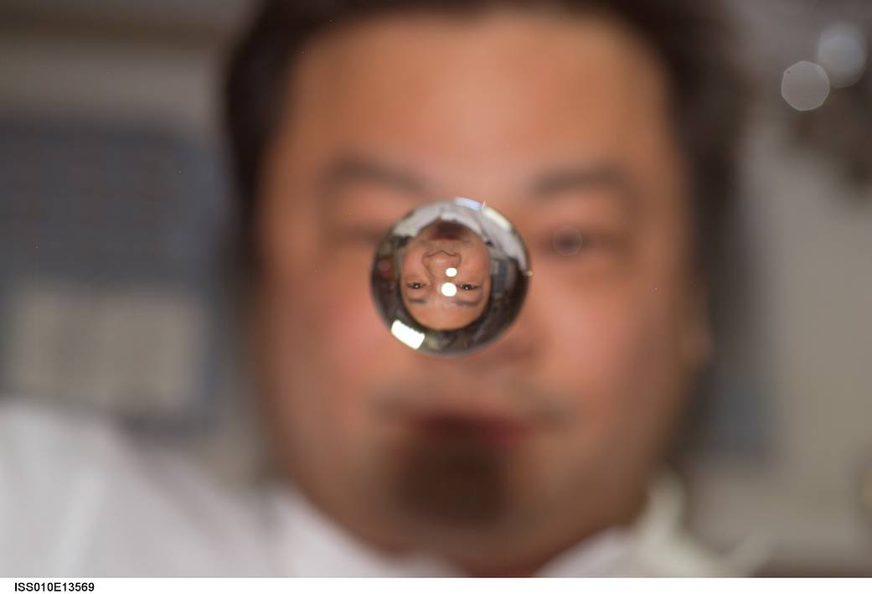
What is environmental engineering?
Environmental engineers solve problems involving:
    Wastewater management
    Drinking water treatment
    Air pollution prevention
    Waste disposal
    Hazardous waste cleanups

Slide 3

What is NASA?

Slide 4


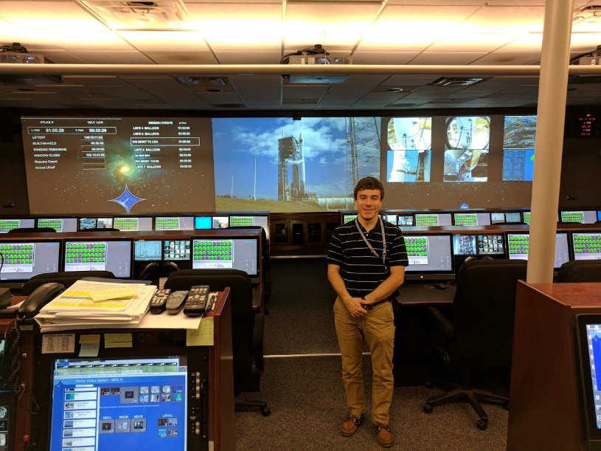
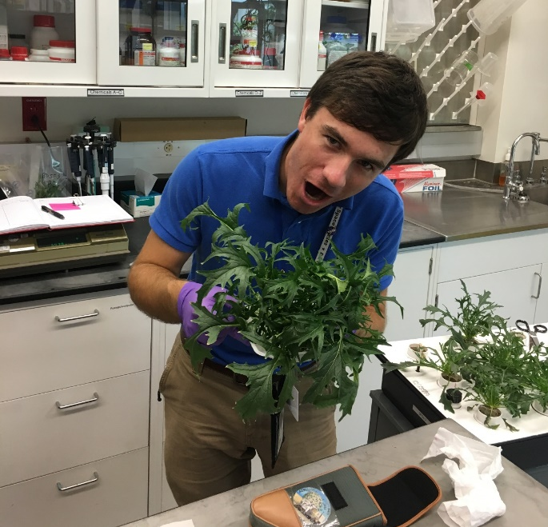
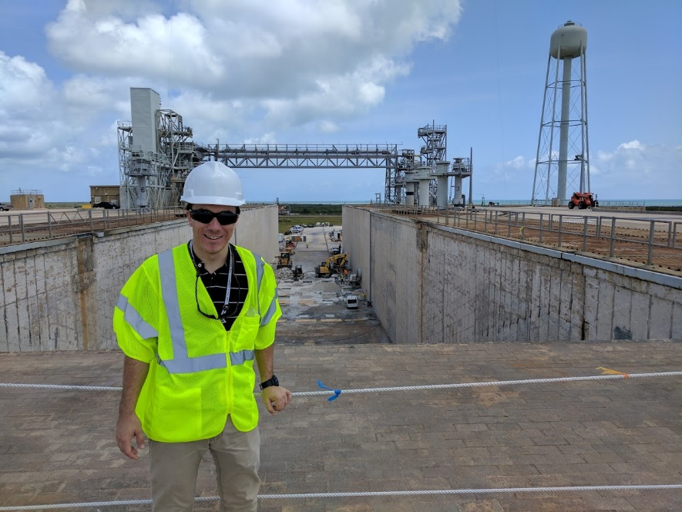
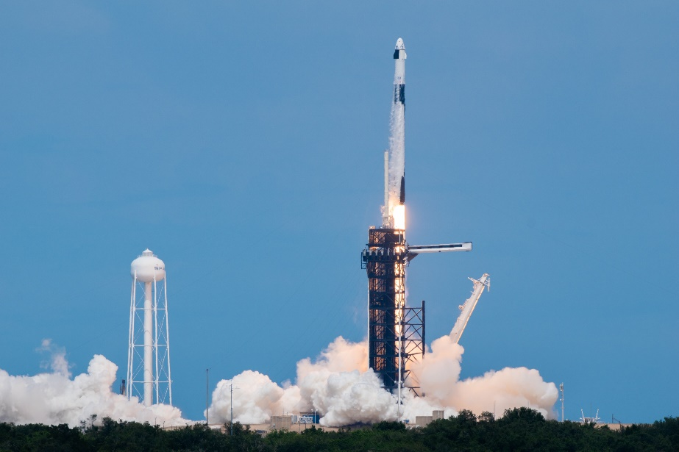
What is it like working for NASA?

Slide 5

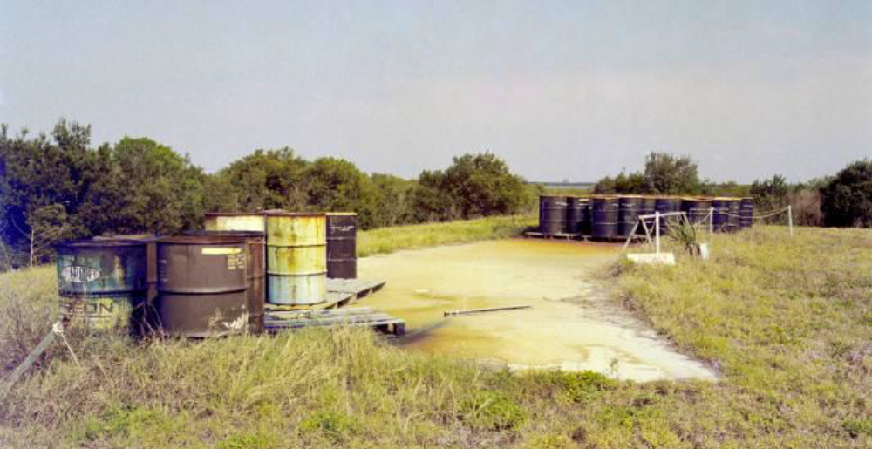

What do I do at NASA?
Image Source: National Archives Cataglog (catalog.archives.gov)

Slide 6
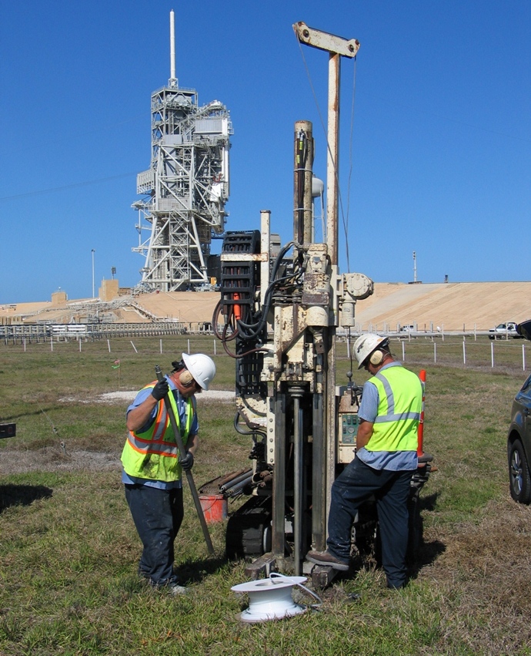
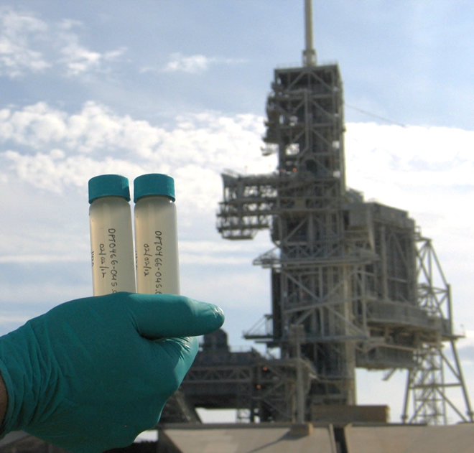
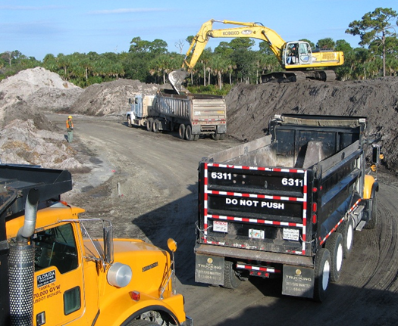
What do I do at NASA?
What?
How Much?
How?

Slide 7
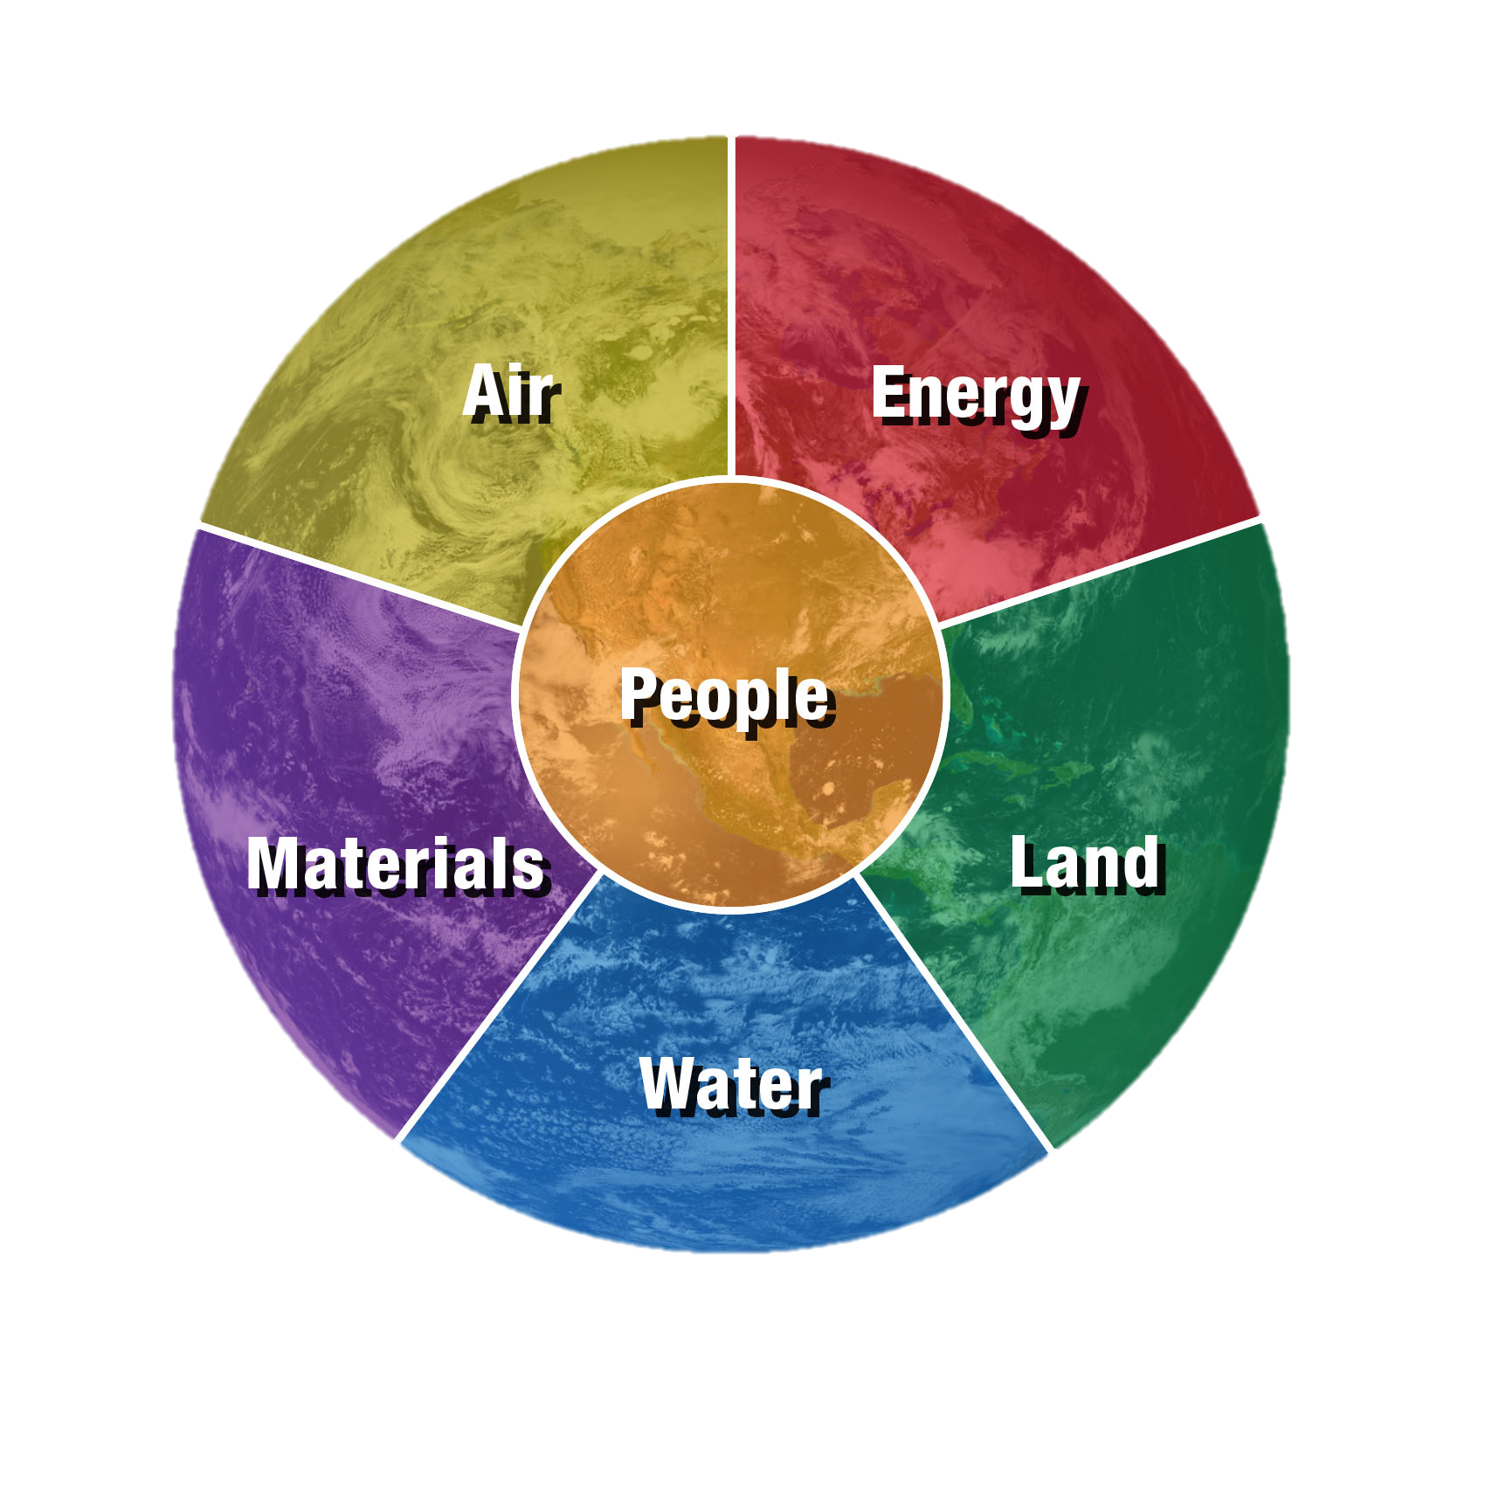
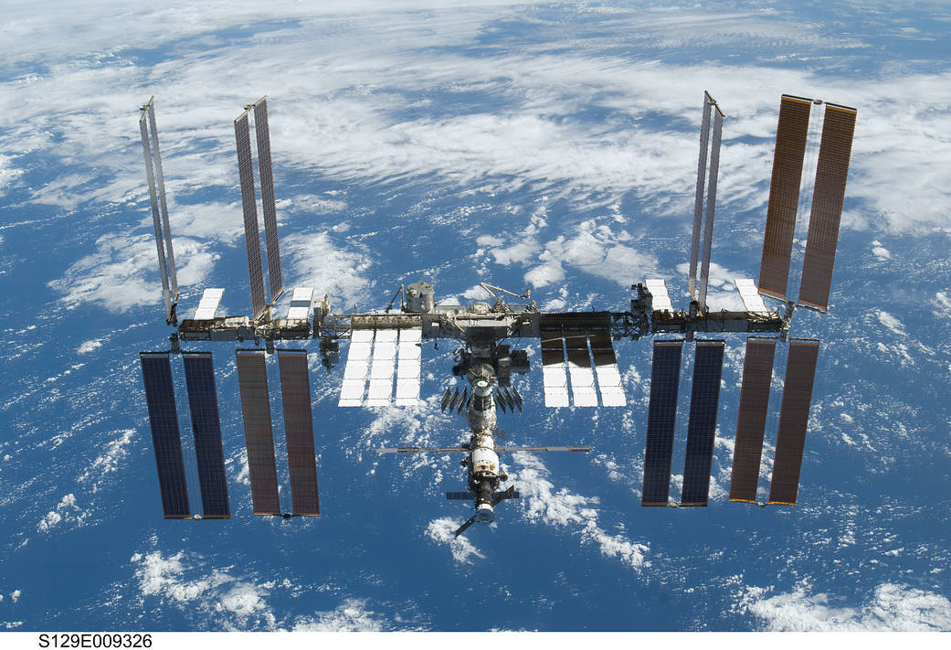
What can you do to help?
Some of the same things we do in space!
  Reduce, Reuse, Recycle
  Conserve Energy
  Conserve Water

Slide 8
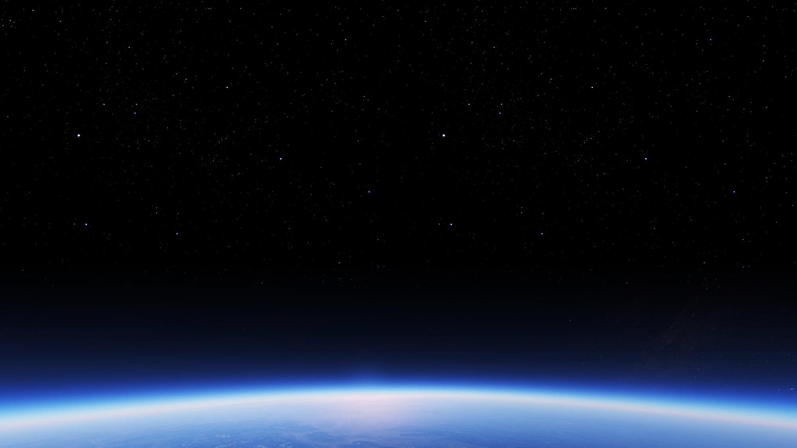

Questions?

