Slide 1
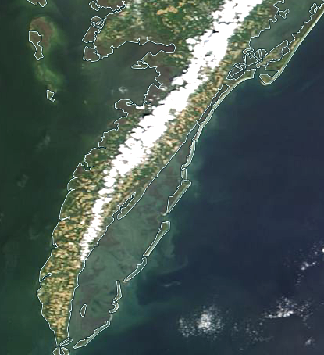


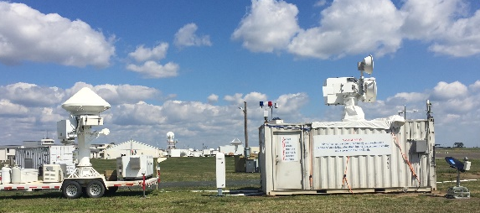

PBL and Clouds: Coastal Region
WFF
PBL structure & evolution influence cloud development
Clouds/precip modulate PBL properties, turbulent energy/moisture exchanges
Overcome observational deficiencies and gaps in knowledge of clouds and precipitation at low-levels using ground-based measurements
Cloud/precipitation profiles + PBL thermodynamics → key information and constraints for development and evaluation of PBL and cloud parameterizations in weather & climate models, aid future PBL mission validation
GSFC+WFF assets: low risk, cost efficient
  ACHIEVE W-, K-, X-band Doppler radars, ceilometer (D3R: Ku-, Ka-band radars)
  Cloud-drizzle-light rain spectra from surface through PBL and cloud layer(s)
  Numerous surface gauges, towers, *SURF²
ACHIEVE
D3R
Adrian Loftus &
SMARTLabs team

