Slide 1
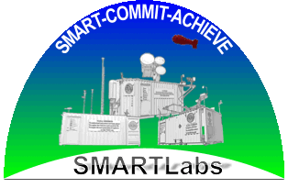
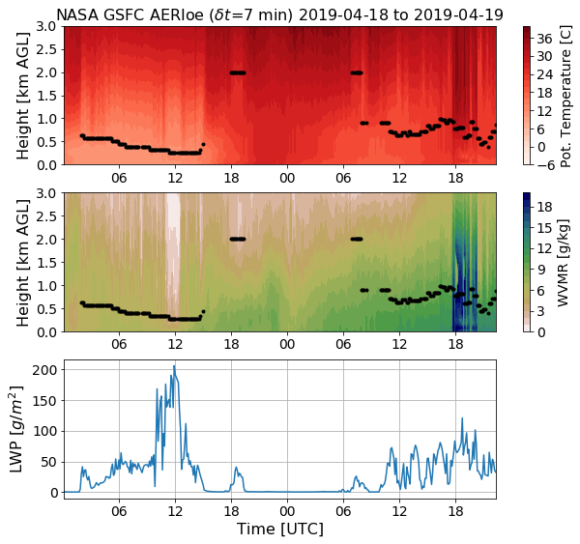
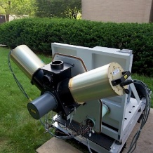
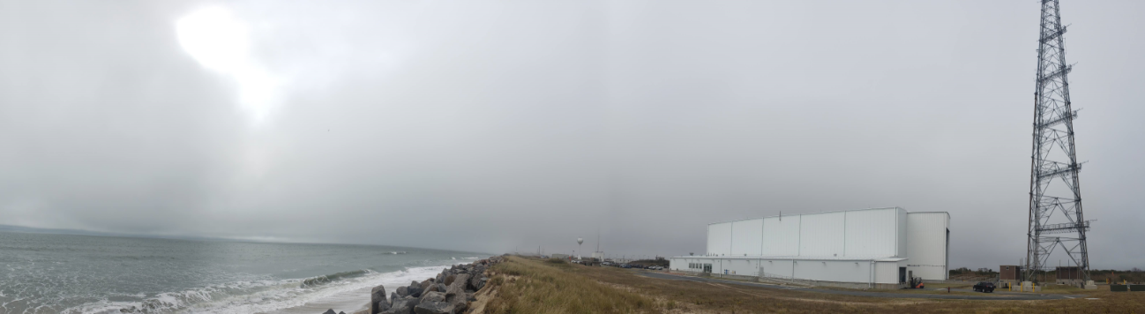
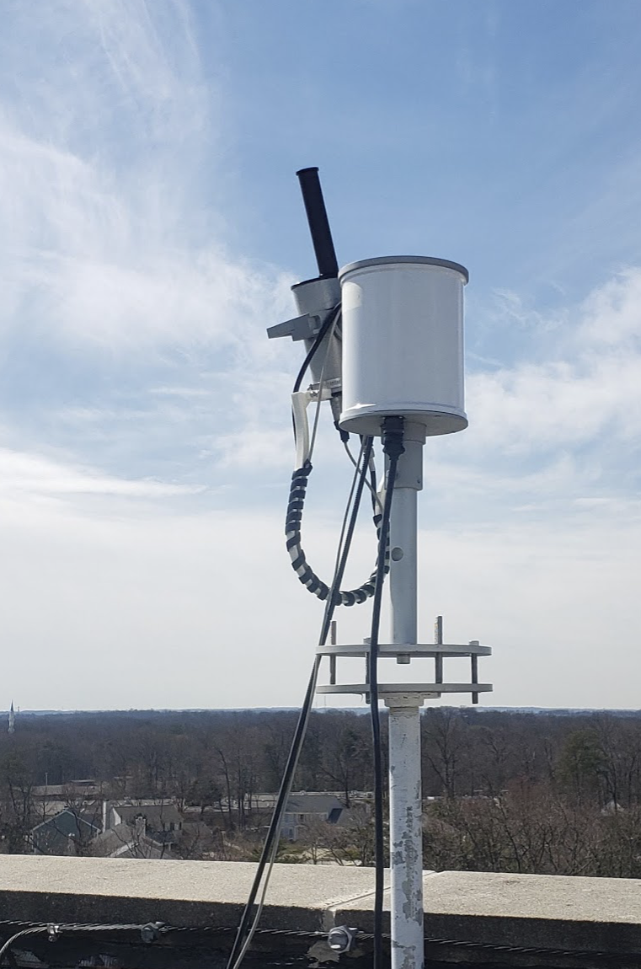


SMARTLabs PBL Profiling Remote Sensors (Passive)
Ground-based passive remote sensors such as the AERI and SMART-s can help answer critical science questions about land/ocean–atmosphere exchanges and PBL processes in strongly heterogeneous coastal regions.
No one instrument solves all PBL problems – an important challenge is designing multi-instrument observing strategies.
As NASA’s only owned test range, Wallops Flight Facility is an exciting location with the infrastructure to become a long-term instrumented super-site that can support future NASA PBL science missions.
AERI: Atmospheric Emitted Radiance Interferometer
SMART-s: Spectral Measurements for Atmospheric Radiative Transfer-spectroradiometer
Trace gases and aerosols
Aerosol extinction vertical profile
Trace Gas Vertical Profile
Total column amount of aerosols and trace gases
Aerosol optical and microphysical properties
AERI
Thermodynamic Profile
Temperature
Water vapor
Cloud properties
Ocean products
Water leaving radiances
Chlorophyll
Fluorescence
Yellow substance and turbidity
Suspended sediment
SMART-s
See: Turner and Loehnert (2014), Turner and Blumberg (2018),
Blumberg et al. 2017, Blumberg et al. 2015.
See: Jeong et al. 2018, 2020
W. Greg Blumberg, Ukkyo Jeong
& SMARTLabs team
Notes:
Mention SMARTLabs has other passive sensors. AERI has ~5000 channels, SMART-s has around 2000 channels.

