Slide 1

Government Working Group Update
NASA Electronic Parts and Packaging (NEPP) Program
2020 Electronics Technology Workshop (ETW)
Prepared by: MSFC ES33/Kathy Laird
June 2020

Slide 2

Agenda
Acronyms
Purpose, Objective, & Scope
Accomplishments
Current Topics

Slide 3
Acronyms
AFC Army Futures Command
AFB Air Force Base
Ag Silver
Au Gold
AvMC Aviation and Missile Center
CCDC Combat Capabilities Development Command
COTS Commercial Off The Shelf
DLA Defense Logistics Agency
DPA Destructive Physical Analysis
ECSS European Cooperation For Space Standardization
EEE Electrical, Electronic, Electromechanical
ESA European Space Agency
GSFC Goddard Space Flight Center
GWG Government Working Group
JEDEC Joint Electronics Device Council
JPL Jet Propulsion Laboratory
MDA Missile Defense Agency
MELF Metal Electrode Leadless Face
MIL-HDBK Military Handbook
MIL-PRF Military Performance Specification
MIL-STD Military Standard
MSFC Marshall Space Flight Center
NEPAG NASA Electronic Parts Assurance Group
NEPP NASA Electronics Parts and Packaging
NRO National Reconnaissance Office
NSWC Naval Surface Warfare Center
PEMs Plastic Encapsulated Microcircuits
Pb Lead
QCI Quality Conformance Inspection
SAE Society of Automotive Engineers
SMC Space and Missile Center
Sn Tin
TM Test Method

Slide 4
Purpose, Objective, Scope, Meetings
GWG was established in January 2017
Scope: Attendees represent 8 government agencies
Objective: To establish a one-government stance applicable to both terrestrial and space programs
Air Force – SMC/The Aerospace Corporation & Wright-Patterson AFB
NASA Centers
Navy – NSWC Crane Division
Army – AFC CCDC AvMC
Meetings: Held 85 meetings to date
Purpose: To discuss in detail government topics from NEPAG which require additional in-depth technical solutions and support other working group initiatives as requested
NRO/The Aerospace Corporation
MDA
DLA

Slide 5
Accomplishments
One Government Stance Responses
  Life Test Parts For End Use
    Supported a JEDEC request to determine if various commodity specification requirements support our disposition/reliability expectations regarding life test parts for flight use.
    We determined that discrete specification should be strengthened with prohibited language if requested by the purchase order along with criteria to readily identify said parts to ensure proper disposition and segregation from flight articles.

Slide 6
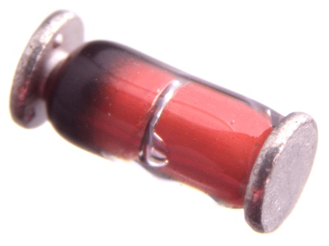
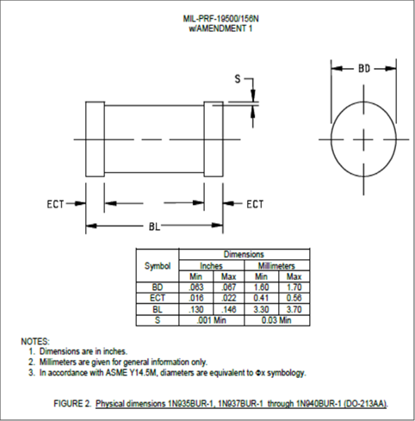
Accomplishments
One Government Stance Responses
  DO-213AA MELF Diode Clearance “S Dimension” Criteria
    Technically discussed and accepted a manufacturer’s proposal to modify MELF UR-1 packaged glass diode S dimension criteria to “reference only” to reduce incoming inspection failures (n=18 MIL-PRF-19500 slash sheets)
  Response:
    GWG is collaborating with a third party to develop a verification process to confirm test equipment capability
Image Source: By oomlout - DIOD-MMA-X-A03D-01Uploaded by bomazi, CC BY-SA 2.0, https://commons.wikimedia.org/w/index.php?curid=28265907

Slide 7
Accomplishments
One Government Stance Responses
  PB-Free Sn Alloy High Temperature Solders
    Technically reviewed and provided from/to language to DLA regarding the incorporation of Pb-free solders into MIL-PRF-28750 Revision K “General Specification for Relays, Solid State.”
    The change reflects the use of Pb-free Sn solder alloyed with Au and Ag for high temperature internal connections. A certain manufacturer was found to be non-compliant to the specification affecting 3 slash sheets. It was found that both AuSn and AgSn solders had been incorporated into their builds (15/5 years, respectively) without any issues.
    Discussions requesting slash sheet updates with specific alloy information were rejected by DLA to protect manufacturer’s proprietary design information. GWG recommended that their use should be noted in the slash sheets for user/DPA lab awareness.

Slide 8
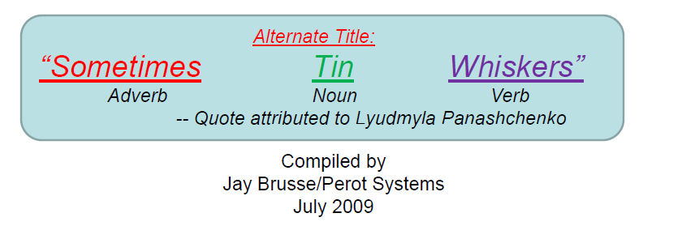
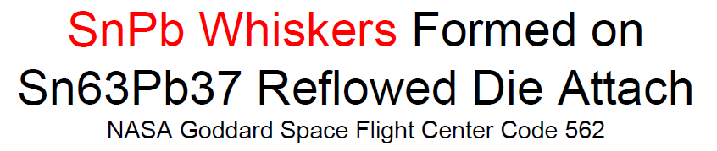
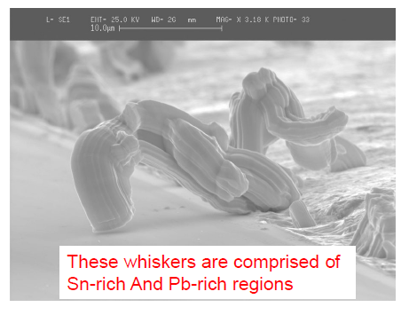
Accomplishments
One Government Stance Responses
  Pb-Free Sn Alloy High Temperature Solders (cont.)
    Section 3.7 of Revision J contains the original requirement.
      “3.7 Pure tin. The use of pure tin, as an underplate or final finish, is prohibited both internally and externally. Tin content of relay components and solder shall not exceed 97 percent, by mass. Tin shall be alloyed with a minimum of 3 percent lead, by mass (see 6.5).”

Slide 9

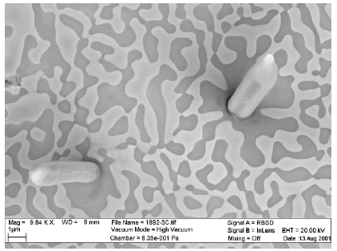
Accomplishments
One Government Stance Responses
  PB-Free Sn Alloy High Temperature Solders (cont.)
    Section 3.7 of Revision K reflected the original wording plus the allowance.
      “The use of lead-free tin alloy high temperature solders (e.g., Au80Sn20, Sn96Ag4, Sn96.5Ag3.5, etc.) for internal connections may be permitted based upon technical justification and requires approval from the qualifying activity, so long as the tin content of the relay components and solder does not exceed 97 percent, mass.”

Slide 10
Accomplishments
One Government Stance Responses
  Random Vibration Requirements for Crystal Oscillators
    Supported an effort by DLA to comply with an Aerospace Addendum 1 request to MIL-PRF-55310F. The request was to add a random vibration test requirement under “Table II, Screening (100 percent) for Class 2 Oscillators”, product level S and keep the random vibration requirement in “Table IV, Qualification Inspection” Group III Subgroup 1 as well as impose a tighter vibration limit for QCI.
    The tighter limit creates a performance margin and due to the fact random vibration induces the mechanism for constant acceleration failures it aids in the identification and removal of nonconforming product.

Slide 11
Accomplishments
Document Draft Reviews
GWG supported the technical review of 19 draft documents and representatives compiled comments. Comments are submitted to DLA, SAE or respective organization for consideration in the next revision or release.
MIL-STD-883 TM1018, TM1015, TM2012
MIL-PRF-14409 Disposition Review “Capacitors, Variable (Piston type, Tubular Trimmer), General Specification for”
MIL-HDBK-xx713 New Document Review NSWC-Crane Solder Electronic Products Handbook
MIL-PRF-55310 Rev F A1 Draft “Oscillator, Crystal Controlled, General Specification for”
SAE SSB1-005 New Document Radiation Hardness Draft Review
MIL-STD-202-208A, 214
MIL-STD-750-2A TM2026, TM2039; MIL-STD-750-3A TM3402; MIL-STD-750-4A TM4016
MIL-PRF-38534 Rev L Draft “Hybrid Microcircuits, General Specification for”
MIL-PRF-28750 Rev K Draft “Relays, Solid State, General Specification for”
SAE SSB1-004B Draft “Failure Rate Estimating”
ESA COTS Initiative Working Group
MDA COTS Assembly Hardware Selection Checklist

Slide 12
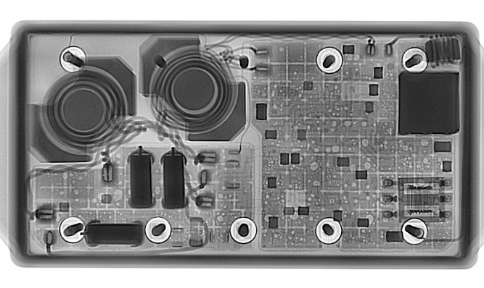
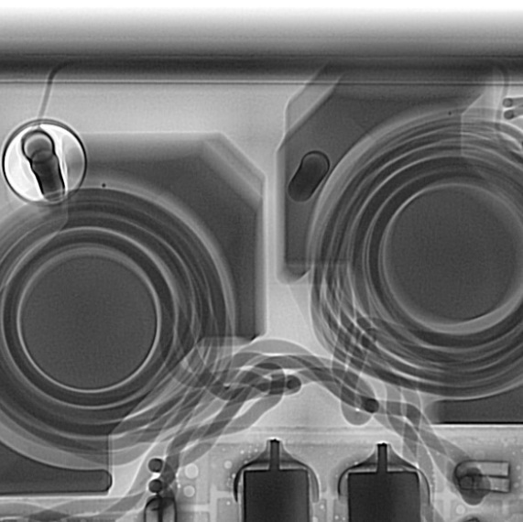
Current Topics
Work In Process
      Burn-In 96 hour Test Window Discussion
      Continuous Improvement of MIL-STD-750-2 TM2012 Radiography Requirements
      Standardization of Foreign Material Definition Within 750/883 Test Methods
      MIL-PRF-19500 Bond Pad Size Mounting Requirements
      MDA COTS Assembly Hardware Selection Checklist Peer Review
      PEMs Space Qualification Standardization Leveraging off of SAE AS6294/1 Flow
      ECSS-Q-ST-30-11C Rev.2 Draft “Space Product Assurance Derating – EEE Components” Document Review
Photos Provided by JPL

Slide 13


Questions?
GWG Co-Chair Contact Information:
  Christian.Schuler@navy.mil
  Kathy.R.Laird@nasa.gov

