Slide 1

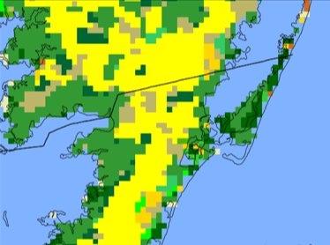
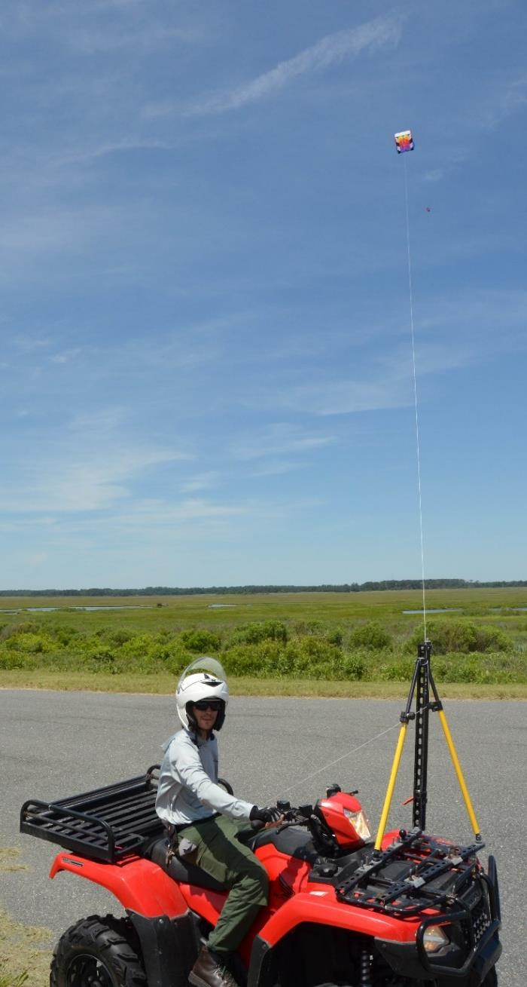
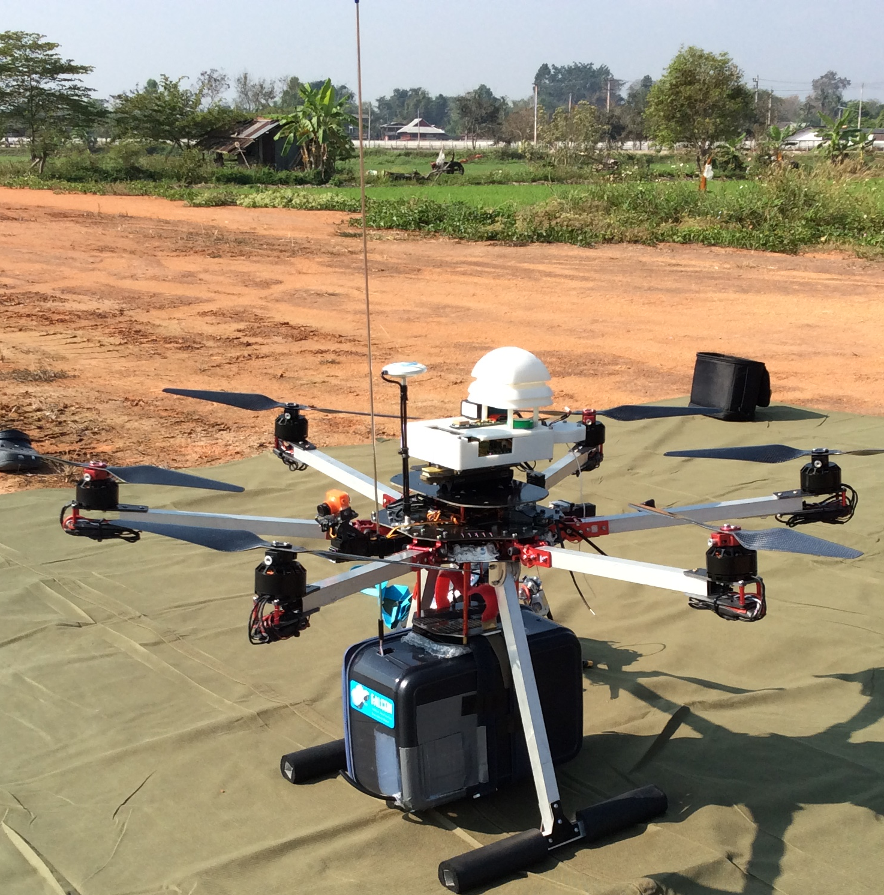
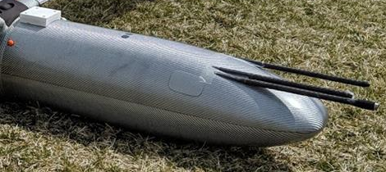
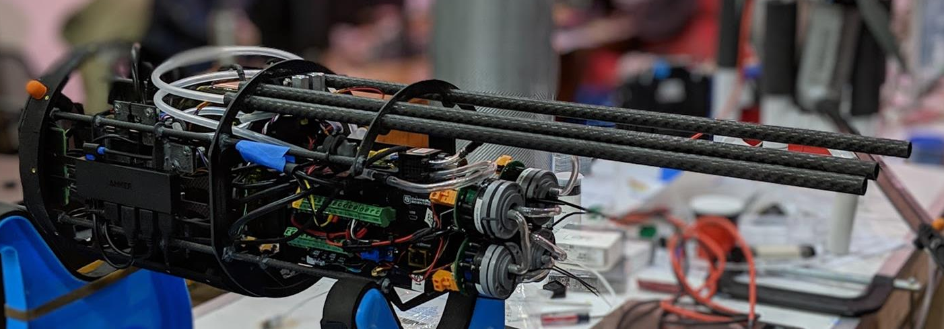
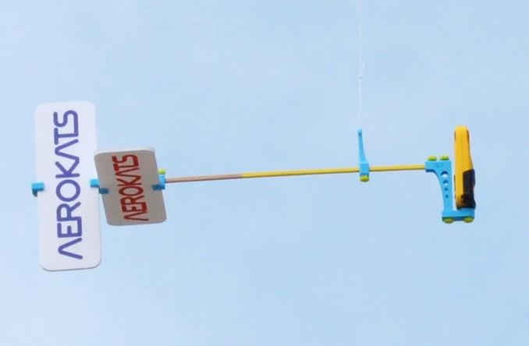
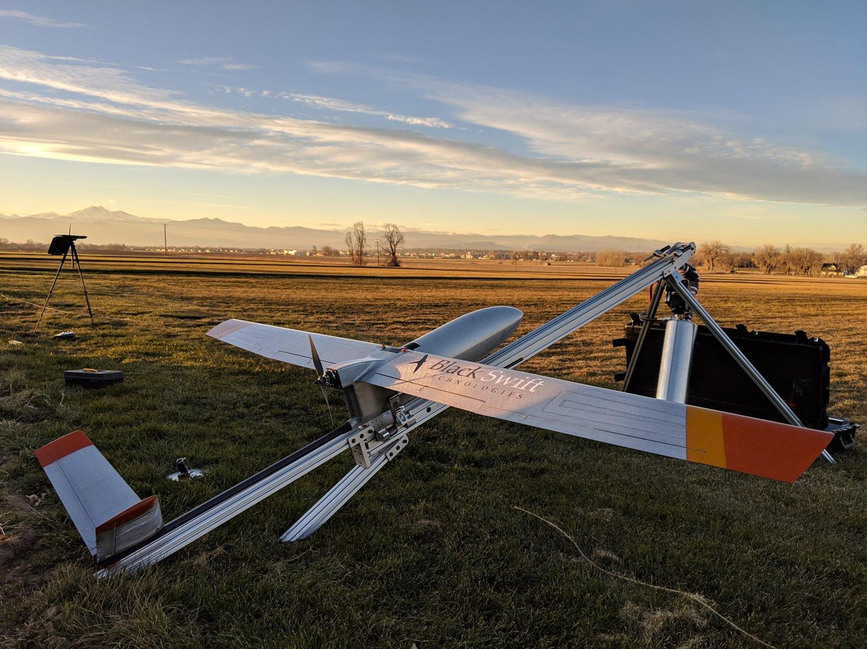
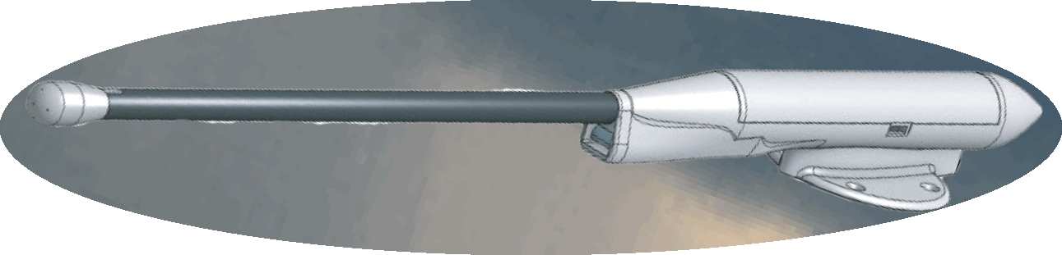


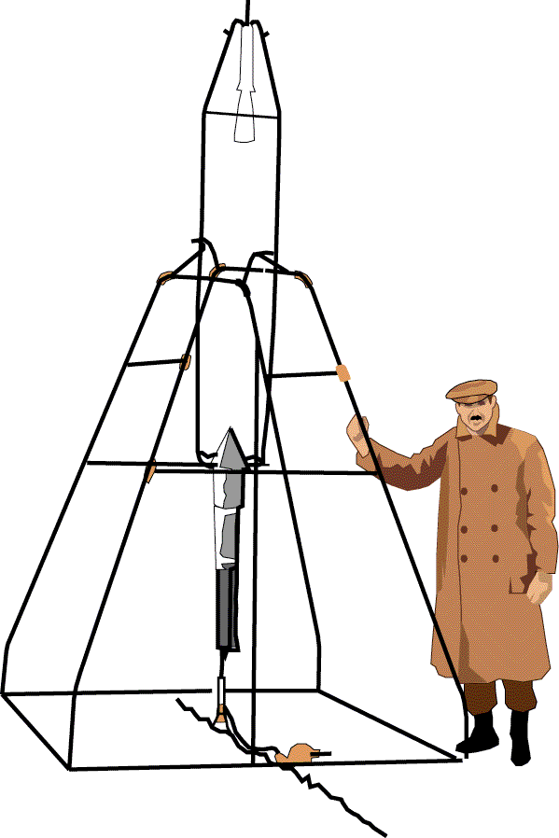

SURF²ing from ground-based network towards space-borne orbit
SURF²: Strategies for UAS Resembled Formation-Flight
FY21/IRAD GSFC/WFF/LaRC
To acquire PBL targeted observables (e.g., thermodynamics, kinematics, air quality, low-level cloud/precip) over densely-populated coastal region requires critical measuring strategies in dealing with heterogeneous surface conditions.
By mimicking space formation flights, sUAS probing over WFF supersite and strategically distributed network sites can characterize the PBL/TOs with reduced risk and improved cost efficiency for unprecedented sample size and statistics.
SURF² observations will help (1) to shape the sampling criteria for future space-based PBL missions, and (2) to establish and serve as a calibration/validation baseline for future coastal PBL missions.
MODIS 30s (~1 km) Land Cover
Kite
inlets
1m inlet
P/T/RH
PM_{2.5} sensors
PM_{2.5}
outside
inside
MD
VA
P/T/RH & 3D-Winds
GPS
Datalogger
Nose cone modular payload
MHP
: WFF
: UMD-ES
(a)
Camera
60km$×$30km
POPS,
MA₂₀₀ sensors
Evergreen Forest
Savannas
Dryer
Deciduous Forest
Grasslands
Fully automated launch & landing
Mixed Forests
Wetlands
(b)
(c)
Closed Shrublands
Croplands
Open Shrublands
Urban/Built-Up
POPS: Printed Optical Particle Spectrometer for sizing range of 140 nm – 3 µm in radius
MA₂₀₀: Micro-Aethalometer, absorption at wavelengths of 375, 470, 528, 625 and 880 nm
MHP: Multi-Hole Probe for 3D wind speeds and direction, including P, T & RH
Woody Savannas
Barren/Sparsely Vegetated
Water
Si-Chee Tsay &
SMARTLabs team

