Slide 1

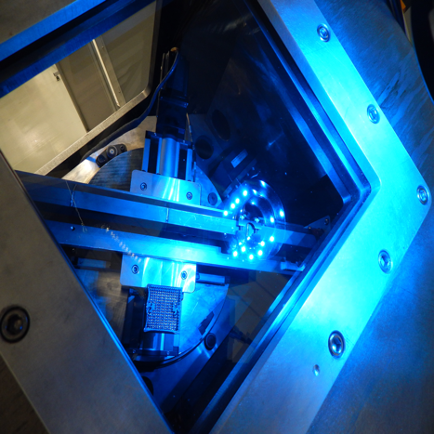
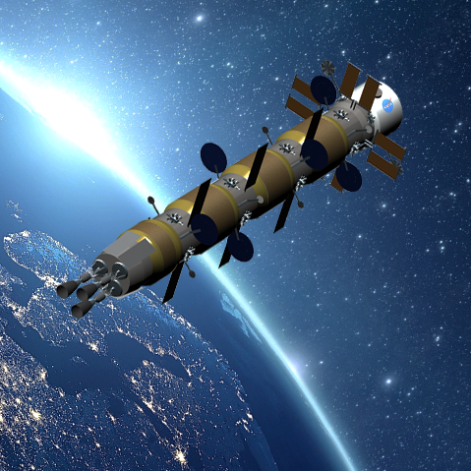
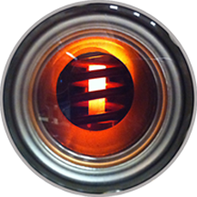
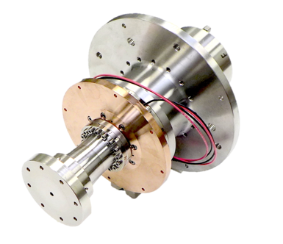
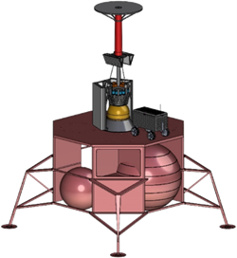
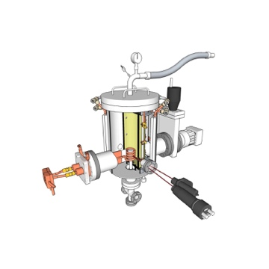
High Performance Nuclear Thermal Propulsion
June 17, 2020
Future In-Space Operations (FISO) Briefing
Presented by Mike Houts, NASA MSFC
STMD SNT: L1 Status Tag-Up | 04.05.20
© 2018. All rights reserved.

Slide 2
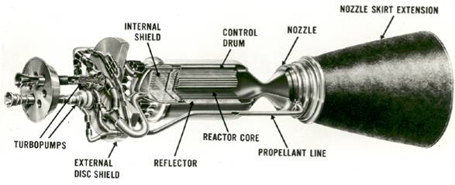
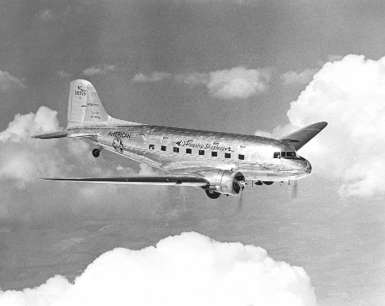
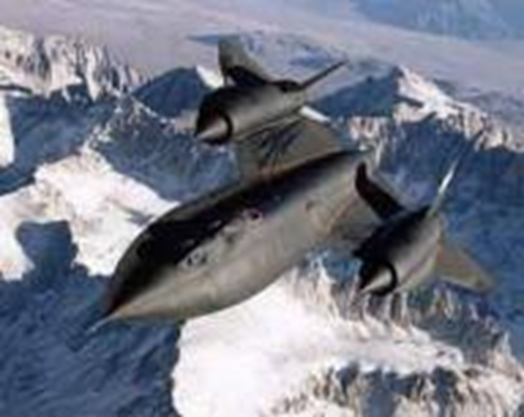
Nuclear Thermal Propulsion (NTP)
1935
Nuclear thermal propulsion (NTP) is a fundamentally new capability
  Energy comes from fission, not chemical reactions
  Virtually unlimited energy density
Traditional NTP systems could have a specific impulse roughly twice that of the best chemical systems
  Reduce propellant (launch) requirements, reduce trip time
High performance NTP systems could have unique capabilities and help enable extremely ambitious missions
High performance NTP systems may be feasible in the near term, enabled by state-of-the-art technologies and techniques
1964
2
Notes:
Beneficial moon, Mars, NEAs, etc.
In-situ propellant, bimodal NTP/NEP, etc.
Eastbound Transcontinental 15 hours with only 3 refueling stops. Westbound 17.5 hours.
157 W/kg
237 mph top speed / 150 mph cruise speed
DC-3 December 17, 1935 – 32 years after Wright Brothers First flight SR-71 22 December 1964

Slide 3
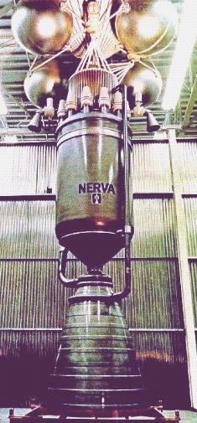
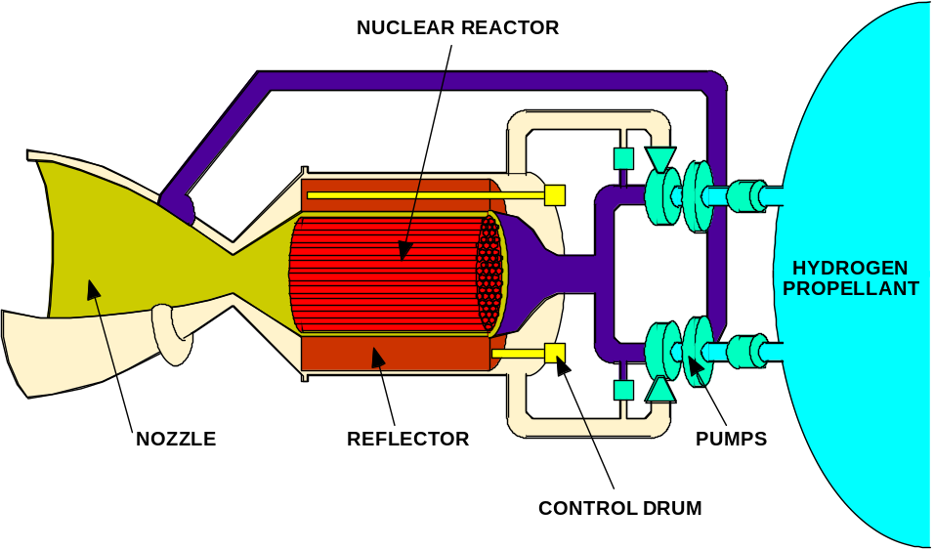
Traditional NTP Systems
Propellant heated directly by a solid fuel nuclear reactor and thermally expanded/accelerated through a nozzle.
Propellant is typically Hydrogen–low molecular weight gives highest specific impulse for a given chamber temperature.
Thrust directly related to thermal power of reactor: 100,000 N ≈ 450 MW_{th} at 900 sec.
Specific Impulse directly related to exhaust temperature: 830 - 1000 sec requires 2300 - 3100K.
Major Elements of a Nuclear Thermal Rocket
NERVA Nuclear Thermal Rocket Prototype

Slide 4
Traditional NTP
For most opposition class human Mars mission opportunities, traditional NTP systems (Isp ~900 s) can reduce crew time away from earth from >900 days to <700 days while still allowing ample time for surface exploration. Reduced mission duration can reduce crew exposure to space radiation, microgravity, and other hazards.
NTP can enable abort modes not available with other architectures. NTP provides option to return to earth anytime during a human Mars mission, with reasonable return times following decision to abort.

Slide 5
Traditional NTP
Stage/habitat optimized for use with NTP could further reduce crew exposure to cosmic rays and provide shielding against any conceivable solar flare.
NTP has the potential for reducing cost, increasing flexibility, and enabling faster response times in cis-lunar space.
Space fission power systems derived from traditional NTP systems could be optimal at unit sizes above 100 kWe. NTP-derived power systems provide the option for using HALEU.

Slide 6
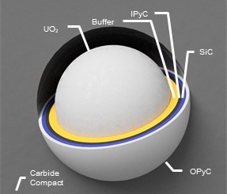
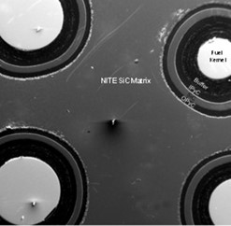
Fuel Particle Production
The SNP fuel development plan will focus on development and testing of coated uranium nitride (UN) fuel particles
  The particles will be embedded in molybdenum-tungsten (Mo-W) for cermet fuel and embedded in zirconium carbide (ZrC) for cercer fuel
  Coatings will include inner layers of graphite and an outer ZrC layer for cercer fuel and an outer layer of W for cermet fuels
The coated particle production capability will be developed in collaboration with DoD-SCO
  DoD interest is in standard tri-structural isotropic (TRISO) fuel form
      350 or 425 µm diameter UCO kernel coated with porous carbon, pyrolytic carbon (PyC), and SiC
      Well studied fuel with extensive qualification testing
    NASA (and others) also interested in coated particle fuel
      200 – 800 µm diameter UN kernel coated with porous carbon, PyC, and ZrC
      Well studied chemistry constituents but little reactor qualification testing
      Coated particles will be designed/engineered for specific application and can be manufactured in DoD TRISO production facility

Slide 7
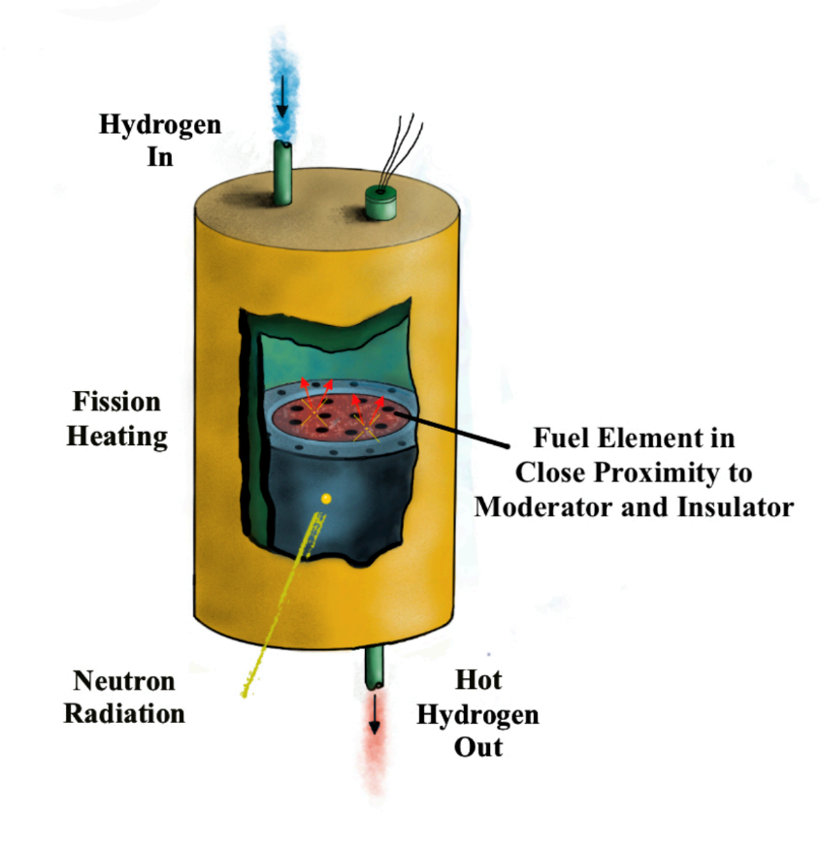
PRIME Tests
PRIME 1 and PRIME 2 will be capstone SNP fuel development tests targeted for irradiation in TREAT during FY 22 and FY 23
  PRIME 1: Test of a near full length cermet fuel element, with surrounding insulator and moderator material, in flowing hydrogen
  PRIME 2: A similar test of cercer fuel and insulated moderator
  All activities in the fuel development plan build toward completion of the PRIME tests
A flowing hydrogen capability is being designed for the TREAT reactor to support PRIME 1 and 2
  Cold hydrogen will enter the reactor and flow through the fuel and moderator
  Hot hydrogen will be monitored and discharged from the facility stack
The tests will be designed to rapidly ramp fuel and moderator temperatures to prototypic values
  High temperature thermocouples and pyrometers incorporated into the experiment capsule will be used to monitor the experimental system
Post irradiation examination will evaluate fuel and moderator stability
  Examinations will look for fuel cracking, hydrogen corrosion, UN dissociation, hydriding, and other failure precursors
PRIME Experiment Concept
PRIME Experiment Assembly Components

Slide 8
PRIME Tests
PRIME 1 and PRIME 2 will be capstone SNP fuel development tests targeted for irradiation in TREAT during FY 22 and FY 23
  PRIME 1: Test of a near full length cermet fuel element, with surrounding insulator and moderator material, in flowing hydrogen
  PRIME 2: A similar test of cercer fuel and insulated moderator
  All activities in the fuel development plan build toward completion of the PRIME tests
A flowing hydrogen capability is being designed for the TREAT reactor to support PRIME 1 and 2
  Cold hydrogen will enter the reactor and flow through the fuel and moderator
  Hot hydrogen will be monitored and discharged from the facility stack
The tests will be designed to rapidly ramp fuel and moderator temperatures to prototypic values
  High temperature thermocouples and pyrometers incorporated into the experiment capsule will be used to monitor the experimental system
Post irradiation examination will evaluate fuel and moderator stability
  Examinations will look for fuel cracking, hydrogen corrosion, UN dissociation, hydriding, and other failure precursors
PRIME Experiment Concept
PRIME Experiment Assembly Components

Slide 9
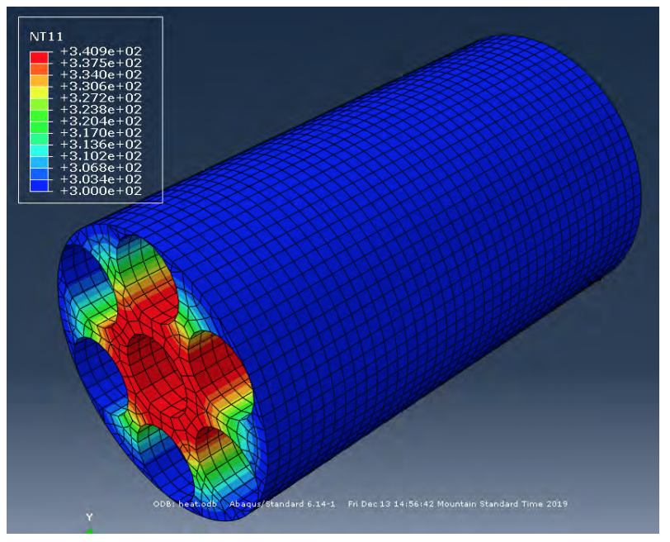
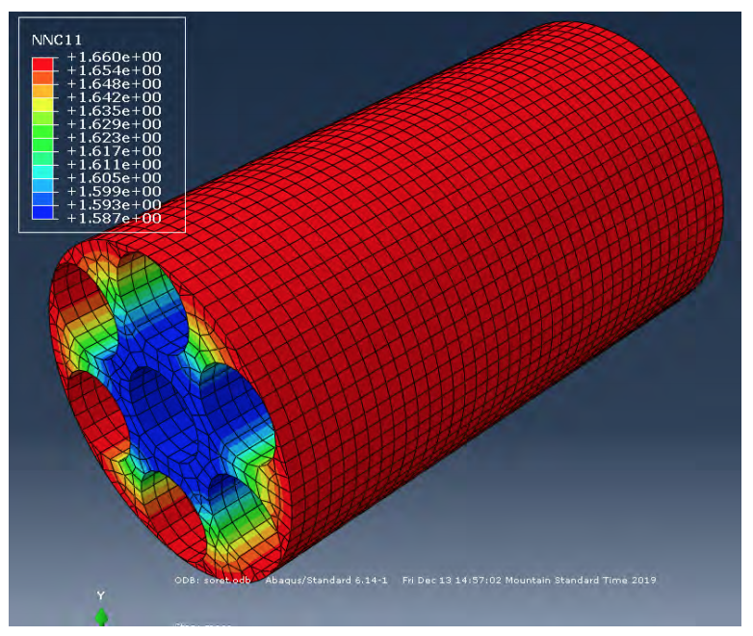
Other Reactor Testing Options
In addition to the PRIME tests, integral testing of reactor components will be useful for demonstrating readiness for full-scale ground or flight demonstration. Options include:
  Moderator hydrogen retention testing:
    Testing of moderator materials to characterize reactivity changes caused by moderator hydrogen loss and redistribution
    Testing could be performed in existing facility
  Critical assembly testing:
    Generally defined as a nuclear test reactor designed to mock-up potential reactor configurations and/or operating conditions
      Critical assemblies generally run at very low powers (~ 1 W or less) for short durations (on the order of minutes), so they produce small amounts of fission products
      Assemblies are used to measure reactivity properties of core materials
    Testing could be performed in existing facility
Modeling of moderator hydrogen redistribution with increasing temperature
Modeling courtesy of Los Alamos National Laboratory
  Low Power reactor testing:
    Testing of prototype reactor at low power levels to demonstrate ability to control hydrogen flow and reactor power during transient and off-normal operations
    Testing could be performed with modifications to existing facilities

Slide 10
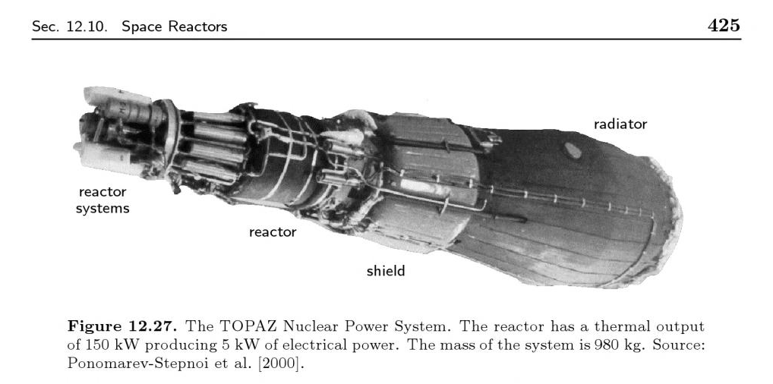
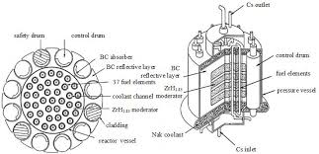
Moderator block flown in space (Russian TOPAZ, 1 yr operation); baselined for SNTP, TWMR, Russian NRE, other
Benefits of Moderator Block Configuration
Improves moderation of neutrons
  Reduces core radius / height → Smaller, lighter cores
  Reduces ²³⁵U loading (for criticality) due to better neutron utilization
  Less structural material → less parasitic neutron absorption
  Provides design flexibility by increasing reactivity
Reduces element and intra-element power peaking and facilitates fuel loading optimization
  More uniform moderation around fuel
  Supports higher Isp (chamber gas temperature) with lower temperature gradients, and lower ²³⁵U loading
Russian TOPAZ Reactor
Moderator block configuration offers proven benefits to reactor design
TWMR- Tungsten Water Moderated Rocket; SNTP – Space Nuclear Thermal Propulsion, NRE – Nuclear Rocket Engine
Russian TOPAZ Reactor Schematic

Slide 11
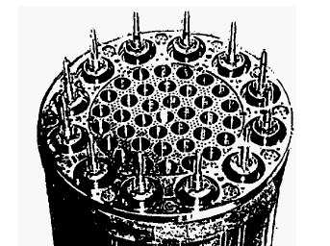
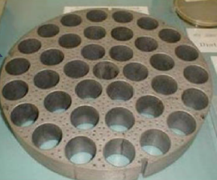
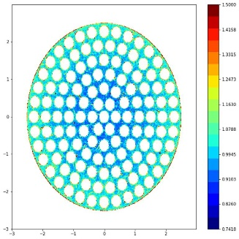

Moderator block flown in space (Russian TOPAZ, 1 yr operation); baselined for SNTP, TWMR, Russian NRE, other
Flexibility from Moderator Block Configuration
Reactor can use various fuel compositions and geometries
  Fuel regions easily arranged to address core radial power peaking
  Supports different fuel types and fuel element shapes (rods, internally cooled cylinders, etc.)
  Provides option to eliminate insulator between fuel and moderator (radial inflow designs, e.g. SNTP)
Simplified Design and Core Assembly
  Easier to plumb single pass cooling flow through the moderator block
  Less heat transfer to moderator through insulator flow tube wall
  Facilitates placement of control rods (if desired)
  Opportunities to reduce manufacturing cost
Russian NRE Test Moderator Block Arrangement
Moderator block configuration provides significant design flexibility
TWMR- Tungsten Water Moderated Rocket; SNTP – Space Nuclear Thermal Propulsion, NRE – Nuclear Rocket Engine
Example of Reduced Intra-Element Peaking in CERMET Fuel

Slide 12
Moderator block can facilitate aspects of NTP Operation
Turbine
To Boost
Turbine
From Boost
Turbine
Coolant
Reactor
Head
Inlet Manifold
Internal Shielding
Q_{SHSPPT}
Boost Pump
Fore Plena / Mid-Flange
Axial Reflector (TBD)
Radial Reflector
Moderator
Block
RV Wall
Cooling
Fuel Assemblies
(FA)
Main Pump
Component/ Core Region
Fuel Assemblies
Moderator Block
Reflector/Control Drums
Shield/Support Plates
Q_{REF}
Q_{MB}
Q_{fuel}
AFT Support Plate and Plena
Regen Nozzle
Section
Chamber/ Nozzle
Throat
High Velocity Exhaust Gas
Notes:
Image from FY2020 NTP Quick Look Activities

Slide 13
Extremely Advanced Missions could be Enabled by High Performance NTP
Specific impulse 1300-1800 seconds.
  Enables 420 day “round trip” human Mars missions
  Enables extensive human Mars exploration and colonization
  Enables ambitious missions to the asteroid belt, Jupiter, and beyond
Flexibility in choice of propellant.
Hydrogen when high Isp is most important
NH₃ when passive storage is most important
Any mixture of NH₃, CH₄, water, etc. when desirable to directly use in-situ volatiles as propellant. Such volatiles are available throughout the solar system, and the eventual ability to directly use such volatiles could enable extremely ambitious space missions and projects.

Slide 14
Significant Safety Benefits from High Performance NTP
Integrated Medical Model (IMM) comparison of 420 day human Mars mission to “typical” 923 day human Mars mission.
Results of study summarized as follows
An Accelerated Mars Mission (420 days) results in significantly decreased risk as calculated by the IMM for in-mission risk and by SRAG for long term health risk.
The Standard Mars Mission (923 days) carries:
  Approximately 2.9x increased likelihood of experiencing loss of crew (LOCL) life event
  Approximately 4.7x increased likelihood that serious medical condition would occur that would warrant medical evacuation (EVAC) if it was available
  Approximately 19% worse crew health index (CHI) that contributes to performance decrements across the duration of the mission
  Between 1.5-2x increased likelihood of the lifetime risk of radiation exposure-induced death from cancer
Reference: Comparison of Risk for Accelerated Mars Mission Scenarios; Erik Antonsen MD, PhD and Mary Van Baalen, PhD

Slide 15
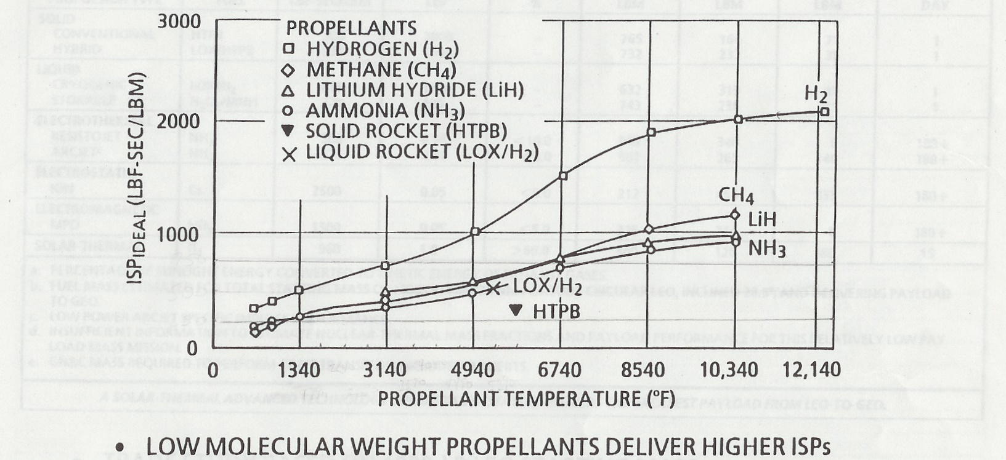
Specific Impulse (Isp)

Slide 16
Potential High Performance NTP Systems
Initial high performance systems could use centrifugal force to contain fuel in regions where the fuel is in the liquid phase.
  Liquid fueled reactors have inherent stability and have been previously operated at high power and moderate temperatures.
  For NTP applications, propellant flow could be designed to adequately cool all structural materials while still achieving extremely high temperatures at the nozzle throat. Analogous to Space Shuttle Main Engine.
  Peak material temperature outside of rotating fuel elements is <800 K.
  Early proof-of-concept experiments may be feasible/affordable.

Slide 17
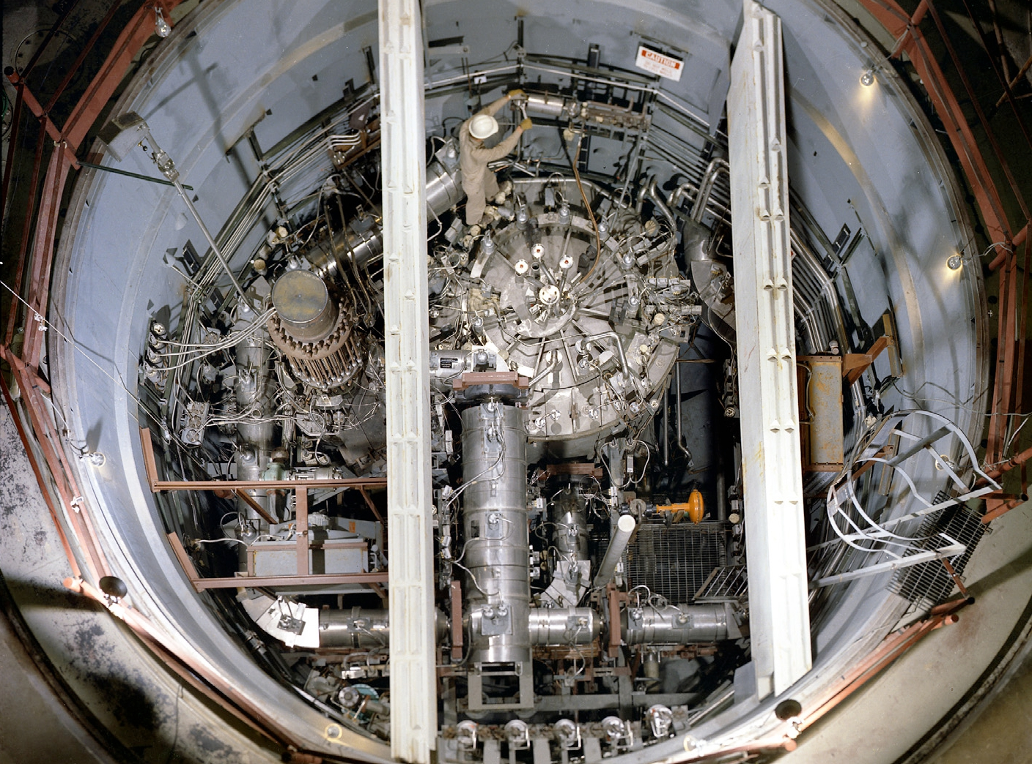
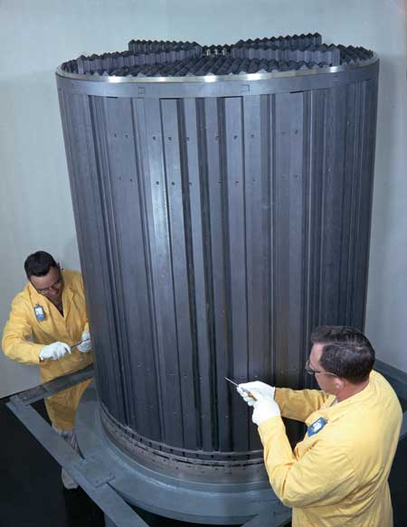
Previously Operated Liquid Fueled Reactors
Molten Salt Reactor Experiment; 7.4 MWt; >900 K; 1.5 years Full Power Operation
(Initial criticality 1965, operated through 1969)

Slide 18
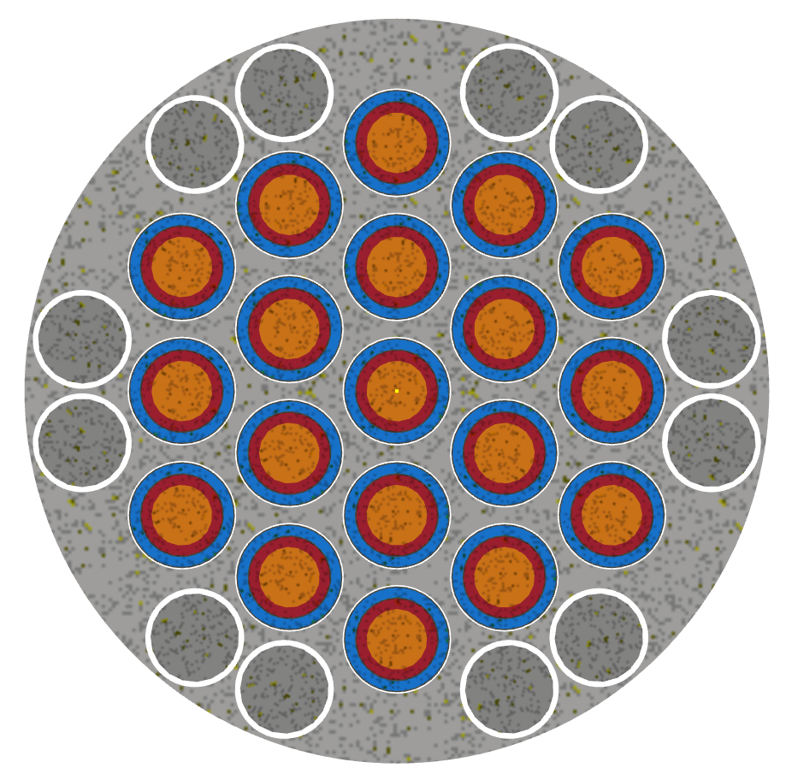
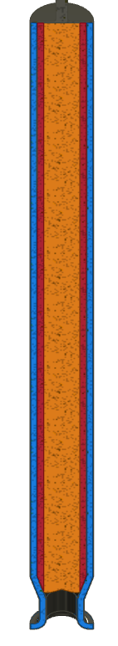
Notional Centrifugal Nuclear Thermal Rocket (CNTR) with 19 Rotating Fuel Elements
Rotating Fuel Element
(19)
Gas In
~1.0 m
Control Drum
(12)
Moderator Block and Radial Reflector
Gas Out
~ 0.8 m

Slide 19
One Potential High Performance NTP Concept
(Centrifugal Nuclear Thermal Rocket)
  One potential high performance NTP concept would use liquid uranium metal fuel to achieve very high specific impulse.
  High density of liquid uranium metal potentially enables low mass, HALEU system.
  Each fuel element (rotating cylinder) would consist of a modified industrial centrifuge lined on the inside with ZrC (compatible with molten uranium) and partially filled with metallic uranium in the center of the cylinder, with coolant channels (cylinder wall / ZrC) and void space (metallic uranium) as required for propellant flow.
  During startup, the fuel cylinders would be spun at a few hundred RPM. Fission power would be initiated / increased prior to the introduction of propellant.
Notes:
Some traditional NTP concepts propose graphite coated UN kernels in a ZrC matrix – similar fuel could be used for solid fissile fuel portion of CNTR.
ZrC/UN may not be needed, but if propellant heated to 1500 K prior to reaching metallic uranium that could perhaps keep metallic uranium from refreezing during operation due to cooling from the propellant.

Slide 20
One Potential High Performance NTP Concept
(Centrifugal Nuclear Thermal Rocket)
  Once fuel temperature exceeded 1405 K the metallic uranium in the inner portion of the rotating cylinder would be molten, but would be held in place by centrifugal force. The ZrC on the edge of the cylinder would remain solid/structurally intact during operation (ZrC operates at up to 2000 K).
  Once the central metallic uranium was completely molten, radial-inward propellant flow (likely H₂ or NH₃) would be increased as power increased. Rotational speed could also be increased, if needed.
  Liquid uranium has a low vapor pressure (15 psi at 4400 K).

Slide 21
One Potential High Performance NTP Concept
(Centrifugal Nuclear Thermal Rocket)
  Liquid uranium in center of cylinder could operate at >5000 K. Liquid uranium in contact with the ZrC would be maintained at ~1500 K.
  All moderator and structural materials within the engine could be maintained at <800 K. Only the ZrC (~1500 K), liquid uranium metal (>5000 K if desired), and propellant (>5000 K if desired) would be at higher temperatures (and possibly the nozzle skirt).
  Shutdown would be achieved by reversing the startup process, with the shutdown state being solid uranium metal fuel on the inside of the ZrC cylinder liner.

Slide 22
Notional Centrifugal Nuclear Thermal Rocket (CNTR) with 19 Rotating Fuel Elements
Rotating Fuel Element
(19)
Gas In
~1.0 m
Control Drum
(12)
Moderator Block and Radial Reflector
Gas Out
~ 0.8 m

Slide 23

CNTR Temperature Map
600 K
Pressure Tube / Moderator Block
800 K
5500 K
Hydrogen
1500 K
Uranium / Hydrogen
5500 K
1500 K
ZrC coating in contact with uranium
800 K
Centrifuge Frit/flow Passages
800 K
Centrifuge Outer Wall
800 K
Centrifuge Cooling/Clearance Gap

Slide 24
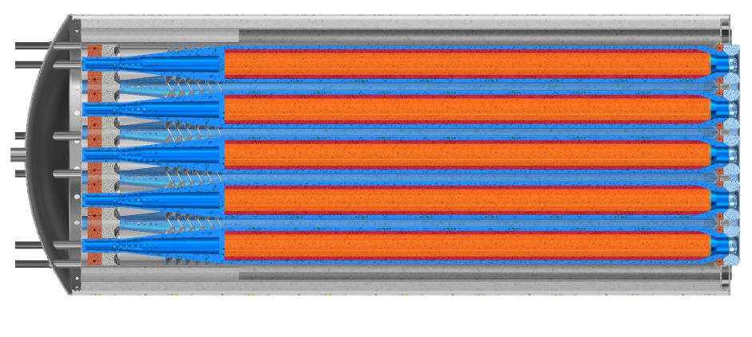
CNTR Components
Drum
Pressure
Vessel
Nozzle Array
Inlet Plenum
Reflector
Centrifuge
Bearing
Centrifuge Turbine
Bearing

Slide 25
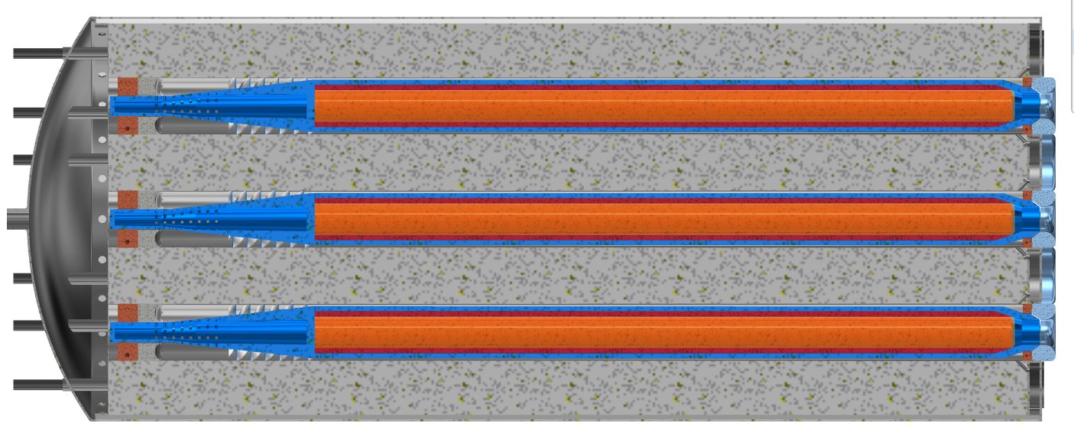
CNTR Propellant Flow Path

Slide 26
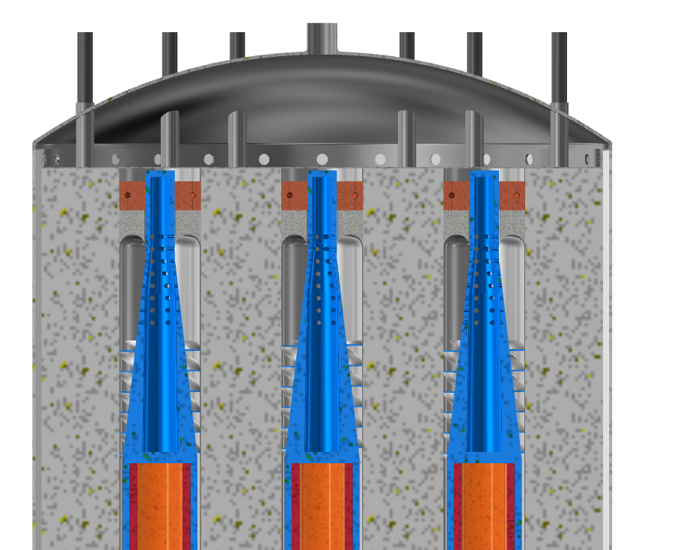
CNTR Turbine Section Detail
Plenum
Drum Feedthrough
Bearing
Gas Passage
Turbine
Be or SiC/hydride Moderator Block (Be reflector)

Slide 27
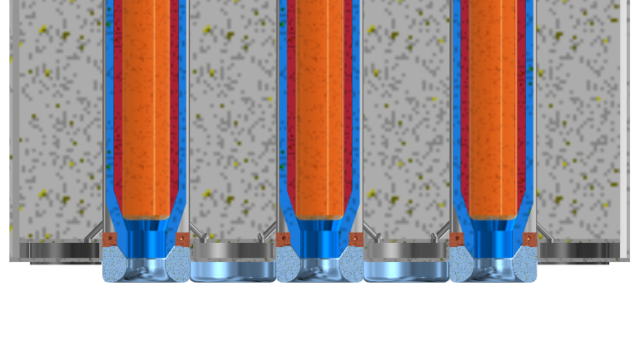
CNTR Exhaust Section Detail
Pressure Boundary
Be or SiC/Hydride Moderator Block
and Be reflector
Cooling channel/passage
Bearing
Nozzle, fixed

Slide 28
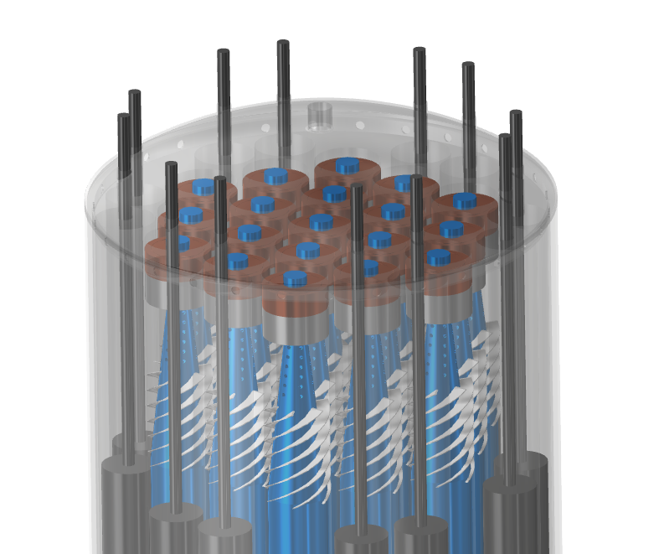
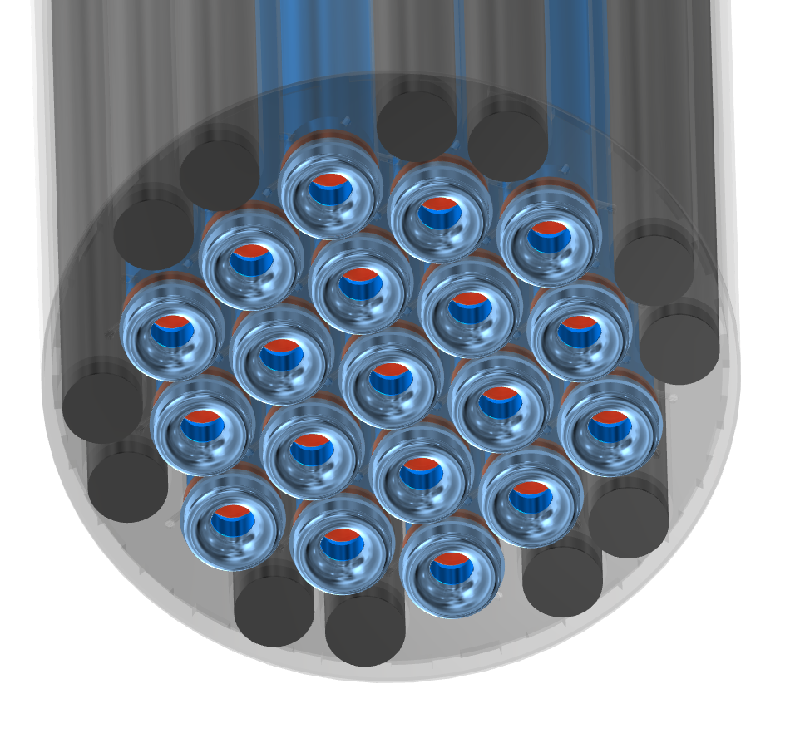
CNTR End Details

Slide 29
Potential Near-Term CNTR Experiment
Investigate basic CNTR operating principles with a simple experiment.
Mixing/separating liquid U and gaseous H could be initially investigated by mixing/separating liquid H₂O and gaseous N₂.
The mixing/separation could be performed in a closed loop cycle with H₂O, a desiccant, and N₂.
Water entrainment in the N₂ could be determined by measuring the change in desiccant weight, or by other means.
Goal of experiment would be to measure H₂O entrainment in N₂ for various operating conditions and cylinder rotation rates.
Experimental data would be used to develop/calibrate codes and to estimate the performance potential of a CNTR.

Slide 30
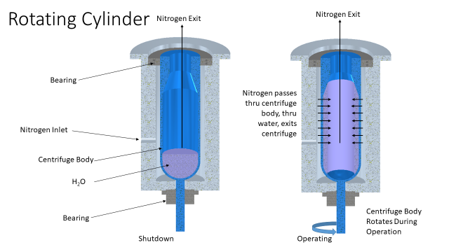
Potential Initial CNTR Experiment

Slide 31
Remaining Issues / Optimizations for CNTR
  Adapt modern centrifuge technology for CNTR applications
  Transpiration cooling of rotating cylinder walls, nozzle cooling (5500K vs 3600K Space Shuttle Main Engine)
  Cylinder diameter vs rotation rate (neutronic and mechanical effects)
  Acceptable uranium loss rate (<0.01%?)
  Uranium entrainment in hydrogen vs hydrogen flow rate, cylinder diameter, and cylinder rotation rate
  Propellant flow across solid/liquid fuel interface and through liquid uranium.
  Heat transfer between fissioning uranium and hydrogen or ammonia
  Verify compatibility of ZrC (or other materials) with liquid uranium at 1500K
  Startup / shutdown sequence. Vibrational modes during startup/shutdown
  Etc., etc., etc.

Slide 32
Traditional NTP will meet early mission requirements if architecture optimized for NTP
For most opposition class human Mars mission opportunities, traditional NTP systems (Isp ~900 s) can reduce crew time away from earth from >900 days to <700 days while still allowing ample time for surface exploration.
High performance NTP systems have the potential for enabling extremely advanced missions.

Slide 33

SignOffPage
Notes:
NASA Presentation Sign-Off Page

