Slide 1
Laser-Induced Acoustic Source Analysis in Aeroacoustic Wind Tunnel Facilities
Christopher J. Bahr
NASA Langley Research Center
Hybrid Anechoic Wind Tunnel Workshop
June 11, 2020

Slide 2
Overview
Introduction
Source characteristics
Facility properties of interest
Example analysis
Open issues

Slide 3
Introduction
Aeroacoustic wind tunnel testing: Conducted to better understand an aeroacoustic source, ideally in an anechoic environment w/ simple propagation characteristics
Wind tunnel tests are never ideal!
  Open-jet testing: propagation through turbulent free shear layer, scattering from model support, minor scattering/reflections from test section boundaries
  Aerodynamic (closed-wall) facility testing: hydrodynamic pressure fluctuations contaminate measurement, significant scattering/reflections from test section boundaries
  Hybrid (Kevlar) facility testing: propagation through turbulent boundary layer and Kevlar sheet, partial scattering/reflections from test section boundaries
Source analysis requires an understanding of how a given facility influences the data

Slide 4
Introduction cont.
Testing purpose: collect data necessary to answer a question about an acoustic source; the ideal answer should (usually) be free of facility effects. To achieve this, we must first understand our facility’s behavior.
Objectives: use known acoustic source for analysis of unknown facility characteristics (forward problem); use resulting measured facility characteristics for improved analysis of unknown acoustic source (inverse problem)
Desirable properties of a known source (with flow):
  Known temporal characteristics
  Known spatial (directivity) characteristics
  Localized (approximate Green’s function?)
  Minimally-intrusive
  Spectral content matching sources of interest
Possible sources: speaker, laser-induced plasma, electric spark source/ionophone, other?

Slide 5
Source comparison
 | Speaker | Laser-induced plasma | Which do I think is more useful?
Temporal characteristics | Controllable/arbitrary within system passband Possible nonlinear distortion of input signal Unknown flow effects | Impulse-like Allows time domain analysis of multipath Model accounts for flow influence Recorded waveform highly dependent on measurement instrumentation, parameters | Depends on test… I think separation of multipath is more valuable for facility characterization, others may require control of correlation timescale.
Directivity | Measurable Unknown flow effects (may be modelled) | Omnidirectional in 2D with no flow Model accounts for flow influence 3D dependent on plasma aspect ratio | Laser
Well-localized | Good | Better | Laser
Minimally-intrusive | In-wall | Off-wall | Depends on test
Frequency range | Low-mid | Mid-high | Depends on test
Recommendation: choose a speaker for low frequency testing (rotorcraft) or source in a wall where directivity is not an issue. Otherwise, a laser-induced plasma is preferable for facility characterization.

Slide 6
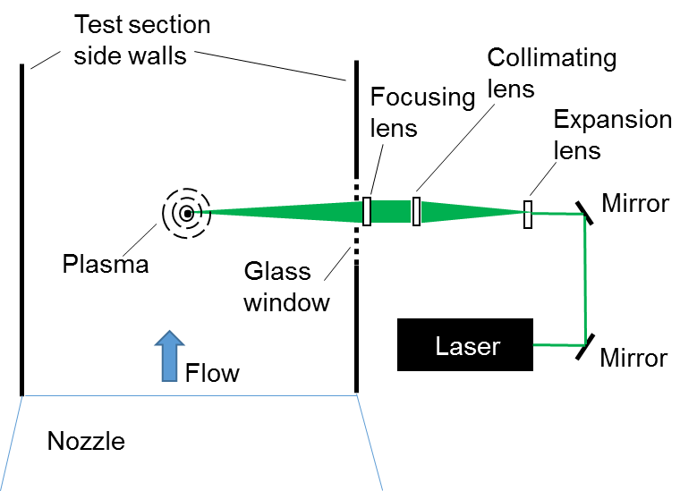
Laser-induced plasma
Rossignol et al. 2015
  Source scales with time derivative of heat release
  Moves with flow (Doppler shift)
Impulse-like: high bandwidth, high frequency
  Pros: easy to visualize and isolate, repeatable, “deterministic”
  Cons: Hard to “know” true waveform
What do I mean by this?
Sketch of laser installation in the NASA Langley Quiet Flow Facility (QFF)

Slide 7
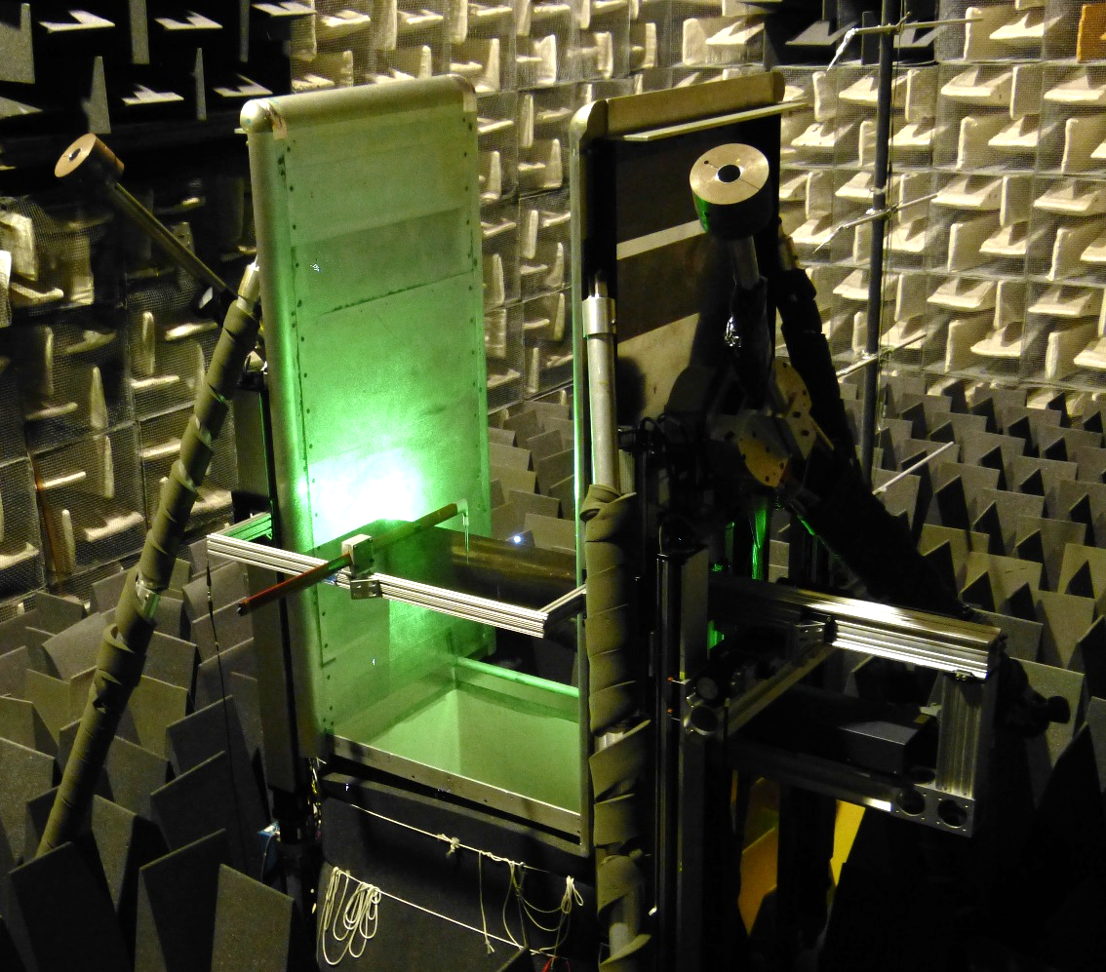
Example measurement
B&K 4138 1/8” microphone (6.5 Hz to 140 kHz passband)
5935 power supply (0.5 Hz to 100 kHz passband)
additional 100 kHz antialiasing filter
10 MSamples/sec
Approximately 45 deg angle of incidence, ~1 ft from plasma source, no flow
Plasma source
Laser system
In-flow microphone
Flow direction
gridcap
bare diaphragm
nosecone

Slide 8
Example measurement cont.
Arrival times approximately match
Waveform shape differs
Similar story for changes in angle of incidence, nosecone design, microphone type, filters
Flow makes this worse
Great source for measuring propagation time
Level comparisons may be an issue
Plasma source
Laser system
In-flow microphone
Flow direction
gridcap
bare diaphragm
nosecone

Slide 9
Facility characteristics
Inverse problem objective: use known facility characteristics for improved analysis of unknown acoustic source
Forward problem objective: use known acoustic source for analysis of unknown facility characteristics
What characteristics are needed?
  Propagation path: influences on arrival time(s), phase calculations
  Level modifications: directivity, e.g., convective amplification, transmission through Kevlar or free shear layer, reflections/multipath
Steady and unsteady (e.g., correct for spectral broadening?)

Slide 10
Evaluation metrics
Data should inform an existing correction model for a facility
  Allow for correction/validation of existing model
  Provide data to develop a better model
Many ways to look at the data from this source
  Which metrics are most useful for validating a model?
  Which metrics are most useful for further model development?
  Which metrics provide an intuitive understanding of the physics of a given facility?
Following is an example of multiple ways to look at data in this context

Slide 11
Example: application to Amiet’s method (steady)
Recently addressed at AIAA SciTech 2020 (Szőke et al., “Characterization of Hybrid Wind Tunnel Environments Using Laser-Induced Acoustic Sources,” AIAA 2020-1253)
Laser-induced plasma test conducted in Virginia Tech Stability Wind Tunnel, compared to existing QFF data (with Kevlar panel)
Reference model for both: Amiet’s “Refraction of Sound by a Shear Layer” (JSV 1978)
  Models propagation path, yielding propagation times
  Models pressure corrections
    Transmission through open-jet shear layer
    Convective amplification effects
  Does not account for Kevlar (panel/membrane transmission) or moving source (Doppler)

Slide 12
Amiet correction: delays
Difference between measured propagation time and predicted propagation time
  Simple to understand, apply directly to data
  Measured time biased by: supersonic propagation near source (reduces arrival time), method of determining arrival time (1% peak? 5% peak? Depends on instrumentation, waveform shape, could be positive or negative shift), Kevlar effect?
Compare *change* in propagation time from no flow to flow between measurement and prediction
  One step removed from direct data correction, less intuitive
  To first order, may mitigate supersonic issue, arrival time detection methods, possible Kevlar influence
Plot vs. emission angle… best choice? Interpretation or model correction?
  Source-observer angle
  Propagation angle (at source or observer)
  Index of refraction
  Other?

Slide 13
Example delay results from QFF
QFF array traversed to map data at broad range of angles
Qualitatively, trends are similar with more deviation downstream
Quantitatively, more positive offset in first metric, second appears to mitigate arrival time calc. bias
Suspect offset is due to specifics of source waveform, so second metric appears better for Amiet correction
Flow

Slide 14
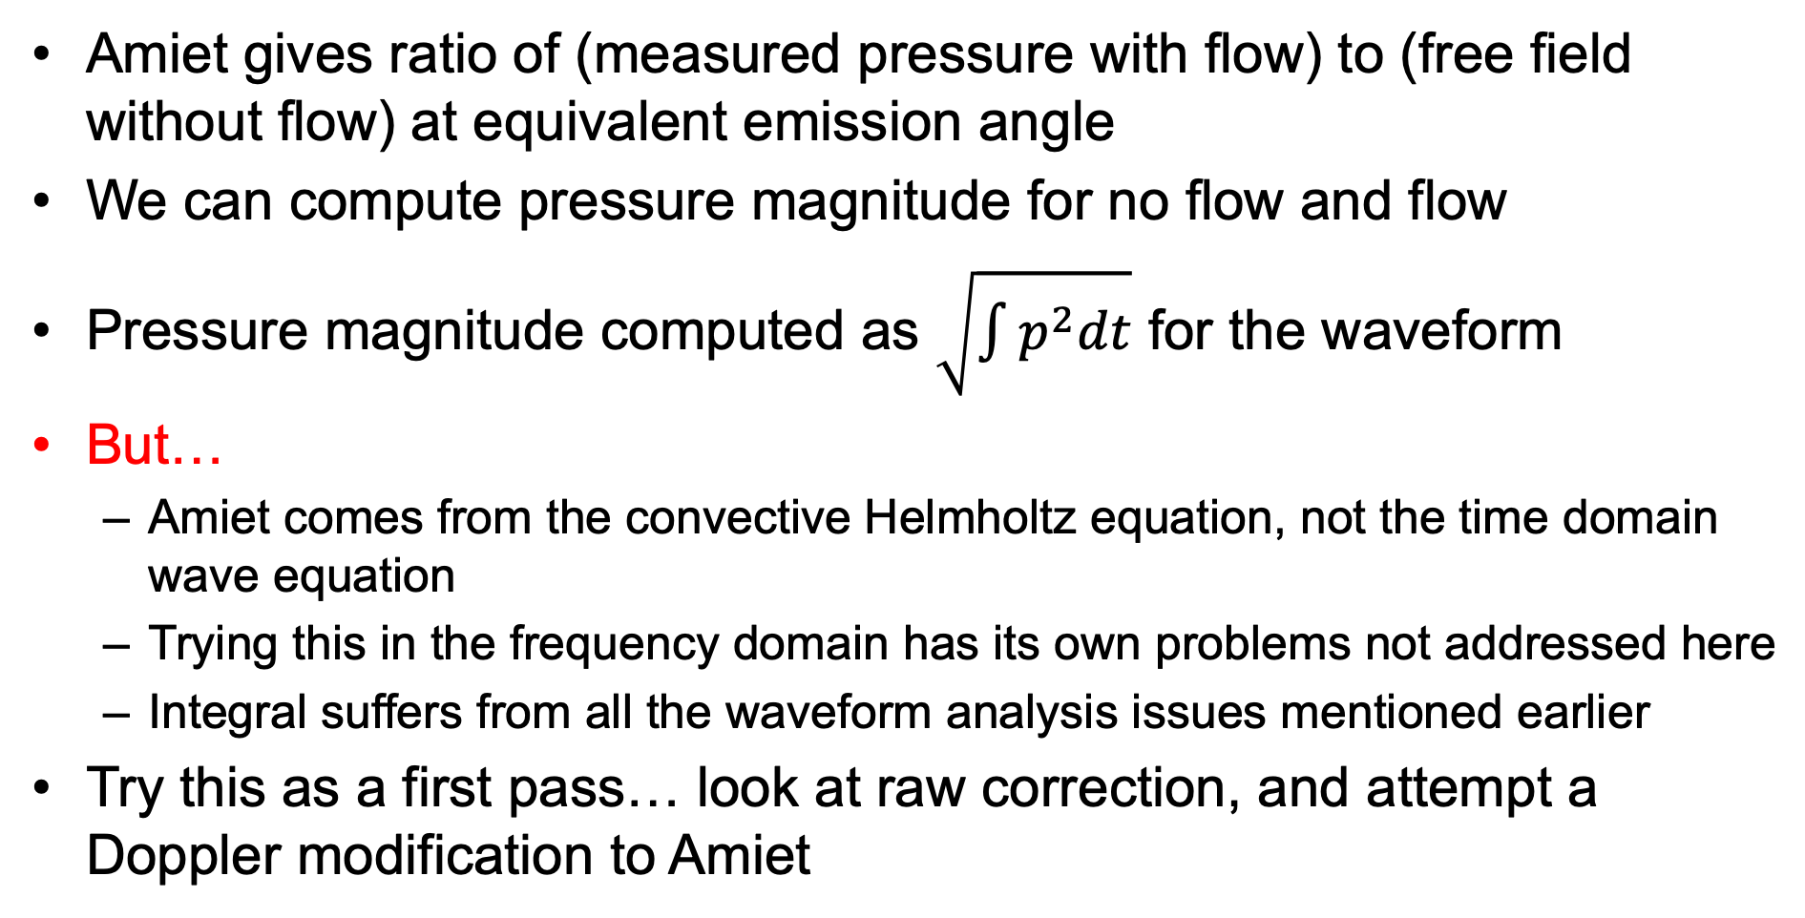
Amiet correction: amplitudes
Amiet gives ratio of (measured pressure with flow) to (free field without flow) at equivalent emission angle
We can compute pressure magnitude for no flow and flow
Pressure magnitude computed as $\sqrt{\int{p^{2}dt}}$ for the waveform
But…
  Amiet comes from the convective Helmholtz equation, not the time domain wave equation
  Trying this in the frequency domain has its own problems not addressed here
  Integral suffers from all the waveform analysis issues mentioned earlier
Try this as a first pass… look at raw correction, and attempt a Doppler modification to Amiet

Slide 15
Example amplitude results from Quiet Flow Facility
Plots of model comparisons for uncorrected and corrected Amiet for multiple array locations in QFF
Doppler correction (partially) detrends difference between model and data
Irregularities appear indicative of short-delay scattering (array frame, reflections which can’t be fully gated)
Dedopplerizing measured data & correcting baseline Amiet for aeroacoustic sources
Flow

Slide 16
My thoughts
Initial results show different ways to consider data wrt a facility correction model, opinions on what is better
Do these results show a path to useful data corrections?
  Time delays: yes, see array point source calibration
  Levels: Short-delay scattering may be difficult to generalize, needs more investigation; smoothed trends are be useful
For steady effects, have not addressed
  Kevlar transmission loss
  Multipath
Source provides data to look at these, but value TBD

Slide 17
Additional comments
Unsteady effects (wander, spread) have been skipped here
  Significant influence on some aspects of the data
  Analysis is straightforward, but correction…?
Measurement setup matters
  These analyses conducted at $5k/mic cartridge, 250 kSamples/sec acquisition rate, clock synchronization to align data to 10 MSamples/sec
  Next round for us: $5k/mic cartridge, direct acquisition at 1.25 MSamples/sec and 20 Msamples/sec, power supplies & filters extended to 140 kHz cut-off
  Ideally, useful analysis should be possible with lower grade acquisition, e.g., ~$100 per channel, 100 kSamples/sec acquisition rate
Big picture: these sources offer great potential in characterizing facilities. Where should this work go beyond an Amiet validation? What holds the most value?

Slide 18

Questions/Discussion

