Slide 1



10-kHz rate tomographic Rayleigh scattering imaging
Naibo Jiang
Paul S. Hsu
Sukesh Roy
Spectral Energies, LLC
Daniel Loriorla
Purdue University
Paul M. Danehy
NASA Langley Research Center
LACSEA, June 22–26, 2020

Slide 2
Acknowledgments
Thanks to Naveed Rahman from Purdue University for his help on data analysis
Funding from NASA SBIR 80NSSC17C0008
Support for PMD provided by NASA Langley Aeronautics Mission Directorate Transformational Tools and Technologies (TTT) Project

Slide 3
Overview
Motivation
High-speed Rayleigh imaging
Tomographic imaging
4D Rayleigh experiment and results
Summary

Slide 4
Motivation
Non-intrusive laser diagnostics is essential for accurate measurements in flow and combustion testing facilities.
Rayleigh scattering is widely applied for important flow parameter measurements, such as density, temperature and mixture fraction.
High-speed 1D and 2D Rayleigh scattering have been demonstrated, but high-speed 3D Rayleigh imaging is still challenging because of the requirement of
high-energy laser pulses for volumetric Rayleigh scattering
compact high-speed tomographic imaging system
3D + time resolved at 10 kHz = 4D: volumetric time-resolved

Slide 5
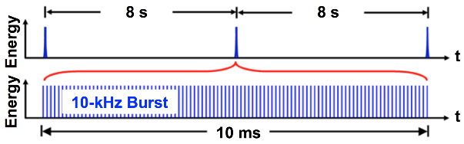
Solution: Burst-mode Laser System
Nominal Specifications
10–100 kHz
10 ms burst duration
1 J/pulse at 10 kHz at 1064 nm

Slide 6
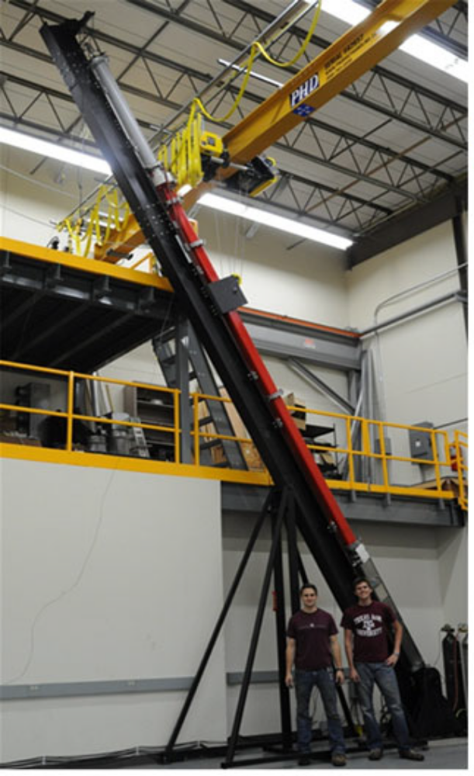
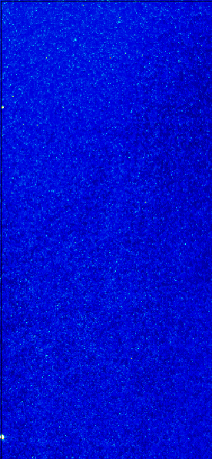
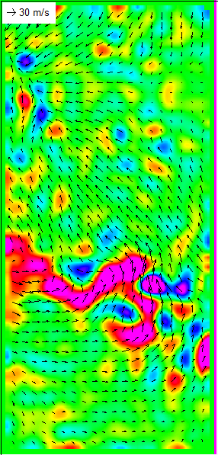
Example: 200-kHz PIV in Shock Tube
200-kHz PIV imaging for Richtmyer–Meshkov instability measurements.

Slide 7
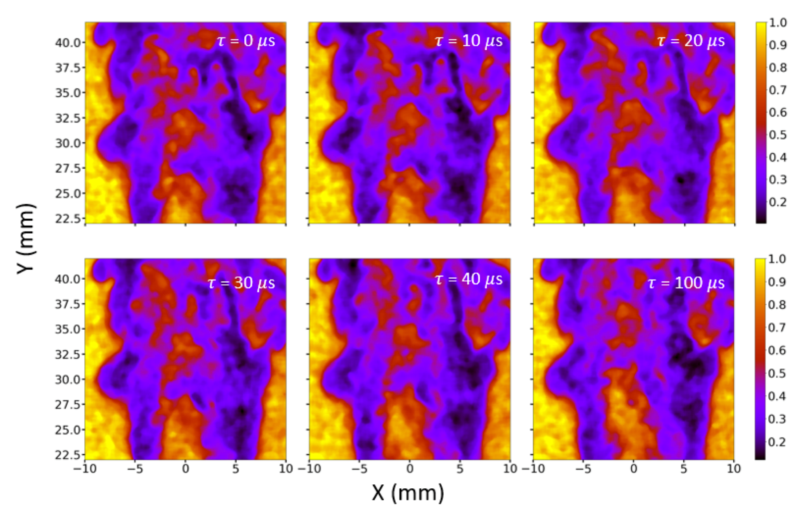
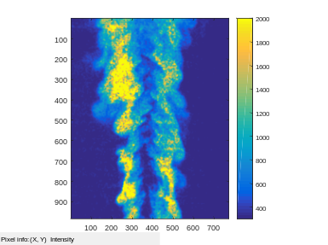
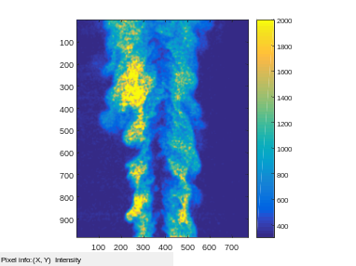
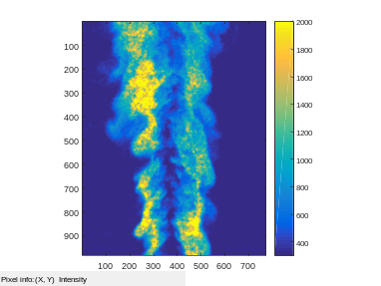

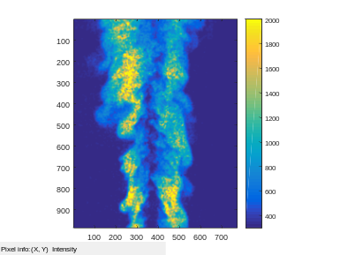
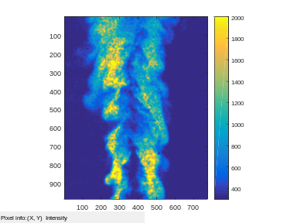
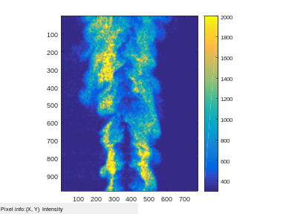
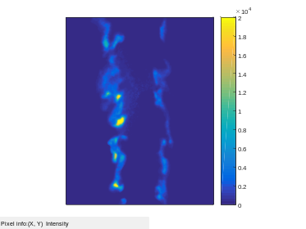






Example: High-speed Rayleigh Imaging in Combustion
100-kHz Rayleigh imaging
10-kHz OH/CH₂O/Rayleigh imaging
100
80
60
0 µs
100 µs
200 µs
×100
T
Y (mm)
300 µs
400 µs
500 µs
100
80
60
T (K)
-20 0 20
-20 0 20
-20 0 20
100
80
60
0 µs
100 µs
200 µs
X (mm)
×10⁴
Grib et al., Optics express 27 , 27902-27916 (2019)
Heat Release Rate
DLR-A Flame, uniform Rayleigh scattering cross sections, 2D Rayleigh images directly show 2D temperature.
Y (mm)
300 µs
400 µs
500 µs
100
80
60
-20 0 20
-20 0 20
-20 0 20
X (mm)
. Jiang et al, Optics express 27, 17017-17026 (2019)

Slide 8
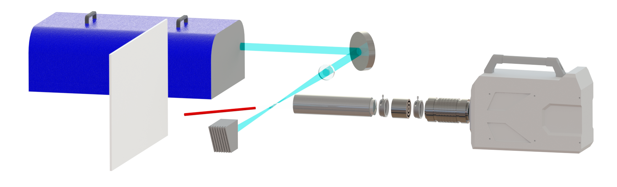
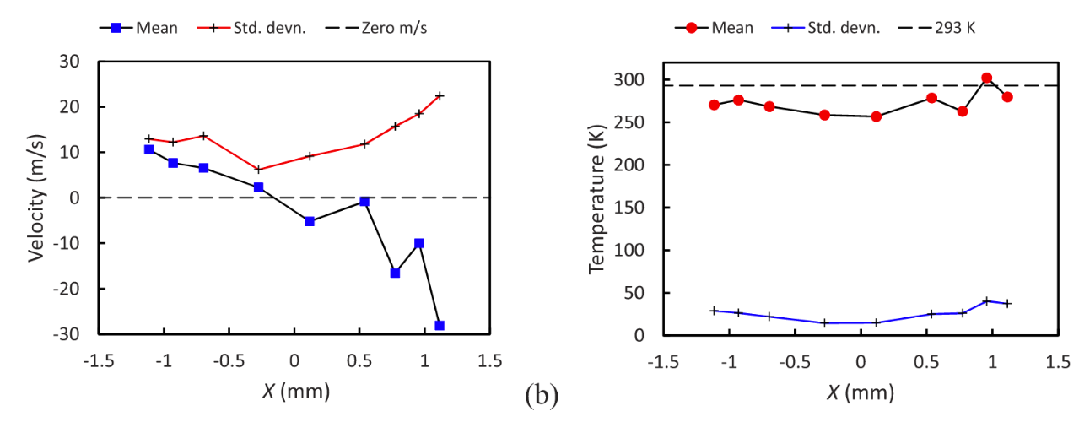
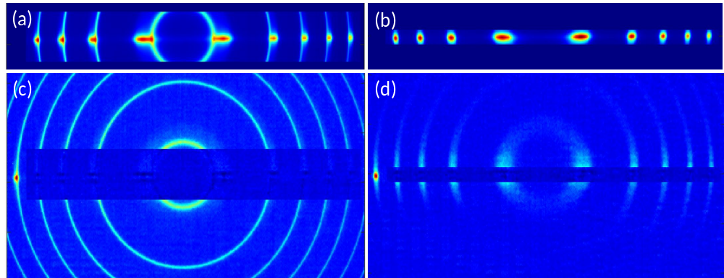
Example: 100-kHz Interferometric Rayleigh Scattering for multi-point flow velocity and temperature measurements
Pulse-burst laser: 100 kHz burst, 40 mJ/pulse
532 nm
High-speed Camera
Focus lens
f =300 mm
Etalon
Jet
Scattering
plate
Collection lens
f₁=100 mm
Image lens
f₂=500 mm
Culter et al., Optics Express 28 , 3025-3040 (2020)

Slide 9
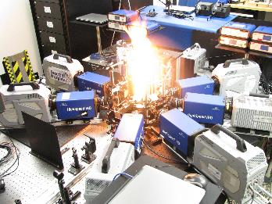
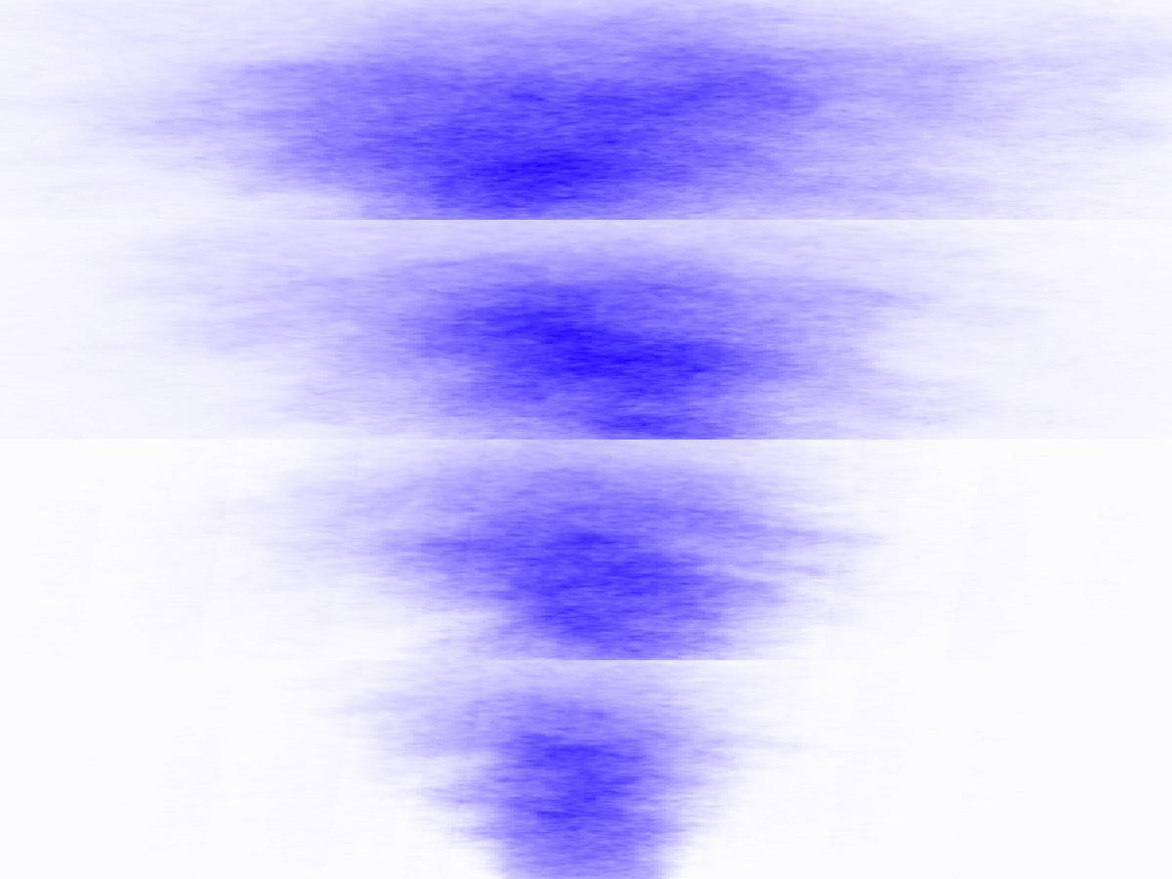
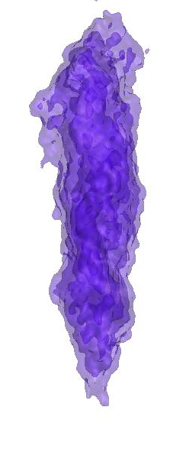
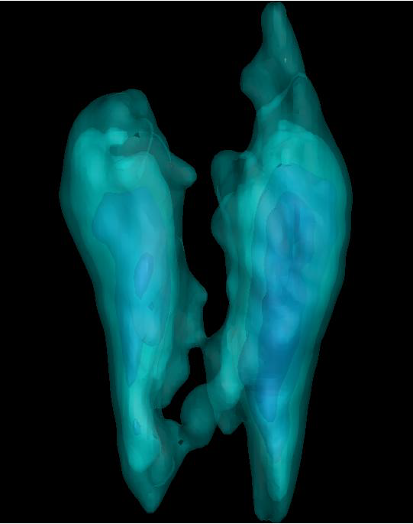
Example: 20-kHz 4D Imaging
4D imaging of mixture-fraction with seeded acetone
x/d =18
x/d =13
4D imaging of CH₂O
x/d =8
x/d =3
Prior tomographic imaging requires lots of cameras
References: Optica, 4, 897, 2017; Optics Letters, 42, 2830, 2017; Proceedings of the combustion institute, 36, 4611, 2017

Slide 10
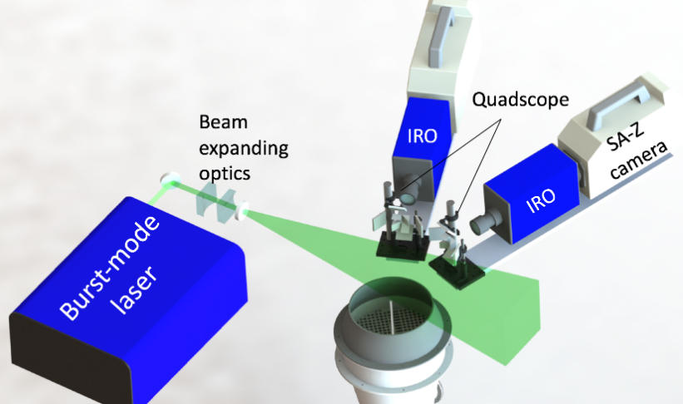
10-kHz Tomographic Rayleigh Scattering
Burst-mode laser + quadscope based compact tomographic imaging system
500mJ/pulse at 532 nm
Two quadscopes to get 8 views
Propane jet
Field of view: 50 mm x 25 mm

Slide 11
8-view of Raw Rayleigh Scattering Images
(a)
(b)
(c)
(d)
(f)
(g)
(a
(e)
(h)

Slide 12
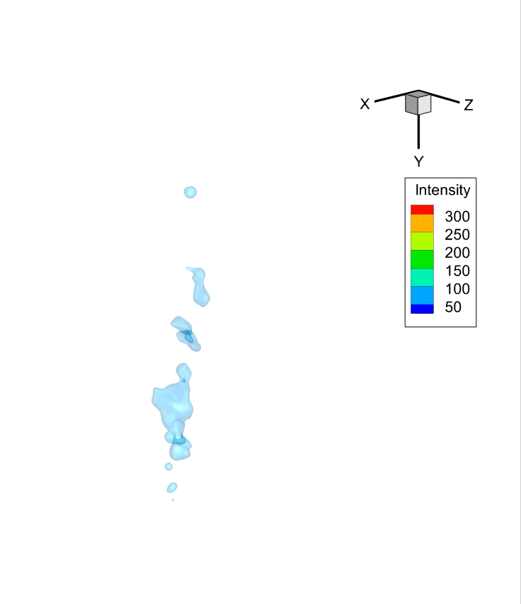
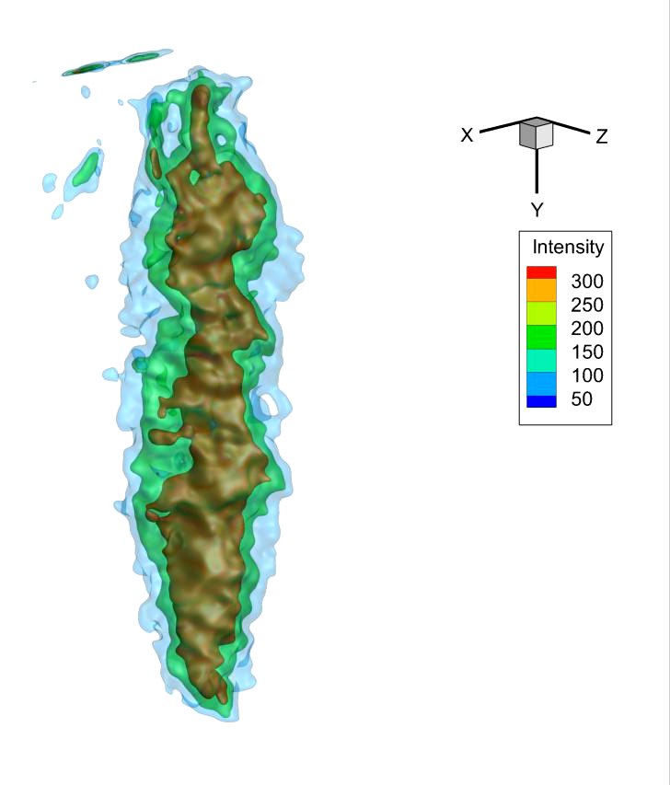
10-kHz Tomographic Rayleigh Scattering

Slide 13
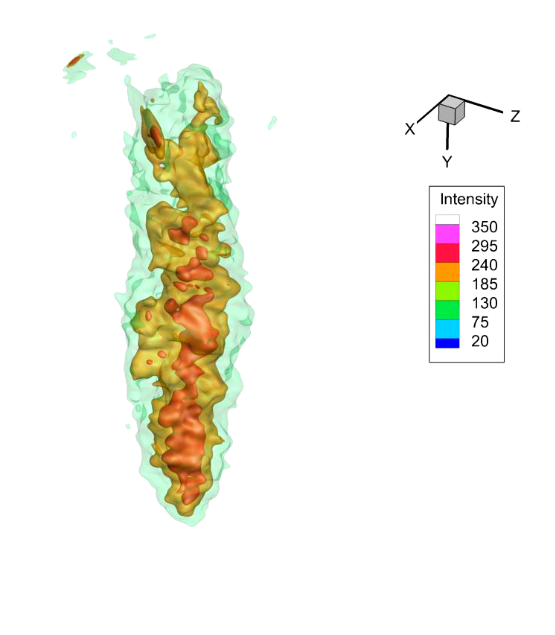
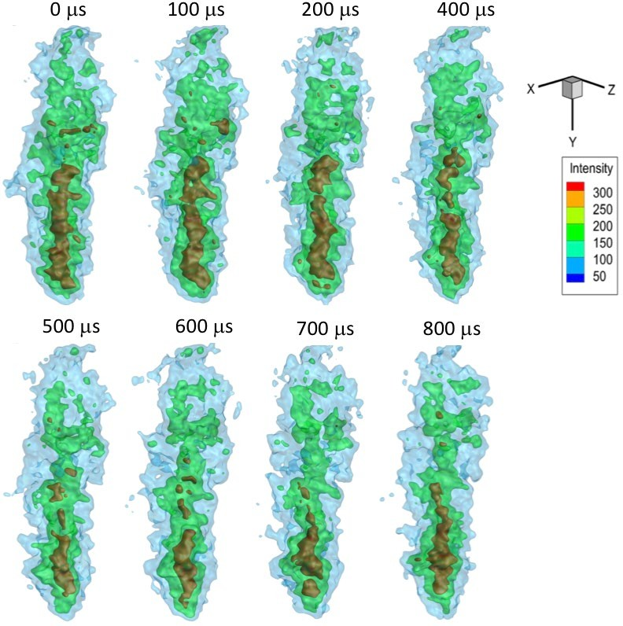
10-kHz Tomographic Rayleigh Scattering
Time evolution of 3D distribution of propane flow Rayleigh scattering

Slide 14
Summary
10-kHz rate tomographic Rayleigh scattering has been demonstrated with the combination of a burst-mode laser and a quad-scope-based compact tomographic imaging system.
• 3-D turbulence structures and their evolutions can be clearly tracked. The spatial resolution is ~0.8 mm.
• Due to the relatively low Rayleigh scattering signals, only propane gas (at room-temperature, atmospheric pressure) has been demonstrated.
• High-pressure and low-temperature flows could be good applications
• With an upgraded high-energy laser, 4D Rayleigh could be possible in combustion or supersonic flow studies.

