Slide 1


Sustainable
Product Lifecycle-Integration Everywhere
AIAA Forum
June 15, 2020
Parimal Kopardekar, PhD (PK)
Director, NASA Aeronautics Research Institute (NARI)
Parimal.H.Kopardekar@nasa.gov

Slide 2
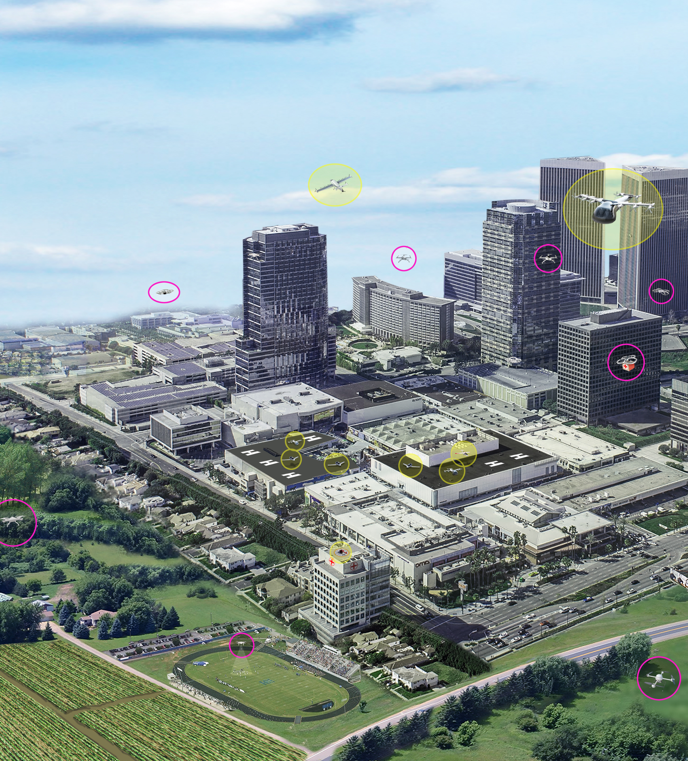
Opportunities for Future Aircraft
Global growth in aviation
Environmental footprint
Aircraft development cycle
Aircraft production rate
Supply chain resiliency
Supply chain sustainability

Slide 3

Aerospace Supply Chain Challenges
Limited/sole sources
Fragile supplier and market
Capacity constrained supply market
Foreign dependency
Diminishing manufacturing sources and material shortages
Gap in U.S. human capital
Product security
Life-cycle supply chain

Slide 4
Grow Emerging Aerospace Ecosystem
Attract non-aero suppliers and manufacturers—work through regional associations
Rebuild skills, talents, digital enterprise and attract new manufacturers to scale deliveries
MROs need rapid access to authenticated parts
Build electronic platform to connect incoming suppliers and OEMs
Build model-based simulation capability to assess aggregate supply chain demand/capacity, and resiliency analysis

