Slide 1
Human Risks in Space
Erik Antonsen MD, PhD, FAAEM, FACEP
Assistant Director
Human Systems Risk Management
NASA Johnson Space Center
June 22, 2020
ATA2020 Conference

Slide 2
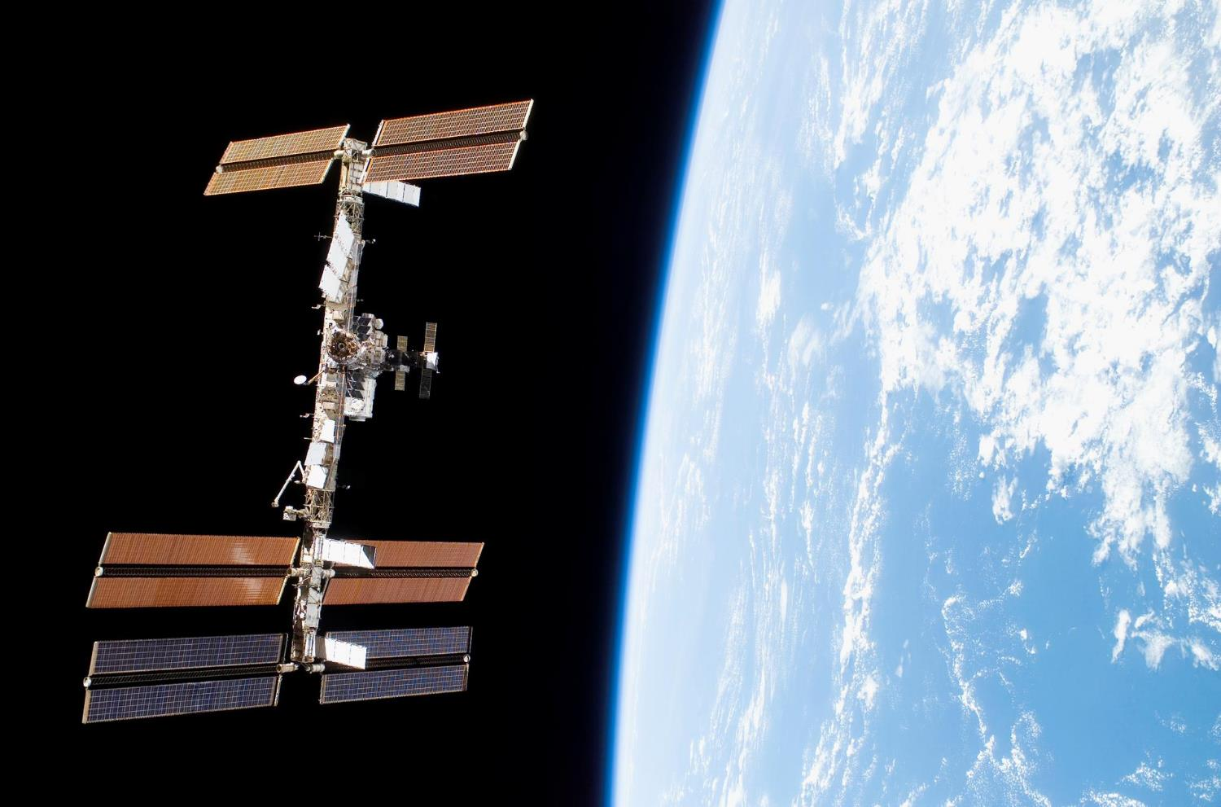
Complex Engineered Systems
20
565
1 billion
Notes:
The first module in the International Space Station was launched in 1998 and the first long term residents arrived in November 2000.
So if you are younger than 19 years old you have not lived in a world where we have not had someone living in space.
Some other interesting numbers – 562 is the number of people who have ever been in space. Contrast that with the number 3000 – which is the low end of the number of participants that the FDA recommends for a phase 3 clinical trial to determine if a medicine works or not.
Or contrast that with 1 billion – which is the number of people who got on an airplane in 2016….in China.

Slide 3
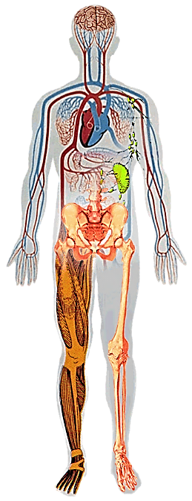
Human System Hazards
Altered Gravity - Physiological Changes
Distance from earth
Drives the need for additional “autonomous” medical care capacity – cannot come home for treatment
  Balance Disorders
  Fluid Shifts
  Cardiovascular Deconditioning
  Muscle Atrophy
  Bone Loss
Hostile/
Closed Environment
Space Radiation
Vehicle Design
Environmental – CO₂ Levels, Toxic Exposures, Water, Food, Dust
  Decreased Immune Function
Acute In-flight effects
Long term cancer risk
Isolation & Confinement
Behavioral aspect of isolation
Sleep disorders
Team dynamics
Human System Risks

Slide 4

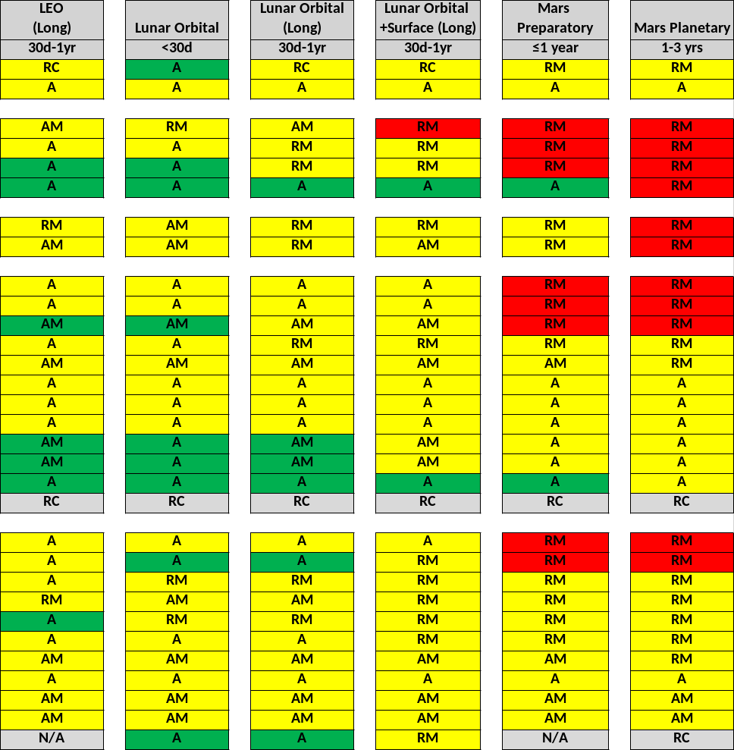
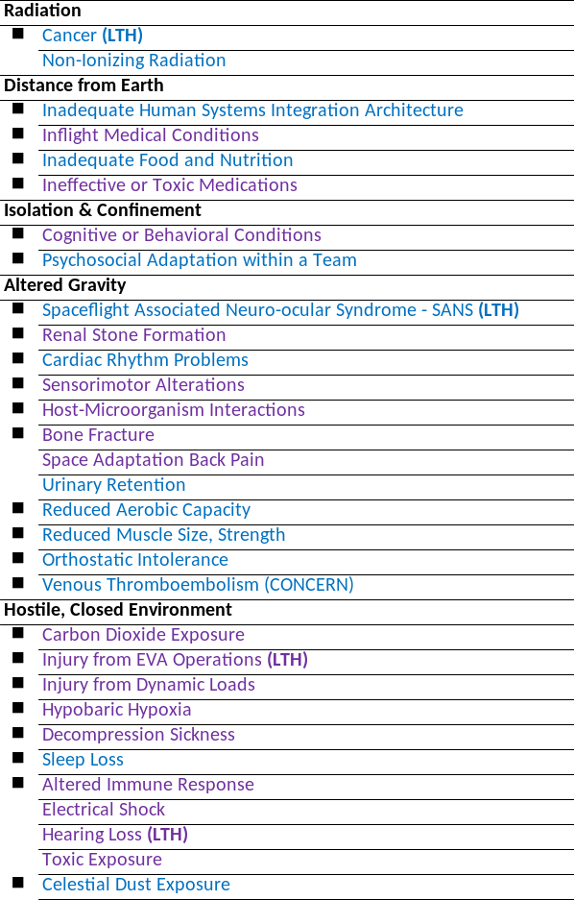
Human System Risk Summary – Risks by Hazard
Notes:
Risk ratings are approved at the Human System Risk Board
Risk ratings are for In-mission operations unless otherwise noted for Long-Term Health (LTH)
Risk text color:
Current risk ratings
Risk ratings under review
Risk colors:
High LxC
Mid LxC
Low LxC
Risk dispositions:
A Accepted
AM Accepted with monitoring
RC Requires characterization
RM Requires mitigation
Denotes specific risks that have HRP research investments

Slide 5
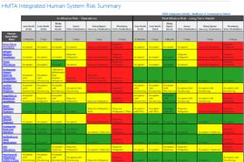
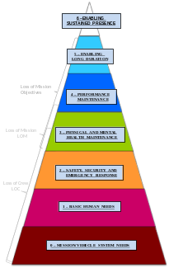
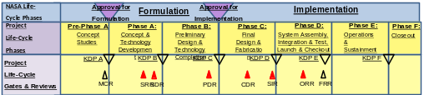
Prioritizing Risk
How much don’t we know?
What risks affect other things?
When do we need to know by?
What are the top risks?
It depends on all these factors as well as the mission you are concerned with.

Slide 6
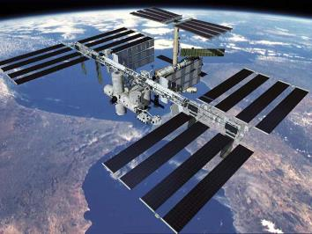
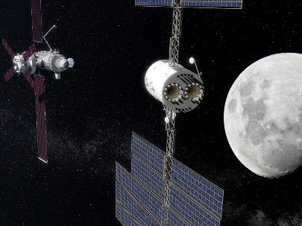
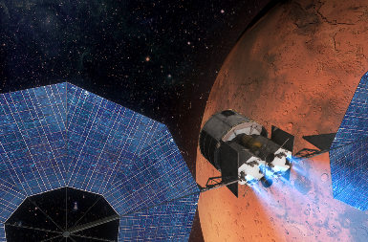
Progressive Earth Independence
Real Time Communications
Evacuation Capability (1.5 – 36 hrs)
Strong Consumables Resupply
Near Real Time Communications
Evacuation Capability (3 – 11 days)
Limited Consumables Resupply
No Real Time Communications
No Evacuation Capability
No Consumables Resupply
Increasing Exposure to Hazards
Notes:
As we change missions and vehicles to get to ever distant horizons, we recognize that the way we’ve done it may not actually apply to the ways we need to do it going forward. You can see some of the most fundamental changes as we take each step toward the horizon of a Mars mission, and the operational challenges that they pose. The systems that we put into place to help that small crew of people meet those challenges are made up of a lot of software and hardware that need to address some of the most fundamental challenges we face with complex engineered systems – unanticipated failure modes.

Slide 7
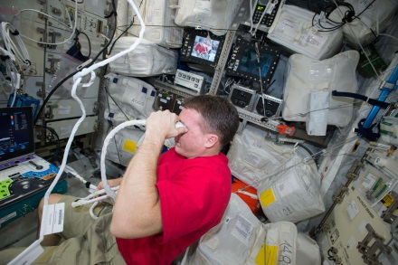
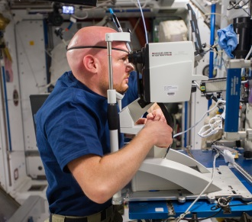
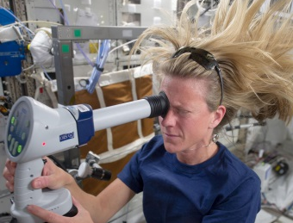
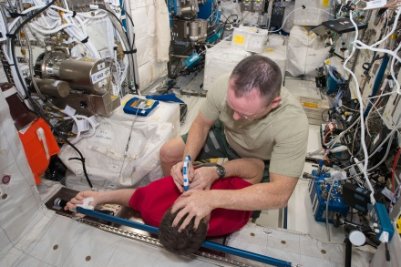
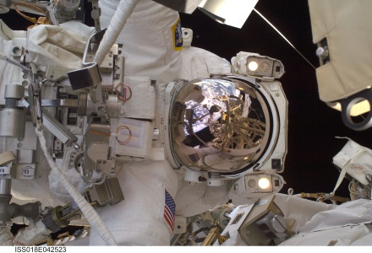
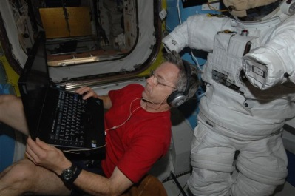
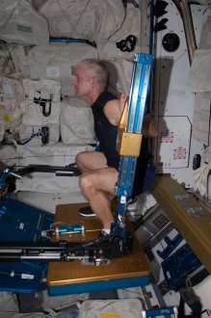
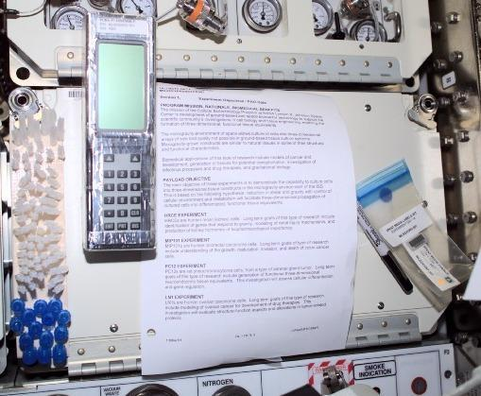
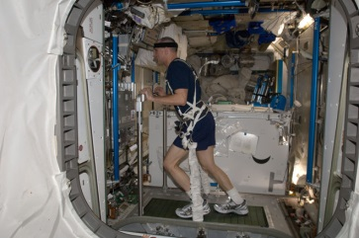
Types of Tele-interaction
Live remote guidance
Live monitoring
Store and forward
Autonomous
Notes:
Go through following slides- who’s doing what (group doing work)
Ops overview slide- telemedicine ISS ops presented in order listed here; before any in-flight happens, need training (next slides)
FYI:
US eye- Terry Virts; OCT- Alexander Gerst; Fundoscopy- Karen Nyberg; Tonometry- Barry Wilmore, Terry Virts
EVA- Richard Arnold
OOHA- Bob Thirsk; treadmill- Don Pettit; ARED- Steve Swanson

Slide 8
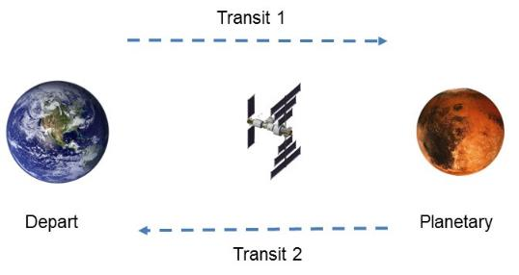
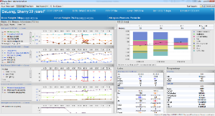
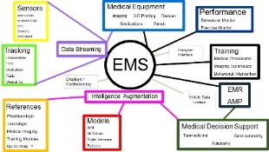

Providing Tele-support requires a System
Ground Support
Crew Autonomy
Move Knowledge, Not People
Notes:
Gateway up to 42 day missions
Use prior spaceflight experience database to define system functionality required
Identify system design constraints (development time, logistics, evacuation
Identify limited system success criteria in support of future exploration missions (medical data integration, Ground Ops paradigm)
Deep Space Habitat up to 400 day missions
Identify mission unique criteria(no experience base)
Preventative Care
Performance maintenance
Medical Autonomy
Resource Constraints (Data, Mass, Volume)
Use Systems Engineering Approach to develop ConOps, Architecture, Requirements and V&V approaches

Slide 9




Crew Health and Performance System Must…
Protect from environmental hazards
  Radiation protection
  Noise, vibration, CO₂, etc.
Keep healthy crew well
  Exercise
  Other physiological countermeasures
  Food
  Behavioral health
Prevent, diagnose, treat, manage long-term health care
  Data system
    Medical Data Capture
    Medical Training
  Medical devices
  Medical supplies
Support crew to accomplish mission tasks
  Procedures
  Training
  User interfaces

Slide 10

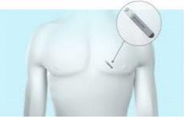









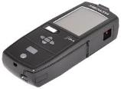









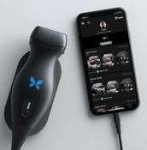


A Crew Health and Performance System is Data Intensive
(Not an intensive care unit)
Behavioral
Pharmacy
Medical
Performance
EMR
Dashboard
Diagnosis
Nutrition
Sleep
Procedures
References
Laboratory
Environment
Training
CMO Only
Inventory
Equipment
Imaging
Medical
Phone Home
Notional
Notes:
When we talk about software systems that can help us do all these things and provide the D portion of this, we all have an image in our mind of what that looks like. I can draw this up here and you can imagine the apps that would be included along with sensors that enable tracking of the pharmacy, input of data into the EMR, Bluetooth and wireless capture of lab values from hand-held devices, same for the capture of images from that little ultrasound. And while it is easy to say that these technologies are advancing and all of this is possible, remember that the reality of actually capturing, storing, integrating and transmitting data, and making it interpretable to non-expert crewmembers actually takes a lot of behind the scenes planning, coding and work. The next couple slides are intended to draw back the curtain for a look at what it takes to get to something like this.

Slide 11
Conclusion
Making spaceflight less risky for crews has always been intimately tied to telemedical and telesupport capabilities.
Creating the system and its infrastructure is the responsibility of NASA and the companies working on spaceflight
Helping figure out what are the best things to include in the system and how to take the next steps in tele-support to face new challenges is part of why we reach out to communities like TRISH and ATA.

