Slide 1

Human Landing System Program

Slide 2
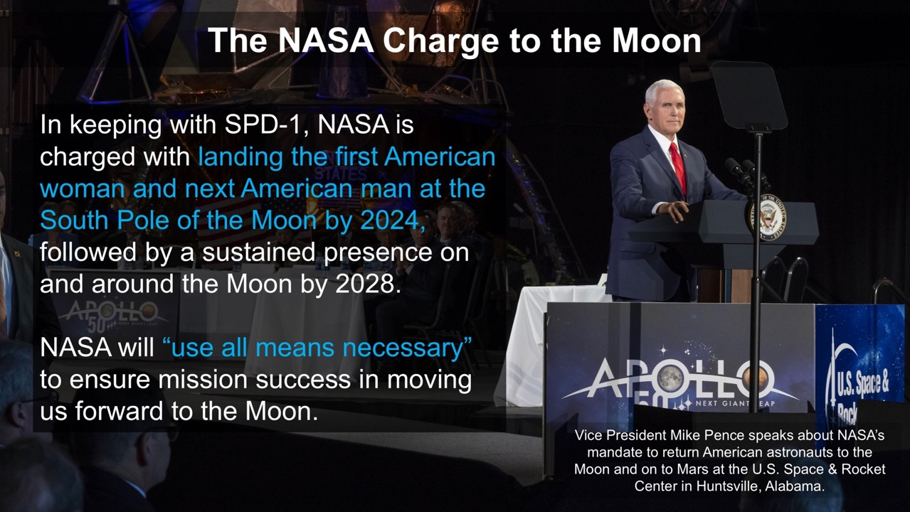
Notes:
In keeping with President Trump’s SPD-1, last year VP Pence charged NASA to land the first woman and the next man on the South Pole of the Moon by 2024

Slide 3
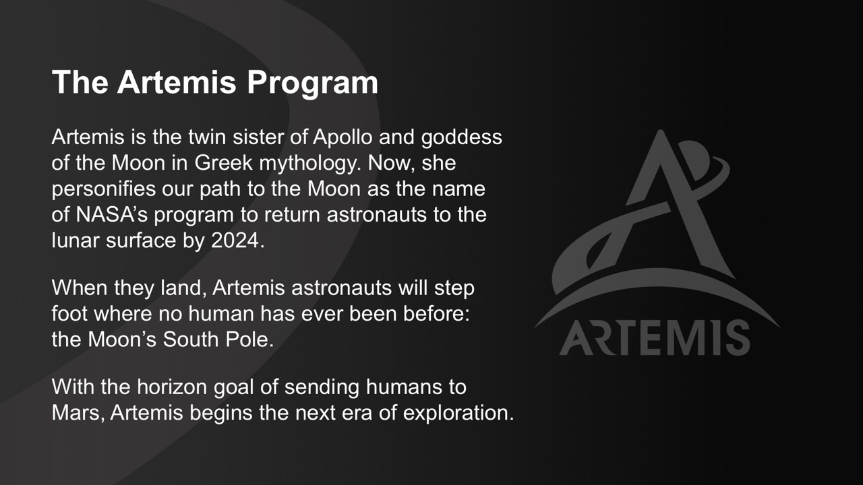
Notes:
In response to this charge, NASA created the Artemis Program, which encompasses all of NASA’s lunar exploration initiatives, including the 2024 lunar landing.

Slide 4
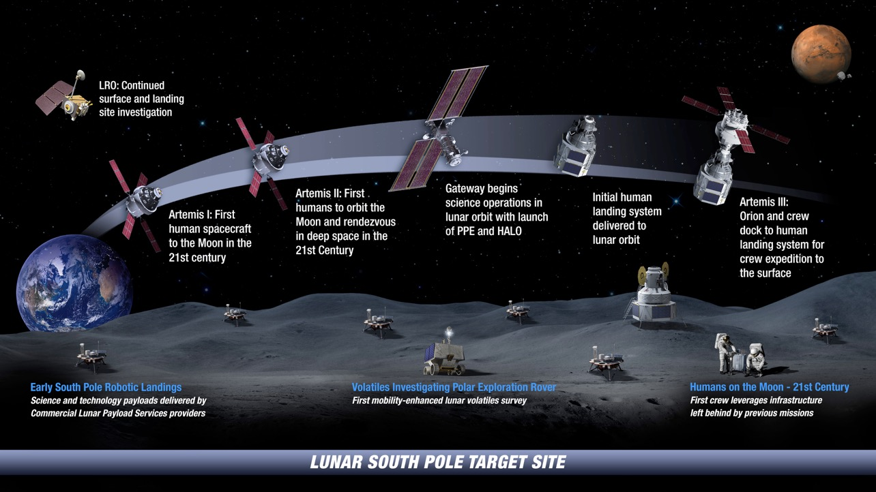
: Landing Humans On the Moon in 2024
Notes:
Here you’ll see the latest plans for the initial Artemis missions.
The first mission, Artemis I, will see the un-crewed Orion spacecraft launch on the SLS rocket to swing around the Moon and come back to Earth. It’s an important mission before putting any humans on board, as they did in the Apollo program.
Artemis II will be the first Artemis mission to launch with a crew, another key milestone before attempting the full launch and landing on the surface of the Moon
Artemis III (on the far right) will be the mission that sends crew to the lunar surface on board a Human Landing System, which I am here to talk more about today. The HLS will have launched uncrewed and be waiting for Orion to arrive with the astronauts on board. The two will dock together and the crew will get on board to head to the surface where they’ll stay several days, doing EVAs and science, before going back up to Orion and heading safely back to Earth.

Slide 5

Human Landing System
Firm Fixed Price Broad Agency Announcement for rapid development and crewed demonstration to return humans to the lunar surface by 2024
Leveraging commercial capabilities to the maximum extent possible; may tailor the traditional NASA program management and systems engineering processes to expedite the schedule
NASA will not take ownership of the HLS hardware/software
HLS will launch as commercial cargo; checkout and testing will occur on orbit prior to any crew launch and egress
NASA provides certification and technical expertise
The HLS plan is to leverage the speed and operating models of the commercial space industry while applying NASA expertise to ensure safety and mission success
Notes:
On the left you’ll see an artist’s rendering of a generic, government reference design of a lunar Human Landing System…
**here I’d give a high-level overview of the Program—that we’re soliciting the design, delivery and demonstration much like we are seeing with CCP, and that NASA won’t own the lander. You can mention the whole “best of NASA and best of industry” approach**

Slide 6
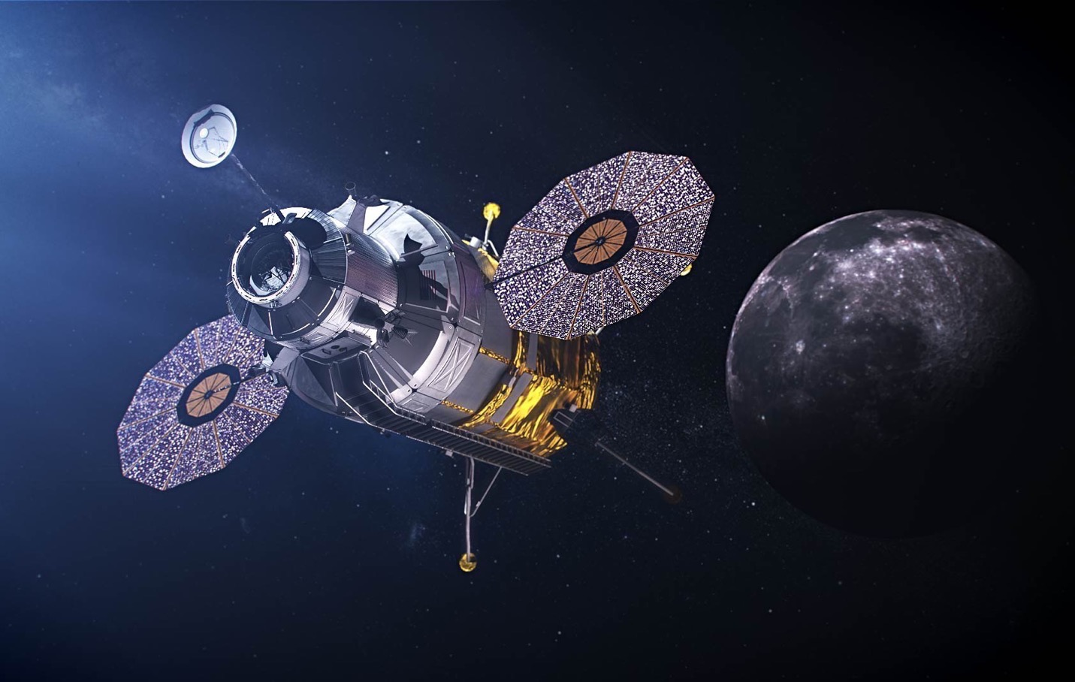

Human Landing System – NextSTEP-2 Appendix H
  Final solicitation issued September 30
    Drafts issued July 19 and August 30;
    +1,150 comments from industry
  Proposals submitted November 5, 2019
  Selections announcement April 30, 2020
  Base Period ends February 2021
Notes:
** this chart covers our basic timeframe, I always like to include it because it shows our speed. You can explain that during this Base Period we’re focused on nailing down requirements, and at the end we’ll have a better idea of who we think can meet the 2024 landing**

Slide 7
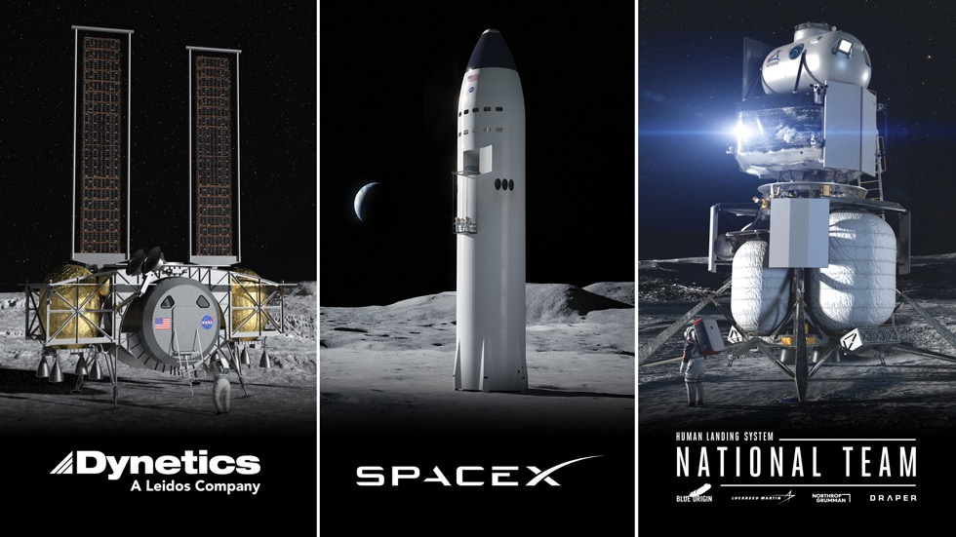
Overview
3 HLS contracts awarded April 30, 2020
Complete lander systems were proposed including launch vehicles for an end to end solution for 2024 and sustaining
Base Period: May 2020 – February 2021
The Broad Agency Announcement achieved the innovation from US Industry it was designed to do.

Slide 8

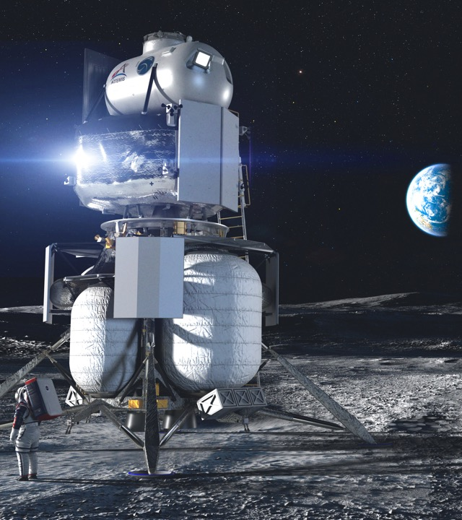
$579M
BASE PERIOD
“INTEGRATED LANDER VEHICLE” (ILV)
Three-stage landing system
  Ascent – Lockheed Martin
  Descent – Blue Origin
  Transfer – Northrop Grumman (future refueler)
  GN&C, Avionics, Software – Draper
Rockets: New Glenn & ULA Vulcan
KEY ATTRIBUTES
Significant proven spaceflight heritage
Orion and Gateway compatible

Slide 9
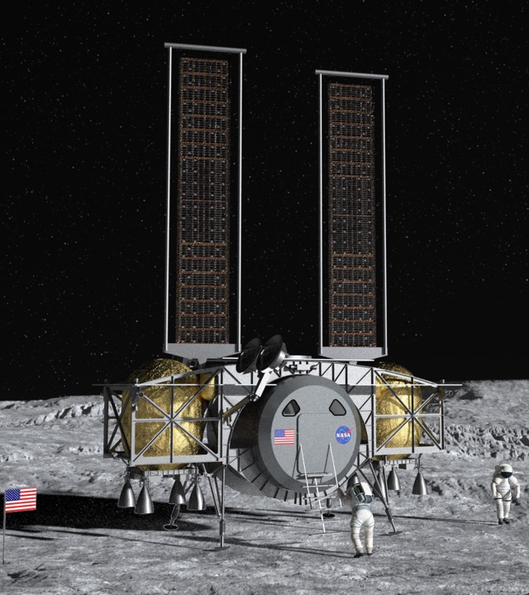

$253M
BASE PERIOD
“DYNETICS HUMAN LANDING SYSTEM”
Single element providing the ascent and descent capabilities
Multiple modular propellant vehicles (MPVs) prepositioned to fuel the engines
Large subcontractor team
Rockets: ULA Vulcan
KEY ATTRIBUTES
“Mass produced” MPVs
Crew cabin sits low to the surface
Double-androgynous docking system
Orion and Gateway compatible

Slide 10
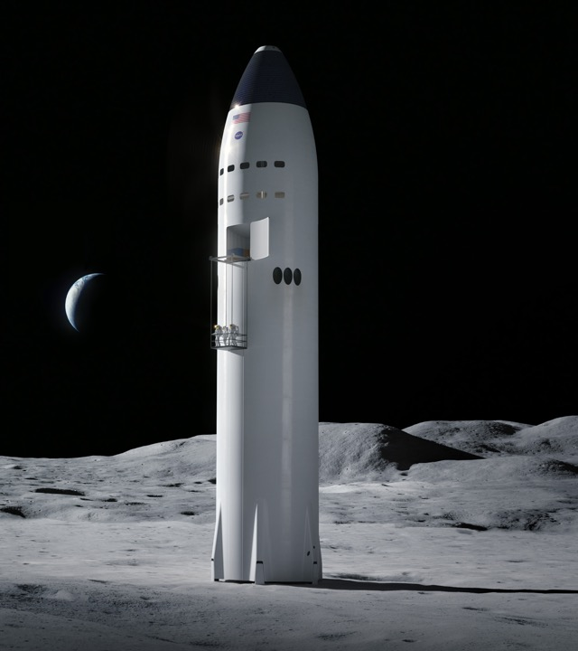

$135M
BASE PERIOD
“STARSHIP”
Integrated lander
Fully reusable launch and landing system
Fueling in low-Earth orbit with Starship storage and Starship Tanker variants
Rocket: SpaceX Super Heavy
KEY ATTRIBUTES
Spacious cabin
Two airlocks
Orion and Gateway compatible; Orion for first demo

Slide 11
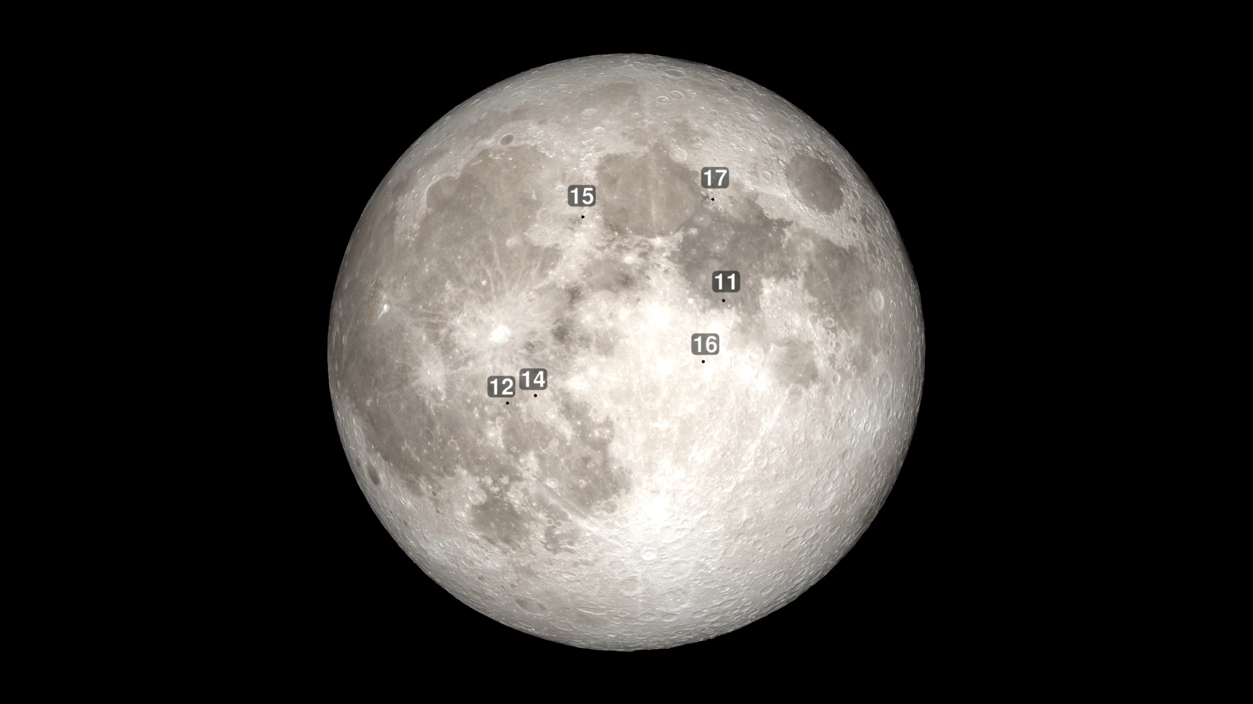
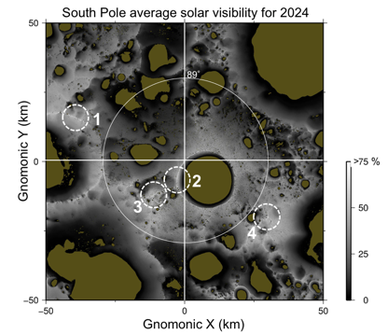
American Strategic Presence on the Moon –
High solar illumination areas within 2 degrees (<50 km) of the lunar south pole.
High Priorities for Sustained Surface Activities
Four highly illuminated areas shown above:
De Gerlache Rim,
Shackleton Rim
Shackleton – De Gerlache Ridge
Plateau near Shackleton
Long duration access to sunlight: A confirmed resource providing power and minimal temperature variations
Direct to Earth communication: Repeatable Earth line-of-sight communication for mission support
Surface roughness and slope: Finding the safest locations for multiple landing systems, robotic and astronaut mobility
Permanently Shadowed Regions and Volatiles: Learning to find and access water ice and other resources for sustainability
Notes:
This animation shows the Apollo landing sites, found generally around the Moon’s equator. When we go back through the Artemis program, we want to explore parts of the Moon we have never been before, namely the South Pole.
As you can see as the animation progresses, the South Pole is a much more dynamic place to try to land.
However, the South Pole has great benefits for lunar missions, including long duration access to sunlight which is key for use of solar panels.
There is also fairly long-duration direct-to-Earth communications, so there is no “going behind the Moon” and losing signal like they had for Apollo.
We’re also very interested in the South Pole because there are permanently shadowed places in the deep craters, where we think we may likely find volatiles like water ice.

Slide 12
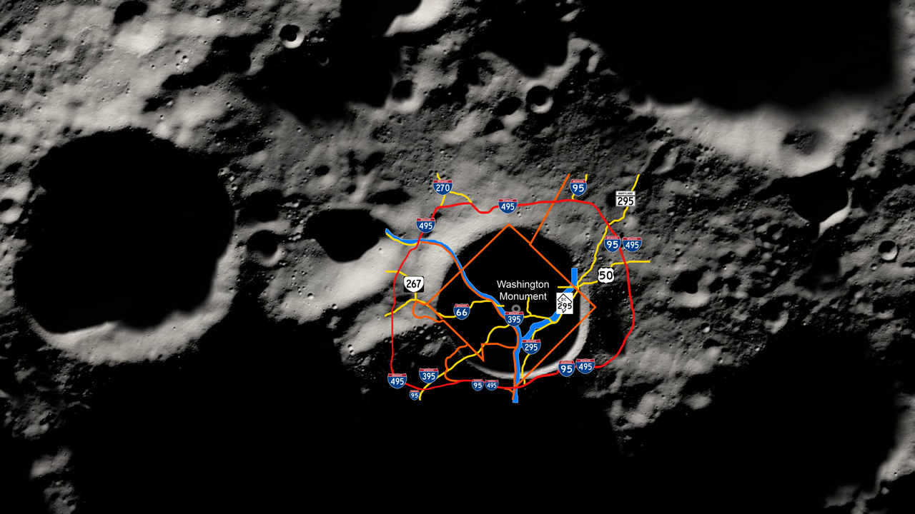
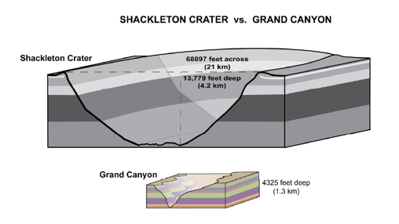
The Lunar South Pole
29400 feet across
(8.96 km)
Shackleton Crater: ~20 km in diameter, ~4 km deep and ~3x deeper and wider than the Grand Canyon
Notes:
There’s lots to explore and learn from at the South Pole, but this chart gives a better picture of the size and dynamic environment we’re talking about—the South Pole’s Shackleton Crater is three times deeper and wider than the Grand Canyon!
Here you can see the Crater itself is roughly the size of the metro DC area

Slide 13
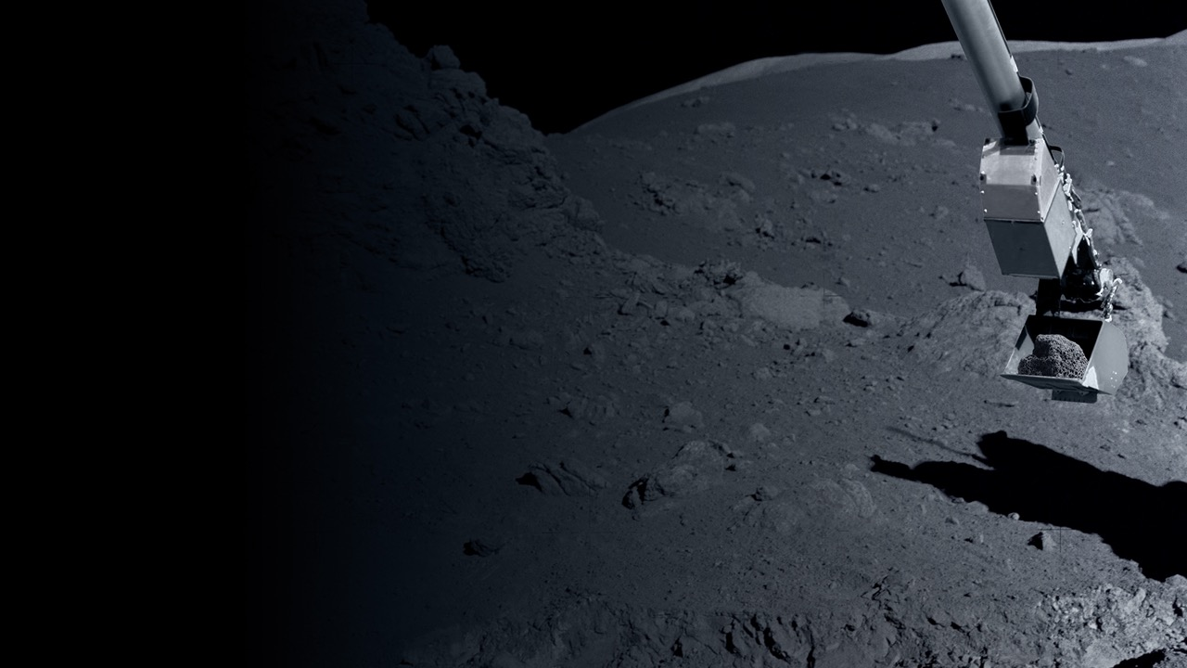
Lunar Science by 2024
Polar Landers & Rovers
First direct measurement of polar volatiles, improving understanding of lateral and vertical distribution, physical state
First surface exploration of permanently shadowed regions
Non-Polar Landers & Rovers
Explore scientifically valuable terrains not investigated by Apollo. Examples could include young volcanic areas, magnetic anomalies, pyroclastic deposits, farside
Move top a PI-led CLPS delivered instrument model conducting focused science for a selected location
Provide opportunities for international cooperation
Orbital data
High-resolution mapping of permanently shadowed regions
CubeSats delivered by Artemis I
High priority new data sets acquired by CubeSats or SmallSats delivered by CLPS
In-Situ Resource Initial Research
Answering questions on composition and ability to use lunar ice for sustainment and fuel
Notes:
Polar Landers and Rovers
First polar volatile direct measurement, improving understanding of lateral and vertical distribution, physical state, and chemical composition
Information on the geology of the South-Pole Aitken basin, the largest impact in the solar system
Non-Polar Landers and Rovers
Ability to explore scientifically valuable terrains
not explored by Apollo
Examples include:
Land at a lunar swirl and make first surface magnetic measurement
Visit young volcanic features to understand volcanic evolution
PI-led instruments - Discovery-class science such
as geophysical network and visiting lunar volcanic region
Orbital Data
Artemis 1 will deploy over a dozen cubesats
Cubesats delivered by CLPS providers, or
comm/relay spacecraft could acquire new
scientifically valuable datasets
Global mineral mapping (including resource identification), global elemental maps, improved
volatile mapping
In-Situ Resource Initial Research
What is the composition and ability
to use lunar ice for sustainment and fuel

Slide 14
Notes:
And of course, we want to take everything we learn from these Artemis lunar missions and apply them to future missions to Mars. The Moon is only a few days away, whereas a round-trip mission to Mars could be 2-3 years at its briefest.

Slide 15
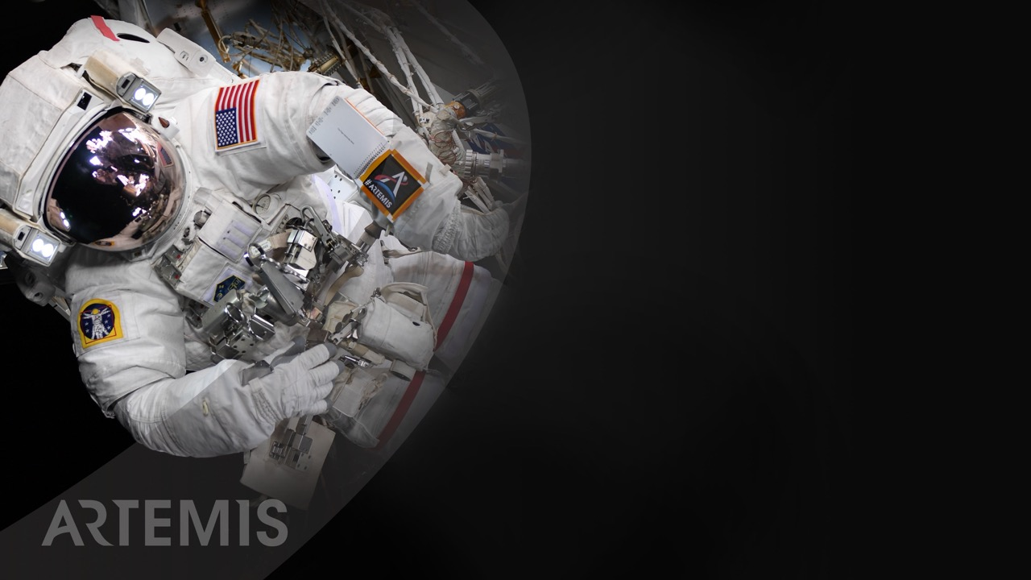
Let’s go.
The time is now.
We have the capability
We have the purpose
We have the charge
We have the responsibility

Slide 16

