Slide 1
Distributed, Data-centric Collaborative Information Management (DDCIM) for Project Management and SE&I
Jenny Devolites, NASA-JSC
Antony Williams, Jacobs Engineering
Kristina Rojdev, NASA-JSC

Slide 2
Outline
Introduction
DDCIM
Comparison to Document-Centric and MBSE Approaches
Examples Over Project Life Cycle
Challenges
Forward Work

Slide 3


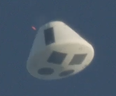
Introduction
Over the past decade, two in-house NASA projects provided opportunities to innovate on and advance a digital collaboration environment for managing the project team and performing systems engineering.
Goal #1: project success. Goal#2: to create approaches that could be scalable for human spaceflight and not limited to small teams, R&D, or uncrewed spacecraft
  Amount of process rigor (lock-down on collaboration, review and approval, mandatory use, etc.) changed over the course of both projects, depending on life cycle and risk tolerance
Both projects were successful:
  13 successful Morpheus lander free flights (autonomous terrestrial lander with LOX-methane propulsion and hazard avoidance / precision landing)
  Fully successful AA-2 CSR delivered 6 months early and under budget for uncrewed Orion ascent abort flight test
Morpheus Lander in free flight at NASA KSC, 2014
Orion’s Ascent Abort 2 flight test, July 2, 2019

Slide 4
Project Success: Morpheus, AA-2
Show Morpheus FF13 Video Clip
Show AA-2 Video Clip

Slide 5
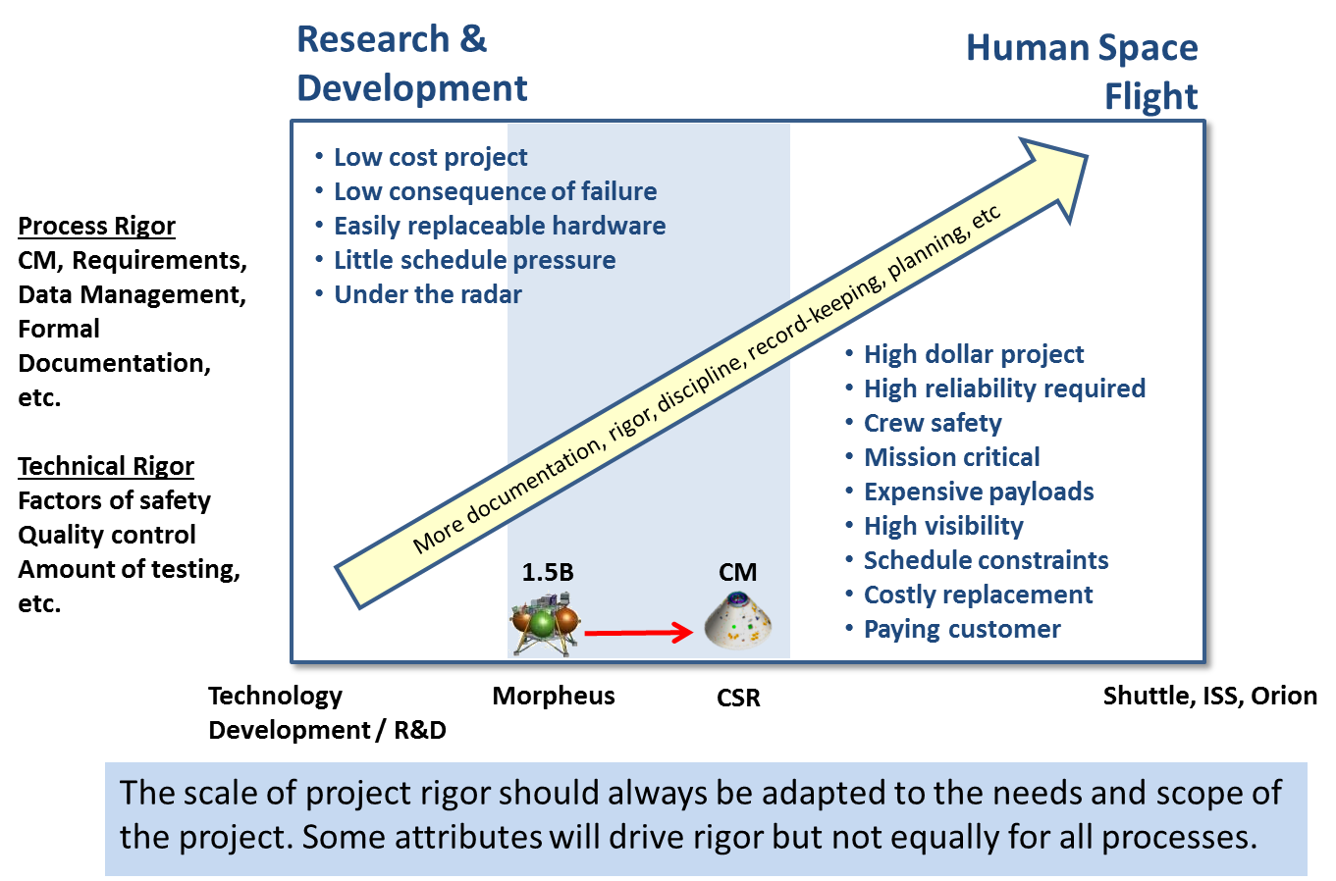
CSR Developed With Increased Rigor Compared To Morpheus
Orion’s AA-2 :
  Uncrewed flight test
  Inherently higher risk tolerance than human spaceflight
  High impact to the program if not successful
CSR built in-house at NASA
  Team encouraged to innovate
  Traditional institutional processes not mandatory as long as deliverables met requirements
Resulting risk approach
  Rigor and risk posture consistent with flight test
  CSR hardware handled as either flight or non-flight (classification)
  CSR flight software is Class B, safety critical, and leverages Goddard’s Core Flight Software
  Processes and tool use intended to be able to “scale up”

Slide 6
What is DDCIM?
What DDCIM is not
  Not a document-centric approach to managing project information
  Does not prescribe or preclude any specific tools, but is not “tool-agnostic;” not all tools can support the full breadth of capabilities
Features
  Distributed – project information is owned and managed by team members across the organization, at the item level to the extent feasible, not by just the management team and/or SE&I team.
  Data-centric – project information is managed as individual data items, not as documents, whenever possible. Data items are linked in relationships to other data items.
  Collaborative – project team members have access to the authoritative source of data, and the ability to add, modify, and change the state for project information (with permissions assigned as appropriate).
  Information Management – covers the breadth and depth of project information over the life cycle; not just systems engineering or project management, but all kinds of project information.

Slide 7
DDCIM
DDCIM is a data-centric approach to managing project information, with a primary goal of greatly reducing the inefficiencies of document-centric information management approaches.
  Data-centric implementations provide a model-based capability that enables many of the same goals and features, but without the graphical representation
DDCIM relies upon the use of a data-centric collaborative environment with linked data relationships. DDCIM improves efficiency in collaborative, data-centric information management across a breadth of both project management and systems engineering artifacts.
DDCIM is scalable and can be used standalone or to augment traditional document management or MBSE approaches to development.
Both of these projects employed the widely accessible Microsoft SharePoint environment, for which no special licenses were required since it is already part of the NASA enterprise tools, and exploited many out-of-the-box features to which the majority of the workforce has not yet had experience.

Slide 8
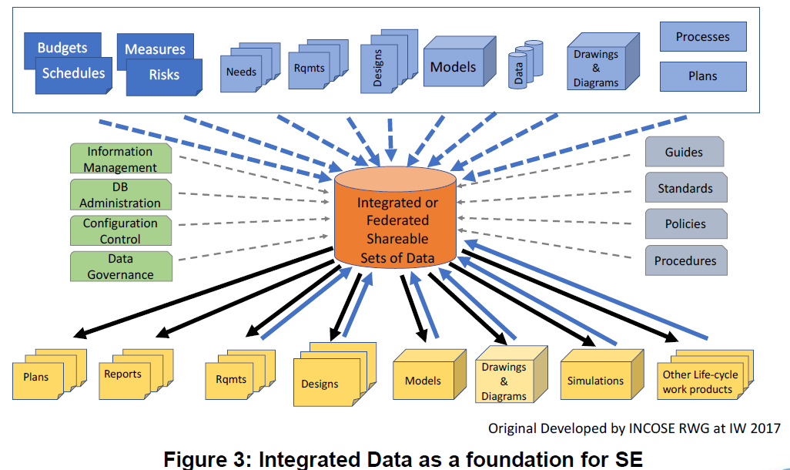
Integrated Data as a Foundation of SE
“The goal…is to have the capability to integrate PM and SE data and information into integrated (federated) shareable sets of data. …. These sets of data not only represent an architectural model of the system under development, but also a model of the system life cycle process activities and resulting work products that can be used to more effectively manage the system engineering efforts across all system life cycle stages. “
From: Integrated Data as a Foundation of Systems Engineering,
December 2018 - Whitepaper by the INCOSE Requirements Working Group

Slide 9
In Distributed, Collaborative SE&I, All Team Members Contribute
Standard Information Management Model with Specialty Tool
DDCIM Model
Team Lead
Team Lead
Tool
Team Lead
Team Lead
Team Lead
Team Lead
Team Lead
Team Lead
Team Lead
Tool User
Tool User
Tool User
Tool User
Tool User
Team Member
Team Member
Team Member
Team Member
Team Lead
Team Lead
Team Lead
Team Lead
Team Lead
Team Lead
Team Lead
Team Lead
Team Lead
Team Member
Team Member
Team Member
Team Member
Team Member
Team Member
Team Member
Team Member
Team Member
Team Member
Team Member
Team Member
Team Member
Team Member
Team Member
Team Member
Team Member
Team Member
Team Member
Team Member
Team Member
Team Member
Team Member
Team Member
Team Member
Tool
Team Member
Team Member
Team Member
Team Member
Team Member
Team Member
Team Member
Team Member
Team Member
Team Member
Team Member
Team Member
Team Member
Team Member
Team Member
Team Member
Team Member
Team Member
Team Member
Team Member
Team Member
Team Member
Team Member
Team Member
Team Member
Team Member
Team Member
Team Member
Team Member
Team Member
Team Member
Team Member
Team Member
Team Member
Team Member
Team Member
Team Member
Team Member
Team Member
Team Member
Team Member
Team Member
Team Member
Team Member
Team Member
Team Member
Team Member
Team Member
Team Member
Team Member
Team Member
Team Member
Team Member
Team Member
Team Member
Team Member
Team Member
Team Member
Team Member
Team Member

Slide 10
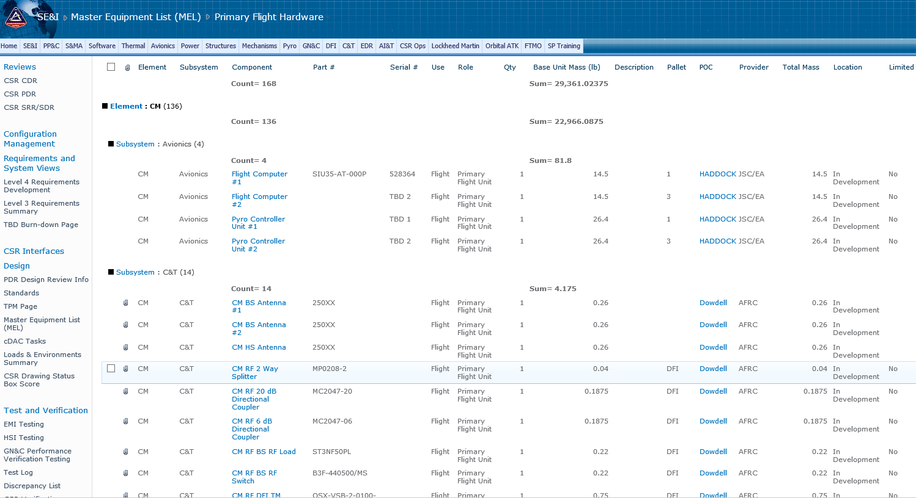
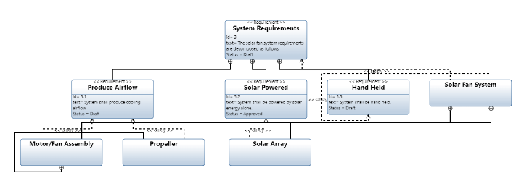
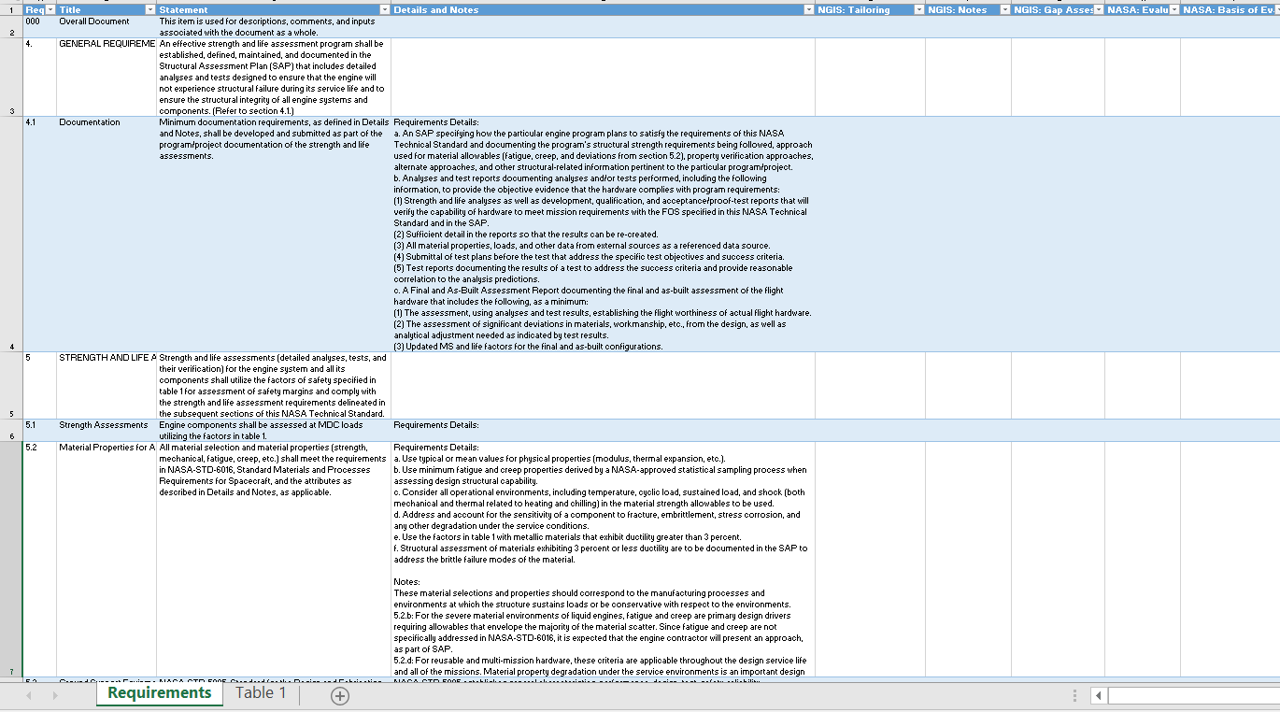
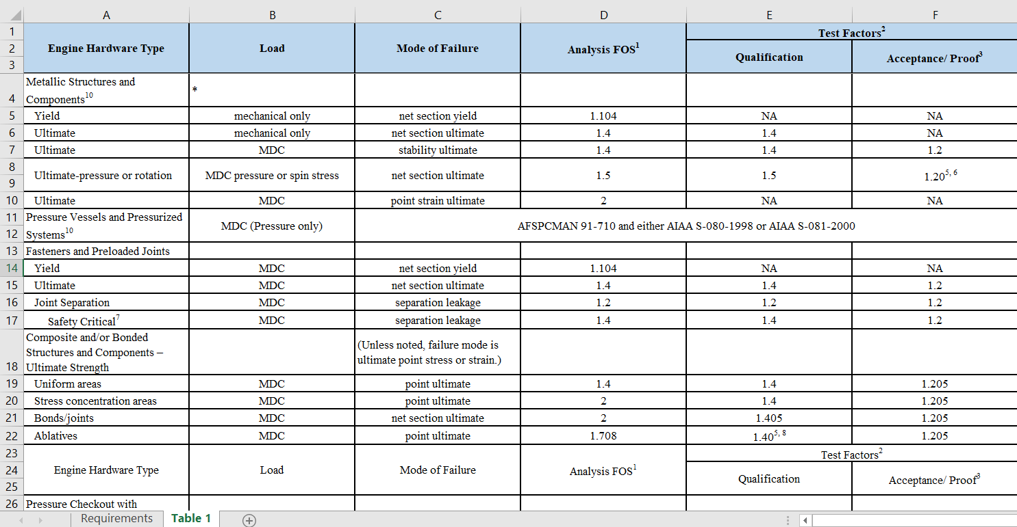
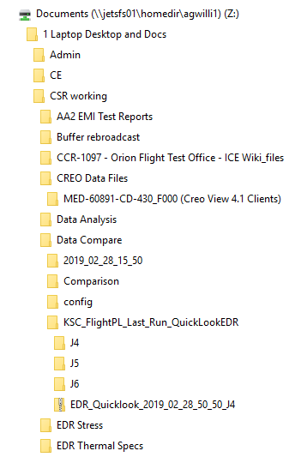
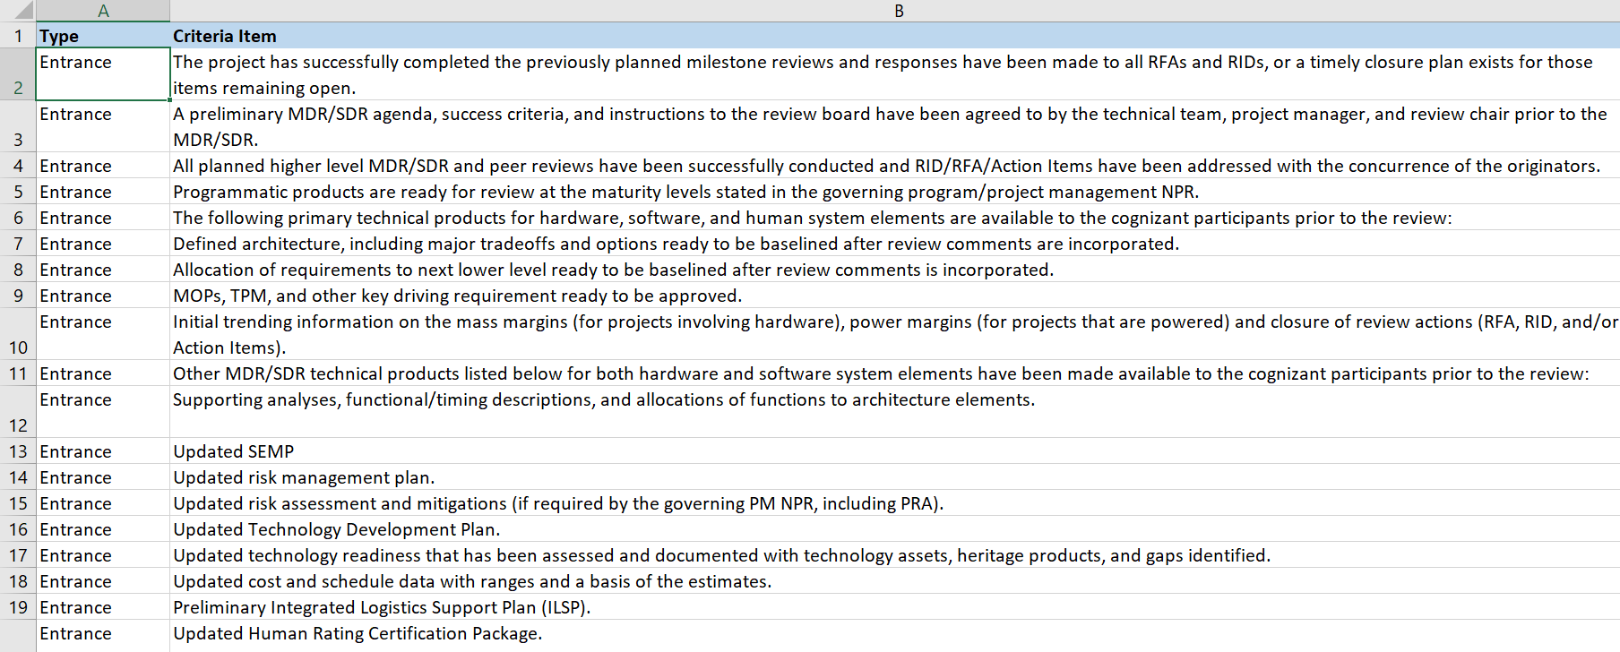
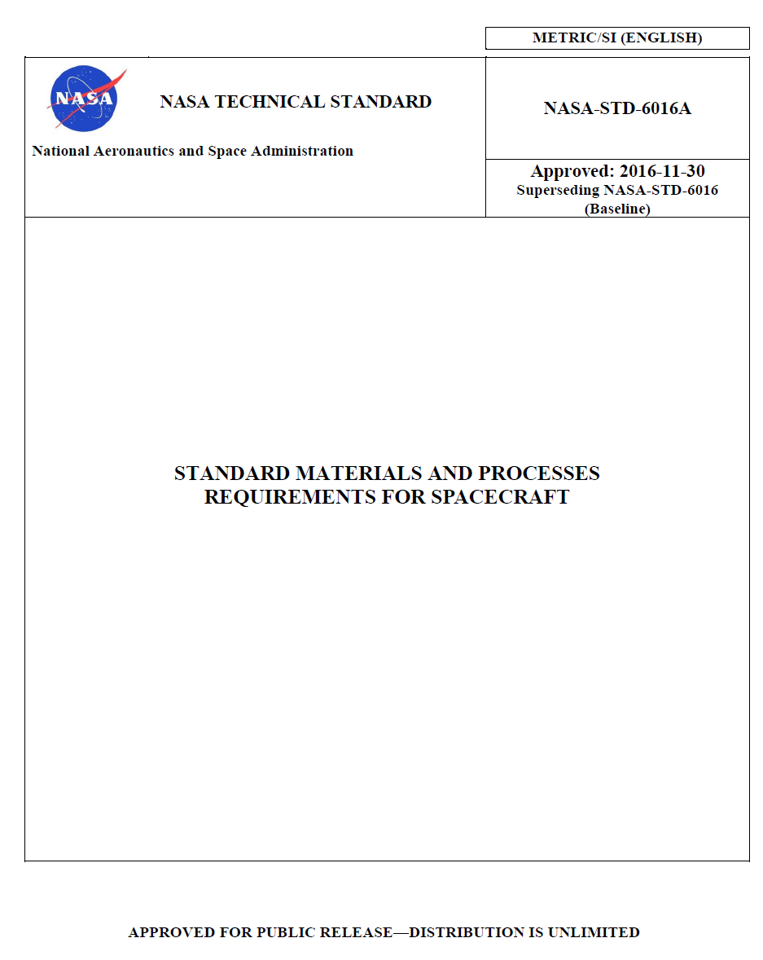
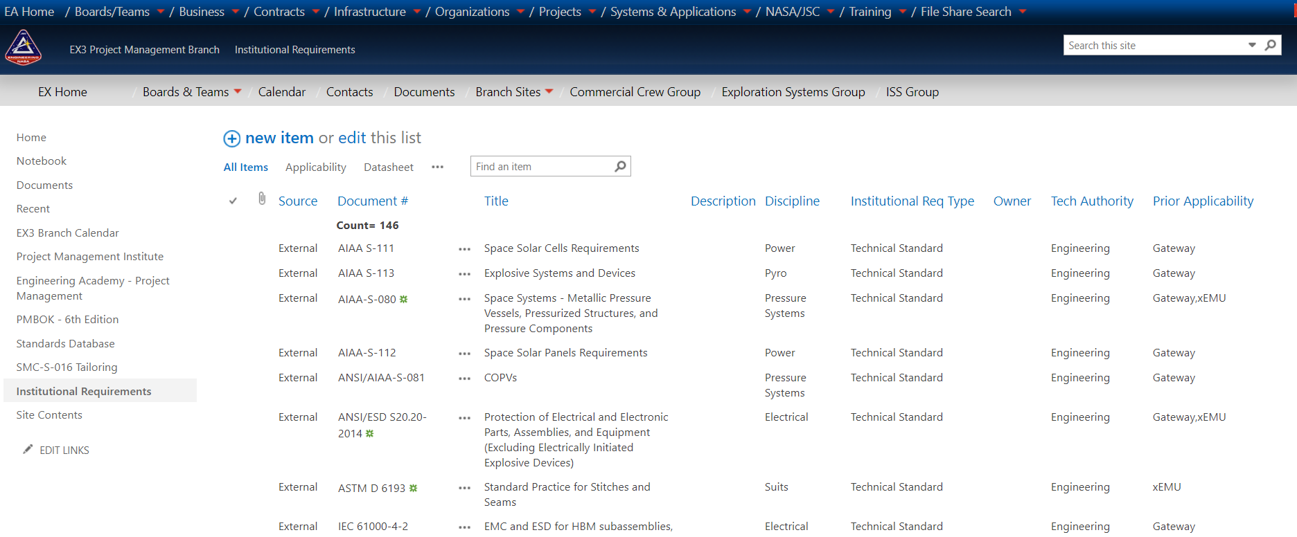
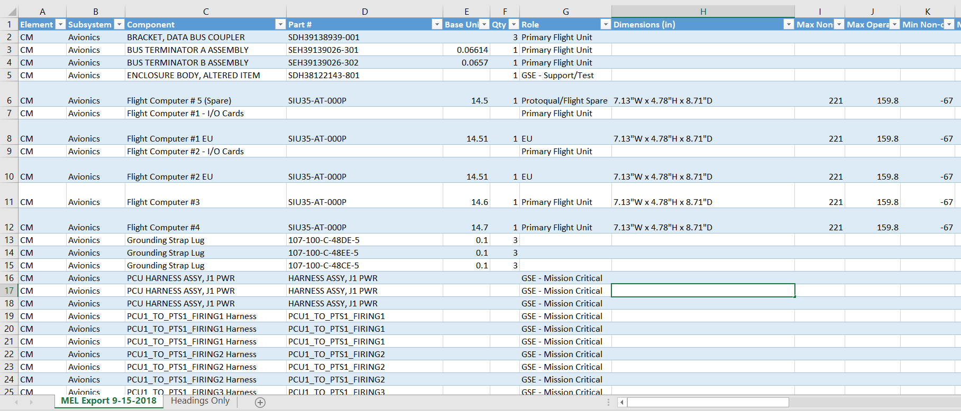
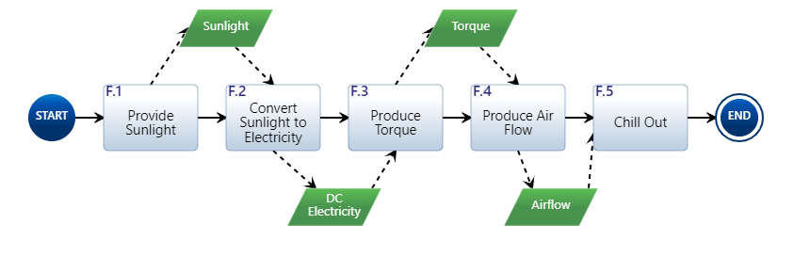
How Data-Centric Relates to Other Information Management Approaches
 | Document-Centric | Data-Centric Model-Based | Graphical Model-Based
Description | Information is captured in documents and either posted in online folders or emailed to participants or end-users of the information | Information is captured in databases, attributes are managed, often with linked data relationships | Information is captured graphically, and the graphical objects often have linked data relationships
Team Access | HIGH: All team members have Office products | VARIABLE: All NASA teams and many contractors have access to SharePoint; other database tools have varying levels of access and licensing arrangements (e.g., DOORS) | LOW: Model-based tool access is usually limited to small number of highly trained users (e.g., CRADLE, MagicDraw, Cameo, Innoslate)
Images
Linking data and managing item relationships are important parts of system modeling, whether the model is displayed graphically or not. Many MBSE tools have data-centric capabilities.

Slide 11
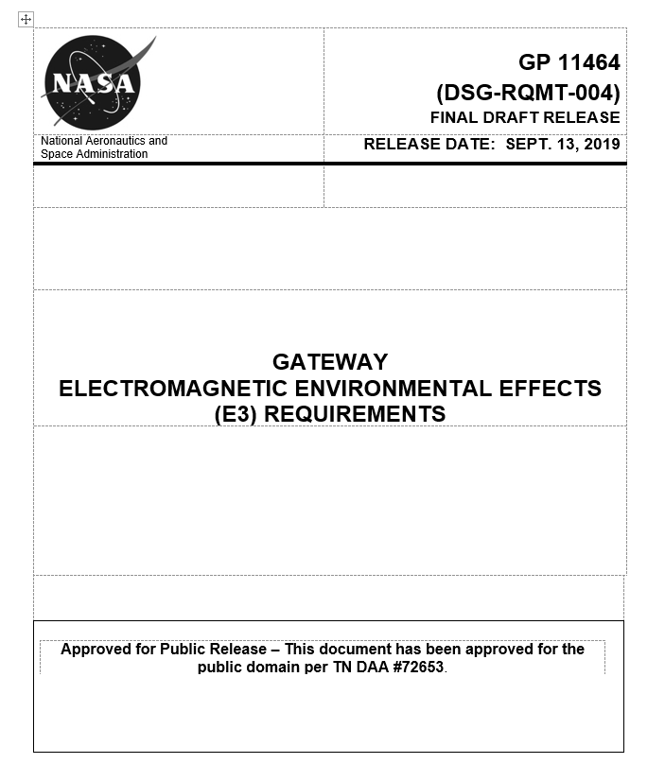
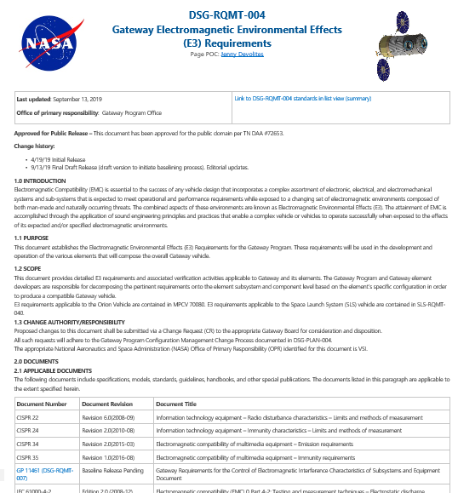
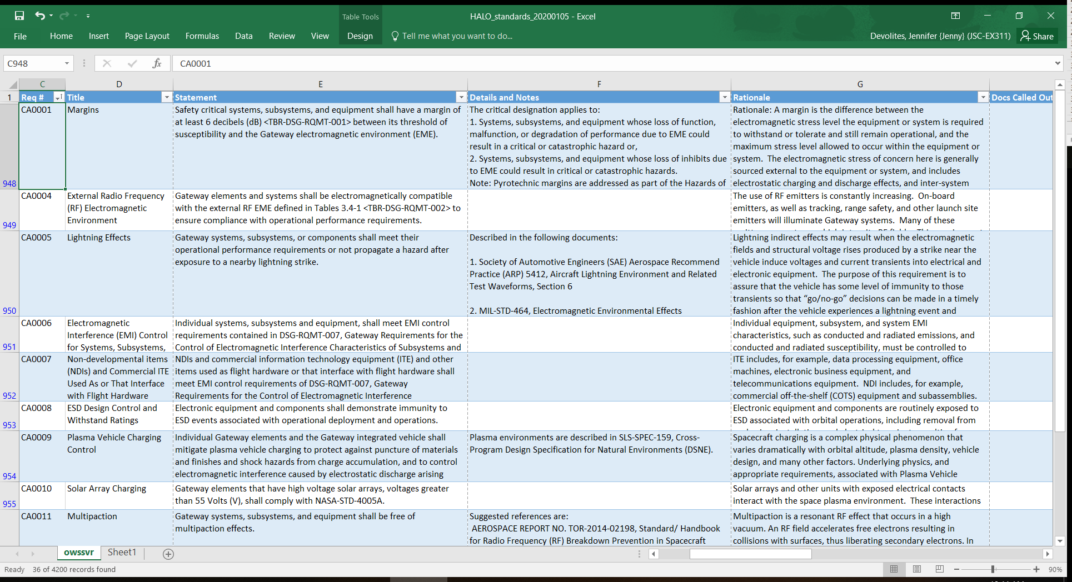
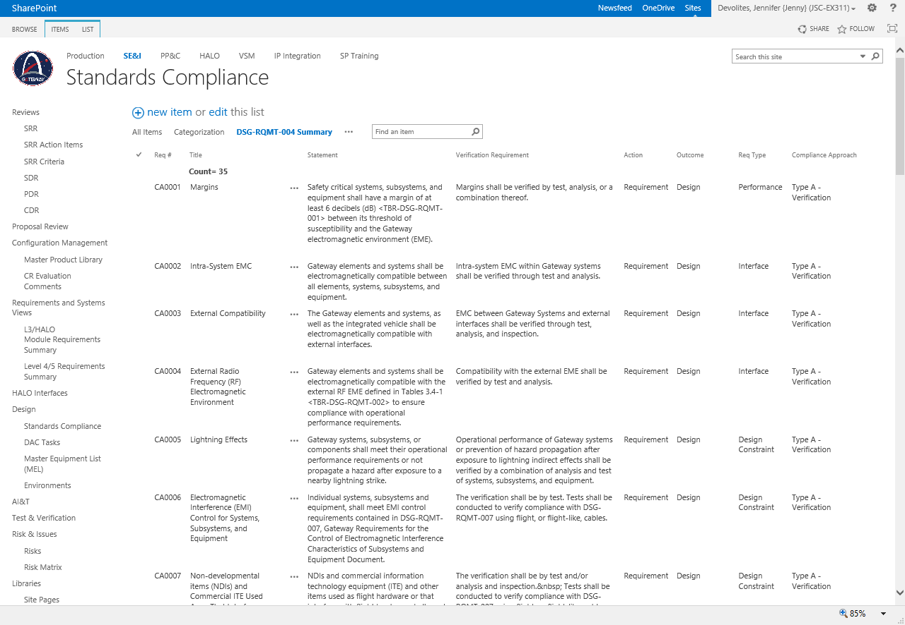
Example: Document-Centric to Data-Centric
Word
Excel
SharePoint List
SharePoint Web Page + List

Slide 12
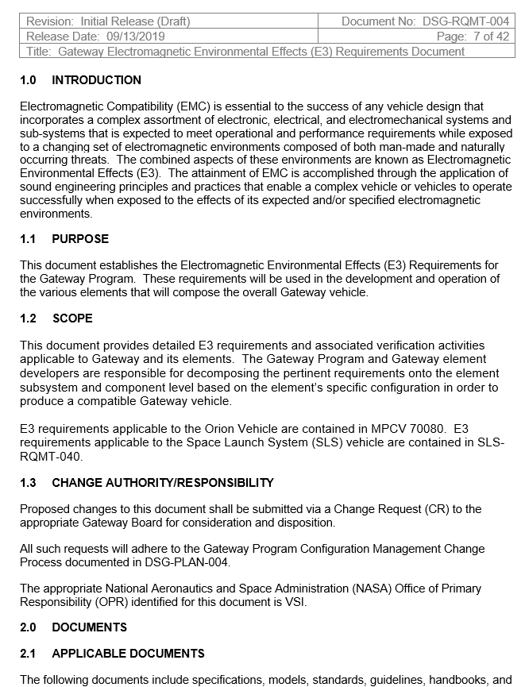
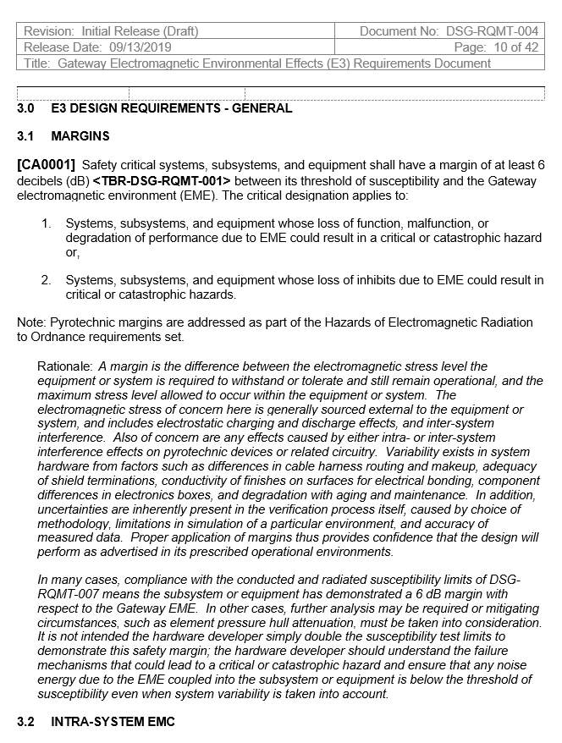
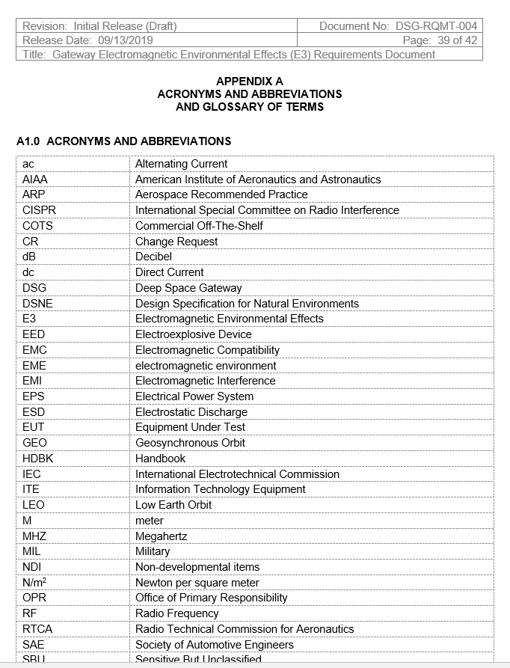
Word Document – DSG-RQMT-004
Word – sometimes generated from DOORS or other specialty tool

Slide 13
Excel

Slide 14
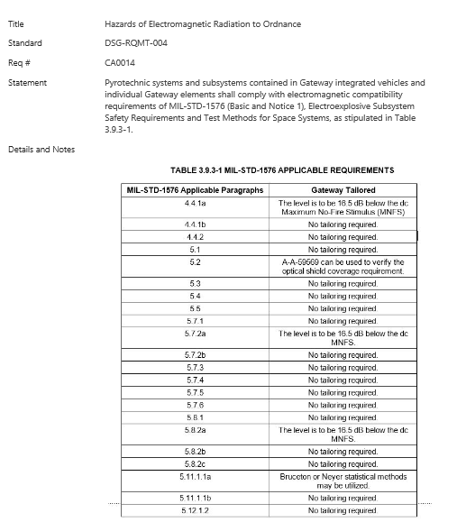
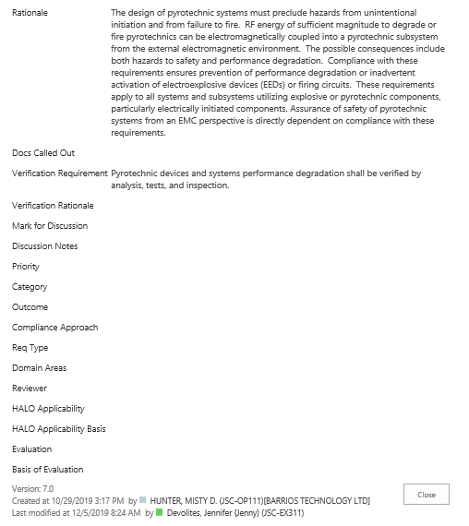
SharePoint List (Database)
View of DSG-RQMT-004 in database
Database record
Metadata
Version Tracking by item

Slide 15
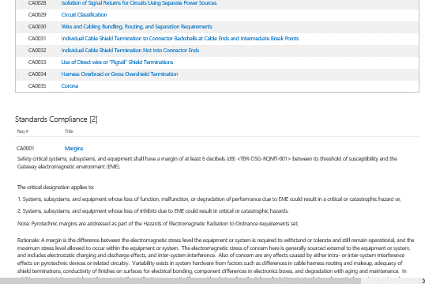
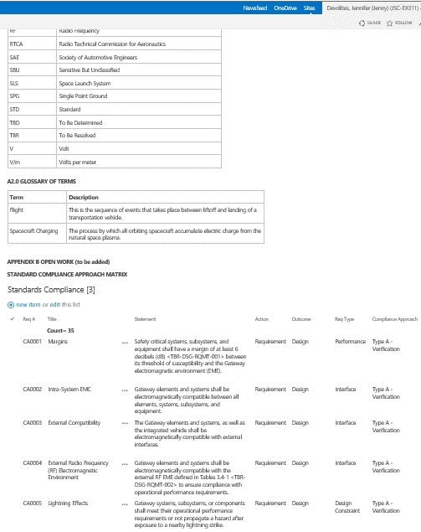
SharePoint as “Document”
Acronyms and glossary
Index
Start of “document view”
Intro / Front Matter on web page
Summary database view with attributes shown
Link directly to applicable document in Master Product Library (or to filtered view in database)
Same database
Live, clickable links to authoritative source
Web Page + Database – lives in SharePoint

Slide 16
Project Information (Examples of Typical Content)
Project Control
Actions
Decision tracking
Risks
Issues
Weekly staff meeting
Weekly calendar
Team leave calendar
Daily activity logs
Meeting agendas
Weekly activity reports
Discrepancy management
Org chart
New member orientation
WBS
PPBE planning
Tracking resources
Staffing
Roles & responsibilities
Procurement management
Tracking FTEs
Project plan
Administrative tasks
Project news and announcements
Supplier contracts
Project Control
Integrated master schedule
Detailed tactical schedules
Meeting presentations
Project documentation
Process diagrams
Change requests
Product reviews
SEMP
Software development plan
Risk 5x5
Acronym list
Team travel planning
Team list
Team event RSVPs
Formal approvals
Meeting charters
Key milestones
Document tree
Meeting minutes
Tool training
Weekly reporting to mgmt
External briefings and presentations
MRB / FRB Decisions
Other technical plans
Requirements
ConOps
Design Reference Missions
Internal interfaces
Requirements - system
External Interfaces (IRDs, ICDs)
Functional decomposition
Context diagram
Architecture definition
NGOs
Requirements - subsystem
Environments definition
TBD resolution/burn-down
N-squared
Standards compliance approach
FDIR requirements
Technical performance measures
Acceptance data packages
Requirements specifications
Requirements traceability matrix
TLYF exceptions
Deviations and waivers
Requirements for Operations and Maintenance (ROAMs)
Design and Analysis
Harness interconnect diagram
Trade studies
Master wire and signal list
Requirements or design analysis cycle tasks
Requirements or design analysis cycle results
Thermal model
Finite element model
Integrated thermal analysis
RF comm spectrum analysis
Loads assessment
CAD models
Drawings
Stress analysis
Command and data dictionary
Peer review inputs
Sys/Subsys block diagram
Vehicle State Diagram
Major Reviews
Milestone review meeting information
Review actions/comments
Milestone review products and data content
CoFTR Endorsements
Review entrance / success criteria and traceability
Review attendees
Hardware Management
Controlled storage management
Hardware location tracking
Shipping and receiving
Maintenance log
Vehicle configuration
Burn-in log
Mass properties management
Master equipment list
Powered equipment list
Thermal equipment list
Master measurement list
Project hardware inventory
Shipping list for major hardware moves
Hardware Upgrade Process/Documentation
Cycle logs (pressure, valves)
Materials Identification and Usage List (MUIL)
AI&T
Remove before flight items
Shift handover logs
Detailed vehicle assembly status
Assembly procedures
AI&T plan
Activity description sheets
Vehicle change record - physical inhibits
Work instructions / processes
S&MA
Mandatory inspection points
Single-point failures
FMEAs
Fault trees
Hazard reports
Quality Plan
Safety Data Package
Human Rating Certification
Reliability analyses
Critical Items List (CIL)
T&V
System functional test list
Test planning
Test readiness reviews
Verification requirements matrix
Verification burn-down
Verification closure evidence
T&V Plan
Test run record / test log
Test objectives
Subsystem functional test list
System environmental test list
Subsystem environmental test list
Test configurations
Test procedures
Test records
Test reports
Operations
Operational procedures
Ops Flow Diagram
Timelines
LCCs and Flight Rules
Contingency scenario definition
Training Records
Crew procedures
Many of these products have relationships to other items on this page

Slide 17
Typical Tool Examples
Color key
Frequently in Excel
Frequently in other specialty tool
Frequently in PowerPoint, Word, or Visio
Project Control
Actions
Decision tracking
Risks
Issues
Weekly staff meeting
Weekly calendar
Team leave calendar
Daily activity logs
Meeting agendas
Weekly activity reports
Discrepancy management
Org chart
New member orientation
WBS
PPBE planning
Tracking resources
Staffing
Roles & responsibilities
Procurement management
Tracking FTEs
Project plan
Administrative tasks
Project news and announcements
Supplier contracts
Project Control
Integrated master schedule
Detailed tactical schedules
Meeting presentations
Project documentation
Process diagrams
Change requests
Product reviews
SEMP
Software development plan
Risk 5x5
Acronym list
Team travel planning
Team list
Team event RSVPs
Formal approvals
Meeting charters
Key milestones
Document tree
Meeting minutes
Tool training
Weekly reporting to mgmt
External briefings and presentations
MRB / FRB Decisions
Other technical plans
Requirements
ConOps
Design Reference Missions
Internal interfaces
Requirements - system
External Interfaces (IRDs, ICDs)
Functional decomposition
Context diagram
Architecture definition
NGOs
Requirements - subsystem
Environments definition
TBD resolution/burn-down
N-squared
Standards compliance approach
FDIR requirements
Technical performance measures
Acceptance data packages
Requirements specifications
Requirements traceability matrix
TLYF exceptions
Deviations and waivers
Requirements for Operations and Maintenance (ROAMs)
Design and Analysis
Harness interconnect diagram
Trade studies
Master wire and signal list
Requirements or design analysis cycle tasks
Requirements or design analysis cycle results
Thermal model
Finite element model
Integrated thermal analysis
RF comm spectrum analysis
Loads assessment
CAD models
Drawings
Stress analysis
Command and data dictionary
Peer review inputs
Sys/Subsys block diagram
Vehicle State Diagram
Major Reviews
Milestone review meeting information
Review actions/comments
Milestone review products and data content
CoFTR Endorsements
Review entrance / success criteria and traceability
Review attendees
Hardware Management
Controlled storage management
Hardware location tracking
Shipping and receiving
Maintenance log
Vehicle configuration
Burn-in log
Mass properties management
Master equipment list
Powered equipment list
Thermal equipment list
Master measurement list
Project hardware inventory
Shipping list for major hardware moves
Hardware Upgrade Process/Documentation
Cycle logs (pressure, valves)
Materials Identification and Usage List (MUIL)
AI&T
Remove before flight items
Shift handover logs
Detailed vehicle assembly status
Assembly procedures
AI&T plan
Activity description sheets
Vehicle change record - physical inhibits
Work instructions / processes
T&V
System functional test list
Test planning
Test readiness reviews
Verification requirements matrix
Verification burn-down
Verification closure evidence
T&V Plan
Test run record / test log
Test objectives
Subsystem functional test list
System environmental test list
Subsystem environmental test list
Test configurations
Test procedures
Test records
Test reports
S&MA
Mandatory inspection points
Single-point failures
FMEAs
Fault trees
Hazard reports
Quality Plan
Safety Data Package
Human Rating Certification
Reliability analyses
Critical Items List (CIL)
Operations
Operational procedures
Ops Flow Diagram
Timelines
LCCs and Flight Rules
Contingency scenario definition
Training Records
Crew procedures
Broad mix of MS Office products, specialty tools. More teams are using SharePoint now for some of the Excel-type processes.

Slide 18
Graphical Modeling Examples
Project Control
Actions
Decision tracking
Risks
Issues
Weekly staff meeting
Weekly calendar
Team leave calendar
Daily activity logs
Meeting agendas
Weekly activity reports
Discrepancy management
Org chart
New member orientation
WBS
PPBE planning
Tracking resources
Staffing
Roles & responsibilities
Procurement management
Tracking FTEs
Project plan
Administrative tasks
Project news and announcements
Supplier contracts
Project Control
Integrated master schedule
Detailed tactical schedules
Meeting presentations
Project documentation
Process diagrams
Change requests
Product reviews
SEMP
Software development plan
Risk 5x5
Acronym list
Team travel planning
Team list
Team event RSVPs
Formal approvals
Meeting charters
Key milestones
Document tree
Meeting minutes
Tool training
Weekly reporting to mgmt
External briefings and presentations
MRB / FRB Decisions
Other technical plans
Requirements
ConOps
Design Reference Missions
Internal interfaces
Requirements - system
External Interfaces (IRDs, ICDs)
Functional decomposition
Context diagram
Architecture definition
NGOs
Requirements - subsystem
Environments definition
TBD resolution/burn-down
N-squared
Standards compliance approach
FDIR requirements
Technical performance measures
Acceptance data packages
Requirements specifications
Requirements traceability matrix
TLYF exceptions
Deviations and waivers
Requirements for Operations and Maintenance (ROAMs)
Design and Analysis
Harness interconnect diagram
Trade studies
Master wire and signal list
Requirements or design analysis cycle tasks
Requirements or design analysis cycle results
Thermal model
Finite element model
Integrated thermal analysis
RF comm spectrum analysis
Loads assessment
CAD models
Drawings
Stress analysis
Command and data dictionary
Peer review inputs
Sys/Subsys block diagram
Vehicle State Diagram
Major Reviews
Milestone review meeting information
Review actions/comments
Milestone review products and data content
CoFTR Endorsements
Review entrance / success criteria and traceability
Review attendees
Hardware Management
Controlled storage management
Hardware location tracking
Shipping and receiving
Maintenance log
Vehicle configuration
Burn-in log
Mass properties management
Master equipment list
Powered equipment list
Thermal equipment list
Master measurement list
Project hardware inventory
Shipping list for major hardware moves
Hardware Upgrade Process/Documentation
Cycle logs (pressure, valves)
Materials Identification and Usage List (MUIL)
AI&T
Remove before flight items
Shift handover logs
Detailed vehicle assembly status
Assembly procedures
AI&T plan (AIT Flow diagram)
Activity description sheets
Vehicle change record - physical inhibits
Work instructions / processes
S&MA
Mandatory inspection points
Single-point failures
FMEAs
Fault Trees
Hazard reports
Quality Plan
Safety Data Package
Human Rating Certification
Reliability analyses
Critical Items List (CIL)
T&V
System functional test list
Test planning (test flow)
Test readiness reviews
Verification requirements matrix
Verification burn-down
Verification closure evidence
T&V Plan
Test run record / test log
Test objectives
Subsystem functional test list
System environmental test list
Subsystem environmental test list
Test configurations
Test procedures
Test records
Test reports
Operations
Operational procedures
Ops Flow Diagram
Timelines
LCCs and Flight Rules
Contingency scenario definition
Training Records
Crew procedures
These products lend themselves well to graphical modeling

Slide 19
AA-2 Tool Examples
Color key
Frequently in Excel
Frequently in other specialty tool
Frequently in PowerPoint, Word, or Visio
Managed in SharePoint list or web page
Not applicable for AA-2
Project Control
Actions
Decision tracking
Risks
Issues
Weekly staff meeting
Weekly calendar
Team leave calendar
Daily activity logs
Meeting agendas
Weekly activity reports
Discrepancy management
Org chart
New member orientation
WBS
PPBE planning
Tracking resources
Staffing
Roles & responsibilities
Procurement management
Tracking FTEs
Project plan
Administrative tasks
Project news and announcements
Supplier contracts
Project Control
Integrated master schedule
Detailed tactical schedules
Meeting presentations
Project documentation
Process diagrams
Change requests
Product reviews
SEMP
Software development plan
Risk 5x5
Acronym list
Team travel planning
Team list
Team event RSVPs
Formal approvals
Meeting charters
Key milestones
Document tree
Meeting minutes
Tool training
Weekly reporting to mgmt
External briefings and presentations
MRB / FRB Decisions
Other technical plans
Requirements
ConOps
Design Reference Missions
Internal interfaces
Requirements - system
External Interfaces (IRDs, ICDs)
Functional decomposition
Context diagram
Architecture definition
NGOs
Requirements - subsystem
Environments definition
TBD resolution/burn-down
N-squared
Standards compliance approach
FDIR requirements
Technical performance measures
Acceptance data packages
Requirements specifications
Requirements traceability matrix
TLYF exceptions
Deviations and waivers
Requirements for Operations and Maintenance (ROAMs)
Design and Analysis
Harness interconnect diagram
Trade studies
Master wire and signal list
Requirements or design analysis cycle tasks
Requirements or design analysis cycle results
Thermal model
Finite element model
Integrated thermal analysis
RF comm spectrum analysis
Loads assessment
CAD models
Drawings
Stress analysis
Command and data dictionary
Peer review inputs
Sys/Subsys block diagram
Vehicle State Diagram
Major Reviews
Milestone review meeting information
Review actions/comments
Milestone review products and data content
CoFTR Endorsements
Review entrance / success criteria and traceability
Review attendees
Hardware Management
Controlled storage management
Hardware location tracking
Shipping and receiving
Maintenance log
Vehicle configuration
Burn-in log
Mass properties management
Master equipment list
Powered equipment list
Thermal equipment list
Master measurement list
Project hardware inventory
Shipping list for major hardware moves
Hardware Upgrade Process/Documentation
Cycle logs (pressure, valves)
Materials Identification and Usage List (MUIL)
AI&T
Remove before flight items
Shift handover logs
Detailed vehicle assembly status
Assembly procedures
AI&T plan
Activity description sheets
Vehicle change record - physical inhibits
Work instructions / processes
S&MA
Mandatory inspection points
Single-point failures
FMEAs
Fault trees
Hazard reports
Quality Plan
Safety Data Package
Human Rating Certification
Reliability analyses
Critical Items List (CIL)
T&V
System functional test list
Test planning
Test readiness reviews
Verification requirements matrix
Verification burn-down
Verification closure evidence
T&V Plan
Test run record / test log
Test objectives
Subsystem functional test list
System environmental test list
Subsystem environmental test list
Test configurations
Test procedures
Test records
Test reports
Operations
Operational procedures
Ops Flow Diagram
Timelines
LCCs and Flight Rules
Contingency scenario definition
Training Records
Crew procedures
Approach for AA-2 was to put as much content directly into SharePoint list constructs as possible. This created a more consistent approach for the team, with maximum access and collaboration.

Slide 20
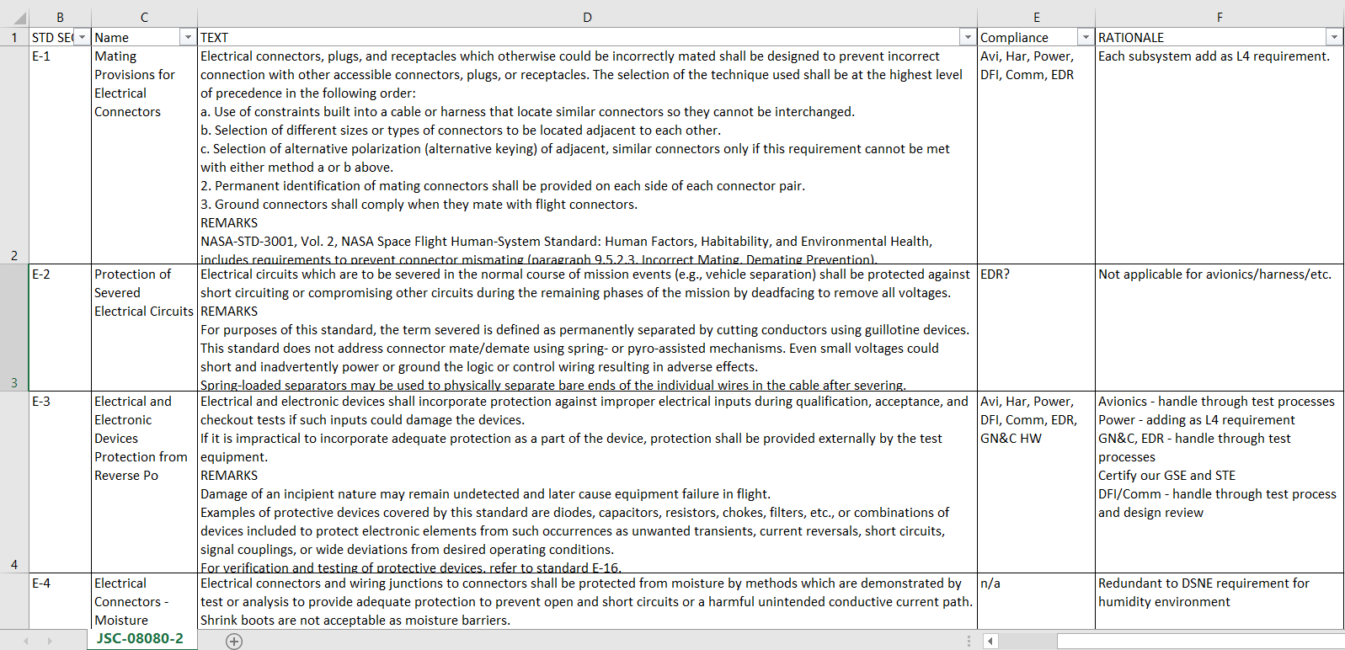
Information Management – Typical Model
Repeat for each iteration
Information is created in one or more applications or tools (DOORS, Excel, PowerPoint tables, MagicDraw), then exported to a shareable format (Office product)
Documents are posted online or emailed to individuals to review and provide inputs
Inputs are manually collected, manually collated, and fed back into original source
New versions are generated and team is notified they are posted (or emailed)
Human communication path
Interaction with source data
In this model, you are frequently taking data out of its native environment and transferring it to an alternate product

Slide 21
Challenges with Typical Information Management Models
End-item integrity
  Authoritative source is not immediately accessible and available for users; requires an export at some periodic rate
    True even for ‘the latest version of the file is on my laptop’
  Manual collation of information can result in data loss
  Change tracking - loss of information on who made which changes when, and why
  Similar or same information carried in multiple locations, and authoritative source may be unclear
Tool customization
  Often complicated or expensive to customize tools, fields, workflows - “need to talk to the tool vendor to see if we can get it changed for our needs”
Time
  Time spent/difficulty finding content in folders and sub-folders
  Time spent collating information back into original tools/constructs
  Bottlenecks
    Product owner or small team of owners must manage all information – limited team members have specialty tool access
    Assigned to lead but lead not available, have to get other team members access
  Time it takes to flow content down to end-users, including management waiting on someone to pull the information together for a status (vs. viewing it as it is updated in the system)
Other challenges
  Attachments or associated materials have to be posted elsewhere or emailed; they can’t be natively grouped with Excel rows, or specialty tools

Slide 22
DDCIM Model
Human communication path
Interaction with source data
Information is created in SharePoint list
Individuals are notified to review or provide inputs
Information owner reviews inputs and closes the loop with initiators
Repeat as needed for individual items
The data remains in its native environment, and users are collaboratively working with the data in that native environment

Slide 23
Data-Centric: Links Between Data Items
Systems Engineering Data
PM Data
RVTM
(L2 Requirements, Verification Tracking
Staffing*
Meetings
Verification Closures
DAC Content
Schedules
Travel Support*
Budgets
Functions
Implemented by
Verification Requirements
Requirements (L3/L4)
Controlled Storage List
Interfaces
Specified by
Implemented by
Test/Verification Activity
Peer Reviews
Actions*
Performs
Master Equipment List
Many links
Employs
Verified by
TPS
Creates
Architectures
TBX
Test Configurations
Discrepancies
Waivers
Sources
Change Requests
Representative – many more data types actually used
Results in
Hazards
Risks
Causes
LCR RFAs
Controls
Verified by
Life Cycle Review Criteria
*Indicates multiple lists

Slide 24
What Makes SharePoint Appealing as a DDCIM Tool
Single authoritative source – database can be viewed as a document without “exporting” it
Ability to add metadata and attributes
Microsoft-based, so the learning curve is fairly low, and high compatibility with other Microsoft tools
  Including Microsoft Project, in the latest release
Since most Excel files and many custom tools are “Excel-like tables,” SharePoint can be used for a wide variety of project products
Every list item can have an attachment, which is very good for keeping different types of information together (documents, specs, photos, etc)
It provides a high level of named item ownership and collaborative capability
Items can be linked across lists
Permissions can be managed down to the item level
Set up with enterprise access – broad access across organizations
Already funded by most NASA organizations
Contractor access is achievable with NDC accounts (although not quick)

Slide 25
Examples

Slide 26
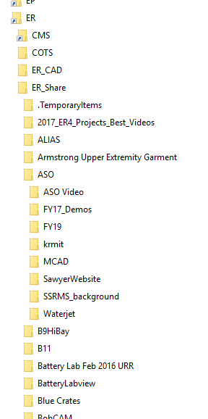
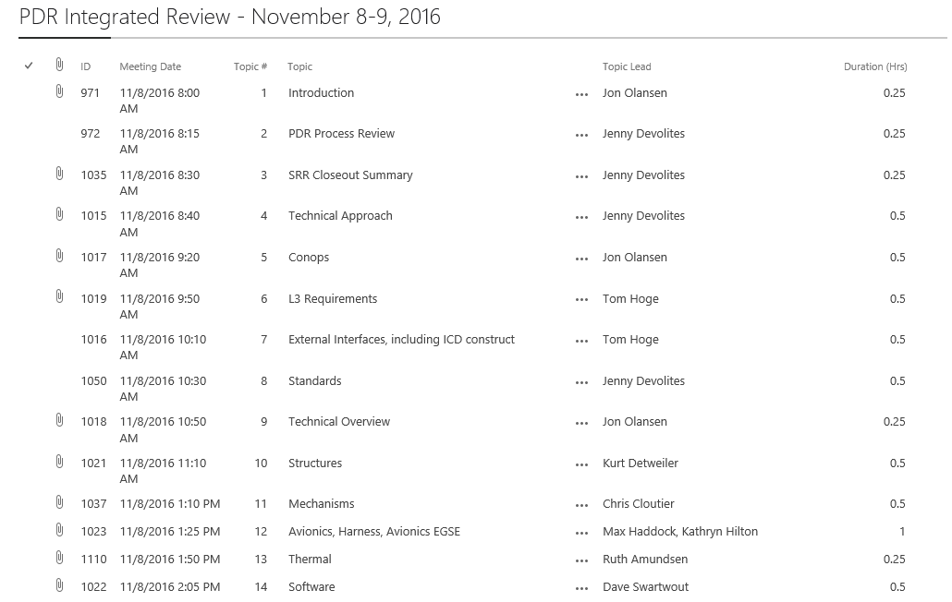
Data-Centric SE&I & PM Collaborative Environment
Typical file server data management schema degrades towards more chaos over time (entropy).
Documents are a limited and only represent a fixed selection of data items.
SharePoint lists take advantage of “metadata” – the principle that every data item has multiple fields, uses, and relationships to other data items

Slide 27
CSR Collaborative Environment Foundation: Master Equipment List

Slide 28
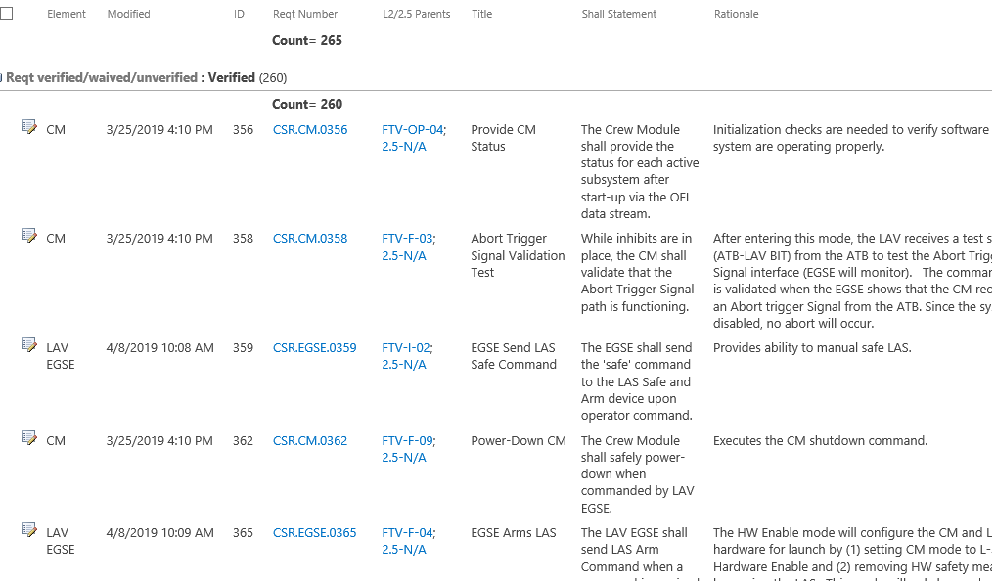
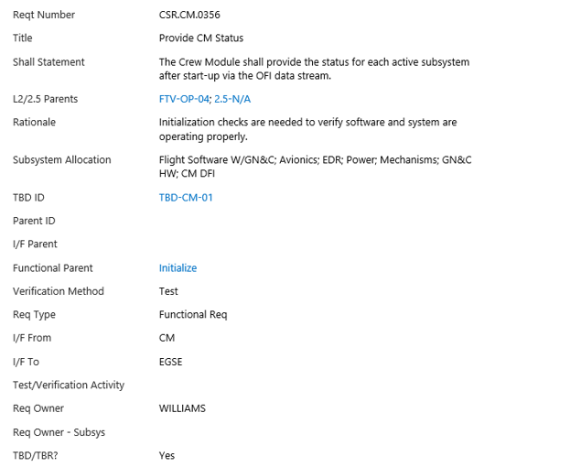
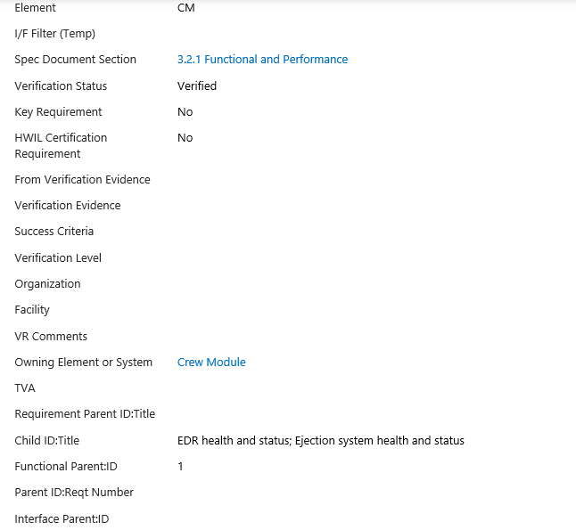
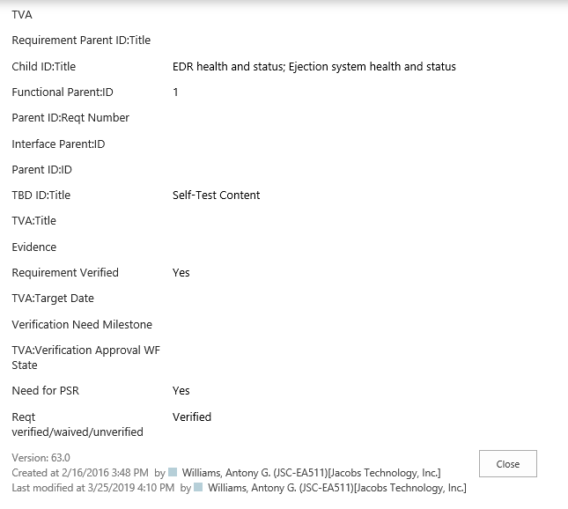
CSR Collaborative Environment Foundation: Requirements List

Slide 29
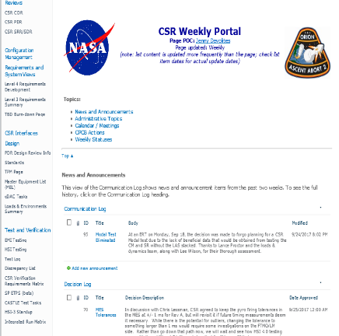
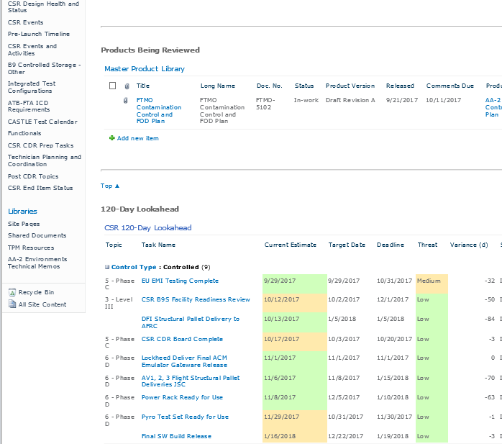
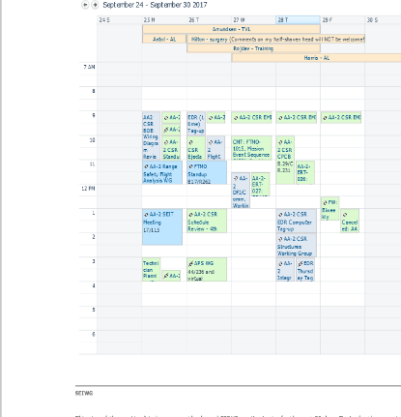
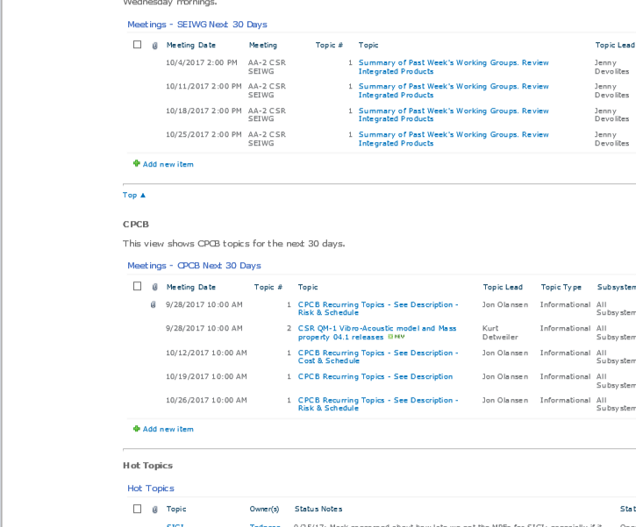
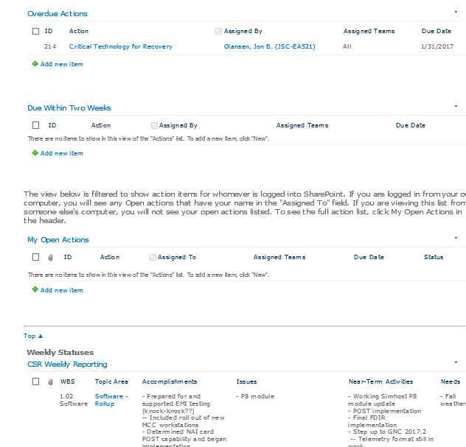
CSR Collaborative Environment Foundation: Portal Pages
This is all on a single web page
Products in Review (internal or external)
This is a filtered view of the Master Product Library (not a separate list)
News and Announcements
Controlled Milestones are color-coded based on proximity to deadline
Decision Log
Weekly meetings +
Leave calendar at the top
Different views of action lists
Weekly Portal is the one-stop shop for team weekly status and planning
All content is available for participants and as a record
The lists keep full chronological records
Reduces need to enter same information in multiple places
Similar portal constructs: Milestone Review Portals, Test Activities
SEIWG and Board Agendas
Team members enter weekly statuses. Great for management roll-ups.
Top Issues (weekly updates)

Slide 30
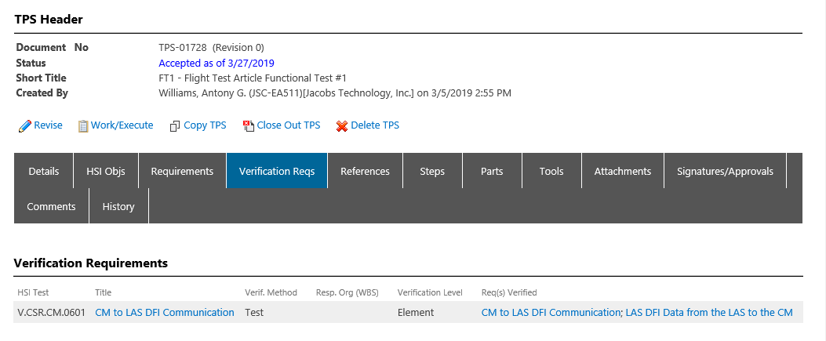
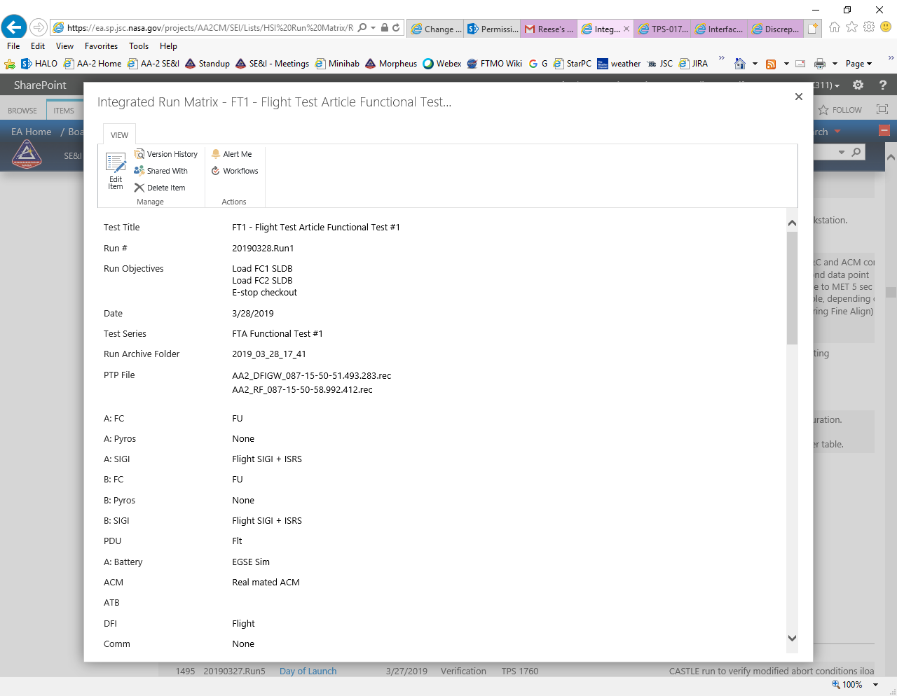
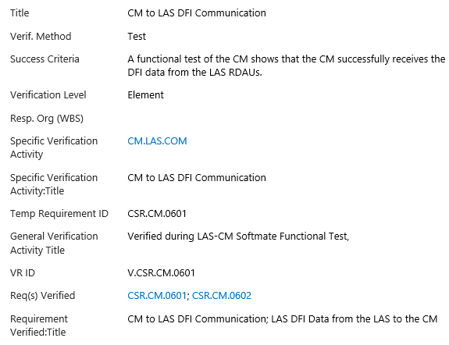
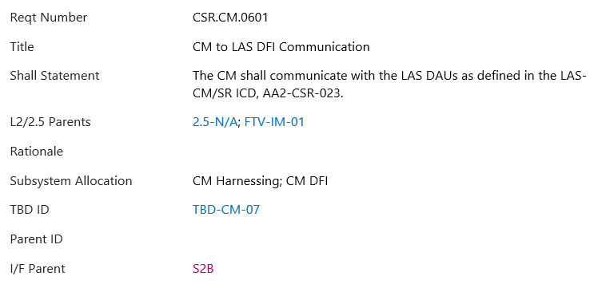
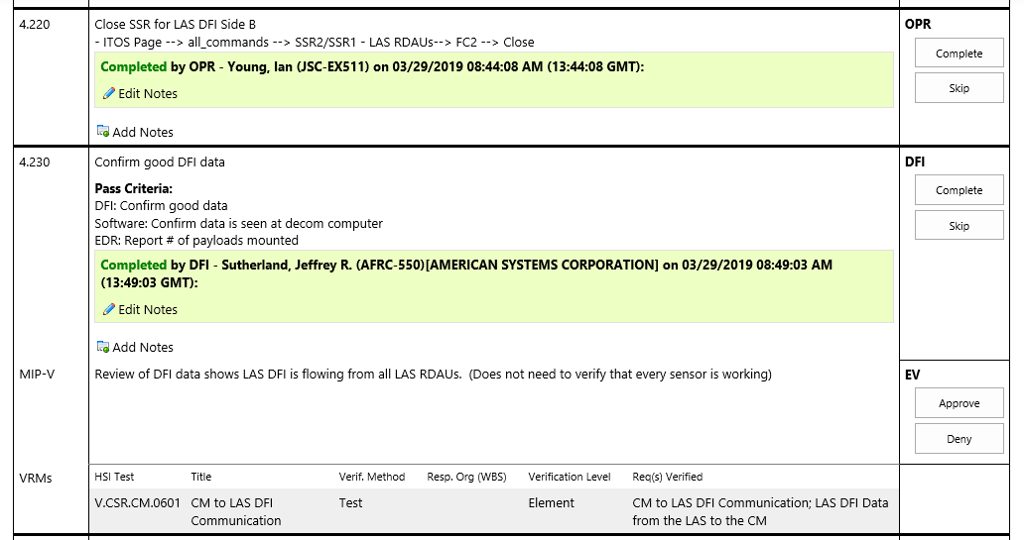
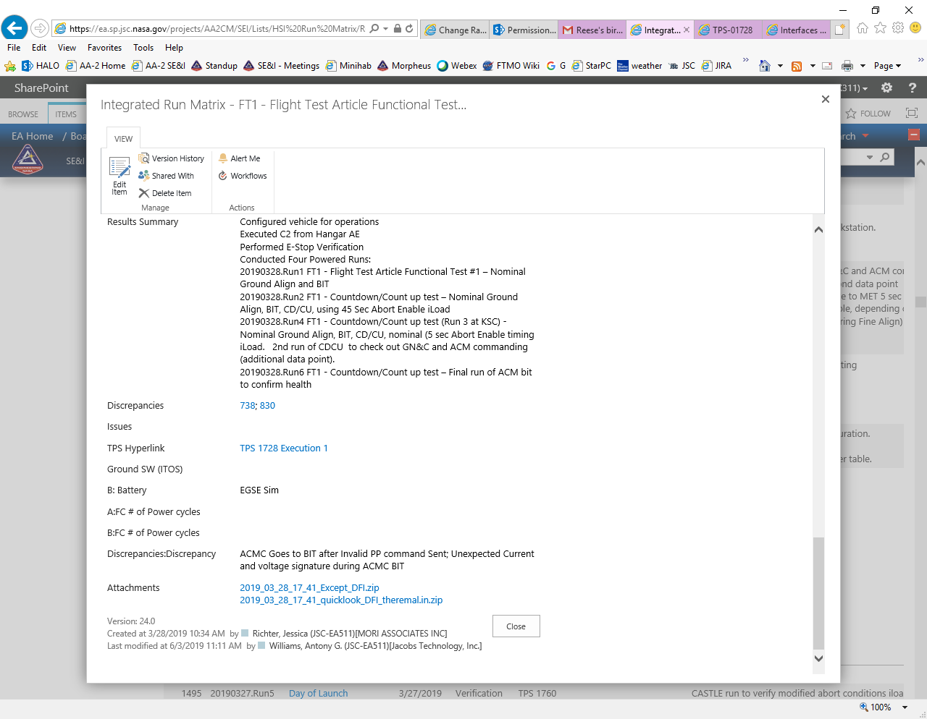
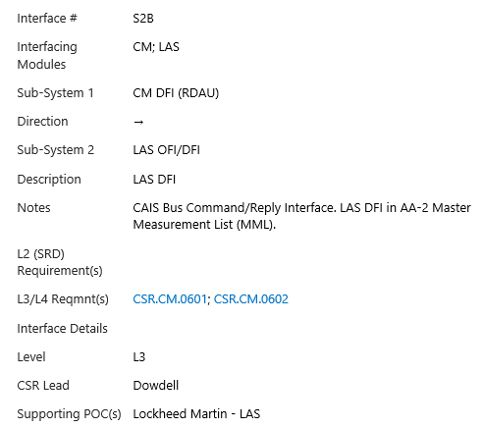
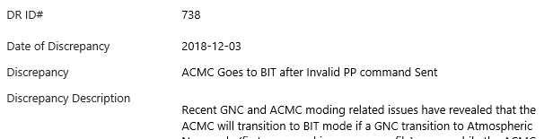
List Linkages Example
TPS DEFINITION
VERIF REQ MATRIX
INTEGRATED RUN MATRIX
REQUIREMENT LIST
TPS STEPS
INTERFACE LIST
DISCREPANCY LIST

Slide 31
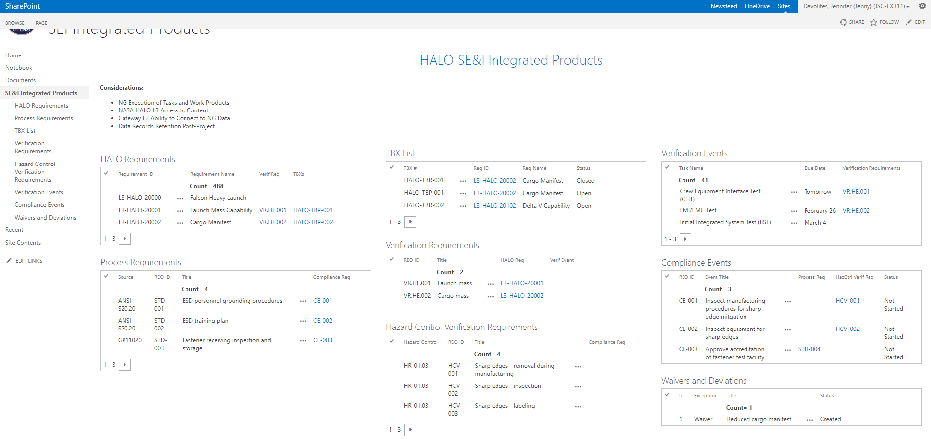
Gateway/HALO Example Construct
Requirements → Verification Requirements → Verification Events is a typical set of linkages
Process Requirements → Compliance Events is a new construct under consideration for managing “alternate
Hazard Control Verif Req → Compliance Events compliance”-type tasks that won’t have individual VCNs
HALO Requirements
TBX List
Verification Events
Verification Requirements
Process Requirements
Compliance Events
Hazard Control Verif Req
Waivers and Deviations

Slide 32
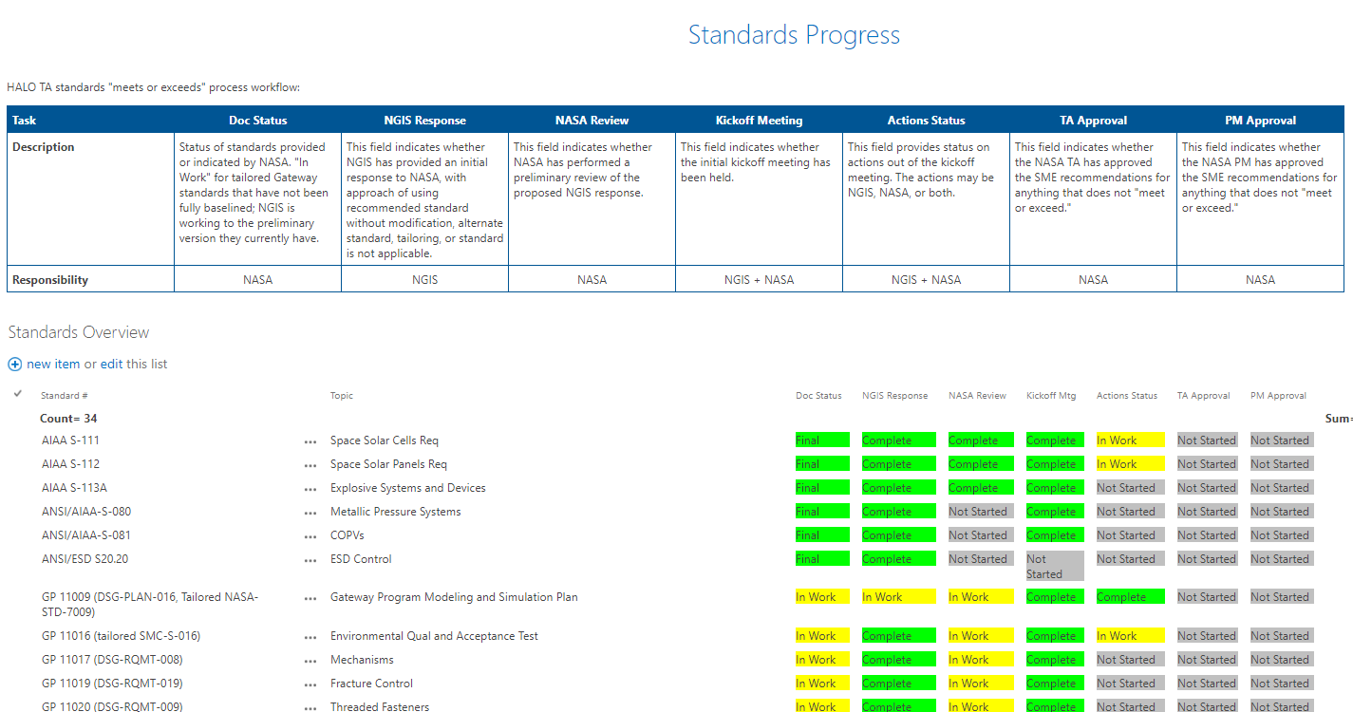
Progress / Stoplight Chart
Status is updated in this single location, visible to management to track progress. Conditional formatting is set up to automatically change the “stoplight” chart when the fields are updated.
Web page provides capability for explanatory text above, plus the actual database

Slide 33
Challenges and Solutions with SharePoint for DDCIM
Challenge | Solutions/Options/Recommendations
Buy in – at first some communities were slow to adopt, but eventually every team member was proficient | Training Management commitment
House-keeping/Data Currency/Config Management | Use of automated triggers to identify stale data and notify data owners
Trying to ‘fake’ a full relational database | Use of custom back-end code – project-process dependent
Dependence on an ‘administrative’ data environment as your project operations tool – reliability issues | Coordination with SP administrators and operators – potentially additional funding to ensure proper support
Also need to ensure, on ongoing basis, that collaborating organizations and contractors maintain easy access | Ongoing training and communications
Custom code requires maintenance beyond projects and upgrades | Stick to Out-of-the-box (OOTB) as much as possible Look for custom solutions that are maintainable
Lack of visual / graphical modeling | Visio can be integrated in SharePoint, if enabled; provides some basic visualization capability, but not fully linked relationships. Additional custom capabilities would be beneficial.

Slide 34
Recent Applications of DDCIM
Gateway Production Office
  Using many of the same constructs for the Production Team
  Seeking ways to collaborate with Northrop Grumman, who has their own implementation of SharePoint
Standards Initiative
  Converting NASA technical standards from documents to databases and adding attributes to make them more usable, reduce project and program startup time

Slide 35
Summary and Forward Work
For Morpheus and AA-2, using DDCIM for project management and systems engineering was successful, providing the team the ‘right’ level of rigor while also providing flexibility needed for an aggressive schedule
  Stretched the Morpheus implementation for AA-2, including all SE&I data elements
  Implemented the Integrated Data concept connecting SE&I data with itself and PM data
  Provided Product Lifecycle Management (PLM) at the data element level (rather than product level)
SharePoint provides flexible DDCIM environment with ability to scale rigor as needed
DDCIM provides a major improvement over document-centric project management and systems engineering, and requires less specialty tool knowledge than MBSE

Slide 36
BACKUP

Slide 37


