Slide 1


Organizational Knowledge Capture
1
Notes:
Jarek
-how do we get the pointer to show up in zoom? (red dot) - That's something I have to do (Brandi)

Slide 2
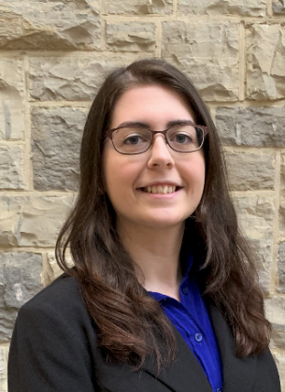
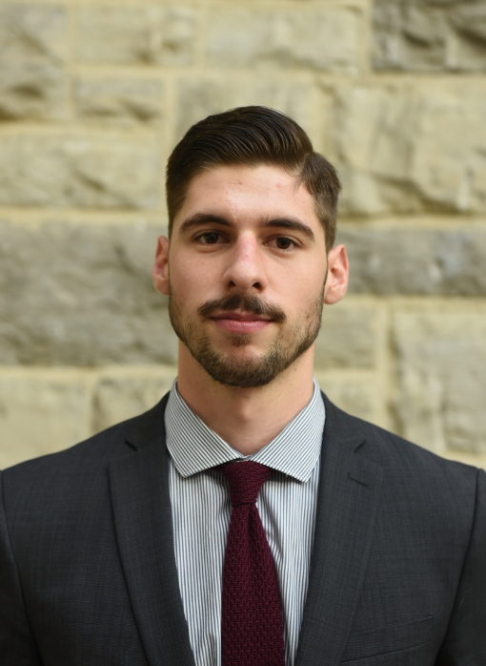
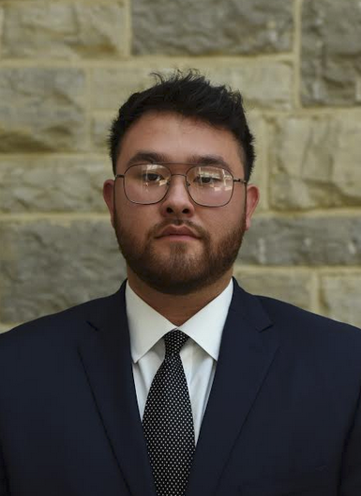
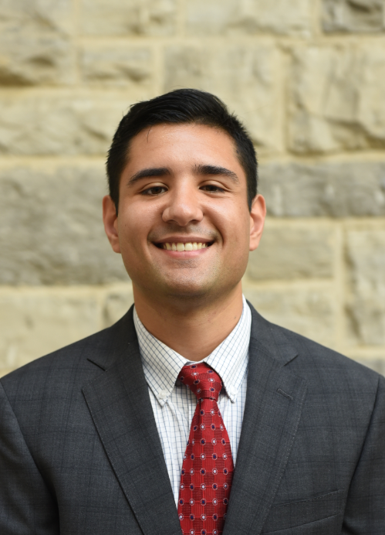
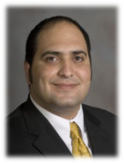

Team Introduction
Faculty Advisor
Brandi Robertson
Jordan
Erisman
Jarek Frankovich
Nikos
Harasty
Dr. Onur Şeref
2
Notes:
Jarek
What is the goal of our presentation? To sell our proposed solution & to push NASA towards more knowledge capture initiatives
What are the 2-3 things we want the audience to remember?
What does 'winning' in this presentation look like? We get the 15-20 people in the call to see the value in our solution

Slide 3
Problem Statement
To preserve past and current insights, how can NASA effectively capture, organize, and disseminate knowledge from employee interviews?
7
Notes:
Nikos
Why are the problems they have important?
Maybe we can add why our project is important... it's critical to mission success!
Based on evidence from discussion and research, based on prob statement we set out a list of objectives to find a solution

Slide 4

Research Findings
Knowledge Categories
are not mutually exclusive and can change state when transferred
Explicit knowledge
is easy to convey and document
Tacit/Implicit knowledge
is hard to convey and is derived from wisdom and personal experience
10
Notes:
Brandi
Thank Marilyn
The SECI model is a conceptual model that helps to explain how tacit and explicit knowledge are converted into organizational knowledge

Slide 5
NASA Legacy Overview
Opt-in program that utilizes in-house resources
Taps into an employee's intrinsic motivation to share their expertise
Multifaceted issue that requires a combination of different methods
Abstracted framework to allow for versatility
3 Main Steps of Exit Interview Process
Pre
During
Post
14
Notes:
Brandi

Slide 6
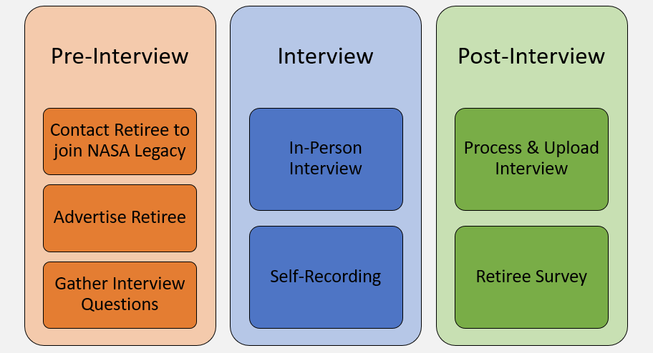
NASA Legacy Framework
15
Notes:
Brandi

Slide 7
NASA Legacy Benefits
Organizational Knowledge Retention
In-House Solution
Promotes Knowledge-Sharing
Labor Efficiency Gains
7
Notes:
Nikos 6/4/20: reduced subsection to 2 bullets
Keep 4 charcoal,
Deploy best practice behaviors
Reduces "reinventing the wheel"
Uses inhouse resources is a major benefit
Greater retiree satisfaction and engagement
More implicit knowledge captured
Standardizes exit interview process
Timely access to knowledge
Faster onboarding
Employee-centric approach
Promotes discussion across all domains

Slide 8
Key Takeaways
A large wave of employees will retire soon
NASA must capture their knowledge before retirement
Emphasis on exit interviews will help to capture this knowledge
19
Notes:
Jordan

Slide 9
Next Steps
NASA Log Notes (NlogN)
  Computer application
  Continuity of notes
  Helps connect people
  Helps provide suggested information
  Natural language processing and knowledge graphs
9
Notes:
Jordan
Nikos: Instead of 'taking note' could it be 'organizational note taking?' Somehow highlight how it would be an organizational-wide effort and process. Rename title from 'Next Steps' to 'Moving Forward?' Maybe add an overall vision statement such as "work towards an environment where knowledge sharing is emphasized, recognized, and permeates NASA"
Nikos: include exit interview checklist?
Could discuss implementation... how do we get buy-in from top level leadership and all other employees?
How does NASA accept our solution into their culture? Director message to all employees, conduct knowledge audit via web-based survey, what key metrics can we use to measure value of solution? Quality/timely delivery or new innovations gained
Emphasis on how the two connect is paramount

