Slide 1
Apache Drill / Unidata TDS for NASA HDF-EOS on S3
ESIP 2020 Summer / HDF-EOS Workshop XXIII
H. Joe Lee
EED-2 / The HDF Group / Software Engineer
hyoklee@hdfgroup.org
*THREDDS Data Server
This work was supported by NASA/GSFC under Raytheon Technologies contract number NNG15HZ39C.
This document does not contain technology or Technical Data controlled under either the U.S. International Traffic in Arms Regulations or the U.S. Export Administration Regulations.

Slide 2
Hierarchical Data Format-Earth Observing System
HDF4
  HDF-EOS2
HDF5
  HDF-EOS5
  netCDF-4

Slide 3
HDF-EOS on S3
HDF4?
  No elegant solution other than GDAL*
  Not so elegant: h4mapwriter / s3fs
HDF5?
  Many OK solutions exist
    HDF5 VFD**/ HSDS*** / GDAL / Hyrax DMR****++ / etc.
  But “Just OK is not OK.”
*Geospatial Data Abstraction Library
** Virtual File Driver
***Highly Scalable Data Service
****Dataset Metadata Response

Slide 4
Apache Drill
Supports Variety of storage - Amazon S3, Azure Blob Storage, Google Cloud Storage, Swift, NAS and local files.
Data agility - query the raw data in-situ.
Table - in-memory shredded columnar representation for complex data
BI Tools and REST API

Slide 5
Apache Drill 1.18 (beta)
Collection of HDF5 files on S3
ANSI SQL
Geoprocessing?

Slide 6
THREDDS Data Server 5.0 (beta)
It supports S3!
both HDF4 and HDF5
NcML?
Catalog for collection of files?

Slide 7
netCDF-Java
This is core library.
THREDDS / Panoply / IDV shares this.
toolsUI is a generic GUI tool based on netCDF-Java.
Like GDAL, if netCDF-Java works with S3, the rest are trivial.

Slide 8
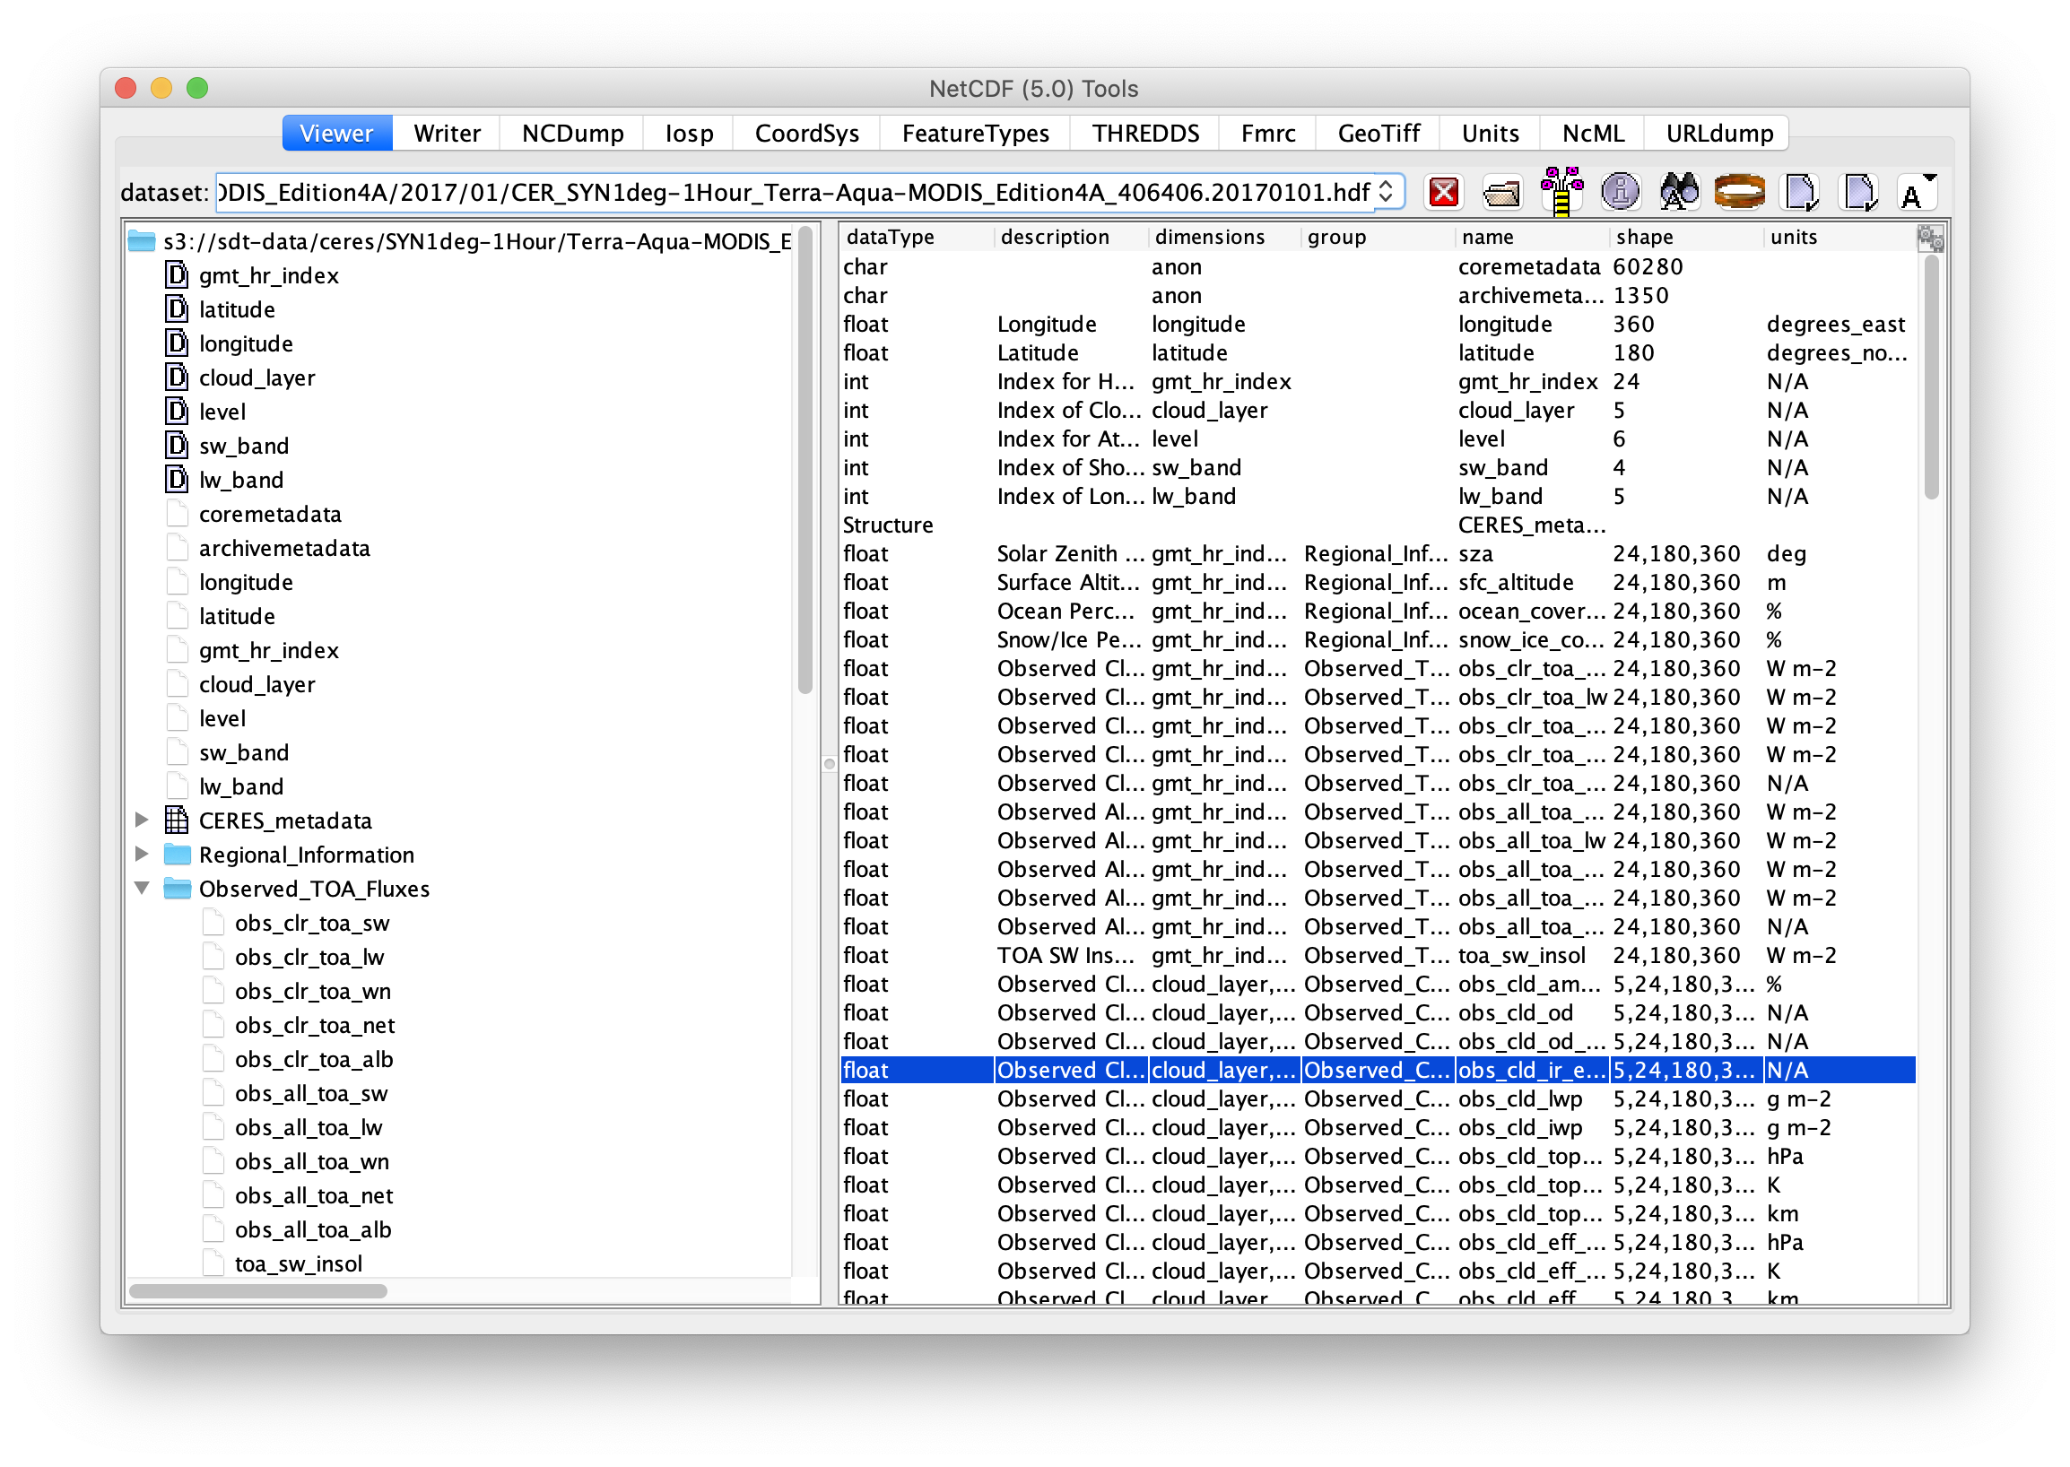
toolsUI - HDF4 on S3

Slide 9
Benchmark: TerraFusion on S3
Test file size: 24G
Format: HDF5/netCDF-4 CF
One orbit data from 5 sensors on Terra
  S3 access from EC2 (m4.xlarge)

Slide 10
Apache Drill fails after 7 minute.
read on s3a://basicterrafusion/TERRA_BF_L1B_O53557_20100112014327_F000_V001.h5: com.amazonaws.AbortedException:
org.apache.drill.common.exceptions.UserException$Builder.build(UserException.java:657)
org.apache.drill.exec.store.hdf5.HDF5BatchReader.convertInputStreamToFile(HDF5BatchReader.java:356)

Slide 11
TDS responds within 2 minutes.
Float32 /MOPITT/granule_20100112/Geolocation/Latitude[ntrack_1 = 46][nstare = 29][npixels = 4];
Float32 /MOPITT/granule_20100112/Geolocation/Longitude[ntrack_1 = 36][nstare = 29][npixels = 4];
Float64 /MOPITT/granule_20100112/Geolocation/Time[ntrack_1 = 436];
} s3-test/TERRA_BF_L1B_O53557_20100112014327_F000_V001.h5;
real 1m47.065s

Slide 12
h5ls responds in 2.5 minutes.
HDF5 Virtual File Driver (VFD)
--enable-ros3-vfd configuration option
It takes 2X longer (5 minutes) outside AWS.

Slide 13
Role-based Access Control (RBAC)
Drill | THREDDS | H5 VFD
Always | Yes | No
RBAC eliminates access key and token.
Access with s3://bucket/key.h5 (no https://)
S3 buckets and objects can be private.

Slide 14
THREDDS 5.0 is a Clear Winner Based on our Benchmark Results.
Performance is good.
It supports HDF4.
RBAC is supported.
Existing netcdf-Java / OPeNDAP based software works seamlessly.

Slide 15
However, Use Case Still Matters
There are many (read-only) solutions for HDF-EOS on S3:
SQL user? Try Drill after sanitization.
  Good for Collection of HDF5 files with 2D Grid.
  Use AWS Lambda (w/ CUMULUS) for sanitization.
Java user? Try netCDF-Java.
Python user? Try GDAL vsis3/ driver for HDF5 and viscurl/ for HDF4.
OPeNDAP user? Try THREDDS 5.0 beta.
HDF5 C/Fortran user? Try HDF5 VFD.

Slide 16














This work was supported by NASA/GSFC under Raytheon Technologies contract number NNG15HZ39C.
in partnership with

