Slide 1
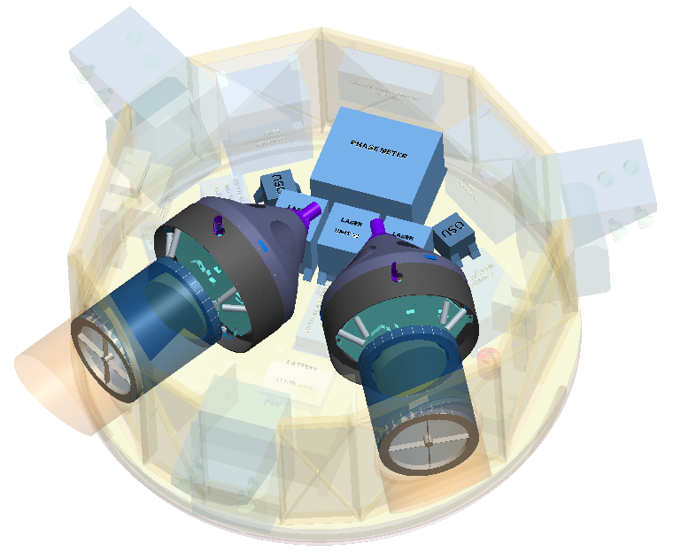
Pupil Aberrations in the
LISA Transceiver Design
J. P. Lehan¹, J. M. Howard¹, Hui Li¹, Ryan Derosa¹, Mark Wilson², & Jeff Livas¹ (+ US LISA Telescope Team)
¹NASA Goddard Space Flight Center Greenbelt, MD 20771
²KBR, Inc., 7701 Greenbelt Road, Greenbelt, Maryland, USA 20770
August 26, 2020

Slide 2
Outline
LISA in a nutshell
Where are we on the road?
Role of the Transceiver
Requirements: key challenges
Standard Solution
Pupil aberrations cognizant solution

Slide 3
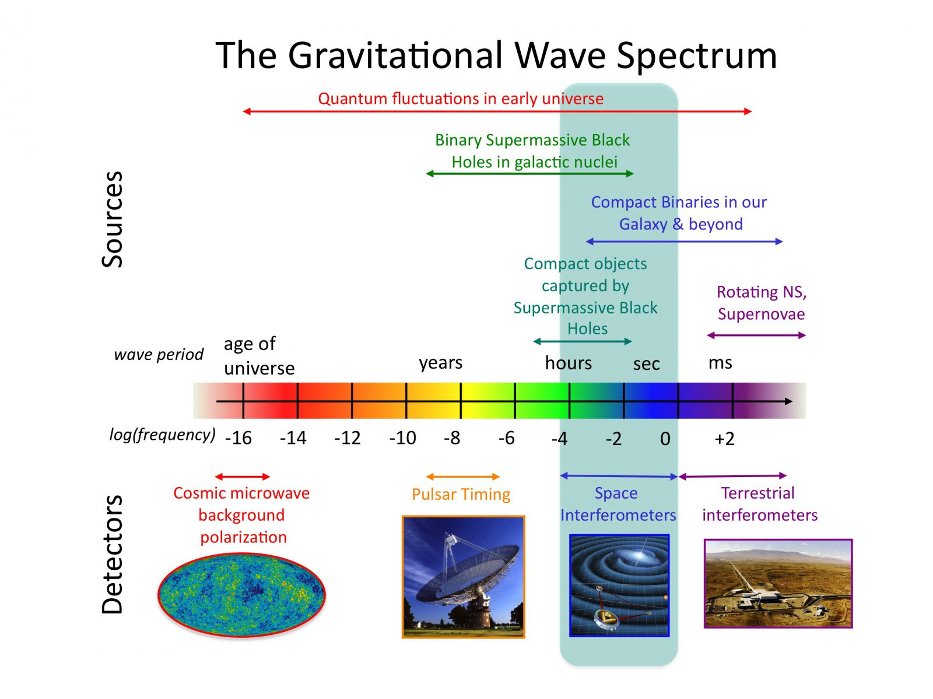
Gravitational Wave Spectrum
Why is this important?
Richest set of sources
ESA L3 (2034 launch)
GW imprint on inflation
Stochastic background
BICEP-2/WMAP/Planck
Figure courtesy of Rick Jenet
Detection 2015!
Image credit: NASA

Slide 4
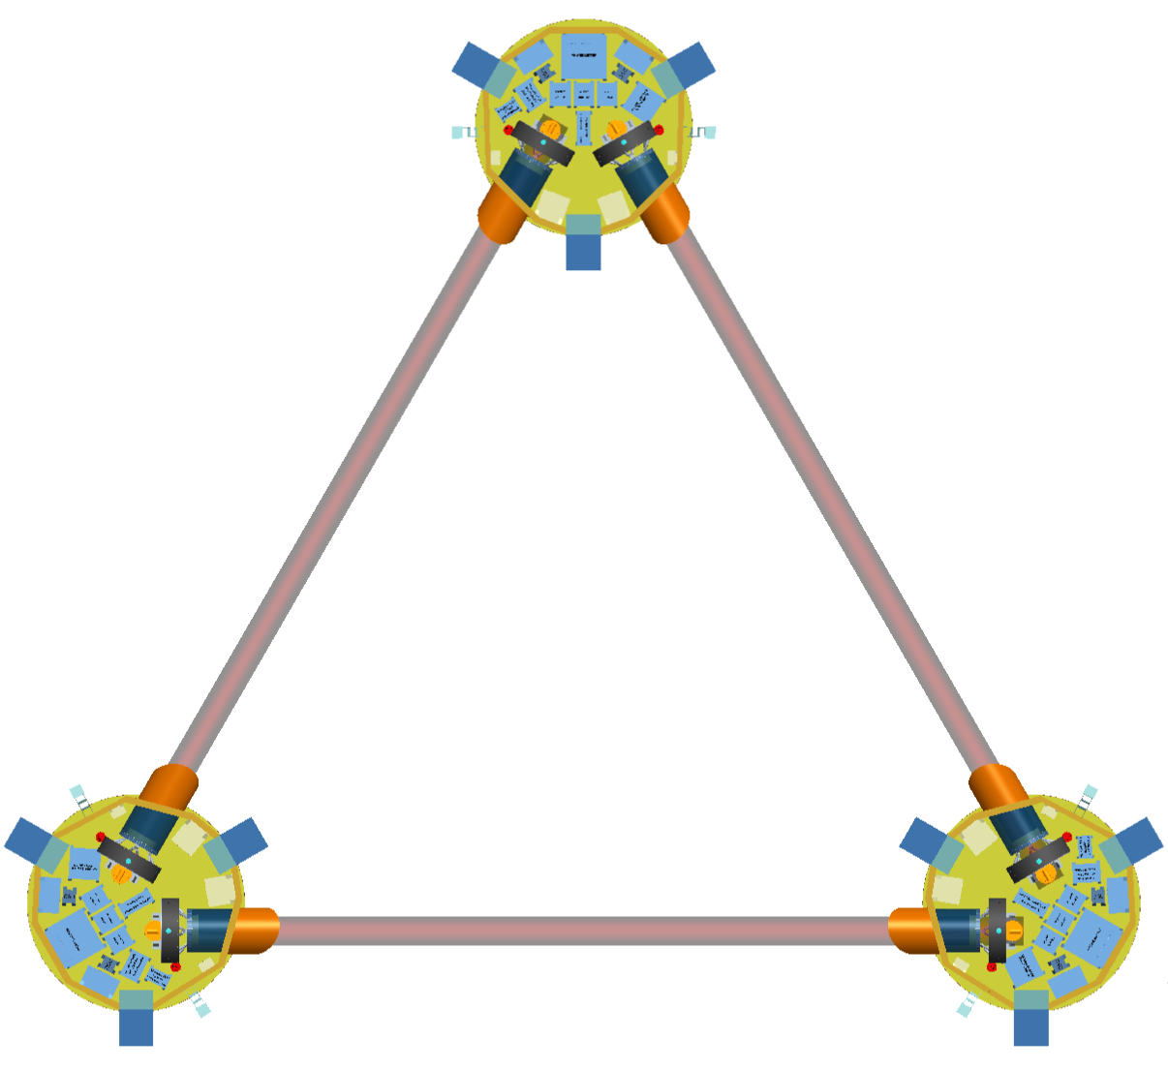
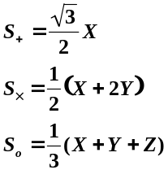
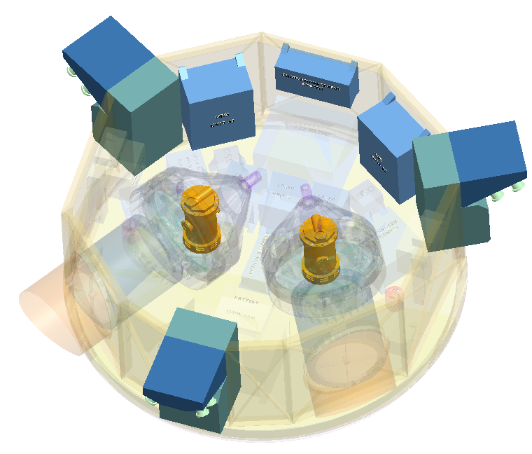
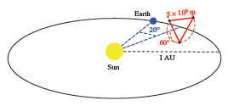
LISA Mission Summary
Mission Design
  2.5 x 10⁶ km arm-length, 3 arms, 60 deg triangle
  3 identical spacecraft
  Payload
    2 - 30 cm transceivers with 2W lasers
  9-21 degree drift away heliocentric orbit
  Direct injection to escape, 18 mo transfer
    Single EELV (e.g. Arian)
  Baseline 6.5 year lifetime (+ 6 years?)
LISA Layout
Z
2.5 million km
+
X
X
Y
“Sciencecraft”
Heliocentric orbit
GRS
Telescope

Slide 5
Inter-Spacecraft Distance Measurement
Test-mass to test-mass measured in 3 parts:
  2 × test-mass to spacecraft measurements (short-arm: LPF tests this)
  1 × spacecraft to spacecraft interferometer (long-arm)
Total separation = d₁ + d₁₂ + d₂
3 spacecraft pairs make up data set
Spacecraft 1
d₁₂ = ~ 2.5 x 10⁶ km
Spacecraft 2
Optical Bench
Optical Bench
Proof Mass
Proof Mass
d₁
d₂
LO
~ 0.5 m
Tx
Tx
~ 2W Transmitted (Tx)
~100 pW Rreceived (Rx)
LO
transceiver
Quad photodetector
~ 0.5 m
Main interferometer
Local Oscillator (LO) employed for heterodyne interferometry

Slide 6
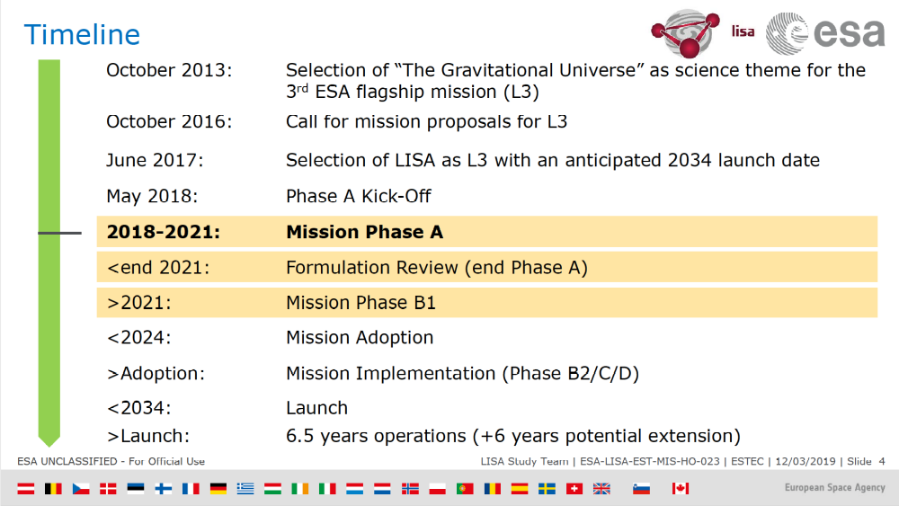
Where are we on this long road?
Date | ESA Milestones
October 2013 | Selection of the “Gravitational Universe as the science theme for the 3rd ESA flagship mission (L3)
October 2016 | Call for L3 mission proposals
June 2017 | Selection of LISA as L3 with 2034 launch
May 2018 | (ESA) Phase A kick-off
2018-2021 | LISA mission Phase A
<end 2021 | Formulation Review and Phase A end
>2021 | Mission Phase B
<2024 | Mission Adoption
<2034 | Launch
Now

Slide 7
Transceiver Scope Overview
Functional:
  Afocal optical beam expander
    LISA: 300 mm/2.24 mm ~ 134x
  Efficiently deliver power from one S/C to another
    Beyond “diffraction limited” lambda/30 at 1064 nm (~ 35 nm)
    Clipped Gaussian beam for highest on-axis power
  Minimize the effects of jitter on the length measurement. This is the so-called tilt-to-length (TTL) coupling. It is defined as the derivative of optical path length with field angle relative to a reference location. For specification purposes, it the maximum of the absolute value of that derivative over the science field.
Other requirements
  Dimensionally stable optical path length
    in series with the main measurement
    Multiple time scales (seconds to lifetime of the mission)
  Low scattered light (transceiver driven)  off- axis design
  Manufacturable: design margin
    (6 flight + 1-2 spares + prototypes ~ 10 telescopes)
  Interchangeable:
    Care toward the interface (because interface is not clean)
    Close to identical

Slide 8

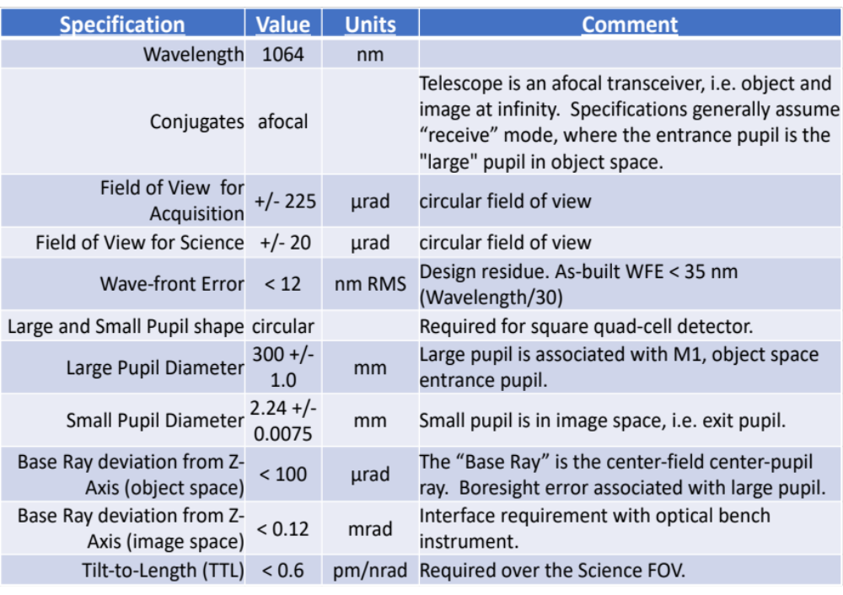
Transceiver Optical Design Requirements
(written in receiver mode)
Design challenge
Fab challenge
Fab challenge
System Stop
Fab challenge
Fab challenge
Design challenge
Two circled design challenges interact
8

Slide 9
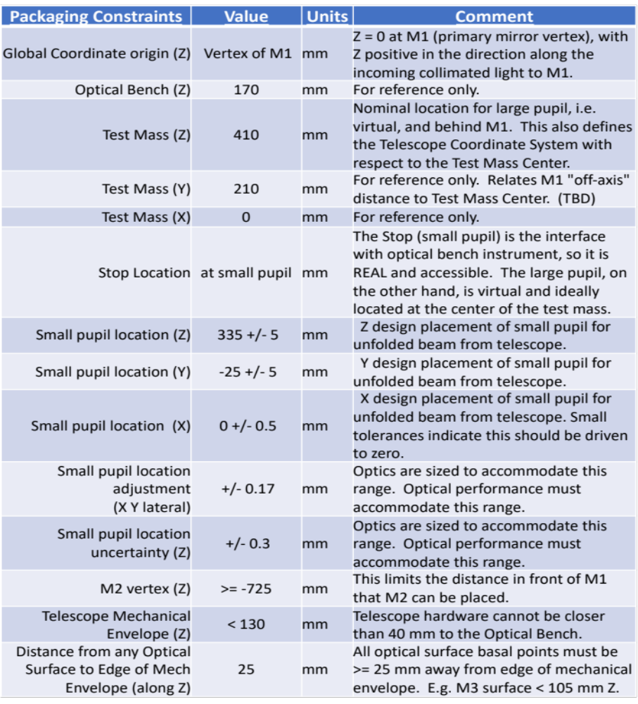
Transceiver Packaging Requirements
A lot!
More than usual,
even for space optics
Alignment challenge
Alignment challenge

Slide 10
Solution space
Despite large # design constraints, a large solution space exists
Many designs generated and studied
Most have (slightly) different packaging constraints as the mission has evolved and will not be shown here
General design evolution path:
  On-axis 4-mirror anastigmats (abandoned due to stray light)
  Off-axis 4-mirror anastigmats (to allow focus)
  Off-axis 3-mirror anastigmats (+ fold for packaging) - focus dropped for greater stability (current approach)

Slide 11
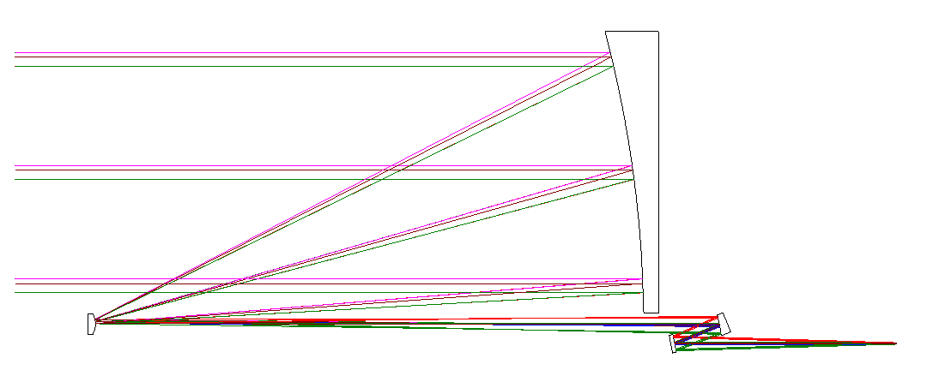

Two Recent Designs
Design 1: 725-v5b – based on classic Korsch all-conic TMA
  Off-axis in aperture
  Third mirror (M3) tilted to accommodate packaging
  Fold mirror added to satisfy small pupil placement requirements (see slide 9)
  Test Mass (TM) plane is large pupil plane (see slide 9)
TM plane
(Large Pupil Plane)
M1
M3
M2
M4
System
Stop

Slide 12
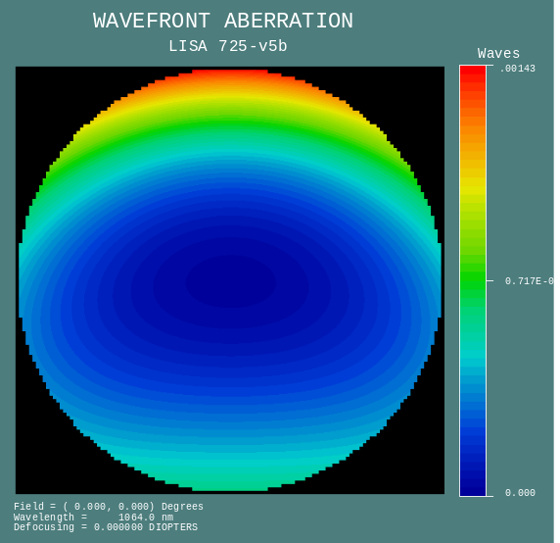
Design 1: 725-v5b
Wavefront Error (WFE) very small
Tilt-to-length (TTL) coupling much better than specifications (0.079 << 0.6 pm/nrad spec)
All packaging criterion met
Signs of trouble appeared upon exercising the design
M1 (PM in receiver mode) size growth
Field footprints wander across M1
We soon found the TTL coupling quickly increased beyond specification during system tolerancing, making fabrication risky
Design residual WFE at the
Center of the field

Slide 13
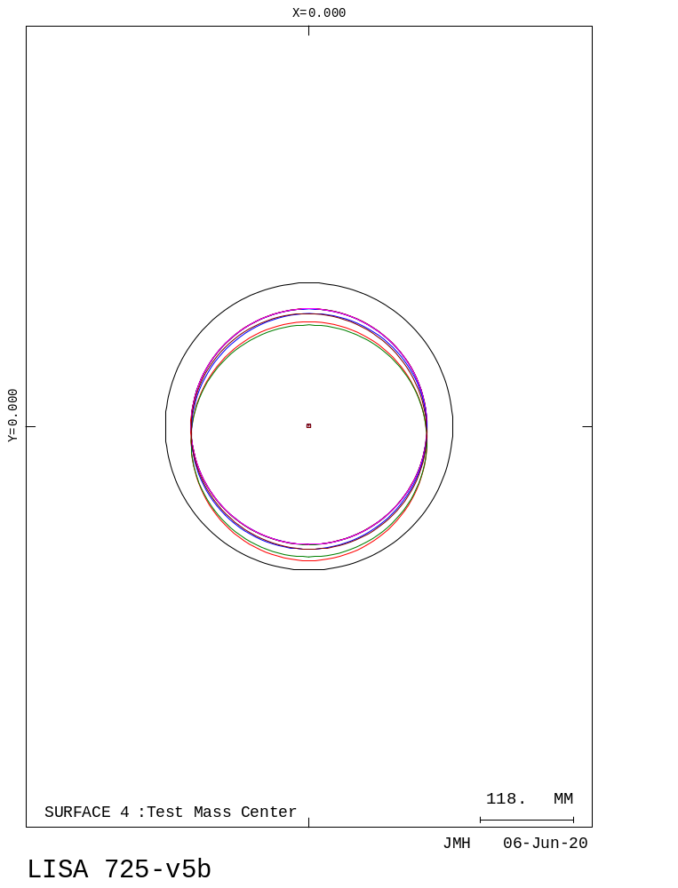
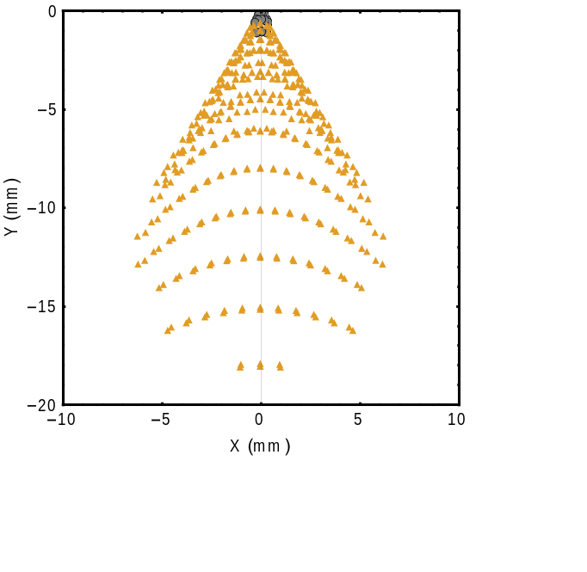
Design 1: 725-v5b
Field footprints wander in the large pupil
Chief Ray Spot Diagram – a tool for visualizing pupil aberrations
Plot chief rays in a plane vs field angle in exact analogy to an image spot diagram which plots rays crossing a plane as a function of ray pupil location
Correspond
M1 beam footprints @ Large Pupil plane with M1 aperture applied (365 mm diameter)
Chief Ray Spot Diagram in large pupil plane
(black are chief rays for fields within the science FOV,
gold are chief rays outside the science FOV but inside the
acquisition FOR).

Slide 14
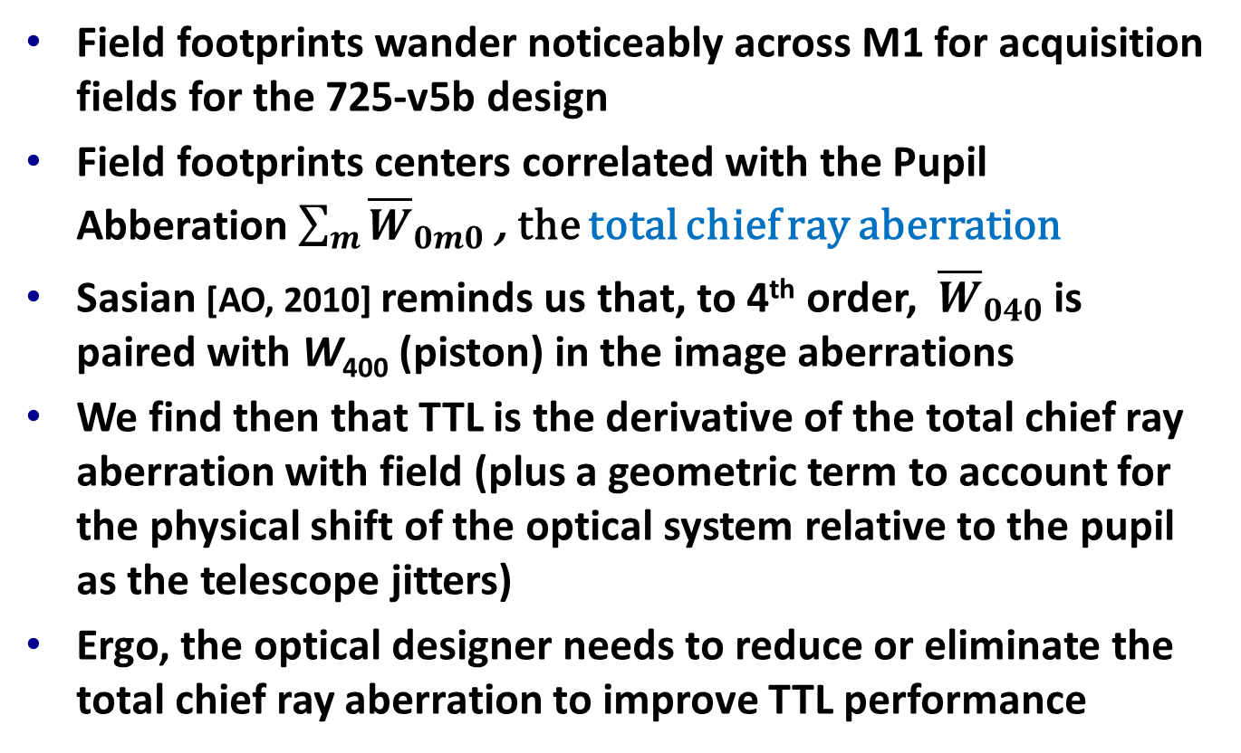
Pupil “Wander” to TTL
Field footprints wander noticeably across M1 for acquisition fields for the 725-v5b design
Field footprints centers correlated with the Pupil Abberation $\sum_{m}{{\overline{W}}_{0m0}}$ , the total chief ray aberration
Sasian [AO, 2010] reminds us that, to 4th order, ${\overline{W}}_{040}$ is paired with W₄₀₀ (piston) in the image aberrations
We find then that TTL is the derivative of the total chief ray aberration with field (plus a geometric term to account for the physical shift of the optical system relative to the pupil as the telescope jitters)
Ergo, the optical designer needs to reduce or eliminate the total chief ray aberration to improve TTL performance

Slide 15
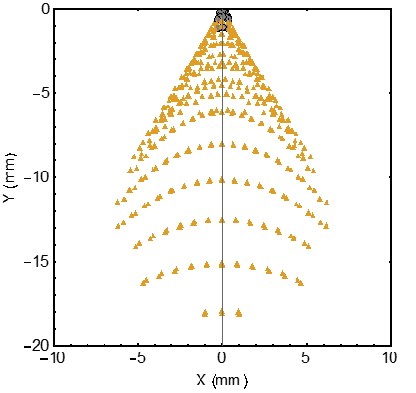
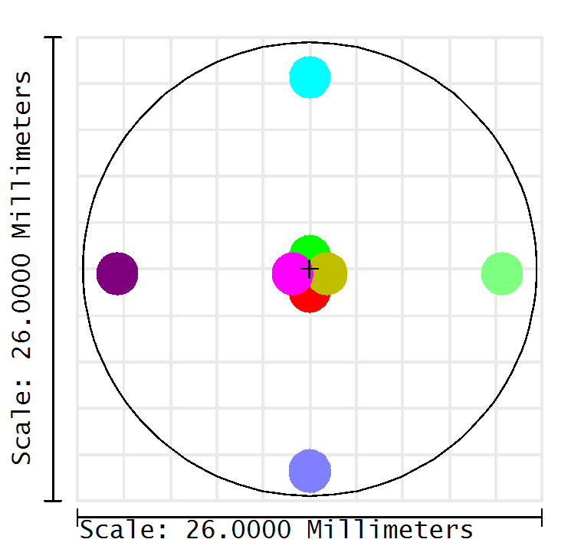
Pupil Aberrations & TTL Reduction
How do we reduce the pupil aberrations (chief ray aberrations) and thus the TTL without destroying the WFE performance?
Shape of Chief Ray Spot Diagram for 725-v5b design suggests a cause of the dominant chief ray aberration
  ⇨ Tilt of M3 ( a la nodal aberration theory)
M3
M4 flat
This chief ray “coma” should be addressable via a freeform to compensate
M3 was identified as the best choice for this since it acts like a field mirror and so pupil and wavefront functions are reasonably separable
Footprint diagram for M3
Center overlapping spots are at the limits of the science FOV (20 μrad in radius)
The outer 4 spots are at the limits of the acquisition FOR (225 μrad in radius)

Slide 16
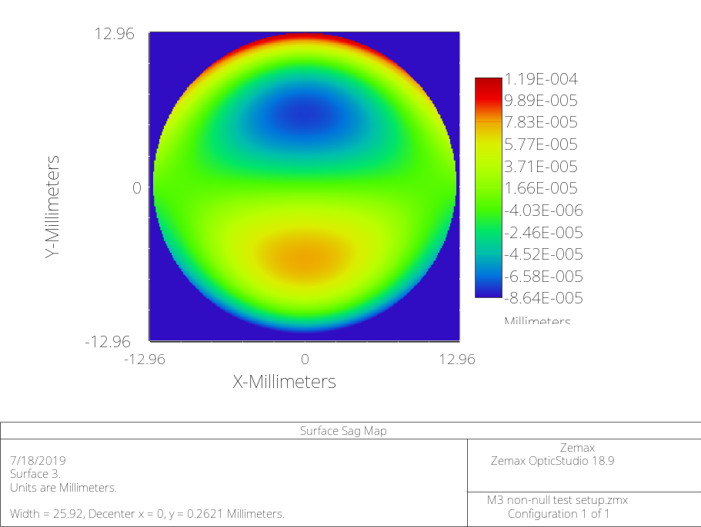
Design 2: 725-v7b
725-v7b is a perturbation of v5b to address its weaknesses
  Same Cassegrain front end as 725-v5b (see slide 11)
  Re-imaging tertiary (M3) changed to freeform to improve pupil imaging
  Freeform is an x-y polynomial (other representations have been shown to perform as well)
  Shape approximates an off-axis section of a conic (or an off-axis toroid) with a little y-coma
Surface sag residual after removing
the principle toroid
for design 725-v7b’s M3 mirror

Slide 17
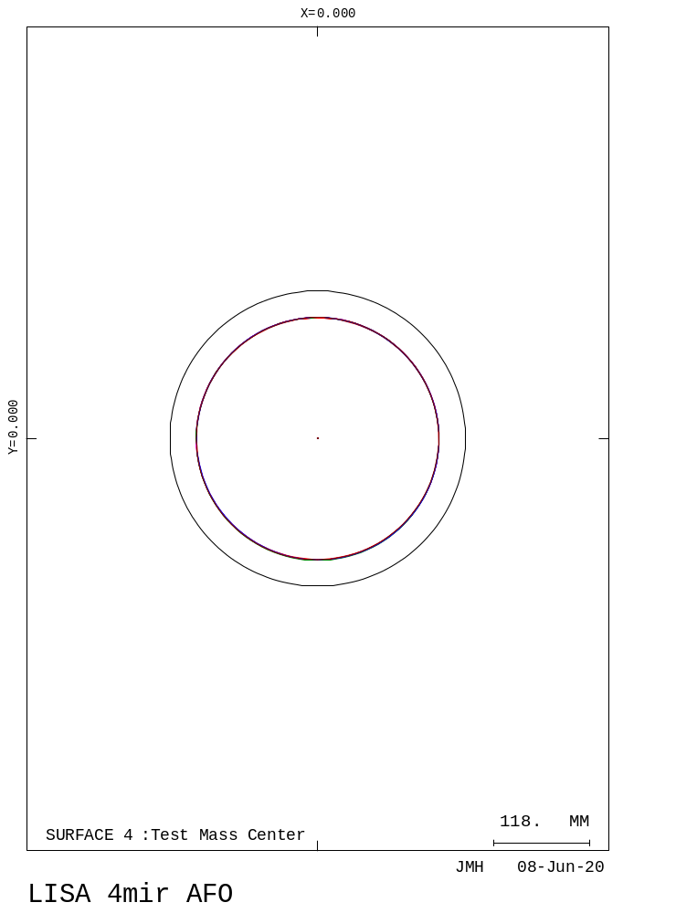
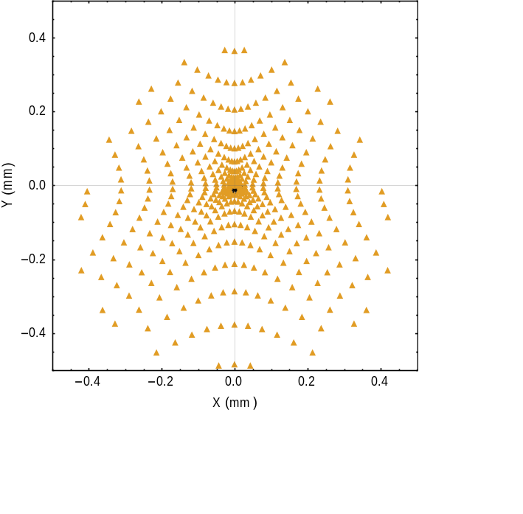
Design 2: 725-v7b - Performance
Beam footprint wander of large pupil reduced (compare to slide 13)
Chief ray spot diagram extent greatly reduced
Maximum TTL over science field dropped to 0.001 pm/nrad (from 0.079) - a 79x reduction!
Field-averaged WFE = 5.95 nm RMS
Correspond
M1 beam footprints @ Large Pupil plane with M1 aperture applied (365 mm diameter)
Chief Ray Spot Diagram in large pupil plane for 725-v7b
(black are chief rays for fields within the science FOV,
gold are chief rays outside the science FOV but inside the
acquisition FOR).

Slide 18
Design 2: 725-v7b - Discussion
TTL & WFE have adequate margin for component fabrication and alignment✓
Design exceeds all optical requirements with margin ✓
An Engineering Design Unit (EDU) is being fabricated to verify performance
EDU delivery expected – Fall of 2021
A key requirement is displacement noise so the entire telescope is made very low CTE material (except bonds)
The entire telescope will be placed into a Fabry-Perot cavity for the displacement noise measurement (2022)

Slide 19
Summary and Conclusions
Approaching the design considering the pupil aberrations lead to a successful design for the LISA transceiver✓
Pupil aberrations are sometimes the best way to look at design problems
Pupil Aberrations also suffer from nodal aberrations
A chief-ray spot diagram is one tool that can provide insight and provide a quantitative measure of some pupil aberrations
There are insufficient tools available for examining pupil aberrations in most optical design codes at this time ☹

Slide 20
Back-Up Slides

Slide 21
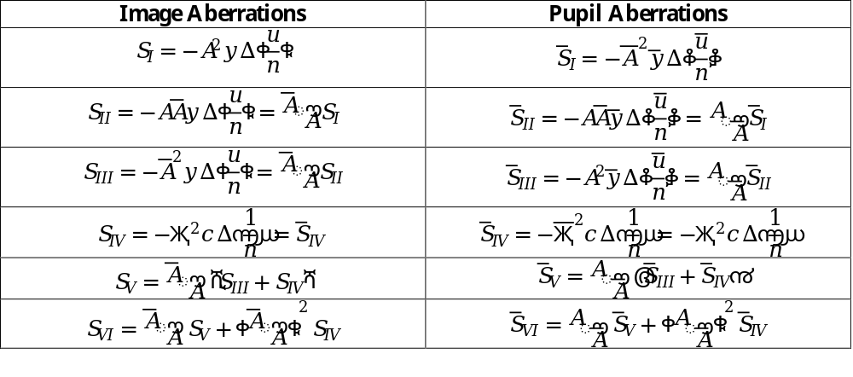

Brief Pupil Aberrations Refresher
Chief ray spot diagram for a pupil plane is a plot of the total chief ray ray-aberration
This chief ray aberration is only one of the pupil aberrations
At the Seidel expansion level, the pupil aberrations can be found from the image aberration expansion by swapping the roles of the marginal and chief rays as shown in the table below
Such simple algebraic correspondence does not continue to hold at higher orders of analysis
More generally, however, aberrations can be expressed in either space
$Җ=\overline{A}y−A\overline{y}$, Lagrange Invariant
$Δ\left(\frac{u}{n}\right)=(\frac{u^{′}}{n^{′}}−\frac{u}{n})$, $Δ\left(\frac{1}{n}\right)=\left(\frac{1}{n^{′}}−\frac{1}{n}\right)\&$ $A=nu+nyc$

