Slide 1

Are We There Yet?
Assessing Solar Cycles from Earth’s Perspective
Marty Mlynczak
NASA Langley Research Center
Linda Hunt
Science Systems Applications, Inc.
CEDAR Prize Lecture 2020/21 Preview

Slide 2
Are We There Yet? -- Outline
The 11-year solar cycle and related metrics
Energetics and effects of the solar cycle on Earth’s thermosphere
Infrared radiation from the thermosphere – a key diagnostic of solar activity
Infrared radiation vs. sunspots
Are we there yet? Has solar minimum occurred for the present solar cycle?

Slide 3
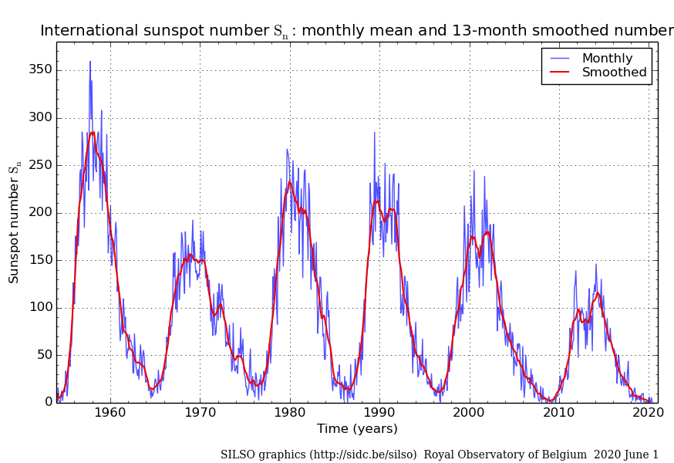
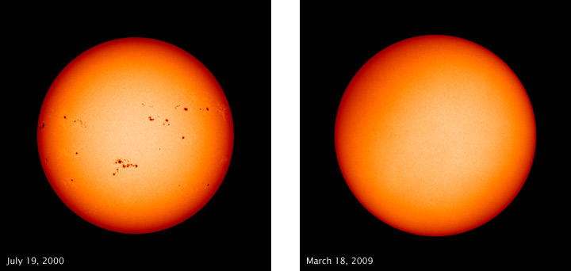
Monthly Sunspot Number 1954 to Present
Solar Maximum Solar Minimum
Sunspot variability is indicative of variability
in solar radiant and particulate (solar wind)
output
What are the tangible effects of this
variability on Earth and its atmosphere?
19
20
21
22
23
24

Slide 4
Are We There Yet? -- Outline
The 11-year solar cycle and related metrics
Energetics and effects of the solar cycle on Earth’s thermosphere
Infrared radiation from the thermosphere – a key diagnostic of solar activity
Infrared radiation vs. sunspots
Are we there yet? Has solar minimum occurred for the present solar cycle?

Slide 5
Thermosphere Thermal Structure – Solar Cycle Effects
500
Altitude (km)
300
Quiet Sun
Active Sun
100
100
500
1000
1500
2000
Temperature (K)
Banks and Kockarts, 1973

Slide 6
Thermosphere Energy Balance – Energy Inputs
External
Energy Input
Solar UV
Solar Wind
500
Altitude (km)
300
Quiet Sun
Active Sun
100
100
500
1000
1500
2000
Temperature (K)

Slide 7
Thermosphere Energy Balance – Energy Redistribution
500
Energy Redistribution
Heat
Conduction
Altitude (km)
300
Quiet Sun
Active Sun
100
Tides, Waves
100
500
1000
1500
2000
Temperature (K)

Slide 8
Thermosphere Energy Balance – Energy Outputs
Energy Loss
500
Altitude (km)
300
Quiet Sun
Active Sun
NO (5.3 μm)
100
CO₂ (15 μm)
100
500
1000
1500
2000
Temperature (K)

Slide 9
Are We There Yet? -- Outline
The 11-year solar cycle and related metrics
Energetics and effects of the solar cycle on Earth’s thermosphere
Infrared radiation from the thermosphere – a key diagnostic of solar activity
Infrared radiation vs. sunspots
Are we there yet? Has solar minimum occurred for the present solar cycle?

Slide 10
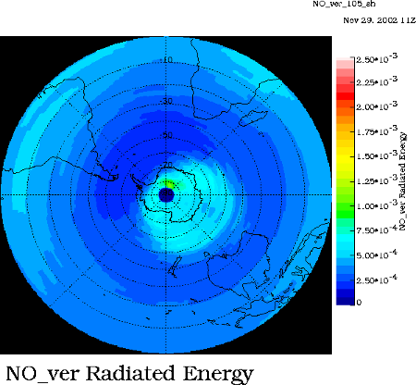
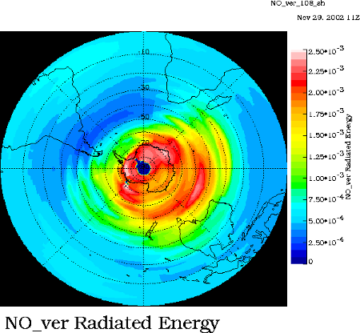
Effects of solar activity on infrared radiation from nitric oxide
Infrared radiation from nitric oxide (NO, 5.3 μm) responds according to exp ( 2700/T)
Figures here are of global flux (W/m²) of energy from quiet to storm time, measured by SABER on TIMED
NO emission is a very sensitive indicator of solar activity, as is CO₂ emission (15 μm)
Flux (mW/m²)
derived from
SABER instrument
on TIMED
satellite during
April 2002

Slide 11
Are We There Yet? -- Outline
The 11-year solar cycle and related metrics
Energetics and effects of the solar cycle on Earth’s thermosphere
Infrared radiation from the thermosphere – a key diagnostic of solar activity
Infrared radiation vs. sunspots – up to 1 year difference in maxima
Are we there yet? Has solar minimum occurred for the present solar cycle?

Slide 12
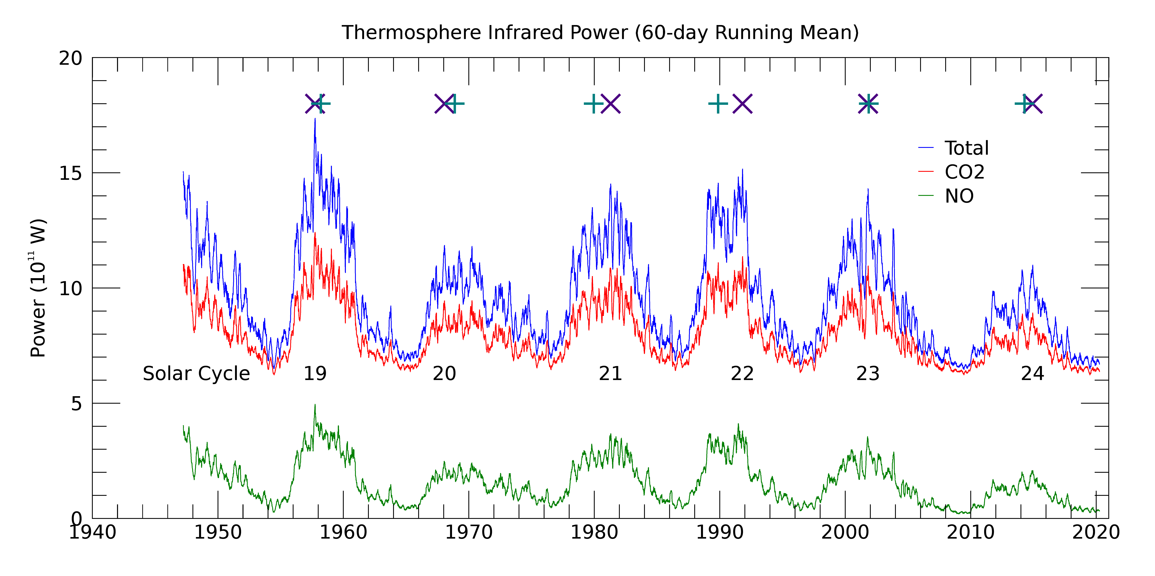
Time Series of Infrared Radiation
Occurrence of Maximum IR vs. Maximum Sunspots
Sunspot Maximum + -- Infrared Maximum X
Infrared Maximum Derived and Extended back to 1947 from SABER data

Slide 13
Are We There Yet? -- Outline
The 11-year solar cycle and related metrics
Energetics and effects of the solar cycle on Earth’s thermosphere
Infrared radiation from the thermosphere – a key diagnostic of solar activity
Infrared radiation vs. sunspots – up to 1 year difference in maxima
Are we there yet? Has solar minimum occurred for the present solar cycle?

Slide 14
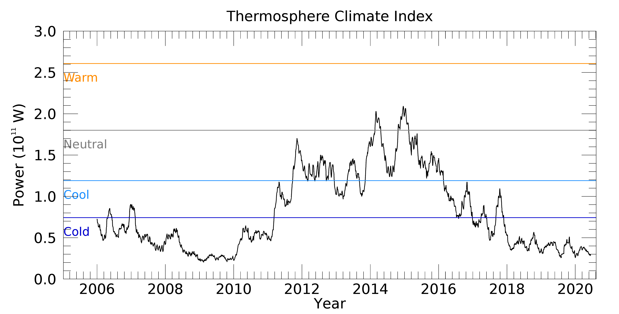
NO Daily Global Power (aka “Thermosphere Climate Index”)
UV
Min.

Slide 15
Summary
Earth’s thermosphere is dramatically impacted by solar activity, particularly the “11-year” solar cycle
Understanding this response is a primary focus of solar-terrestrial research
It is also relevant to many applications, such as the forecasting of density at satellite altitudes for orbit predictions
Currently we are in a prolonged minimum from the Earth’s perspective based on observations of infrared energy radiated by NO in the thermosphere
Multiple local minima in the infrared emission – not coincident with the UV min.
Are we there yet for SC 24 minimum? Time will tell!

