Slide 1

CompMods Team
Possible CompMods* Challenge Problems
Ed Glaessgen
Vesselin Yamakov
Nelson Carvalho
David Wagner
Matt O’Connell
Nate Hildebrand
* DARPA Computational Models Program

Slide 2
Thermal protection system (part I)
Thermal protection material
Flight vehicle
Retrofiring jet in exothermic
hydrogen and oxygen reaction
forming water vapor.
Hypersonic flow
Water vapor breaks down in endothermic reaction, helping cool the surface.

Slide 3
Thermal protection system (part II)
Key disciplines:
In-service damage/manufacturing imperfection
Fluid mechanics
  Mechanical pressure
  Thermal loading
Chemistry
Solid mechanics
  Fracture/damage
Thermal protection material
Fracture
Flight vehicle
Retrofiring jet in exothermic
hydrogen and oxygen reaction
forming water vapor.
Ablation
Hypersonic flow
Water vapor breaks down in endothermic reaction, helping cool the surface.

Slide 4
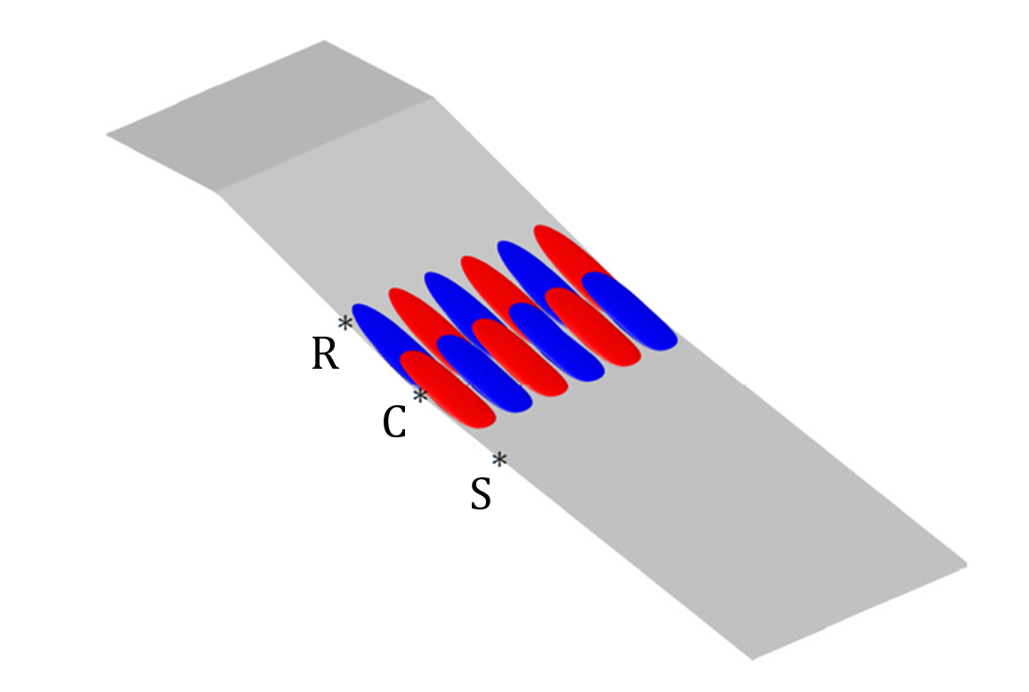
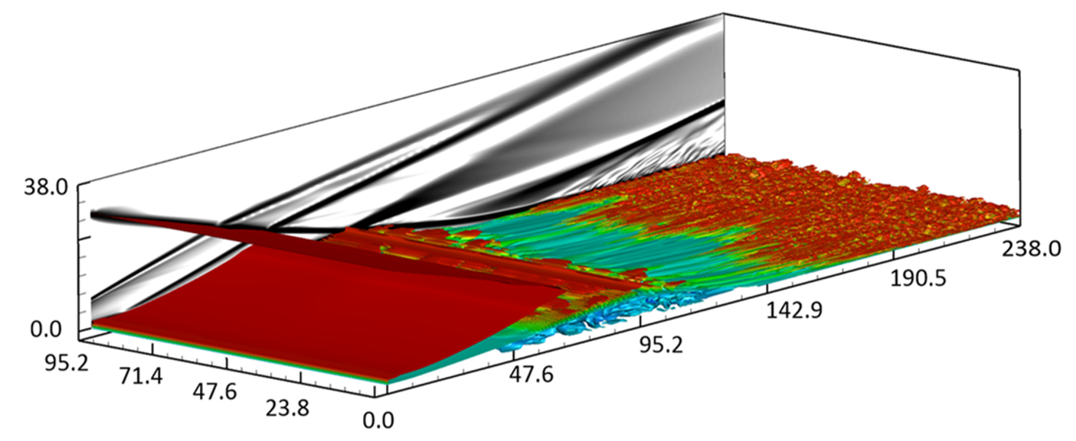
Hypersonic Shock-Wave/Boundary-Layer Interaction (SWBLI)
Tightly-Coupled Physics
  SWBLI
  Shock/Shock Interactions
  Transition/Turbulence
  Chemistry
Laminar vs Turbulent Incoming Boundary Layer
  Low-Frequency Unsteadiness
Different Geometries: Oblique SWBLI vs Double Cone
Can physical mechanisms be extracted?
  What causes amplification of disturbances?
Recent Studies
  Dwivedi et al. (JFM 2019)
  Tumuklu, Levin, & Theofilis (PRF 2019)
  Priebe & Martin (JFM 2018)
Mach 5.92

Slide 5
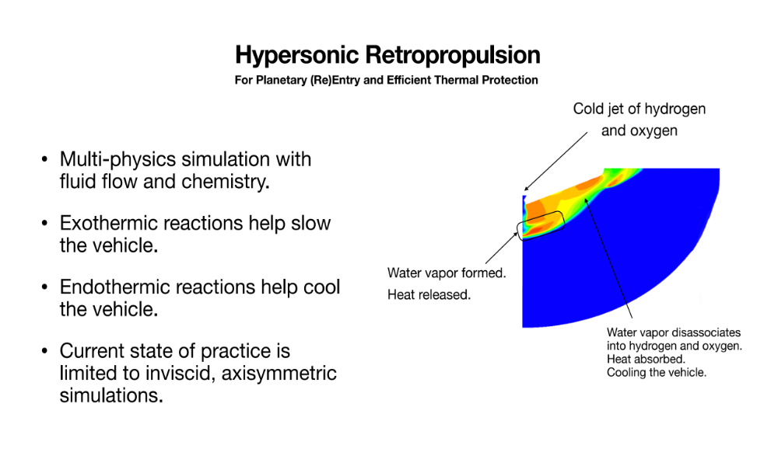

Slide 6
Non-Equilibrium Processes During Rapid Solidification in Additive Manufacturing
PROBLEM: Predict the rapid microstructure evolution (e.g., grain formation, phase segregation, porosity)
(Landau first order phase transition)
during transient heat transfer
Multiphysics
from the surface, which is subject to radiation and convection:
Grain structure of Ti-6Al-4V alloy subjected to selective laser melting (SLM)
(O. Zinovieva et al. Comp. Mat. Sci. 141 (2018) 207)

Slide 7
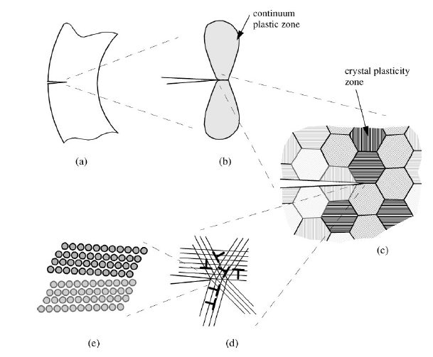
Multi-Scale Modeling of Fracture
Micromechanics Simulations of Fracture*
Current approaches to concurrent
multi-scale modeling of fracture
-----------------------------------------------------
• Attempt to address 6 to 8 orders of magnitude in length scale and ~12 orders of magnitude in time scale
• Understanding relationships between free surface creation and plasticity
• Passing dislocation/plasticity information across representational boundaries
• Various means of homogenizing lower-length scale material information
• 2 or 2.5D representation of 3D processes (lower length scales)
• Poor representation of governing microstructural features and local material variability
Component Scale
Continuum Plastic Zone
Microstructure
Atomistic
Dislocation
*van der Giessen and Needleman, Annu. Rev. Mater. Res., 2002, 32: 141-162.

