Slide 1
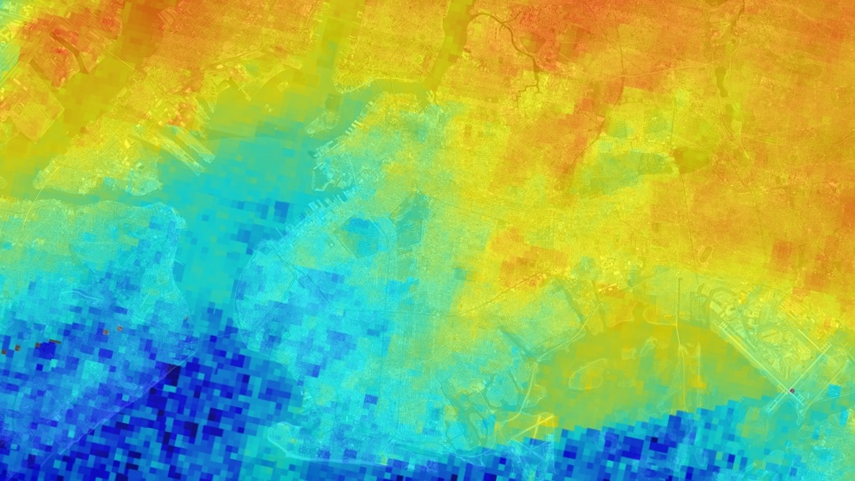
Revealing TEMPO’s Capability for Observing Ozone Precursors
Presented by Laura Judd, NASA Langley Research Center

Slide 3
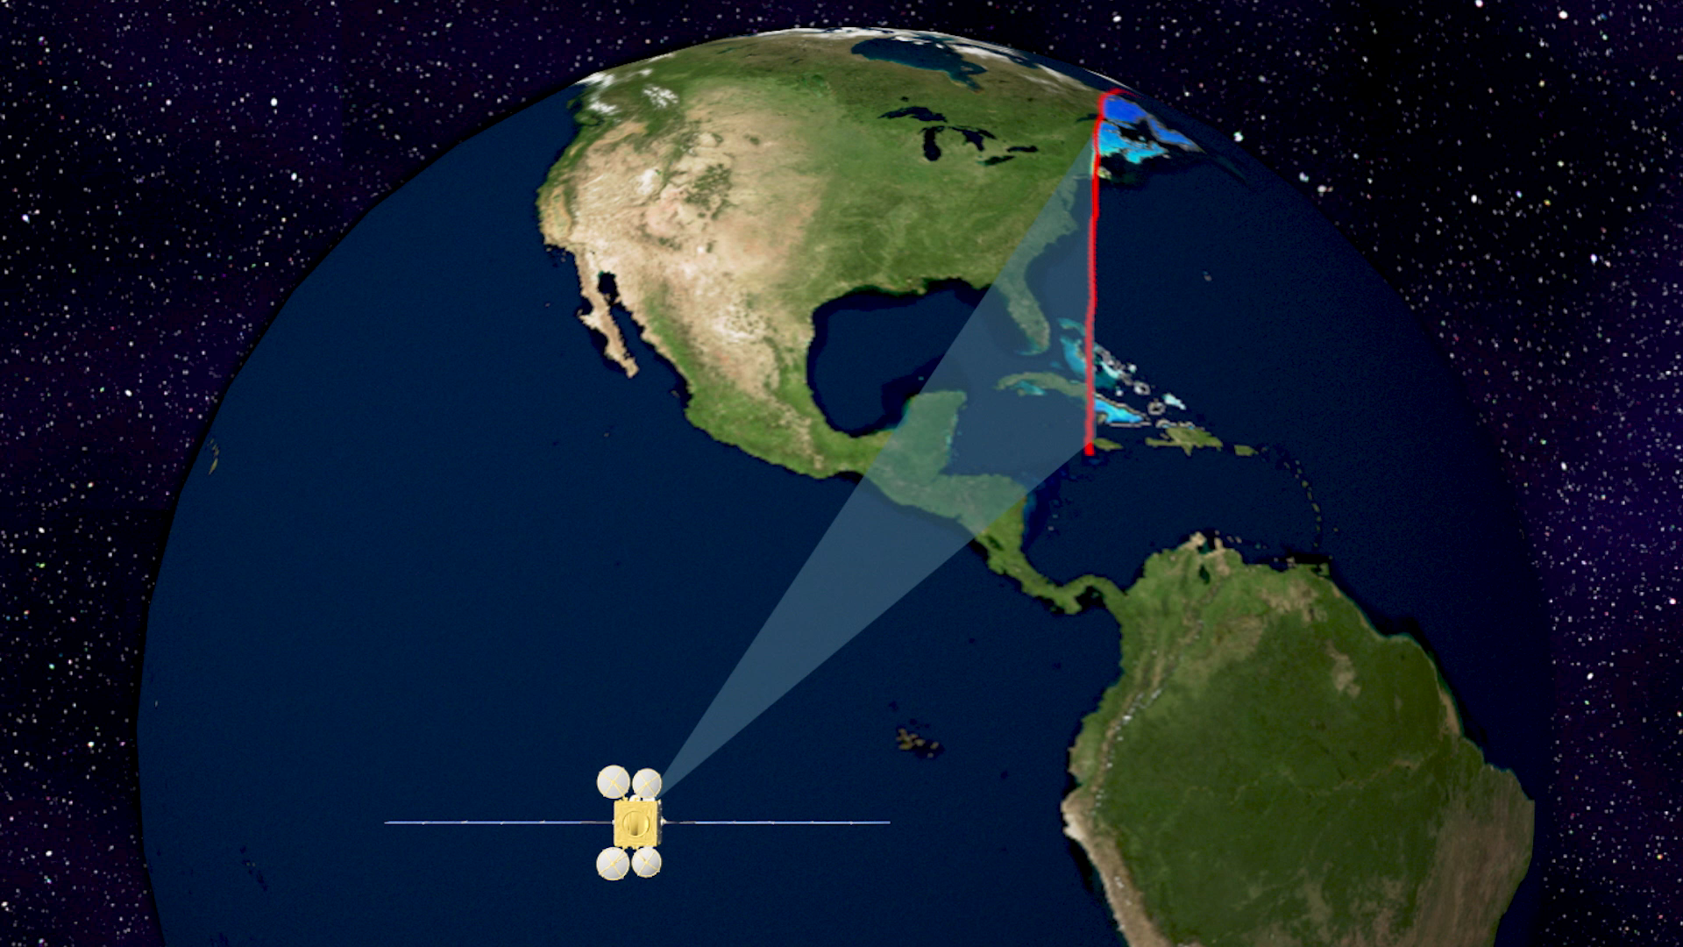
Launching in 2022
TEMPO Mission Leads:
Principal Investigator:
Kelly Chance, Smithsonian Astrophysical Observatory
Instrument Development:
Ball Aerospace & Technologies Corporation
Project Management:
NASA/Langley Research Center
Provides hourly daylight observations to capture rapidly varying emissions & chemistry important for air quality
  Key tropospheric pollutants measured
    Tropospheric ozone
    Ozone Precursors: nitrogen dioxide (NO₂) and formaldehyde (HCHO)
    Aerosol optical depth
  Distinguishes boundary layer from free tropospheric ozone
http://tempo.si.edu/
Model-simulated NO₂. Warmer colors indicate larger amounts.

Slide 4
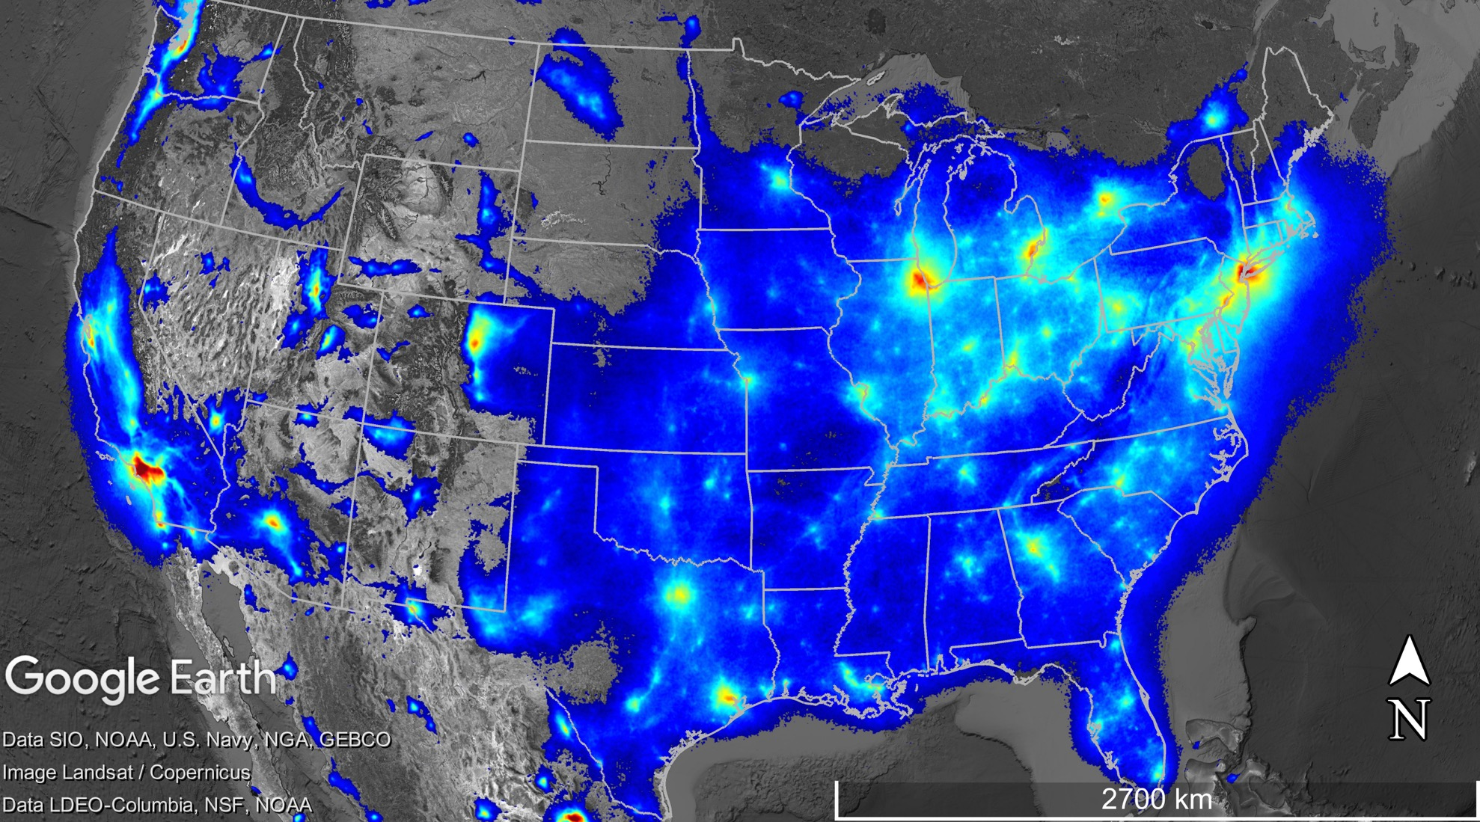
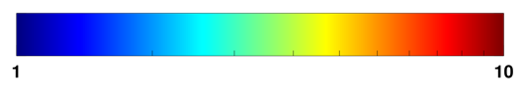
NASA-Associated Air Quality Remote Sensing Campaigns 2011-Present
Base Map: S5P TROPOMI Oversampled NO₂
April 2018-March 2019
Data provided by Henk Eskes/KNMI
5, 12
1: DISCOVER-AQ Maryland 2011
2: DISCOVER-AQ California 2013
3: DISCOVER-AQ Texas 2013
4: DISCOVER-AQ Colorado 2014
5: Korea-US Air Quality (KORUS-AQ) Study 2016
6: Lake Michigan Ozone Study (LMOS) 2017
7: Student Airborne Research Program (SARP) 2017
8: Ozone Water-Land Environmental Transition Study (OWLETS)-1 2017
9: Ozone Water-Land Environmental Transition Study (OWLETS)-2 2018
10: Long Island Sound Tropospheric Ozone Study (LISTOS) 2018
11: Fire Influence on Regional to Global Environments and Air Quality (FIREX-AQ) 2019
12: GEMS Validation (2020)
13: TRACER-AQ (September 2021)
11
6
10
4
1,9
2
8
7
3, 13
Tropospheric NO₂ x 10¹⁵ molecules cm⁻²

Slide 5
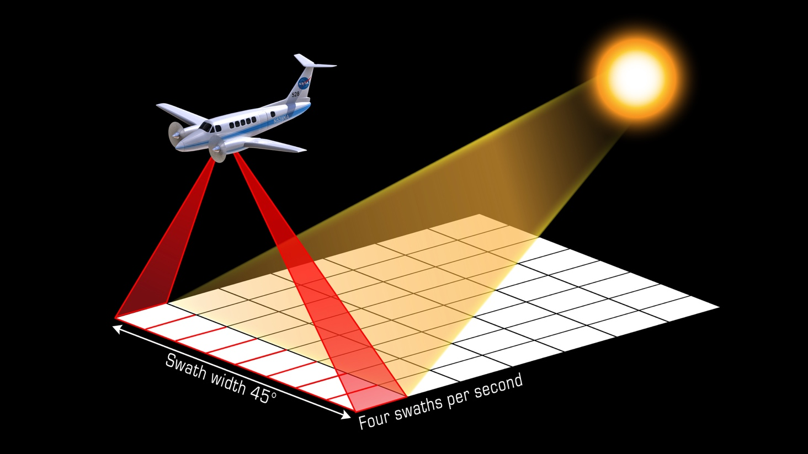
NASA GCAS/GeoTASO Airborne Spectrometers
Instrument PI:
Scott Janz, GSFC
Primarily been used for preparatory measurements for geostationary air quality observations as well as emissions mapping
Measures spectra in the UV-VIS-(NIR) at high spectral and spatial resolution from which trace gas columns can be remotely retrieved (NO₂ and HCHO)
Observes from the bottom of an airplane (often the NASA LaRC B200) with a field of view of ~7 km at a nominal altitude of 28,000 feet executing gapless mapping over areas of interest
Heritage campaigns: DISCOVER-AQ 2013 & 2014, GOES-R Validation 2017, LMOS 2017, SARP 2017, LISTOS 2018, FIREX-AQ 2019, KORUS-AQ 2016, GEMS campaigns (fall 2020)
Trace gas data are publicly available on study archives, but also work toward the creating of a TEMPO-proxy dataset
~
Sampling strategy for the airborne spectrometers operating in a push-broom configuration
Some References:
Kowalewski & Janz, 2014: doi:10.1117/12.2062058
Leitch et al., 2014: doi: 10.1117/12.2063763
Nowlan et al., 2016: doi:10.5194/amt-9-2647-2016
Nowlan et al., 2018: doi:10.5194/amt-2018-156
Judd et al., 2019: doi: 10.5194/amt-12-6091-2019
Judd et al., 2020: doi:10.5194/amt-2020-151

Slide 6
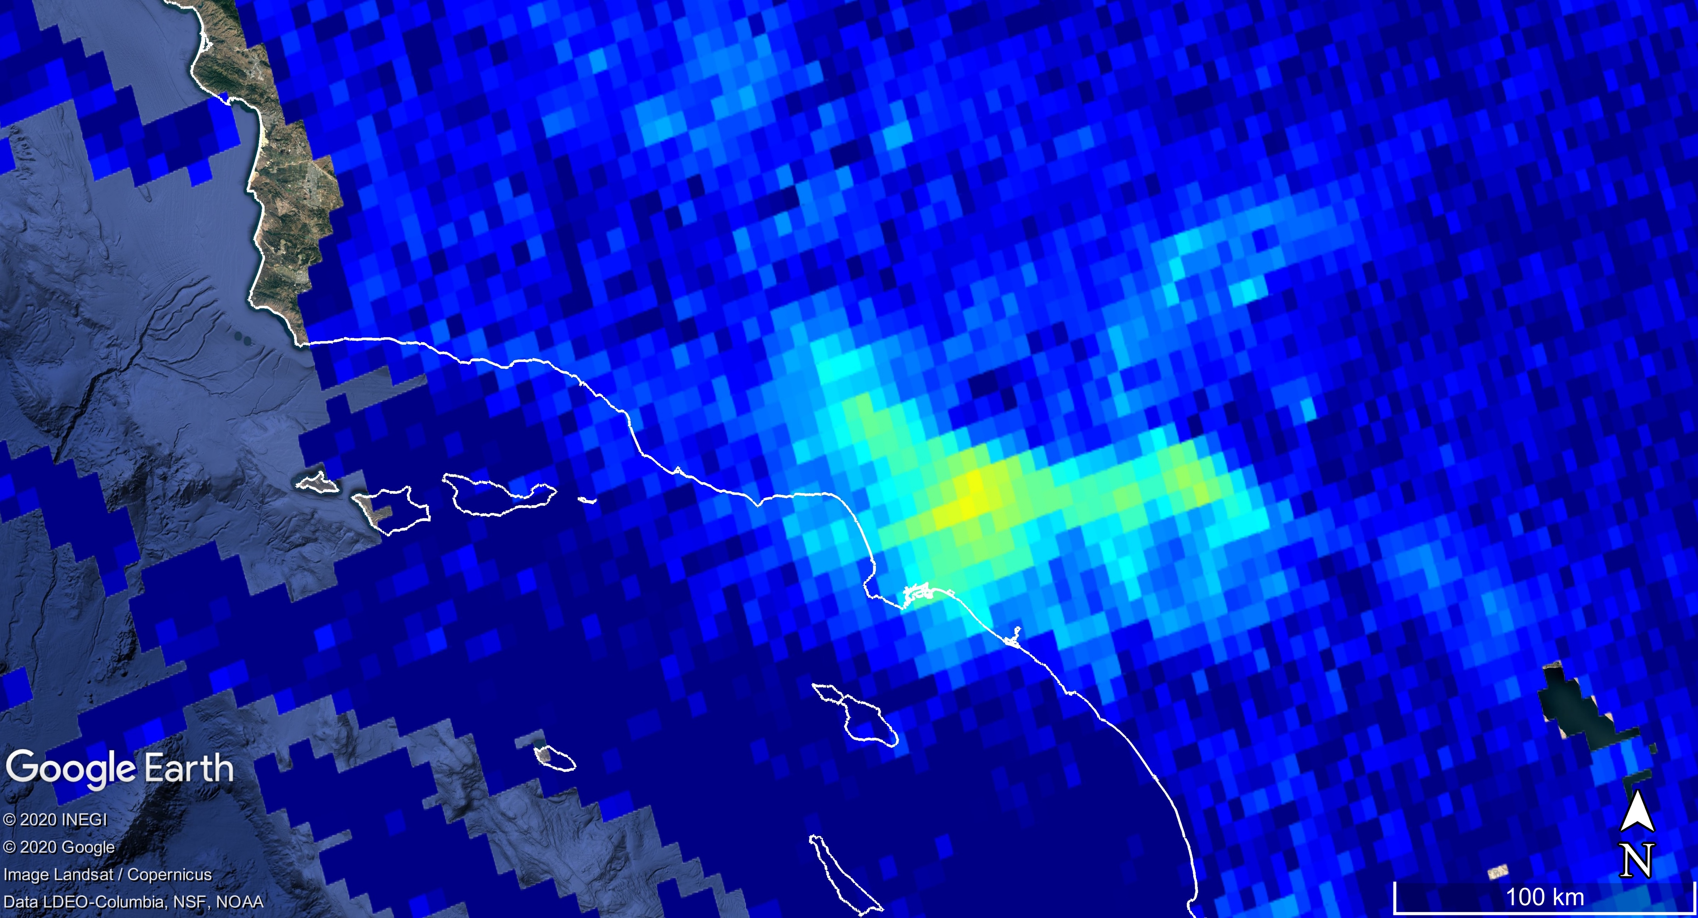
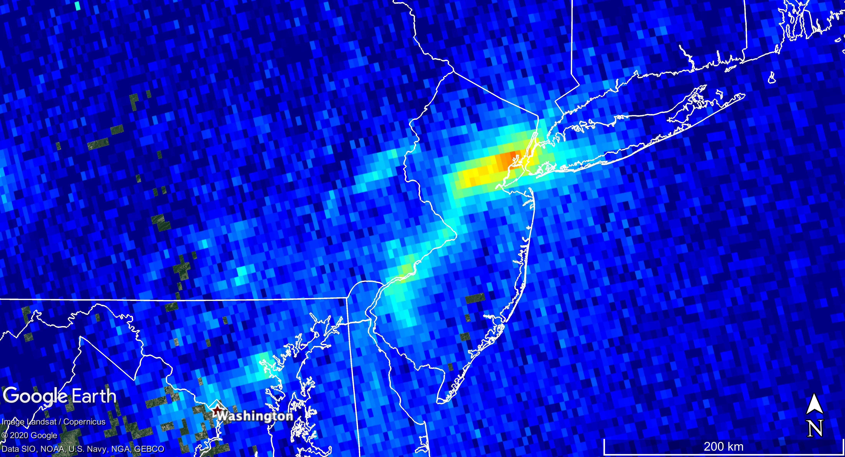
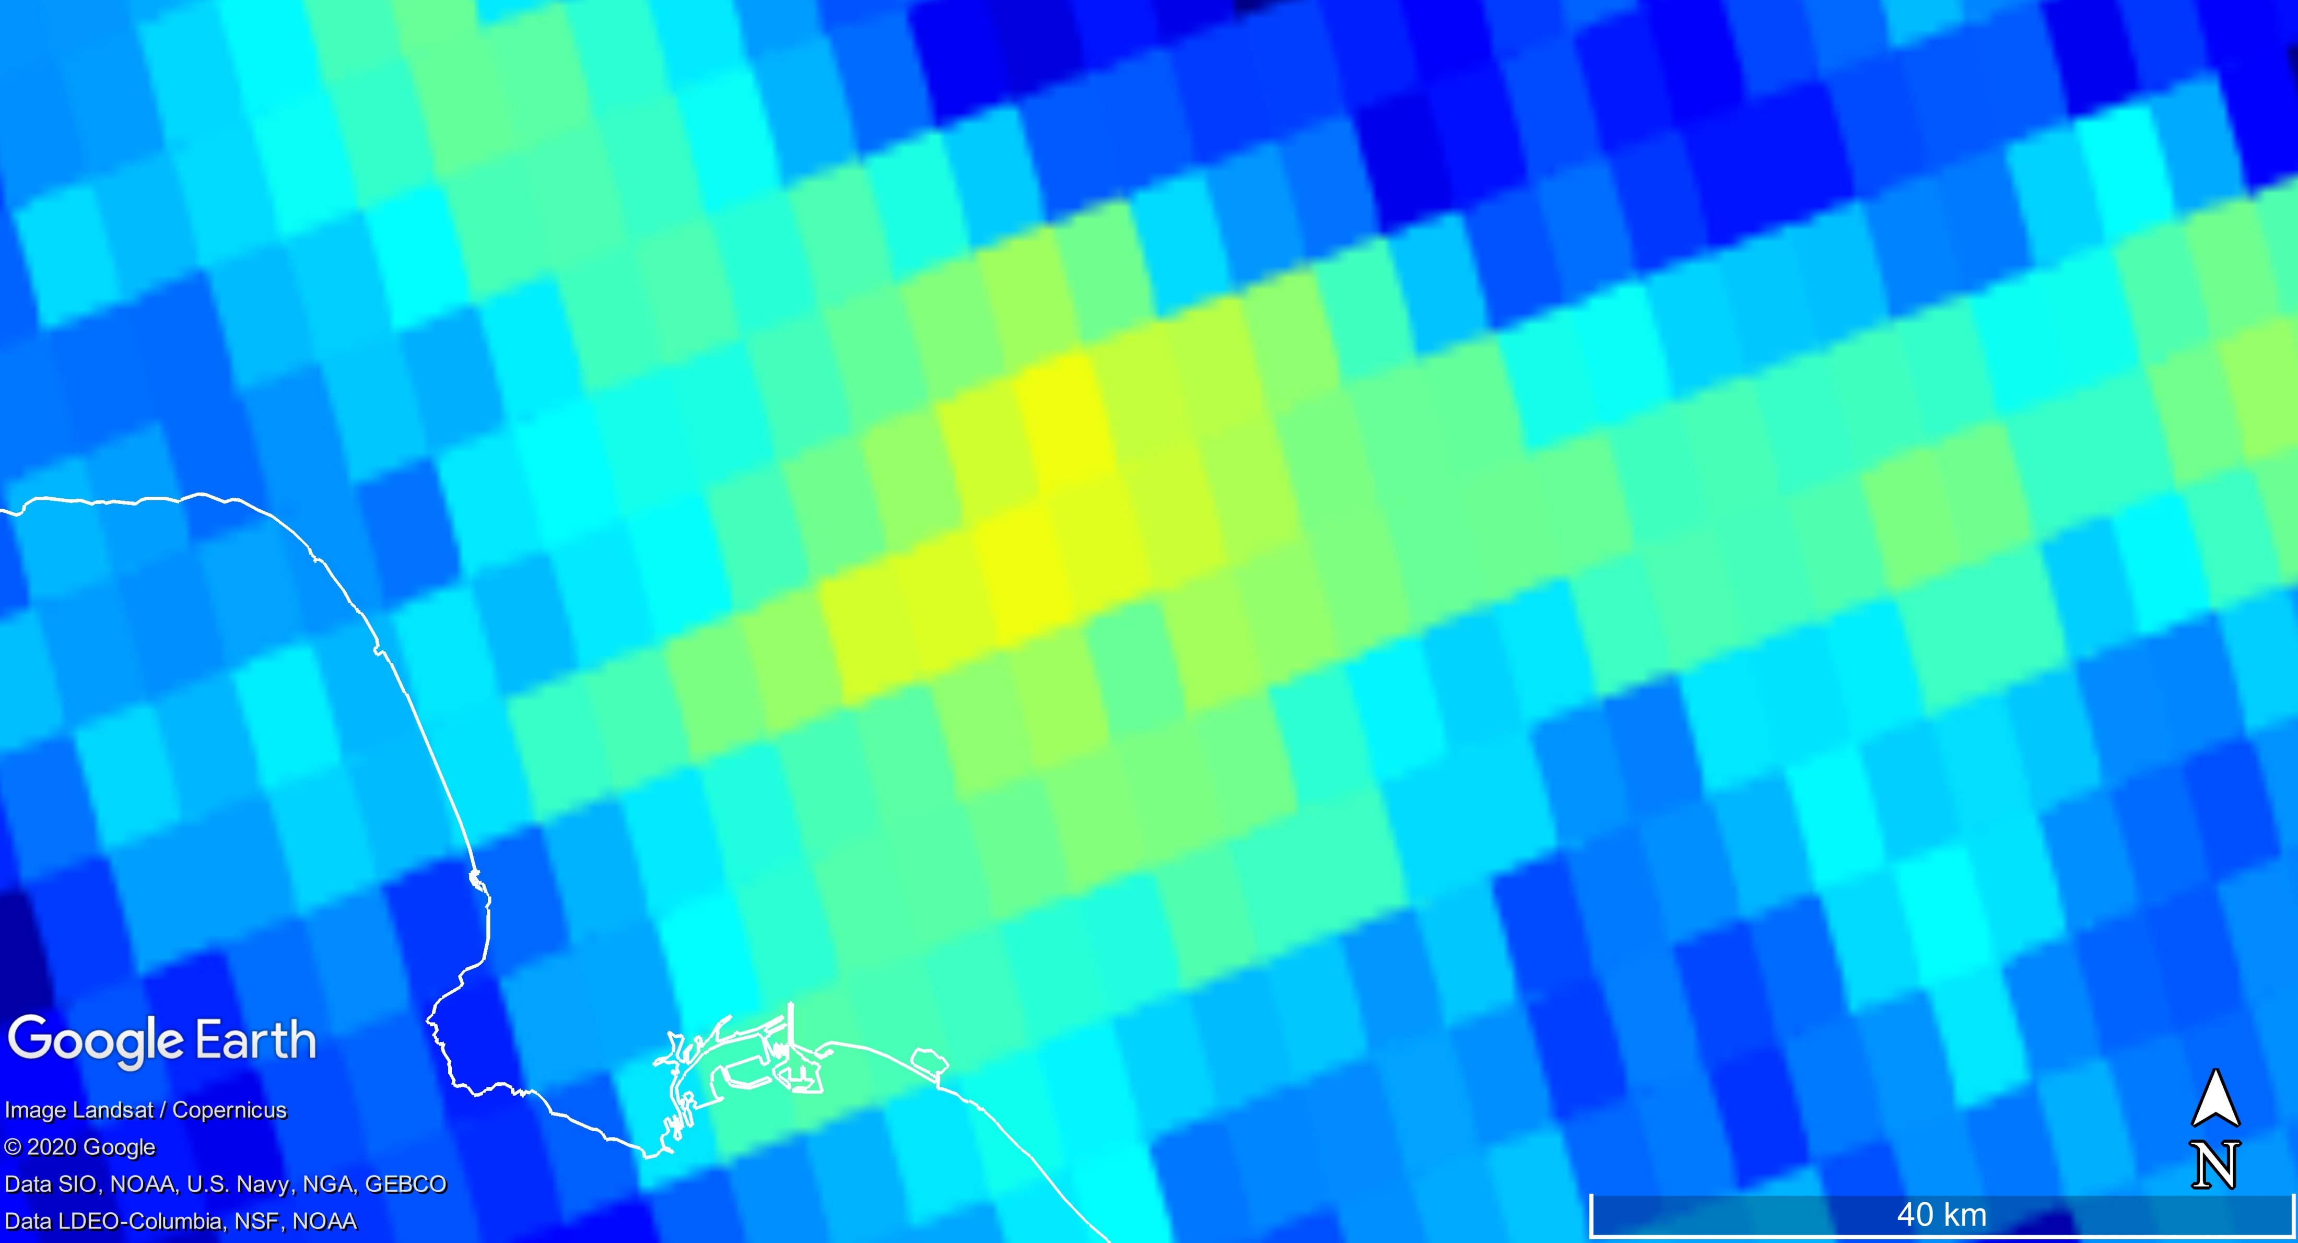
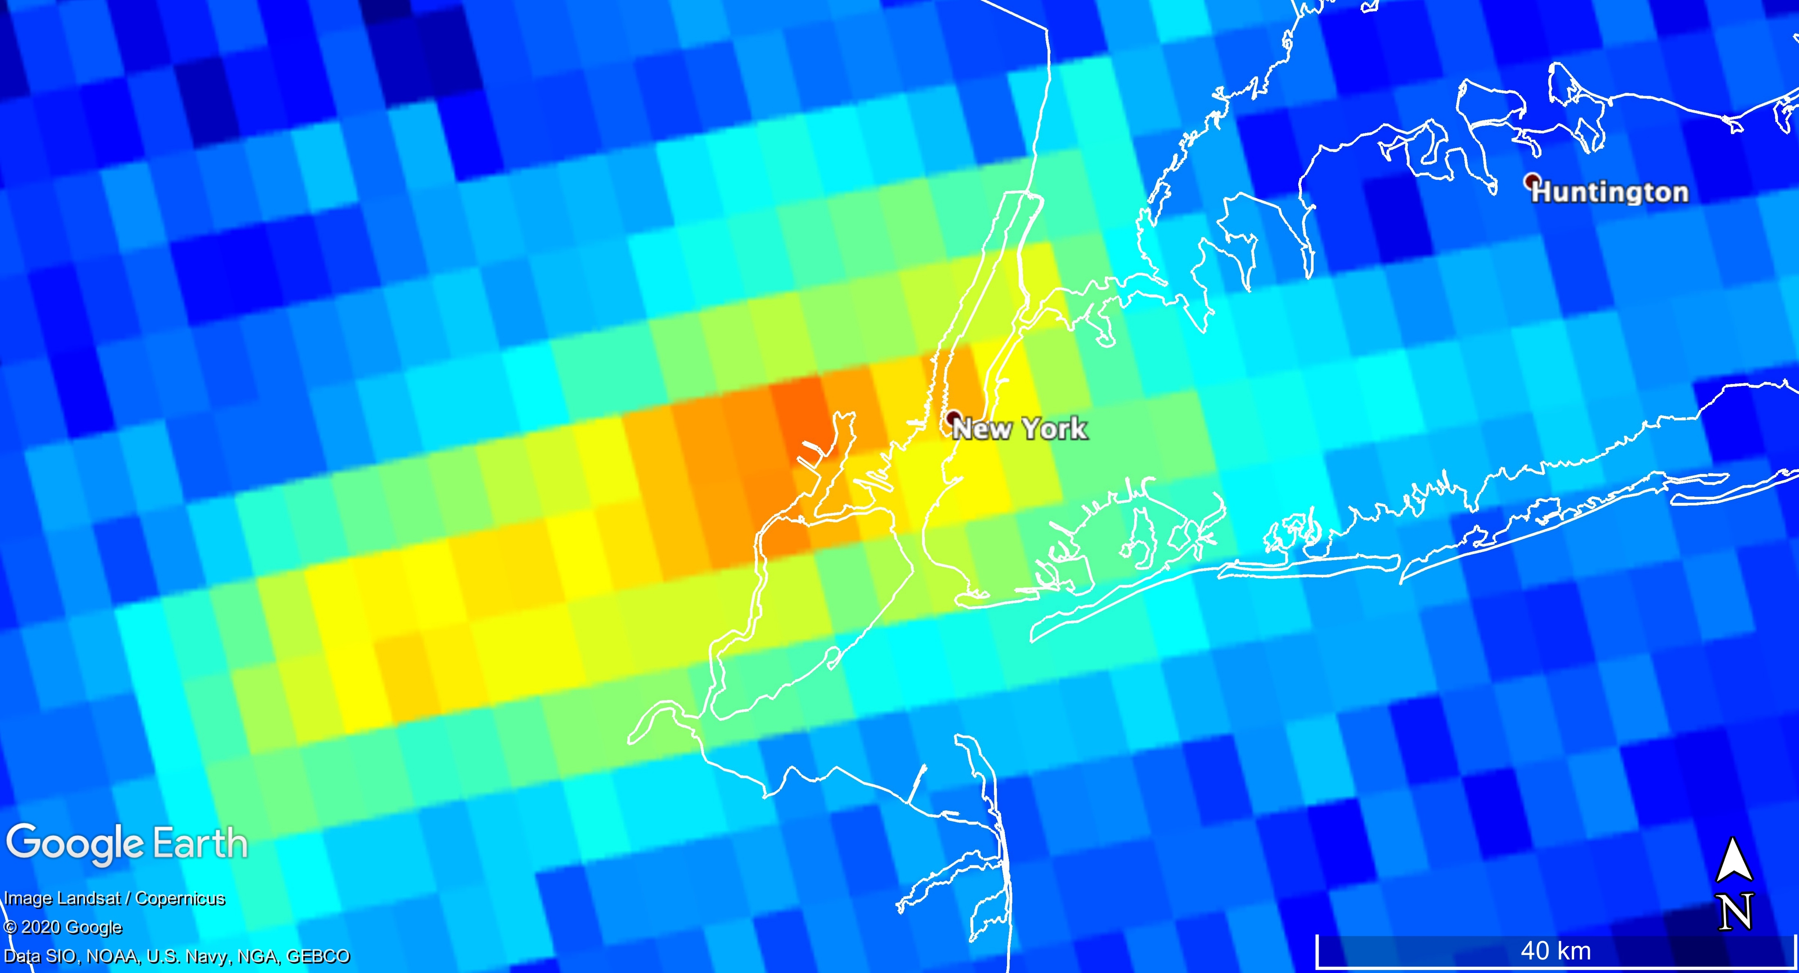
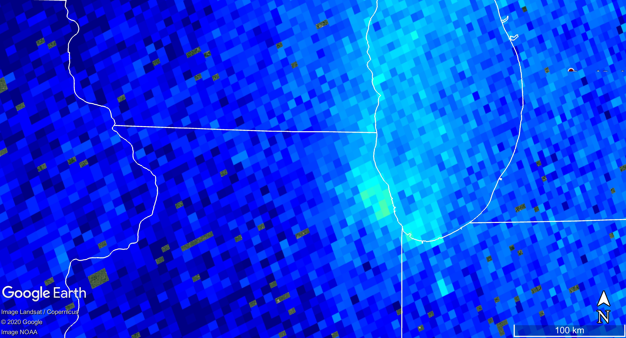
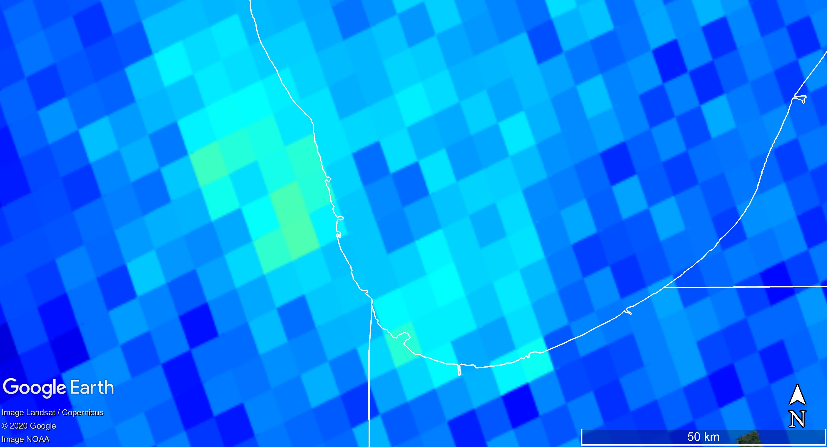
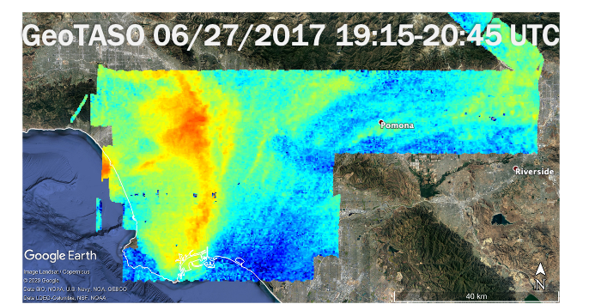
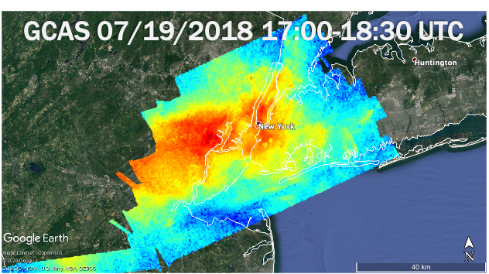
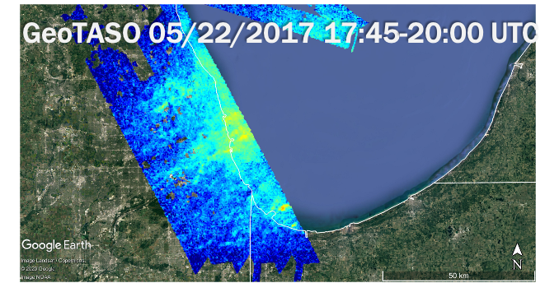
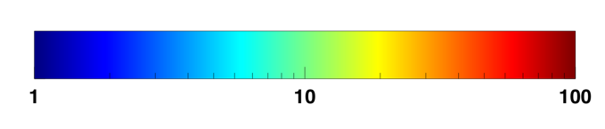
Revealing the capabilities to observe hi-res NO₂
Los Angeles, California
New York City, New York
Chicago, Illinois
TROPOMI 06/25/2018 20:20 UTC
TROPOMI 07/19/2018 18:11 UTC
TROPOMI 07/08/2018 18:37 UTC
*not same date as TROPMI was not yet launched
NO₂ Column (molecules cm⁻² x10¹⁵)
*not same date as TROPMI was not yet launched

Slide 7
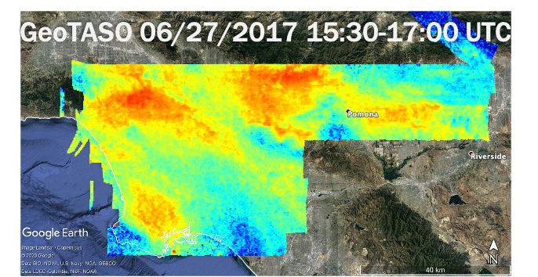
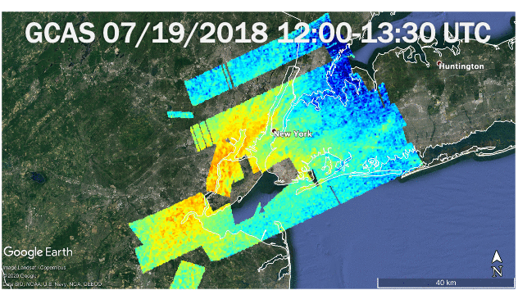
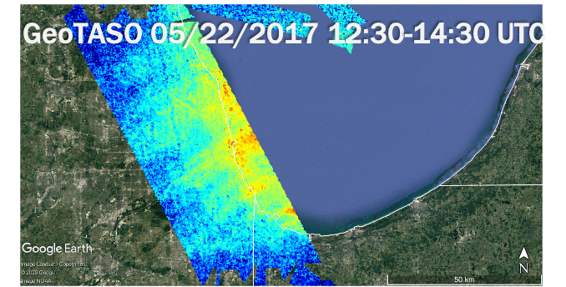
Revealing the capabilities to observe hi-res NO₂
Los Angeles, California
New York City, New York
Chicago, Illinois
TROPOMI 06/25/2018 20:20 UTC
TROPOMI 07/19/2018 18:11 UTC
TROPOMI 07/08/2018 18:37 UTC
*not same date as TROPMI was not yet launched
NO₂ Column (molecules cm⁻² x10¹⁵)
*not same date as TROPMI was not yet launched

Slide 8
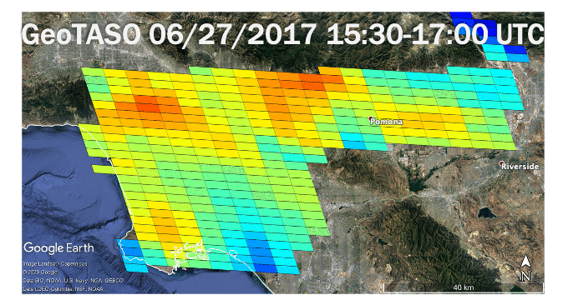
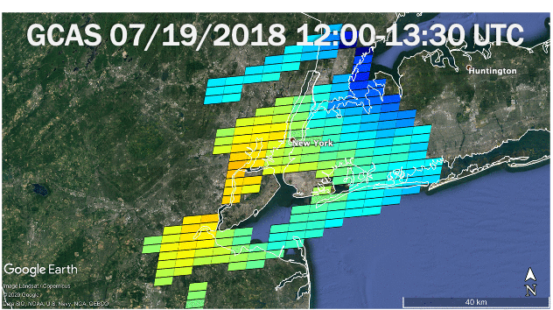
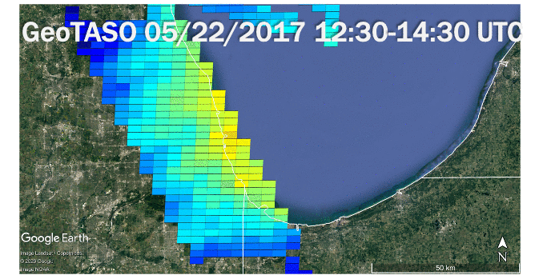
Revealing the capabilities to observe hi-res NO₂
Los Angeles, California
New York City, New York
Chicago, Illinois
TROPOMI 06/25/2018 20:20 UTC
TROPOMI 07/19/2018 18:11 UTC
TROPOMI 07/08/2018 18:37 UTC
*not same date as TROPMI was not yet launched
NO₂ Column (molecules cm⁻² x10¹⁵)
*not same date as TROPMI was not yet launched
Pixel sizes here ~2.5 km x 5 km
TEMPO FOR footprints courtesy of Xiong Liu, SAO

Slide 9
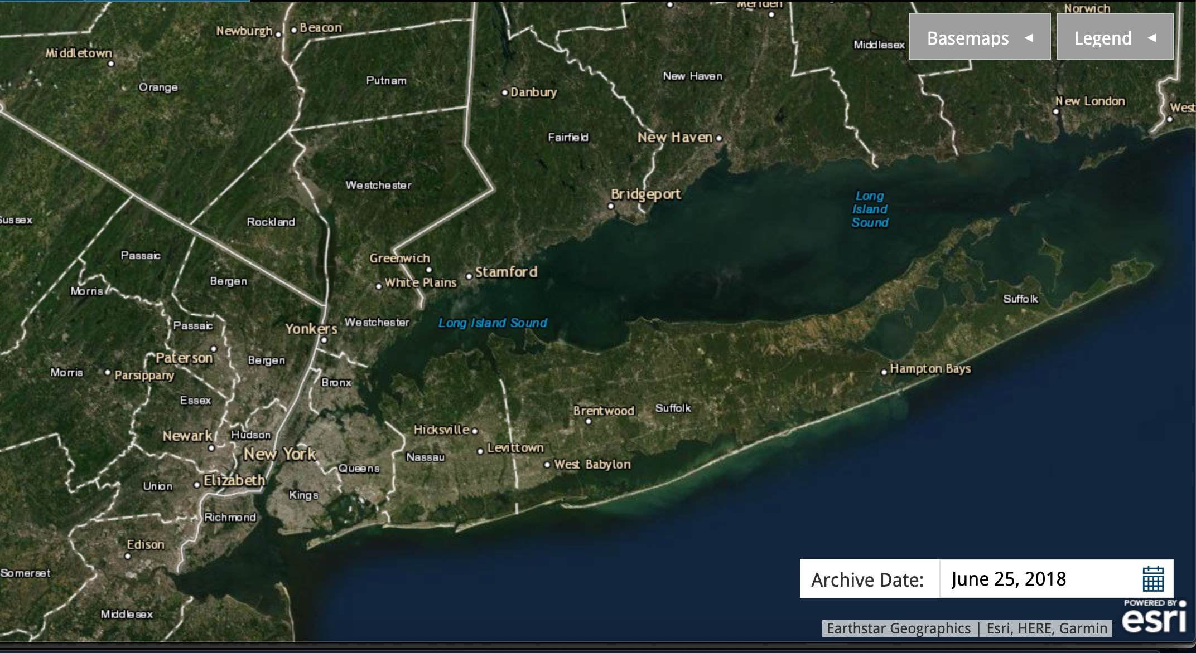
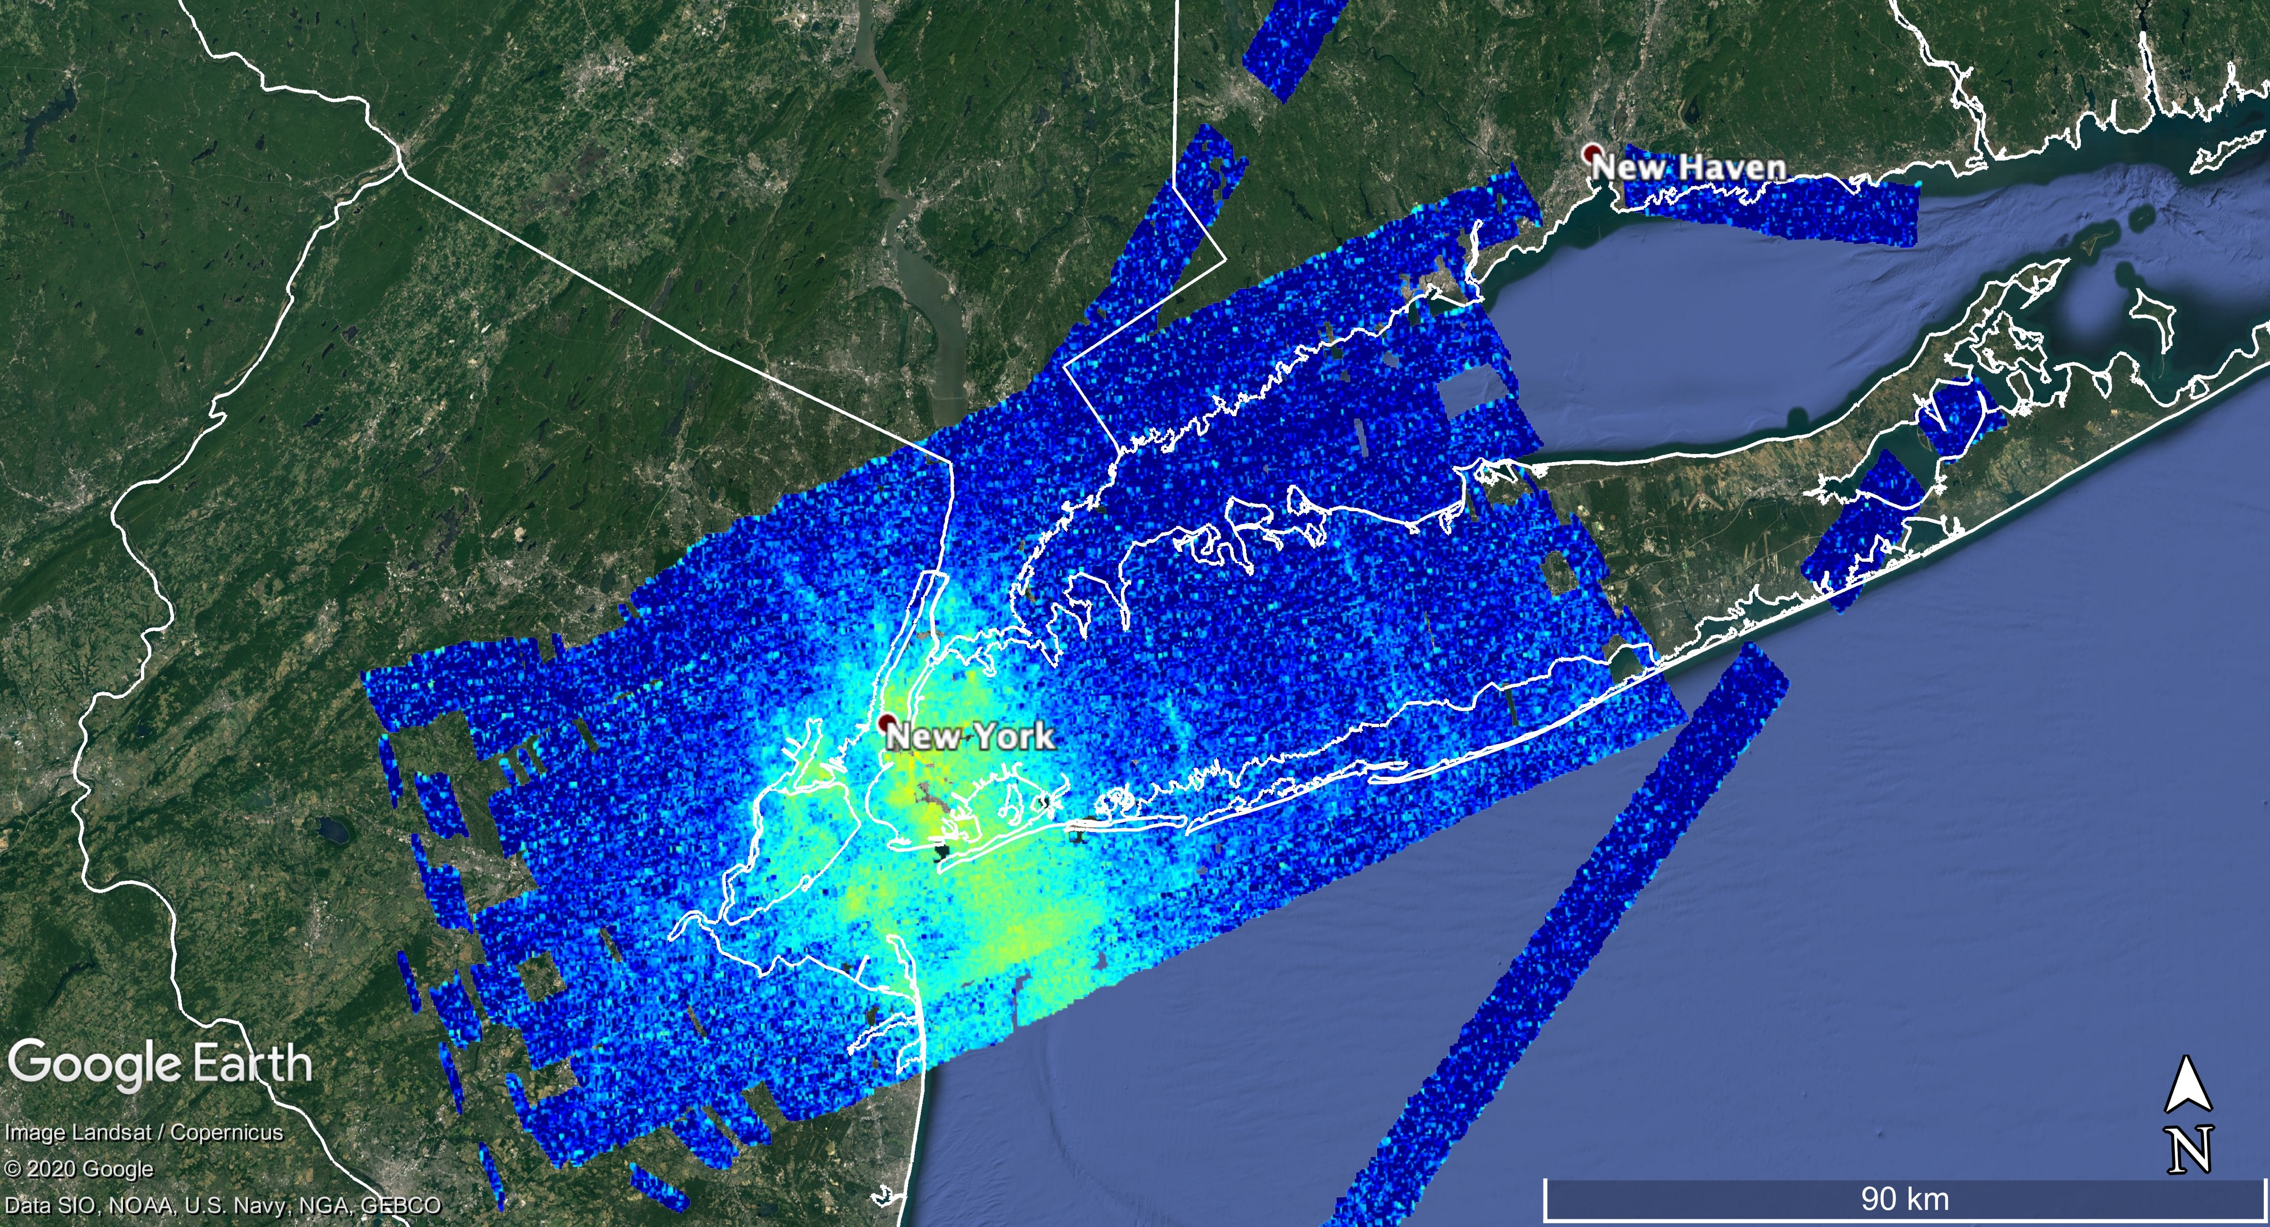
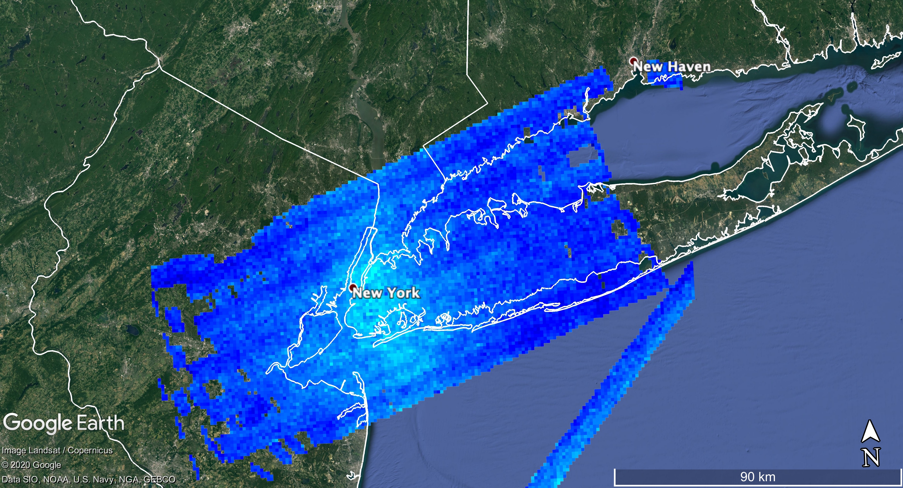
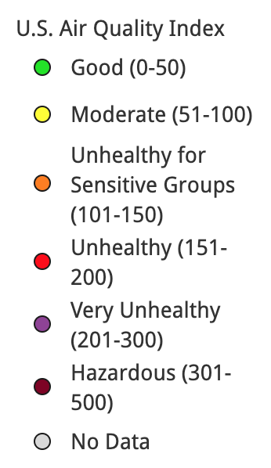
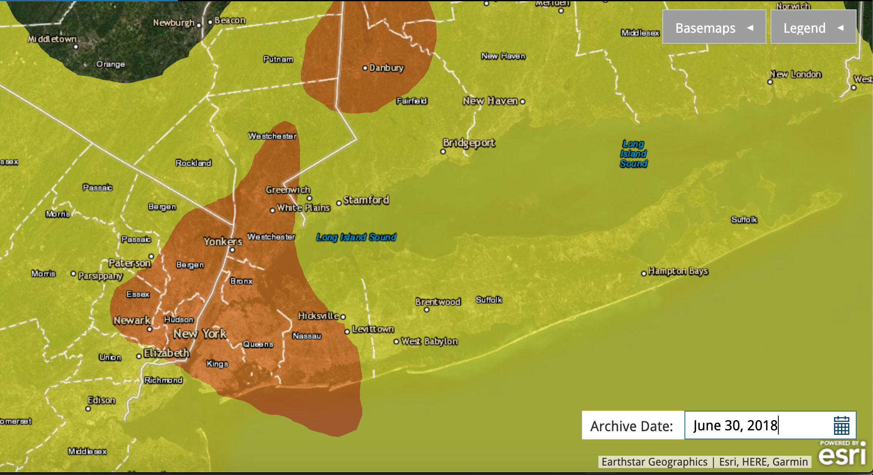
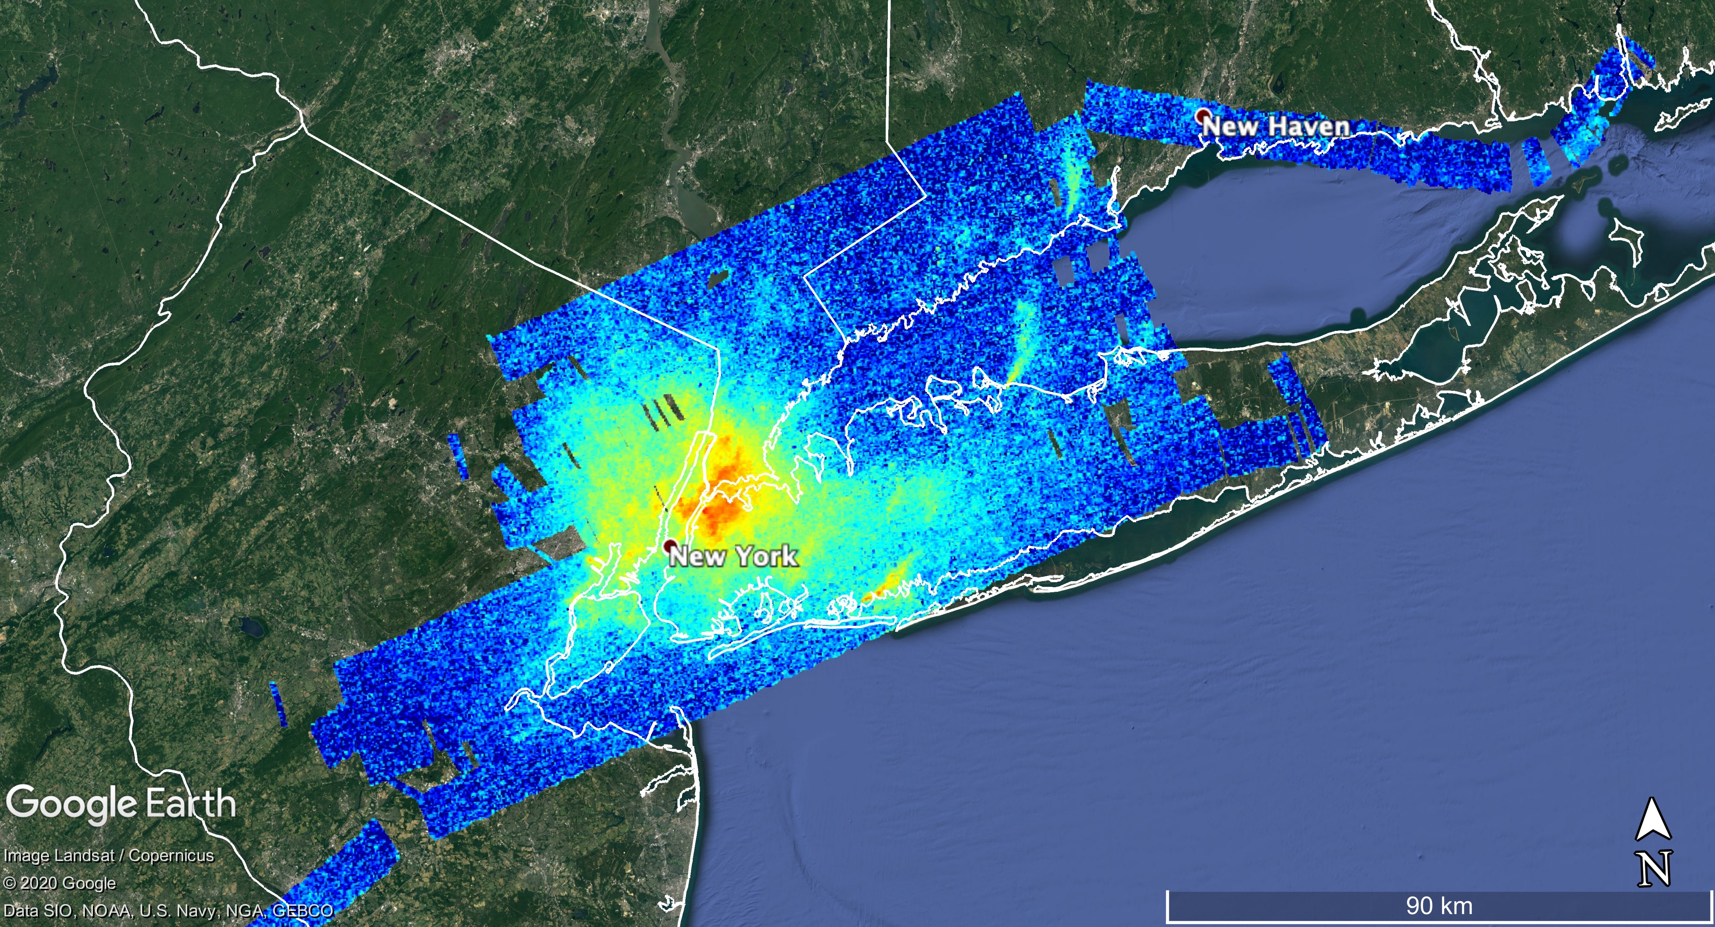
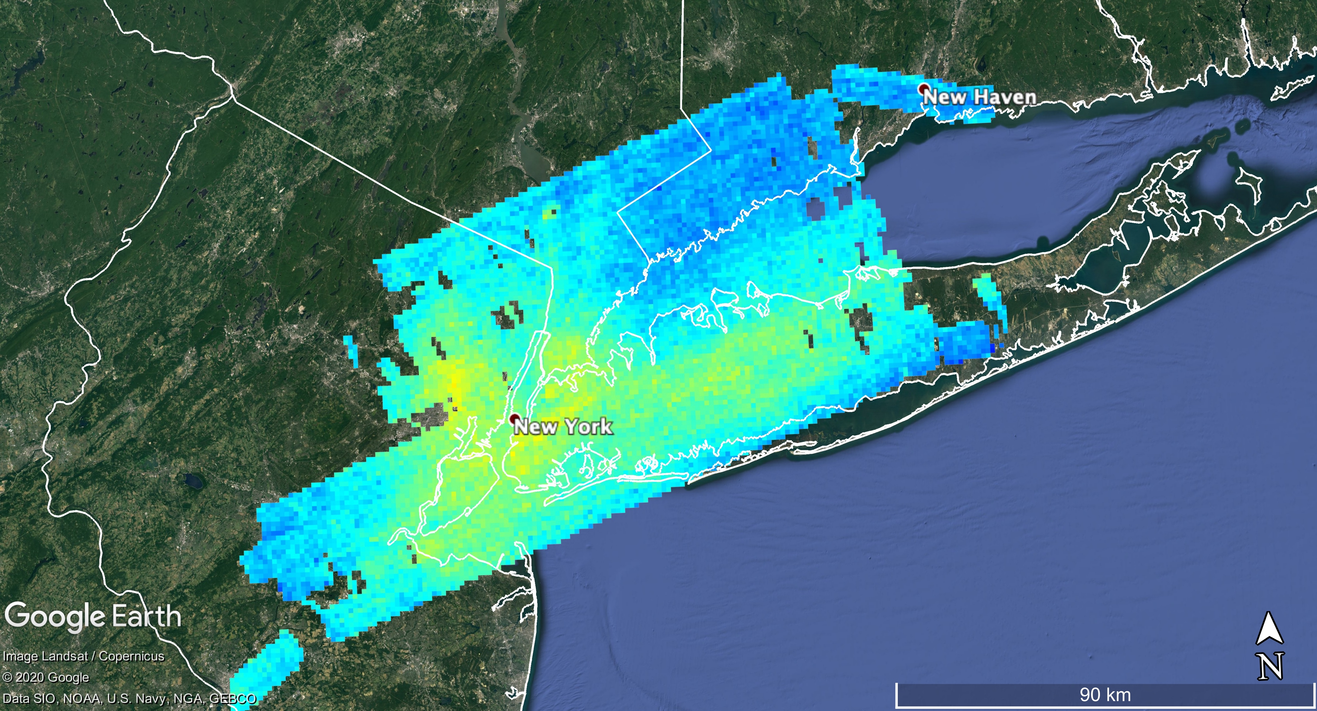
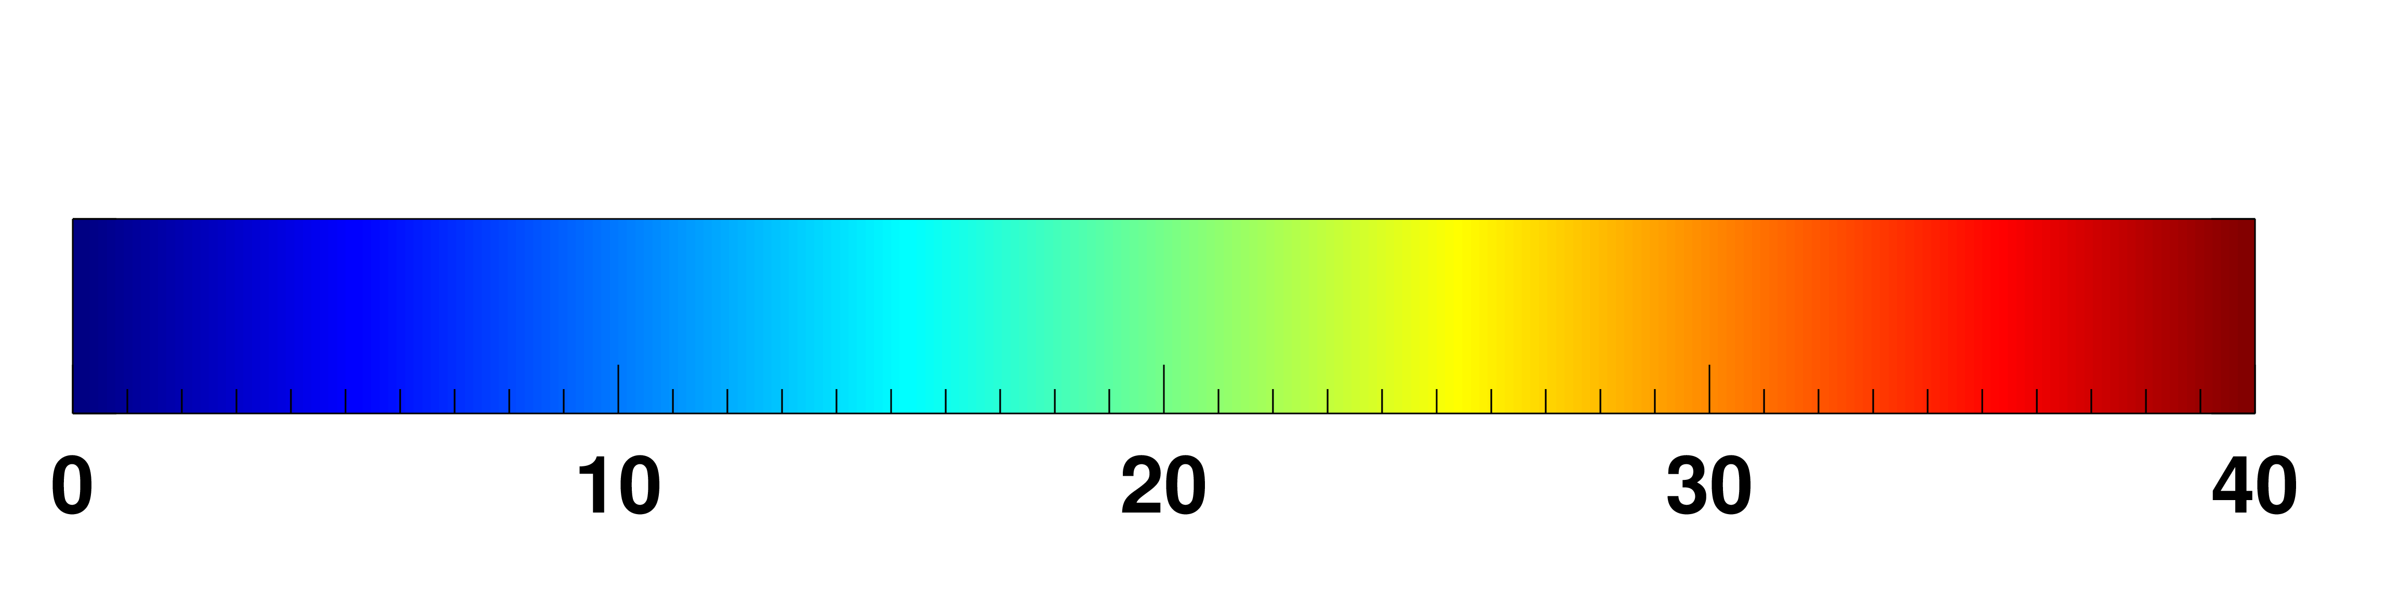
Developing applications with hi-res HCHO columns
2018-06-25 O₃ AQI
2018-06-25 Afternoon NO₂
2018-06-25 Afternoon HCHO
2018-06-30 O₃ AQI
2018-06-30 Afternoon NO₂
2018-06-30 Afternoon HCHO
Source: Airnow.gov
NO₂ Column (molecules cm⁻² x10¹⁵)
HCHO Column (molecules cm⁻² x10¹⁵)
Disclaimer: results of these ideas are not shown here but are being worked on
(1)
HCHO column relationship to surface ozone
(e.g., Schroeder et al., 2016
https://doi.org/10.1002/2016JD025419
(2)
NOx/VOC sensitivity for O₃ production
(e.g., Souri et al., 2020
https://doi.org/10.1016/j.atmosenv.2020.117341)

Slide 10
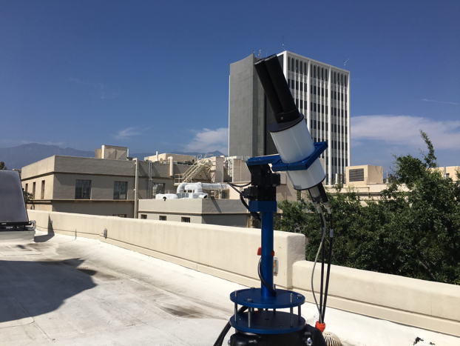
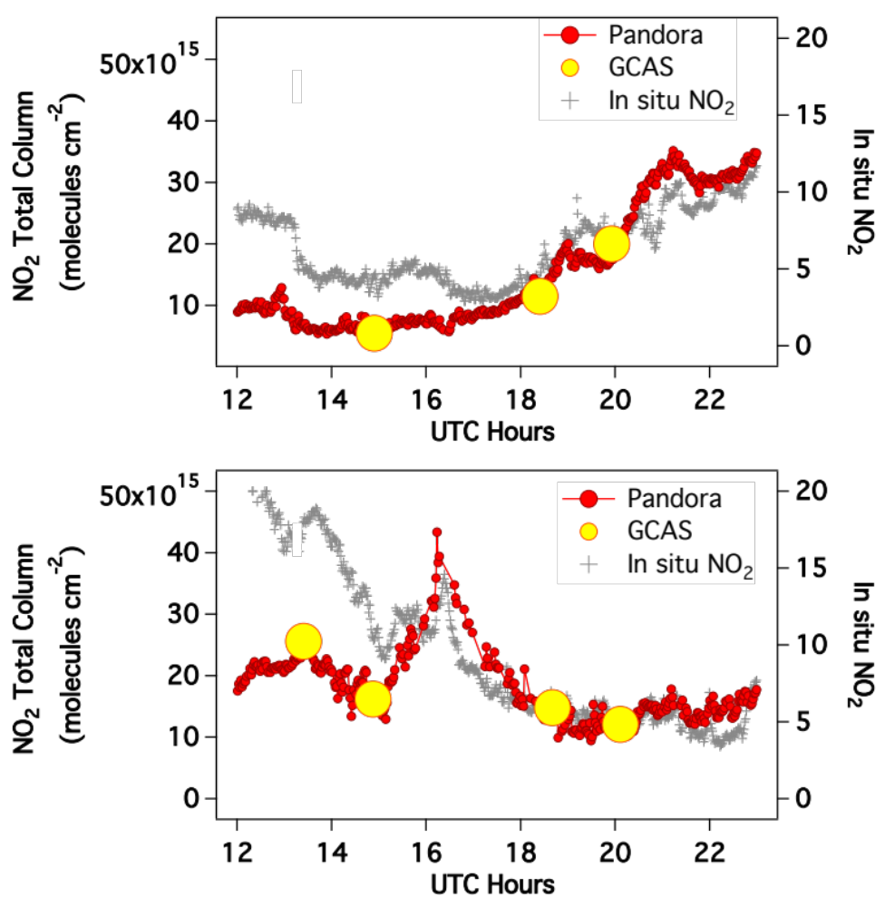
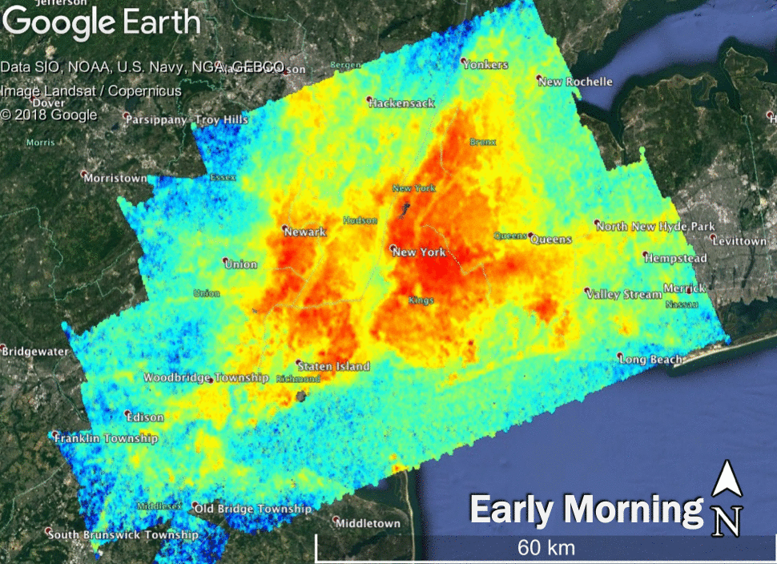
Pandora Spectrometers
  Ground-based UV-VIS spectrometer system collecting spectra in which trace-gas column densities can be retrieved continuously throughout the day.
  Operational products are NO₂ and O₃
  Research products include HCHO and others
Developed at NASA GSFC and is primarily used for satellite validation activities, supporting science through NASA EV Missions and R&A Activities and EPA-PAMS Enhanced Monitoring upper air measurements.
Friday, July 20th, 2018
Bronx-Pfizer
Links: https://www.pandonia-global-network.org/ & https://pandora.gsfc.nasa.gov/

Slide 11
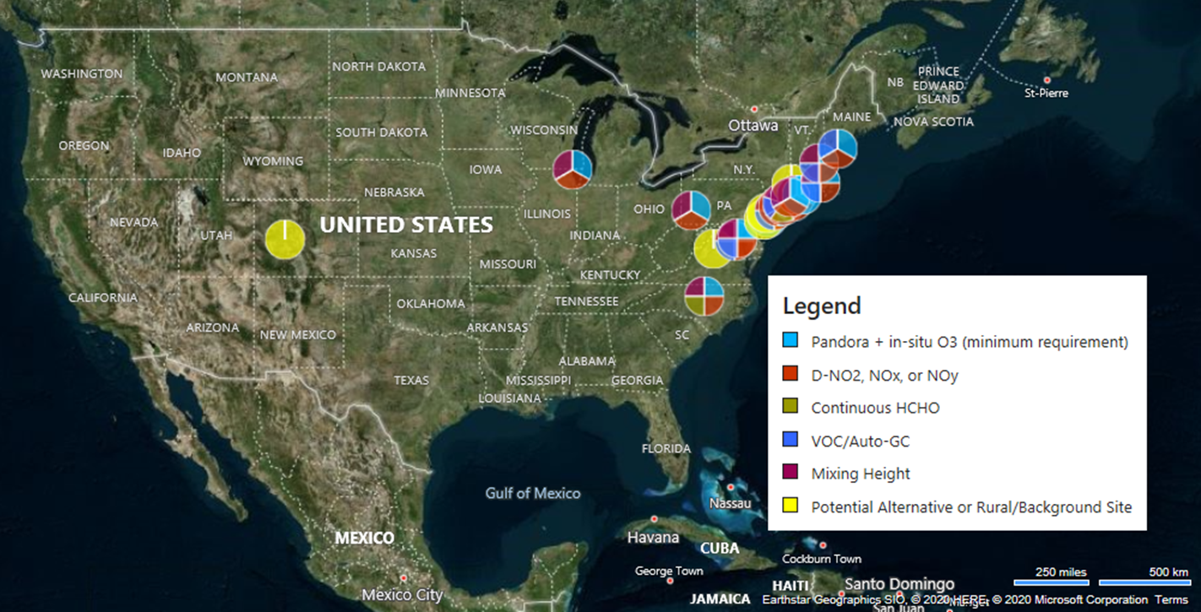
EPA-NASA Pandora Network at U.S. Air Quality Sites
First deployment in the NE Corridor region in 2018
Currently Operating Sites:
Rutgers, NJ
Bronx, NY
Queens College, NY
The number of sites will expand rapidly upon the lifting of restrictions related to COVID-19.
Current and future considerations for site placement are motivated by air quality management and TEMPO
Open to feedback on how you think Pandora + co-located measurements can address issues related to air quality and TEMPO
Flax Pond, NY
New Haven, CT
Chiwaukee Prairie, WI (May 2020)
Map of sites that currently or by the end of the summer (COVID-willing) include Pandora spectrometers colored by available co-located measurements.
Opportunity to add perspective to the understanding local/regional air quality by connecting to the satellite point of view.
Assists with satellite validation/evaluation studies (e.g., TROPOMI and TEMPO)
Contact: Jim Szykman (james.j.szykman@nasa.gov) and Luke Valin (valin.lukas@epa.gov )

Slide 12
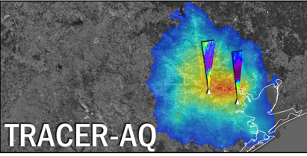
Finishing thoughts
Contact: laura.m.judd@nasa.gov
Airborne research campaign data can be found at
https://www-air.larc.nasa.gov/index.html
Questions about this presentation or data? feel free to contact me (laura.m.judd@nasa.gov)
Doing a research study and you think these capabilities or TEMPO can help?
We want to hear about it!
Upcoming Activities
Summer 2021
GCAS will be used to do similar work for GEMS this fall in South Korea in collaboration with NIER.
First look at geostationary air quality data prior to the launch of TEMPO.
https://www-air.larc.nasa.gov/missions/tracer-aq/index.html

