Slide 1

Supporting Safe, Robust Aerospace Structures Through HPC Enhanced Computational NDE
Elizabeth Gregory & Bill Schneck

Slide 2
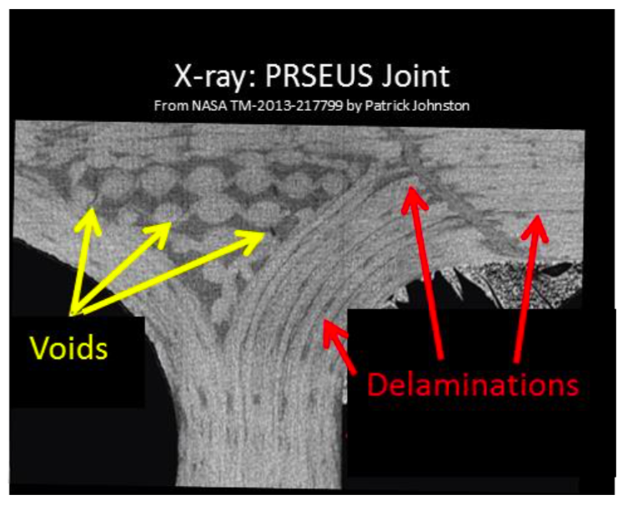
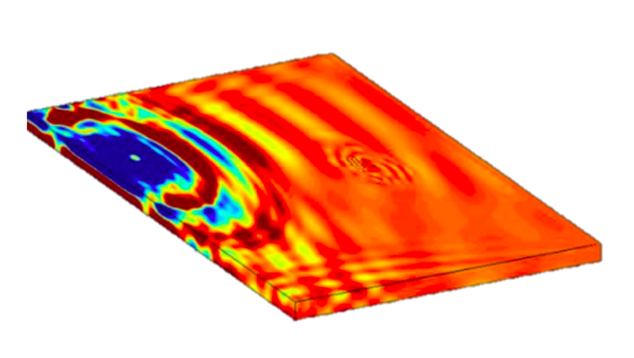
Computational Nondestructive Evaluation
Nondestructive Evaluation (NDE) of Aerospace Structures: Detect, quantify, and characterize damage inside aerospace materials/structures through any method that leaves the structure intact and unchanged.
Computational Nondestructive Evaluation (CNDE): Simulation, modeling, and data analysis tools to aid in the NDE process.
Value to NASA:
Modeling
        Provides NDE information during the design stage leading to inspectable and optimal designs.
        Makes it feasible to study a large number of damage and flaw cases to establish confidence in inspectability.
        Cost effective method to develop optimized inspection techniques.
Data Analysis
          Reduces inspection time and cost.
          Illustrates non-obvious trends and relationships.
          Can remove subjectivity of human interpretation.
          Connects with modeling to inform decision making.

Slide 3
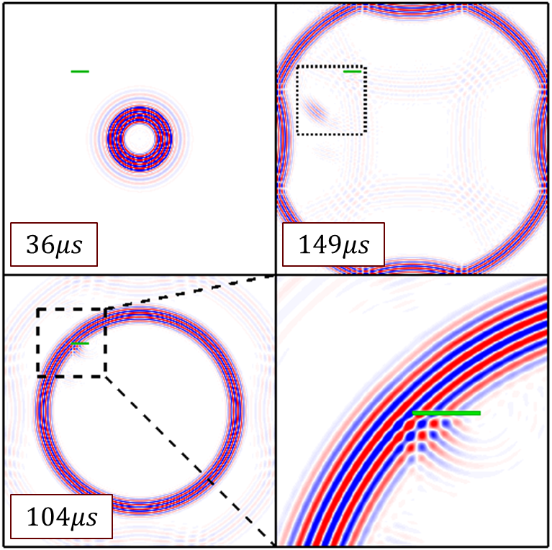
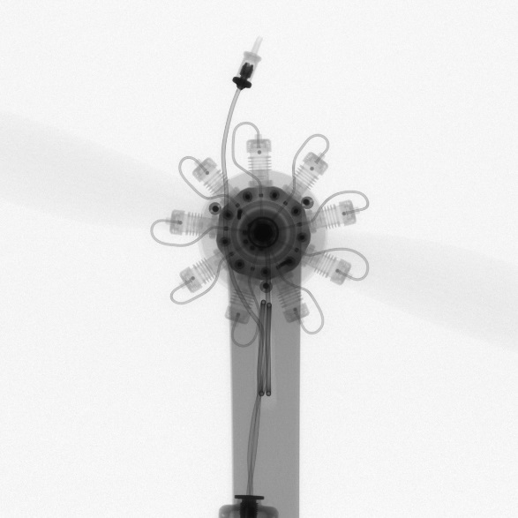
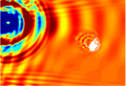
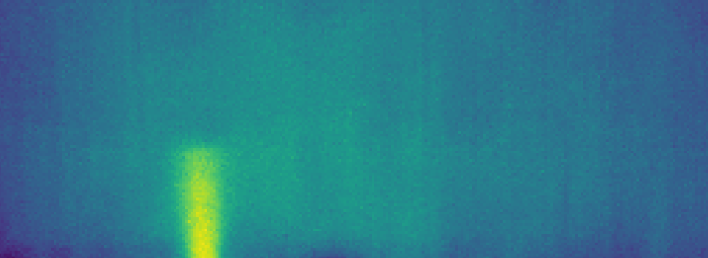

Ultrasound Inspection Simulation CompCell EFIT
Elastodynamic Finite Integration Technique optimized for Intel Xeon Phi Knights Landing processors
Cannot handle anisotropic heterogeneous media (e.g. composites)
X-Ray CT Ray Tracing
A simplified interface layer for scientific ray-tracing has been implemented as an available library for additional ‘app’ development.
RSG
3D staggered grid time-domain finite difference
C++ code with MPI parallelization, CPU kernel validated with GPU kernel under development
Natively handles 3D fully anisotropic heterogeneous media
Data Fusion and ML/AI
Automated Analysis of many GB of thermographic data from Automated fiber placement (AFP), quickly.
Tensorflow with python real-time processing.

Slide 4
Ultrasound Simulation

Slide 5
Ultrasound Testing Simulation for NDE
Ultrasonic elastic waves excited using transducer, piezoelectric wafers, pulse laser, or other methods.
Elastic waves interact with defect/damage, propagating with damage information.
Detection of these waves using a piezoelectric transducer, fiber optic sensor, non-contact laser Doppler vibrometer, etc.
Simulation can:
  Provide insight into underlying interaction phenomena and energy paths.
  Predict and quantify energy-damage interaction.
  Identify features correlated with relevant parameters.
  Optimize inspection setup.
  Provide confidence in inspection results.

Slide 6
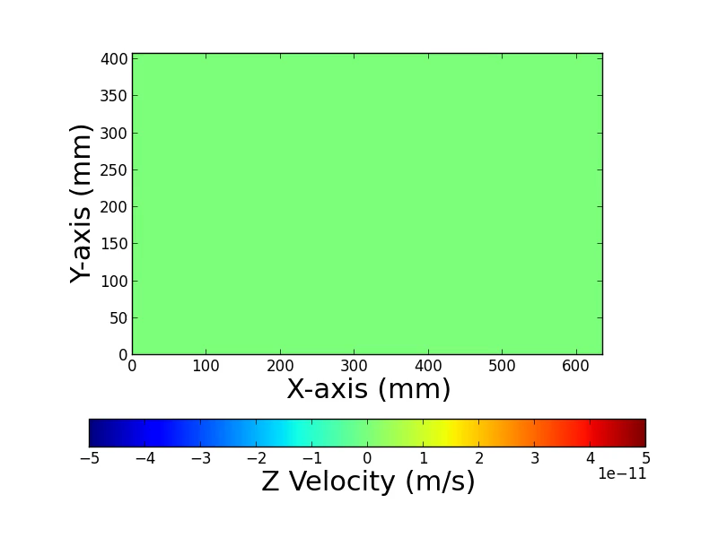
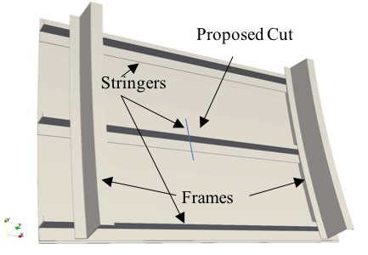
EFIT CompCell Ultrasound Simulation Code
EFIT - Elastodynamic Finite Integration Technique: 2nd order Finite Difference scheme
CompCell: 3D modular code version of EFIT aimed at complex geometries and written in C++
Works well for isotropic and orthotropic materials
Used to simulate a crack in a stringer of an Aluminum fuselage panel in collaboration with the FAA.
Scaled well for medium to large problems.
Not appropriate for anisotropic materials or small problems that result in too much communication.

Slide 7



Rotated-Staggered Grid Ultrasound Simulation Code
Development began under the Advanced Composites Project (ACP).
Computational tool that models the physics of an ultrasound (UT) inspection
  3D staggered grid time-domain finite difference
  C++ code with MPI parallelization, CPU kernel validated with GPU kernel under development
  Natively handles 3D fully anisotropic heterogeneous media
Solves stress-velocity elastodynamic equations, 2nd order accurate in time and space.
$ρ∂_{t}v_{i}$= $∂_{x_{j}}σ_{ij}+f_{i}^{v}$
$∂_{t}σ_{ij}=c_{ijkl}∂_{x_{l}}v_{k}+f_{ij}^{σ}$
$σ_{xx},σ_{yy},$ $σ_{zz}$
$$τ_{xz, }τ_{yz, }τ_{xy }$$
$$v_{x},v_{y},v_{z}$$
Repeating unit cell for ultrasound simulation algorithm – rotated staggered grid (RSG) finite difference
Additive Manufacturing (AM) Applications
Exploration of flaw parameter space and microstructural effects on UT inspection
Guiding the emergence of novel UT techniques for AM part inspection
Help define limits of inspectability as relevant to effect-of-defect analysis
General Capabilities
MPI parallelized, highly optimized solver
Verified and validated for a range of general elastodynamic cases

Slide 8
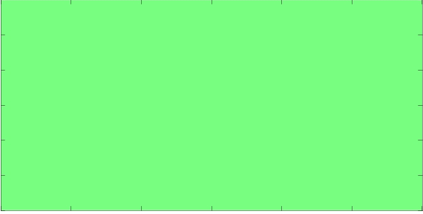
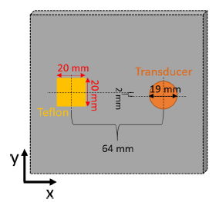
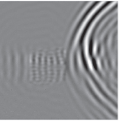
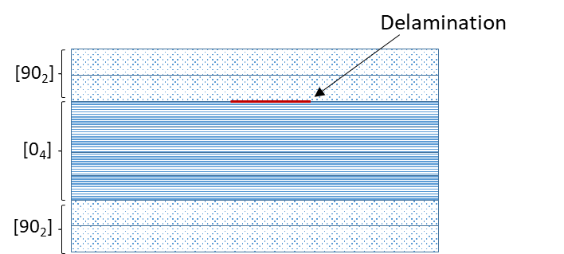
Benchmark Case – Delaminated Composite Plate
Experimental, FEM, and in-house code benchmark for composite laminate
  Delamination between 2nd and 3rd ply
  Experimental data full wavefield capture via laser Doppler vibrometry
Quantifiable velocity and wavenumber changes above delamination observed via simulation and experiment
v_{z} surface wavefield, RSG simulation code
Experimental Wavefield data
Run time comparison with COMSOL, Abaqus, ANSYS
 | T_{run} (hours) | # DoF (10⁶) | Memory (GB)
COMSOL | 19.5 | 7.77 | 266
ABAQUS Implicit | 40 | 1.7 | 28
ABAQUS Explicit | 53 | 26 | 30
ANSYS | 170 | 10 | 16
RSG | 0.15 | 16.6 | 4.6
Between ~130-1100 times faster simulation time for converged model, using comparable compute resources
Leckey, Cara AC, et al. "Simulation of guided-wave ultrasound propagation in composite laminates: Benchmark comparisons of numerical codes and experiment." Ultrasonics 84 (2018): 187-200.

Slide 9
Data Fusion, Analysis, and Machine Learning for In Situ Thermographic Inspection

Slide 10
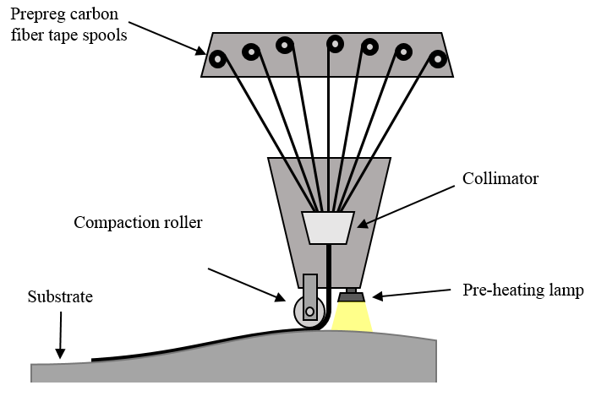
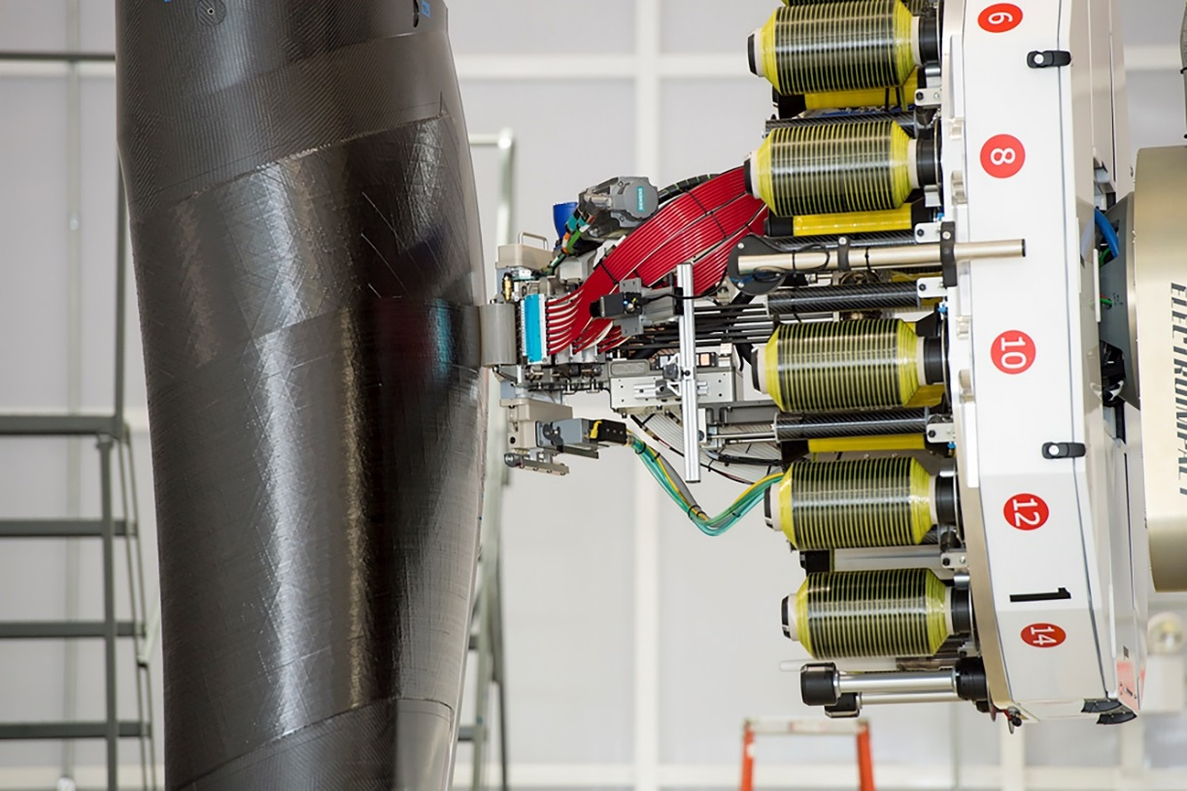
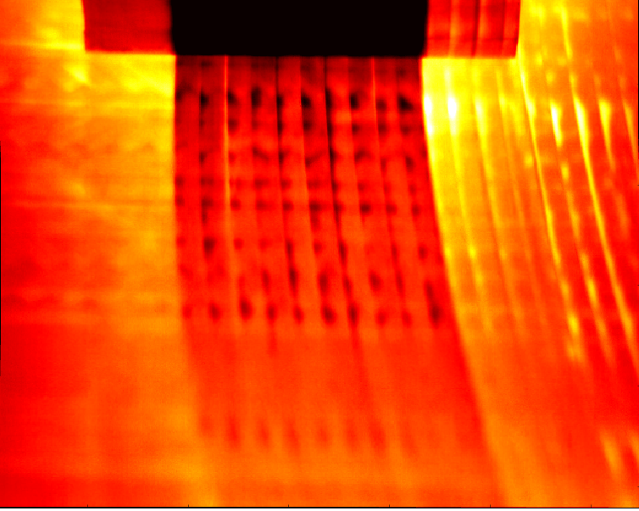
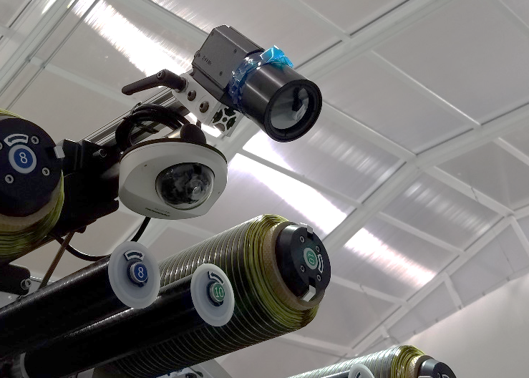
In Situ Thermographic Inspection System (ISTIS) of
Automated Fiber Placement
Faster than traditional hand layup methods, less scrap waste
Better repeatability
Advances in robotic automation can enable rapid prototyping and more complex structures
Added IR camera is minimally invasive.
Uses AFP head for power and communication.
Results in 100s of GB of data for a single part.
Shows:
  Tow Overlaps and Gaps.
  FOD
  Peel-up
  Tow Twists
Notes:
Brief overview of what AFP is and the advantages it offers

Slide 11
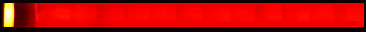
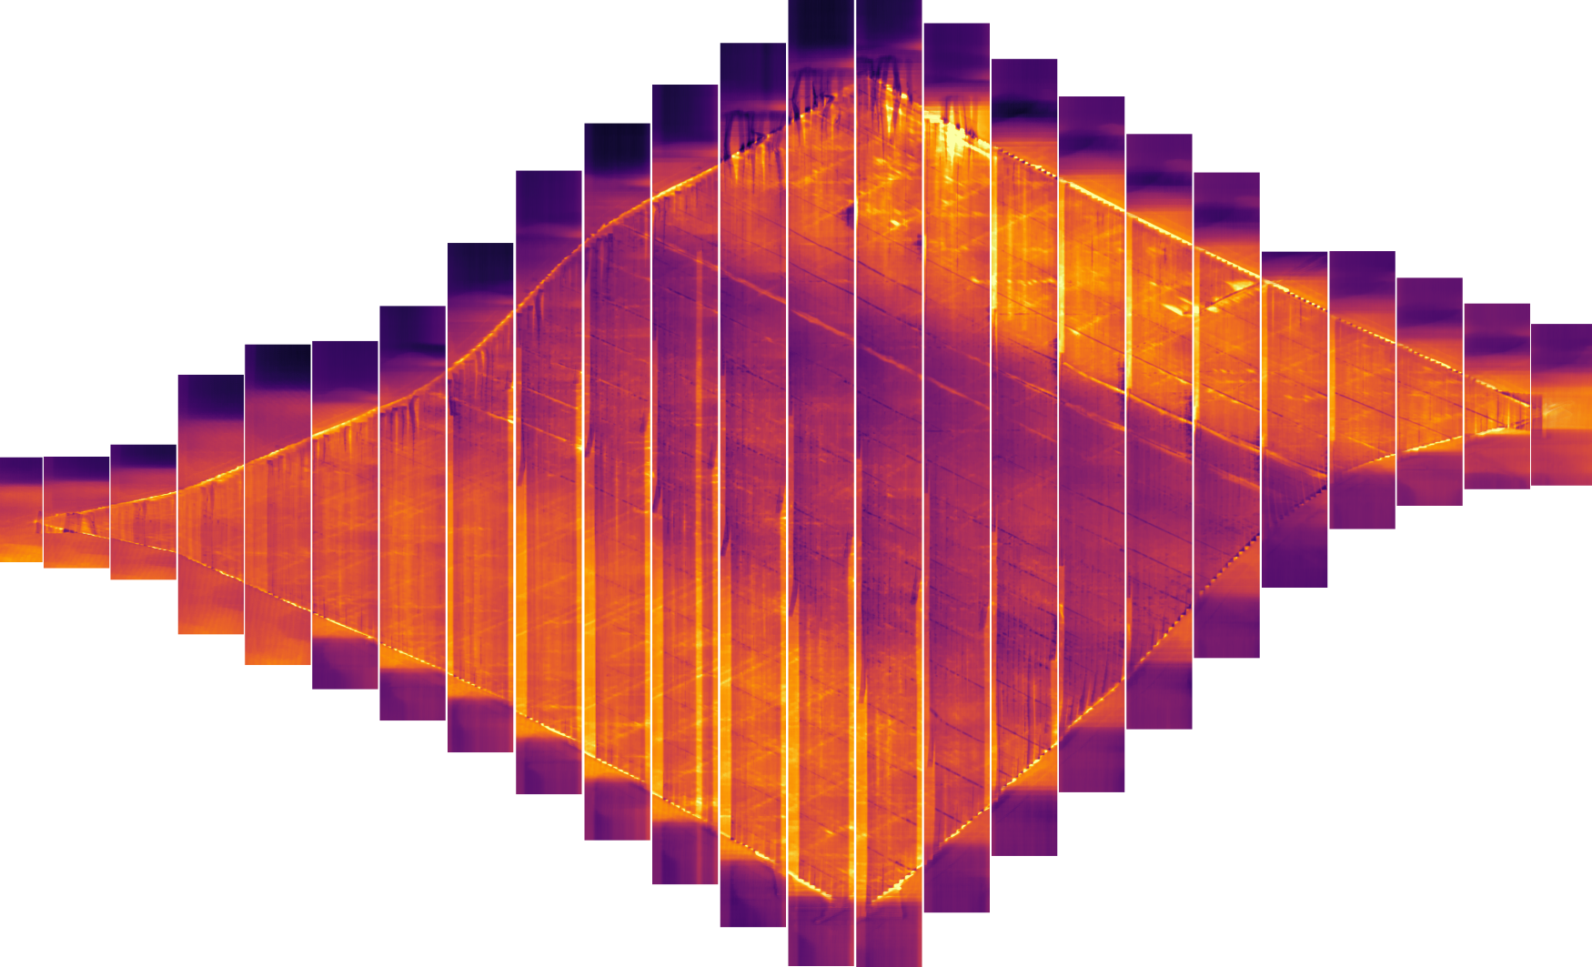
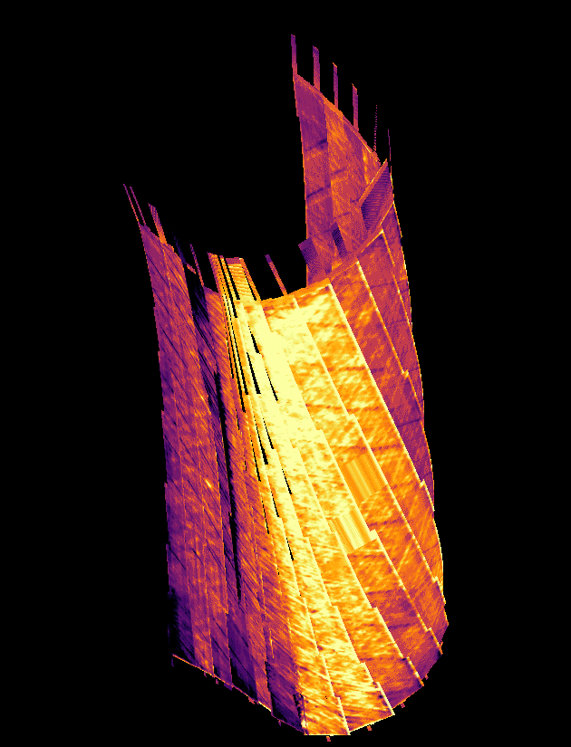
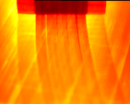
Data Registration and Fusion
Large scale data (~100GB) processing required for real-time analysis
Optimized, rapid code is required
Frames
Courses
2D Plies
3D Plies
Snapshots
Time histories
Registration in Space and Time

Slide 12

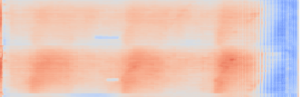
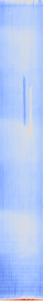
Machine Learning for Labeling and Localization
Lap/Gap pair
FOD
disks
Machine Learning Techniques
  Convolution Neural Networks for Labeling
  Clustering for Segmentation
  Encoder and Decoder for Segmentation and Labeling
  Edge Detection
  Background Subtraction
Optimized code required for real-time analysis.
Data Labelling services
  AWS SageMaker Ground Truth
  Google Cloud Data Labelling
FOD
strips

Slide 13
Impact of Fast HPC Code:
CNDE Physics Simulations (ultrasound & X-ray mini-apps)
  Fast code enables use of simulation tools to identify inspection solutions for NASA's unique inspection challenges
    Rapid simulations (running in less than 60 seconds) is a requirement for many optimization methods (such as HPC based Monte Carlo)
  Quick iterations enable robust exploration of the problem space, reducing risk
  Parameter exploration enables solving the ‘inverse problem’ for improved damage/defect characterization
Large Scale Data Analysis
  Data-informed decisions are enabled by ability to rapidly analyze very large datasets to yield quick and robust identification of trends and features.
  Provides insight at the time of data collection instead of hours or days later.
  Machine learning is only possible with efficient HPC based code

Slide 14
The Path Forward
X-Ray CT: Continuing model development under the Convergent Aeronautics Solutions (CAS) - Sensor-based Prognostics to Avoid Runaway Reactions & Catastrophic Ignition (SPARRCI) project to model Lithium metal battery X-Ray inspections.
Ultrasound Simulation: Transformational Tools and Technologies (TTT) is using ultrasound simulation code (RSG and components of CompCell) to simulate inspection of additively manufactured (AM) parts to enable faster certification of AM parts.
ISTIS: Advanced Air Transportation Technology (AATT) is using ISTIS for AFP process development and AFP part inspection.

Slide 15
Lessons Learned
Trade names and trademarks are used in this report for identification only. Their usage does not constitute an official endorsement, either expressed or implied, by the National Aeronautics and Space Administration

Slide 16
HPC Software Ecosystem
Build Tools
  CMAKE® (of Kitware, Inc.) greatly improves portability and build consistency
    Learning curve: gcc -> shell scripts -> make -> CMAKE® (of Kitware, Inc.)
    Directly calling gcc on anything much more sophisticated than HelloWorld.c gets complicated!
    Directly writing shell scripts and make files becomes cumbersome for projects of even a modest size or complexity.
External Libraries
  Difficulty: Learning curves and documentation difficulties
  Benefit: Allows focus on core elements of current software
    Example: 1D partitioning vs using Metis

Slide 17
Collaboration and Portability and Continuous Integration and Testing
Use version control to collaborate and share.
Use workflows to prevent conflict and maintain functionality.
Establish style guidelines for the team (inherit from another guide).
Interface control documentation for components.
Select a testing framework or combination of testing frameworks.
  CMAKE® (of Kitware, Inc.)
  PYTESTSM (of H. Krekel, et al.)
  GOOGLETESTSM (of Google, LLC)
If you can’t test it, it is bad code.
Test often.
Master
Development
Feature
Feature

Slide 18
‘Clean’ Development
Technical ‘debt’ is real!
  Bad architecture and/or bad code causes greater difficulty down the road!
Poorly thought out architecture results in monolithic, brittle code bases
  Changes and new features become exponentially increasingly difficult to produce
Bad code results in hard to read, hard to reuse, hard to validate software
  Limited reusability results in many re-invented wheels -> inefficiently used time
  Difficulty to read means less reuse due to coder apprehension regarding functionality
  Poor validation leads to lack of confidence in actual use cases of software -> ultimately, software goes unused

Slide 19
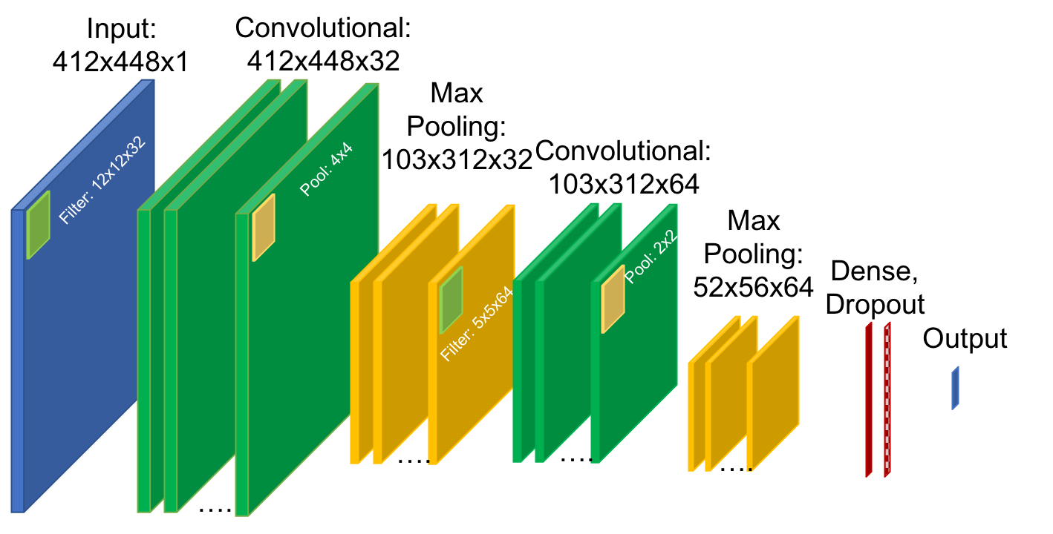
Machine Learning and AI Tools
Use Virtual Environments in python on K-cluster to maintain package compatibility. (matches Pleiades environment)
Use cloud computing resources when applicable to leverage their ML/AI environments.
Services:
KERASSM (of F. Chollet, et al.)
PyTorch
TENSORFLOW® (of Google, LLC)
GOOGLE® (of Google, LLC) Cloud
AMAZON WEB SERVICES® (of Amazon Technologies, Inc.)

Slide 20
EFIT CompCell Ultrasound Simulation Code
EFIT - Elastodynamic Finite Integration Technique
  2nd order Finite Difference scheme
  Works well for isotropic and orthotropic materials
CompCell
  3D Modular code version of EFIT aimed at complex geometries and written in C++
  Allows easy discretization of complex geometry
S_{y}
S_{x}
V_{x}
𝚫n
S_{z}
T_{xy}
V_{Y}
V_{Z}
T_{xz}
T_{yz}
Velocities, Normal and Shear Stresses
ρ = density
λ & μ = Lamè parameters
  Prevents wasted memory on empty space (i.e., memory efficient)
  Uses pointers to modularize the EFIT equations
  Uses MPI and OpenMP for parallelization
Voxel Cell Object
Material Coefficients
Boundary Definitions
Pointers
  Own Values
  Neighbor Values
Arrays of Stresses and Velocities for Entire Volume

Slide 21
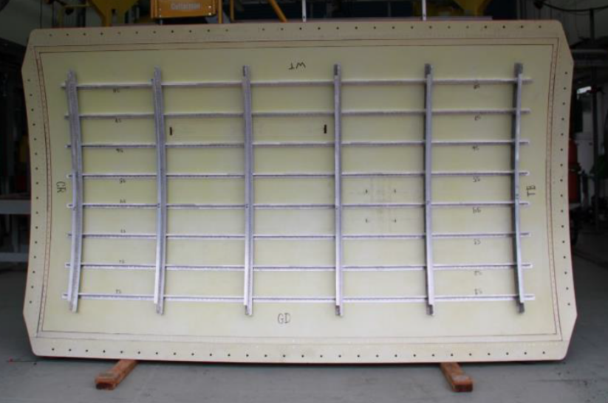
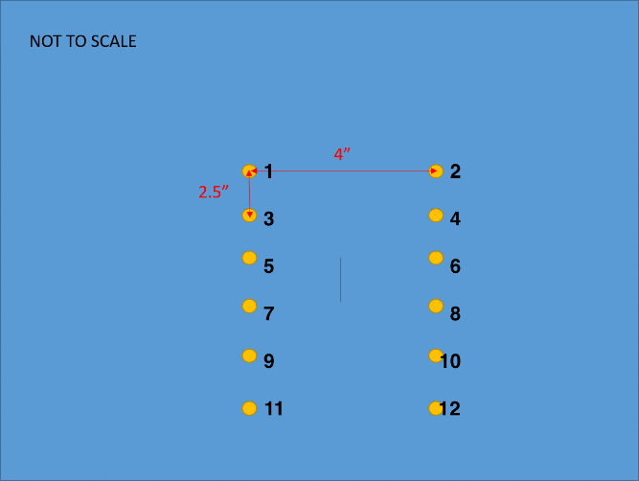
FAA Panel & Simulation Case
FAA AL 2024-T3 panel
  3.175 m (125 in) long by 1.85 m (73 in) wide
  Skin thickness = 1.6 mm
  0.1 mm wide 60 mm long vertical cut (‘crack’)
Simulation case: 2 bays of the panel
  Δx = 0.1 mm, Δt = 7.9 ns
  200 kHz excitation
  8 hour run time on 400 cores Xeon 6148 Skylake
Vertical Cut = 0.1 mm wide 60 mm long
73”
Image from FAA
Notes:
Because of the internal air pressure for loading, they have to seal the saw cut and crack with a material that keeps the air from escaping. It looks like they are putting on some type of sticky tape on the stringer which was also severed with the saw cut. The clamps are used to ensure a good seal.

Slide 22

Results

Slide 23
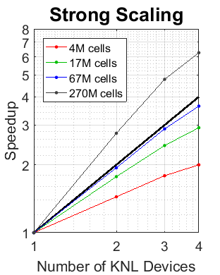
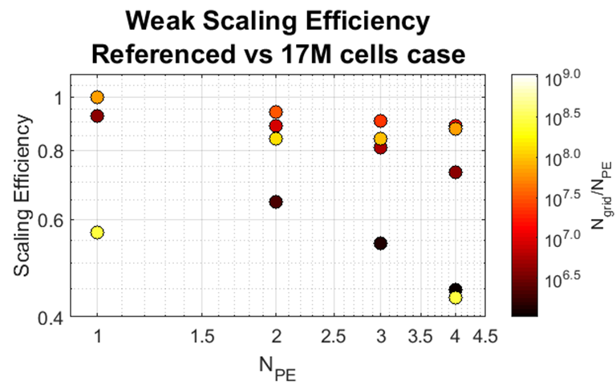
Scaling
Weak Scaling:
  “More hardware=bigger problem”
  Weak Scaling is good for mid-sized problems (orange/red), bad for really big/small (yellow/black)
    Small problems: too much communication compared to compute volume
    Big problems: very large messages, sent from ‘slow’ system memory
Strong Scaling:
  “More hardware=faster solution”
  Superscalar performance observed with large problem (problem size per node drops enough to work from cache)
  Very subscalar performance observed for small problems (too much communication)
Weak scaling efficiency. Small problem sets have insufficient amortization of communication overhead and large problem sets require accesses to larger, slower memory. The weak scaling efficiency was normalized to the timing of a single node 17M cell case.
Strong scaling performance. Superscalar performance gains are found for very large working sets, worse scaling performance is found for very small working sets.

Slide 24
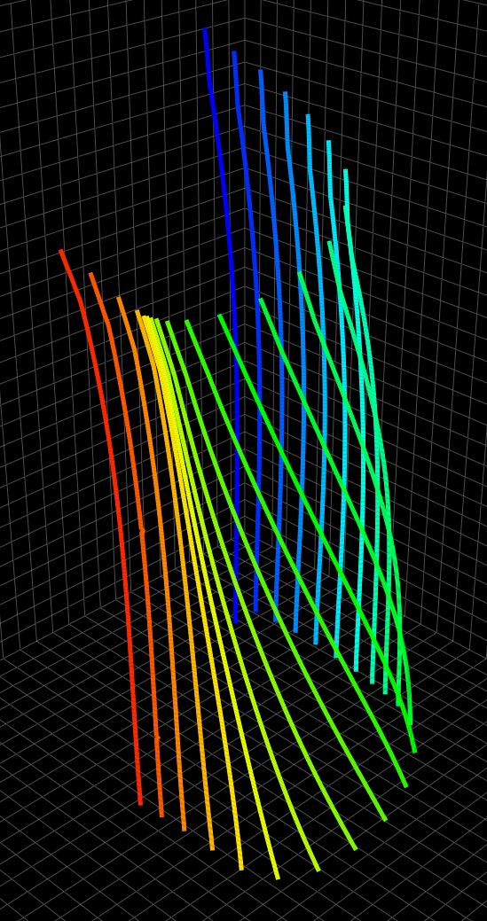
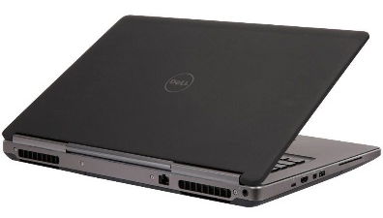

ISTIS Architecture
Each frame has meta data associated with it such as location, orientation, course width, etc
Data represented as 3D model
Post processing algorithms
Trigger_List.tsv

Slide 25
DBSCAN CLUSTERING
Uses Euclidian distance to form clusters.
Operates on individual frames or reconstructed plies.
Speed up scales directly with number of processes used.
MPI for C++ code
Mpi4py for python implementation.

Slide 26
Total Simulation Performance
Simulation Parameters:
  2000x2000 pixel detector
  3142 projections
  Full-domain 1414x1414x1414 voxel reconstruction volume
2.5 – 3 min simulation wall-time
  ~40 sec for actual computation of all 3142 X-Ray projections
    Peripheral processes (file I/O, resource allocation, etc.) are candidates for further optimization
    Commercial software performance requires very long [~1 day] runs
      Compute kernel: ~2200x speedup
      With peripheral processes: ~400x speedup
  Key enabler for iterative analysis
CAD Geometry
X-Ray Inspection
2.5-3 minutes
CT Reconstruction
Notes:
More performance speedup info

Slide 27
X-Ray Simulation

Slide 28
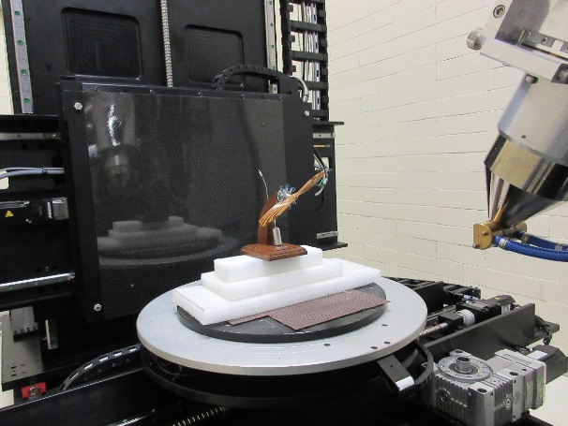
X-Ray CT Inspection
X-Ray source
X-Ray CT provides a ‘Gold-Standard’ 3D representation of the internal structures and flaws of an inspected part
X-Ray Projections:
  An X-Ray source emits radiation that passes through an object under inspection
  Object attenuates the ray intensity
  Ray intensity is captured by the detector, producing a projection of the object
CT reconstruction:
  Convert projections to 3D model
Interrogated object
X-Rays
projection of object
X-Ray detector
Notes:
Introduce

Slide 29

X-Ray Inspection Modelling
Ray-triangle intersections
Distance between entry and exit of closed hull along ray
  $M_{exit}=M_{0}\exp\left(−αL\right)$
For X-Rays, a valid first assumption is only absorption with no/negligible scattering and refraction
Simulation Performance
  2.5 – 3 min simulation wall-time for a single wavelength (~40 kernel time)
Object
under inspection
CAD Geometry
X-Ray Inspection
2.5-3 minutes
CT Reconstruction

Slide 30
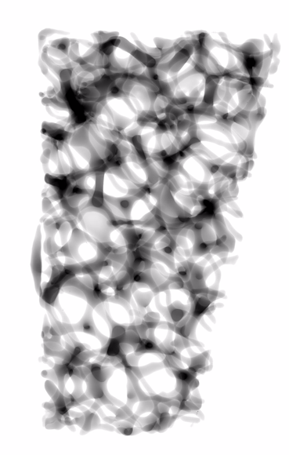
X-Ray CT Summary
X-Ray CT provides a ‘Gold-Standard’ 3D representation of the internal structures and flaws of an inspected part
Ongoing developments for improved fidelity
Efficiency of this technique enables NASA target applications
  Design for Inspection
  Model inversion for flaw detection/characterization
This model is an enabling technology for these agency objectives
Notes:
Add speedups

