Slide 1
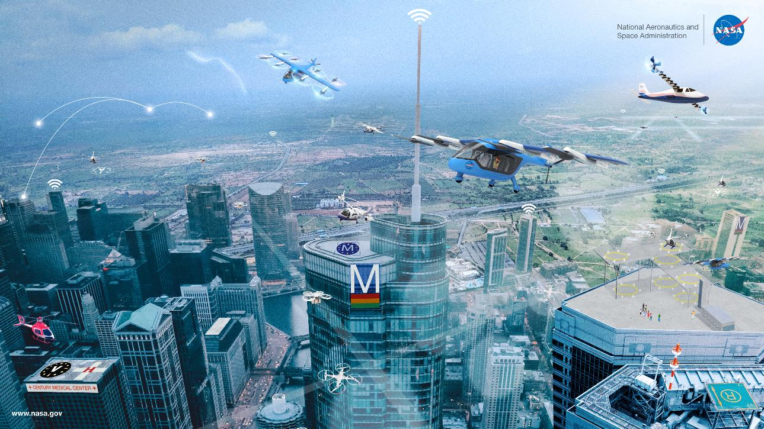

AAM Airspace Working Group Kickoff

Slide 2
AAM Airspace Working Group Kickoff Agenda
June 23, 2020
Topic | Speaker | Time (EDT) | Description
Introduction | Parimal Kopardekar (PK) | 3:00PM – 3:20PM | Welcome attendees, share the meeting agenda, introduce the NASA lead, and discuss the working group’s path forward
Panel: Open, Safe and Secure National Airspace Moderator: PK | Airbus: Rob Eagles Akin Gump: Jennifer Richter Commercial Drone Alliance: Lisa Ellman DoD: Brent Ingraham DHS: Tim Bennett FAA: Bill Stanton Hitachi UAM: Diana Cooper NBAA: Heidi William Uber: Tom Prevot | 3:20PM – 4:30PM | Panel with aircraft industry stakeholders to discuss perspectives and viewpoints regarding the integration of AAM
Q & A | PK/Taumi Daniels and Panelists | 4:30PM – 5:00PM | Open discussion with participants regarding their questions, concerns, etc. through conference.io

Slide 3
Airspace system should be ready when vehicles are ready

Slide 4
Conference.io
(also on registration site, youtube)
  Web Address:
  https://arc.cnf.io/sessions/jjwc/#!/dashboard

Slide 5
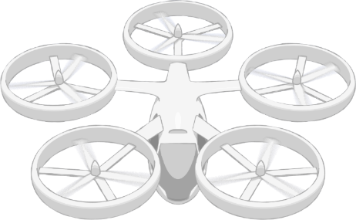
UAM Framework and Barriers
1. Public Acceptance
2. Supporting Infrastructure
3. Operational Integration
4. Local Regulatory Environment & Liability
1. Airspace Design
2. Operational Rules, Roles, & Procedures
3. CNSI & Control Facility Infrastructure
4. UAM Port Design
1. Safe Airspace Ops
2. Efficient Airspace Ops
3. Scalable Airspace Ops
4. Resilient Airspace Ops
5. Fleet Management
6. Urban Weather Prediction
Community Integration
Airspace System Design & Implementation
Airspace & Fleet Operations Management
5
3
4
Vehicle
Development & Production
Individual Vehicle Management & Operations
1. Vehicle Design & Integration
2. Airworthiness Standards &
Certification
3. Vehicle Noise
4. Weather-Tolerant Vehicles
5. Cabin Acceptability
6. Manufacturing & Supply Chain
1. Safe Urban Flight Management
2. Increasingly Automated Vehicle Operations
3. Certification & Ops Approval
4. Ground Ops & Maintenance
1
Safety
2
Security
Affordability
Noise
Autonomy
Vehicle Barriers
Airspace Barriers
Community Integration Barriers
Pillar number
UAM Ports
Regulations/Certification
#

Slide 6
Pillar 3: Airspace System Design & Implementation
  Category
  Pillar
  Operational objective
2
Airspace Design & Operations
3
Airspace System Design & Implementation
Design, regulate and manage the airspace and supporting ground facilities to enable safe, efficient and reliable UAM flights in and around metropolitan areas.
Airspace Design
Operational Rules, Roles, & Procedures
Comm, Nav, Surveillance, Information & Control Facility Infrastructure
UAM Port Design
Notes:
Airspace Design
Develop a practical, feasible, flexible, scalable, implementable, and equitable airspace design and implementation for UAM operations that includes the interoperability of diverse missions and vehicle types (e.g. piloted, autonomous, VTOL, STOL, sUAS, manned) and the placement of UAM ports to minimize community concerns such as noise and privacy , and consideration for cumulative fleet emissions (e.g., noise, CO2) over local communities.
Operational Rules, Roles, & Procedures
Develop operating rules, roles, procedures and airspace management Concepts of Operation that enable safe and efficient operations and are compatible with urban environments, scalable operations, interoperability, and operations in moderately poor weather operations.
Comm, Nav, Surveillance, Information & Control Facility Infrastructure
Develop and implement in an economically viable manner sufficient, resilient, and secure communication, navigation, surveillance, information (CNSI) and control facility infrastructure, including spectrally-efficient communication links; navigation services including but not limited to GPS; weather surveillance near the ground with high resolution; ability to account for non-cooperative vehicles; and functionality in urban canyons.
UAM Port Design
Develop an understanding of and guidelines for the optimal UAM port design and procedures to support the anticipated number of operations, including safe handling of contingency situations, minimizing noise impacts, and the development of design standards.

Slide 7
Pillar 4: Airspace & Fleet Operations Management
  Category
  Pillar
  Operational objective
2
Airspace Design & Operations
4
Airspace & Fleet Operations Management
Provide airspace operations management services as well as fleet operations management services that ensure safe, efficient, scalable, and resilient UAM operations in and around metropolitan areas.
Safe Airspace Operations
Efficient Airspace Operations
Scalable Airspace Operations
Resilient Airspace Operations
Fleet Management
Urban Weather Prediction
Notes:
Safe Airspace Operations
Develop and implement an airspace operations management system and the corresponding regulations and procedures that enable safe, secure, sustained, resilient, close-proximity, multi-vehicle operations in constrained, urban environments and allow for interoperability of diverse missions and vehicle types, including in off-nominal situations.
Efficient Airspace Operations
Develop and implement an airspace operations management system that provides user-preferred routing while allowing equitable, predictable, and on-demand airspace access for diverse missions and vehicle types, including legacy as well as emerging operations.
Scalable Airspace Operations
Develop and implement a scalable airspace operations management system to enable higher volumes of air traffic that exist today through the use of automation.
Resilient Airspace Operations
Develop and implement an airspace operations management system that allows for a graceful degradation of UAM operations in reaction to un-intended disruptions to UAM services (e.g., loss of GPS, flight services, CNSI, and/or weather information; UAM Port issues; cyber security attacks).
Fleet Management
Develop scalable, safe, secure, affordable and efficient fleet operations management services, that ensure safe navigation and efficiently handle vehicle operations throughout the operator’s UAM network while managing contingencies, meeting mission demand, and minimizing the impact of vehicle fleet emissions (e.g., noise, CO2, etc.) on the community.
Urban Weather Prediction
Develop a means of predicting high-resolution weather over short time frames for hyper-local conditions all the way to the ground, including understanding the impacts of wind fields in urban canyons.

Slide 8
Airspace Working Group Path Forward
Working group will be one open group
  Won’t have sub-groups
  All discussions open to the public
Airspace WG meetings up to once per month
  Kickoff covers a broad range of topics
  Subsequent meetings will each be focused on a single topic
  More discussion-based
Airspace WG leads
  WG leads: PK – parimal.h.kopardekar@nasa.gov
        Taumi Daniels - taumi.daniels@nasa.gov
  – NASA Aeronautics Research Institute Lead: Cecelia Town – cecelia.s.town@nasa.gov

Slide 9









Airspace WG Kickoff Panel
Rob Eagles
Strategy and Rulemaking Lead
Airbus UTM
Bill Stanton and Scott Rosenbloom
Senior Advisor – Policy
Federal Aviation Administration
Jennifer Richter
Partner
Akin Gump
Diana Cooper
Head of US Policy
Hyundai UAM
Heidi Williams
Director, Air Traffic Services &
Infrastructure
National Business Aviation Association
Lisa Ellman
Executive Director
Commercial Drone Alliance
Brent Ingraham and Col. David Bennett
Director of Surface Warfare
Office of Secretary of Defense for
Acquisition and Sustainment
Tom Prevot
Director of Engineering for Airspace Systems
Uber Elevate
Notes:
Rob Eagles – Airbus UTM
Rob Eagles is Strategy and Rulemaking Lead at Airbus UTM, actively engaged in the development of services, standards and functionality for UTM and Urban Air Mobility. Having spent more than 30 years as an Air Traffic Control and in the aerospace industry, he is recognized as an innovator in new airspace operations.
Rob’s technical work is complemented by practical worldwide experience having held previous management and operational positions at Loon (part of Alphabet), IATA, UK NATS and Eurocontrol. With UK NATS he was an R&D technical lead, and inventor, for an award-winning project that delivered the most significant advancement in London’s airspace in 20 years.
He holds a Master’s Degree (with distinction) in Air Transport Management from City University in London.
Jennifer Richter – Akin Gump
Jennifer L. Richter is a partner with Akin Gump Strauss Hauer & Feld and represents a number of clients on UAS/drone strategy, development and operation. Jennifer has represented technology and communications companies and investors for more than two decades. She is ranked by Chambers USA as a leading lawyer in telecommunications, and she has been named a Super Lawyer for communications law multiple times. She brings years of in-depth experience in the communications field to her clients in the industry, possessing an insider’s knowledge of the business, gained while serving as vice president and general counsel of a wireless communications company she helped to build and sell to Sprint Corporation.
Jennifer was a voting member on the FAA’s Aviation Rulemaking Committee that studied and made recommendations to the FAA Administrator regarding technology to enable remote tracking and identification of UAS. Jennifer is a member of NASA’s Advanced Air Mobility Ecosystem National Campaign. She also serves on the Steering Committee for ANSI’s Standardization Roadmap for Unmanned Aircraft Systems, Version 2.0 and she was an active participant in NASA’s UTM working groups. She served for many years as a subject matter expert on the FCC’s Technological Advisory Council on UAS and the Department of Homeland Security’s CIPAC that is studying how to protect critical infrastructure from drones. For the CTIA/NASA UAS Working Group, Jennifer is active with members, the FCC and the FAA on spectrum solutions for Communication, Navigation and Surveillance needs for UAS.
Lisa Ellman – Commercial Drone Alliance
The Commercial Drone Alliance is led by industry veteran Lisa Ellman, a partner at global law firm Hogan Lovells LLP. A co-founder of CDA, Lisa is widely recognized as one of the “world’s foremost authorities” on drone policy and law. Lisa was featured in Fortune's "Most Powerful Women" series for her efforts to develop policy governing drone use in the United States.
Brent Ingraham - DoD
Mr. Brent Ingraham is a member of the Senior Executive Service and serves as the Director of Surface Warfare, responsible for responsible for managing and analyzing major platform and weapons capability portfolios across land, maritime and munition tactical warfare systems. Before assuming his position, Mr. Ingraham began serving as the Director of Unmanned Systems at the Office of the Under Secretary of Defense for Acquisition and Sustainment Platform and Weapons Portfolio Management Directorate, where he was responsible for the acquisition, policy, governance, and developing technology roadmaps for unmanned, robotic and autonomous systems portfolio.
Mr. Ingraham began his career in the Automotive Industry, as a powertrain engineer, responsible for development and production of domestic and international powertrain systems, while providing a principle role in forming global automotive partnerships. In 2010, he joined the federal government supporting the Joint Program Office Mine Resistant Ambush Protected (MRAP) vehicle as the Chief Engineer for the MRAP All-Terrain Vehicle (M-ATV), where he was responsible for the engineering, production and fielding of urgent lifesaving technology. In 2013, he was awarded the Navy’s Top Scientist and Engineer of the Year Award for his work in the field of vehicle survivability.
In 2014, Mr. Ingraham was assigned to Pacific Command, where he was responsible for developing strategic plans and bilateral defense frameworks, returning back to support Marine Corps Combat Development Command, to develop and transition Marine Corps warfighting capabilities. In 2015, he joined the Naval Surface Warfare Center Dahlgren Division as the Branch Head for a multi-disciplinary technical organization responsible for the development and fielding of asymmetric disruptive capabilities.
Mr. Ingraham received his Bachelors of Science in Mechanical Engineering in 1998 from the University of New Hampshire. Over his career Mr. Ingraham has received numerous citations and accolades for his contributions and dedication while in industry and during his career in the Department of Defense. He has received the Office of the Secretary of Defense Medals for Meritorious Civilian Service, the Navy’s Top Scientist and Engineer of the Year Award, two Joint Meritorious Unit Awards, and most recently, he was awarded the 2019 Federal Computer Weekly FED 100 Award, celebrating these exceptional individuals, from both industry and government, who are transforming government and its ability to deliver on critical missions.
Bill Stanton – FAA
Bill currently serves as the FAA Air Traffic Organization’s Senior Advisor for Policy. This position directly influences the development of regulatory policy (Rulemaking, Policy and Procedure) and coordination within an organization that provides procedural development and support to National Airspace System (NAS) stakeholders.
Previous experience includes - Air Traffic Services Manager of UAS and Commercial Space Operational Integration. This position represented all operational facilities from ground control to high altitude en-route environments that provides service to UAS activity in controlled airspace throughout the National Airspace System (NAS).
Prior to working in the UAS environment, Bill served in positions as Lead Investigator-audits and assessments, Operations Manager, Operations Supervisor, Air Traffic Controller and United States Marine.
Diana Cooper – Hyundai UAM
Ms. Cooper is the Head of US Policy for Hyundai Urban Air Mobility. She is responsible for working with legislators, regulators, local communities and industry to foster a forward-leaning regulatory and policy framework for UAM and to drive public acceptance.
Diana previously served as General Counsel and Senior Vice President of Policy and Strategy at PrecisionHawk, a commercial drone company. Prior to that she founded and led the UAS and Robotics Practice Group at a leading law firm.
Ms. Cooper is a member of the World Economic Forum UAM Working Group, and she serves as Special Advisor to the Chairman of the FAA Drone Advisory Committee.
Diana has held leadership roles across many industry associations including as President of Small UAV Coalition. She has served on various FAA aviation rulemaking committees, and as a Legal Expert for the United Nations Working Group on Geospatial Information Management.
Diana has testified on aviation policy and legal frameworks before the US House Transportation & Infrastructure Committee and the US Senate Commerce Committee.
Ms. Cooper holds a BA in Politics and Governance, a MA in Globalization Studies and a JD in Law and Technology.
Heidi Williams – NBAA
Brief bio: Heidi J. Williams joined the National Business Aviation Association in December of 2016 where she serves as the Director, Air Traffic Services & Infrastructure. In her current role, she is responsible for NBAA’s policy and coordination with the FAA, state and local officials, and association members relating to air traffic control, air traffic management/design activities, Nextgen, UAS/New Entrants and oversees the NBAA Air Traffic Services at the FAA Air Traffic Control Command Center. Prior to joining the NBAA team, Ms. Williams served as the UAS lead for Lockheed Martin and as Vice President, Air Traffic Services for AOPA. She has been actively engaged in the industry for over twenty years and is a commercial pilot and flight instructor.
Tom Prevot – Uber Elevate
Tom Prevot is Director of Engineering for Airspace Systems at Uber Elevate. Prior to joining Uber in 2017, Tom was with NASA Ames for more than 20 years. He was head of the Airspace Operations Lab and project lead for NASA’s UTM research. Tom won numerous awards including two NASA software of the year awards. He earned his PhD in aerospace in Munich for his thesis on autonomous and cooperative on-board flight planning.

Slide 10
Upcoming Events
Please visit https://nari.arc.nasa.gov/aamecosystem for more details!
  June Events
  UAM Concept of Operations (ConOps) Overview (Pillar 1 and 2)
    DATE: Thursday June 25, 2020
    TIME: 1:30PM – 3:00PM EDT (10:30AM – 12:00 PM PDT)
    UAM Concept of Operations (ConOps) Aircraft Focus
    DATE: Friday June 26, 2020
    TIME: 1:30PM – 3:00PM EDT (10:30AM – 12:00 PM PDT)
  July Events
    UAM Community ConOps Airspace Focus (Pillar 3 & 4)
    DATE: Thursday July 16, 2020
    TIME: 3:00PM – 4:30PM EDT (12:00PM – 1:30 PM PDT)
    UAM Community ConOps Community Integration Focus (Pillar 5)
    DATE: Friday July 10, 2020
    TIME: 1:00PM – 2:30PM EDT (10:00AM – 11:30 AM PDT)

Slide 11
Embracing innovation while maintaining safety of operations

Slide 12
Questions and Answers
  Web Address:
  https://arc.cnf.io/sessions/jjwc/#!/dashboard

