Slide 1

Climate Intervention with Stratospheric Aerosols
Jean-Paul Vernier
National Institute of Aerospace
@ NASA Langley Research center

Slide 2
Outline
Natural Analogs of Climate Intervention: Major volcanic eruptions
How well do we understand the stratospheric aerosol Layer ?
The longest record of Satellite Observations: Stratospheric Aerosols
Ground-based, balloon and airborne measurements
Growing complexity of the stratospheric aerosol layer:
    The Summer Asian Monsoon : a source of pollution into the stratosphere
    Rising smoke into the stratosphere

Slide 3
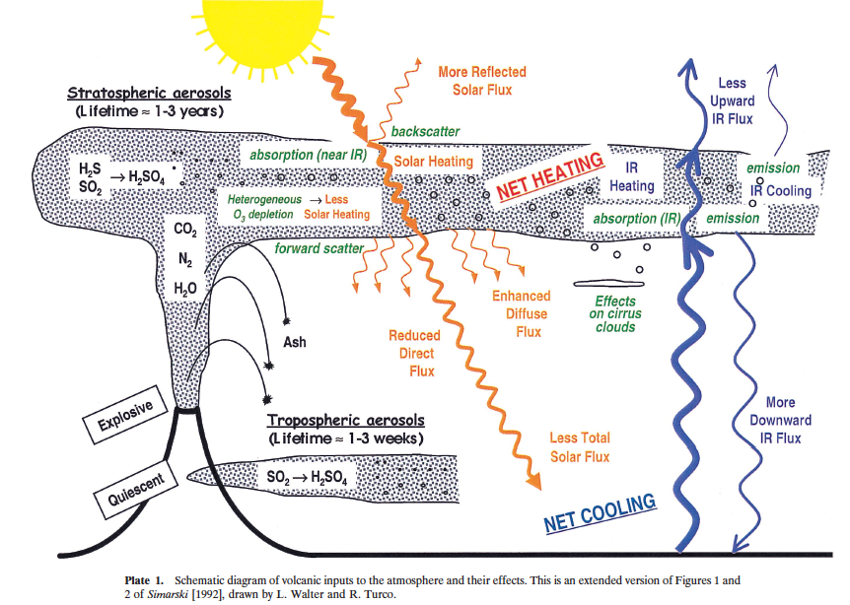
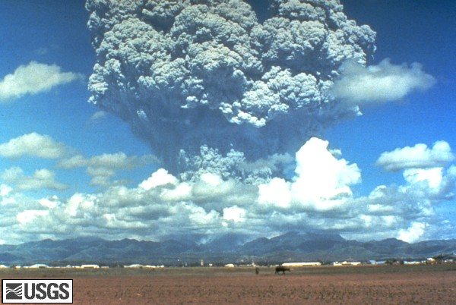
Impacts of Major Volcanic Eruptions Climate
Robock,2000, Science
Mt Pinatubo eruption in June 91
Radiative :solar shortwave radiation reflected by volcanic aerosols : Cooling at the surface.
Chemical :Impact on ozone chemistry, O3 depletion via heterogeneous reaction.
Microphysical : Ice nuclei in the upper troposphere inducing cirrus cloud modifications
Notes:
Major volcanic eruptions are known to largely impact the atmosphere. In fact, The sulfur dioxide emitted
By those events is transformed within a few weeks into droplets of sulfuric acid.
Those particles are very efficient in reflecting solar radiation back to space leading to a cooling at the surface and a warming
In the volcanic layer. Moreover, those particles also serve as sites to activate ozone depleting species via heterogeneous chemical
reaction. Finally, when removed in the upper troposphere by sedimentation or stratosphere-troposphere transport, they represent
An important source of Ice Nuclei, that can possibly alter cirrus clouds macro and microphysics.

Slide 4
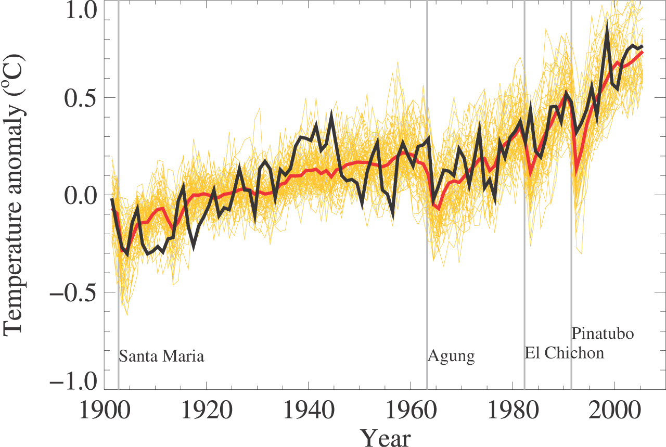
Temporary Cooling after Major Volcanic Eruptions
Figure 8, Chap 8 IPCC/ AR5

Slide 5
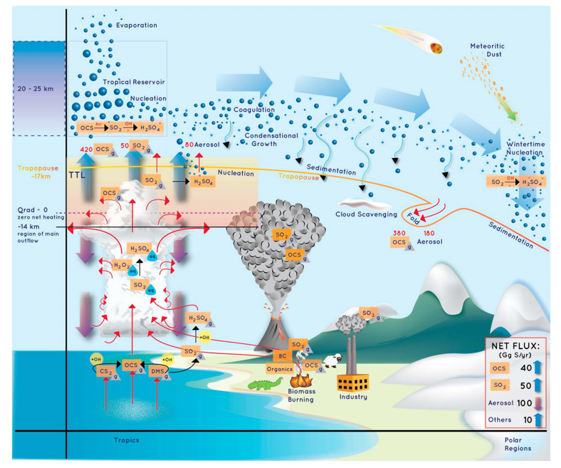
Stratospheric Sulfur and Its Role in Climate (SSiRC)
initiative
Kremser et al., 2016

Slide 6
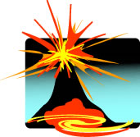
Stratospheric aerosol observations by satellites since late 70’s
SCHIAMACHY/ENVISAT ^
* Active Lidar
^ Passive Limb (scatter-emission)/Occultation (UV-Vis-IR)
# Observations at high latitudes
CATS/ISS*
MIPAS/ENVISAT ^
GOMOS/ENVISAT ^
OMPS-LP
POAM #
HALOE ^
CALIPSO *
SAM II #
SAGE III ^
SAGE III/ISS ^
SAGE II ^
SAGE I ^
OSIRIS/Odin ^
MEASTRO/ACE ^
El Chichon
Mt Pinatubo
1983
2005
2009
2013
2015
2017
2020
1985
1997
1999
1989
1993
2001
2007
2011
1981
1991
1995
2003
1979
1987
Notes:
Thus, satellite measurements using occultation technique such as the Stratospheric Aerosol and Gas Experiments (SAGE)
have provided quasi-complete observations between 1979 to 2005. However, it should be noticed that gaps exist in the record during very important periods following the two major eruptions of El Chichon and
Mt Pinatubo due to the fact that :
El Chichon erupted between SAGE I and SAGE II
There were no direct satellite measurements below the opaque plume of Mt Pinatubo.
During the last decade, several other instruments including OSIRIS/Odin, GOMOS/ENVISAT and CALIPSO have completed the record, offering an unprecedented accurate view of the stratospheric aerosol level.

Slide 7
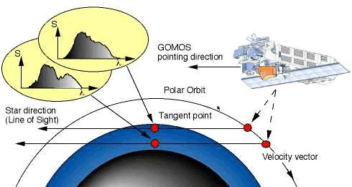
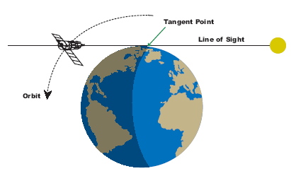
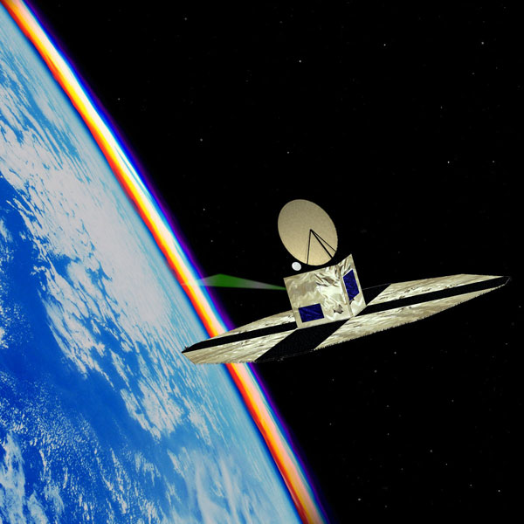
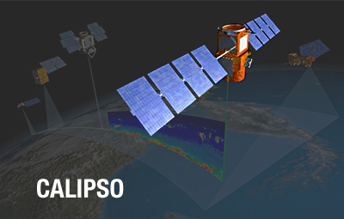
Multiple Satellite Observations Techniques
SAGE I/II/III
GOMOS/ENVISAT
Stratospheric Aerosols
1979-2005
2002-2014
2006-now
OSIRIS/ODIN
2002-now
Notes:
So this trend has been investigate with a number of space borne observations including :
The solar occultation instrument SAGE II
The stellar occultation instrument GOMOS/ENVISAT
The Limb-scatter instrument OSIRIS/Odin
The space-borne lidar CALIPSO

Slide 8
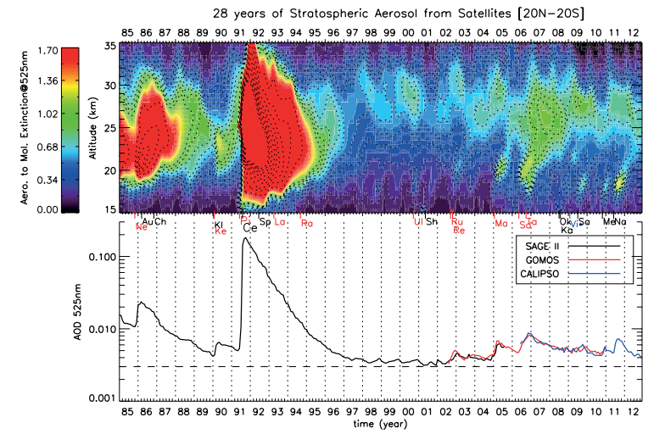
Stratospheric Aerosol Database from Satellite Observations

Slide 9
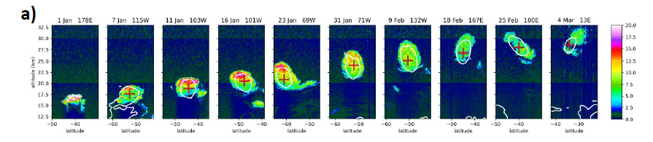
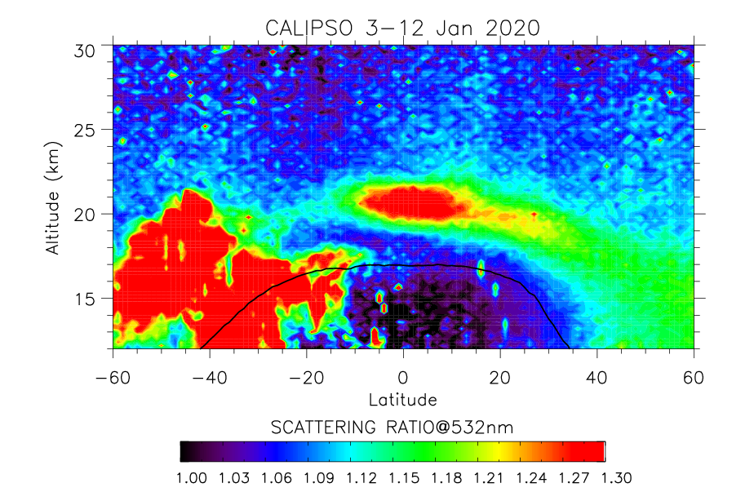
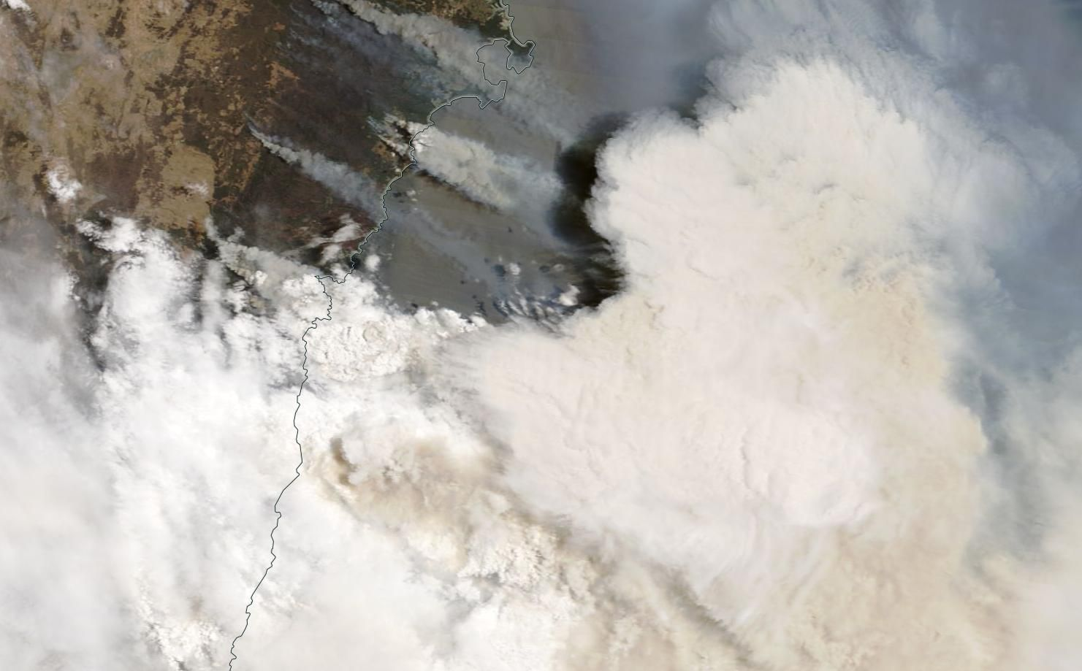
Smoke Rising into the stratosphere after the 2019/2020 Australian Busfires

Slide 10
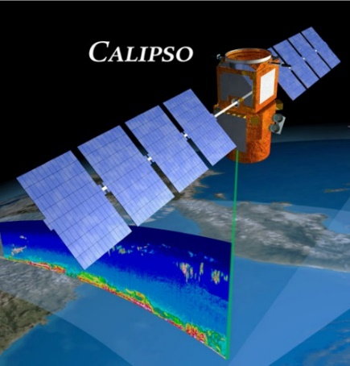
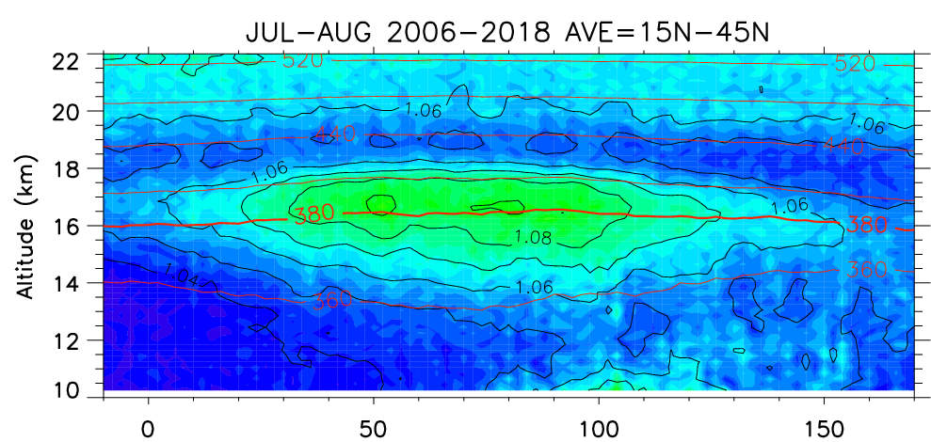
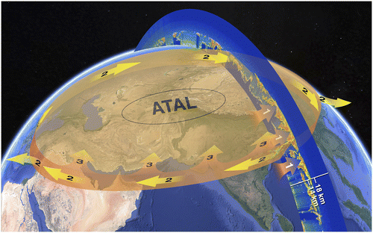
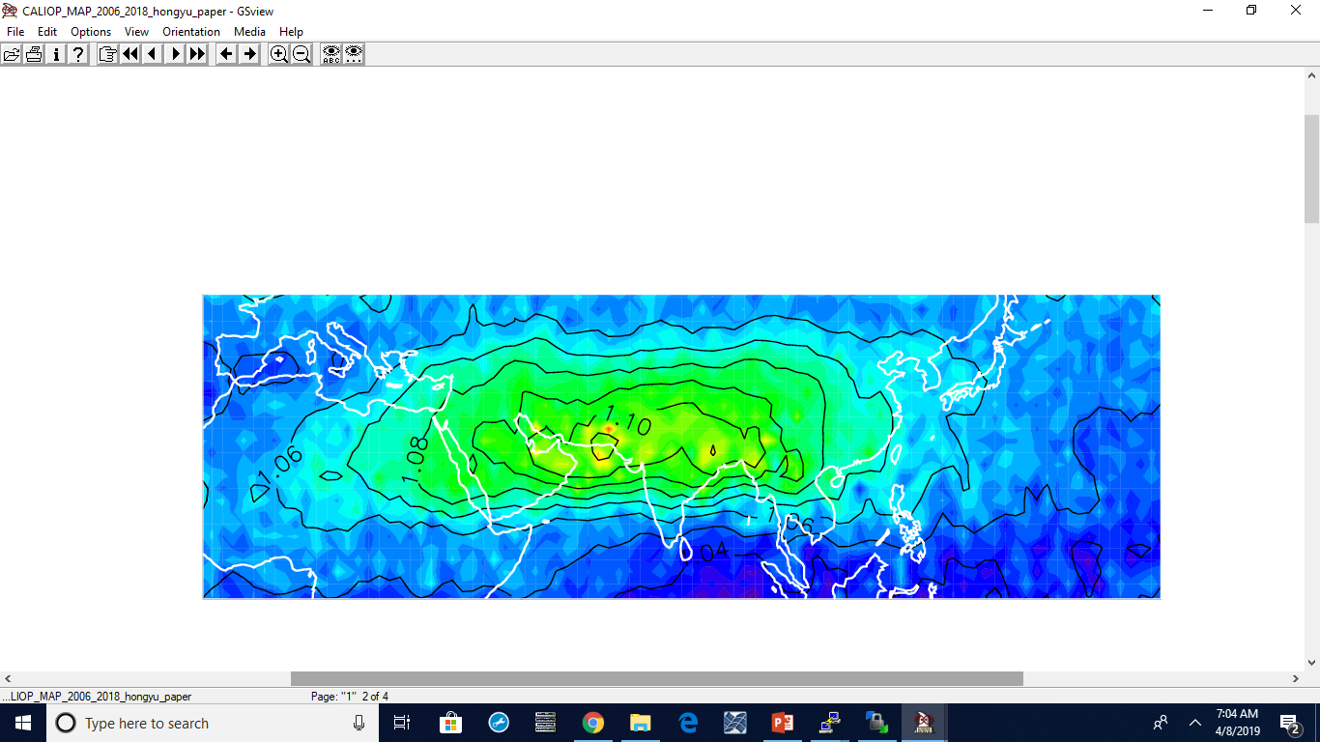
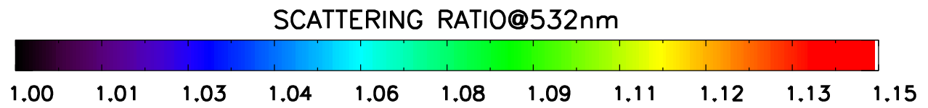
Summer Asian Monsoon influence on UTLS aerosols: The Asian Tropopause Aerosol Layer
Junge Layer
ATAL
15-18 km
Vernier et al., 2017, BAMS
Transport pathways and the ATAL:
Deep convection from the ASM connects boundary layer pollution to the UTLS (Park et a., 2009, Randel et al., 2010)
The monsoonal outflow transport through tropical easterlies southern branch of the Asian anticyclone
Air in the tropical upper troposphere/southern edge of the Asian anticyclone can be uplifted into the lower stratosphere via diabatic ascent (Garny and Randel 2016)
Scattering Ratio : SR
Optically Equivalent to an Aerosol Mixing Ratio
Notes:
Over the past decade, we used the CALIPSO space borne lidar which is still amazingly active today to study aerosols in the Upper Troposphere
And Lower Stratosphere. W

Slide 11
Conclusion
Stratospheric aerosol have been monitored since the late 70’s
Climate cooling impacts of major volcanic eruption is relatively well documented
Still lack in situ measurements to understand processes influencing the stratospheric aerosol layer
New sources of aerosols in the stratosphere from Asian Pollution and extreme wildfires add layers of complexity to stratospheric aerosol Geoengineering concept.

Slide 12
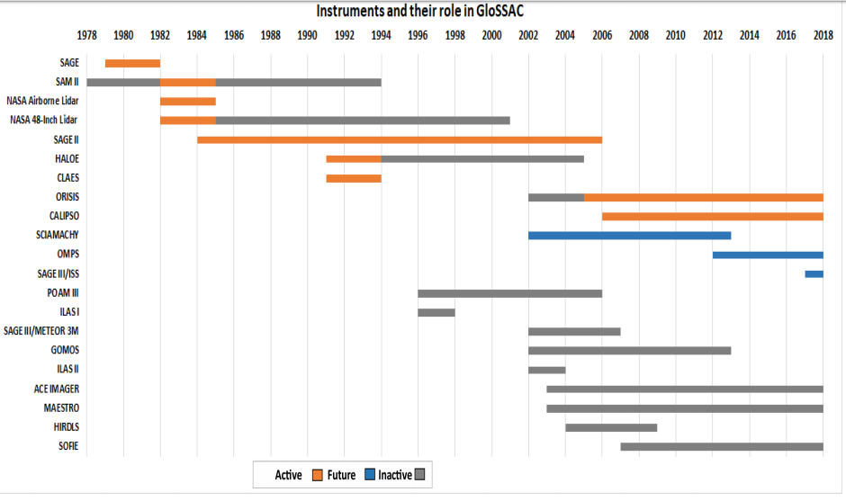
Extra slides

