Slide 1
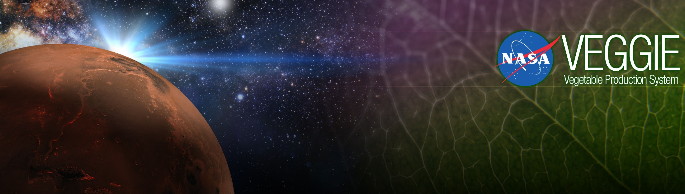
Growing Plants in Space
Gioia Massa
Exploration Research and Technology Programs
NASA, Kennedy Space Center, FL, USA

Slide 2
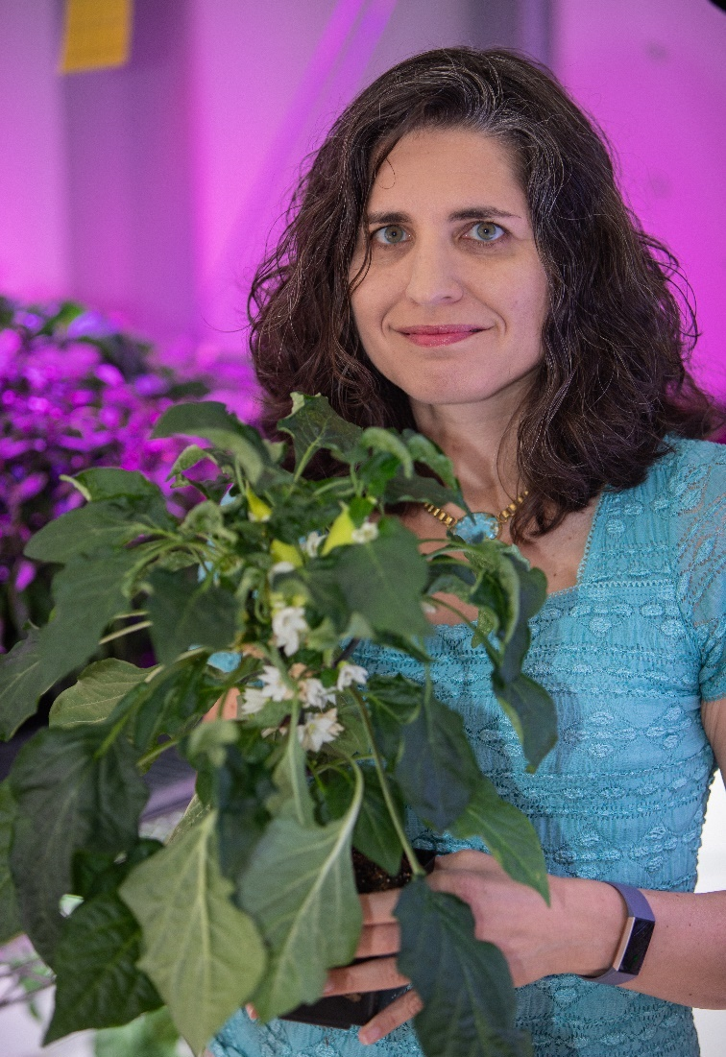



Education
BS – Cornell University – Plant Science
PhD – Penn State – Plant Biology with Geosciences minor
Gioia Massa, PhD
Kennedy Space Center
Life Sciences Project Scientist

Slide 3


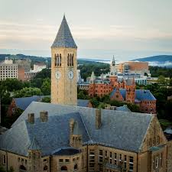
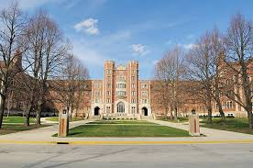
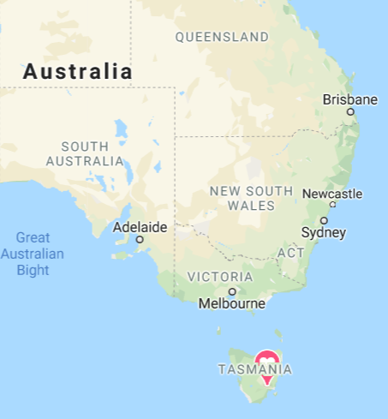
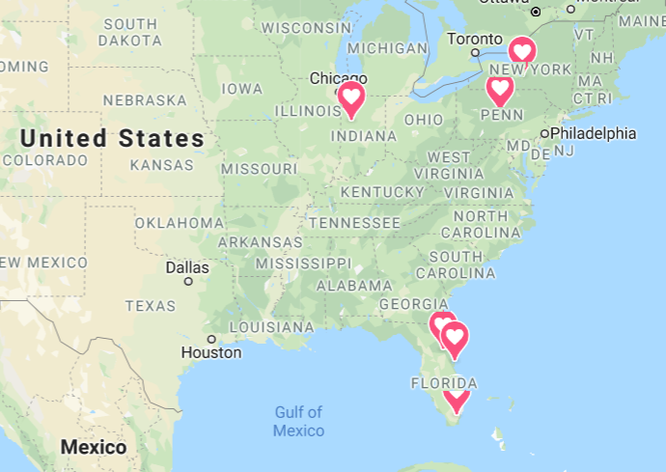
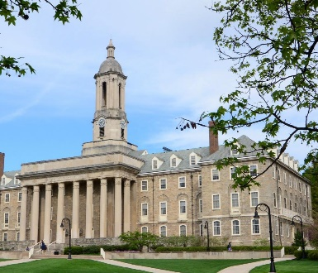

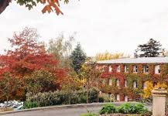

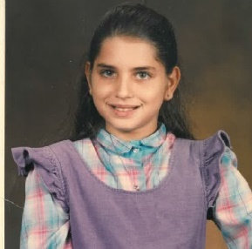
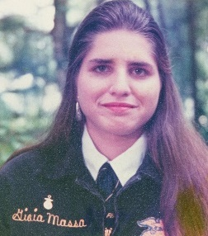

My Journey

Slide 4
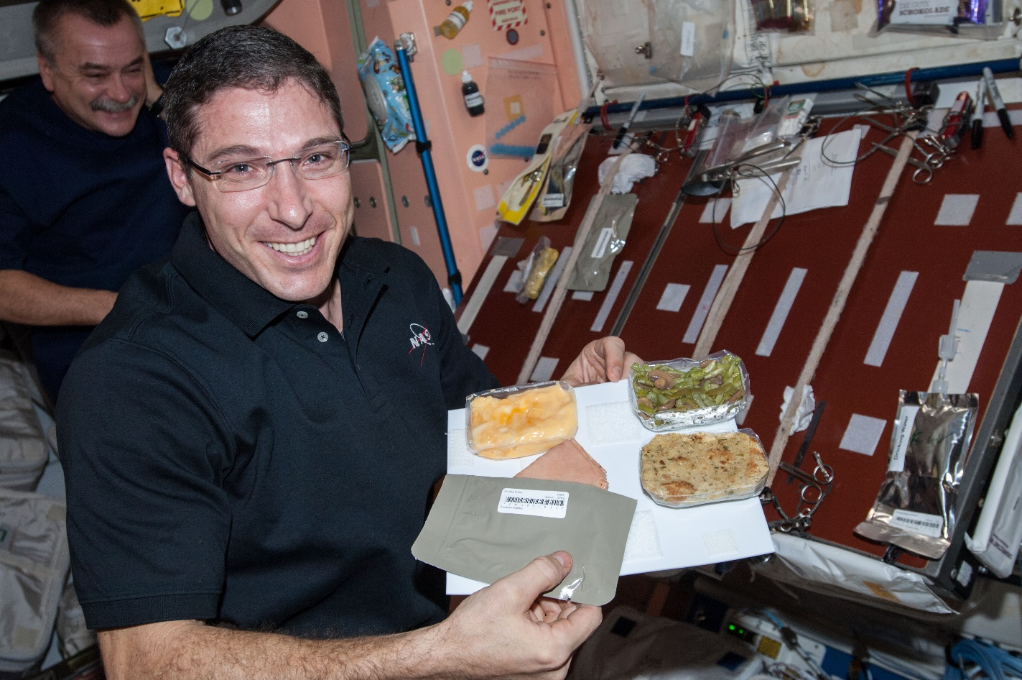
Why grow plants in space?
Food
Psychological well being
Atmosphere
Water

Slide 5
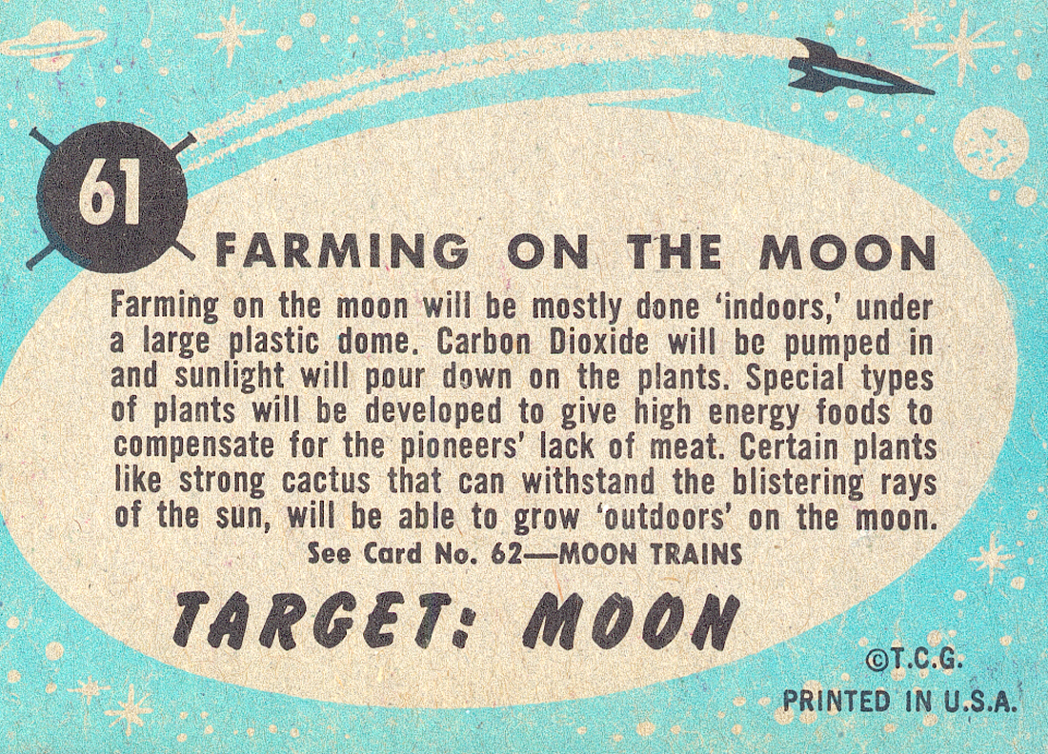

Slide 6
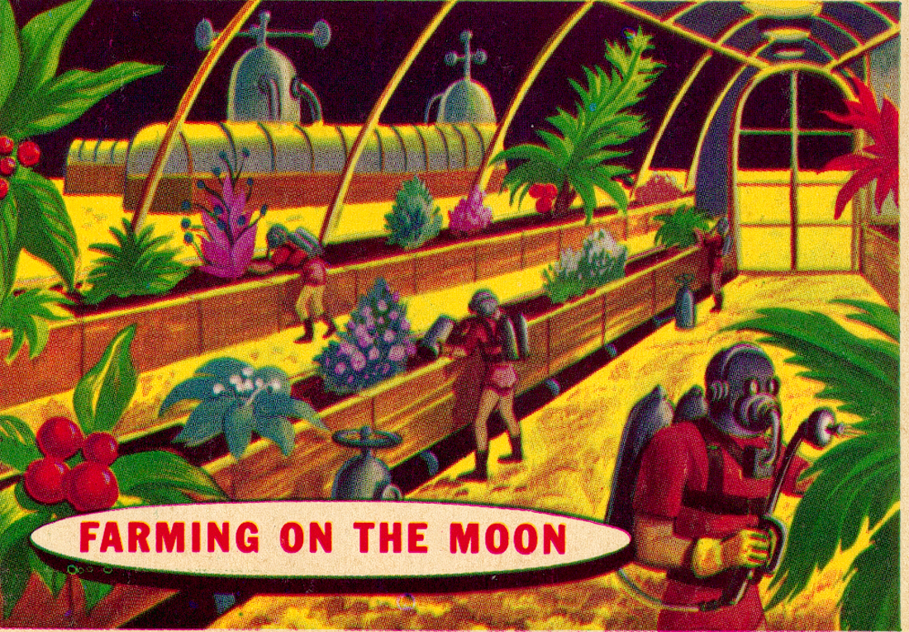

Slide 7
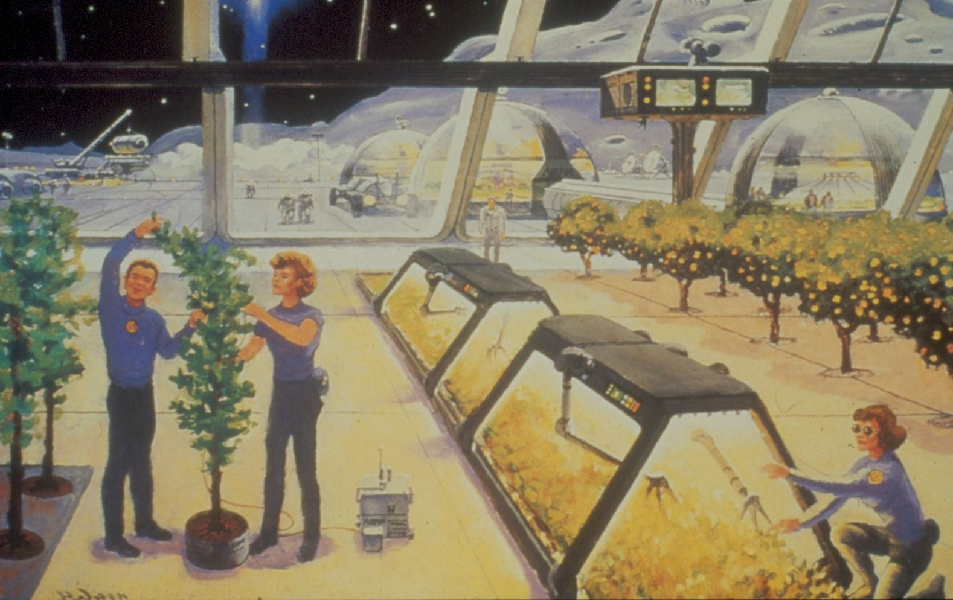
Luna City
agriculture part of life support
transparent domes realistic?
dangers of surface living
problems with lunar agriculture

Slide 8
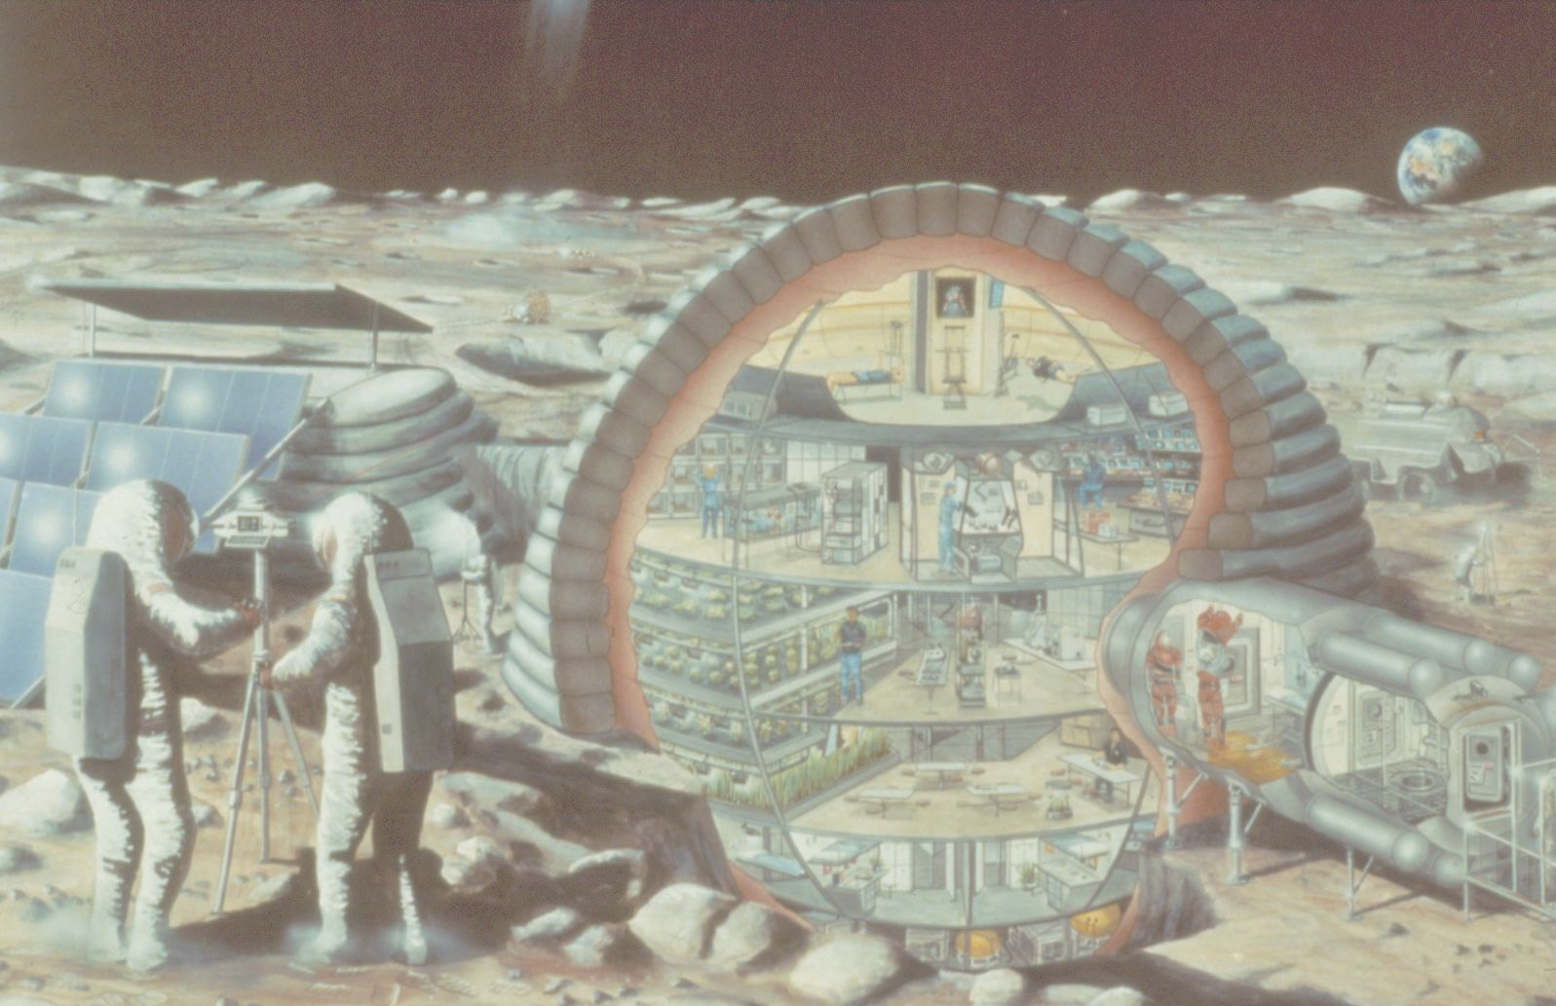

Slide 9
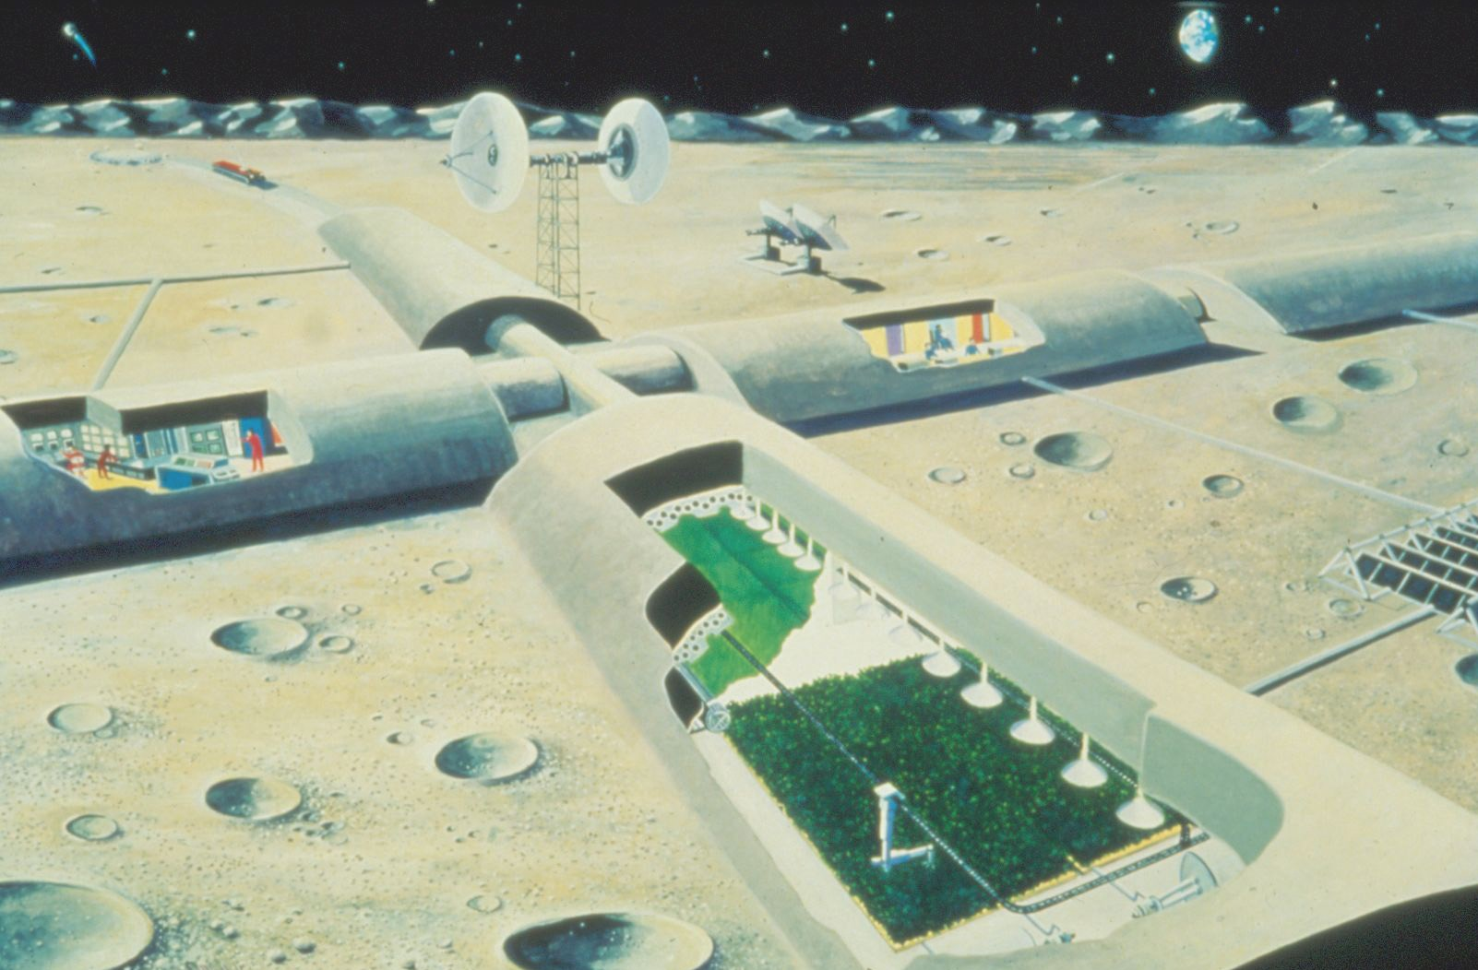
Evolved Lunar Base
thick-walled “concrete”
formed from
lunar regolith

Slide 10
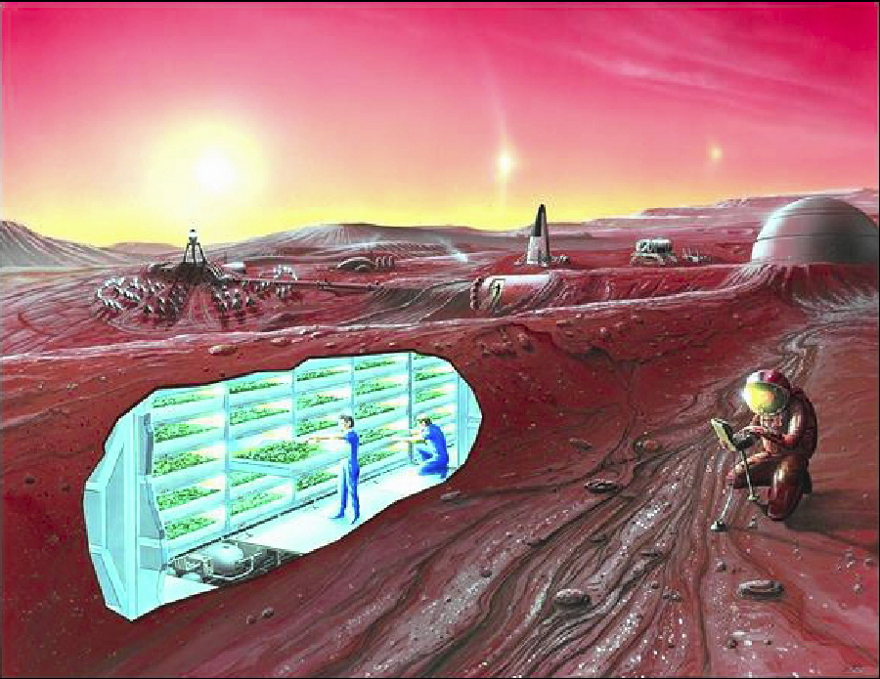

Slide 11
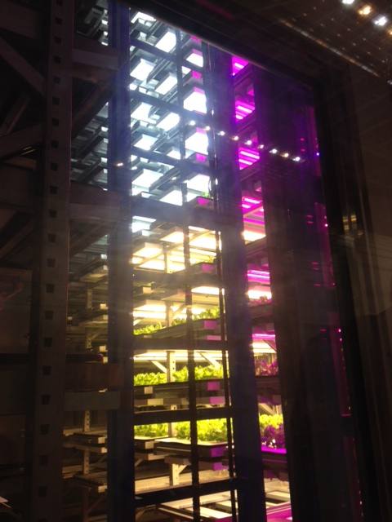
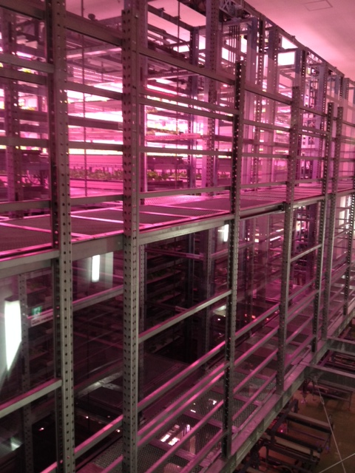
Plant Factories
Photos of Osaka Prefecture University training facility courtesy of Ray Wheeler

Slide 12
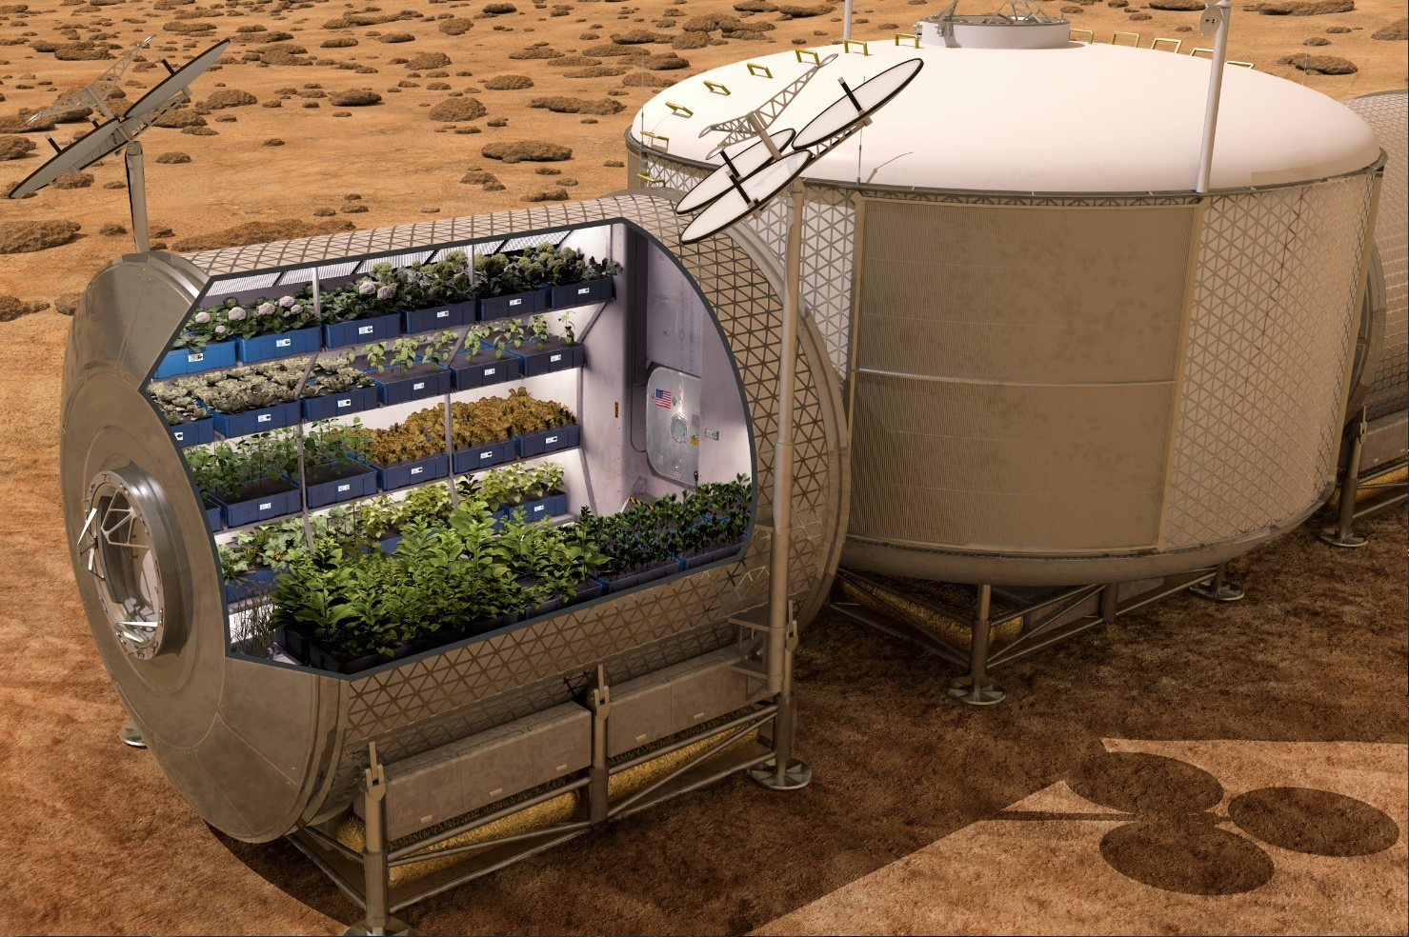

Slide 13
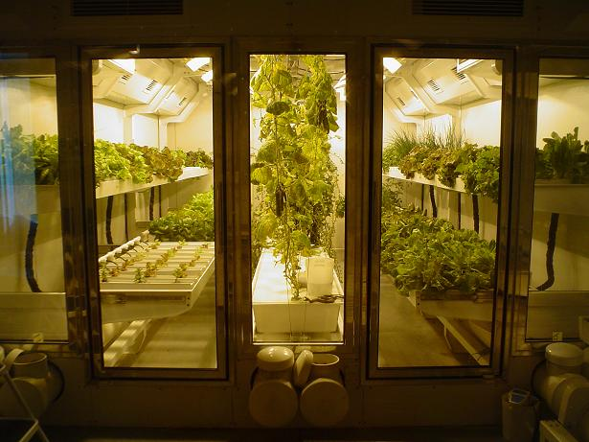
South Pole Greenhouse
Photo from “On the Ice” Blog of Russ Durkee

Slide 14



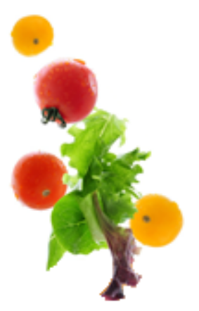



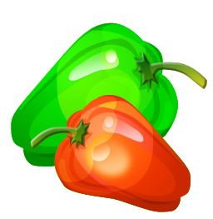

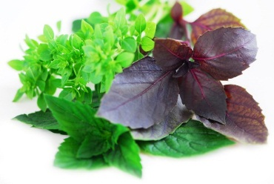


Space Crop Production Candidates
Salad
Leafy Greens
Tomato
Pepper
Radish
Strawberry
Green Onion
Pea
Carrot
Lettuce, Chinese cabbage, Swiss chard, Mizuna, Spinach
Staple Crops
White Potato
Sweet Potato
Rice
Wheat
Dried Bean
Soybean
Peanut
MINIMAL PREPARATION / COOKING
SIGNIFICANT PREPARATION / COOKING
CONSUMED FRESH WITHOUT PROCESSING
Spice
Basil
Mint
Chives
Dill

Slide 15


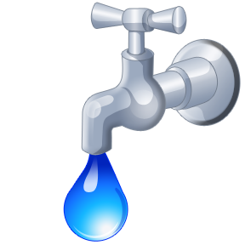

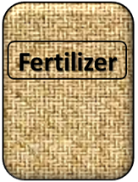

Plant Growth and the Environment
5 Cardinal Factors of Plant Growth…..
O₂

Slide 16

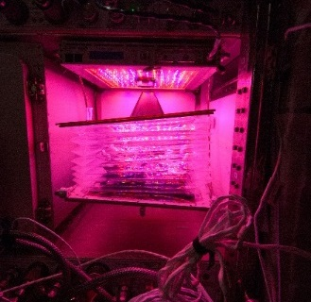
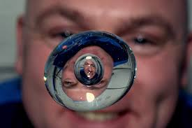

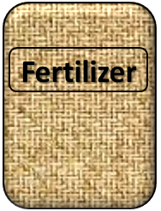
The Space Environment
….and how these work with and without Gravity!
Humans like white light, but plants may grow well with other wavelengths
No convection in space so need to mix the air
O₂
Water forms a ball, and water and air don’t mix well, and roots need both!
Fertilizer is heavy to launch so we need to learn how to recycle plant waste

Slide 17

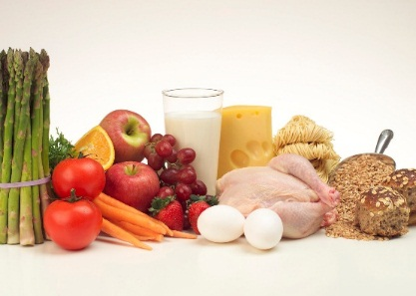


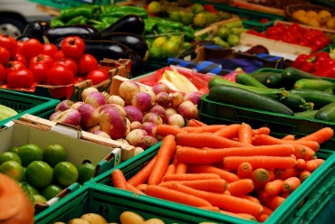

Crew Needs
Plants can contribute to human needs of food, oxygen and water.
O₂
+
=
A balanced diet
Crew time is limited!

Slide 18


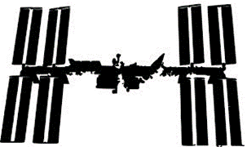
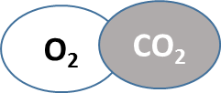

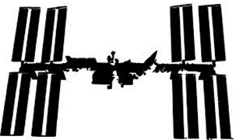





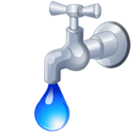
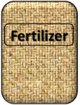
Example of an ISS Crop Scenario
Select
+
from
+
with
6 x
Use
Select
Grow
Eat
+
per crew member per week
2 x
from
+
+

Slide 19
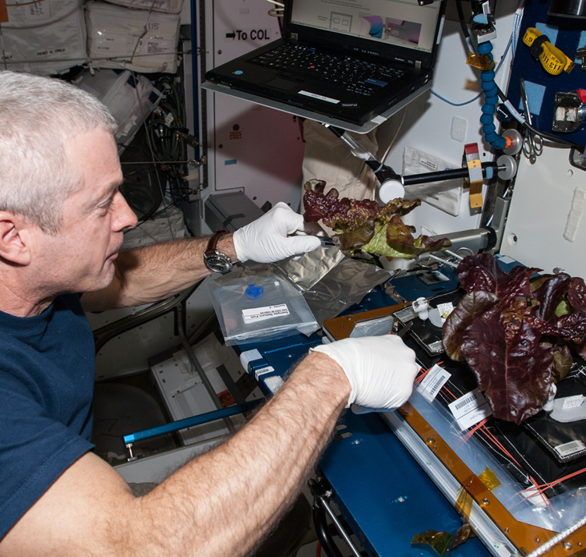
Goal: To down select crop candidates for crew to grow, pick, and eat on ISS to supplement a packaged diet.
Example of Candidate Salad Crop Selection
ISS Cmdr. Swanson harvesting lettuce from the Veggie test– June, 2014
ISS Cmdr. Swanson harvesting lettuce from the Veggie test– June, 2014

Slide 20
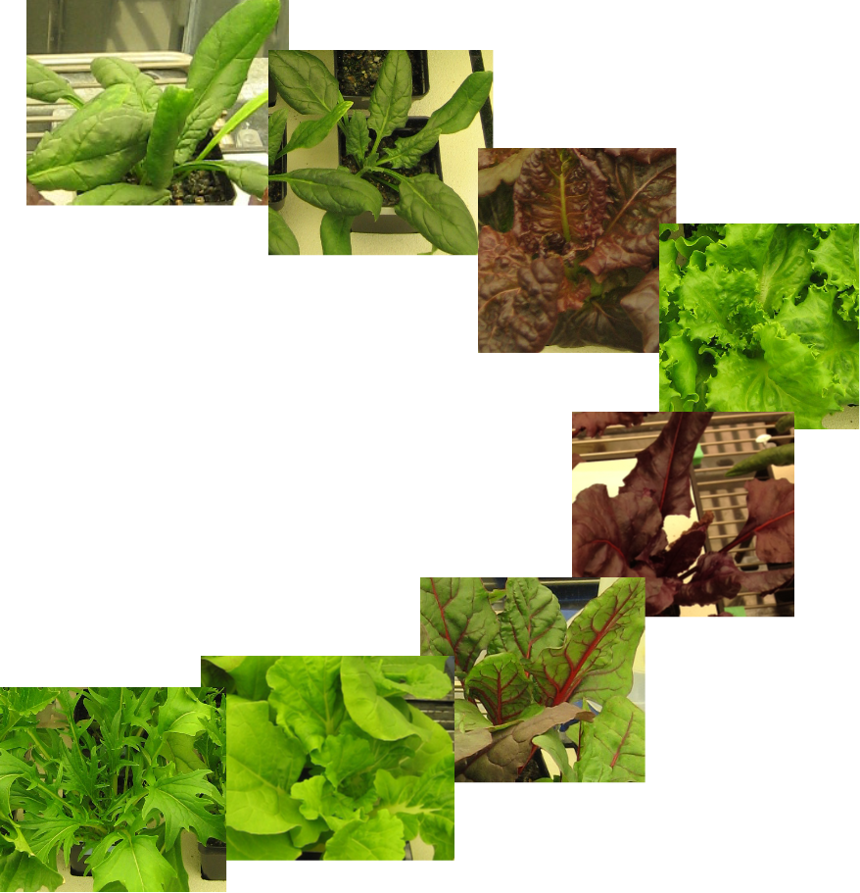
Leafy Greens - Candidates
‘Tyee’ spinach
‘Flamingo’ spinach
‘Outredgeous’ Red Romaine lettuce
‘Waldmann’s Dark Green’ Leaf lettuce
‘Bull’s Blood’ beet
‘Rhubarb’ Swiss chard
‘Tokyo Bekana’ Chinese cabbage
Mizuna

Slide 21
Selection Criteria Overview
  Horticultural factors
    Germination, ease of growth, amount of growth (food), size
  Dietary factors
    Percent dry matter
    Elemental Factors - Composition of key elements (K, Fe, Ca, Mg)
    Nutrient Factors - Beneficial phytonutrients (Vitamin K, Lutein, Zeaxanthin, Antioxidants)
  Organoleptic factors
    9-pt Hedonic Scale: Overall taste, Appearance, Color, Bitterness, Flavor, Texture
    5-point Just About Right Scale: Crispness, Tenderness

Slide 22
Weighting and Ranking
Weighting factors were developed for each parameter based on subjective importance.
Data were normalized, weighted, and ranked.
Divided into:
  Horticultural Factors
  Elemental Factors
  Nutrient Factors
  Organoleptic Factors
8 varieties were down selected to 4 for nutrient and organoleptic evaluation.
4 crops were grown and shipped to JSC for organoleptic testing.
Final ranking performed on down selected crops.

Slide 23
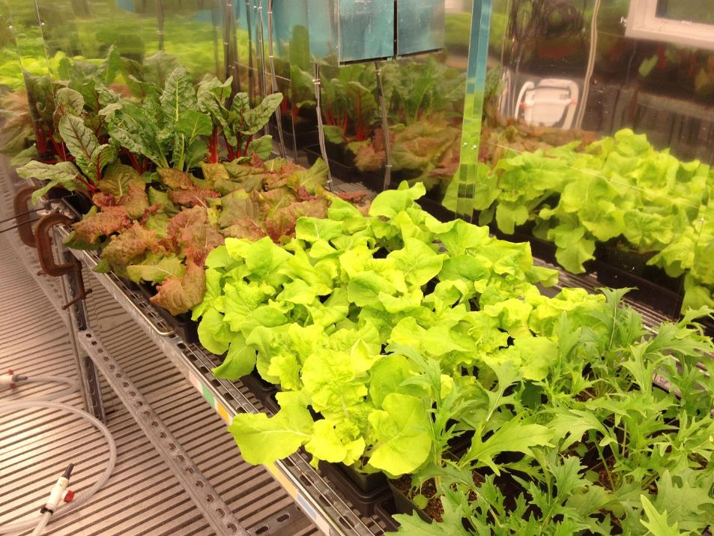
Growth Studies
Plants are grown in a controlled environment chamber at KSC, with environmental conditions set to mimic those on ISS (Temperature, RH, CO₂, PAR).

Slide 24
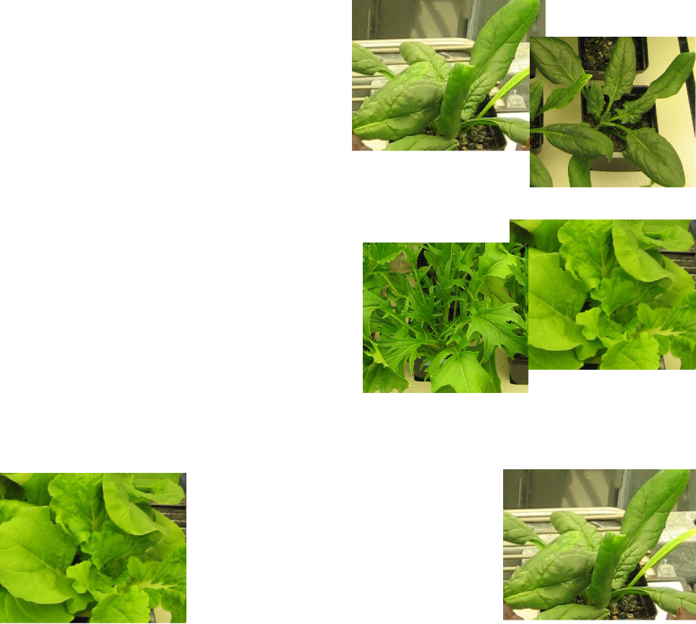
Horticultural Factors
Percent germination
Speed to maturity
Fresh Mass
Spinach had poor germination
Chinese cabbage and Mizuna had excellent rapid growth
Chinese cabbage had excellent yield
Spinach had poor
yield

Slide 25
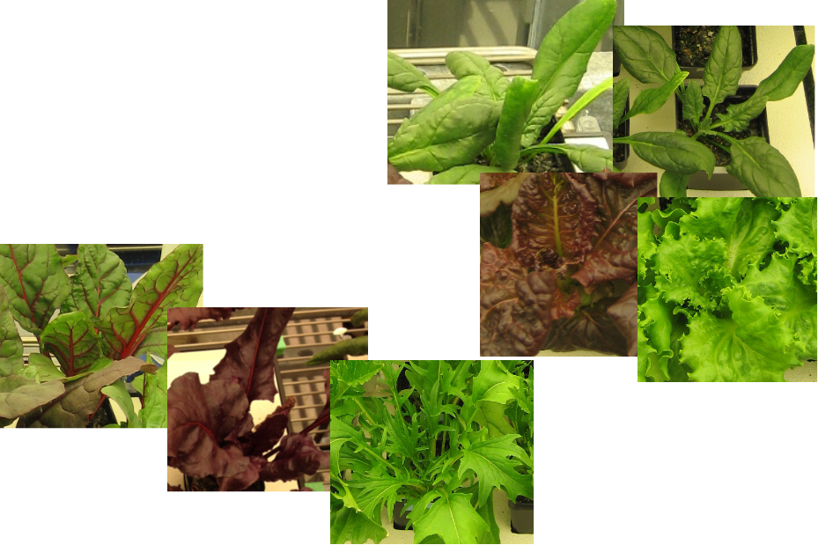
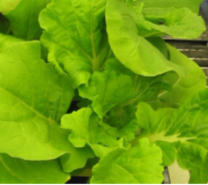
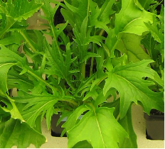
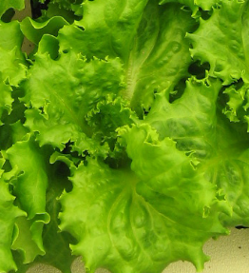
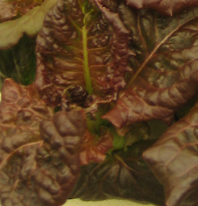
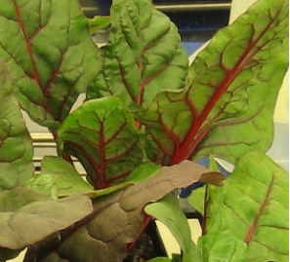
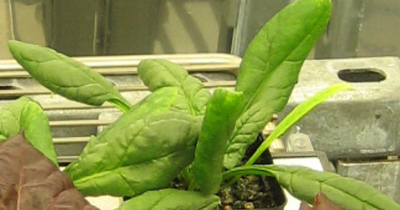
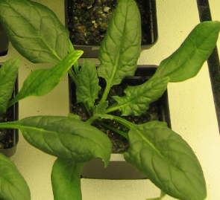
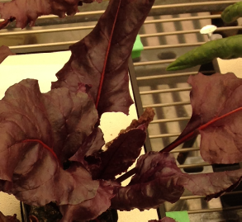
Horticultural Factors (cont.)
Spinach and lettuce had low size
Area, Height, Volume
Plant Growth Ranking
Swiss chard, Beet and Mizuna had high size

Slide 26
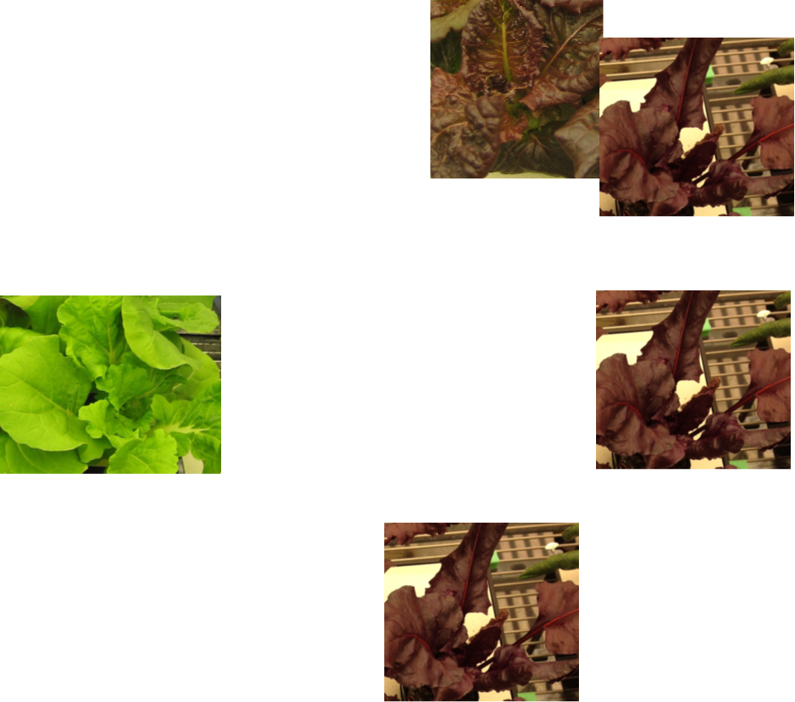
Elemental Factors
All had similar dry matter
Dry Matter
Potassium
Iron
Magnesium
Red lettuce and Beet had excellent potassium
Chinese cabbage had low iron
excellent
Beet had high iron
poor
Beet had excellent magnesium

Slide 27

Elemental Factors
Calcium
Elemental Ranking
Plant Growth + Elemental Combined Ranking
Chinese cabbage, beet, Mizuna and Swiss chard had similar high calcium
excellent

Slide 28




Nutrient Factors
Antioxidants
Lutein & Zeaxanthin
Vitamin K
Nutrient Ranking
Red lettuce and Swiss chard had high antioxidants excellent
Swiss chard had high Lutein and Zeaxanthin excellent
Mizuna had high Vitamin K excellent

Slide 29

Organoleptic Factors
Overall Acceptability, Flavor, & Texture
Appearance & Color
Bitterness
Hedonic Scale
Chinese cabbage had excellent overall acceptability, flavor, and texture
Swiss chard and Chinese Cabbage had excellent appearance and color
All crops had acceptable bitterness.
All crops had hedonic scores > 6 for all parameters

Slide 30
Organoleptic Factors
Crispness & Tenderness
Organoleptic Ranking
Overall Ranking
Chinese cabbage was “Just about right” for crispness and tenderness
excellent

Slide 31

The International Space Station

Slide 32





Example crops tested in plant pillows
Snow pea
Swiss chard
Red lettuce
Dwarf
Chinese
cabbage
Radish
Zinnia
Petunia
Marigold

Slide 33

Veggie on ISS

Slide 34















Slide 35

Notes:
View of Earth from the ISS – 2012
The International Space Station is a groundbreaking scientific research facility. Through advancing the state of scientific knowledge of our planet, looking after our health, and providing a space platform that inspires and educates the science and technology leaders of tomorrow, the benefits discussed today will drive the legacy of the space station as its research strengthens economies and enhances the quality of life on Earth for all people.

