Slide 1

Pathways Student Showcase
Peter Buckoski

Slide 2

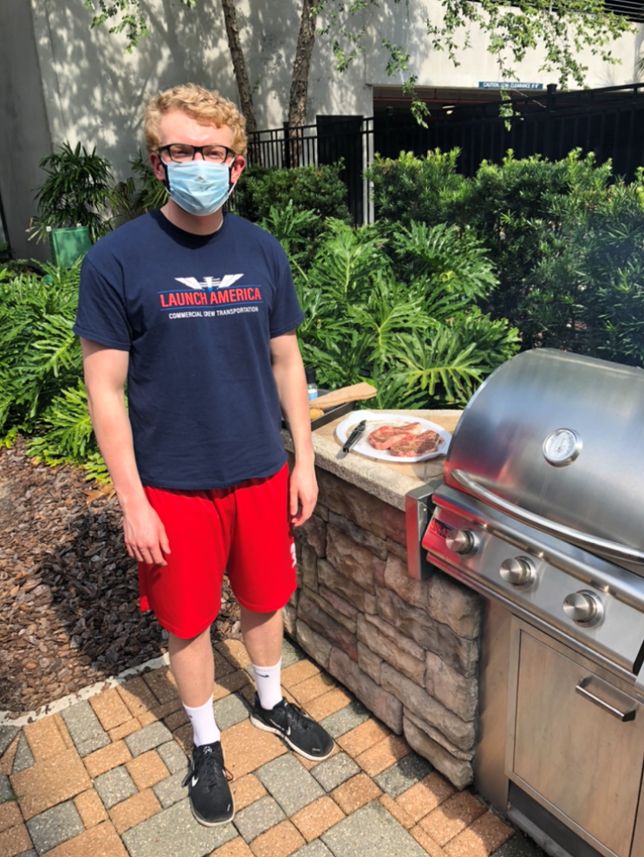
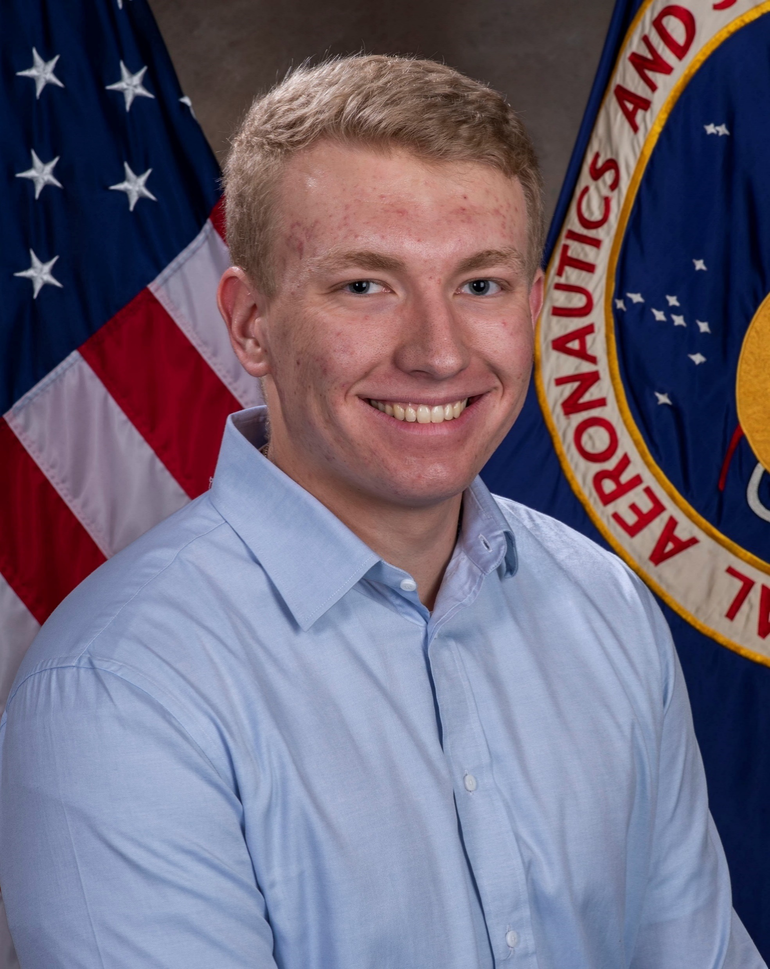

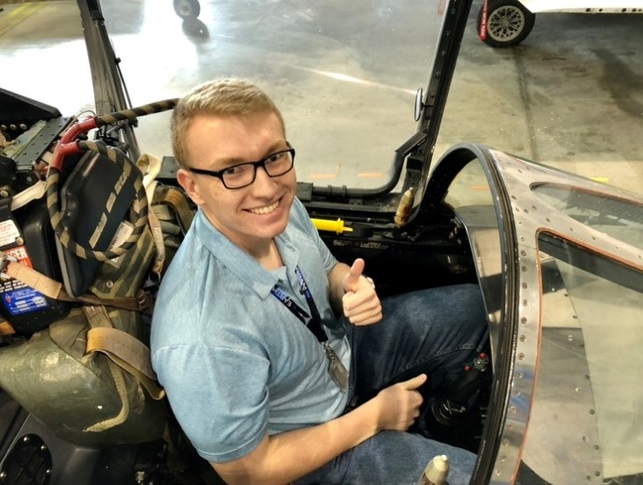
Peter Buckoski
University of Florida
Undergraduate Senior studying Mechanical Engineering
Graduate May 2021
KSC NE-XX
Engineering Directorate
Exploration Systems & Operations Division
Storable Propellants & Hydraulic Systems Branch

Slide 3

Storable Propellants & Hydraulic Systems Branch (NE-XX)
NE-XX is responsible for the design, development, and operations of ground support equipment (GSE) to service Orion Propulsion System, the Mobile Launcher (ML) umbilical's hydraulic systems, and the Thrust Vector Control (TVC) Hydraulic Sub-System (THSS) for Space Launch System (SLS). NE-XX is also responsible for the software development for flight and GSE operations.
Throughout the internship, I have completed various projects in design, software development, and processing operations primarily supporting Orion Propulsion System servicing

Slide 4
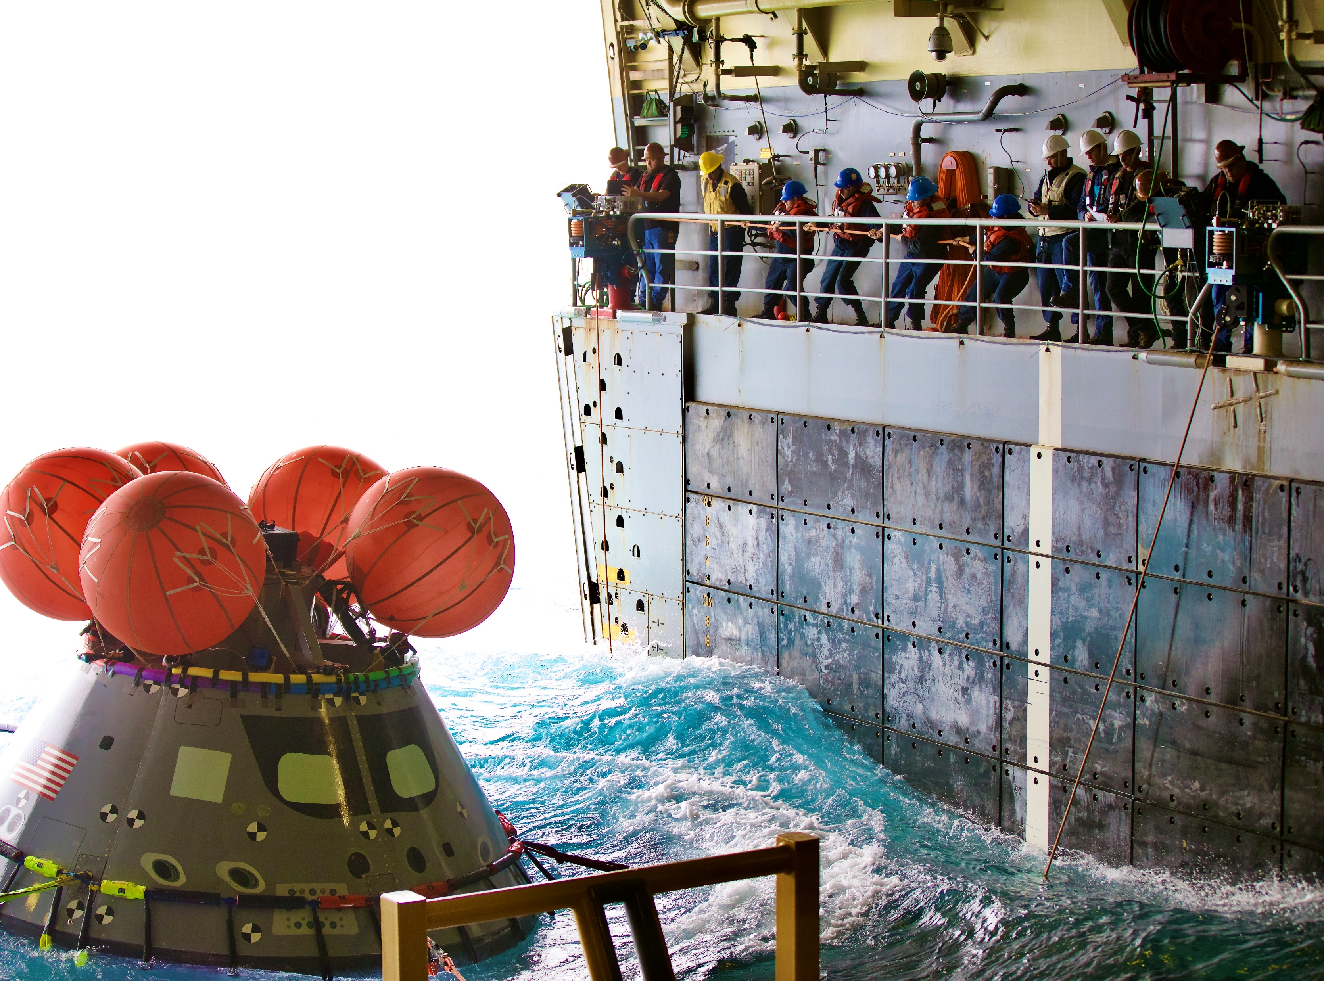
Design Projects
Lockheed Martin Filter Kit Drawings
  Filter assemblies that interface with Orion for propellant servicing
  NASA gained ownership of assemblies from Lockheed Martin
  Uploaded drawings into Kennedy Design and Data Management System (KDDMS)
    Large undertaking due to Lockheed Martin having a much different design protocol and system from NASA
    Updated and revised every model, assembly, and drawing to be compatible with KSC system

Slide 5
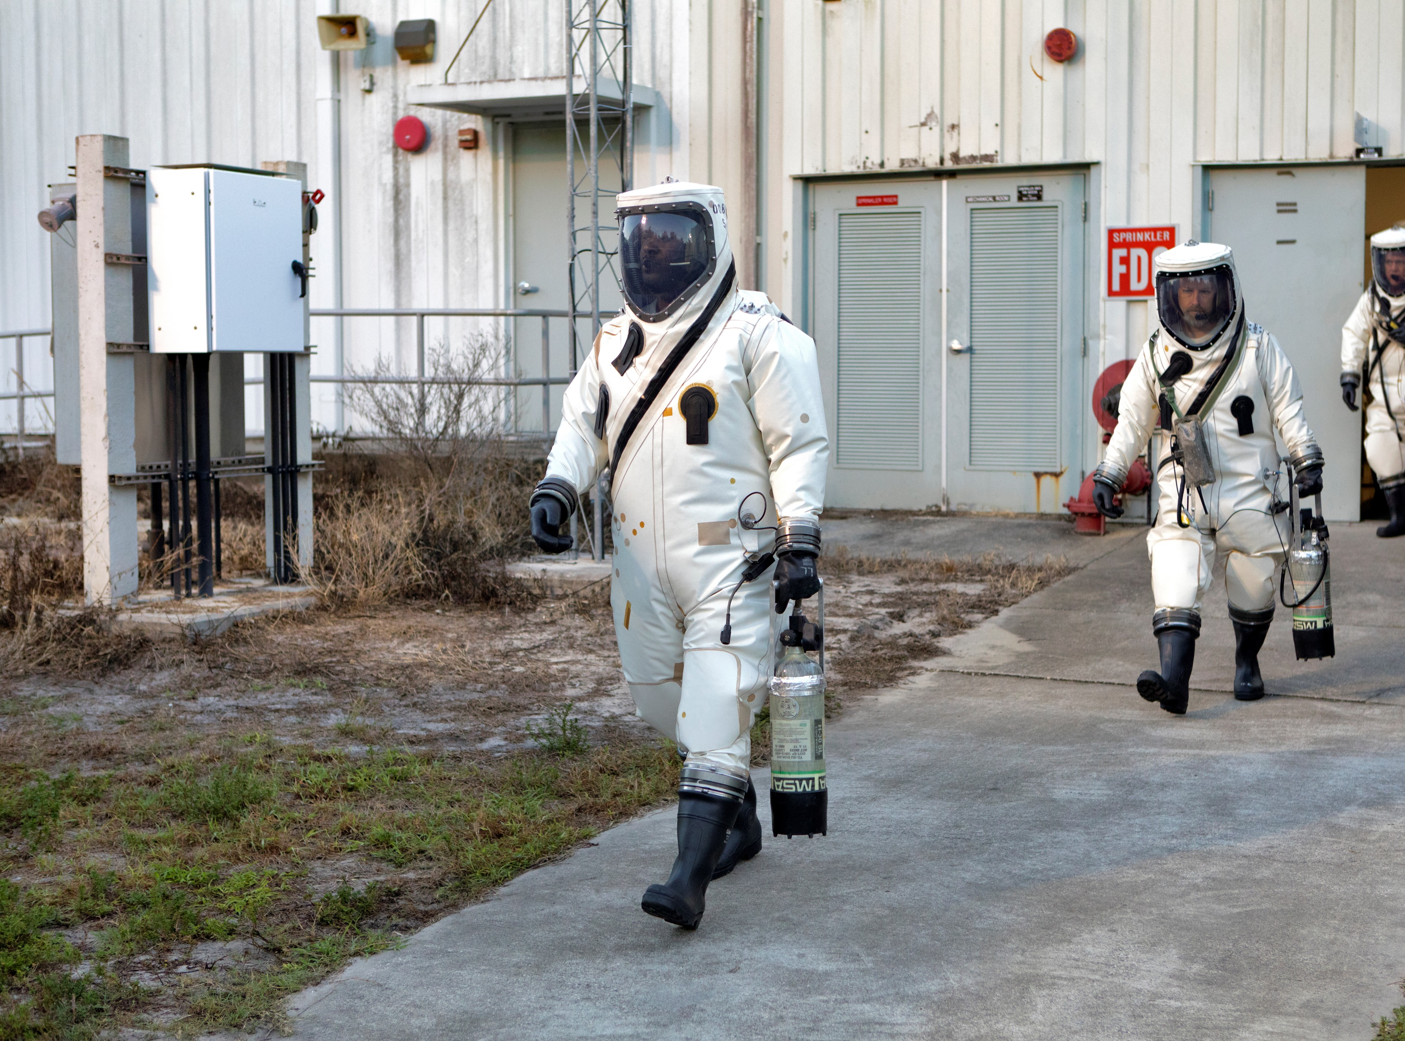
Design Projects continued
Fuel and Oxidizer Calibration Panels
  In-place calibration of instrumentation in MPPF
    More efficient than removal of components needing calibration
    Greatly reduces time required for decontamination and cleaning
  Using Creo to make fluids schematic and panel drawings

Slide 6
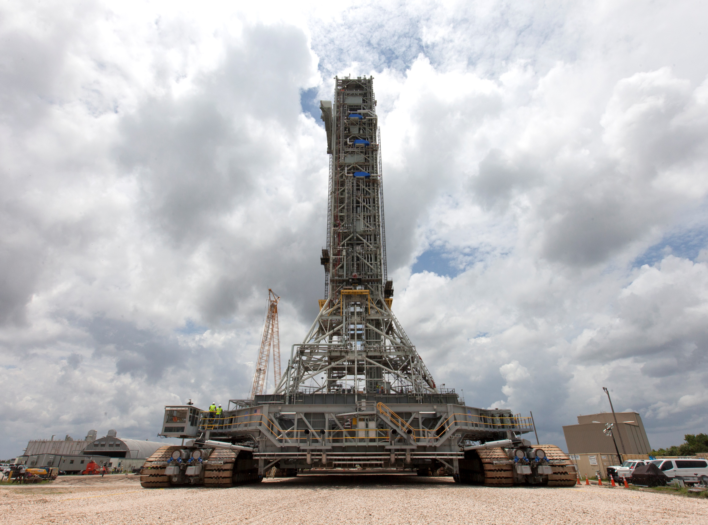
Design Projects continued
Hypers and Hydraulics Servicing Bathtubs for ML2
  Located on ML where technicians can hook up flexhoses and supply vehicle with GN2 and GHe
  Improvement upon design from ML1
    Flexhose routing
    Drainage/Clog mitigation
    Technician accessibility (SCAPE)
  Researched solutions and created design using Creo
    Angled bathtub
    Larger drain
    Increased size

Slide 7
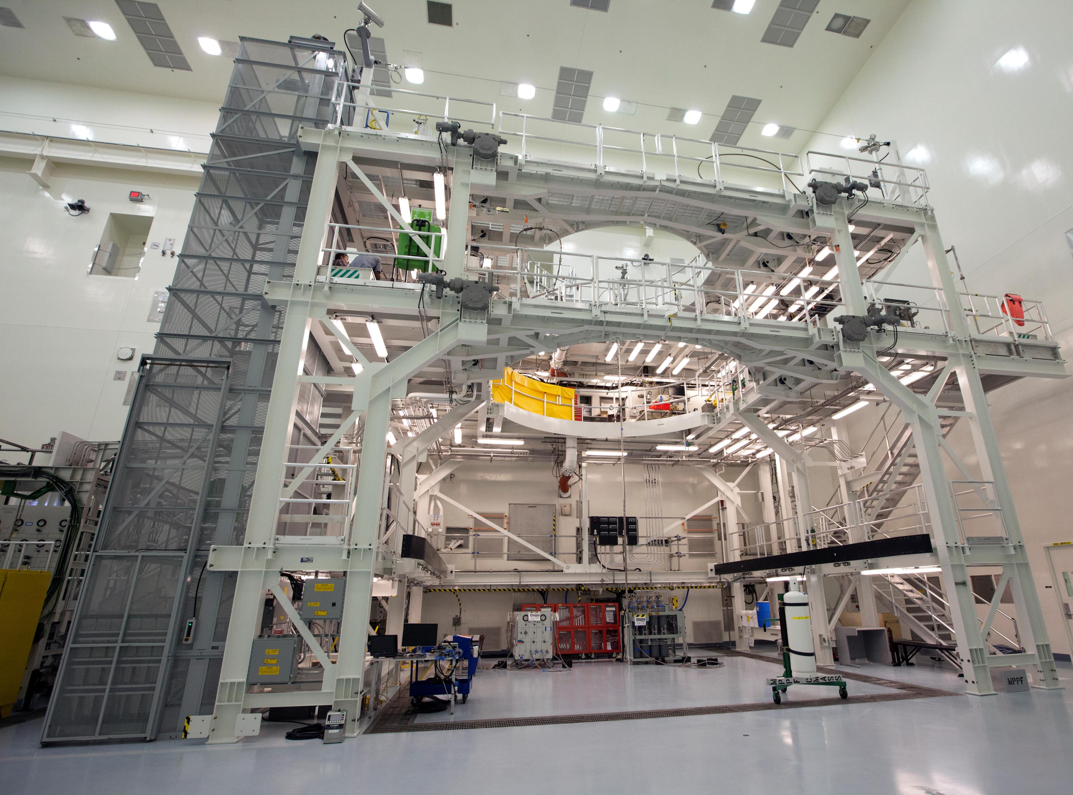
GSE Software Development
Divergence Detectors
  Software development of divergence detectors for Orion propellant servicing
  Calculates running total of propellant transferred from tanks using load cells
  Calculates divergence between load cells, load cells to flow meter, and sum of both for compound divergence
    Hydrazine divergence detector (CM)
    MMH divergence detector (SM)
    C programming language
  Software Requirements and Design Specification (SRDS)
  Test Procedures
  Assisted in console display

Slide 8
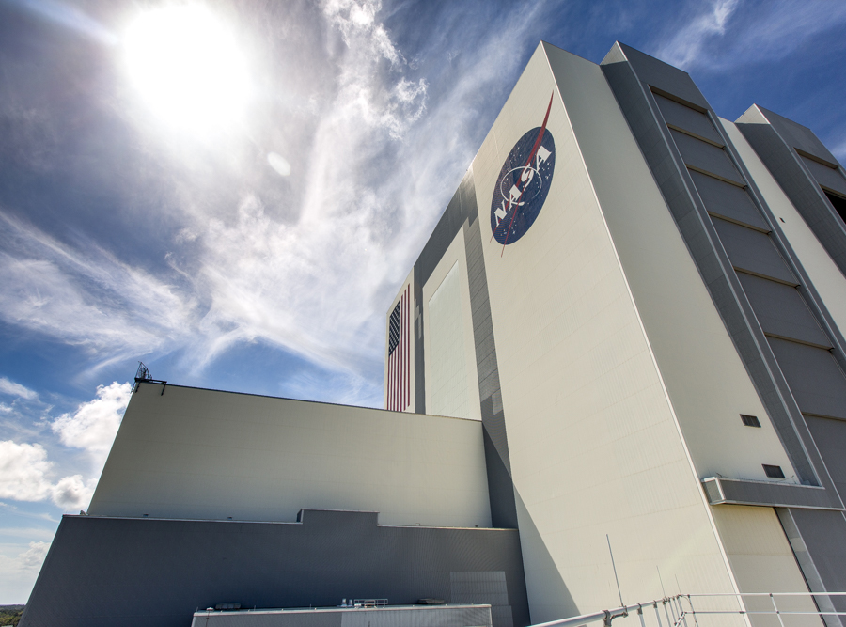
Other Projects
Orion GN2 pneumatic pack repressurization operations
  Reviewing work authorization documents (WADs)
  Providing a sketch of test demonstration setup
Hydrazine decomposition volume
  Calculations for volume of gas produced from hydrazine reacting through cat bed
  Assist in thruster plugs analysis based on possible pressure developed during L&R
Analysis for Contingency Operations
  Fluid analysis of how long k-bottle manifold would last for contingency operations on Orion at LASF, VAB, and Pad 39B
KSC-STD-Z-0006
  Verified reference document validity for new revision of “Standard for Design of Hypergolic Ground Support Equipment”

Slide 9
Skills & Competencies Developed
Advantages and hazards of using hypergolic propellants (hydrazine, MMH, NTO)
KSC Engineering Design and Technical Review Process
Engineering Drafting and Drawing Practices
Computer aided drafting using Creo
Software development process
C programming language
Kennedy Design and Data Management System (KDDMS)
Technical procedure reviewing within Solumina
Pressure relief devices

Slide 10
Significance of Experience
Contributing to projects that support Artemis program
  Helping NASA get back to the Moon and then on to Mars
Being able to work with and learn from a very knowledgeable, driven, and diverse group of people
Being able to apply what I have learned from school to internship projects
  Mechanical Design
  Fluid Mechanics
  Computer Aided Design
  Computer Programming
Life changing experience
  Deepened my passion for space exploration and hope to continue to support NASA’s goals and missions

Slide 11
Thank you!
Pablo Aguayo – NE-XX Branch Chief
My many mentors – Gabriela Escalera, Andrew Christopher, Brandon Johnston, Alyssa Garcia, John Peters
All the members of NE-XX for welcoming me and making me feel like an integral part of the team since day one
Pathways office

