Slide 1
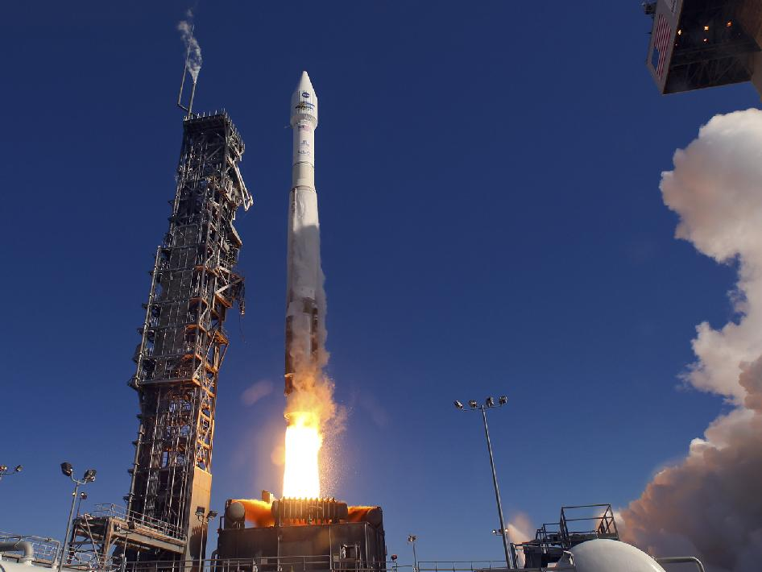
Engineering Intern
LSP – Flight Dynamics
GN&C Group
(VA-H1)
Jimmy Smith

Slide 2
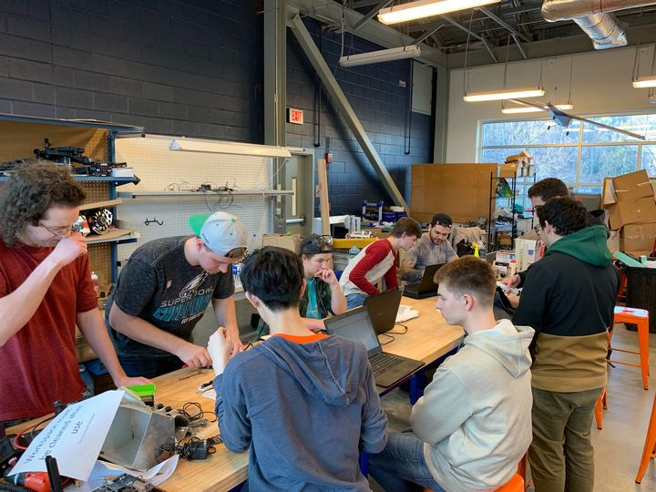
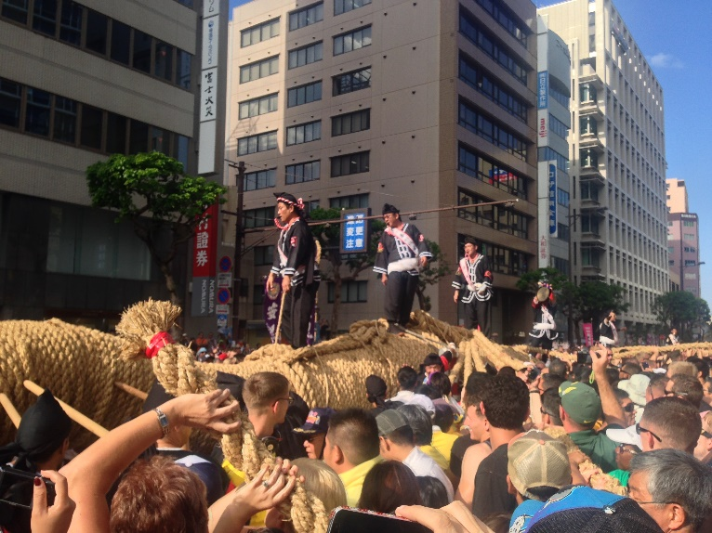
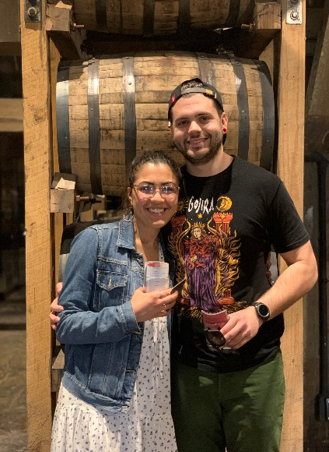
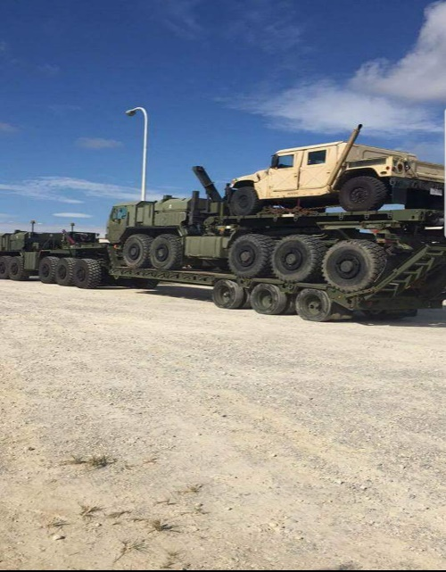

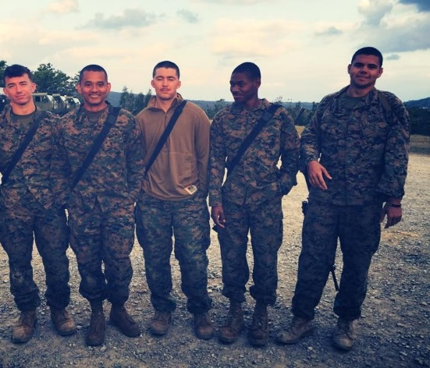
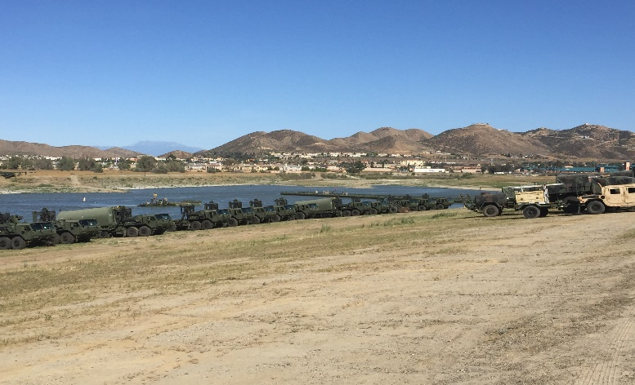

Personal Introduction
Notes:
University of Virginia (Class of 2021)
Major: Aerospace Engineering
Minor: Astronomy
Club Involvement: President of High-Powered Rocketry Club (HPRC), Student Veterans of America (SVA), and Students for the Exploration & Development of Space (SEDS)
Marine Corps (2012 – 2016)
Served with two different USMC combat engineering battalions
Stationed in Okinawa, Japan & San Diego, CA
Bridge build and driving a truck with a truck on it that has a truck on it
Travel
Silra dive

Slide 3
Project – BENDING VISUALIZATION TOOL DEVELOPMENT

Slide 4
Overview
Bending Visualization Tool Development
TASK: Create a tool using MATLAB that allows users to select bending data from various missions and visualize the bending modes of the vehicle in both the frequency and time domains
REQUIREMENTS:
  Tool integrates several previously developed bending visualization programs into one coherent and intuitive interface to create a robust and diverse tool.
  Functionality for a variety of launch vehicles from different companies
  Capable of generating 3-D animations of the various modes of bending present in the vehicle data across the duration of the launch
  Capable of generating bode plots of frequency response for various user selected bending modes for both general and targeted analysis
  Allow user to view the semi-raw data ingested by the tool from the provided data file
  Include all of the above capabilities in one interface that allows users to seamlessly switch between features and functions
Notes:
What LSP & the flight dynamics branch do
What you do at LSP – Ground Navigation & Controls (primarily focused on controls)
Talk generally about requirements
Integrate old tools
Works with various launch vehicles
Show 3D animations of bending modes across time domain
Frequency response plots for user selected bending modes (targeted and general cases)
Data table
All-in-one

Slide 5
Relevance
Relevance of Flexure on Mission Success
Bending has impacts on both the structure and performance of the vehicle
Can impact the active thrust vector of the vehicle and therefore its trajectory an control system stability
Accurate knowledge can allow flight engineers to account for bending via the on-board engine gimbaling software and control systems
Tool can help build an intuition for how vehicle is flexing throughout launch
Time domain simulation with bending modes is costly. Tool helps engineers to down select to only the most important bending subset
Notes:
Talk to the importance of bending
Effects on thrust vector
How thrust vector can impact trajectories
How bending can confuse the onboard computers into thinking it is properly gimbaling
Understanding can allow for more accurate on-board systems accounting for the bending
Aid in building intuition

Slide 6
Theory & Development
General structural dynamics, beam theory and frequency response theory was used for the development of mode deflections and bode plots
MATLAB App Designer chosen as development environment
Pre-existing tools were updated such that they functioned on their own and then adapted to be functional in new environment
New features added to meet requirements and increase fluidity
App Logic Flow Chart
Tab Selection Changed?
User Runs App
Mode Visualization Tab
Frequency Response Tab
Table Tab
Data location?
Interprets which data reader to use
Translation/Rotation?
Time?
Modes?
Stage?
Cell Selected?
Stage?
Data Vendor?
Ingests data
Time?
Mode?
Stage?
General/Targeted Analysis?
Expand selected data
Runs initial analysis
General
Targeted
Generate Tables
Generate Plots
Input Force?
Output Response?
Analysis Plane?
Input Loc?
Output Loc?
Notes:
Rocket can be thought of as a free-free beam during launch and a fixed-free beam when bolted to the pad
Explain how the two cases effect bending using ruler analogy
MATLAB App Designer chosen as environment because of it’s interface building features and the power of the MATLAB software
Pre-existing tools updated and adapted
New functionality and features added
Brief explanation of logic flow chart
Start-up menu prompts user to select data file via a browser and the data’s respective owner via a drop-down menu
The app then reads in that data and filters it through a reader to import and reformat relevant data in an form that is easy to manipulate
It then generates the default plot for the default view of the interface
From here users have a variety different inputs they can adjust as well as two other tabs to select from with their own interfaces

Slide 7
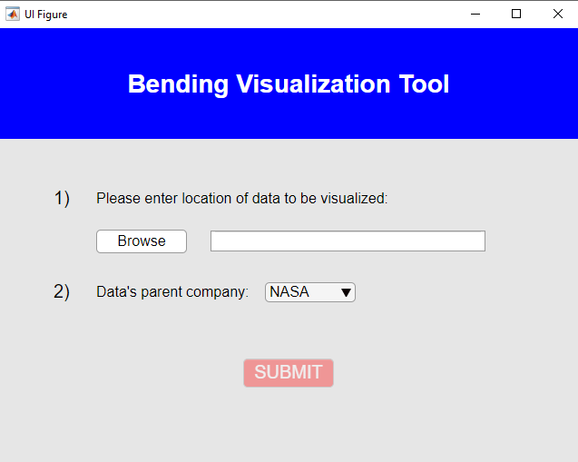
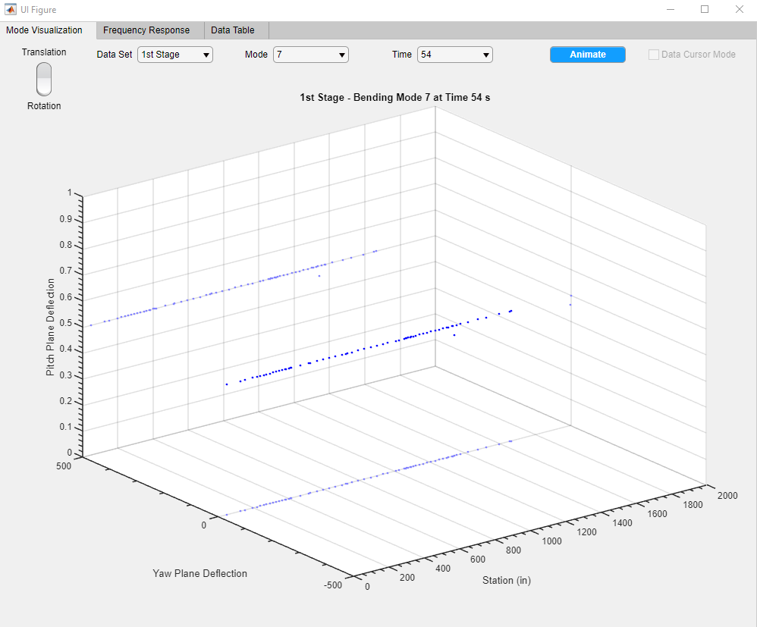
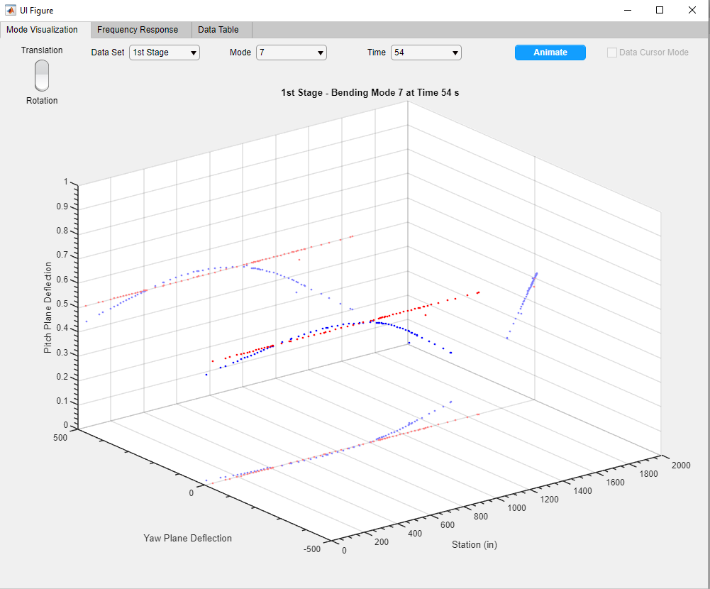
App Interface

Slide 8
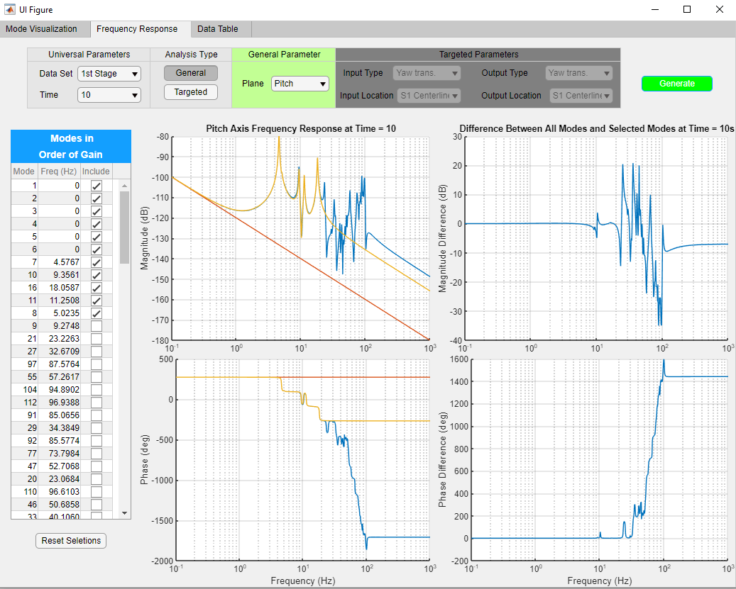
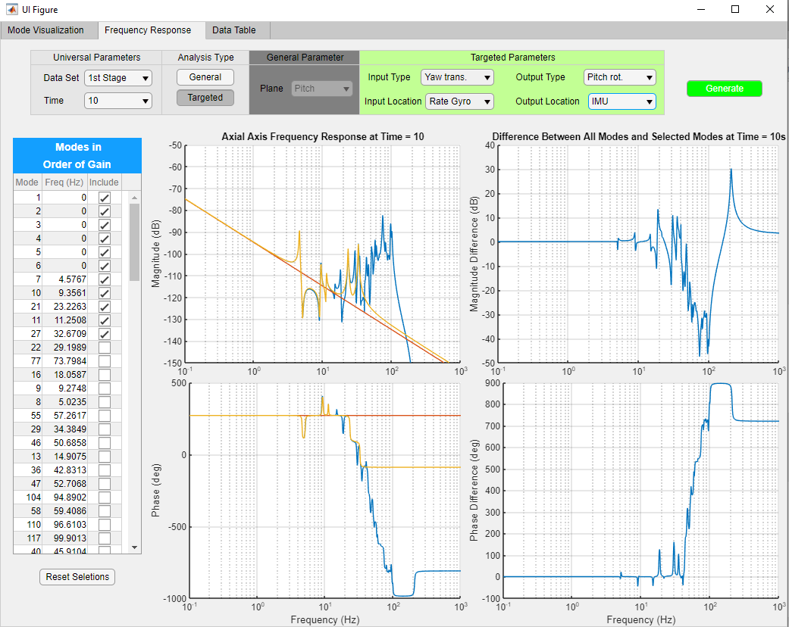
App Interface Cont.

Slide 9
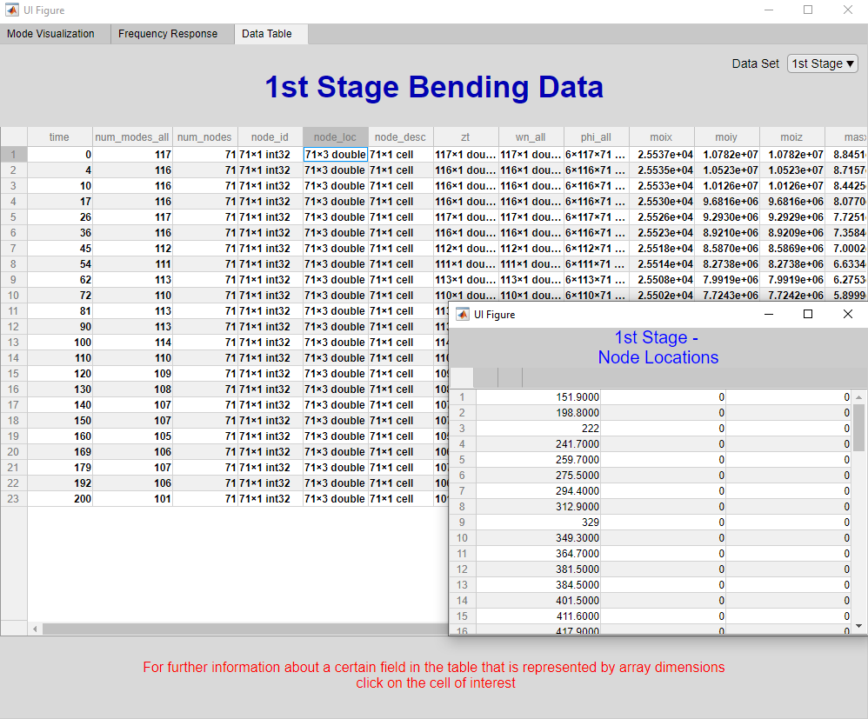

App Interface Cont.

Slide 10
Recap & Conclusion
Recap: App was developed in MATLAB’s App Designer environment that allows users to visualize launch vehicle bending data and responses in a variety of ways without having to run separate programs and open multiple tools
Tasks Remaining:
Create a version in MATLAB r2020a and added data cursor functionality to 3-D visualization plot
Alter code to allow for use with multiple launch vehicles and missions
Increase robustness of targeted frequency response analysis
Personal Project Takeaways:
  Importance and significance of vehicle flexure during launch
  How to develop an analysis tool for general use
  How very niche areas of expertise/analysis contribute to overall operations and mission success
  Just how adaptable and flexible NASA is and can be
Notes:
Recap project
To-Do:
Newer version in 2020a with added functionality
Integrate code for other launch vehicles
Continue to add features and de-bug targeted freq. response
Project takeaways:
Importance of launch vehicle flexure
Developing analysis tools for general use
Coding in a way that logic can be easily followed
How to use the MATLAB App Designer
How seemingly niche areas are needed and contribute to overall mission success
Flexibility and adaptability of NASA and it’s employees

Slide 11
QUESTIONS?

