Slide 1
Performance Tuning Experience from Three Langley Applications
Dan Kokron
NASA Advanced Supercomputing Division
NASA Ames Research Center
NASA/Langley (virtually), 10 July 2020

Slide 2
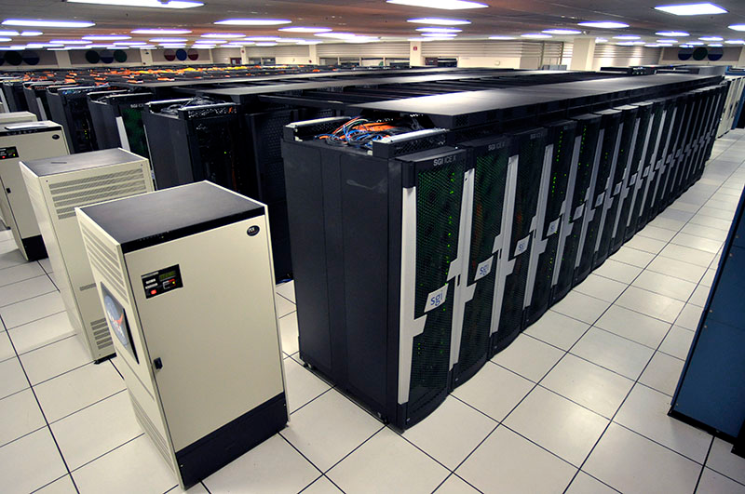
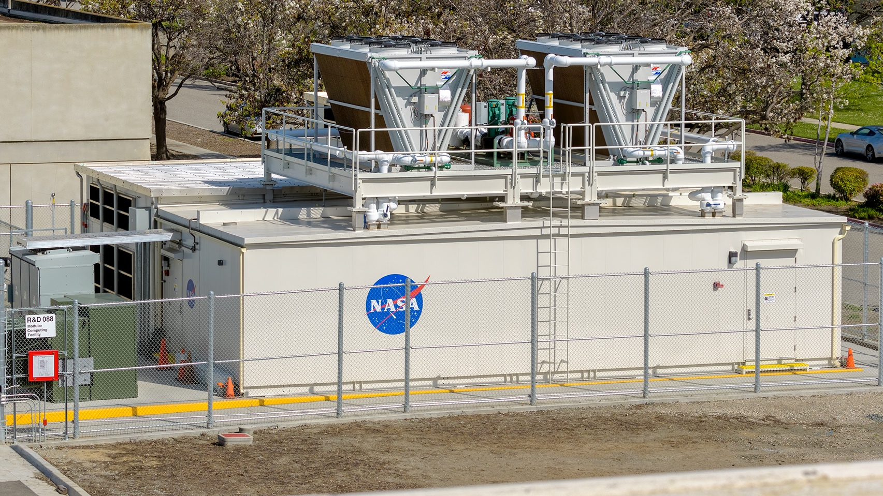

The HECC Project at NASA Ames
High End Computing Capability
Facilitating Science/Engineering at NASA
5 compute systems, including:
  Pleiades: #39 in Top500; #20 in HPCG
  Electra: #46 in Top500; #42 in HPCG
  Aitken: Phase 1 available
Visualization system: 128-node hyperwall
1300+ users from across Agency Missions
  Aeronautics, Human Exploration, Science
~900 MPI applications (+ non-MPI codes)
Goal: Maximize resource delivery to users
Strive for >80% utilization of resources
Embrace new facility technologies
Continually evaluate procurement options
2
Notes:
The High.End.Computing.Capability. (or "HECC") project at Ames has over 1300 users who bring more than 900 different HPC applications to run on its ...
Pleiades: 157 racks/11207 nodes (San, Ivy, Has, Bro) Small GPU cluster 64 nodes of K40, 19 nodes of V100
Electra: 34 racks/3456 nodes (Bro, Sky)
Aitken: 4 E-Cells/1152 nodes (Cas)
Merope: 56 racks/1792 nodes (Wes)
Hyperwall: 128 nodes

Slide 3
Application Performance & Productivity Group
Scientific Consulting
Debugging job failures and I/O issues
Porting codes
Advising on usage of compilers, libraries, tools
Training & Documentation
Application Optimization
Tuning, scaling, parallelization of application codes
Assistance with scripting
Performance Technologies & Tools
Evaluating what’s available
Developing tools as needed—including cloud capability
Developing benchmarks
Sample Activities
Evaluating and Improving User Project Productivity
Automation of System Testing
Cloud Trade Study

Slide 4
Performance Analysis Workflow
  Compile the code with the normal flags adding -g for debug symbols
  Run the test case under a performance analysis tool (profiling)
  Review the profile to see where the bottlenecks are located
  Review the code to look for obvious issues
    loop nesting order
  Review compiler optimization reports (some examples later) to see if the compiler can fully optimize the code
    non-unit stride array access
    irregularly indexed array access (index array)
  Restructure the code and/or add compiler directives until the compiler is able to optimize
  Review the assembly code to ensure vector instructions are actually being used
    the compiler will often generate multiple versions of a loop nest then pick one at runtime
  Compare new science output against the expected output after every change
    revert the modification if it changes the science or hurts performance
  Generate another profile and repeat from step 3
Notes:
Use Vtune or op_scope to view machine instruction.

Slide 5
Role of Tools
Requirements:
  Finding hotspots & load imbalance
  Examine how code was compiled (e.g. vector vs. scalar)
  Low, uniform overhead
Choice of Tool: pros cons
  mpiprof free, low overhead, high-level view only high-level view
  op_scope low overhead, fast GUI even w/o VNC, source line timings licensed, no side-by-side comparison
  Vtune source line timings, side-by-side timings, hw counters GUI is slow in remote env, VNC helps.
  HPCToolkit free, source line timings, side-by-side, low overhead trace GUI is slow in remote env, VNC helps
  Nsight Systems free, timeline view on NVIDIA hardware recommend local install of the viewer
  Nsight Compute free, access hw counters (similar to Vtune) high runtime overhead

Slide 6
Codes and Contributors
HyperSolve
  Developed by Matthew O’Connell, Cameron Druyor, and Kyle Thompson, NASA LaRC
  Optimization team: Kyle Thompson, Gabriele Jost and Dan Kokron
FEMERA
  Developed by David Wagner, NASA LaRC
  Optimization team: David Wagner, Gabriele Jost and Dan Kokron
ALADYN
  Developed by Vesselin Yamakov , NASA LaRC
  Optimization team: Vesselin Yamakov, Gabriele Jost and Dan Kokron

Slide 7
HyperSolve Miniapp
HyperSolve
  is part of NASA Langley’s T-infinity framework, seeking to facilitate decentralized development of software to enable rapid CFD technology maturation.
  It relies heavily on templating features of C++, which often pose challenges to compiler optimizations and resulting performance issues
HyperSolve Miniapp used for this evaluation
  Captures the compute kernel of the full application
  Captures C++ object-oriented programming using templated code
  Captures the use of the Eigen C++ template library for linear algebra
APP conducted
  Performance analysis of the miniapp using op_scope, Intel APS, Intel Vtune
  Implementation of optimizations
    Compiler flags to increase aggressiveness of inlining small functions
    Function decorations to override compiler inlining heuristics

Slide 8
Increase Aggressiveness of Compiler Inlining
gcc 6.2, -g -O3 -mavx2: 49.5 secs
icc v18, -g -O3 -xcore-avx2: 59.5 secs
icc -g -O3 -ipo -xcore-avx2 -finline -inline-forceinline -inline-max-size=300 -inline-level=2: 40.2 secs.
Function Decoration
Building the full application using the aggressive inlining flags was not feasible due to excessive memory consumed by the compiler and excessive compile time
Targeted inlining of certain functions (operator overloads)
  __forceinline (icc)
  __attribute((always_inline)) (gcc)
#if defined (__INTEL_COMPILER)
__forceinline
#else
__attribute__ ((always_inline))
#endif
inline void operator+=(const Ddata<T, n> &rhs) {
value += rhs.value;
for (size_t i = 0; i < n; i++)
derivatives[i] += rhs.derivatives[i];
}
gcc 6.2, -g -O3 -mavx2: 26.8 secs
icc v18, -g -O3 -xcore-avx2: 25.2 secs
Notes:
We also did some work on converting memory layout from Array-of-Structures (AoS) to Structure-of-Arrays (SoA). SoA can improve vectorization.
Skipping tool usage for time. Mainly proves the point that we can’t simply trust that the compiler is doing everything it can do.

Slide 9
FEMERA Node-level Performance
FEMERA
  High performance Finite Element Solver
  Parallelized using OpenMP
  Optimized for use cases across a wide range of problem sizes
Objectives
  Vectorization of the physics kernel
  Optimize memory bandwidth: preferably all data should come from L1
  Femera-Miniapp:
    Captures the compute kernel of the full application
    C++
    Recursive invocation of methods
HECC conducted
  Performance analysis of the femera-miniapp using op_scope, Intel APS, Intel Vtune, Intel Vector Advisor
  Experiments with source code modifications and a variety of compiler flags
  Rewrite of critical loops using vector intrinsics
  Suggestions for OpenMP modifications to improve data locality

Slide 10
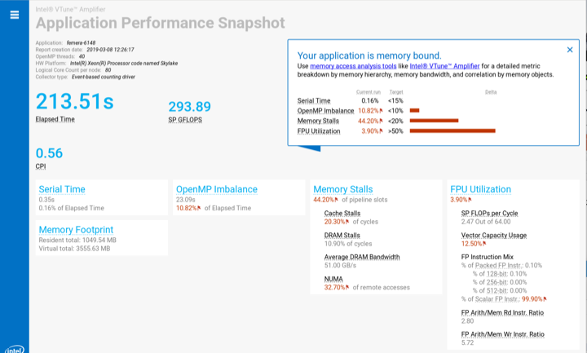
APS indicates significant remote memory access

Slide 11
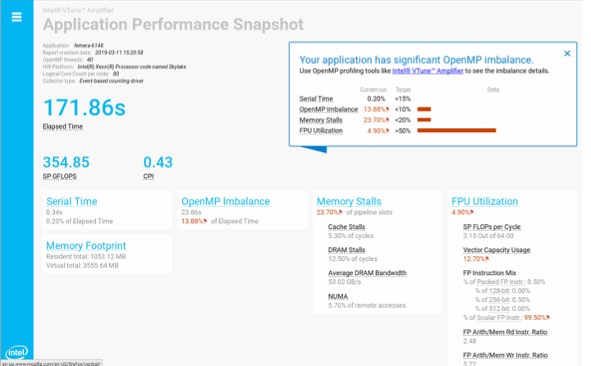
After the developer changed memory layout
Notes:
Developer quickly made changes to ensure each thread had a copy of key data structures

Slide 12
Tall pole loop nest
for(int i=0; i< 9 ; i++){
A[i]=0.0;
}
//#pragma omp simd
for(int k=0; k<Nc; k++){
for(int i=0; i<3 ; i++){
G[3*k+i]=0.0;
for(int j=0; j<3 ; j++){
G[(3*k+i)] += jac[3*i+j] * intp_shpg[ip*Ne+ 3*k+j];
};
for(int j=0; j<3 ; j++){
A[(3*i+j)] += G[(3*k+i)] * u[ndof*k+j];
};
};
for(int i=0; i< 9 ; i++){ A[i]=0.0;};
for(int k=0; k<Nc; k++){
G[3*k+0]=0.0;
G[3*k+0] += jac[3*0+0] * intp_shpg[ip*Ne+ 3*k+0];
G[3*k+0] += jac[3*0+1] * intp_shpg[ip*Ne+ 3*k+1];
G[3*k+0] += jac[3*0+2] * intp_shpg[ip*Ne+ 3*k+2];
A[3*0+0] += G[3*k+0] * u[ndof*k+0];
A[3*0+1] += G[3*k+0] * u[ndof*k+1];
A[3*0+2] += G[3*k+0] * u[ndof*k+2];
G[3*k+1]=0.0;
G[3*k+1] += jac[3*1+0] * intp_shpg[ip*Ne+ 3*k+0];
G[3*k+1] += jac[3*1+1] * intp_shpg[ip*Ne+ 3*k+1];
G[3*k+1] += jac[3*1+2] * intp_shpg[ip*Ne+ 3*k+2];
A[3*1+0] += G[3*k+1] * u[ndof*k+0];
A[3*1+1] += G[3*k+1] * u[ndof*k+1];
A[3*1+2] += G[3*k+1] * u[ndof*k+2];
G[3*k+2]=0.0;
G[3*k+2] += jac[3*2+0] * intp_shpg[ip*Ne+ 3*k+0];
G[3*k+2] += jac[3*2+1] * intp_shpg[ip*Ne+ 3*k+1];
G[3*k+2] += jac[3*2+2] * intp_shpg[ip*Ne+ 3*k+2];
A[3*2+0] += G[3*k+2] * u[ndof*k+0];
A[3*2+1] += G[3*k+2] * u[ndof*k+1];
A[3*2+2] += G[3*k+2] * u[ndof*k+2];
}
Notes:
The compiler refused to vectorize the code at left no matter what directives we used
Unrolling the inner loops by hand revealed some data reuse

Slide 13
G[0] = (jac[0]*intp_shpg[ip*Ne+0]) + (jac[1]*intp_shpg[ip*Ne+1]) + (jac[2]*intp_shpg[ip*Ne+2]);
G[1] = (jac[3]*intp_shpg[ip*Ne+0]) + (jac[4]*intp_shpg[ip*Ne+1]) + (jac[5]*intp_shpg[ip*Ne+2]);
G[2] = (jac[6]*intp_shpg[ip*Ne+0]) + (jac[7]*intp_shpg[ip*Ne+1]) + (jac[8]*intp_shpg[ip*Ne+2]);
A[0] = G[0]*u[0]; A[3] = G[1]*u[0]; A[6] = G[2]*u[0];
A[1] = G[0]*u[1]; A[4] = G[1]*u[1]; A[7] = G[2]*u[1];
A[2] = G[0]*u[2]; A[5] = G[1]*u[2]; A[8] = G[2]*u[2];
G[3] = (jac[0]*intp_shpg[ip*Ne+3]) + (jac[1]*intp_shpg[ip*Ne+4]) + (jac[2]*intp_shpg[ip*Ne+5]);
G[4] = (jac[3]*intp_shpg[ip*Ne+3]) + (jac[4]*intp_shpg[ip*Ne+4]) + (jac[5]*intp_shpg[ip*Ne+5]);
G[5] = (jac[6]*intp_shpg[ip*Ne+3]) + (jac[7]*intp_shpg[ip*Ne+4]) + (jac[8]*intp_shpg[ip*Ne+5]);
A[0] += G[3]*u[3]; A[3] += G[4]*u[3]; A[6] += G[5]*u[3];
A[1] += G[3]*u[4]; A[4] += G[4]*u[4]; A[7] += G[5]*u[4];
A[2] += G[3]*u[5]; A[5] += G[4]*u[5]; A[8] += G[5]*u[5];
G[6] = (jac[0]*intp_shpg[ip*Ne+6]) + (jac[1]*intp_shpg[ip*Ne+7]) + (jac[2]*intp_shpg[ip*Ne+8]);
G[7] = (jac[3]*intp_shpg[ip*Ne+6]) + (jac[4]*intp_shpg[ip*Ne+7]) + (jac[5]*intp_shpg[ip*Ne+8]);
G[8] = (jac[6]*intp_shpg[ip*Ne+6]) + (jac[7]*intp_shpg[ip*Ne+7]) + (jac[8]*intp_shpg[ip*Ne+8]);
A[0] += G[6]*u[6]; A[3] += G[7]*u[6]; A[6] += G[8]*u[6];
A[1] += G[6]*u[7]; A[4] += G[7]*u[7]; A[7] += G[8]*u[7];
A[2] += G[6]*u[8]; A[5] += G[7]*u[8]; A[8] += G[8]*u[8];
The k=0 iteration expands to this set of instructions
We see clearly that each value in intp_shpg is used 3 times
We see that each value in jac is also used three times
Notice that I haven’t initialized the A[]
Let’s try Explicit Vectorization aka vector instrinsics
Available in C and C++, no direct FORTRAN support
Works with Intel and GNU compilers
Often able to generate more efficient machine code using intrinsics than the compiler is able to generate from high level code
One example is triangular loop nests such as found in Gaussian elimination
Another case is the multi vector dot product in PETSc (VecMDot_Seq)
https://software.intel.com/sites/landingpage/IntrinsicsGuide

Slide 14
__m256d j0,j1,j2;
j0 = _mm256_loadu_pd(&jac[0]); // j0 = [j3 j2 j1 j0]
j1 = _mm256_loadu_pd(&jac[3]); // j1 = [j6 j5 j4 j3]
j2 = _mm256_loadu_pd(&jac[6]); // j2 = [j9 j8 j7 j6]
_MM256_TRANSPOSE3_PD(j0,j1,j2); // [ j6 j3 j0]
// [ j7 j4 j1]
// [ j8 j5 j2]
__m256d s0,s1,s2,s3,s4,s5, a036, a147, a258;
__m256d u0,u1,u2,u3,u4,u5,g0,g1,g2;
__m256d is0,is1,is2,is3,is4,is5;
double * restrict isp = &intp_shpg[ip*Ne];
is0= _mm256_set1_pd(isp[0]); is1= _mm256_set1_pd(isp[1]); is2= _mm256_set1_pd(isp[2]);
u0 = _mm256_set1_pd( u[0]); u1 = _mm256_set1_pd( u[1]); u2 = _mm256_set1_pd( u[2]);
s0 = _mm256_mul_pd(j0,is0) ; s1 = _mm256_mul_pd(j1,is1) ; s2 = _mm256_mul_pd(j2,is2);
g0 = _mm256_add_pd(s0, _mm256_add_pd(s1,s2));
a036 = _mm256_mul_pd(g0,u0); a147 = _mm256_mul_pd(g0,u1); a258 = _mm256_mul_pd(g0,u2);
_mm256_storeu_pd(&G[0],g0);
is3= _mm256_set1_pd(isp[3]); is4= _mm256_set1_pd(isp[4]); is5= _mm256_set1_pd(isp[5]);
u3 = _mm256_set1_pd( u[3]); u4 = _mm256_set1_pd( u[4]); u5 = _mm256_set1_pd( u[5]);
s3 = _mm256_mul_pd(j0,is3) ; s4 = _mm256_mul_pd(j1,is4) ; s5 = _mm256_mul_pd(j2,is5);
g1 = _mm256_add_pd(s3, _mm256_add_pd(s4,s5));
a036 = _mm256_add_pd(a036, _mm256_mul_pd(g1,u3)); a147 = _mm256_add_pd(a147, _mm256_mul_pd(g1,u4)); a258 = _mm256_add_pd(a258, _mm256_mul_pd(g1,u5));
_mm256_storeu_pd(&G[3],g1);
Second attempt: Transpose jac first!
We can avoid all those shuffles if we transpose the jacs first
The code at left shows 2 iteration of the ‘k’ loop
This time we broadcast individual values from intp_shpg and u instead of loading them sequentially
After the multiplies, each s# register holds only one component that makes up G
Adding the s# registers together yields three complete values of G (g#) which we store for later use (hoping they stay in L1)
Simply adding the g# onto the a# accumulators completes one iteration
Here I show two iterations using different registers to show how both iterations can be scheduled somewhat independently
Note that the a# accumulators are labeled with the indexes where they will land in the A matrix. We need to transpose the a# registers before storing to &A[]
Notes:
Not showing first attempt to save time
This basic approach was implemented though out the FEMERA kernel
Don’t trust that the compiler is doing everything it possibly can do.

Slide 15
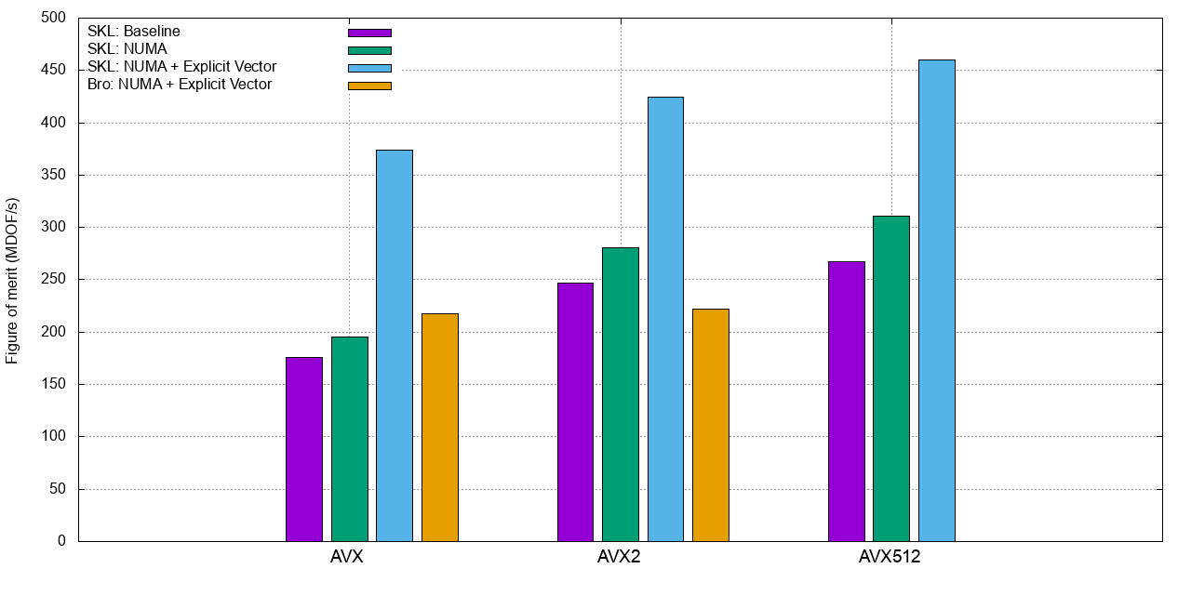
Notes:
This code benefits from skylake having two vector units (blue versus orange)

Slide 16
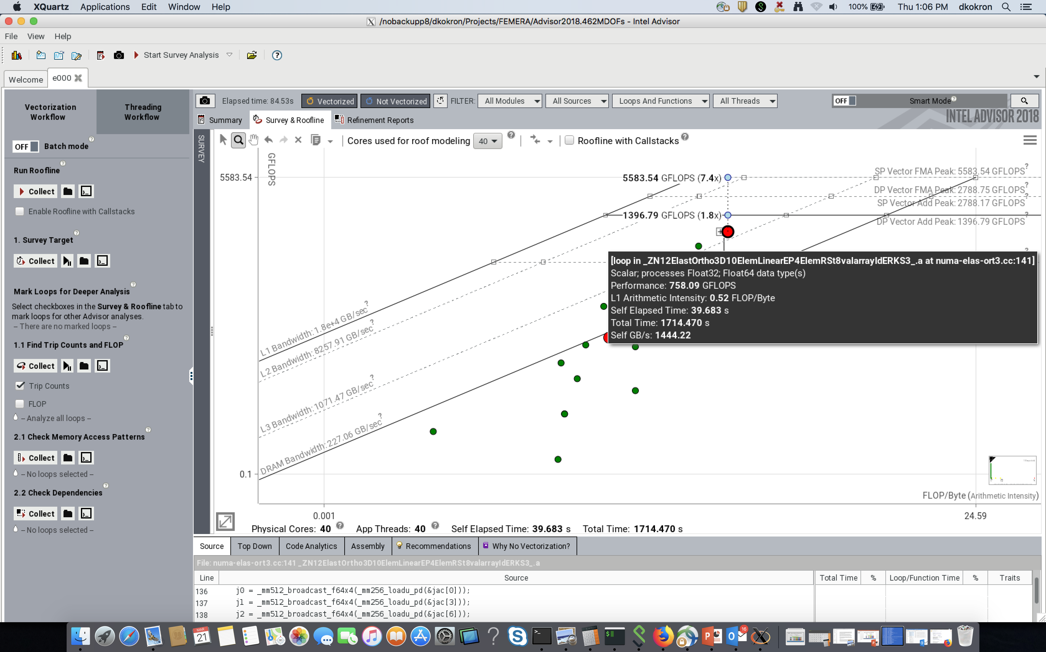
Notes:
758 Gflops is ~27% of peak (40*2.2GHz*32 FLOPS/Hz = 2816 GFLOPs)

Slide 17
ALADYN Miniapp
ALADYN
  ALADYN is a mini-app approximating a full Molecular Dynamics (MD) code.
  A defining feature of this MD code is the use of an interatomic potential generated from an Artificial Neural Network (ANN) that is trained on smaller quantum (DFT) simulations
APP conducted
  Performance analysis of the miniapp using
    op_scope: to focus the optimization efforts
    compiler optimization reports: tell us what the compiler did or did not do
    Intel Vtune: to verify our work and let us know when to stop
    Intel Advisor: to verify our work and let us know when to stop
  Implementation of optimizations
    OpenMP scheduling
    Compiler directives to convince the compiler to vectorize
    Hoist memory alloc/dealloc out of time loop
    Memory layout changes to avoid gathers
    Initialize arrays in parallel to avoid NUMA access
Notes:
Not showing work done to use OpenACC
Not showing work done on port to CUDA Fortran (multi-GPU)

Slide 18
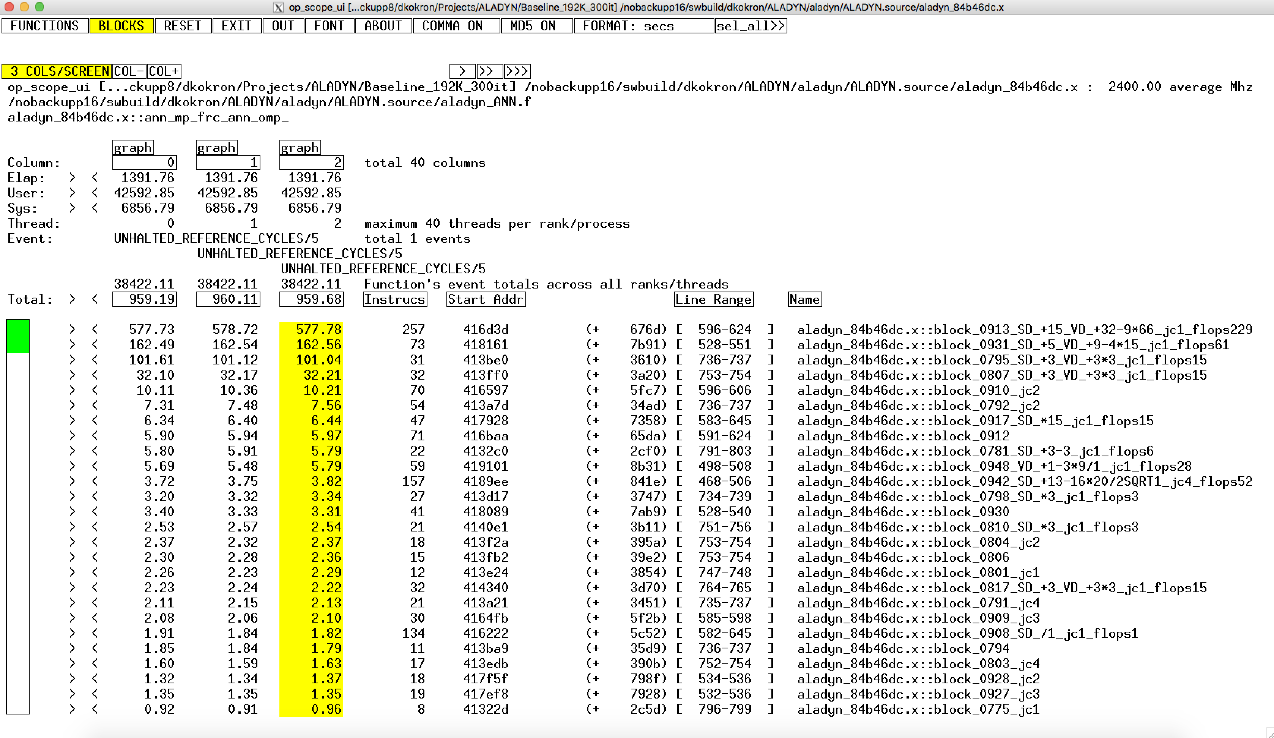
op_scope
VD=Vector Double -> SSE

Slide 19
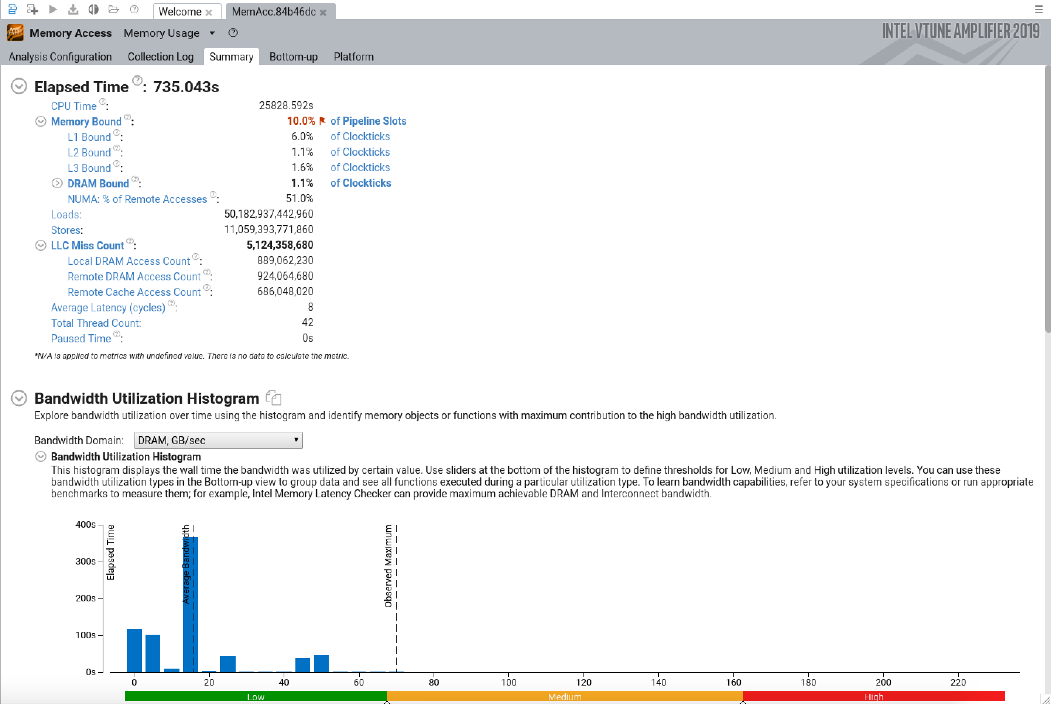

Slide 20
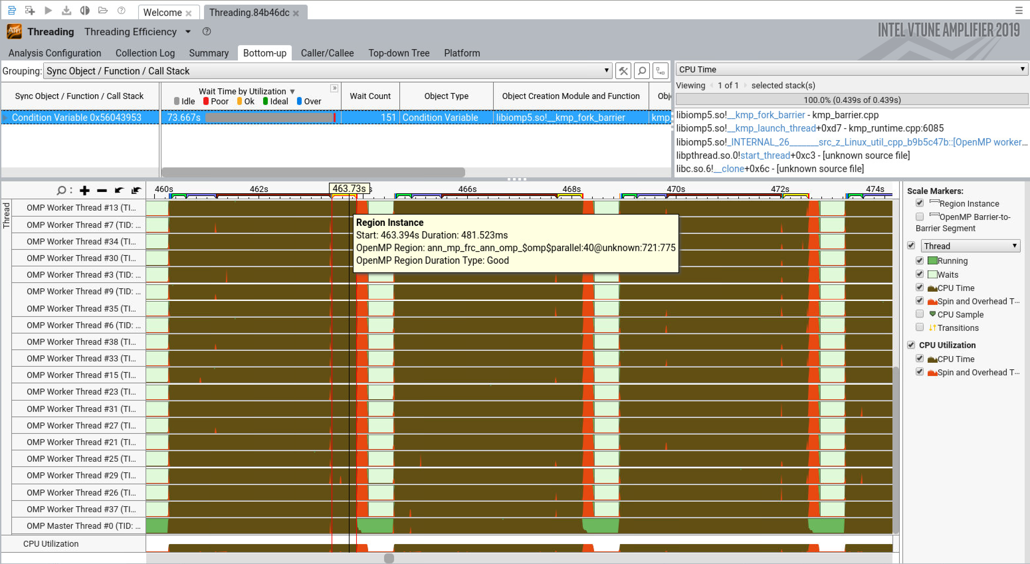

Slide 21
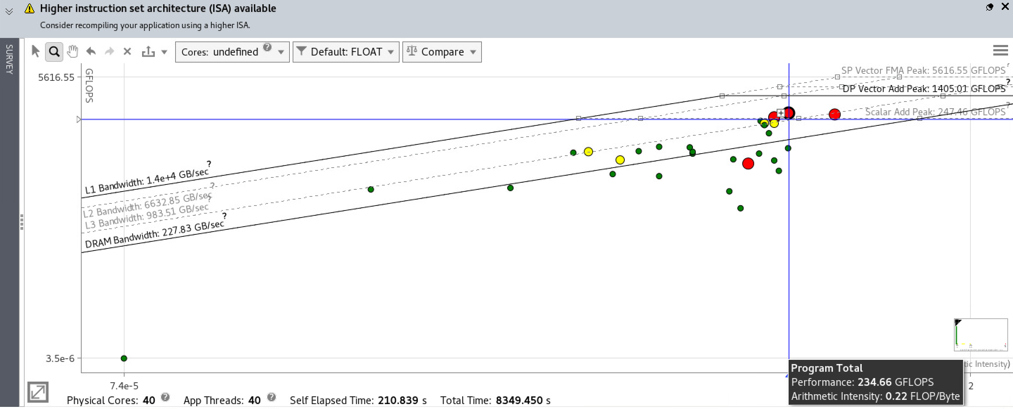

Slide 22
Tools and major findings from each
ifort (2019.3.199) optimization reports (-qopt-report=5)
  Inefficient memory layout for some arrays resulting in gathers
op_scope (4.13)
  Default compilation flags target SSE with good looking assembly
  Only a few hotspots to deal with
vtune (2019.3)
  memory-access
    highlights high NUMA access ratio (51%; want this to be zero)
    very good average latency (8 cycles) indicating the code is running from L1 and L2
    DRAM bandwidth usage is far below the capabilities of the hardware (peak 69GB/s of 230GB/s)
  μarch exploration
    CPI Rate: 0.416 (ideal is ~.25; typically see this in the range 0.5-1)
      https://software.intel.com/en-us/vtune-amplifier-help-clockticks-per-instructions-retired-cpi
    Vector Capacity Usage (FPU): 24.8%
    Average CPU Frequency: 3.045 GHz (Nominal 2.400 GHz)

Slide 23
Tools and major findings from each (cont)
vtune (2019.3)
  threading
    Effective CPU Utilization: 41.6% (33.3 out of 80 logical CPUs) (want this to be 40 out of 80)
    Serial Time (outside parallel regions): 236.736s (16.5%)
    Spin and Overhead Time: 2945.736s (5.8% of CPU Time)
  Hardware counter for REMOTE_DRAM
    What’s going on at line 599 of ALADYN_ANN.f?
advisor (2019.3)
  235 GFLOP/s (~8% of DP peak)

Slide 24
Optimization Ideas and results
NUMA
  Change OpenMP scheduling from dynamic,16 to static
    Big reduction in remote access
    Actually slower but will keep using static because it should be better
Compiler options
  -O3 -----> -O3 -xcore-avx2 -----> -O3 -xSKYLAKE-AVX512
    Big speedup from using AVX2
    No benefit from AVX512
Transpose dfs_rij_3D
  allocate(dfs_rij_3D(3,max_nbrs,natoms,n_set_ann)) becomes
  allocate(dfs_rij_3D(3,n_set_ann,max_nbrs,natoms))
Split arrays with short (3) leading dimension (use three scalars or arrays instead)
  dfs_rij_3D, xr_ij_dev, Gi_sum_*, Gi_3D_dev, U1f, U2f
  Compiler report indicates good things but no benefit at SSE, AVX2 and only small speedup at AVX512
Hoist alloc/dealloc from Frc_ANN_OMP()
  Effective CPU Utilization: 46.6% (37.296 out of 80 logical CPUs)
  Serial Time (outside parallel regions): 5.355s (4.0%)
  Spin and Overhead Time: 200.652s (3.9% of CPU Time)

Slide 25
Optimizations ideas (cont)
Ensure that max_nbrs is a multiple of 8 in get_neighbors()
  if (mod(max_nbrs,8) .ne. 0) max_nbrs = ((max_nbrs/8)+1)*8
Inform the compiler
  Eliminate loop peeling on short loops
    !DIR$ VECTOR UNALIGNED
  Tell the compiler that max_nbrs is a multiple of 8 and it doesn’t need to generate a remainder loop
    !DIR$ ASSUME (mod(max_nbrs,8) .eq. 0)
  Force the compiler to use 512-bit vectors when it would prefer to use 256-bit
    !$OMP simd simdlen(8)
  Tell the compiler that n_set_ann is 12
    !DIR$ LOOP COUNT (12)
Eliminate 'if' test on iPOT_file_ver variable inside main loop nest
Initialize nbr_list in parallel
Finally, split U_x(3) into three scalars

Slide 26
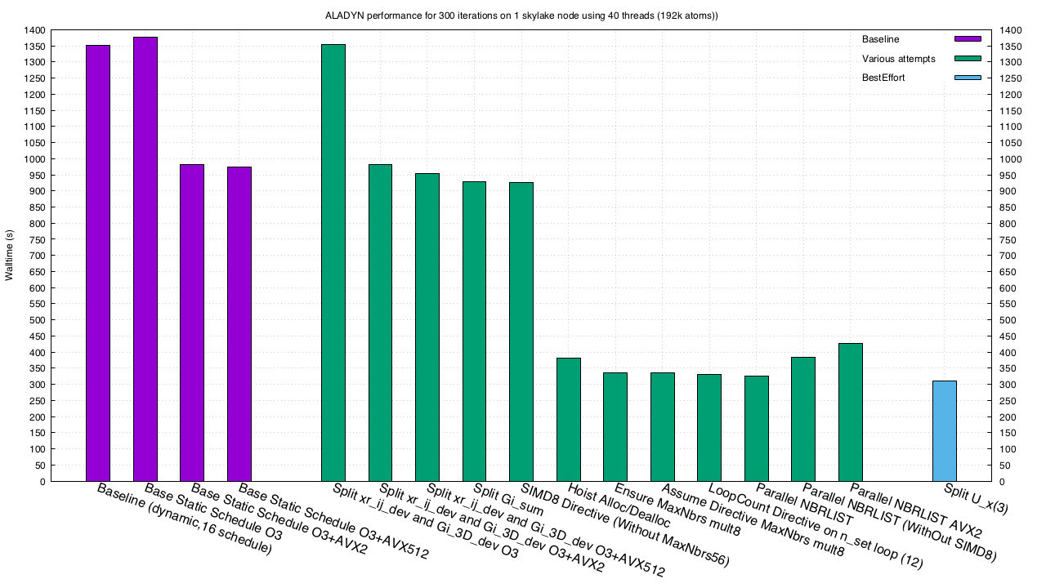
Results
Notes:
Rightmost two green bars represent test of removing optimizations

Slide 27
Conclusions
Unless your code is hitting some hardware limitation (check it!), then there is usually something that can be done to improve performance
The APP group at NASA/Ames is happy to evaluate your code and recommend improvements
Don’t trust the compiler

Slide 28
Intel Application Performance Snapshot (APS)
module load vtune
which aps
/nasa/intel/vtune/vtune_amplifier_2019.3.0.590814/bin64/aps
Note: The executable must be linked with –lpthread
https://software.intel.com/sites/products/snapshots/application-snapshot/

Slide 29
Vtune command line examples
amplxe-cl -collect hpc-performance -r HPC_$EXPNAME.$jobid -data-limit=4096 numactl --physcpubind=1 a.out args
amplxe-cl -collect memory-access -r MemAcc_$EXPNAME.$jobid -data-limit=4096 numactl --physcpubind=1 a.out args
amplxe-cl -collect uarch-exploration -r GenExp_$EXPNAME.$jobid -data-limit=4096 numactl --physcpubind=1 a.out args

Slide 30
op_scope command line example
set EXPNAME=SplitLord1m_MemLayout7_169491b_DGER_2SSM2
setenv OP_SCOPE_EXE build/l2_fp
setenv OP_SCOPE_DISLOC /test-config/$EXPNAME
setenv OP_SCOPE_CTRLOC $OP_SCOPE_DISLOC
setenv OP_SCOPE_EXE_DISLOC $OP_SCOPE_DISLOC
setenv OP_SCOPE_EVENTS "UNHALTED_REFERENCE_CYCLES/4,INSTRUCTION_RETIRED/4"
setenv OP_SCOPE_EXTRA_ARGS "-B stricter -X"
setenv OP_SCOPE_SKIP_MINUS_D true
mkdir -p $OP_SCOPE_DISLOC
numactl --physcpubind=1 $OP_SCOPE_EXE ${l2_config_file} ${output_file}
op_scope_ui -d
mv op_scope_ui $OP_SCOPE_DISLOC
cd $OP_SCOPE_DISLOC
./op_scope_ui

Slide 31
Compiler report for FEMERA tall pole loop nest
LOOP BEGIN at numa-elas-ort3.cc(106,7)
remark #15541: outer loop was not auto-vectorized: consider using SIMD directive remark #25456: Number of Array Refs Scalar Replaced In Loop: 24
LOOP BEGIN at numa-elas-ort3.cc(107,9)
remark #15541: outer loop was not auto-vectorized: consider using SIMD directive remark #25436: completely unrolled by 3
LOOP BEGIN at numa-elas-ort3.cc(108,11)
remark #25085: Preprocess Loopnests: Moving Out Load and Store [ numa-elas-ort3.cc(109,13) ]
remark #15389: vectorization support: reference jac[i*3+j] has unaligned access [ numa-elas-ort3.cc(109,29) ]
remark #15381: vectorization support: unaligned access used inside loop body
remark #15328: vectorization support: irregularly indexed load was emulated for the variable <intp_shpg[ip*Ne+k*3+j]>,
part of index is linear but may overflow [ numa-elas-ort3.cc(109,44) ]
remark #15305: vectorization support: vector length 2
remark #15389: vectorization support: reference jac[i*3+j] has unaligned access [ numa-elas-ort3.cc(109,29) ] remark #15381: vectorization support: unaligned access used inside loop body
remark #15335: loop was not vectorized: vectorization possible but seems inefficient. Use vector
always directive or -vec-threshold0 to override
remark #15415: vectorization support: irregularly indexed load was generated for the
variable <intp_shpg[ip*Ne+k*3+j]>, masked, part of index is linear but may overflow
remark #15305: vectorization support: vector length 4
remark #15427: loop was completely unrolled
remark #15309: vectorization support: normalized vectorization overhead 0.444 remark #15456: masked unaligned unit stride loads: 1
remark #15458: masked indexed (or gather) loads: 1
remark #15475: --- begin vector cost summary ---
remark #15476: scalar cost: 7
remark #15477: vector cost: 13.500
remark #15478: estimated potential speedup: 0.260
remark #15488: --- end vector cost summary --- remark #25436: completely unrolled by 3

Slide 32
Compiler report for ALADYN tall pole loop nest
remark #15389: vectorization support: reference FSIJ_DEV has unaligned access [ aladyn_ANN.f(598,22) ]
remark #15381: vectorization support: unaligned access used inside loop body
remark #15328: vectorization support: non-unit strided load was emulated for the variable <XR_IJ_DEV>, stride is unknown to compiler [ aladyn_ANN.f(599,10) ]
remark #15328: vectorization support: non-unit strided load was emulated for the variable <XR_IJ_DEV>, stride is unknown to compiler [ aladyn_ANN.f(599,10) ]
remark #15328: vectorization support: non-unit strided load was emulated for the variable <XR_IJ_DEV>, stride is unknown to compiler [ aladyn_ANN.f(599,10) ]
remark #15305: vectorization support: vector length 4
remark #15309: vectorization support: normalized vectorization overhead 0.792
remark #15300: LOOP WAS VECTORIZED
remark #15442: entire loop may be executed in remainder
remark #15450: unmasked unaligned unit stride loads: 1
remark #15452: unmasked strided loads: 3
remark #15475: --- begin vector cost summary ---
remark #15476: scalar cost: 334
remark #15477: vector cost: 140.500
remark #15478: estimated potential speedup: 2.310
remark #15389: vectorization support: reference fsij_dev has unaligned access [ aladyn_ANN.f(605,22) ]
remark #15389: vectorization support: reference xr_ij1 has unaligned access [ aladyn_ANN.f(607,33) ]
remark #15389: vectorization support: reference xr_ij2 has unaligned access [ aladyn_ANN.f(607,63) ]
remark #15389: vectorization support: reference xr_ij3 has unaligned access [ aladyn_ANN.f(607,93) ]
remark #15381: vectorization support: unaligned access used inside loop body
remark #15305: vectorization support: vector length 4
remark #15309: vectorization support: normalized vectorization overhead 1.126
remark #15300: LOOP WAS VECTORIZED
remark #26013: Compiler has chosen to target XMM/YMM vector. Try using -qopt-zmm-usage=high to override
remark #15450: unmasked unaligned unit stride loads: 4
remark #15475: --- begin vector cost summary ---
remark #15476: scalar cost: 317
remark #15477: vector cost: 97.250
remark #15478: estimated potential speedup: 3.120

