Slide 1
NASA Flight Opportunities – A Stepping Stone to Orbit
Anh N. Nguyen
NASA Ames Research Center anh.n.nguyen@nasa.gov
SmallSat 2020

Slide 2

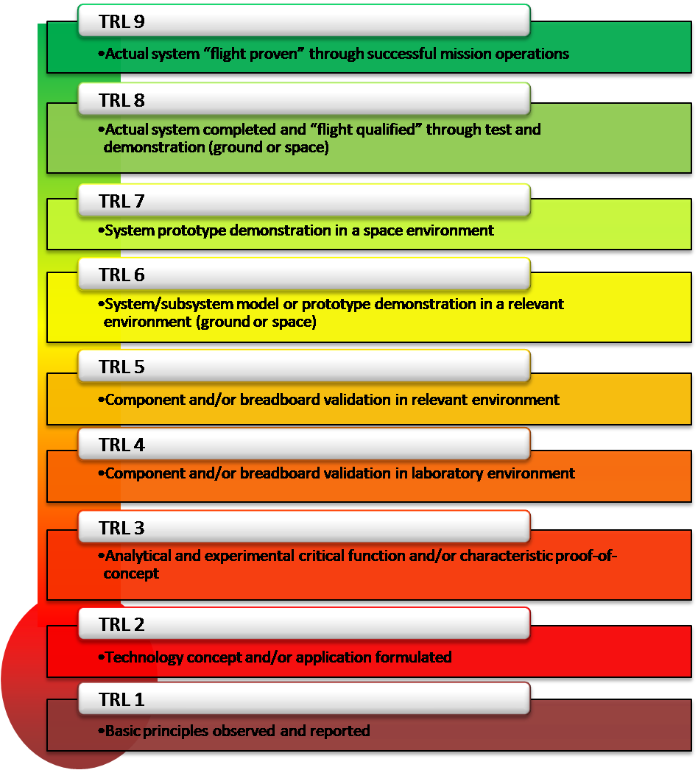
Payload Accelerator for CubeSat Endeavors (PACE) goals are to mature Payloads from TRL 4 to TRL 7/9 utilizing a suborbital flight test supported by NASA Flight Opportunities and orbital flight supported by NASA CubeSat Launch Initiative through the NASA Small Spacecraft Technology Program

Slide 3
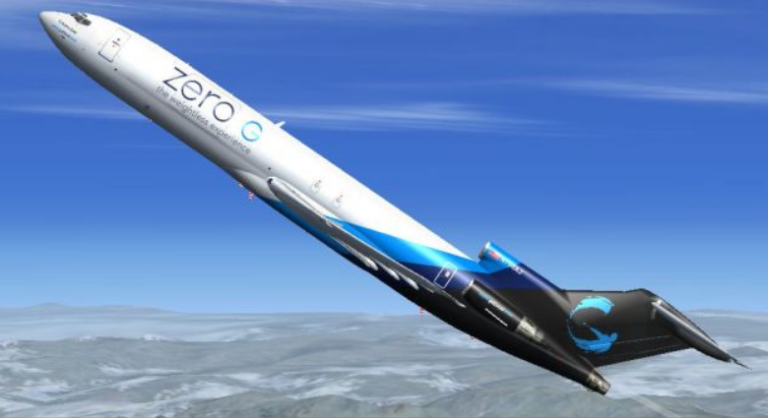


NASA Suborbital Flight Opportunities
Parabolic aircraft
Rocket-Powered Lander Vehicles
(RPLV)
Suborbital reusable launch vehicles (sRLVs)
Credit: Johnny MItchell
Aircraft Following Reduced-Gravity Flight Profiles
High-altitude balloons
Controlled descent and controlled vertical landing of a free-flying vehicle using a propulsion system of a class that can operate in a vacuum.
Minimum altitude of 30 km above MSL
Minimum altitude of 80 km above Mean Sea Level (MSL)
Minimum altitude of 30 km above MSL

Slide 4
Payload Maturation to Flight
Other STMD Programs
Small Spacecraft Technology
(SSTP)
Flight Opportunities
(FOP)
CubeSat Launch Initiative (CSLI)
Center Innovation Fund
NASA Innovative Advanced Concepts
Game Changing Development
NASA iTech
TRL 4 Payload
FO AI&T
Flight Opportunity
TRL 7 Payload
Orbital Development
Lunar Surface Innovation Initiative
Prizes & Challenges
Small Business Innovation Research
Technology Transfer
Integration onto SC Bus
SC-level
Env. test
Launch
Mission Ops
Close-out
Small Business Technology Transfer
Space Technology Research Grants

Slide 5




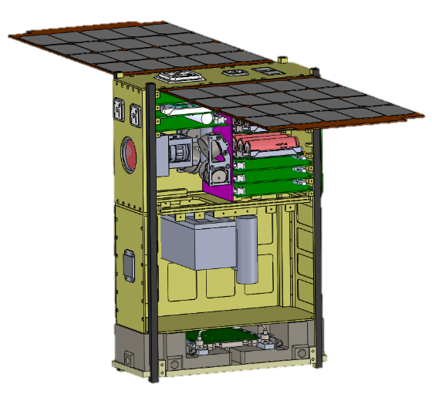
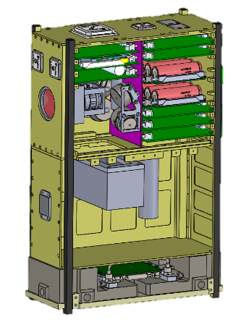
PACE-1FO and PACE-1 Summary
NASA SUBORBITAL FLIGHT OPPORTUNITIES
ADP: Advanced Developments Projects group at NASA ARC
TRL: Technology Readiness Level
FO: Flight Opportunity
S/C: Spacecraft
CSLI: CubeSat Launch Initiative
Suborbital reusable launch vehicles
High Altitude
Balloon
Rocket-powered lander vehicles
Parabolic
Aircraft
ADP Avionics Core
ADP
Core
ADP Spacecraft Platform
ADP
Core
ADP
Core
CSLI
Launch
Payload
Development
TRL4
Payload
Payload
Here
FO Development
Payload
Here
Orbital Development
TRL7
Payload
Payload
Here
Balloon Configuration
PACE-FO
Orbital Configuration
PACE-X
TRL 9 Payload

Slide 6

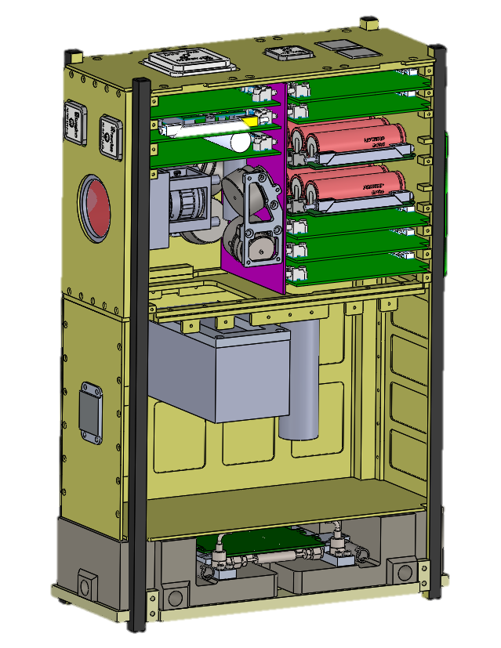
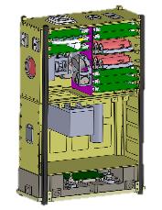
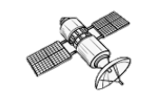

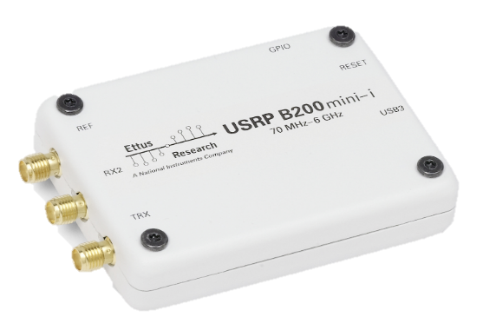
PACE-FO: PACE Flight Opportunities Unit
Notional Images
Sun
Sensors
27 cm
12 cm
GlobalStar Simplex
Iridium Duplex
Processing
Power
Communications
Sensors
Structure
TRL 4 Payload
GPS
37 cm
UHF UL/DL 900.0 MHz
S-band UL/DL 2.4 GHz
≤12 kg

Slide 7

PACE-X:PACE Orbital Unit
Notional Images
Additional components integrated to balloon configuration to complete the ADP S/C Platform for orbital flight
Processing
Power
Communications
Sensors
Structure
TRL 7 Payload
ADCS Unit
Solar Panels
Propulsion Unit (optional)
Solar Panels
Re-use where possible from Balloon
Orbital Additions
ADCS Unit
Propulsion Unit

Slide 8
Notional Initial ADP Platform Capabilities
C&DH: Command and Data Handling
EPS: Electrical Power System
ADCS: Attitude Determination and Control System
RW: Reaction Wheel
MT: Magnetorquer
GNC: Guidance Navigation and Control
Comm: Communications
SDR: Software Defined Radio
FO: Flight Opportunities
SC: Spacecraft
ADP: Advanced Developments Projects group at NASA ARC
ADP Platform
FO Platform
Solar Array
EPS
SC Platform
Additions
RW, MT, Sensors
Star Trackers
ADCS
SkyTraq, NovAtel
GNC
Propulsion
C&DH
Iridium, GlobalStar
Comm
Payloads
S-band SDR,
UHF LoRa
Payload Interface
TBD

Slide 9
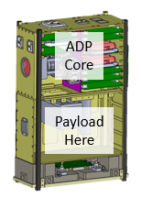
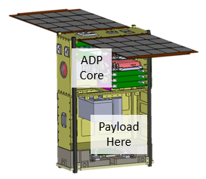
PACE
FO
PACE
CSLI
5-7 mo.
5-7 mo.
ADP Avionics Core Development
ADP S/C Platform
Development
Payload
TRL 4
PACE-XFO
I&T
Flight
Opp.
Payload
TRL 7
PACE-X
I&T
Launch
ADP Core
Dev Kit
Mission Ops
Close-out

Slide 10
PACE Program Opportunities
PACE utilizes an Advanced Developments Projects (ADP) platform built for modularity that can be adapted to accommodate a variety of payload interfaces and requirements for both suborbital flight test supported by NASA Flight Opportunities and orbital launches supported by NASA CubeSat Launch Initiative
  ADP platform is developed at NASA ARC based on industrial electronics and hardware
  Can ‘up-scope’ ADP platform for payloads with demanding spacecraft requirements such as tight pointing needs, high data through-put needs, and challenging operational environments
  Can ‘de-scope’ ADP platform for payloads with less stringent spacecraft requirements for cost-effective and reliable quick-turn tech demos
A payload’s early-adoption of the PACE ADP FO platform for the FO-campaign provides a smooth and rapid transition to an orbital flight utilizing the PACE ADP SC platform
  Relieves the burden of payloads developing standard supporting subsystems (comm, power, processing)
  Focuses efforts (and funds) on the development of the payload itself

Slide 11
Conclusion
The Payload Accelerator for CubeSat Endeavors (PACE) is a STMD Small Satellite Technology Program that focuses on maturing payloads from TRL 4 to TRL 9 utilizing a suborbital flight test supported by NASA Flight Opportunities
PACE is currently in its first pilot year
  First PACE Suborbital Flight Opportunities campaign Late 2020
  First PACE Orbital Launch targeted for Spring 2021
The PACE program will support flight demonstrations of new technologies, capabilities and applications for small spacecraft and reduces the cost, risk, complexity and/or time required to advance the state-of-the-art

Slide 12










Roger Hunter
SST Program Manager
Anh Nguyen
Project Manager
Jan Stupl
Deputy Project Manager,
Systems Engineer
Dayne Kemp
Electrical Engineer Lead,
Systems Engineer
Cedric Priscal
Communications Lead,
Flight Software
Adam Zufall
Attitude Determination and Control Lead,
Systems Engineer
Terry Stevenson
Propulsion Lead,
Lead Mechanical Engineer
Steve Battazzo
Embedded Systems Lead
Connor Nelson
Flight Software Lead
Jackson Parker
Flight Software,
Electrical Engineer

Slide 13

Payload Accelerator for CubeSat Endeavors (PACE)
Anh N. Nguyen, NASA ARC anh.n.nguyen@nasa.gov

