Slide 1



Standardized Algorithm Documentation for Improved Scientific Data Understanding: The Algorithm Publication Tool Prototype
Kaylin Bugbee¹, Aaron Kaulfus¹, Alyssa Harris², Sean Bailey³, Rahul Ramachandran⁴, Sean Harkins², Aimee Barciauskas², Deborah Smith¹
(1) University of Alabama in Huntsville (2) Development Seed (3) NASA Goddard Space Flight Center (4) NASA Marshall Space Flight Center

Slide 2

What are ATBDs and why are they important?
Earth observation satellites measure solar radiation or thermal energy
  Geophysical quantities must be inferred from these measurements
  Algorithms and corresponding code convert measurements into geophysical quantities
Algorithm Theoretical Basis Documents, or ATBDs, describe the physical theory, mathematical procedures and assumptions made for developing scientific algorithms that convert radiances received by remote sensing instruments into geophysical quantities
ATBDs are important because:
  Provide a mechanism for peer review of the algorithm
  Ensure reproducible science by documenting key scientific assumptions made
  Promote understanding and proper use of Earth observation data by serving as a reference for each data product for users
Notes:
carry sensors that measure different sections of the visible, infrared and microwave regions of the electromagnetic spectrum.

Slide 3
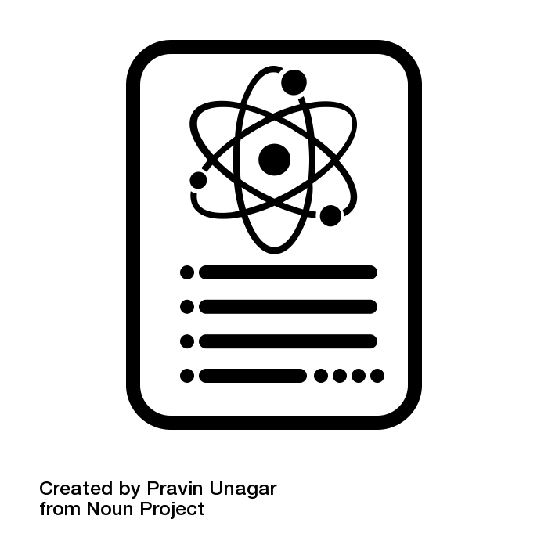
What is the current state of ATBDs within NASA?
ATBDs are required for every NASA EOS instrument data product
A standardized ATBD template does not exist
  Difficult for scientists to know if all requirements have been met
  Inconsistent structure and information across ATBDs provides a challenge for users
ATBDs are difficult to discover
  Often stored as PDFs, making them difficult to discover via search engines
  Not consistently referenced in a dataset’s metadata
  No centralized location to find ATBDs
The Algorithm Publication Tool (APT) alleviates issues surrounding ATBDs by :
  Streamlining writing, publishing and maintaining ATBDs
  Facilitating the ATBD review process
  Providing a centralized discovery repository

Slide 4
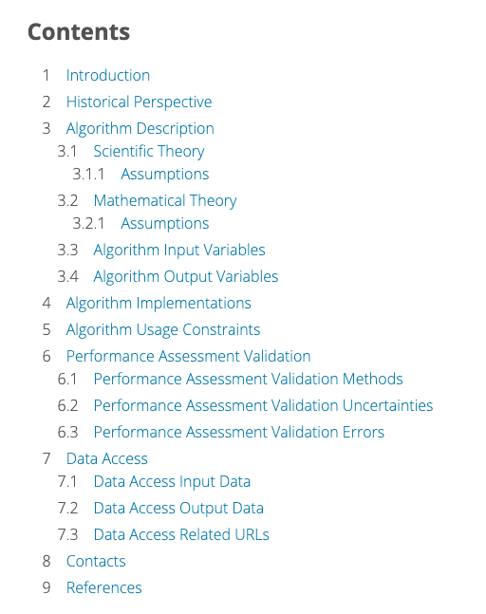
Key APT Features
Uses a standardized ATBD template
  Improves communication with and expectations of ATBD authors
Template development was informed by a review of ATBDs throughout the Earth observation community
  Reviewed ATBDs from NASA, NOAA, ESA, NEON
  Also leveraged ‘Algorithm Description’ documents created by the Ocean Biology Processing Group (OBPG)
ATBD content is stored as metadata, making this information
  Machine readable
  Interoperable with other tools and services

Slide 5
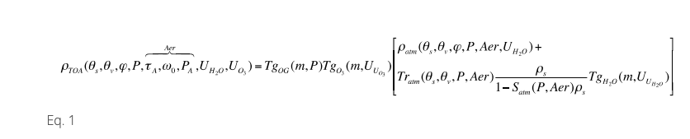
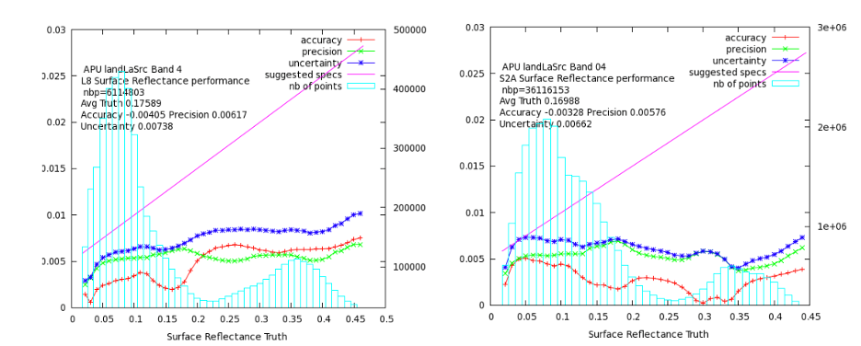
Key APT Features
Steps the author through 7 major document sections
Uses:
  LaTex to properly render mathematical equations, tables and figures
  Bibtex for citation management
  State.js for writing dynamic rich text
Generates the ATBD as either a PDF or an HTML page
  HTML includes Schema.org mark up
Equations and figures from the HLS ATBD drafted in APT.

Slide 6
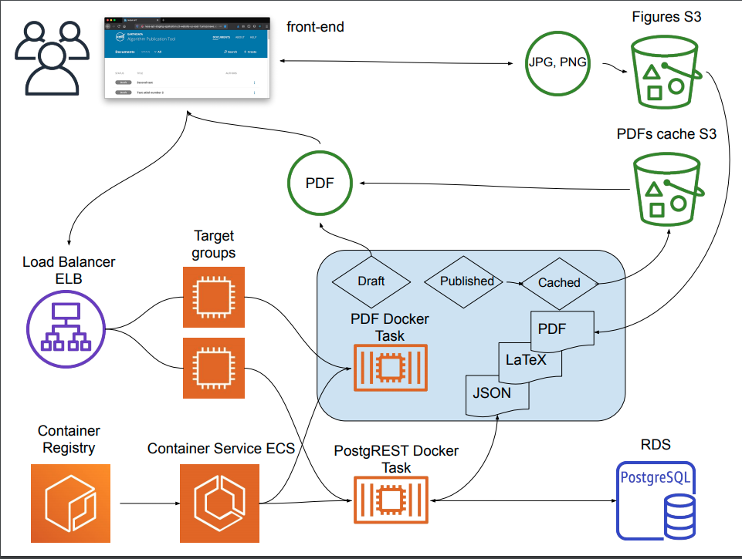
APT Cloud Based Architecture
Notes:
APT is built in the cloud using Amazon services. This cloud-based architecture is designed to ensure the site scales and that services are balanced out.

Slide 7
Next Steps
Provide a centralized discovery portal for ATBDs
Facilitate the ATBD review process by providing a dashboard for tracking and managing workflows
Develop ATBD
Review/Approve ATBD
Deliver/Publish ATBD
Maintain ATBD
AS
Write ATBD
Make Needed Changes
Notify SIPS/DAAC of algorithm availability
AS
DC
Format/Place ATBD on Website
Update dataset metadata
Continue to Monitor for Errors/Problems
DC
RB
Review ATBD
Approve ATBD
RB
Notify of need for ATBD Production
Approve ATBD
PS
PS
AS
Instrument/Algorithm Scientists
HQ
Define ATBD Requirements
DC
DAAC / Data Center / SIPS
HQ
RB
Review Board
PS
Program/Mission Scientists
HQ
Appropriate HQ personnel

