Slide 1
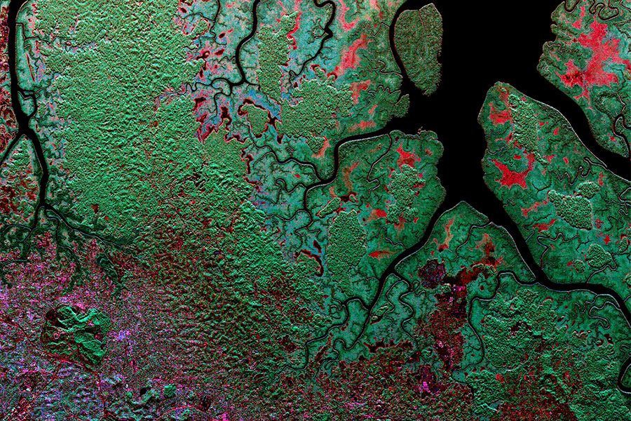



Advancing Open Science Through Innovative Data System Solutions: The Joint ESA-NASA Multi-Mission Algorithm and Analysis Platform (MAAP)’s Data Ecosystem
Kaylin Bugbee¹, Rahul Ramachandran², Manil Maskey², Aimee Barciauskas³, Aaron Kaulfus¹, Dai-Hai Ton That¹, Katrina Virts¹, Kel Markert¹, Christopher Lynnes⁴
(1) University of Alabama in Huntsville (2) NASA Marshall Space Flight Center (3) Development Seed (4) NASA Goddard Space Flight Center

Slide 2



What is MAAP?
The MAAP is a virtual environment dedicated to the unique needs of sharing and processing data from relevant field, airborne and satellite measurements related to ESA and NASA missions
  Jointly managed by ESA and NASA and accessible to designated ESA and NASA scientists.
  Initially populated with pre-launch and complimentary data from other projects.
Science focus is to improve the understanding of global terrestrial carbon dynamics & to support algorithm development
Addresses a need expressed by the science community to more easily share and process data collected by NASA and ESA activities

Slide 3
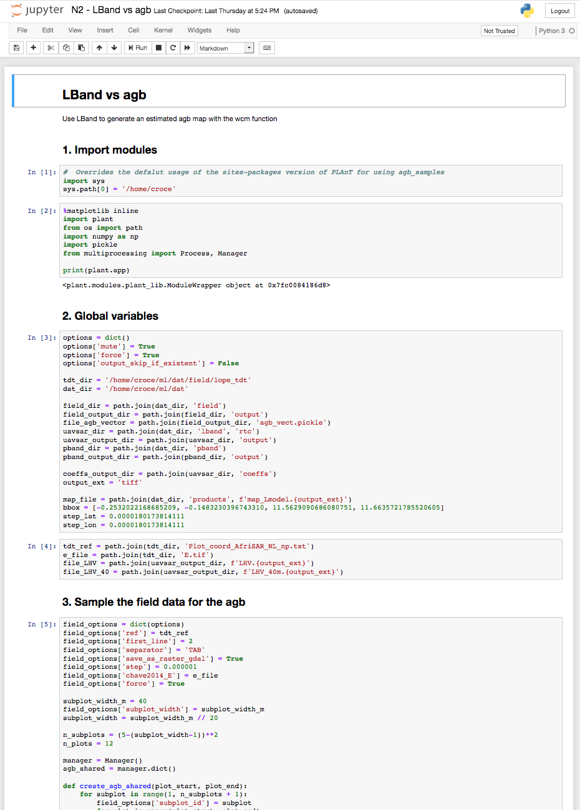
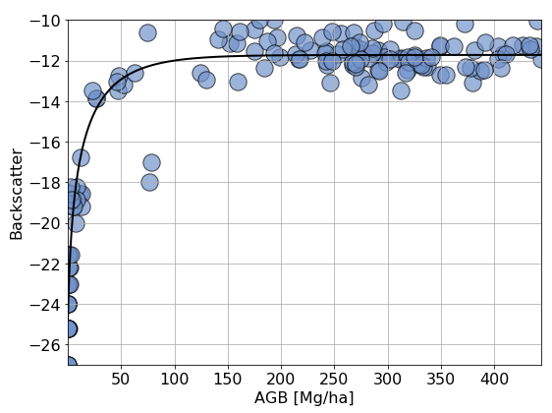
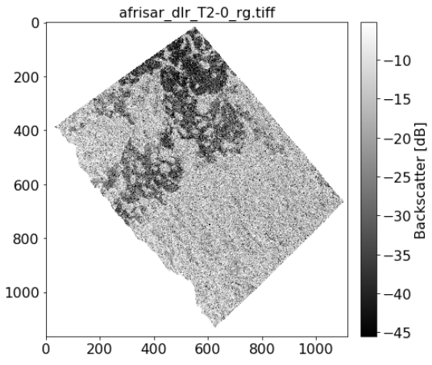
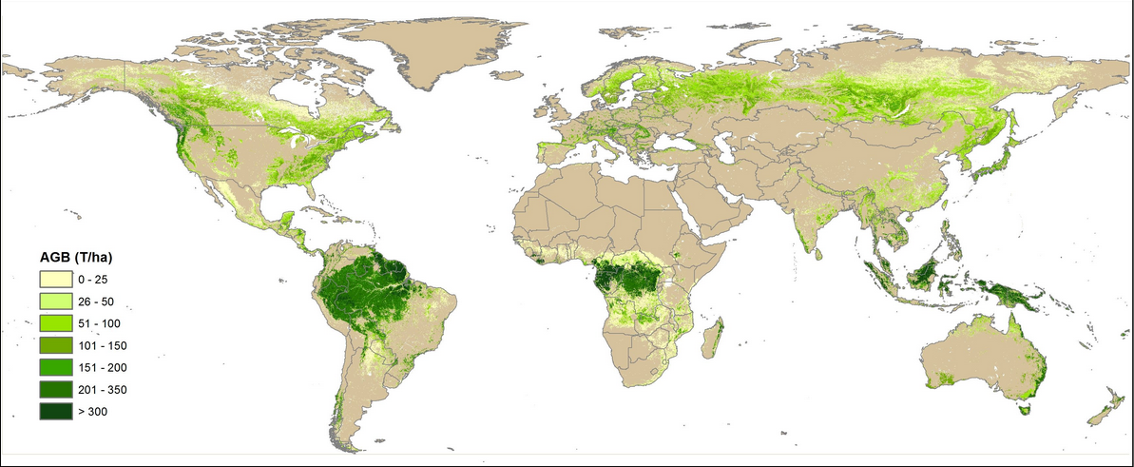

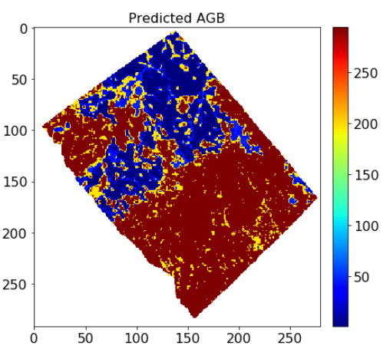
MAAP Goals
Prototype new and innovative data system solutions to enable open science in cloud-based platforms
Enable seamless open access to airborne, spaceborne and field ESA and NASA data for biomass mapping
Provide the ability to upscale user’s algorithms from small regions of interest to global scale
Facilitate collaboration on end-to-end calibration and validation of higher-level science products
ESA field data + NASA L-band
ESA
P-band
Sample global biomass map (for illustration only)
Biomass map from L/P band and lidar fusion
Develop and collaborate on Jupyter notebooks
Upscale processing to generate global biomass map and validate
Calibrate and fine-tune algorithms accessing multiple data sources

Slide 4
Conceptual Cloud-based Data System Architecture
Direct data access via files
Data Lake: large repository of heterogeneous raw data (Sawadogo et al.)
Data spaces highly coupled to containers and workflows
Want to minimize direct file access
Data processed by sending code to data
Analytics Optimized Data Store
Data structured and organized based on schema/ontology
Client Access
(APIs, Tools)
Structured Data Store
Data structured and organized based on schema or ontology
Core Data Services
Lowers barriers to use by providing a metadata catalog, documentation visualization
Data Spaces
Curate, harmonize data in personalized workspace
Containers
Workflows
Run code for in-situ data analysis
Data Lake
Ability to access files
Data Lake
(Object Store, Tiered storage)

Slide 5
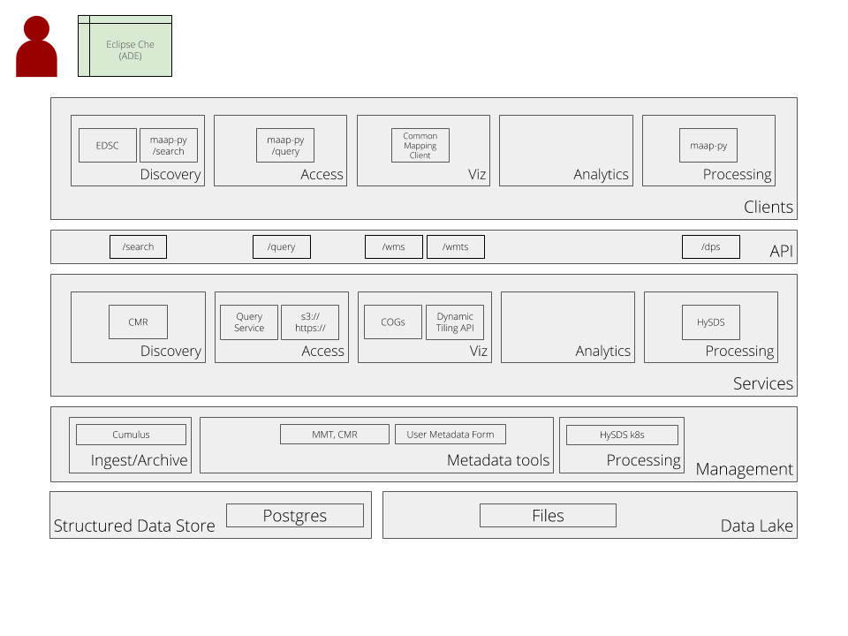
NASA MAAP Data System
Legend
Client Access
Data Spaces
Core Data Services
Data Lake
Structured Data Store

Slide 6
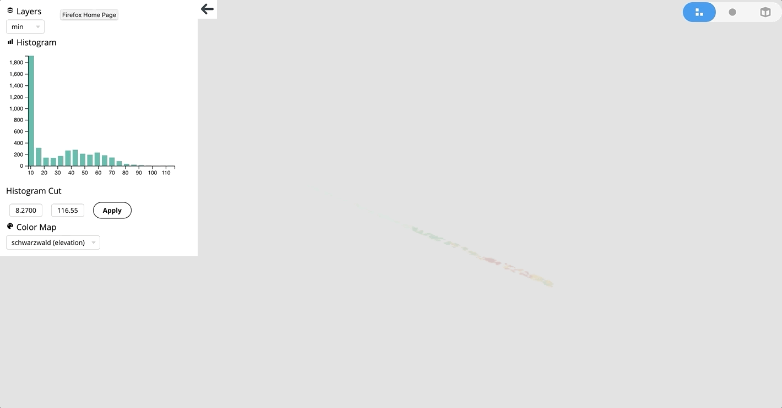
Future Work
Expansion of core data services including
  Metadata to support sharing and discovery of user created software, code and supporting documentation
  Innovative fast browse solutions
Prototyping structured data store solutions
Technology transfers with other projects, collaborators in different scientific domains

Slide 7
Conclusions & Lessons Learned
Data discovery and access opportunities
  Need to consider how users will discover and use structured data stores
  With data on the cloud, users may want to use data in multiple data lakes
    How is data curated within a platform to ensure relevancy to a given research problem?
    How do users discover data from other data lakes that are relevant?
New data sources
  How do we provide services for user shared data, user generated data, citizen science data, etc?
  What types of data stewardship activities do we provide for these data?
As more data is made available on the cloud, MAAP and other similar platforms will need to evolve to provide value-added services to the research community
  Continual assessment of services provided in the platform to meet needs
  Evolving data stewardship activities including updated data management plans and levels of service

Slide 8
References
    Sawadogo, Pegdwendé Nicolas & Scholly, Etienne & Favre, Cécile & Ferey, Eric & Loudcher, Sabine & Darmont, Jérôme. (2019). Metadata Systems for Data Lakes: Models and Features.

