Slide 1
Trajectory Optimization for OSIRIS-REx Earth Return
Noble Hatten, Jacob A. Englander, Donald H. Ellison, Ryo Nakamura, Brian Sutter, Kenneth E. Williams, Jeremy M. Knittel, James McAdams, Daniel Wibben, Peter Antreasian, Kenneth Getzandanner, Michael C. Moreau, Dante S. Lauretta
2020 AAS/AIAA Astrodynamics Specialist Conference
August 9 – 12, 2020

Slide 2
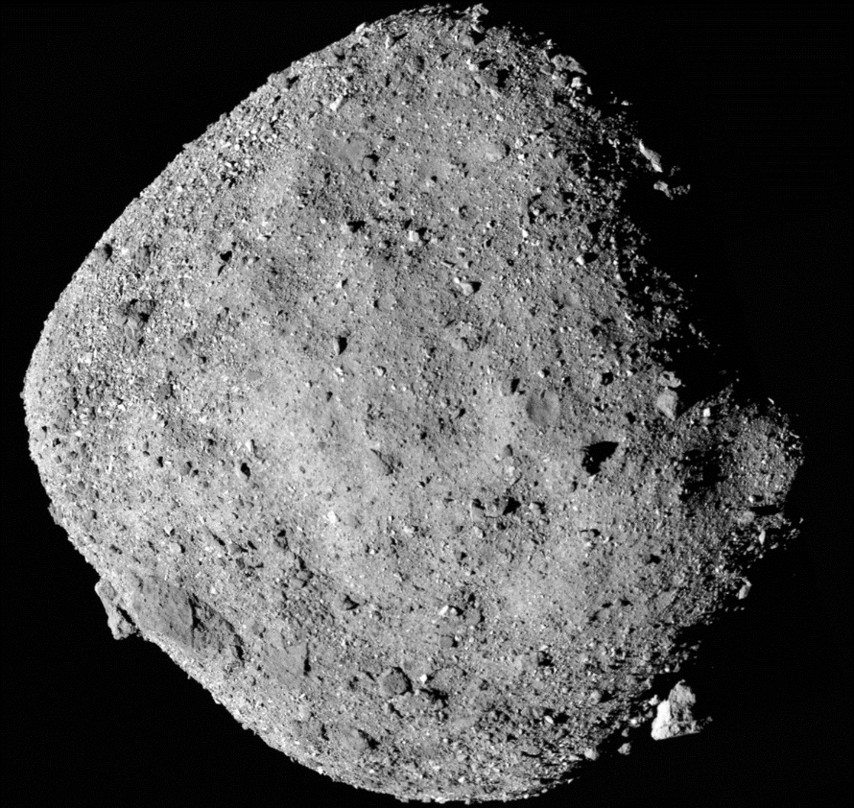
OSIRIS-REx
Origins, Spectral Interpretation, Resource Identification, and Security-Regolith Explorer
New Frontiers mission to return sample from NEA Bennu
Launched 2016; arrived 2018; currently in orbit
  Smallest body ever orbited
  Lowest orbit ever achieved
Sample acquisition: Touch and Go (TAG)
  Currently scheduled for fall 2020
https://www.nasa.gov/press-release/nasa-s-newly-arrived-osiris-rex-spacecraft-already-discovers-water-on-asteroid

Slide 3
Earth Return
Mission objective 1 is to return and analyze a sample
Post-TAG, spacecraft returns to Earth to deliver sample return capsule (SRC)
Nominally: Depart March 3, 2021, arrive Sept. 24, 2023

Slide 4
But …

Slide 5
Motivation for Current Work
TAG is a complex operation with many uncertainties
Multiple TAG attempts may be required
→ Need Earth-return trajectories with a broad range of departure dates
We want to further explore the trade space
  Examine effect of (1) multiple DSMs and (2) tighter EDL interface velocity restriction on Δv
Establish Boundary Conditions
Develop Reference Trajectory
Prelim
States
And
Mnvrs
EMTG, GMAT
and/or STK
PIRATE or
MIRAGE
Iterate on Entry
Interface State
Final States and
Maneuvers
Determine UTTR
Ground Ellipse
Perform Monte-Carlo Analysis
Iterate on TCM
Placement and
Various Error
Assumptions
POST II
PIRATE or
MONSTER
Possible Feedback
to Establish Walk-In Flyby Altitude
Verify UTTR
Ground Ellipse
POST II

Slide 6
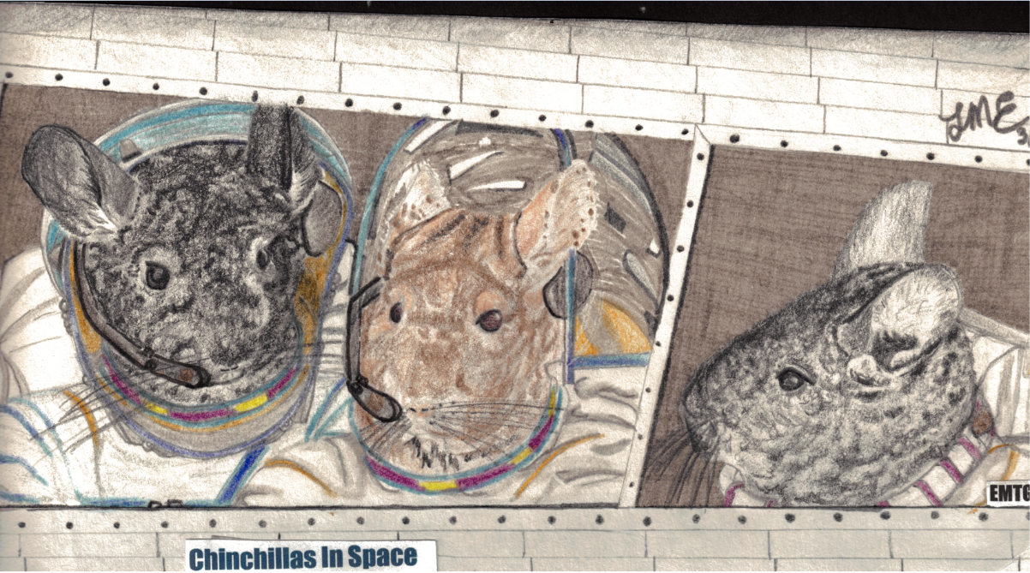
Analysis and Optimization Tool: EMTG
Evolutionary Mission Trajectory Generator
Interplanetary trajectory optimization tool developed at NASA GSFC
Stochastic method to generate initial guesses combined with gradient-based optimizer
Finite burns and impulsive maneuvers
Scalable fidelity
100% analytical gradients
Recently released open-source
  https://github.com/nasa/emtg
EMTG Software Design Document

Slide 7
Problem Setup
Bennu (massless)
Earth SOI
Fwd prop
EDL constraints
Radius
Velocity
Flight path angle
Parachute constraints
Altitude
Latitude
Longitude
Match point
Bwd prop
Parachute
deployment
Earth
EDL Interface

Slide 8
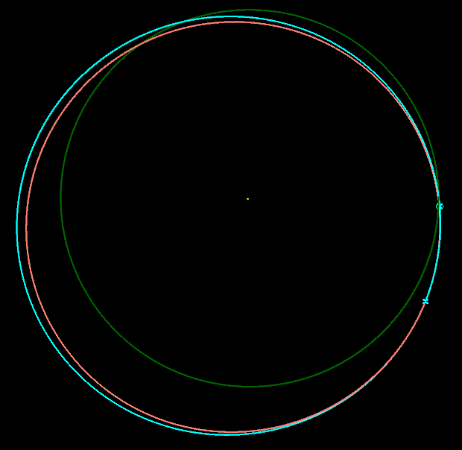
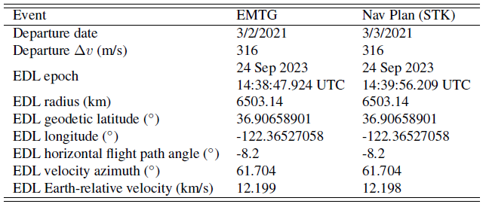
Proof of Concept: Reproduction of Nav Plan Baseline
Stop propagation at EDL interface (“soft” constraints)
Low-fi → High-fi
Bennu
Sun
Earth
OREx

Slide 9
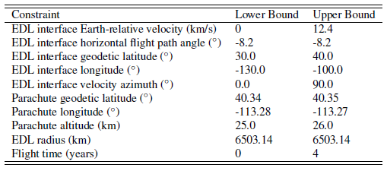
Alternate Departure Dates
No exact EDL interface state to match → propagate to approximate parachute deployment (altitude boundary)
  Simple exponential atmosphere
  Eliminate “soft” constraints
Focus on most likely departure date range: March 3, 2021 – May 30, 2021
No post-departure DSM allowed

Slide 10
Using “Seed-Sharing” to Find Solutions with EMTG
Use decision variables of converged solution as initial guess for a similar case
  Can be done with low-fi or high-fi dynamics
  Seed across departure dates
  Seed longitude-constrained problem with longitude-free solution
  Gradually step down Δv allowed at post-departure DSM until it disappears entirely
Allows a single EMTG solution to propagate to produce many more solutions
Seed-sharing also works backward: If a newly converged case finds a more optimal solution than a nearby, already-converged case, the new case seeds the old

Slide 11
Alternate Departure Dates
Nav Plan Baseline
Arrive 9/25/2023
Arrive 9/24/2023
Minimum-Δv is 249 m/s on May 24
Dates between 3/20 and 4/19 require either large Δv or a post-departure DSM

Slide 12
EDL Interface Atmosphere-Relative Velocity
Requirement: < 12.4 km/s
Arrival date change

Slide 13
EDL Interface Velocity Azimuth
Arrival date change

Slide 14
Additional Trade Studies
Examine departure dates through Sept. 2022
One post-departure DSM, 12.4 km/s max EDL velocity
Two post-departure DSMs, 12.4 km/s max EDL velocity
Two post-departure DSMs, 12.2 km/s max EDL velocity
  ~Same EDL velocity as Nav Plan baseline
EMTG + seed-sharing + server time = lots of solutions

Slide 15
Δv vs. Scheduled Departure Date Summary
All loitering
12.4 km/s loitering
Leaving less efficient than waiting during loitering periods
Second DSM provides negligible benefit

Slide 16
Δv vs. Scheduled Departure Date Summary
All loitering
12.4 km/s loitering
12.4 km/s solutions in June 2021 do not use a post-departure DSM
→ Continuation of the May 2021 family of solutions
Arrival date slips to Sept. 28, 2023 for June 30, 2021 departure

Slide 17
Δv vs. Scheduled Departure Date Summary
12.2 km/s 2023/2024 arrival switch: 07-05-2021
12.4 km/s 2023/2024 arrival switch: 07-31-2021
All loitering
12.4 km/s loitering
Starting in July 2021, the Δv-optimal arrival date moves from Sept. 2023 to Sept. 2024
Optimal solution results in arrival velocity < 12.2 km/s

Slide 18
Δv vs. Scheduled Departure Date Summary
12.2 km/s 2023/2024 arrival switch: 07-05-2021
12.4 km/s 2023/2024 arrival switch: 07-31-2021
All loitering
12.4 km/s loitering
DSM benefits 12.2 km/s arrival velocity case
DSM date moves forward in time with departure date:
  6/16/2021 for 3/3/2021 departure; 4/25/2022 for 7/5/2021 departure

Slide 19
EDL Interface Velocity Azimuth
12.4 km/s loitering
All loitering
Constant azimuth during loitering periods (same solution)
Azimuth declines more steeply at end of analyzed window (as Δv increases)
12.2 km/s, 2 DSMs not shown for clarity (same as 1 DSM until Aug 2022)

Slide 20
Conclusions and Future Work
EMTG used to optimize OSIRIS-REx Earth-return trajectories
  Recreated baseline
  Produced daily trajectories for two opportunities between March 2021 and June 2021
    Δv ranges from 249 m/s to 320 m/s
  Performed trade studies for departures through Sept. 2022
    Δv-optimal solution switches to Sept. 2024 arrival in July 2021
Next steps:
  Flight-fidelity retargeting of point solutions
  Monte Carlo analyses

Slide 21
Acknowledgments
This material is based on work supported by NASA under Contracts NNM10AA11C, NNG12FD66C, and NNG13FC02C.
OSIRIS-REx is the third mission in NASA’s New Frontiers Program. Dante Lauretta of the University of Arizona, Tucson, is the mission’s Principal Investigator, and the University of Arizona leads the Science Team and the science observation planning and data processing.
Lockheed Martin Space Systems in Denver built the spacecraft and is providing flight operations.
NASA Goddard Space Flight Center and KinetX Aerospace are responsible for navigating the OSIRIS-REx spacecraft.
We are grateful to the entire OSIRIS-REx team for making the encounter with Bennu possible!

Slide 23
Backup Slides

Slide 24
DSM Date: 12.2 km/s-limited Case, Early Departures
294-day lag
85-day lag
177-day lag

Slide 25
DSM Date: 12.2 km/s-limited Case, Early Departures

Slide 26
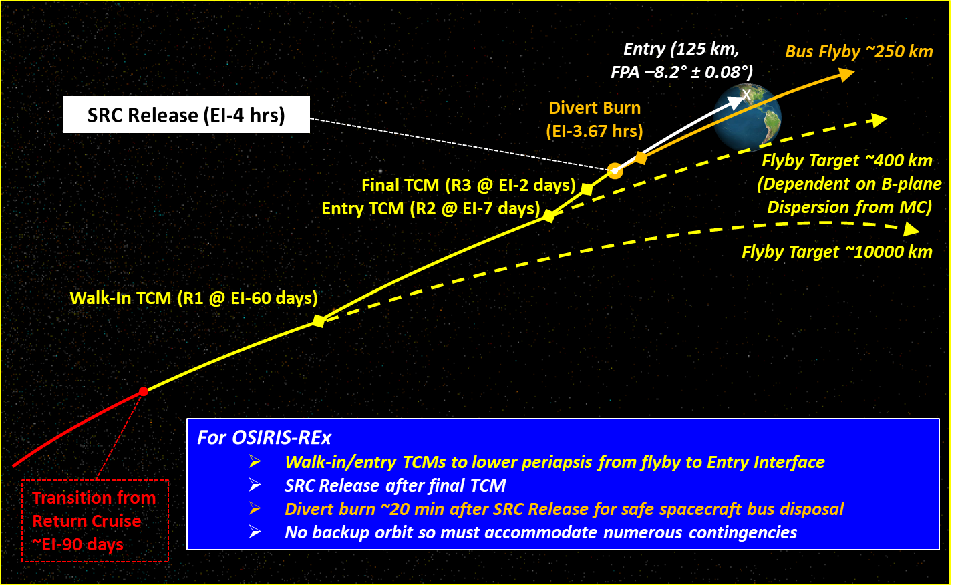
Earth Return Concept of Operations

Slide 27
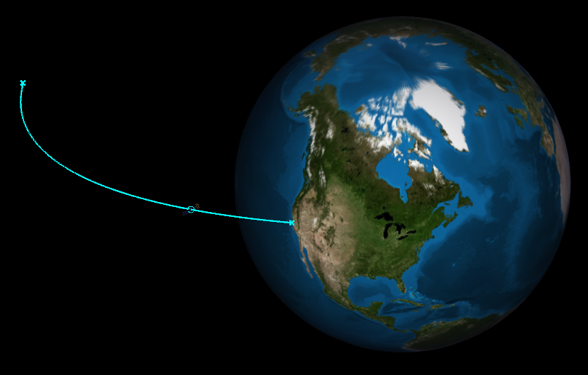
Nav Plan Baseline Trajectory in Earth SOI
OREx

