Slide 1

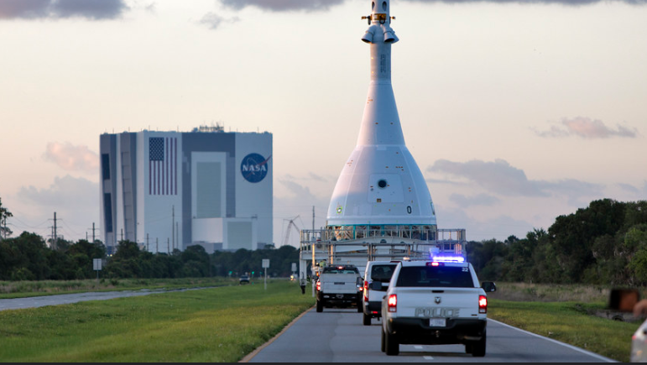
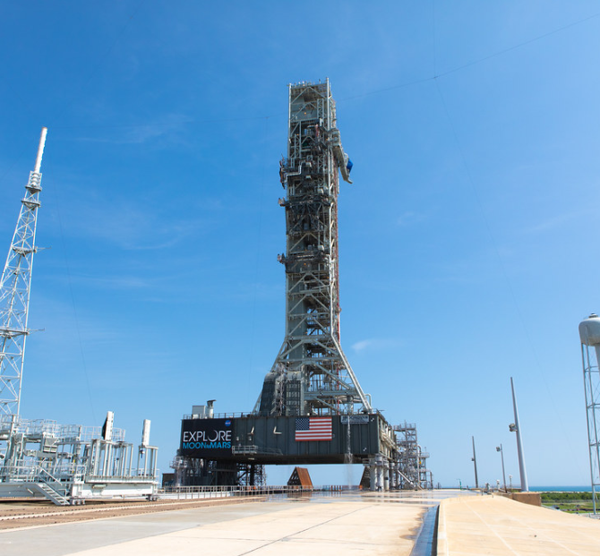
Optical Metrology and Precision Measurement Alignment Laboratory
Flight Window Testing and Vehicle Stacking Alignment
Ian Rook

Slide 2
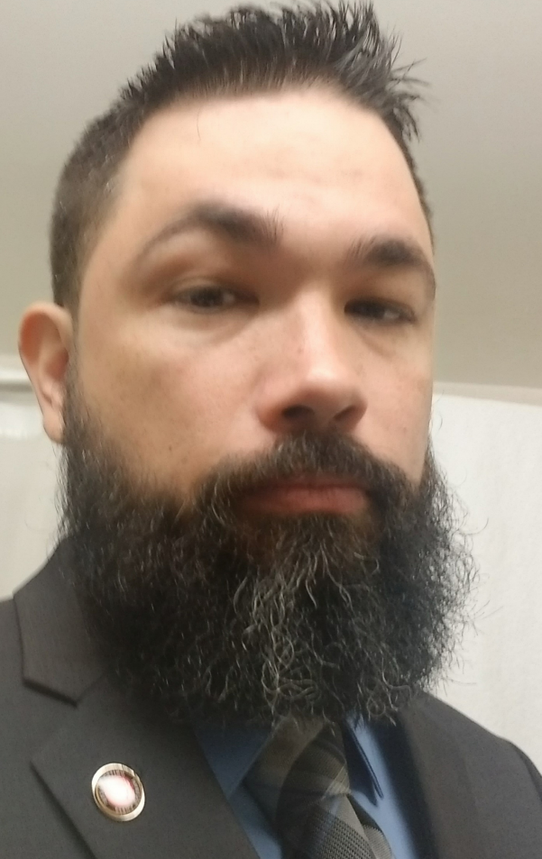

Ian Rook
Senior at Florida International University
Mechanical Engineering
Graduating in Spring 2021
Currently working in the Analytical Laboratories Branch (NE-L3)
Former U.S. Marine
Fall Research
Chemical Transformations in 2D Chalcogenide Materials for Advanced Optoelectronic Devices

Slide 3
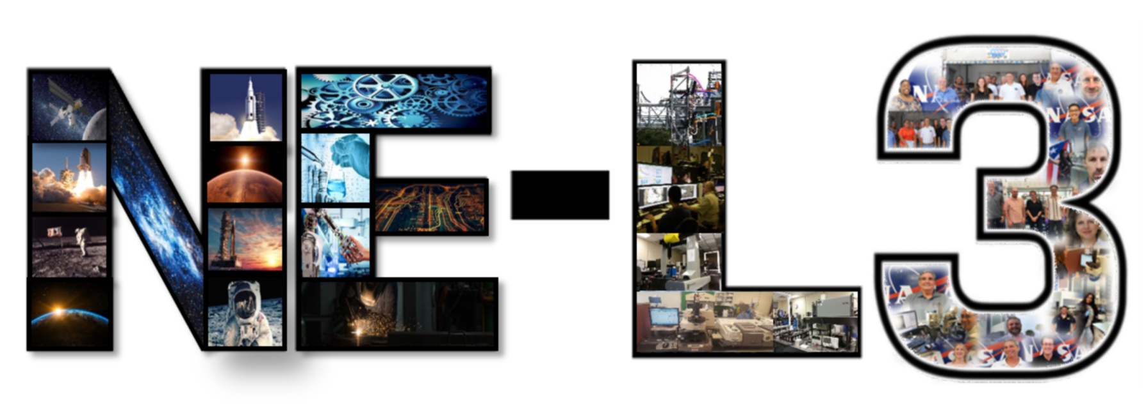
Analytical Laboratories Branch
Capabilities include chemical analyses to identify unknown materials/contaminants
Testbed for air and water revitalization systems and plant biology research
Image analysis of space flight hardware and ground support equipment for ground operations.
Metrological evaluations of components in support of failure analyses
Spacecraft windows inspection and testing
Field metrology and large scale precision measurements and real-time tracking

Slide 4
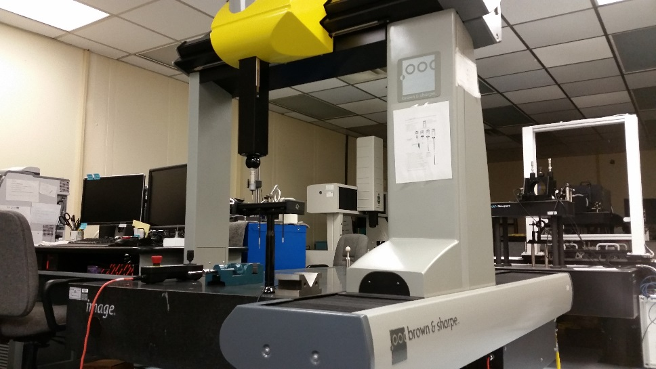
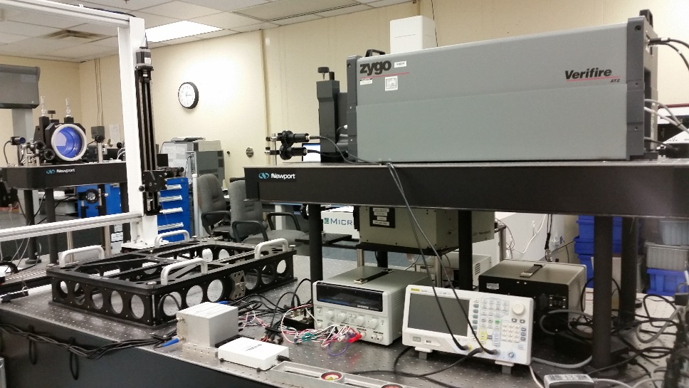
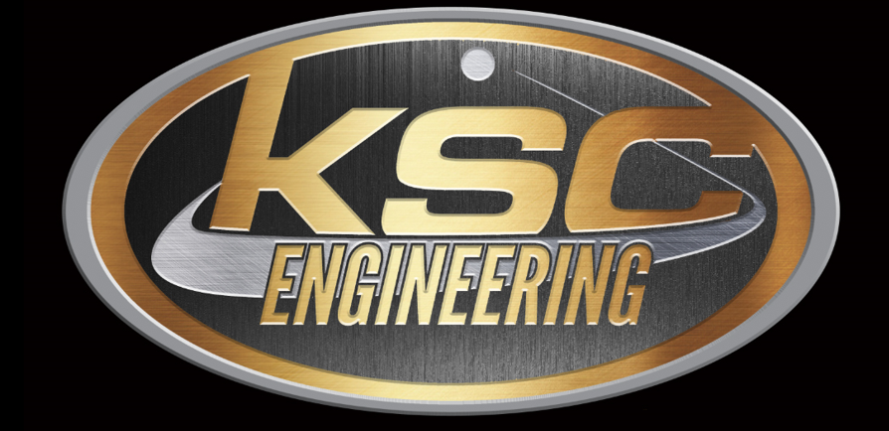
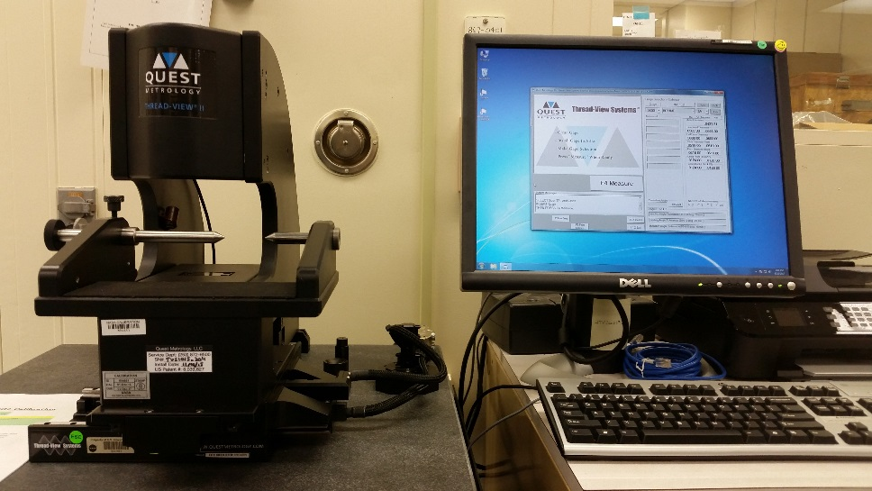
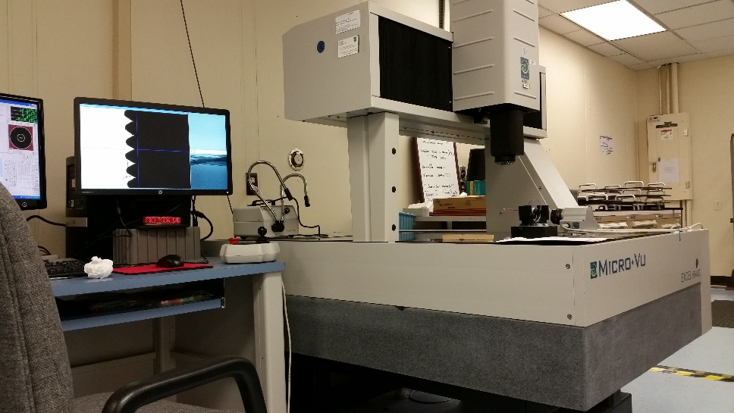
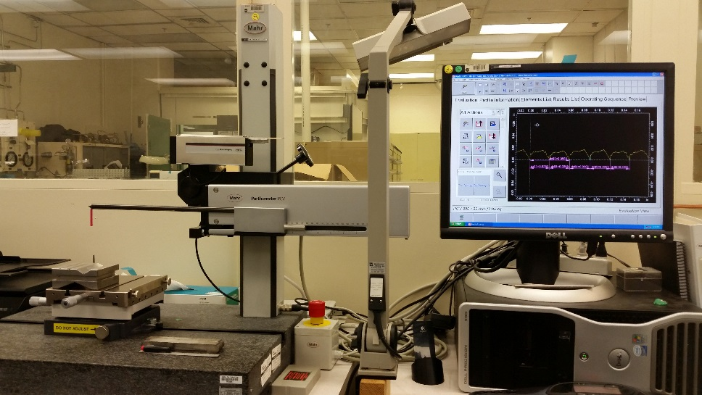
Metrology Laboratory
Metrology
Dimensional Inspection
Optical Windows Properties
Pictures sourced from
KSC-PLN-2322_MET

Slide 5
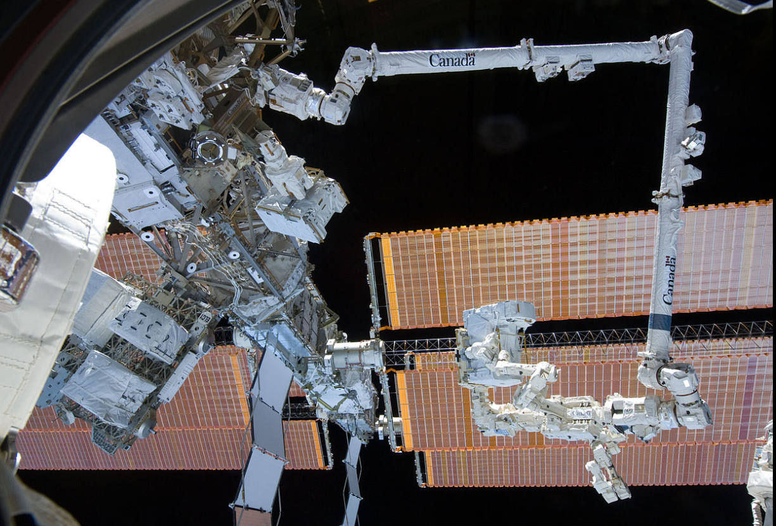
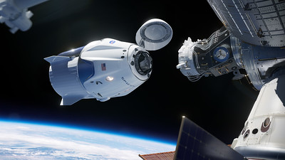
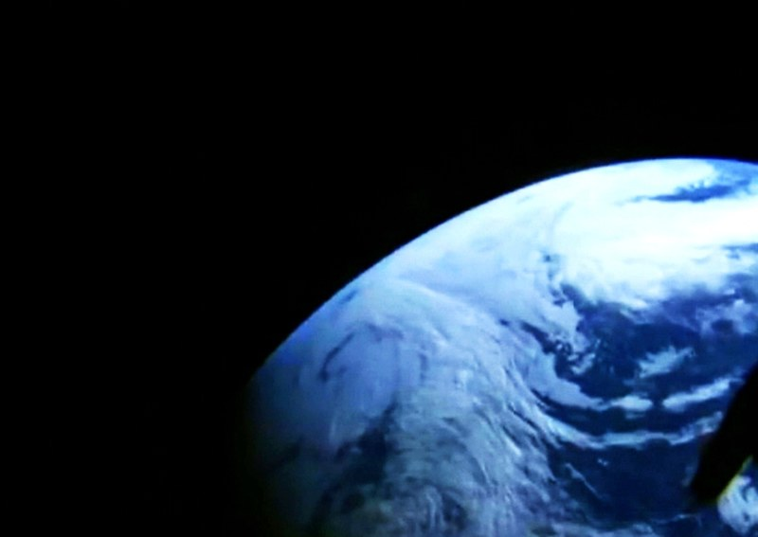
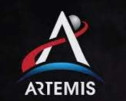
Optical Window Testing
Clearest view from vehicle
Pictures used for study of weather, geology and other scientific research
Experiments
Docking procedures
Visibility to support the control of the ISS remote manipulator system

Slide 6


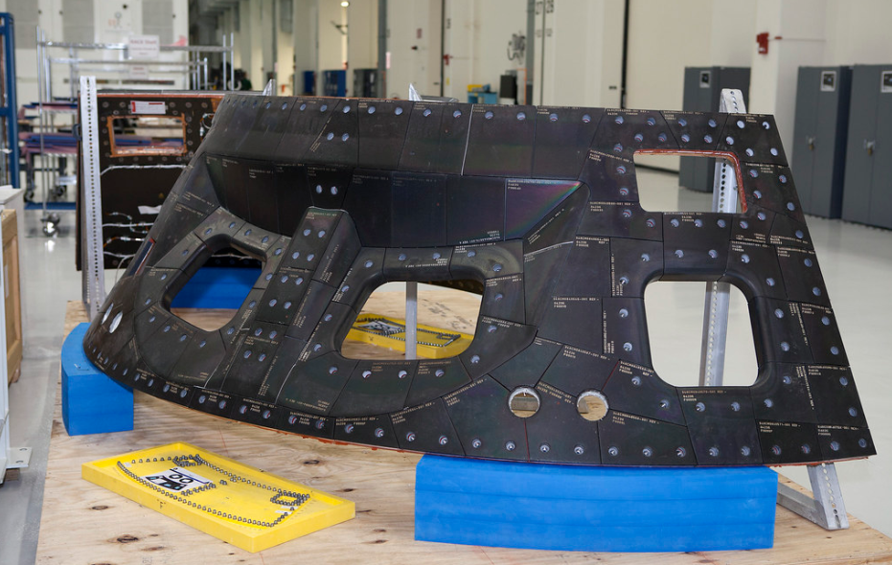


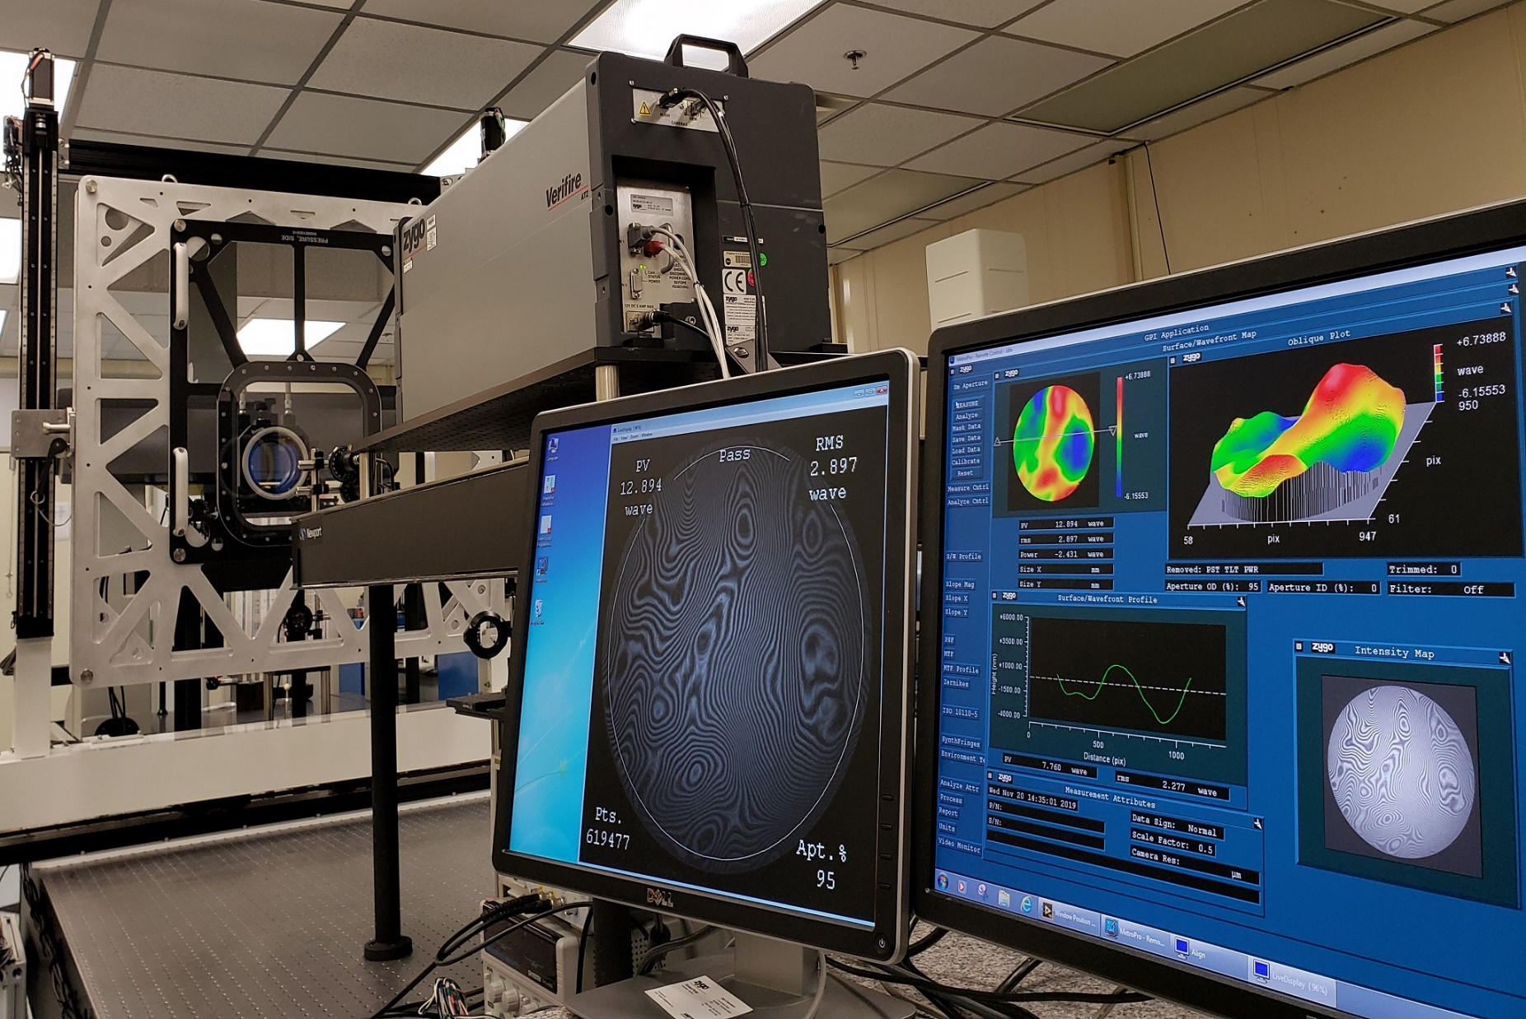

Waveform Data
An interferometer is used to collect waveform data in order to test the thickness of a window pane sample.
Results are displayed in the form of a topographical map from the sections of the window that were scanned in a nanometer scale.

Slide 7
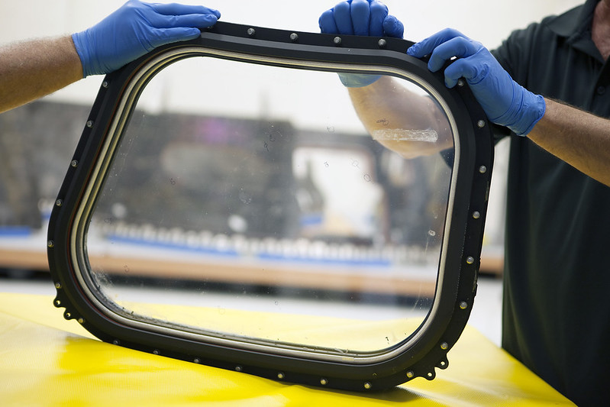
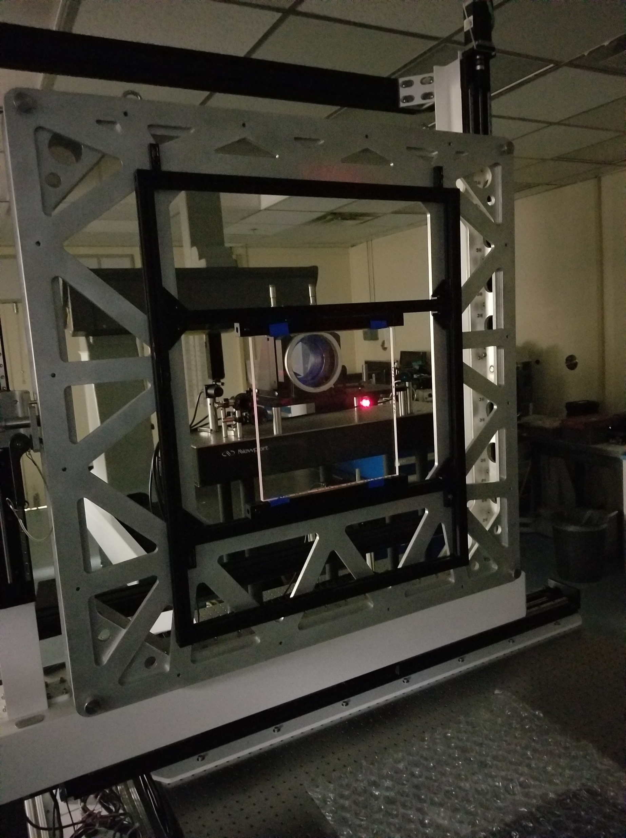
Haze Data
Using a low power red diode laser and two photodetectors we can collect haze data on the window pane.
Comparing the data received by the 2 detectors, we can see how light scatters once it hits the window material.

Slide 8
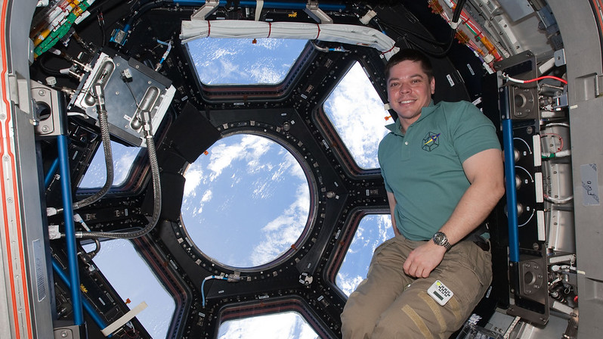
Transmission Data
A visible light spectrometer is used to obtain transmittance data. This data is used to find color balance, and reflectance of the window pane.
Extended Transmission
Using a near IR spectrometer extended transmission data can be collected. This data is used for the safety of the astronauts as high levels of IR radiation can cause eye damage.

Slide 9

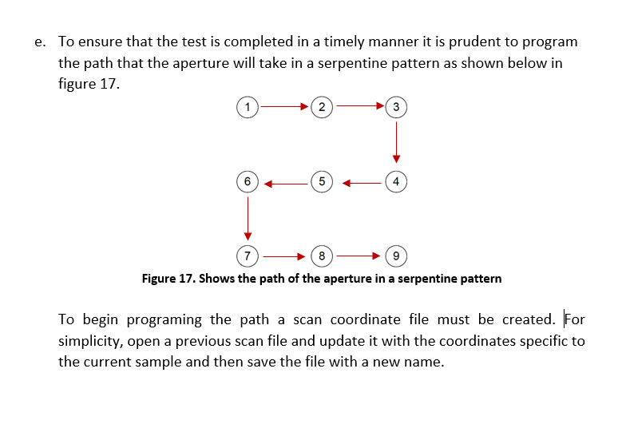
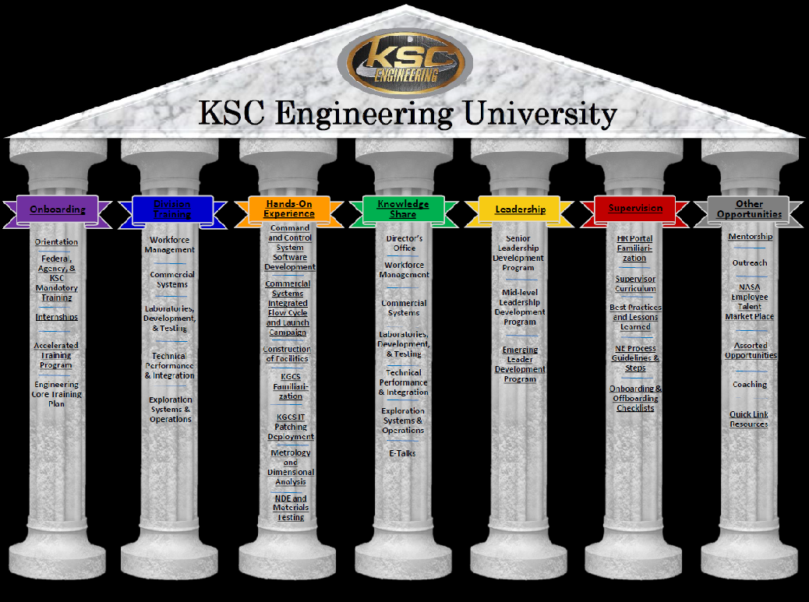
KSC Engineering University Guide
In depth step by step instructional guide with pictures.
Will walk an operator through waveform, haze, transmission, and extended transmission tests in the metrology lab.
To participate: Mechanical or Aerospace Engineer; can be early, mid or experienced in their career. Preference to have been at KSC for at least a year so that they have a basic understanding of technical terminology (NASA, KSC, and discipline terms).
https://sp.ksc.nasa.gov/ne/engineeringu/SitePages/Home.aspx

Slide 10
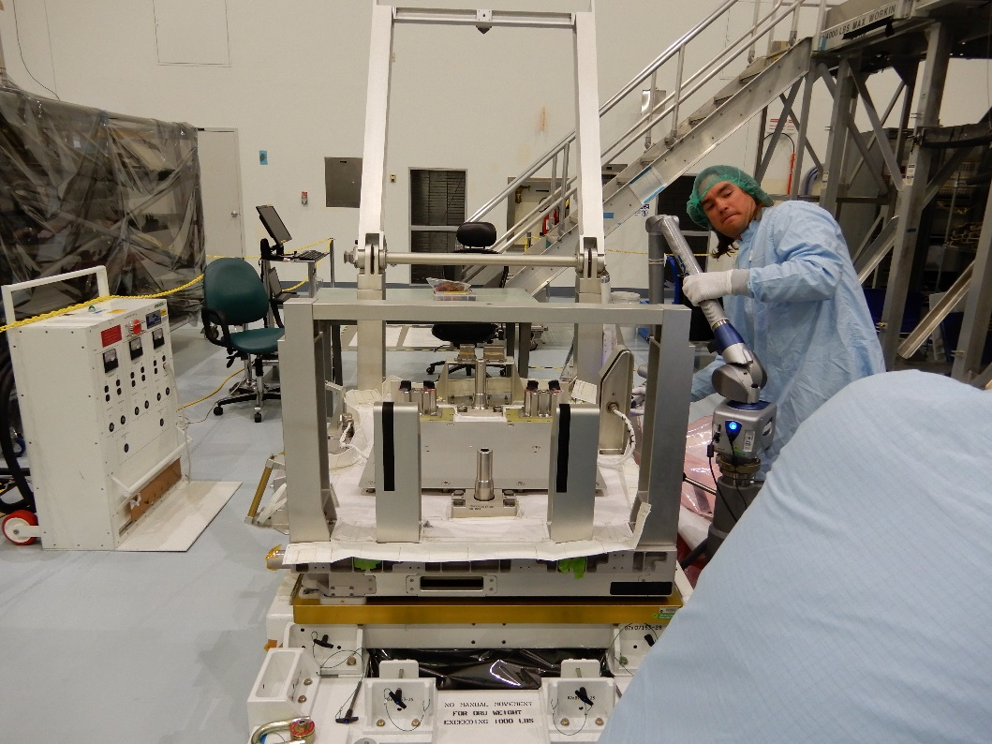
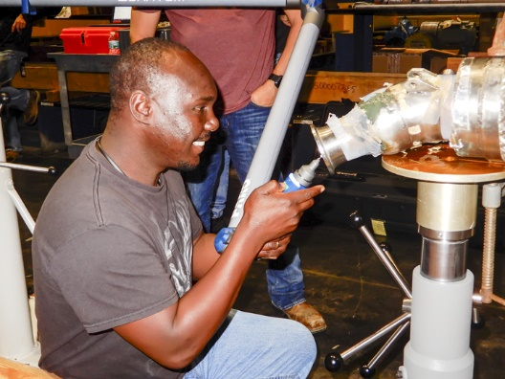
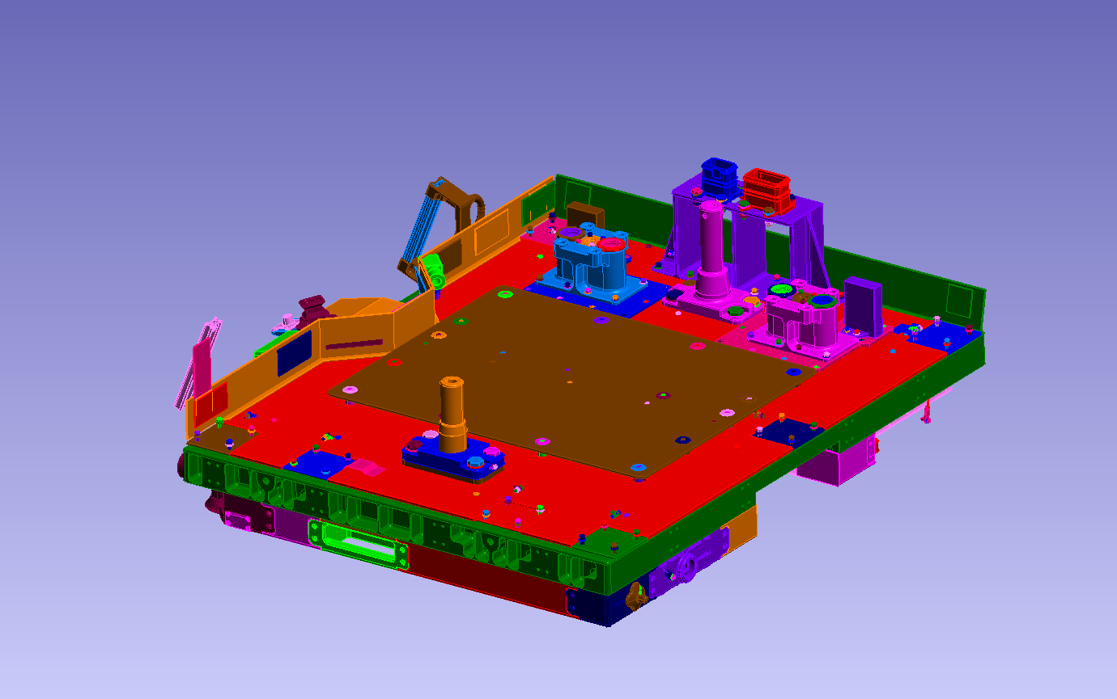
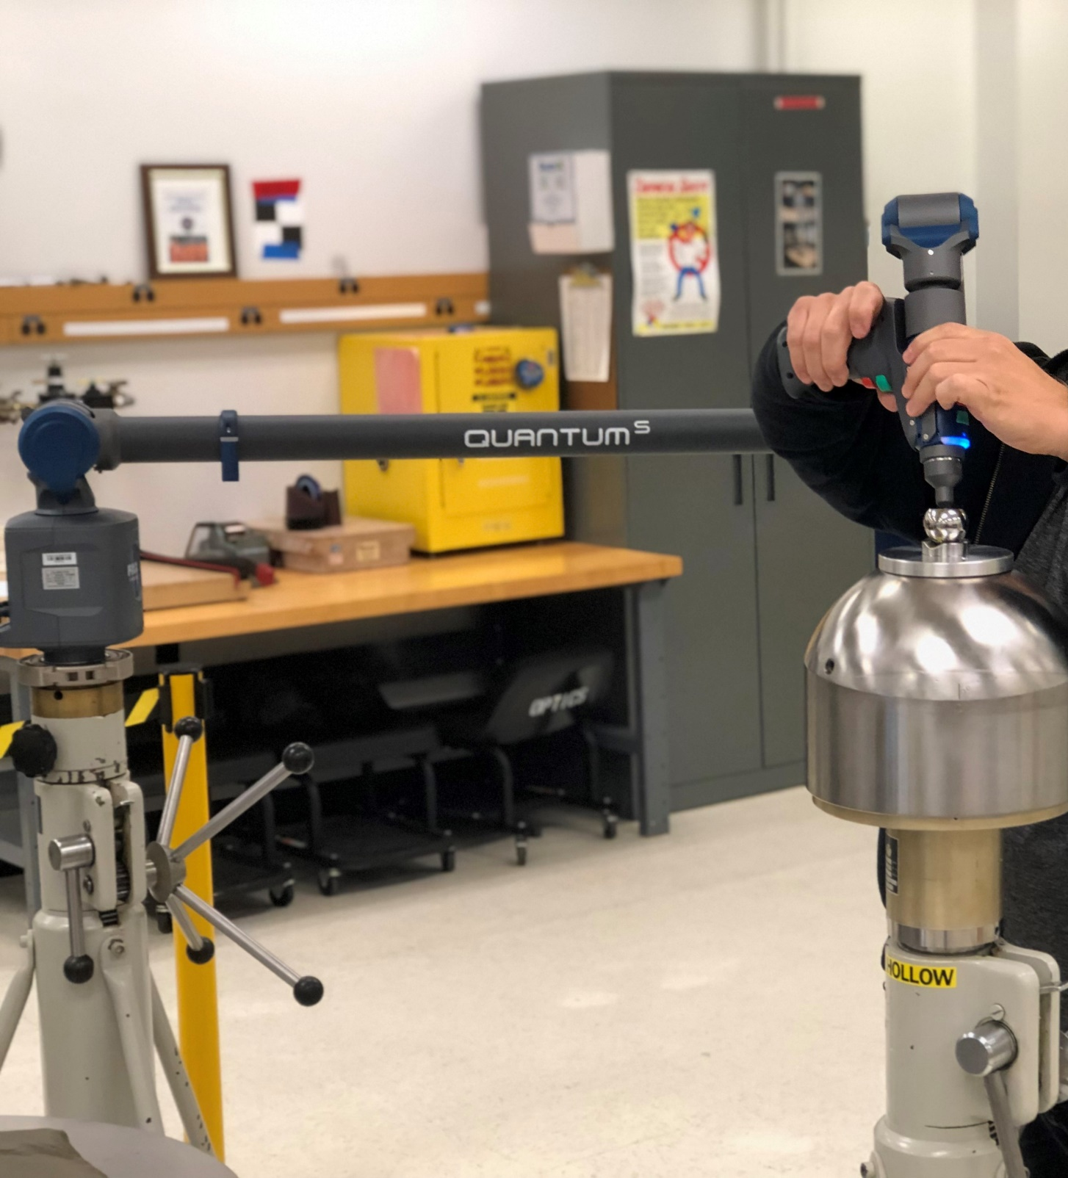
Precision Measurement and Alignment Lab
The Precision Measurement Alignment (PMA) Lab is a field metrology support group that provides real time measurements and alignments on Ground Support Equipment (GSE) and flight hardware for various customers across the space center (mainly supporting the Exploration Ground Systems program).
Measurements over long distances and on complex geometric shapes

Slide 11
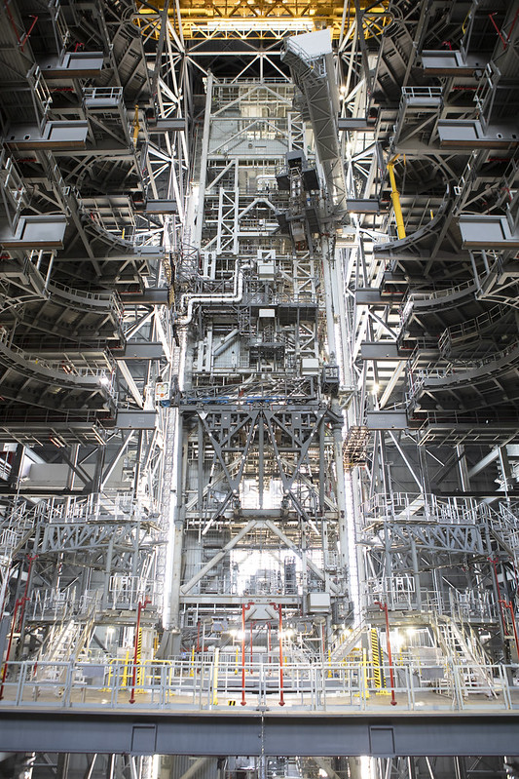
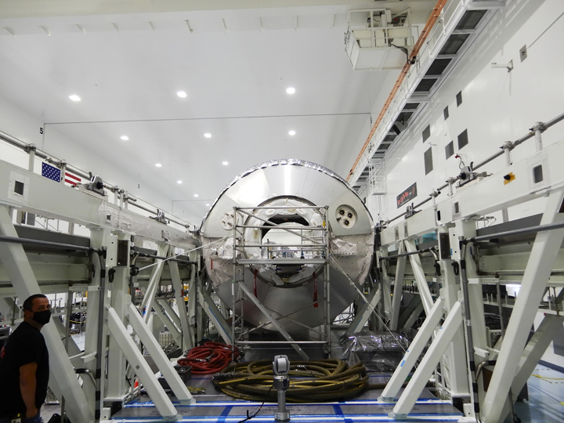
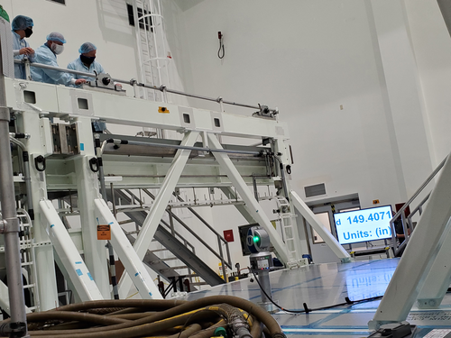
Capable of creating generated 3 dimensional models of objects that have been measured using point cloud data.
Compare measured data with as built computer-aided design models.
SLS Vehicle Stacking:
  Vertical Support Post Alignment
  Booster Final Alignment
  Navigation Package Alignments

Slide 12
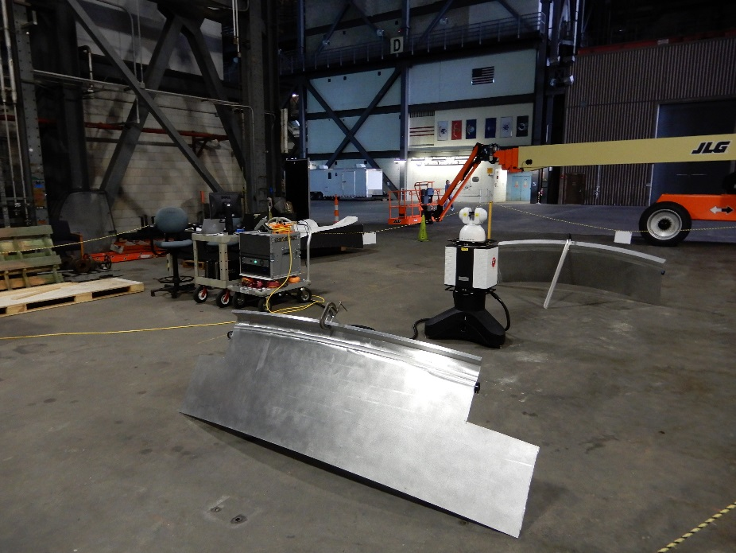
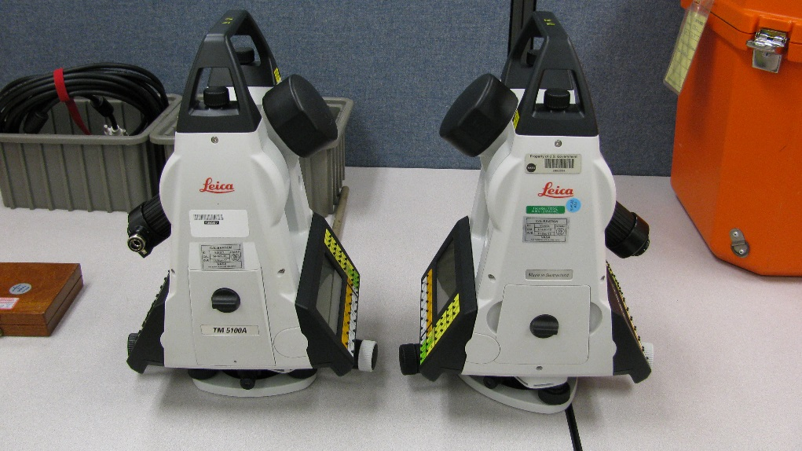
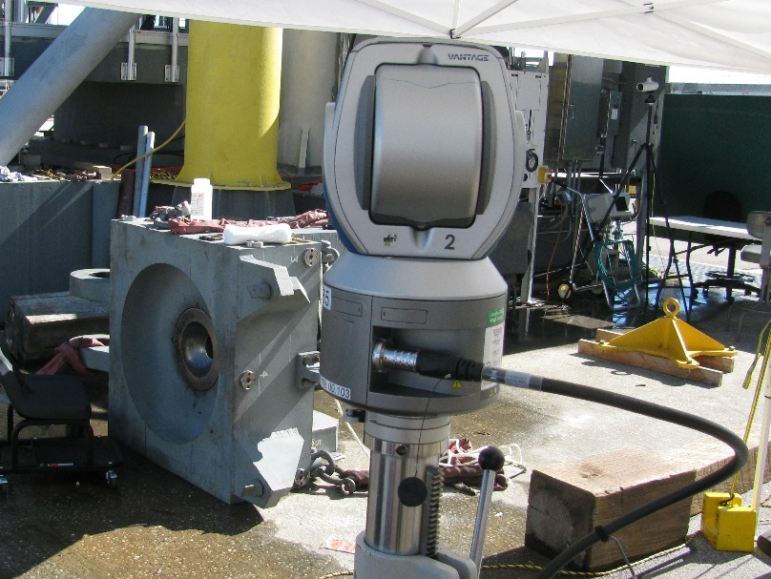
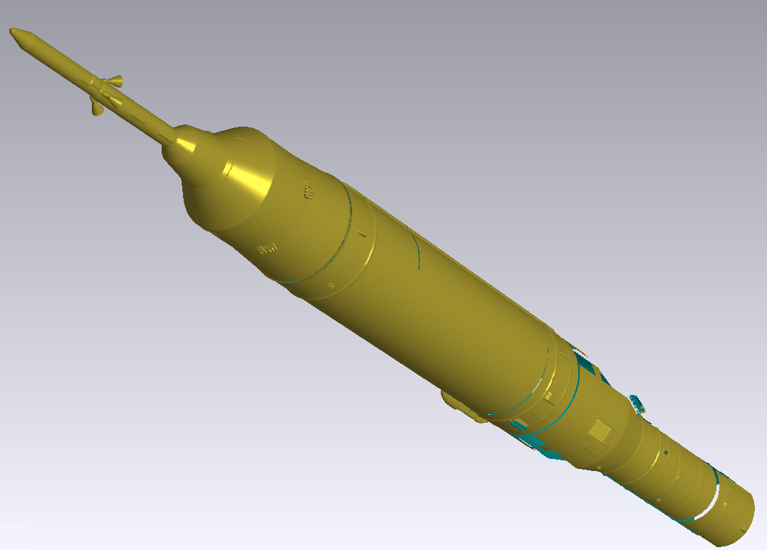
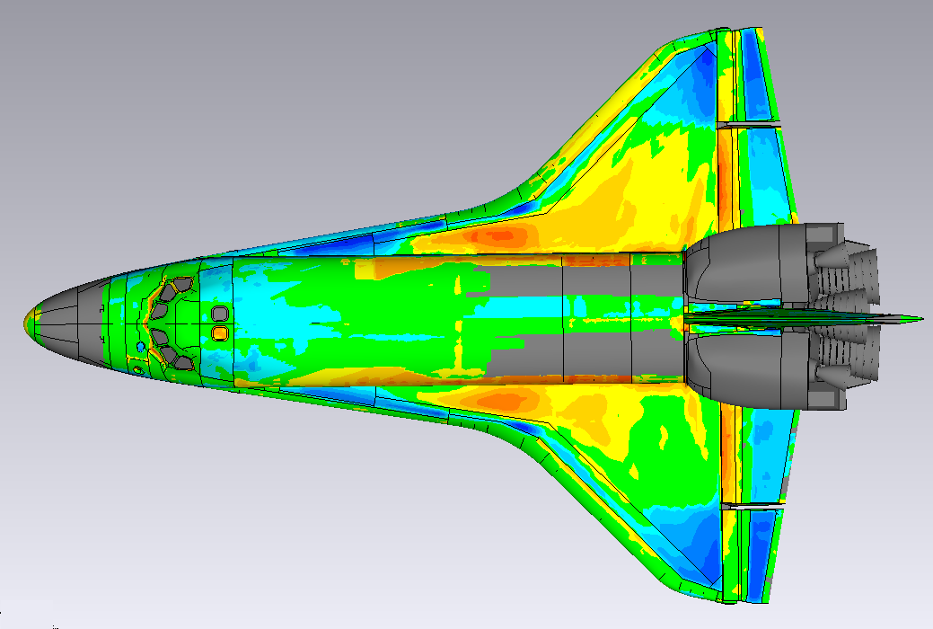
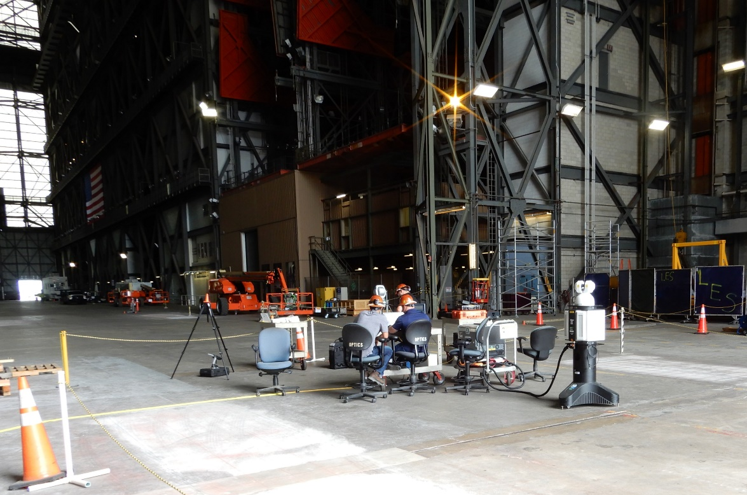
Skills Developed
Familiarization with new software
  Metro Pro
  MX Software (future)
  Lab View
  Spatial Analyzer
  GeoMagic
Familiarization with new hardware
  Interferometers
  Ultra Violet and Near Infrared Spectrometers
  Optical CMM
  Coordinate Measuring Machines
  Laser Trackers and Scanners
  Electronic Theodolites
  Jig Transits
  Precision Sight Levels

Slide 13

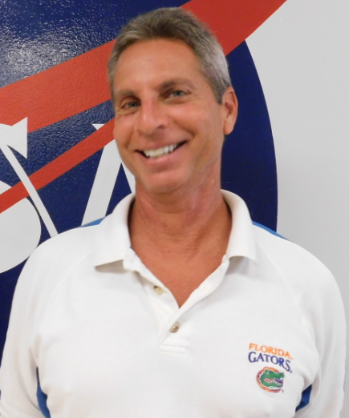
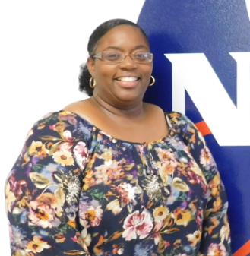
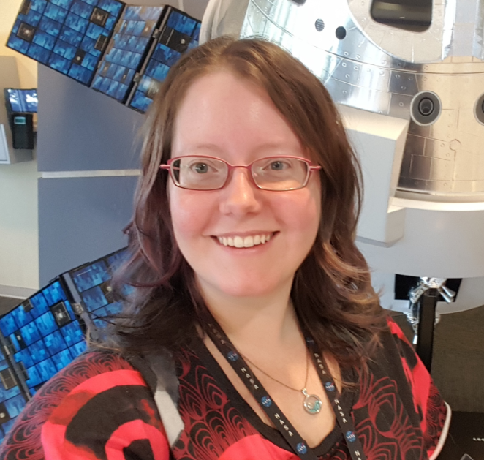
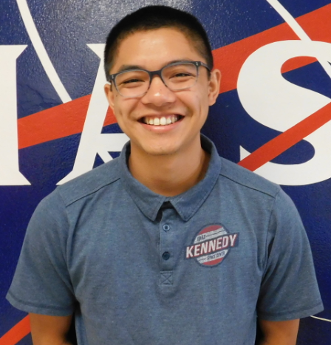
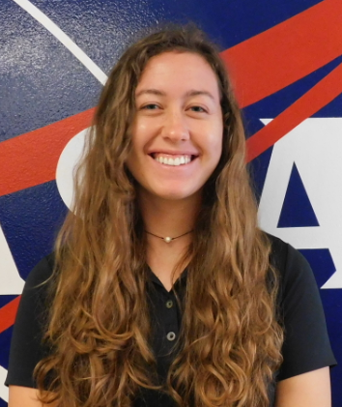
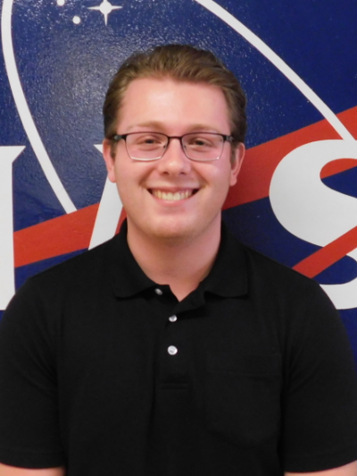
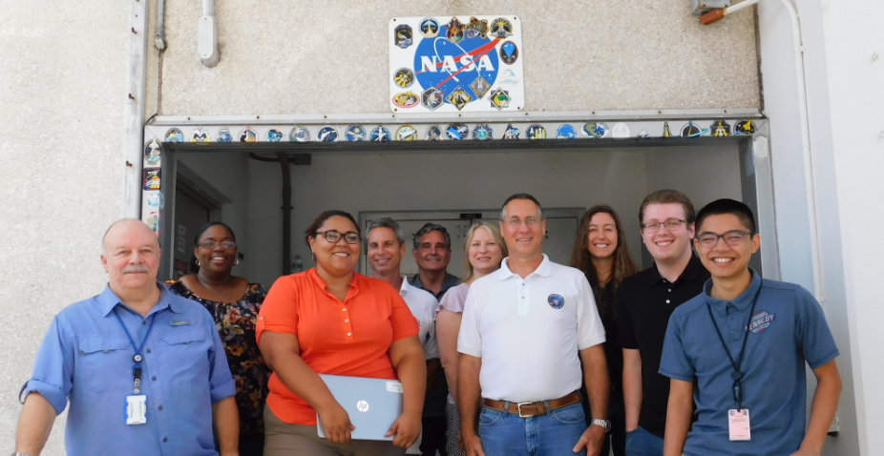
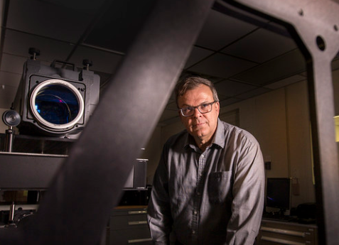
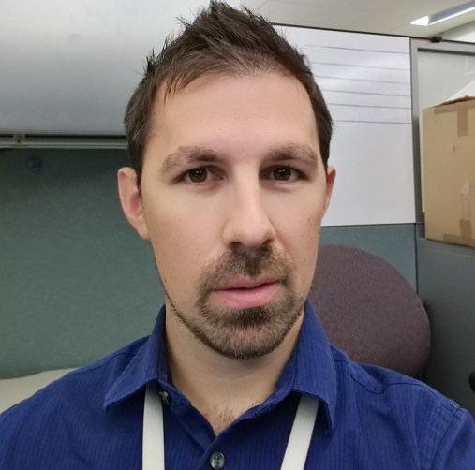
Thank You!!!!

