Slide 1
Virtual and Augmented Reality Technologies in the Engineering Process
By Taylor Waddell

Slide 2
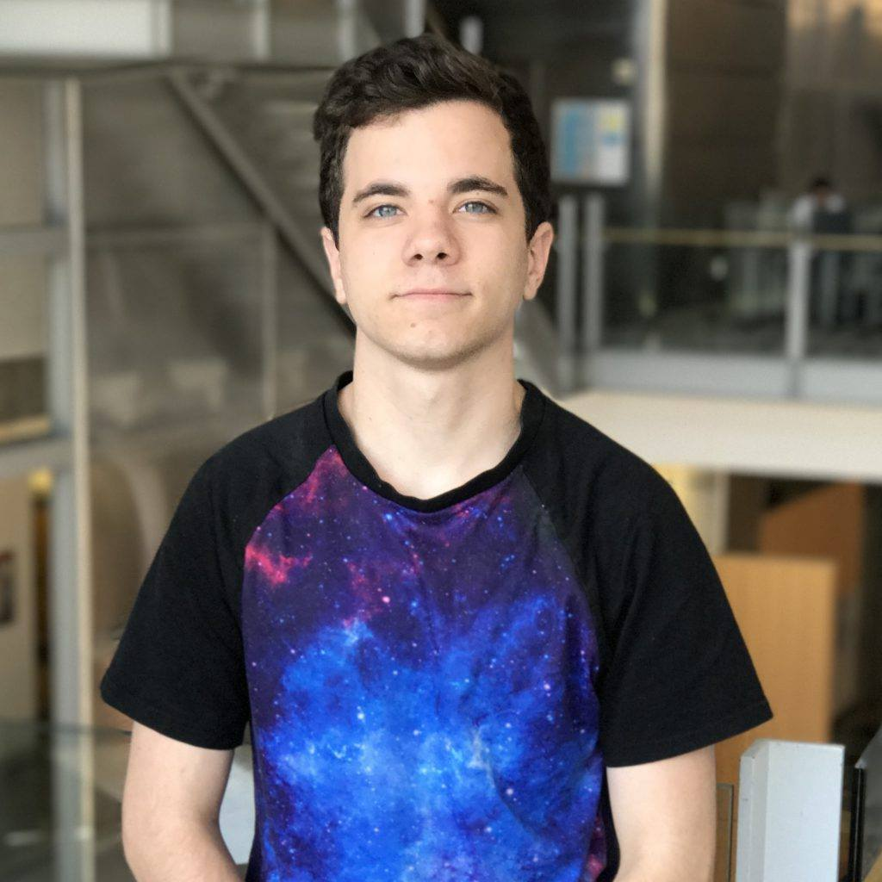
About me.
I Attend University of Wisconsin Madison.
I am a double major in Mechanical Engineering and Computer Science.
My Pathways rotation in ITC-1 Augmented/Virtual Reality Lab.
I will graduate in May 2021
My primary Focuses have been Robotics, Additive Manufacturing and Extended Reality (XR)
My biggest hobby is making/hacking

Slide 3
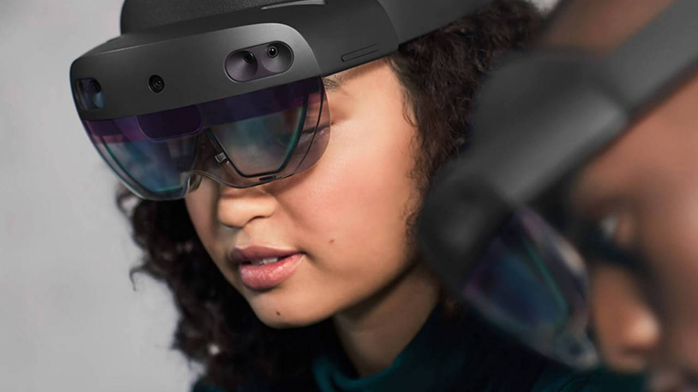
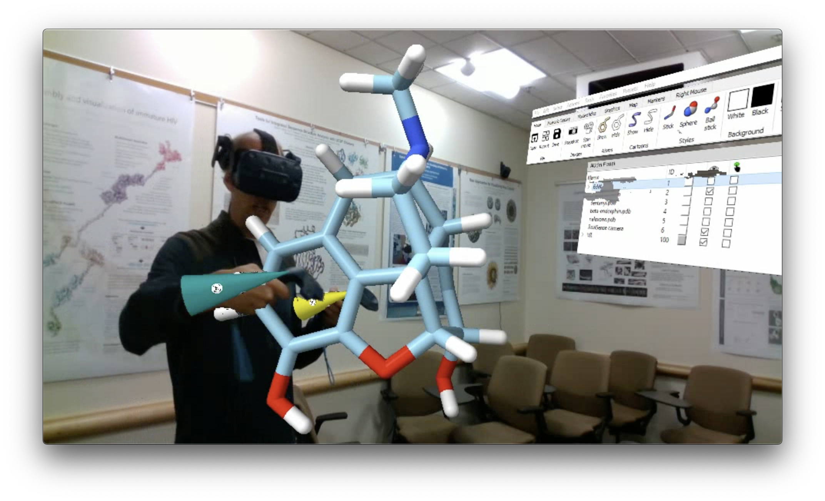
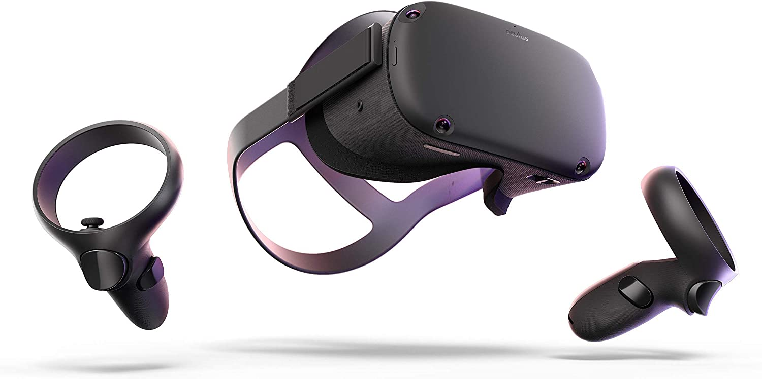
Basic Definition of XR.
Virtual Reality (VR)
Augmented Reality (AR)
Mixed Reality (MR)
Virtual Reality completey replaces real world enivronments.
Augmented Reality overlays objects into real world environments.
Mixed Reality is the merging of real and virtual worlds to produce new environments and visualizations.

Slide 4
Common Misconceptions.
01.
02.
03.
Its too expensive.
Its not accurate.
It will make me sick.
04.
05.
There’s not a large market.
Its only for gaming.
A entry level engineering stand-alone VR Headset can cost as little as $350
The HTC Vive headset has basic tracking accuracy of .3mm
Most headsets refresh at a higher rate than any eye can detect
This year VR had a consumer $9.6B Market cap. By 2022 it is predicted to be $16.3B
This technology has been widely adopted by the Military, Commercial Aerospace, and workplace training organizations

Slide 5

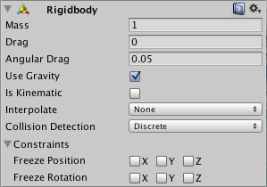
It’s based on physics, and simulation.
Our core XR program is called Unity. And it entirely revolves around physics and simulation. Within Unity you can simulate properties as simple as drag or as complex as springs, friction, and more. All of these features allows for development of complex XR simulations.

Slide 6
01.
Why we need XR in the Engineering Industry

Slide 7
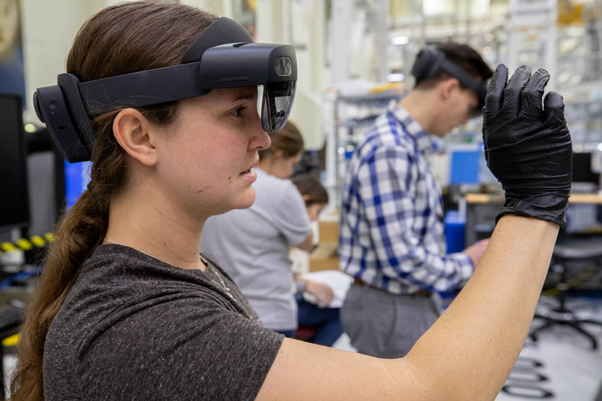
Saving money & time.
Technicians working on the Orion capsule used AR to assist them in installation, this speed up installation tasks that normally took 12 days to 1 day.
Full-scale habitat mockups at MSFC take weeks or months to manufacture. With VR a model it takes minutes to set up while saving the entire material needed to build the mockup.

Slide 8
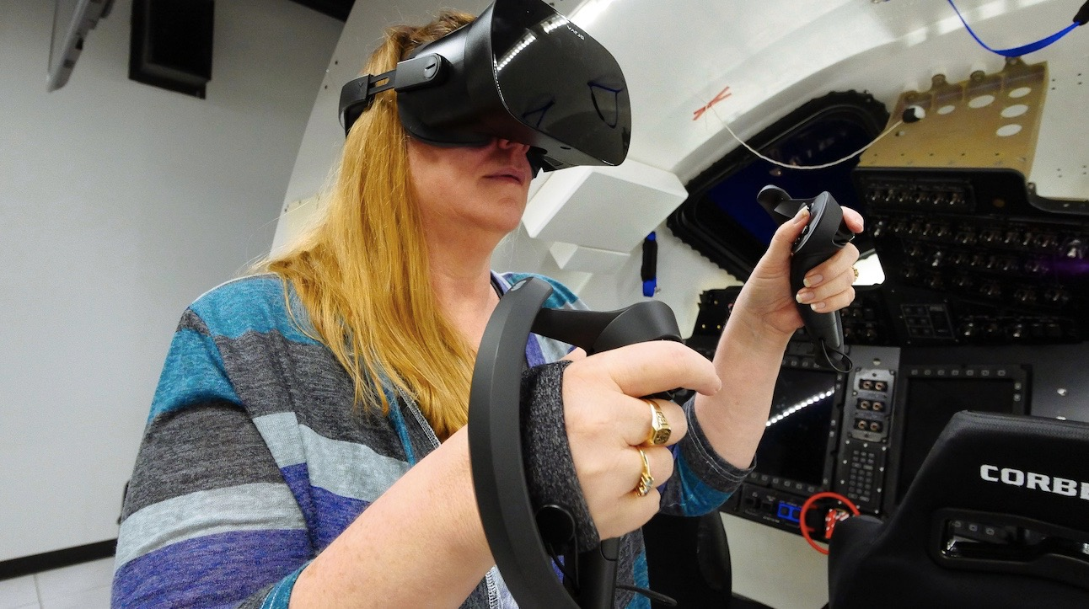
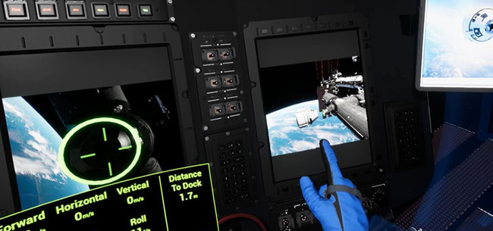
Doing what physical mockups cannot.
Models and simulations can be directly updated when CAD models are updated in as little as seconds.
Environments can be put under unique virtual simulations such as zero gravity.
Users can move, edit and analyze models in ways that would normally be impossible, this includes movement, editing, interaction data, and more.

Slide 9
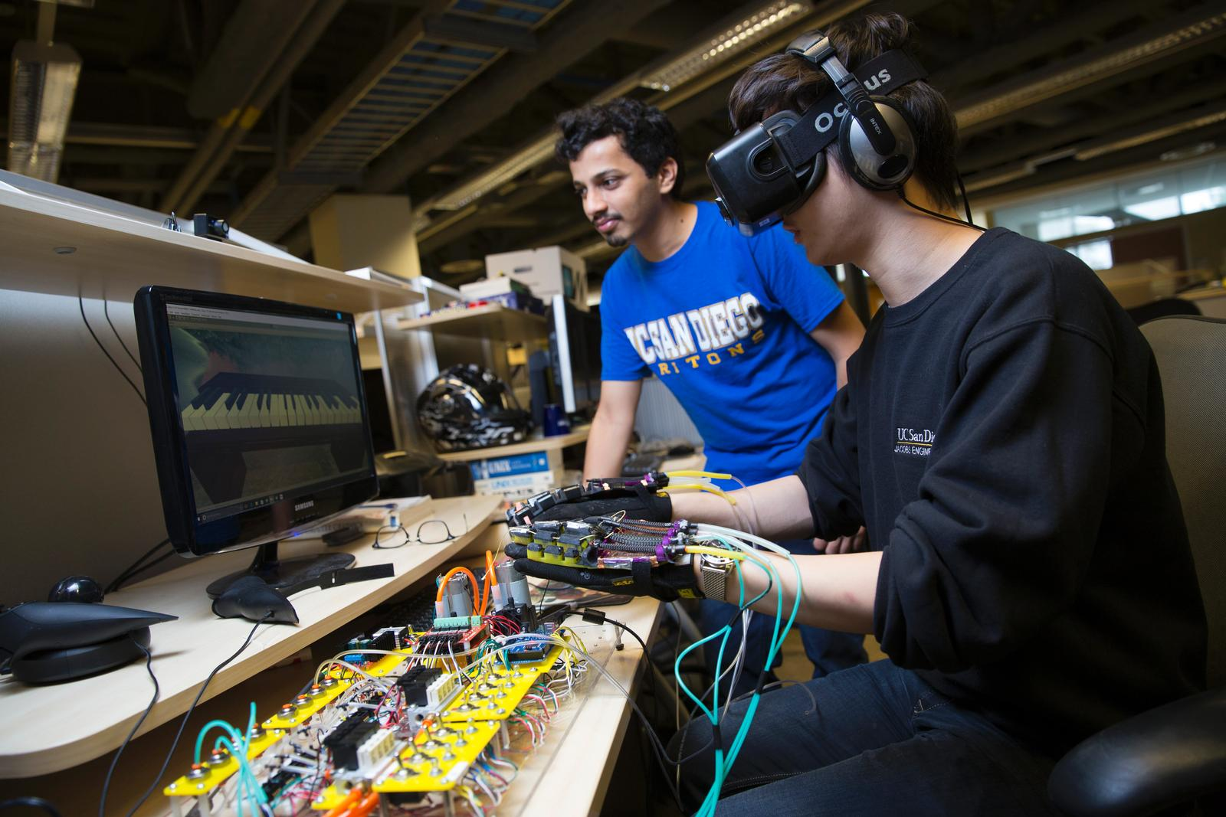
Getting the future workfoce excited.
Simply put, technologies such as Virtual Reality and Augmented Reality excite the incoming workforce. Integrating XR into the workplace will invigorate employees, while increasing efficiency and decreasing spending.

Slide 10
02.
Using the Rapid Model Import Tool (RMIT) for Engineering Models

Slide 11
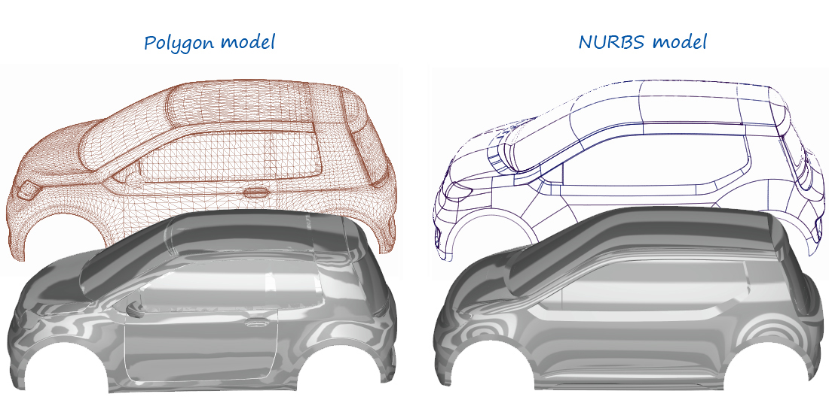
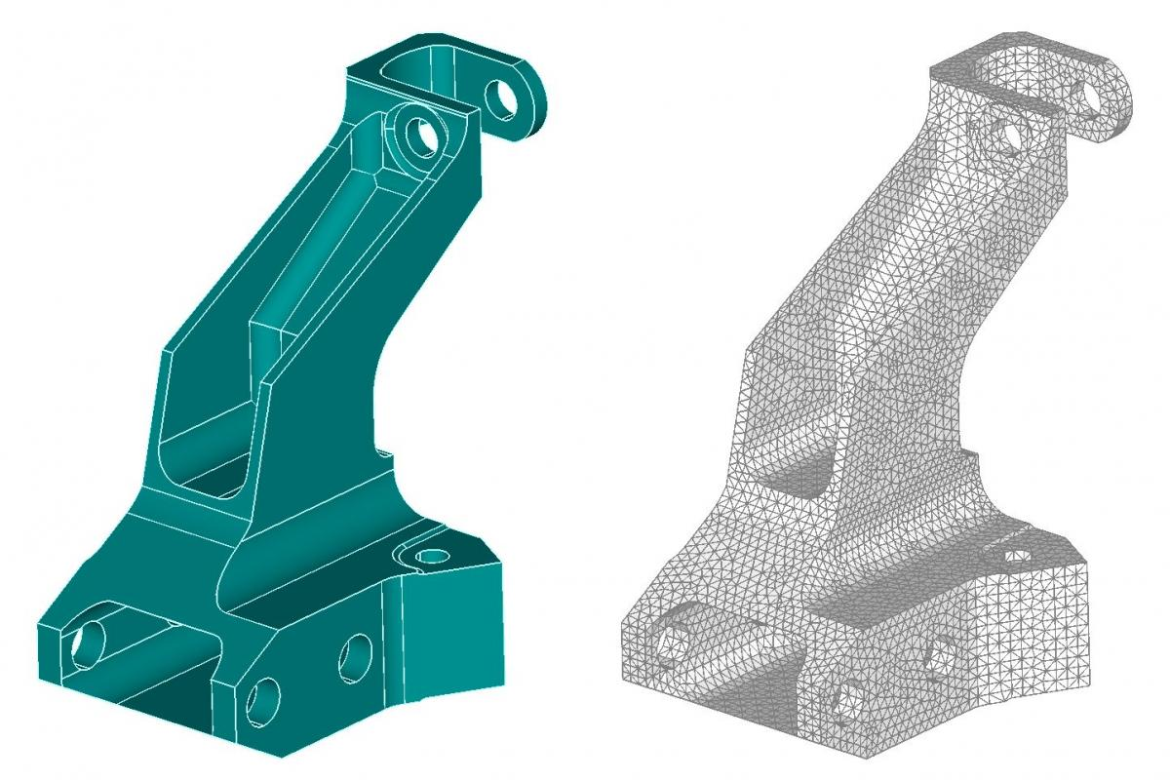
The basics of models.
Not all 3D models are the same. CAD models are based on points and geometric constraints. Models used in XR development are based on polygons and meshes. This difference can lead to a lot of messy conflict between CAD and XR.
A simulation program has to load each polygon in a mesh and compute any updates. The higher the polygon count, the lower quality of your program. This leads developers to find a balance between model quality and processing power.

Slide 12
Where RMIT comes in.
Complex Polygon model
XR Ready Model in Unity
CAD Model
Reduced Polygon model
RMIT First takes a normal CAD file such as .prt or .asm and converts it into a workable polygon model.
Our model is finally ready for XR use, the last step is a linkage between RMIT and Unity that allows us to view our Models in the XR realm.
The next part of RMIT is to use various functions to find the balance of quality vs complexity.

Slide 13
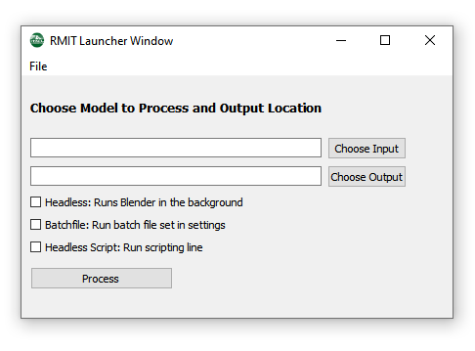
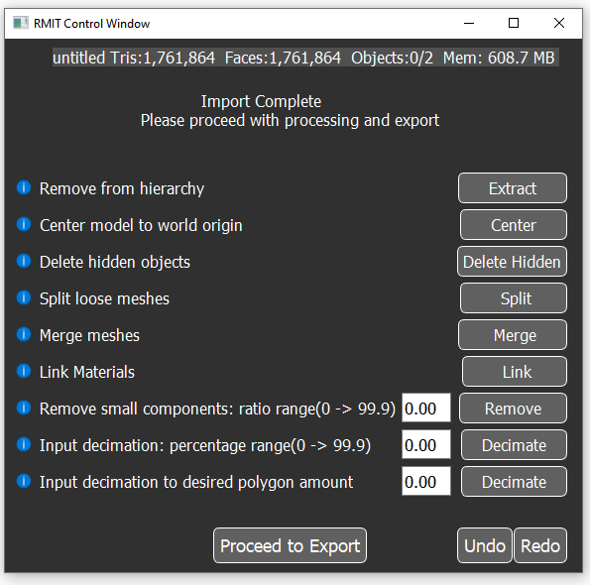
What it can do.
RMIT is capable of processing models in 4 different modes. Default mode launches the control window. This allows for precise editing of the model using the following features seen on the right.
Headless mode processes the model in the background. Batch file mode allows for processing multiple files at once. Scripting mode allows for custom scripting on how to process the model.
Currently RMIT can support the following file types: fbx, dae, obj, gltf, stl, ply, asm, prt, sat, x_t, mdl, c4d, jt, iges, ifc, CATPart, cgr, 3drep, 3dxml, iam, ipt, sldprt, sldasm, 3dm, stp, step, creo, igs, CATproduct

Slide 14
My role & milestones reached.
Milestones reached:
RMIT was successfully accepted into the NASA software catalog
A secondary RMIT Heavy was developed
The program was delivered to various centers around the agency for use
My role:
I updated RMIT with core new features, testing procedures, and standard code upgrades
I created the entire RMIT heavy suite, which allows for new workflows, working with extended model types, and more.
Overhauled much of the old RMIT code to be more concise, efficient and documented.

Slide 15
03.
Creating a Multi-User Model Review Program
An Intuitive and Realstic Model Review Experience

Slide 16
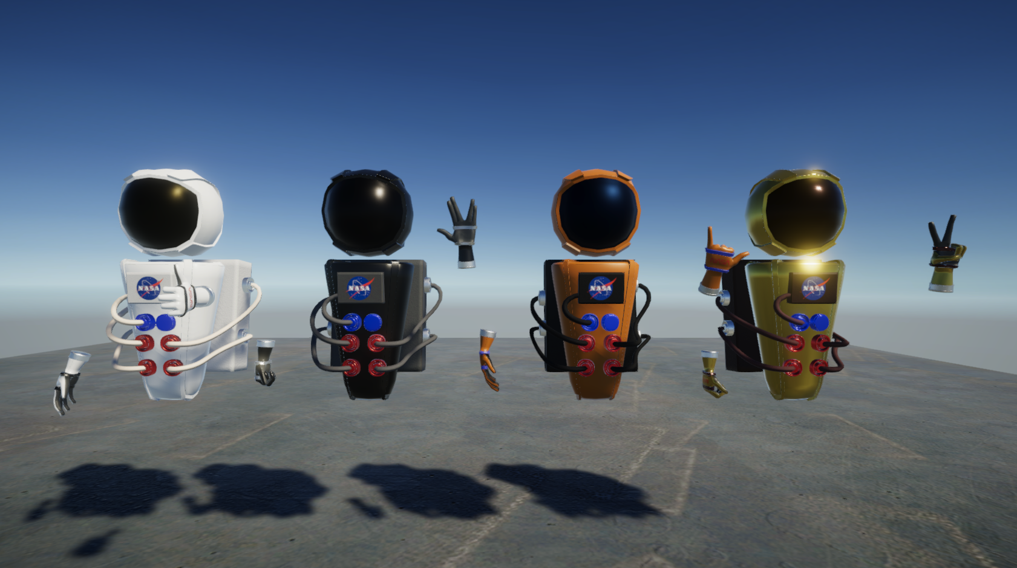
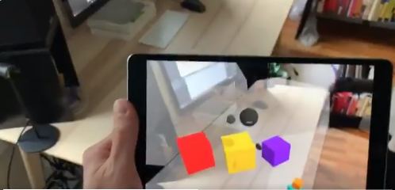
The Planned Core features of the prorgram.
Multiuser integration allowing you to review models in a 3D environment with your co-workers from multiple remote locations.
CAD Model support that will allow for direct loading of your CAD models into the program.
Complete integration with models, allowing to move, scale, mark your models and more.
Various design review tools for communicating and evaluating such as highlighting, note taking and voice recording.
Support for more than VR, allowing to join with a phone and desktop.

Slide 17
Current progress.
Basic multiuser implementation is complete, allowing a user to move, talk and edit models together.
UI and Avatars are nearly done, allowing for a clean and precise look.
Direct model loading from files and folders has been completed.
3 different centers are contributing to the project (KSC,MSFC,JSC), with more expected to join.
Implementing successful software development practices such as version control, agile method, scrum and more.
Most standards for the program have been created, reducing overhead and complex in the future.

Slide 18
My current and future roles.
Current Role:
I am responsible for integration of everyone's induvial code and development.
Assist with ensuring everyone’s tasks are being completed and helping if they are having any development issues.
I am the senior developer for the program.
Near Term Role:
Integrating current interns work from KSC and MSFC into the program.
Automating RMIT into the program to allow for model import.
Implementing a update to all UI.
Integrating new models and avatar into the program.

Slide 19
04.
My Takeaways and Personal Development

Slide 20
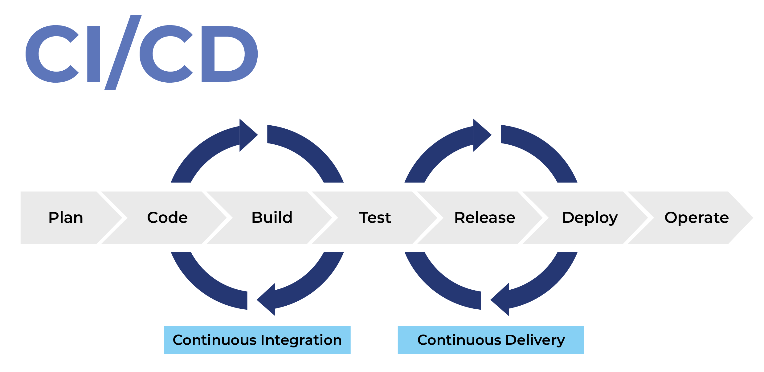
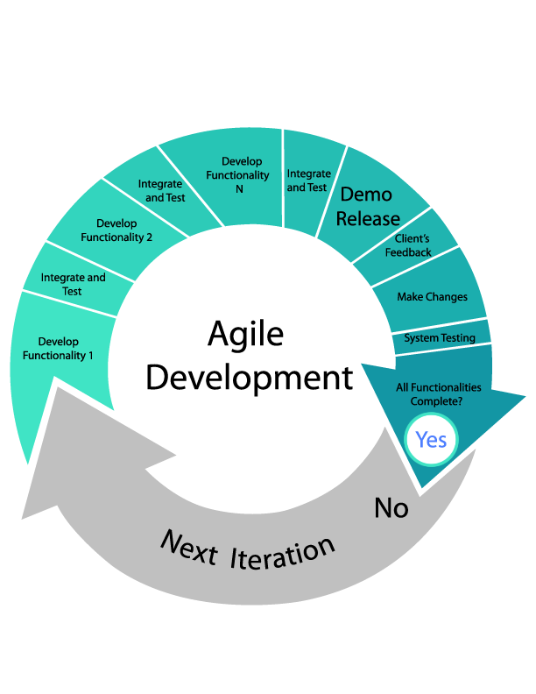
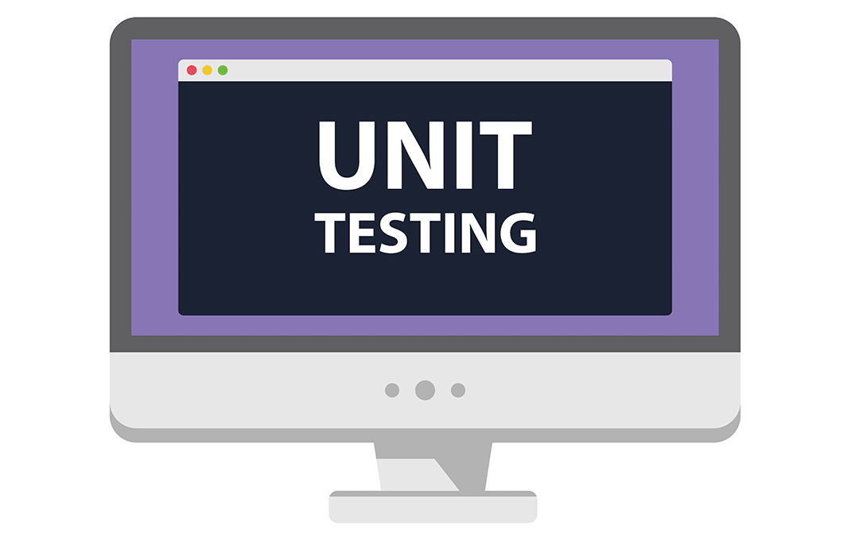

What I learned.

Slide 21
Significance of work experience on my growth.
Teleworking has really pushed me to grow in time and work balance.
I have gained project development skills which I will apply to future projects.
I have refined both my leadership and development skills.

Slide 22
Q/A

