Slide 1
TDRWP Operational Acceptance Test Results (2020)
Nathan Curtis (Nathan.L.Curtis@nasa.gov)
BJ Barbre, Frank Leahy
August 5, 2020

Slide 2
Background
A new pulse shape was uploaded onto the Tropospheric Doppler Radar Wind Profiler (TDRWP) with hopes to improve the Effective Vertical Resolution (EVR) from 450 m to 300 m while avoiding Amateur Radio frequencies.
KSC Weather asked MSFC Natural Environments to conduct an Operational Acceptance Test (OAT) to verify if the EVR was improved to 300 m and that the TDRWP is working as good or better than prior to the upgrade.
The requirements for this OAT, other than the EVR requirement, are compared to the results from the prior TDRWP configuration’s certification for the Space Launch System (SLS).

Slide 3
OAT Requirements
Requirement | Criteria | Rationale
Data Collection Period | Greater of 60 days or the number of days that yield 30 concurrent balloon and TDRWP profiles | Consistent with prior OAT methodologies that ensures enough data is analyzed to accurately draw conclusions from.
Time Interval | 5 min | Supports DOL timeline.
Vertical Data Interval | 150 m | Consistent with database used for SLS design.
Wind Accuracy | 1.5 m/s root-mean-square component difference between 1,795 – 19,280 m | Accuracy of heritage balloon and DRWP systems. Altitude range over which TDRWP was certified to prior to upgrades.
Effective Vertical Resolution | 300 m | KSC Weather requirement for upgrade to be considered successful.

Slide 4
OAT Requirements
Requirement | Criteria | Rationale
Data Collection Period | Greater of 60 days or the number of days that yield 30 concurrent balloon and TDRWP profiles | Consistent with prior OAT methodologies that ensures enough data is analyzed to accurately draw conclusions from.
Time Interval | 5 min | Supports DOL timeline.
Vertical Data Interval | 150 m | Consistent with database used for SLS design.
Wind Accuracy | 1.5 m/s root-mean-square component difference between 1,795 – 19,280 m | Accuracy of heritage balloon and DRWP systems. Altitude range over which TDRWP was certified to prior to upgrades.
Effective Vertical Resolution | 300 m | KSC Weather requirement for upgrade to be considered successful.

Slide 5
Data Collection Period
The OAT began with the January 30th 2315 UTC synoptic balloon launch from Cape Canaveral Air Force Station (CCAFS).
The collection period experienced a delay due to an extended power outage of the TDRWP from February 18th until March 4th.
The data collection period came to an end with the April 16th 2315 UTC synoptic balloon from CCAFS with 110 concurrent TDRWP/balloon comparisons.

Slide 6
OAT Requirements
Requirement | Criteria | Rationale
Data Collection Period | Greater of 60 days or the number of days that yield 30 concurrent balloon and TDRWP profiles | Consistent with prior OAT methodologies that ensures enough data is analyzed to accurately draw conclusions from.
Time Interval | 5 min | Supports DOL timeline.
Vertical Data Interval | 150 m | Consistent with database used for SLS design.
Wind Accuracy | 1.5 m/s root-mean-square component difference between 1,795 – 19,280 m | Accuracy of heritage balloon and DRWP systems. Altitude range over which TDRWP was certified to prior to upgrades.
Effective Vertical Resolution | 300 m | KSC Weather requirement for upgrade to be considered successful.

Slide 7
Time Interval
Under nominal operating conditions the time between TDRWP profiles was 5 minutes.

Slide 8
OAT Requirements
Requirement | Criteria | Rationale
Data Collection Period | Greater of 60 days or the number of days that yield 30 concurrent balloon and TDRWP profiles | Consistent with prior OAT methodologies that ensures enough data is analyzed to accurately draw conclusions from.
Time Interval | 5 min | Supports DOL timeline.
Vertical Data Interval | 150 m | Consistent with database used for SLS design.
Wind Accuracy | 1.5 m/s root-mean-square component difference between 1,795 – 19,280 m | Accuracy of heritage balloon and DRWP systems. Altitude range over which TDRWP was certified to prior to upgrades.
Effective Vertical Resolution | 300 m | KSC Weather requirement for upgrade to be considered successful.

Slide 9
Vertical Data Interval
The vertical range gates of the TDRWP ranged between 149 m – 150 m.

Slide 10
OAT Requirements
Requirement | Criteria | Rationale
Data Collection Period | Greater of 60 days or the number of days that yield 30 concurrent balloon and TDRWP profiles | Consistent with prior OAT methodologies that ensures enough data is analyzed to accurately draw conclusions from.
Time Interval | 5 min | Supports DOL timeline.
Vertical Data Interval | 150 m | Consistent with database used for SLS design.
Wind Accuracy | 1.5 m/s root-mean-square component difference between 1,795 – 19,280 m | Accuracy of heritage balloon and DRWP systems. Altitude range over which TDRWP was certified to prior to upgrades.
Effective Vertical Resolution | 300 m | KSC Weather requirement for upgrade to be considered successful.

Slide 11
Wind Accuracy
The methodology from the full certification (Barbre et al. 2019) is mainly used to calculate wind accuracy where *’s denote deviation from that methodology:
TDRWP data is manually QC’d.
One second balloon data is vertically matched within 75 m of TDRWP altitudes. Altitude gates with at least 15 balloon measurements are kept and averaged across the gate.
TDRWP timestamps are subtracted by 7.5 minutes to account for temporal averaging. Then the balloon measurements are matched to the closest profile within 5 minutes.
Deltas between the TDRWP and time and height matched balloons are calculated if at least 75% of the profiles are complete.
* Spatial separation is accounted for using NARR data from Jan 30th to April 16th.
* 10 hours were required between comparisons to ensure differing atmospheres were measured.
Overall 110 comparisons were used in this analysis.

Slide 12
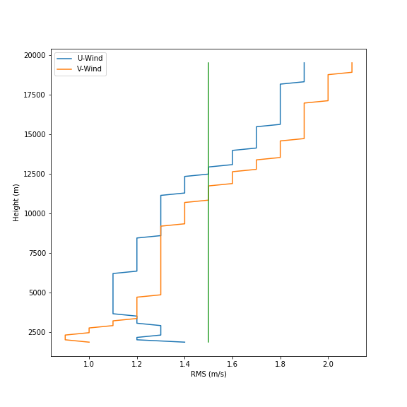
Wind Accuracy
U-wind meets the wind accuracy requirement from 1869 m – 13078 m (6132 ft - 42906 ft)
V-wind meets the wind accuracy requirement from 1869 m – 11883 m (6132 ft - 38986 ft)
Thus the TDRWP meets the wind accuracy requirement from 1869 m – 11883 m (6132 ft - 38986 ft)

Slide 13
OAT Requirements
Requirement | Criteria | Rationale
Data Collection Period | Greater of 60 days or the number of days that yield 30 concurrent balloon and TDRWP profiles | Consistent with prior OAT methodologies that ensures enough data is analyzed to accurately draw conclusions from.
Time Interval | 5 min | Supports DOL timeline.
Vertical Data Interval | 150 m | Consistent with database used for SLS design.
Wind Accuracy | 1.5 m/s root-mean-square component difference between 1,795 – 19,280 m | Accuracy of heritage balloon and DRWP systems. Altitude range over which TDRWP was certified to prior to upgrades.
Effective Vertical Resolution | 300 m | KSC Weather requirement for upgrade to be considered successful.

Slide 14
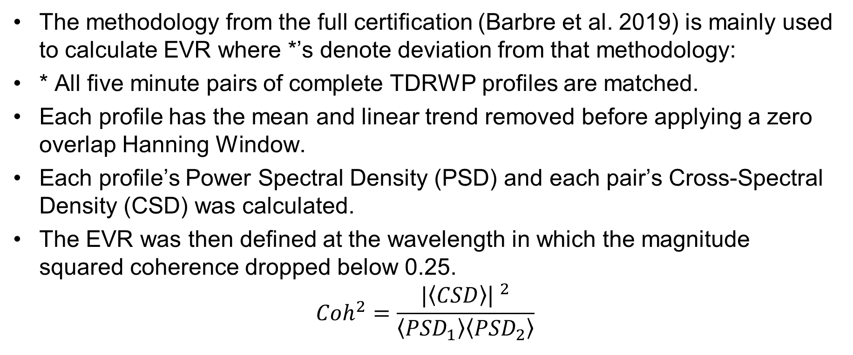
Effective Vertical Resolution
The methodology from the full certification (Barbre et al. 2019) is mainly used to calculate EVR where *’s denote deviation from that methodology:
* All five minute pairs of complete TDRWP profiles are matched.
Each profile has the mean and linear trend removed before applying a zero overlap Hanning Window.
Each profile’s Power Spectral Density (PSD) and each pair’s Cross-Spectral Density (CSD) was calculated.
The EVR was then defined at the wavelength in which the magnitude squared coherence dropped below 0.25.
$$Coh^{2}=\frac{|\left\langle CSD\right\rangle {\text{| }}^{2}}{\left\langle {PSD}_{1}\right\rangle \left\langle {PSD}_{2}\right\rangle }$$

Slide 15
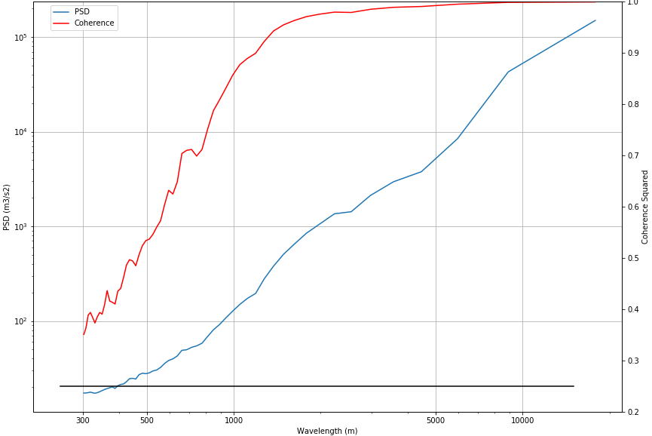
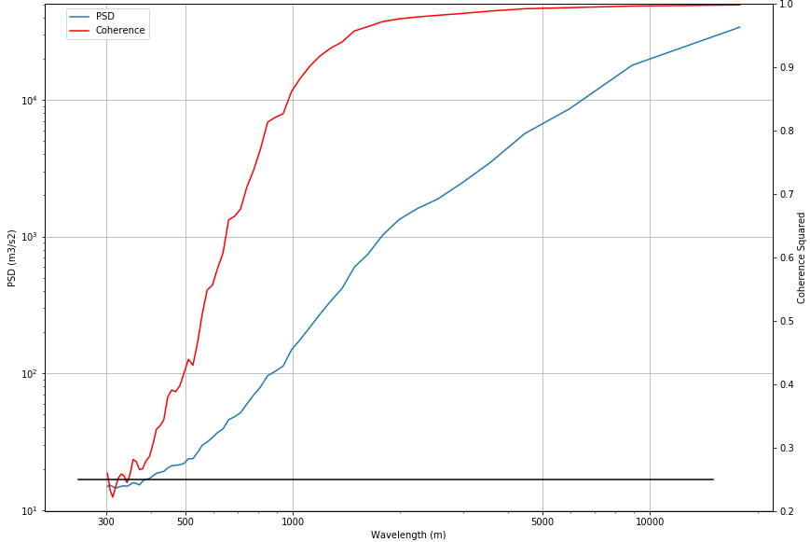
Effective Vertical Resolution
U-wind
V-wind
The U-wind EVR is nyquist limited (300 m), while the V-wind EVR is ~330 m.

Slide 16
OAT Requirements and Results
Requirement | Criteria | Rationale | Result
Data Collection Period | Greater of 60 days or the number of days that yield 30 concurrent balloon and TDRWP profiles | Consistent with prior OAT methodologies that ensures enough data is analyzed to accurately draw conclusions from. | The data collection period spanned from January 30th at 2315 UTC until April 16th at 2315 UTC with 110 concurrent balloon and TDRWP profiles.
Time Interval | 5 min | Supports DOL timeline. | Pass. The time between profiles under nominal conditions was 5 minutes.
Vertical Data Interval | 150 m | Consistent with database used for SLS design. | Pass. The vertical range gates ranged between 149 m – 150 m.
Wind Accuracy | 1.5 m/s root-mean-square component difference between 1,795 – 19,280 m | Accuracy of heritage balloon and DRWP systems. Altitude range over which TDRWP was certified to prior to upgrades. | Fail. The TDRWP meets the wind accuracy requirement from 1869 m – 11883 m (6132 ft - 38986 ft)
Effective Vertical Resolution | 300 m | KSC Weather requirement for upgrade to be considered successful. | Fail. The EVR of the system is 330 m.

