Slide 1

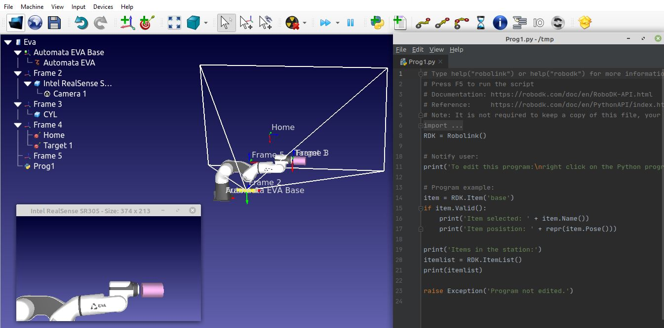
Robotic Arm Sensor Tia B. Grey – Navajo Technical University | Code 540 – Advanced Systems Development – Mentor Paul Bean
Introduction
Results
The pattern magnet research, the robotic arm will be used to autonomously move to test the cryogenic fluid coupling mechanisms and to perform-in-the-loop tests in conjunction with direct reconnect linkage relating to the mothership-drones. Such methods will assimilate input from machine vision to accomplish their mission.
The time-consuming difficulties interrupted the research as the model of the Eva arm was not in the RoboDK simulated library, therefore; the joints were not properly attached. Automata Eva is a six-degree-of-freedom
desktop, collaborative arm based in London. I contacted both company to consent to import the Eva arm into RoboDK library so that I can proceed this project.
Task
Market research for six-degree-of-freedom robotic arm requirements
- Investigate robotic simulator software
Modeling a robotic arm dimensions and limitations
Method
Goal
In preparation for sensor-in-the-loop control, market analysis was conducted to select the required arm for the task including the findings of robotic simulation software. The six-degree-of-freedom arm will be configured to integrate a vision system feedback to conduct the sensor-in-the-loop testing.
Research machine vision script
Explore magnetic end-effector
Acknowledgement
Mentor Paul Bean
[RoboDK simulator]. Retrieved from NASA Armstrong – Intern Tia Grey snapshot

