Slide 1
Date Year
Space Launch System Launch Windows and Day of Launch Processes
Scott Craig/NASA/MSFC/EV42
Naeem Ahmad/NASA/GSFC/5910

Slide 2
Introduction
NASA’s Space Launch System (SLS) is the launch vehicle that will be taking Crew back to the Moon
Flying lunar missions requires a different approach to launch windows than what was flown for the Space Shuttle
Instead of yaw-steering into the desired orbit plane, it is more efficient to track the Moon’s apparent motion by varying the launch azimuth
This methodology creates daily launch windows in excess of 2 hours on some days
The SLS Guidance Team must take the Three Degree of Freedom optimized trajectories to develop target polynomials for use on flight day

Slide 3
Challenges of the SLS Launch Geometry
Due to the Delta-V split on the SLS Block 1 configuration, the SLS Core Stage must insert the Interim Cryogenic Propulsion Stage (ICPS) and Orion Stack into an elliptical parking orbit.
  The ICPS does not have sufficient performance to insert a spacecraft of Orion’s mass into a Trans-Lunar trajectory
Since SLS will launch from Kennedy Space Center in the northern hemisphere and inserts into the target orbit at a true anomaly of approximately 33 degrees, this puts the apogee in the southern hemisphere.
The optimal location for the Trans Lunar Injection (TLI) burn is to center it about perigee, which means the line of apsides of the resultant orbit will be pointing toward the southern hemisphere.
This restricts SLS Block 1 lunar missions to occur when the Moon is near its minimum declination for the current orbit.
  The exact launch period, or number of days a launch is possible in a lunar month, is dependent on how much performance margin is available on the vehicle.

Slide 4
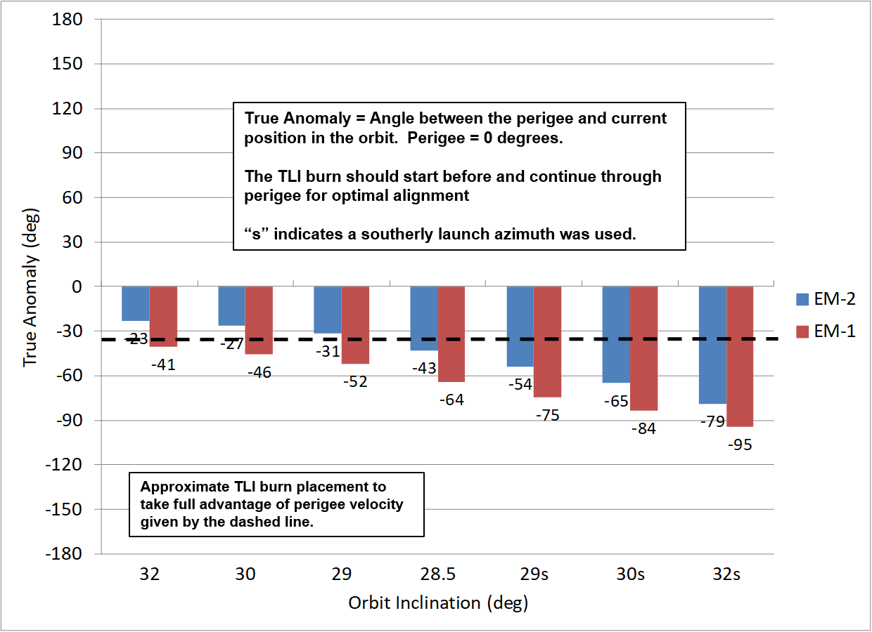
Pre-TLI True Anomalies for Artemis I and II
(Formerly known as EM-1 and EM-2)
TLI Burn alignments are better along more northerly launch azimuths for Artemis I compared to Artemis II
Approximate TLI burn placement to optimally increase apogee is given by the dashed line
Northerly launch azimuths
Southerly launch azimuths

Slide 5
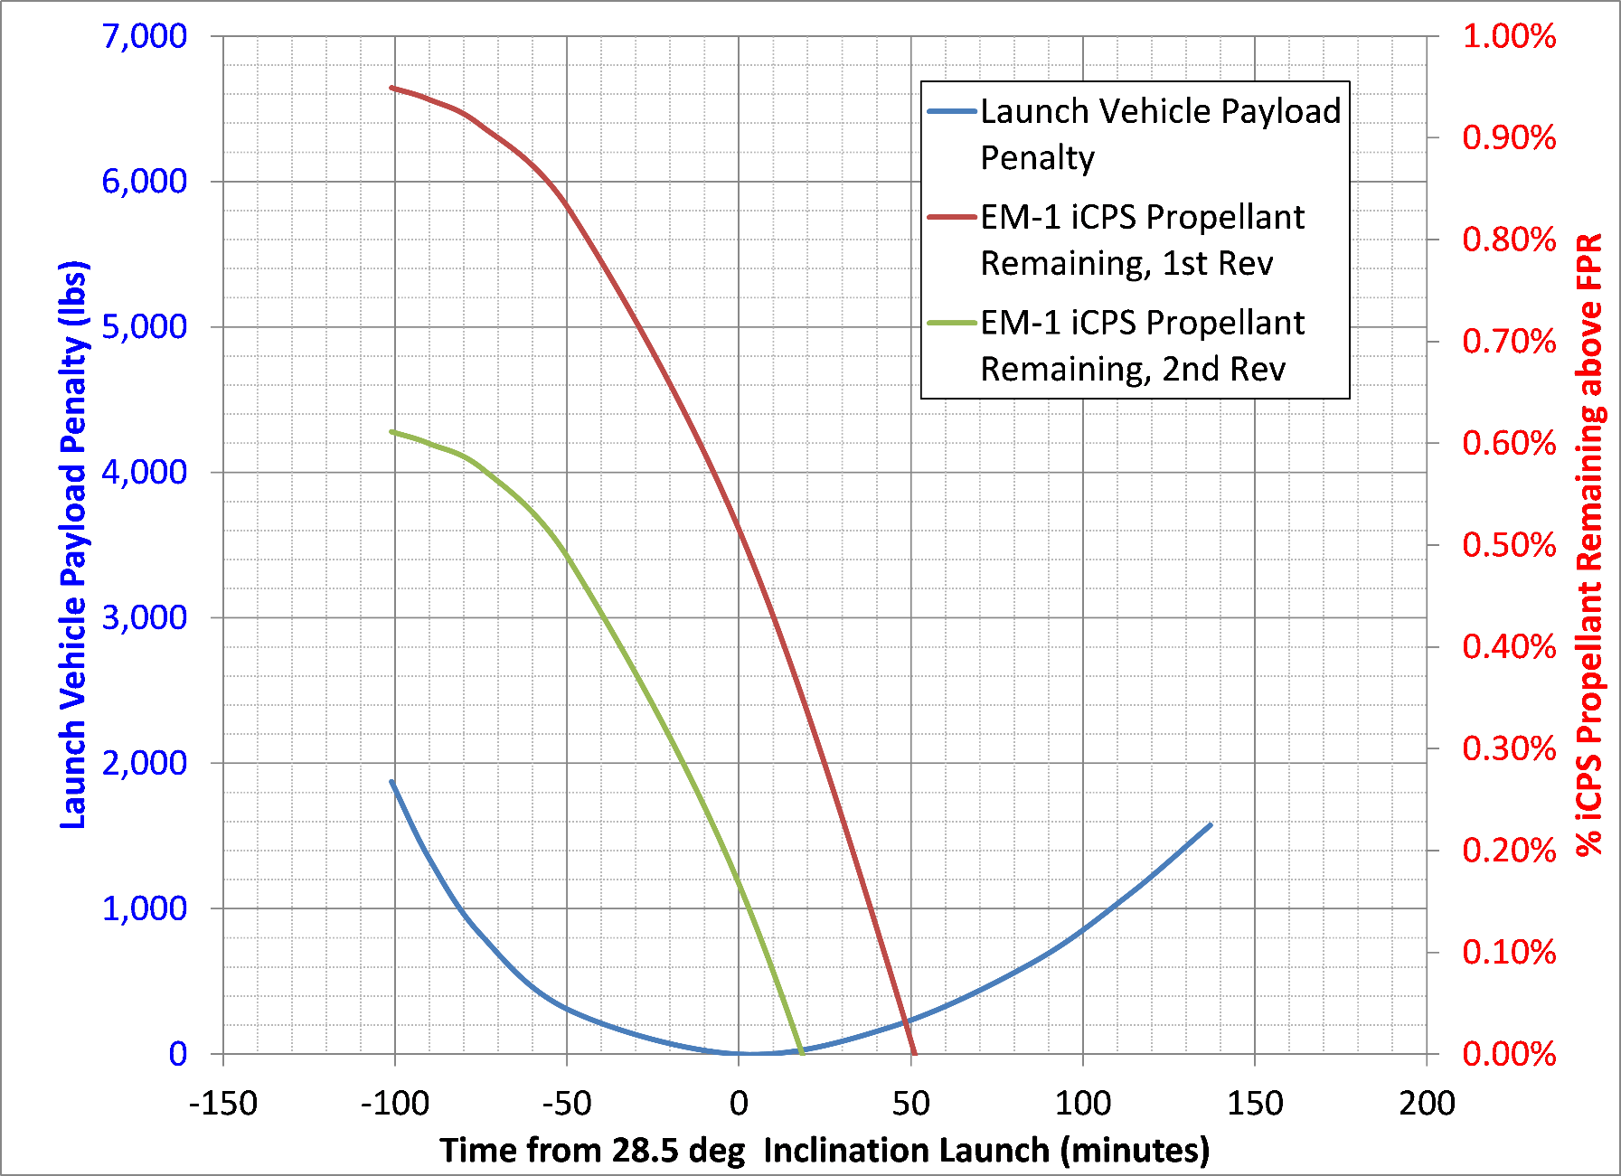
Artemis I Daily Launch Window example
Launch window widths are typically determined by Core performance for the opening and ICPS performance for the closing of the daily windows
Opening of the window for 1,000 lbm of launch window reserve
Closing of the window due to running out of ICPS performance

Slide 6
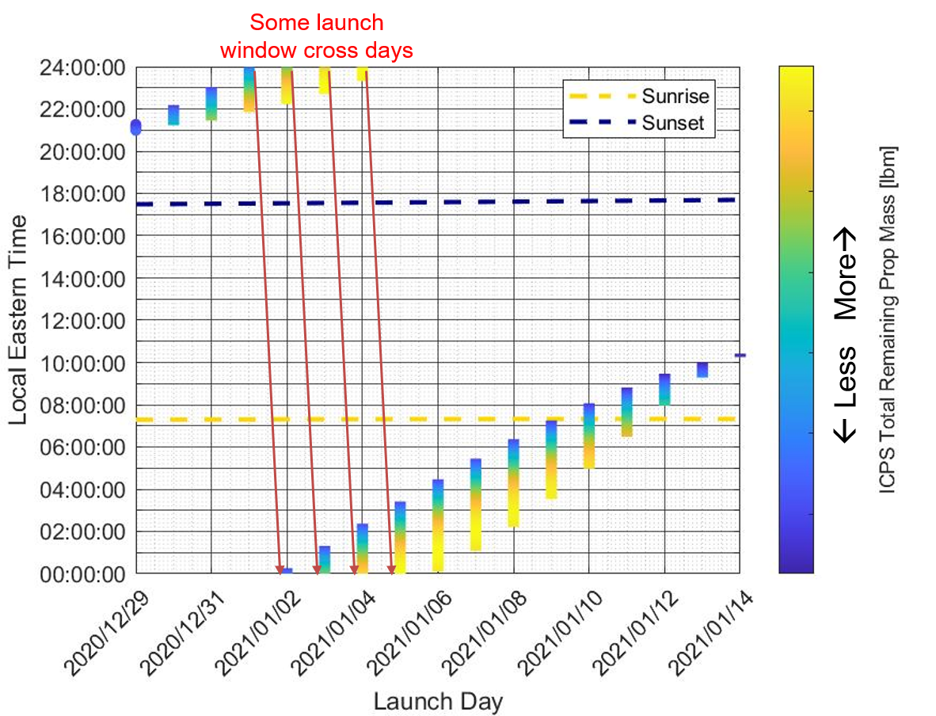
Example launch period from Artemis I Flight Readiness Analysis Cycle
Performance based window, provides up to 16 days of opportunities

Slide 7
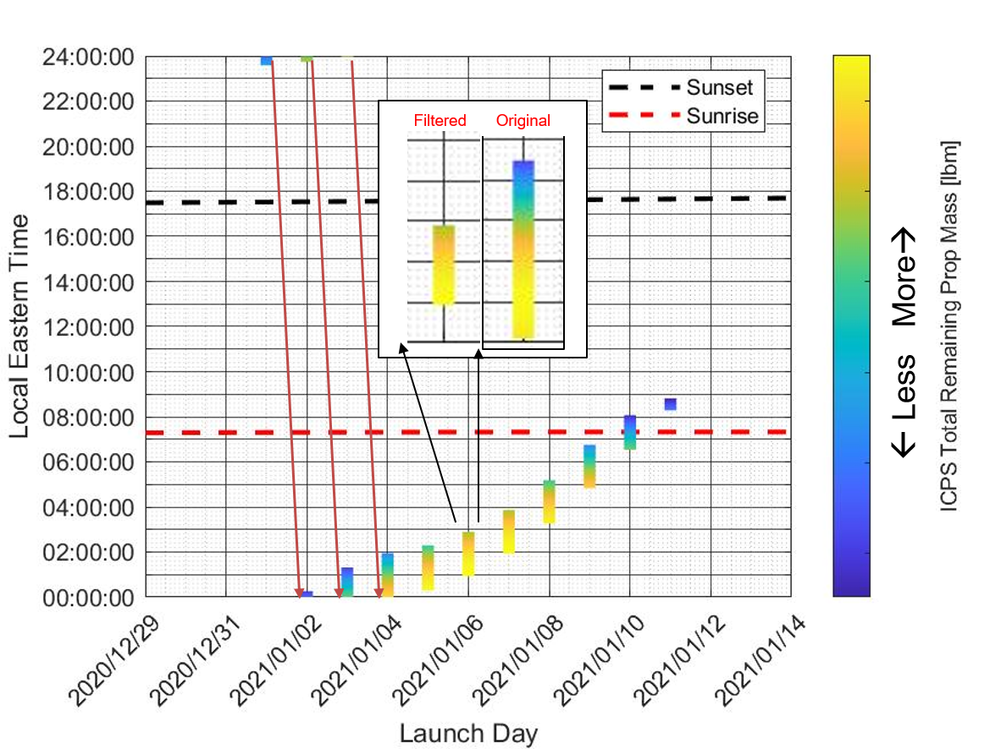
Example launch window from Artemis I Flight Readiness Analysis Cycle
Impacts of protecting for worst case Engine Out
Protecting for engine out may reduce both daily opportunities and width of daily windows

Slide 8
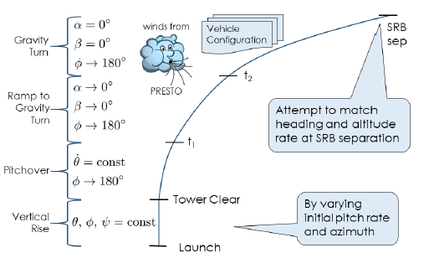
Day of Launch Initialization Loads Update (DOLILIU)
CHANGO (Chi Angle Optimizer) is used to generate a lookup table for SLS’s first stage open loop guidance
  CHANGO is an optimizer that attempts to match desired state at termination of first stage while subjected to trajectory constraints shown in top right figure
  CHANGO generated chi table which consists of Roll, Pitch and Yaw commands
  Inputs to CHANGO are designed by SLS GNC Team
DOLILIU system anticipates unique set of inputs for CHANGO for each day in the launch opportunity (~70 different set of inputs across a year)
  Figure on bottom right shows launch azimuth variation for a typical launch period
  This variation results in some days requiring lower azimuth launch and other higher azimuth

Slide 9
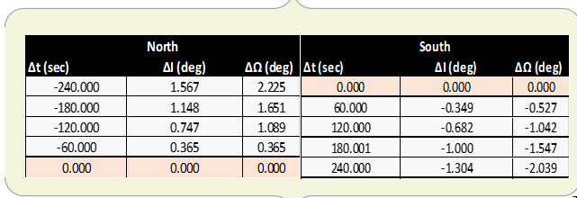
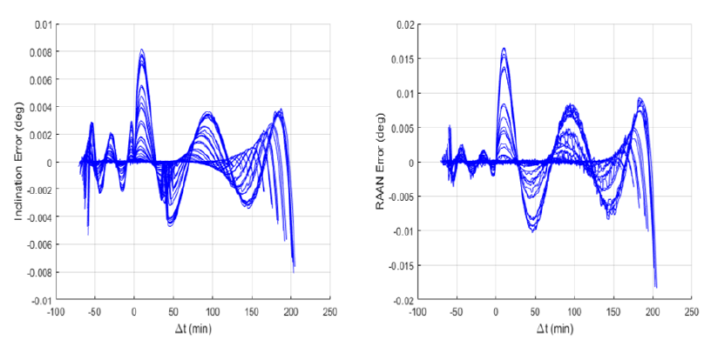
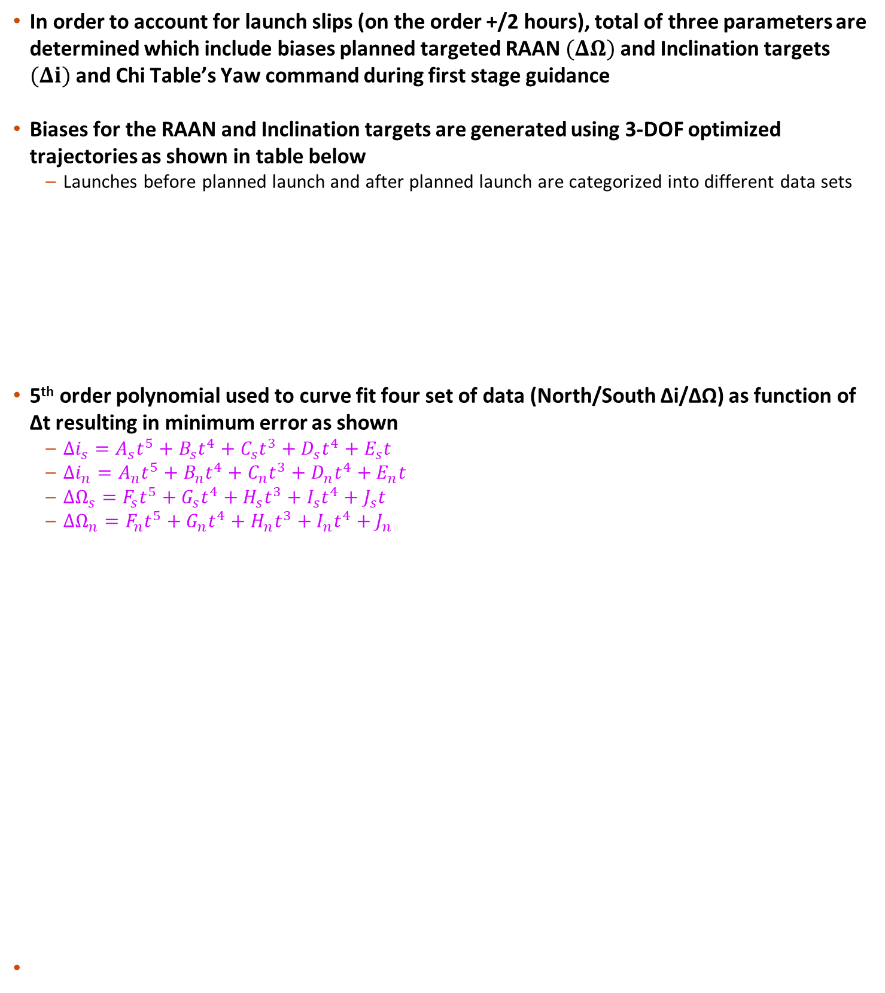
Launch Window GN&C Design
In order to account for launch slips (on the order +/2 hours), total of three parameters are determined which include biases planned targeted RAAN $(ΔΩ)$ and Inclination targets $(Δi)$ and Chi Table’s Yaw command during first stage guidance
Biases for the RAAN and Inclination targets are generated using 3-DOF optimized trajectories as shown in table below
  Launches before planned launch and after planned launch are categorized into different data sets
5th order polynomial used to curve fit four set of data (North/South ∆i/∆Ω) as function of ∆t resulting in minimum error as shown
  $Δi_{s}=A_{s}t^{5}+B_{s}t^{4}+C_{s}t^{3}+D_{s}t^{4}+E_{s}t$
  $Δi_{n}=A_{n}t^{5}+B_{n}t^{4}+C_{n}t^{3}+D_{n}t^{4}+E_{n}t$
  $ΔΩ_{s}=F_{s}t^{5}+G_{s}t^{4}+H_{s}t^{3}+I_{s}t^{4}+J_{s}t$
  $ΔΩ_{n}=F_{n}t^{5}+G_{n}t^{4}+H_{n}t^{3}+I_{n}t^{4}+J_{n}$

Slide 10
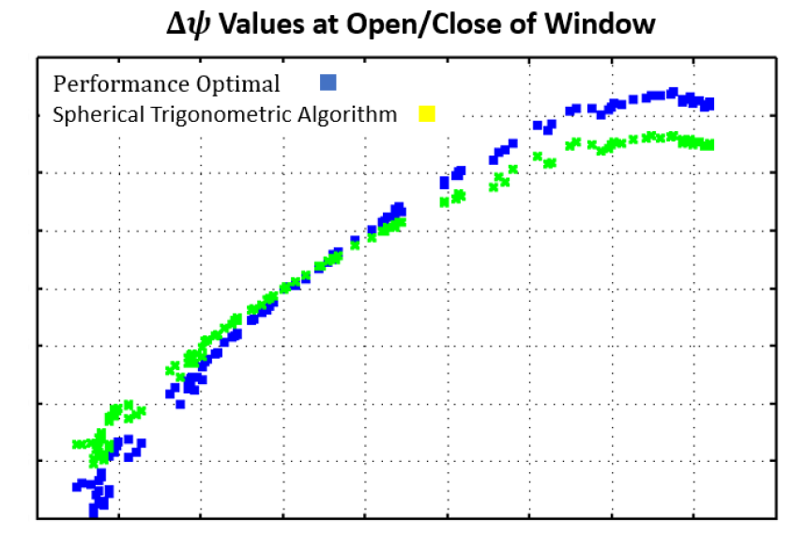
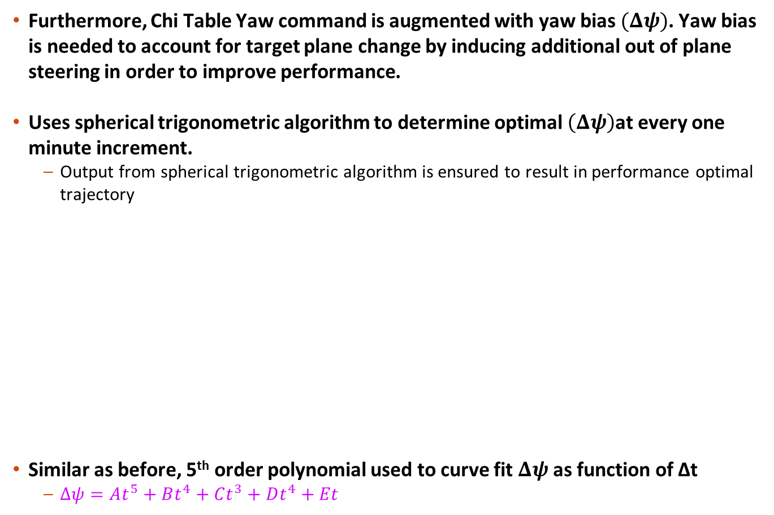
Launch Window GN&C Design
Furthermore, Chi Table Yaw command is augmented with yaw bias $(Δψ)$. Yaw bias is needed to account for target plane change by inducing additional out of plane steering in order to improve performance.
Uses spherical trigonometric algorithm to determine optimal $\left(Δψ\right)$at every one minute increment.
  Output from spherical trigonometric algorithm is ensured to result in performance optimal trajectory
Similar as before, 5th order polynomial used to curve fit $Δψ$as function of ∆t
  $Δψ=At^{5}+Bt^{4}+Ct^{3}+Dt^{4}+Et$

Slide 11
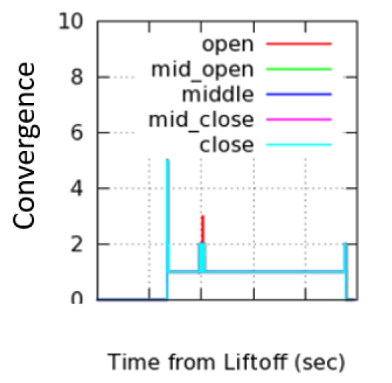
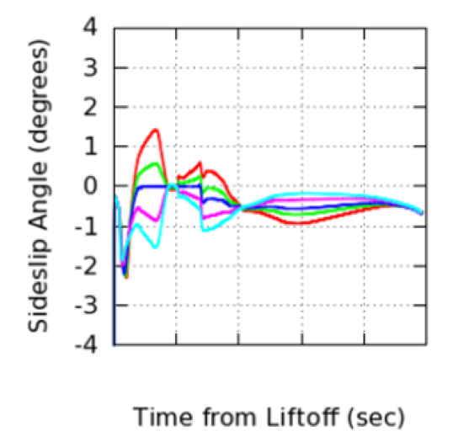
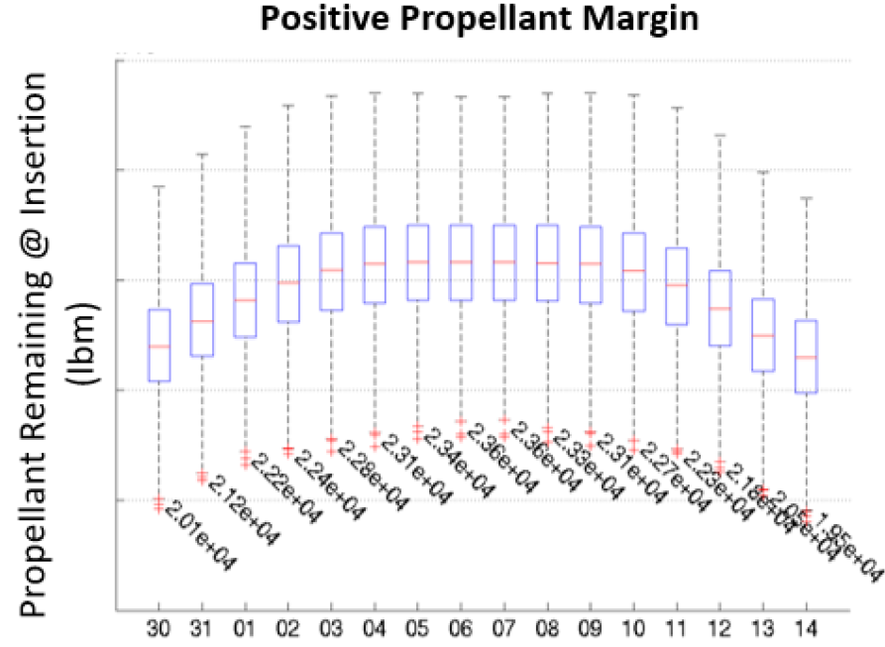
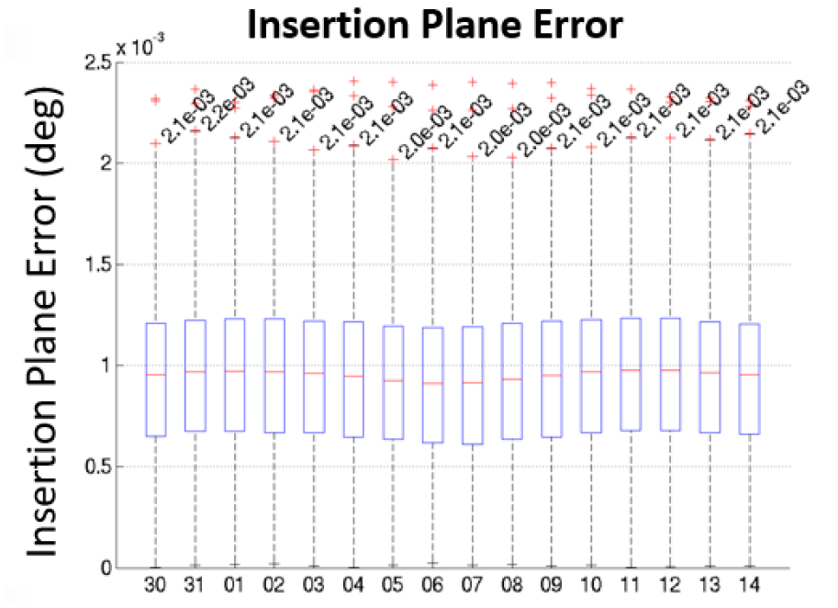
Results
Nominal sets of 6-DOF trajectories, across launch window, were simulated to ensure that the SLS maintained desired attitude by a) verifying lower side slip angles, b) Guidance ability to converge to biased targets
6-DOF Monte Carlo assessment to
verify overall design for every day in a launch period including ensuring insertion into desired plane

